Slide 1
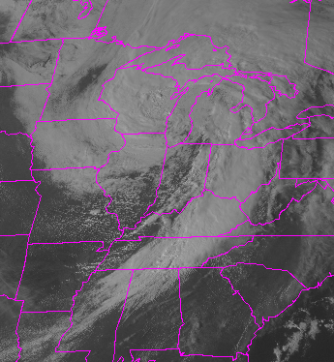
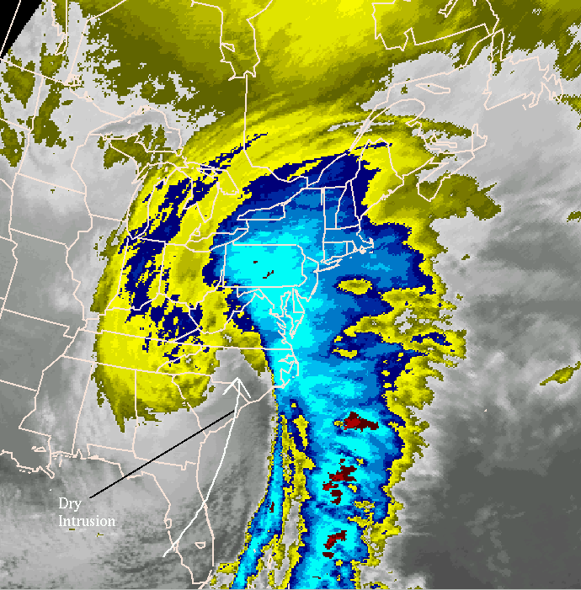
Notes:
Mid-latitude cyclones (MLC) are extratropical cyclones (ETC). There structure takes a comma shape, shown below.

Slide 2
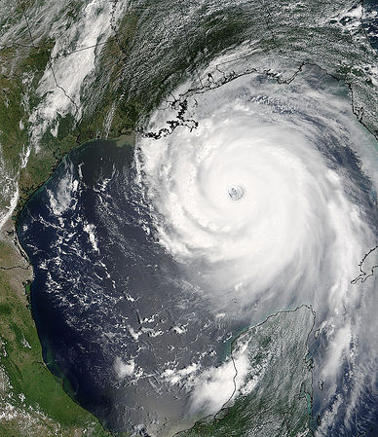
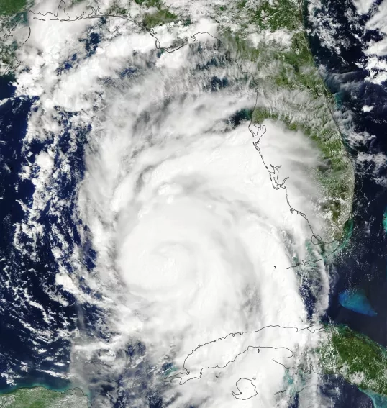
Notes:
Hurricanes are tropical cyclones (TC). Note the circular appearance and the presence of the central “eye”.
Pacific typhoons can reach 800-1000 km across. Atlantic hurricanes range from 100-600 miles across. For both, most of the strong sustained winds are in a small area around the eye.

Slide 3
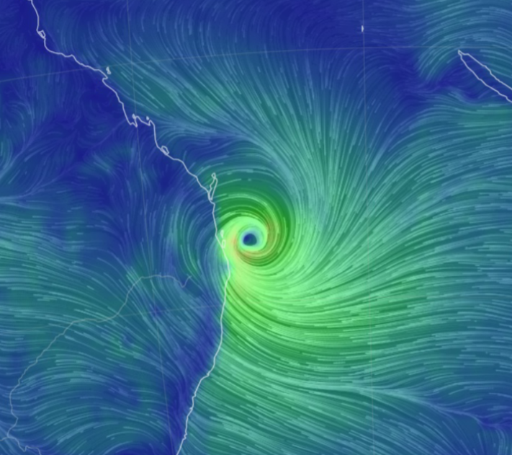
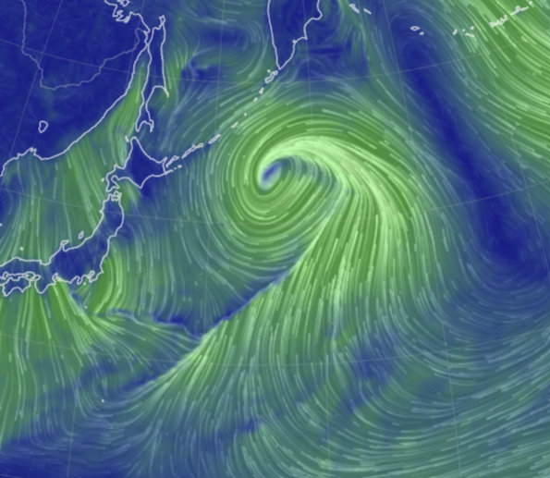

Slide 4
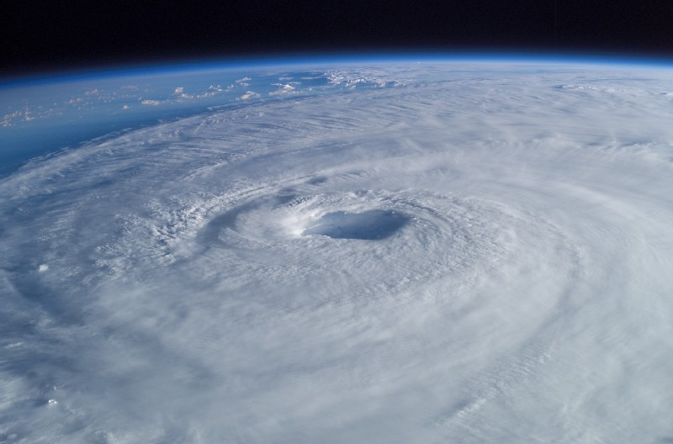

Slide 5
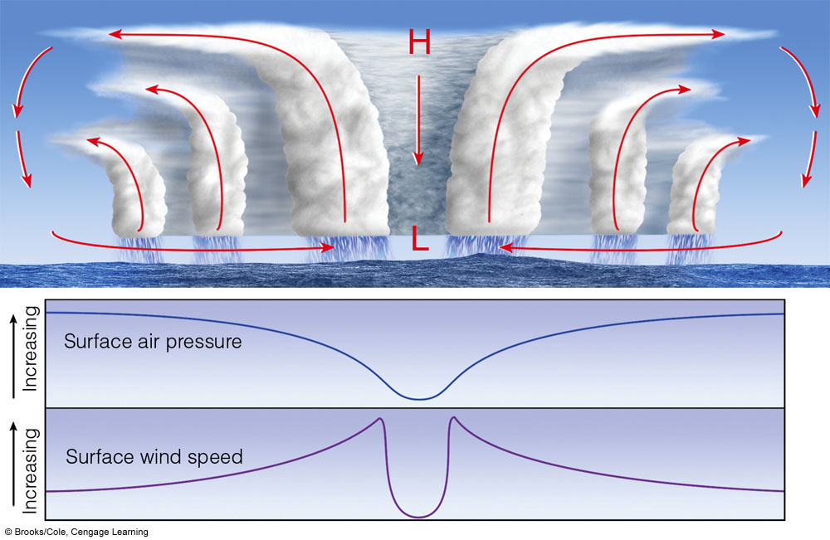
Notes:
Centrifugal force in eye keeps clouds out and dry upper air descends and warms adiabatically. The eye is 20-40 miles across.

Slide 6
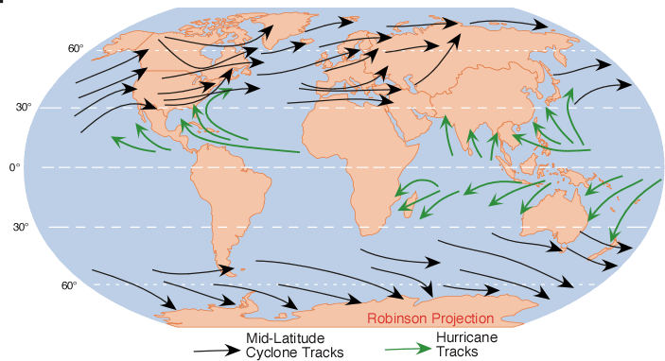
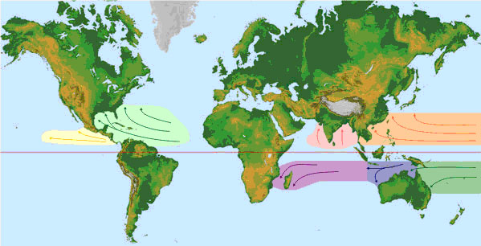
Notes:
Note that tropical storms go by different names in different areas
https://coast.noaa.gov/hurricanes/#map=4/32/-80

Slide 7
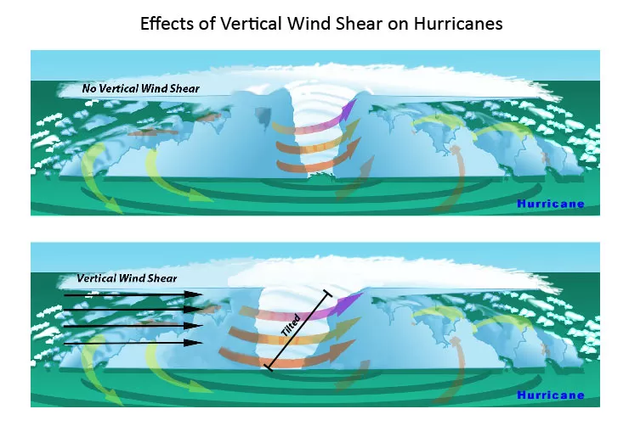

Slide 8
Stages of development of hurricane
Each level represents increase in windspeed and central air pressure
Tropical wave
Tropical depression
Tropical storm
Hurricane (winds in excess of 74 mph)

Slide 9
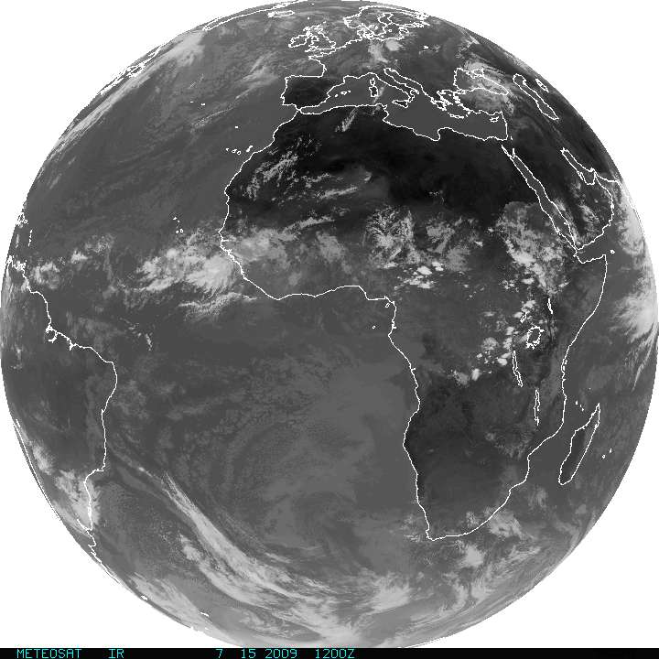
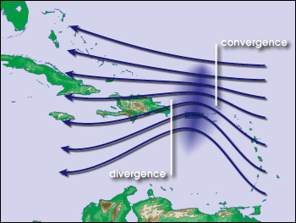
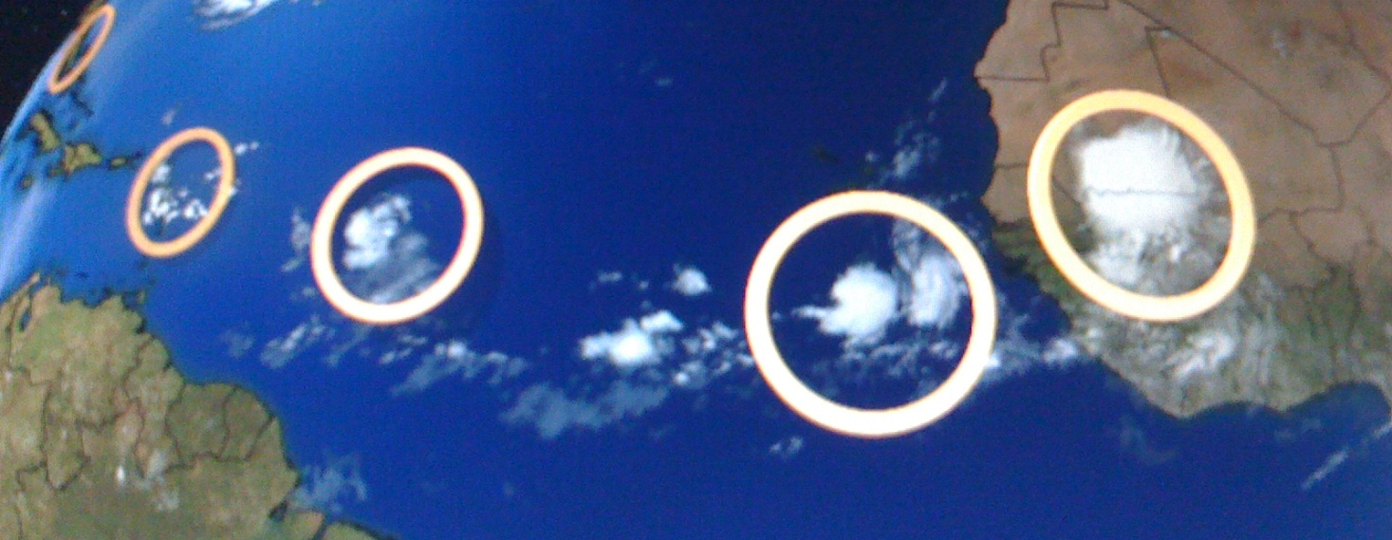
Tropical waves off African coast
Notes:
Tropical waves off African coast. These disturbances are collections of showers and thunderstorms that can lead to a hurricane.

Slide 10
Mechanisms of formation
Strong evaporation over warm ocean water
Latent heat release
High pressure forms aloft
Air moves out laterally
Descending air warms and drawn back into low pressure
Coriolis force starts rotation
Winds speed increase toward the center of rotation
Positive feedbacks develop between air pressure gradient, wind speed, wave height, and evaporation.

Slide 11
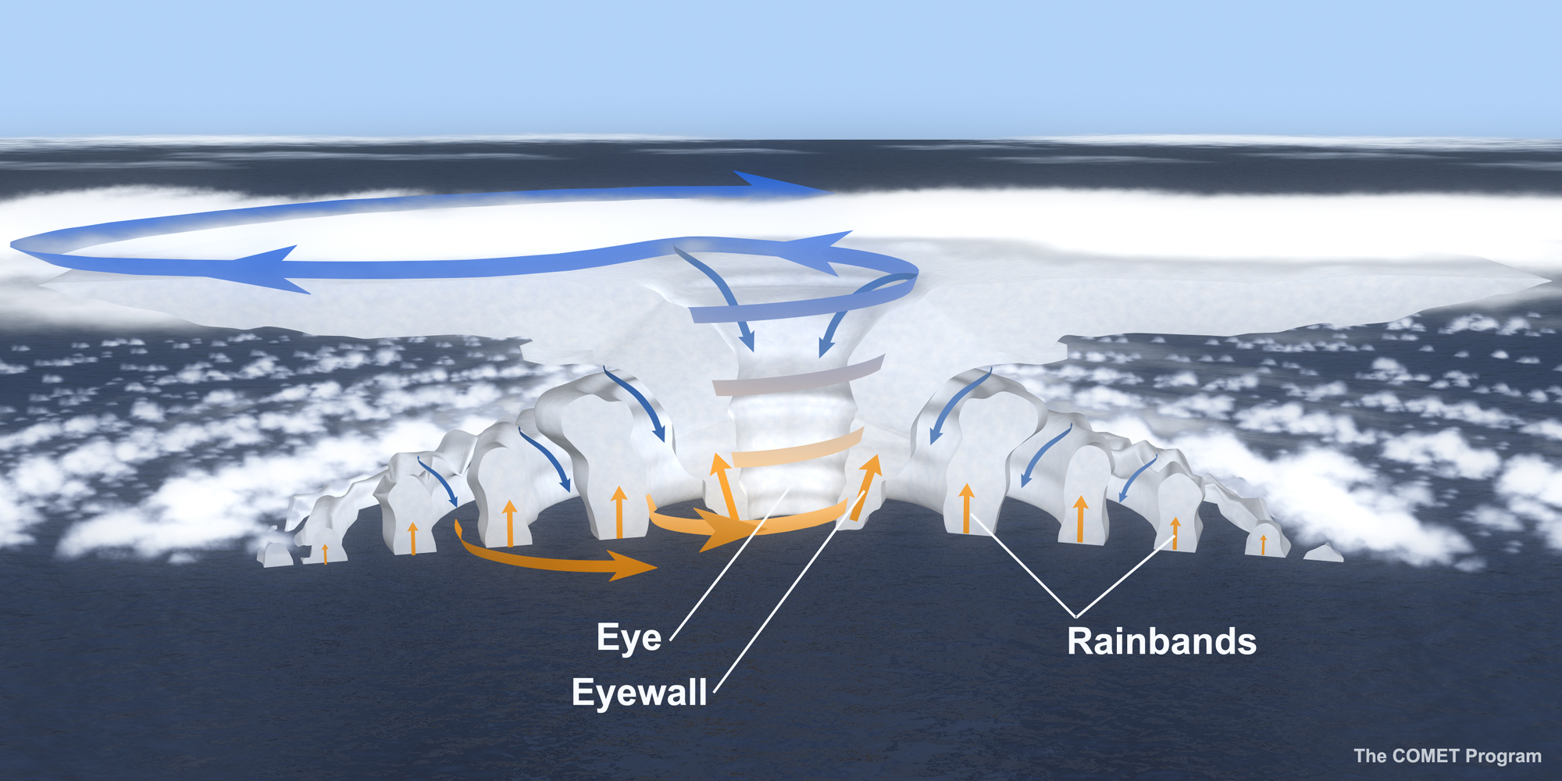

Slide 12
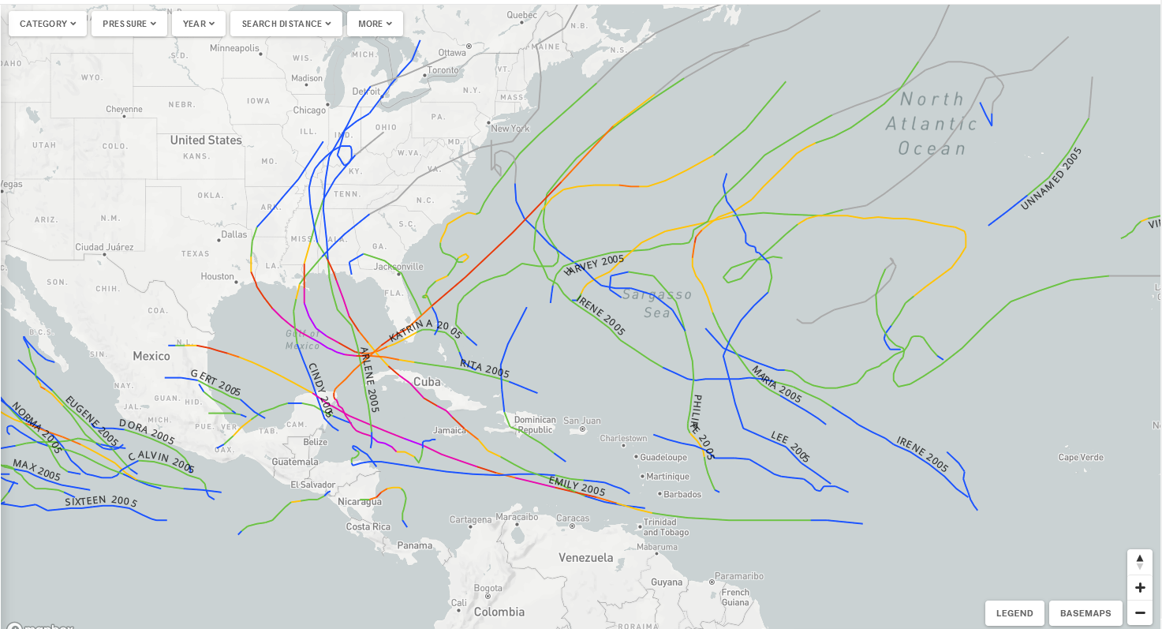
Notes:
https://coast.noaa.gov/hurricanes/#map=4/32/-80

Slide 13
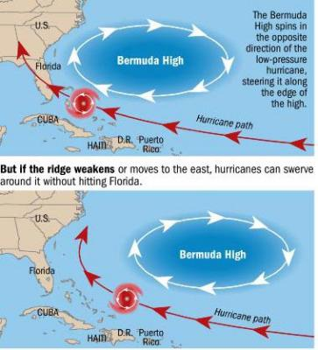
Path of US Atlantic TCs steered by:
Atlantic STHP (also called the Bermuda High)
Tradewinds (southerly winds out of the Atlantic STHP
Westerlies
Transient low and high pressure systems (for example)

Slide 14
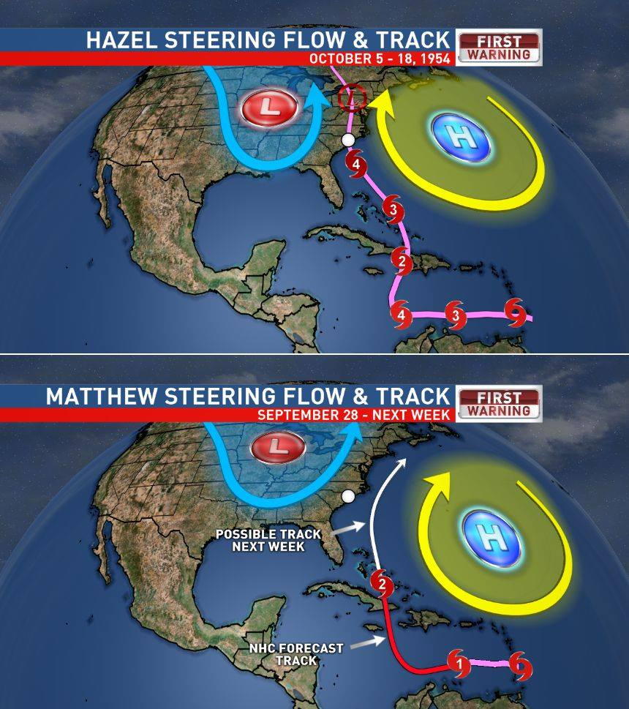

Slide 15
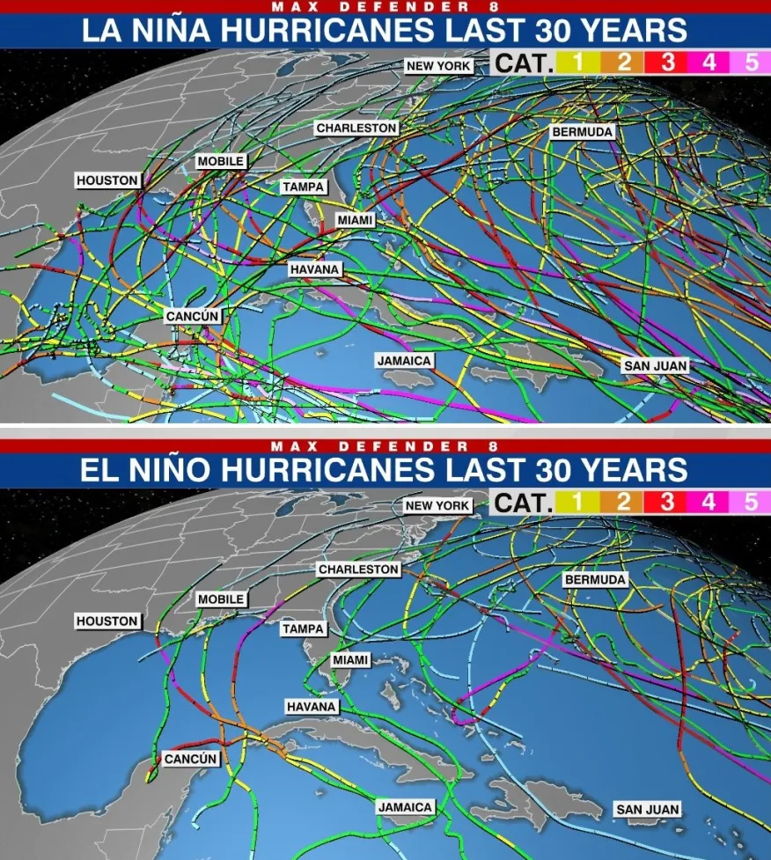

Slide 16
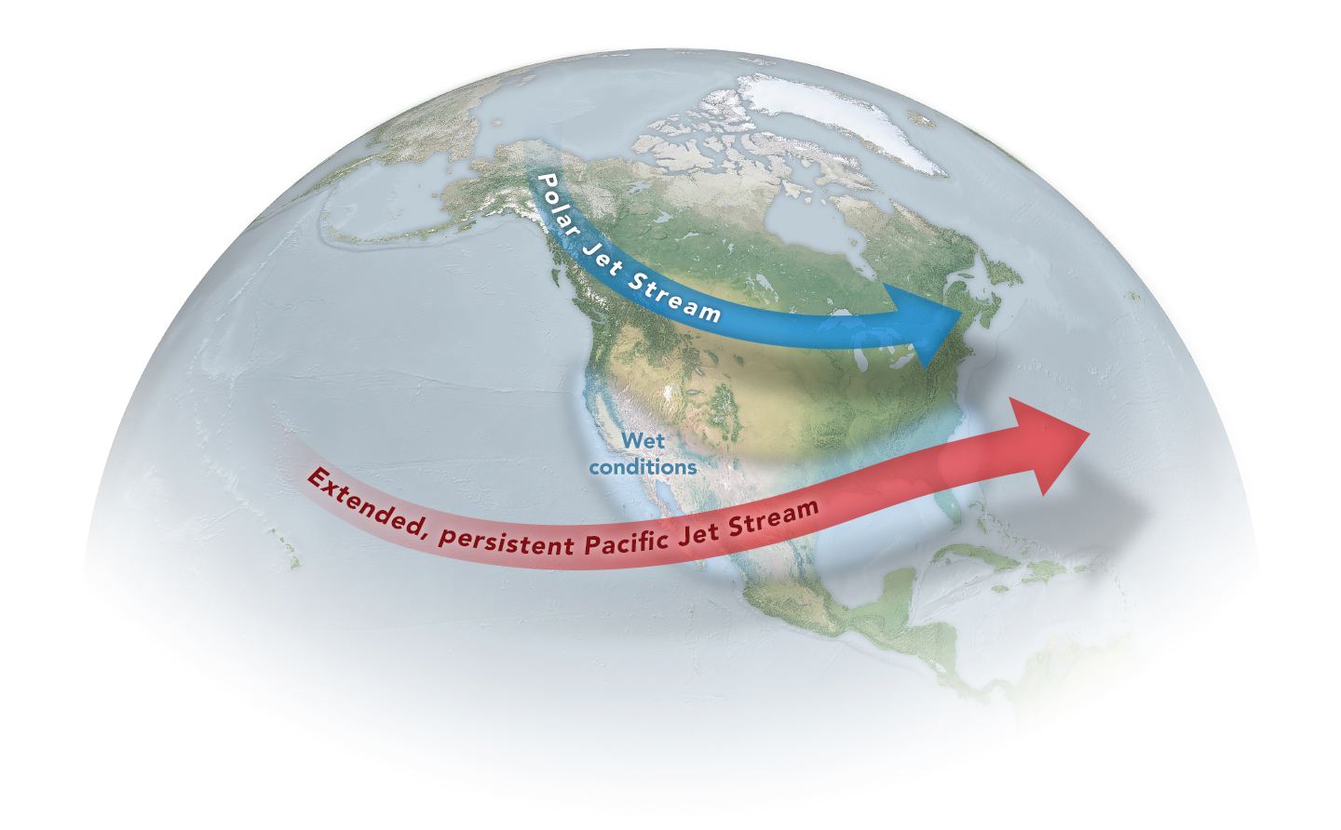
Notes:
El Niño usually alters the Pacific jet stream, stretching it eastward, making it more persistent, and bringing wetter conditions to the western U.S. and Mexico.

Slide 17
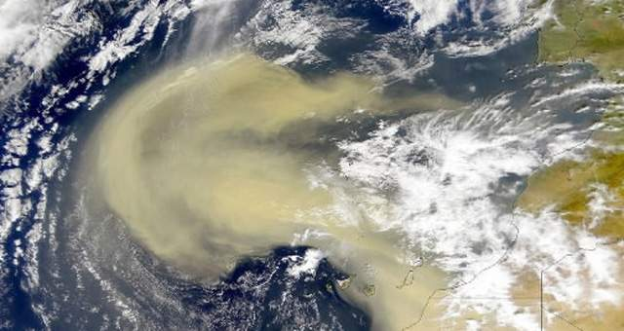

Slide 18
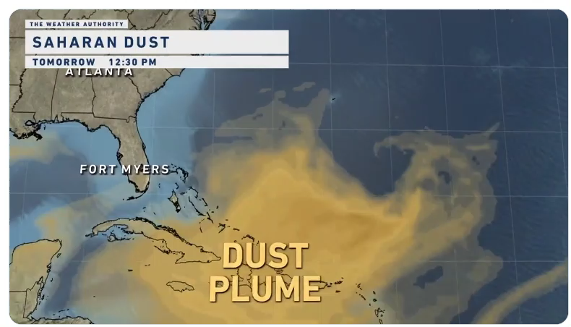

Slide 19
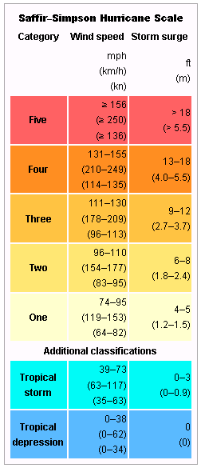
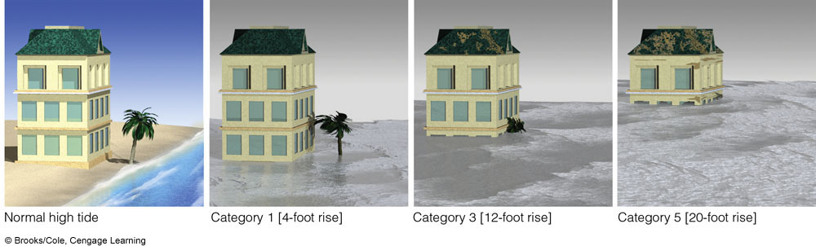

Slide 20
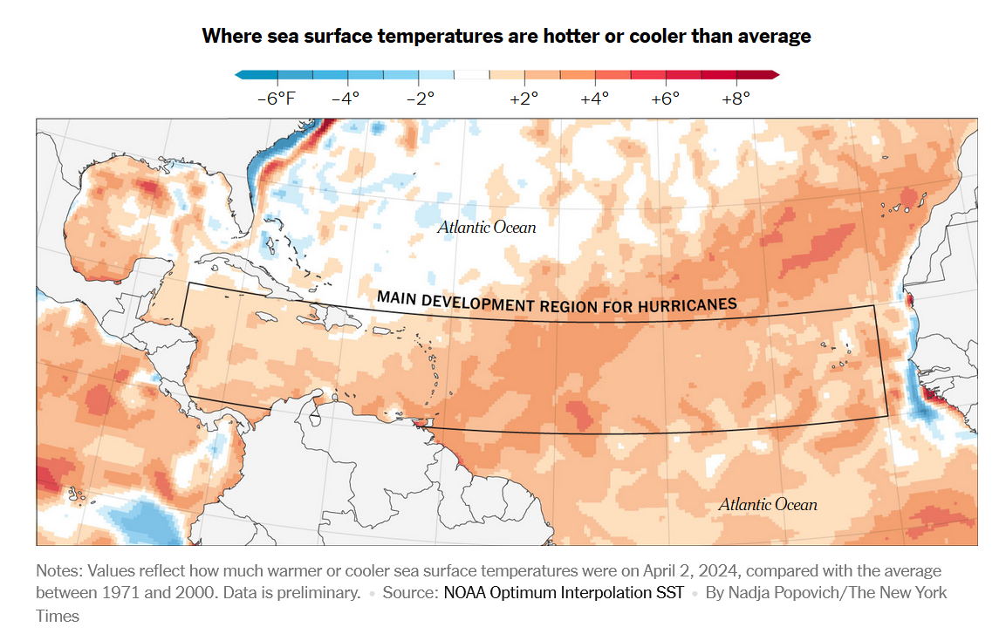

Slide 21
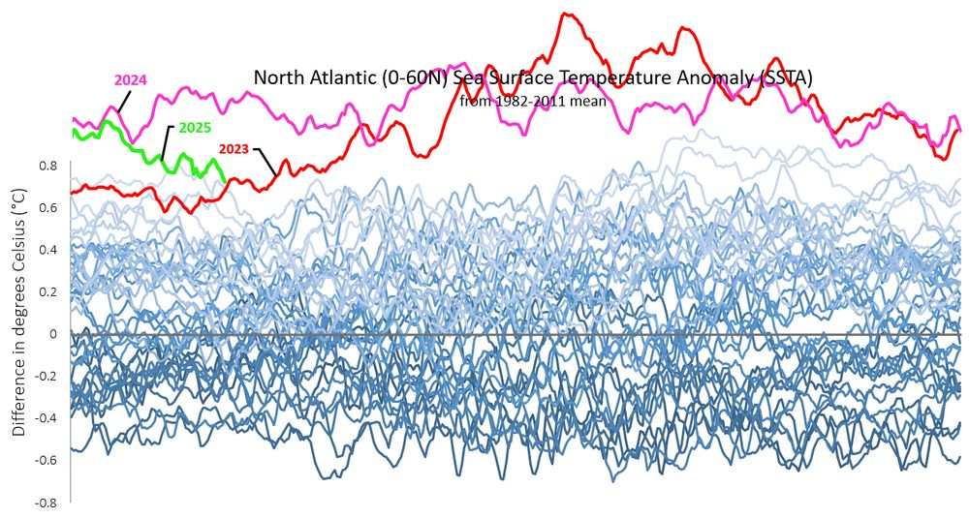

Slide 22
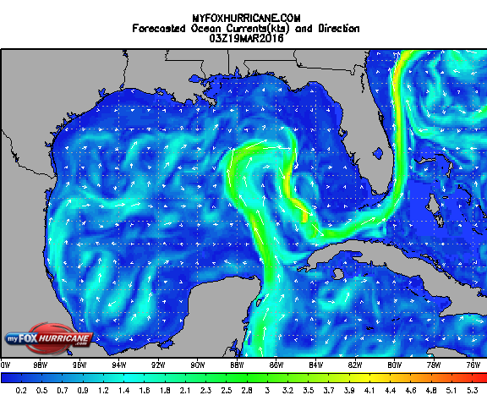
Notes:
http://www.myfoxhurricane.com/custom/models/rtofs/rtofs_current_gulf.html

Slide 23
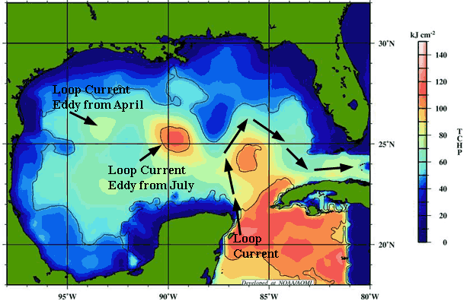
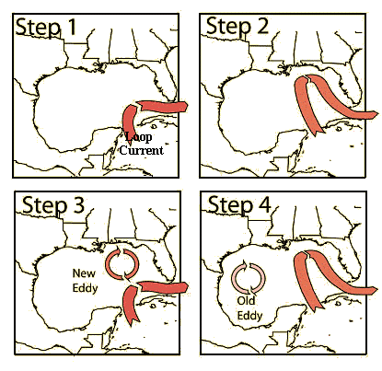
Loop currents
Notes:
Colors indicate temperature of water

Slide 24
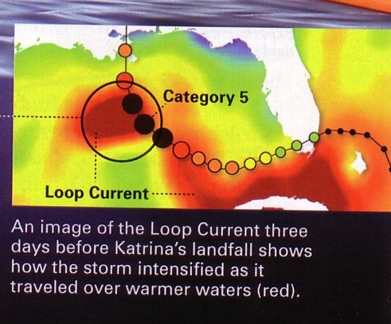
Notes:
Variable position of ocean currents can lead to unexpected changes in hurricane intensity

Slide 25
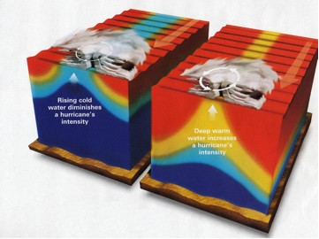
Notes:
Depth of warm ocean water is also important – the deeper the warm surface layer, the less cooler water will be pulled up due to mixing driven by hurricane low pressure and winds. So the thicker this warm layer, the stronger and more sustained a hurricane will be

Slide 26
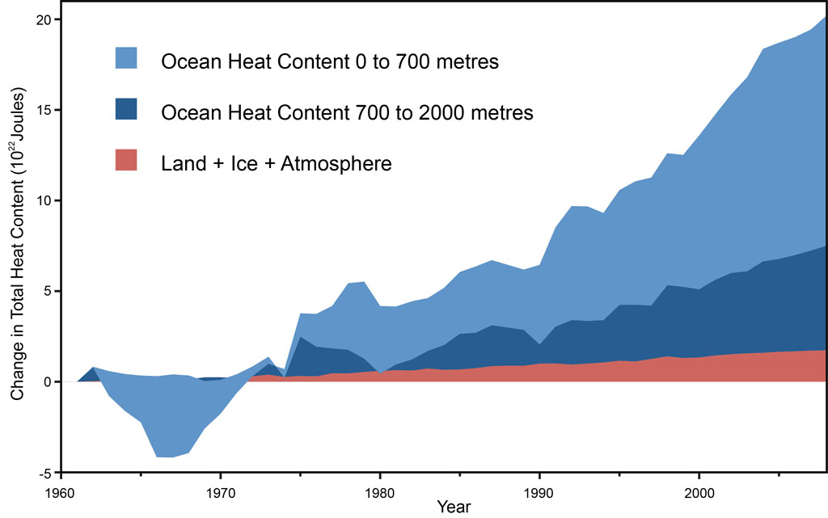

Slide 27
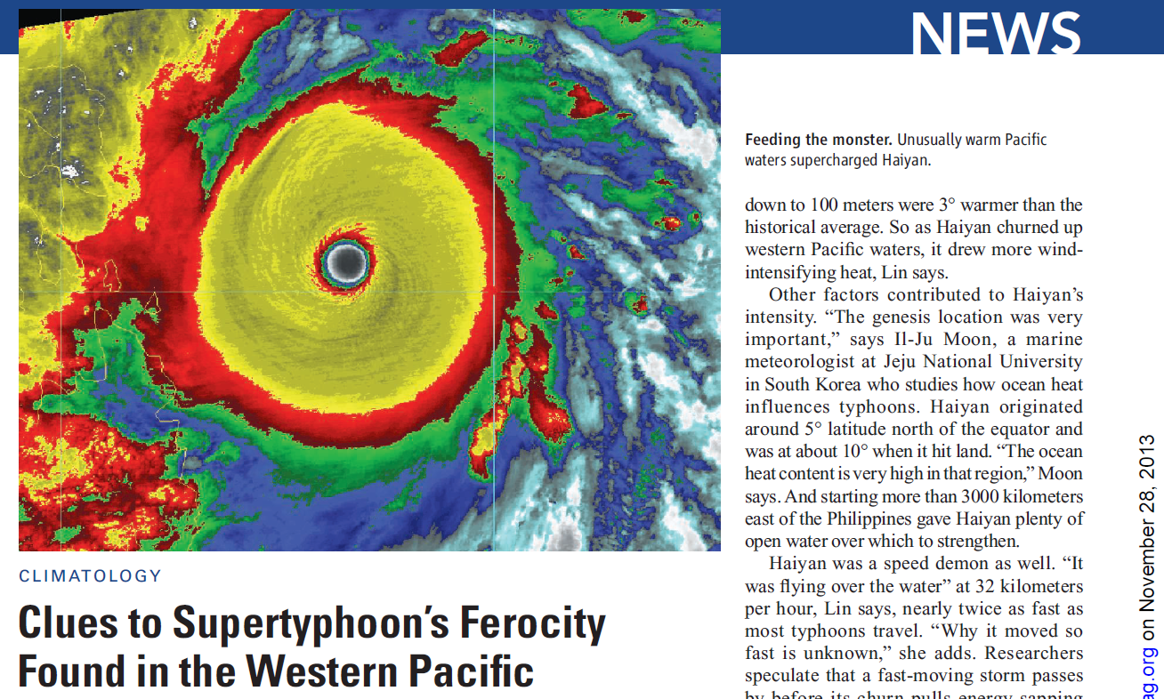
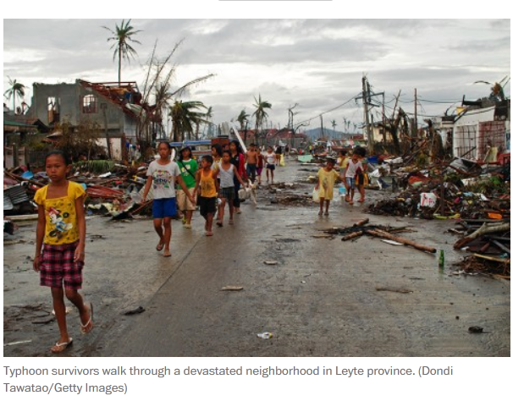

Slide 28
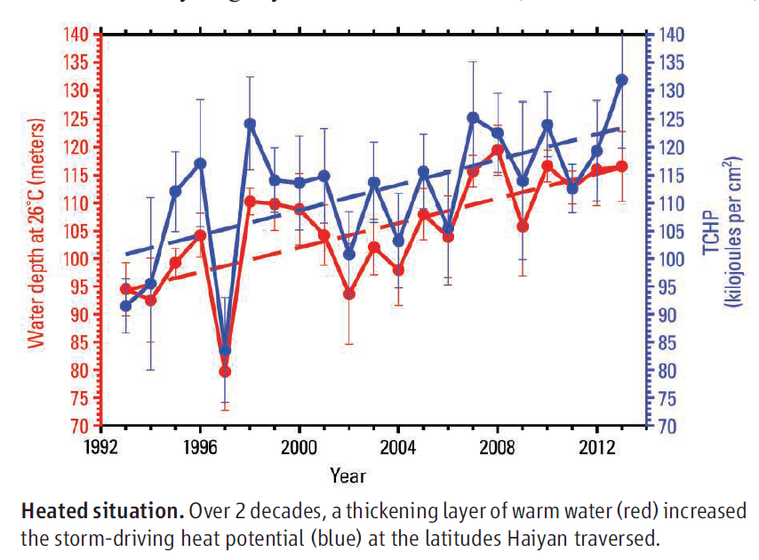
Notes:
The blue Y axis represents the potential increase in a hurricane’s strength due to warmer water. 78.8 degrees F

Slide 29
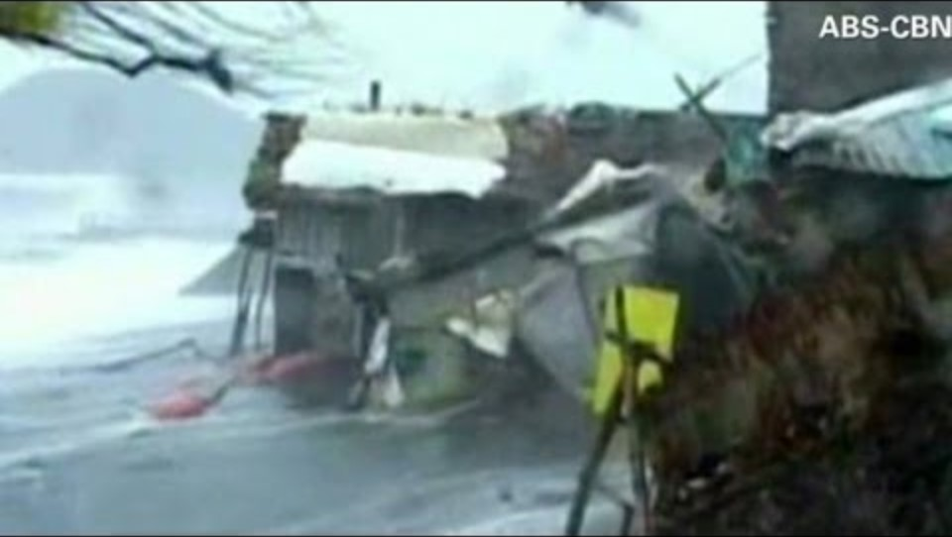
Notes:
https://youtu.be/8UJW84Fqhgw?si=m8UWKcQ6b_LpPUpe

Slide 30
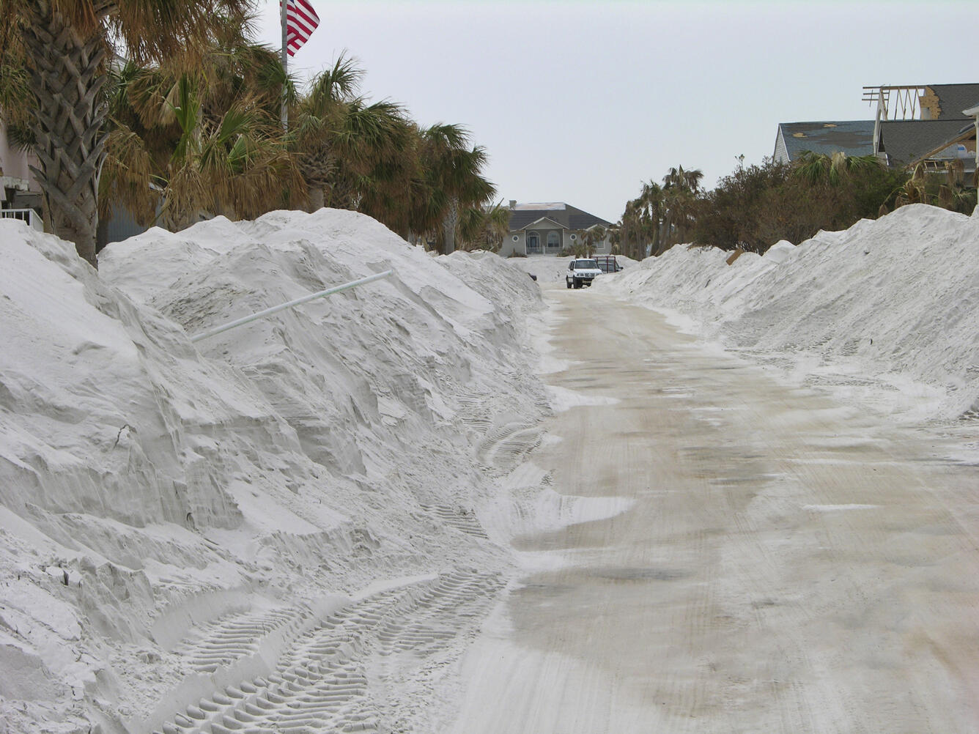

Slide 31
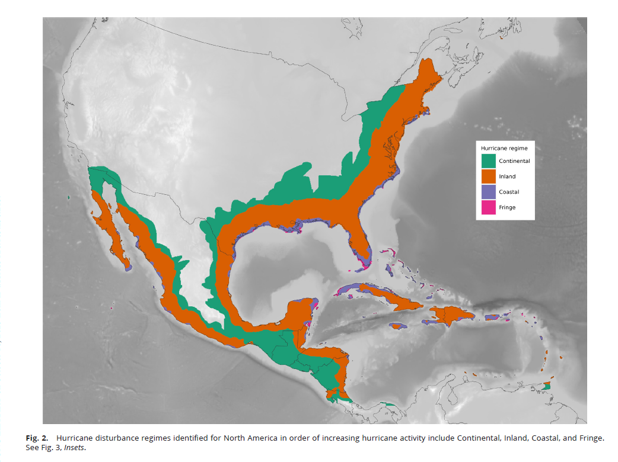
Notes:
Hurricane wind regime

Slide 32

Notes:
https://youtu.be/zIornya6eII?si=KWXOODsv-WCWSBy3

Slide 33
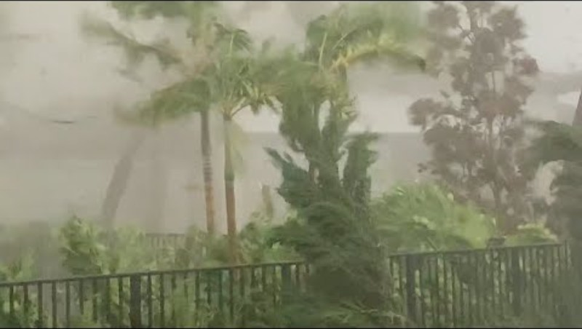

Slide 34
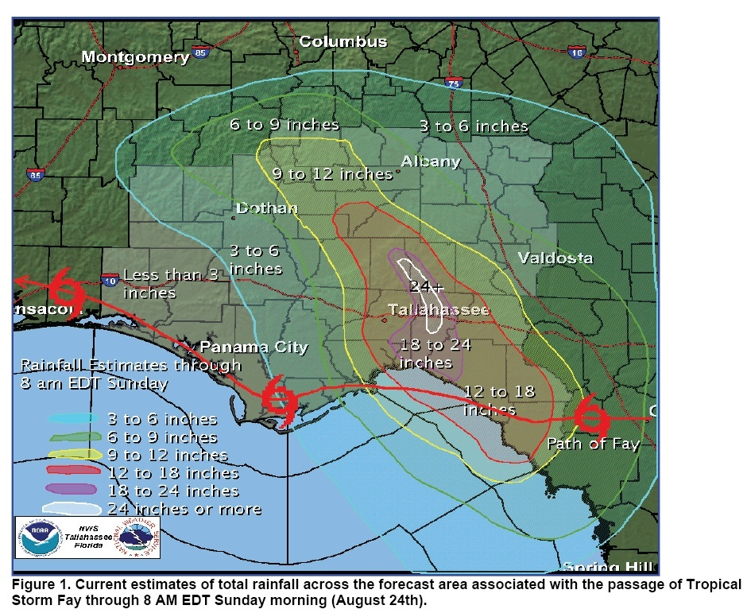

Slide 35
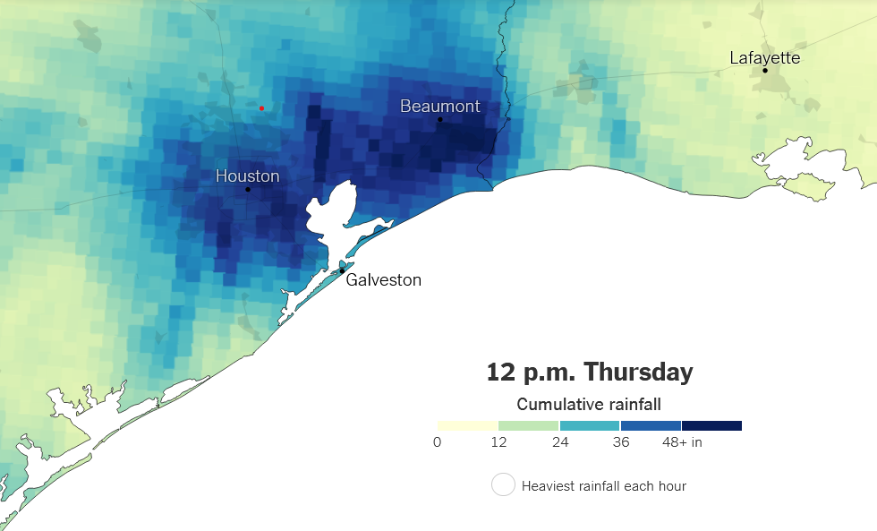
Notes:
https://www.nytimes.com/interactive/2017/08/24/us/hurricane-harvey-texas.html

Slide 36
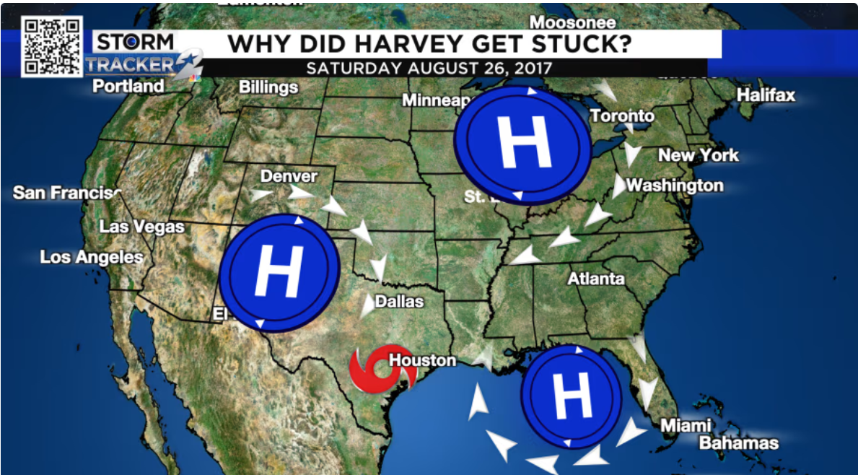

Slide 37
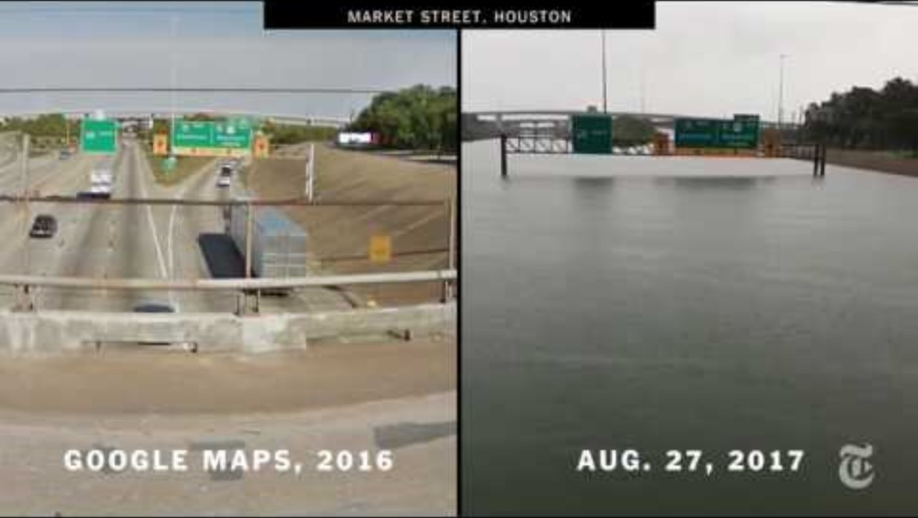

Slide 38
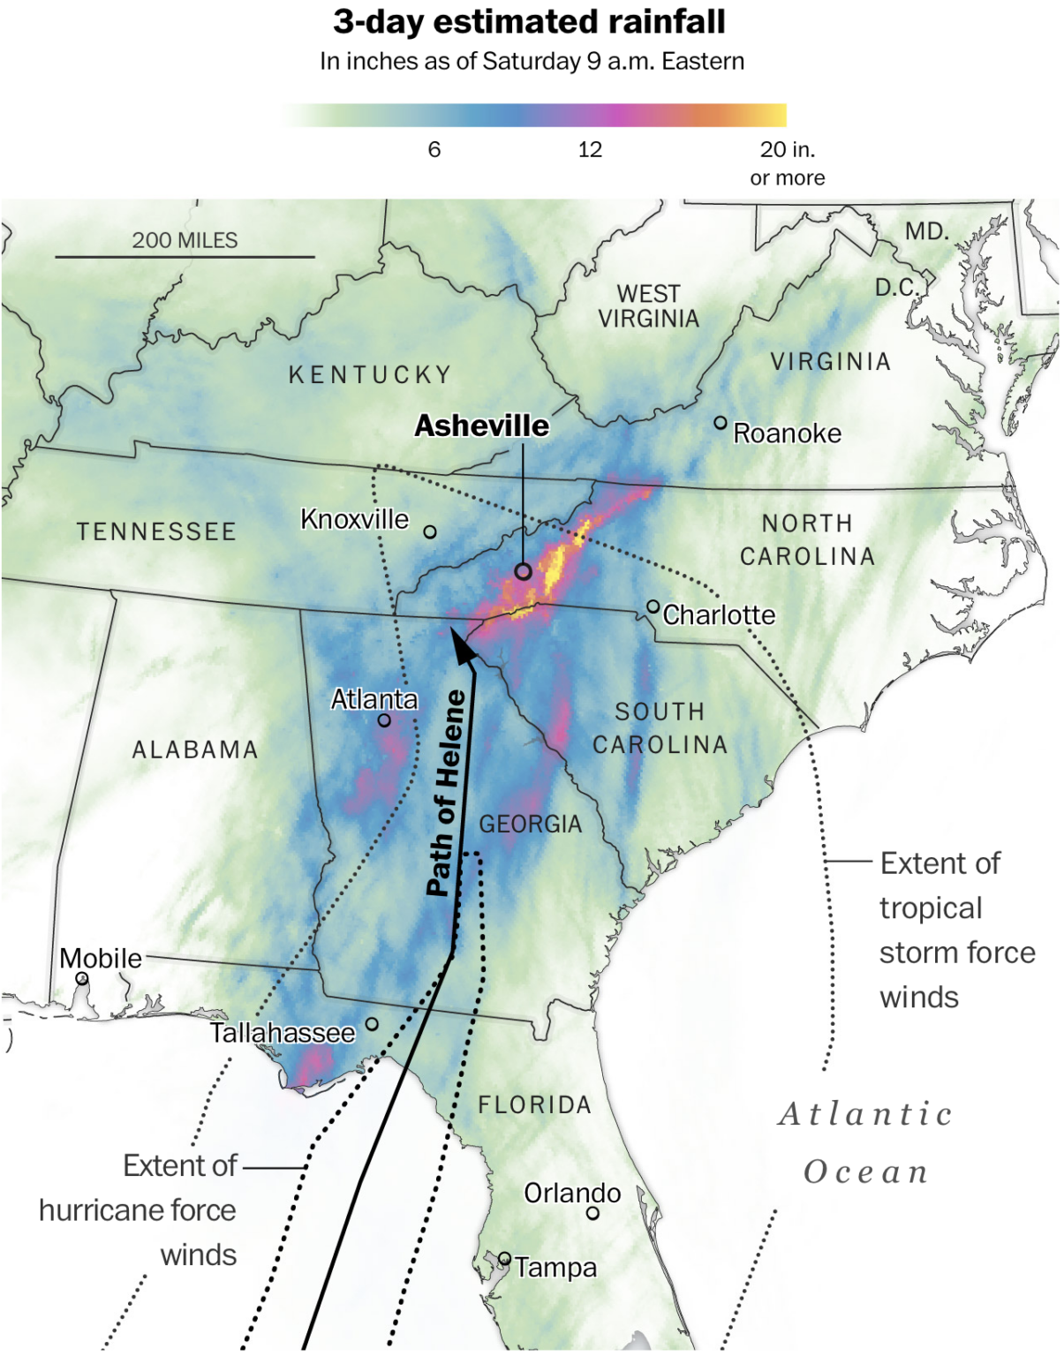
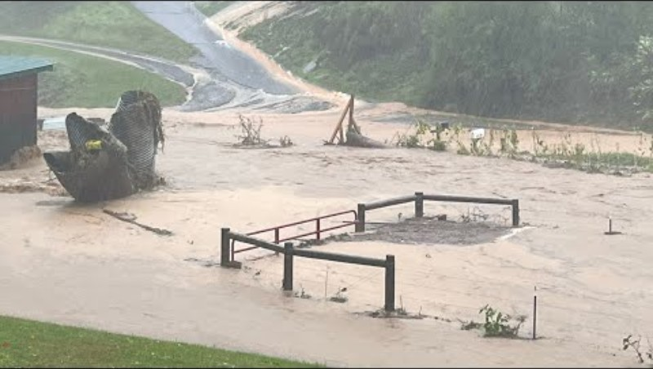
Hurricane Helene (2024)

Slide 39


Slide 40
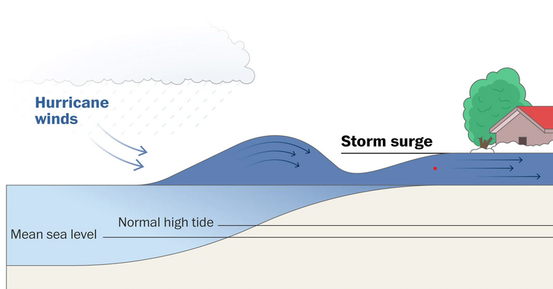

Slide 41
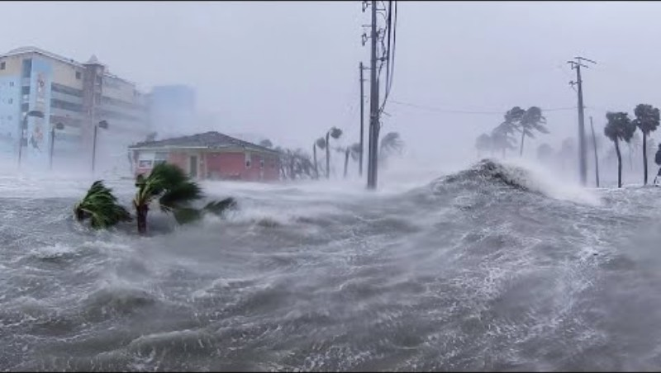

Slide 42
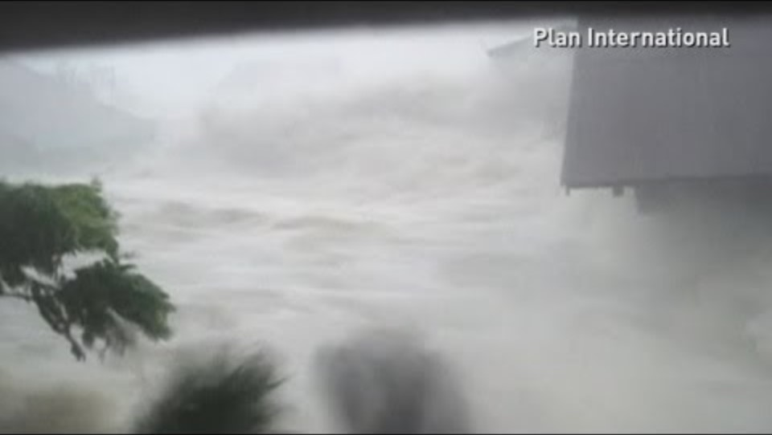
Notes:
https://youtu.be/xCq6mcLwBDI?si=JPgG35PMs0F4OZBA

Slide 43
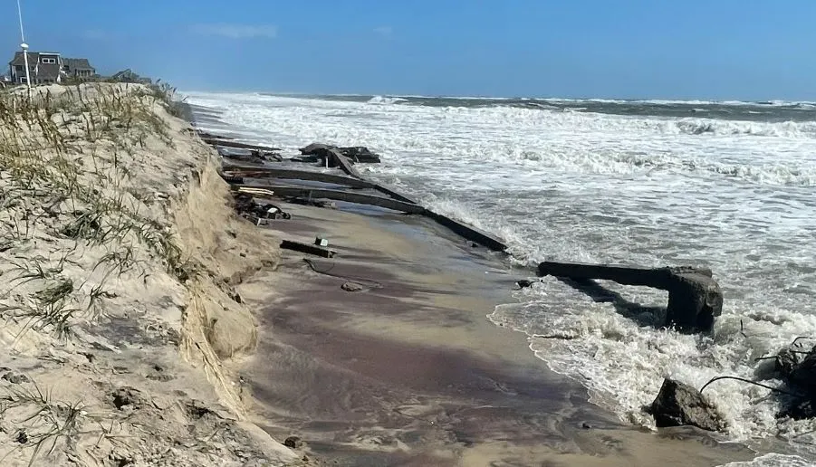
Coastal erosion

Slide 44
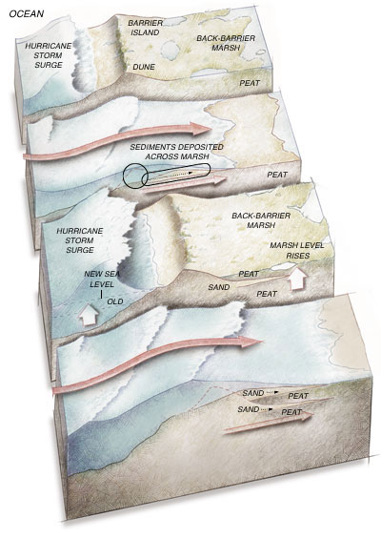


Slide 45


Slide 46


Slide 47


