Slide 1
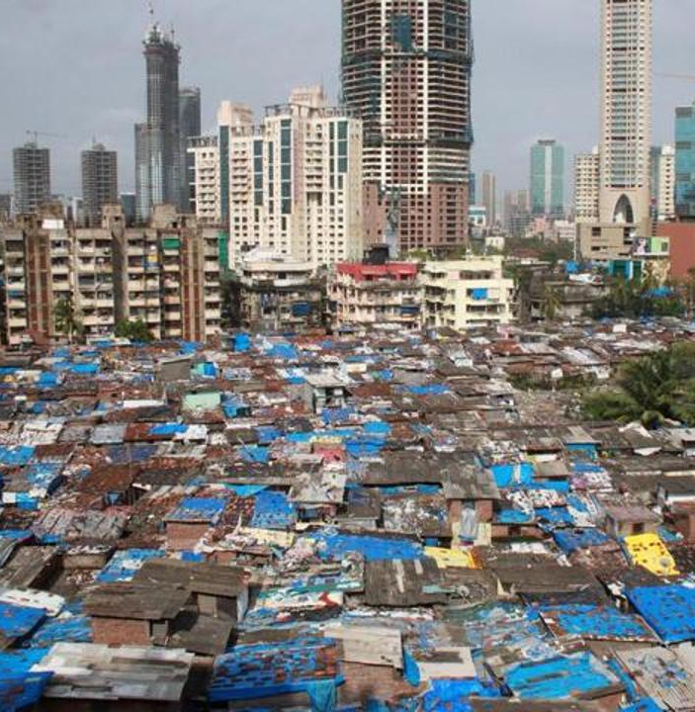
The tradeoffs of globalization
Globalized economies have benefits: among the wealthiest with high rates of literacy and longer life spans
However, there are costs or harms: globalization can also produce poverty and new health and environmental problems
Benefits and harms from globalization can be experienced unevenly and in complex ways
Notes:
Not entirely valid to say that globalization raises standards of living everywhere and creates wealth.
You could also say that if globalization creates new health and environmental problems, it also creates the potential for novel solutions through the integration of economies, knowledge exchange, and collaborative problem solving.
Displacement of workers have health impacts, for example, part of the rise of the opioid epidemic in the US were the layoffs of thousand of workers in factories and manufacturing when jobs went overseas because of lower wages that could be paid there.

Slide 2
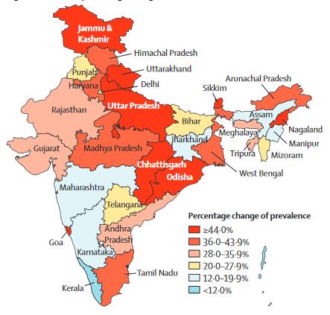
Infectious (communicable) diseases like may decrease as countries globalize
They often then experience increases in non-communicable diseases of affluence as countries develop economically, enter the global economy, and experience shifts in the types of foods consumed
Notes:
Percentage change of prevalence of diabetes (1990-2016)
https://www.thelancet.com/pdfs/journals/langlo/PIIS2214-109X(18)30387-5.pdf
As part of the epidemiological transition from communicable diseases to non-communicable diseases, the burden of diabetes and its risk factors has been increasing in India. Globalization, and urbanization have altered traditional diets and increased rates of obesity and diabetes.

Slide 3
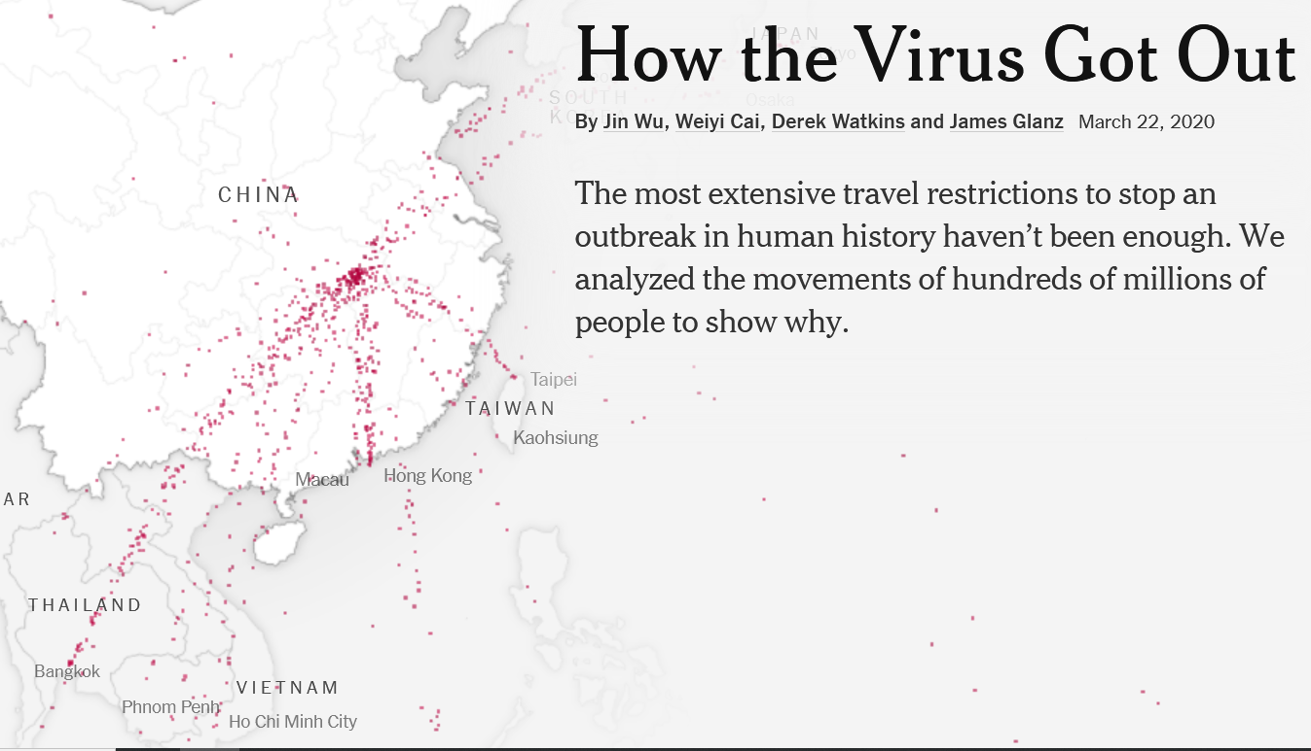
The Covid (SARS-CoV2) pandemic illustrates the complex tradeoffs of globalization
Globalization fueled the growth of urban areas and the high population densities that enhanced the spread of coronavirus SARS-CoV-2
Hyperconnectivity through air travel enhanced the spread of the virus

Slide 4
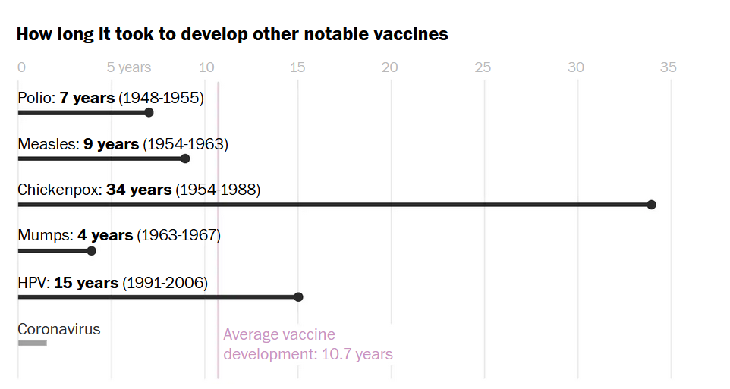
Global cooperation aided design and manufacture of mRNA Covid vaccines
The Pfizer (US) mRNA vaccine took less than a year to bring to market.
Prior, fastest development of a vaccine was for mumps, which took four years
Collaboration across countries around the world were necessary to do this
Notes:
https://www.washingtonpost.com/graphics/2020/health/covid-vaccine-update-coronavirus/

Slide 5
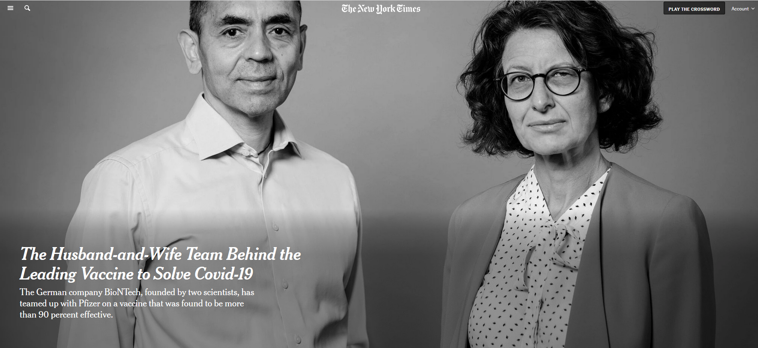
Pfizer mRNA vaccine developed by German company BioNTech started by Turkish immigrants
Notes:
https://www.nytimes.com/2020/11/10/business/biontech-covid-vaccine.html BioNTech coordinated the development of their mRNA vaccine with Pfizer, an American company
BioNTech was co-founded by Dr. Uğur Şahin and Dr. Özlem Türeci, a married couple of Turkish descent. Dr. Şahin was born in İskenderun, Turkey, and moved to Germany at the age of four to join his father, who worked at a Ford factory in Cologne. Dr. Türeci was born in Germany to a Turkish physician who had immigrated from Istanbul. Together, they established BioNTech in 2008, focusing on individualized cancer immunotherapy and later developing one of the first COVID-19 vaccines.

Slide 6
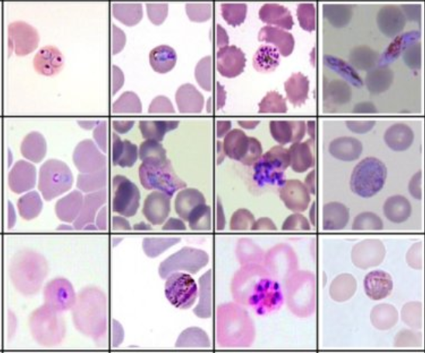

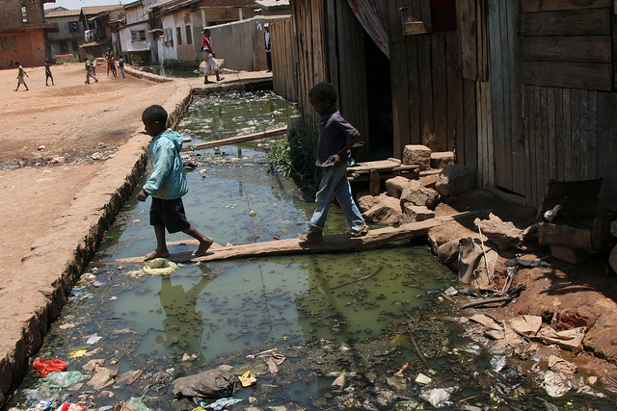
Global health is multi-scalar
Health is shaped by processes occurring at multiple scales time and space.
The scales we choose shape how we attribute causality and designate a response
For example, clinicians (medical doctors and nurses), epidemiologists, and planners associate causes of disease and ways to counter it that is scale dependent
Notes:
The scales of clinicians: Malarial parasites (Plasmodium) in human red blood cells (top photo). Artemisinin, a drug prescribed to treat and prevent malaria (center). Epidemiologists and planners might address the causes of malaria and its treatment at a larger scale, such as the open canal carrying waste water in Madagascar (bottom)

Slide 7
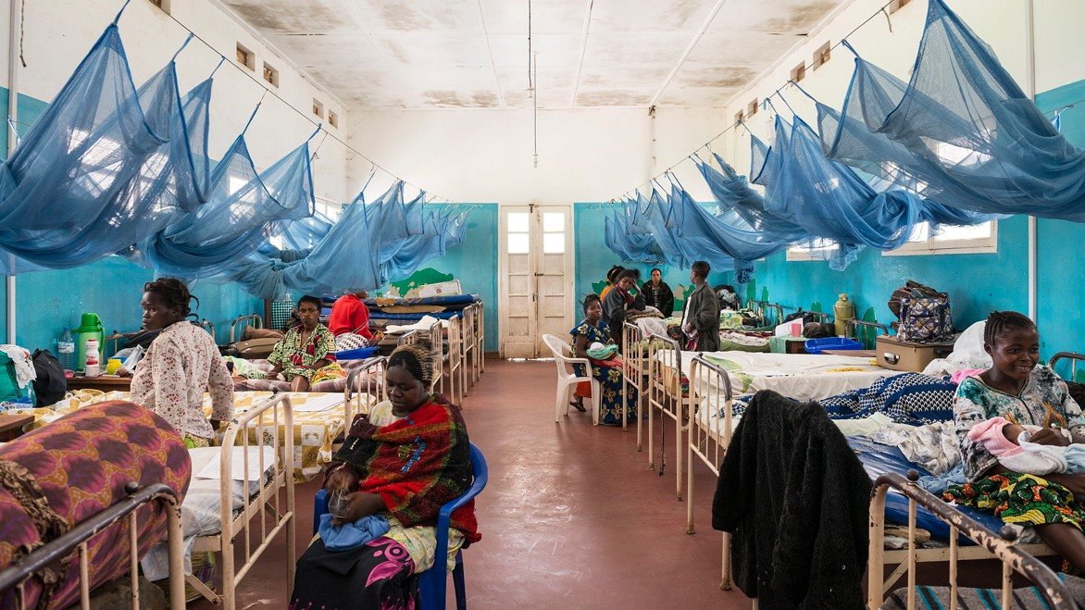
Notes:
Women in a hospital ward with malaria bed nets in Bunia, the Democratic Republic of the Congo.

Slide 8
‘Treating’ malaria is multi-scalar
For clinical doctors, the cause of malaria is the parasite Plasmodium and treatments are artemisinin-based drugs
Epidemiologists, public health planners, and environmental scientists might focus on standing water that breeds mosquitoes. Better drainage, insecticides and mosquito nets would be their recommendation.
Sociologists, economists, historians, and geographers may lean toward causes related to unequal access to adequate housing
Notes:
Malaria has causal relationships that span scales – it is not just one particular scale that is important, but all of them. You could include the spatial and temporal domains that define ecology and evolution, as the co-evolution of the malarial parasite, mosquitoes, and the human immune system are also a key part of understanding how to lessen the burden of malaria.

Slide 9
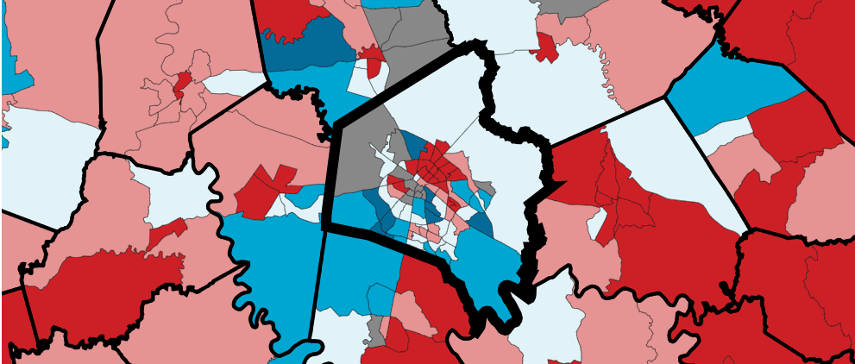
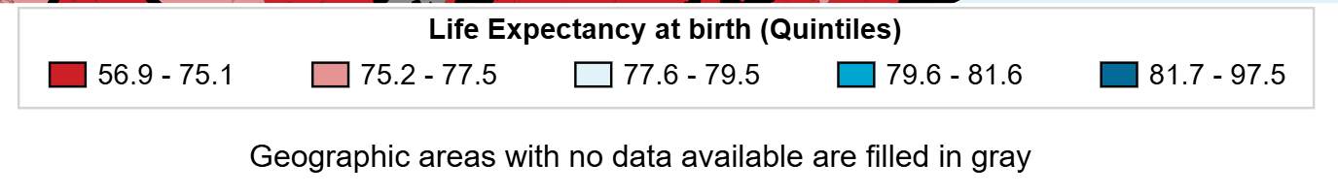
Patterns of health and disease are multi-scalar
Notes:
Even with a country, county, or city, health disparities can be extreme. On the map above, life expectancy can vary by several years as a result of local conditions of poverty, unemployment, and exposure to environmental hazards like air pollution. In Lexington, life expectancy can be expected to vary by up to 15 years (85 versus 70) depending upon your where you live around the city.

Slide 10
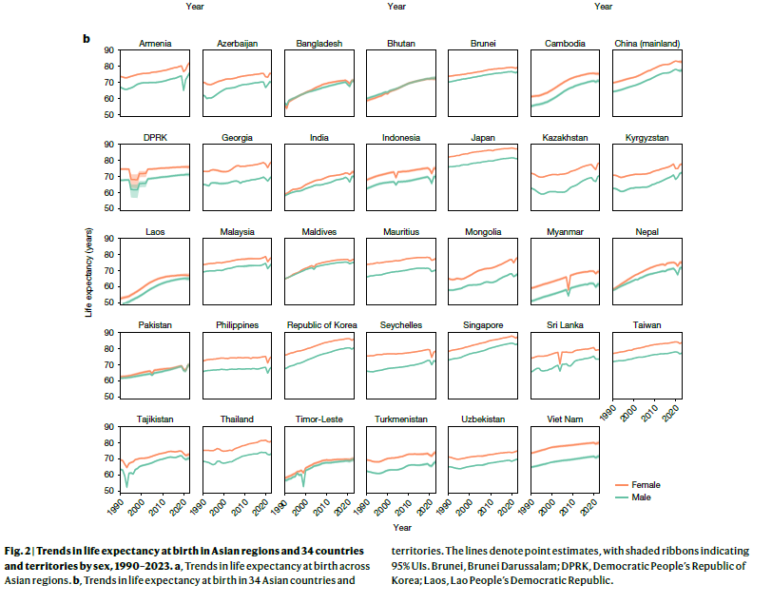
Notes:
Kang, J. et al. Mapping drivers of life expectancy change in Asia from 1990 to 2023. Nature https://doi.org/10.1038/s41586-026-10739-6 (2026).

Slide 11
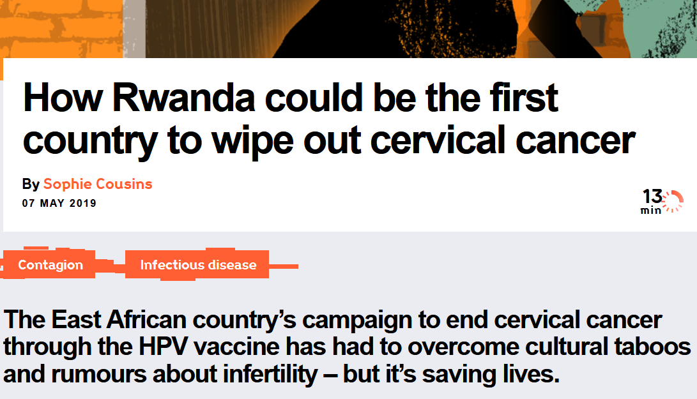
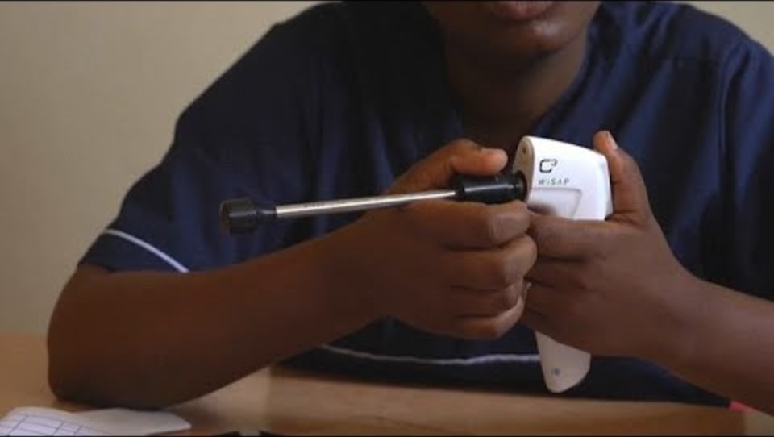
Global, continental, and national averages can obscure local differences in health
Video
Notes:
HPV is the human papilloma virus. It causes cervical cancer. A vaccine is available to inoculate women and prevent cervical cancer. Even though overall incidence of cervical cancer is high in Africa, some countries, like Rwanda. have been successful with HPV vaccination programs and stand apart from their neighbors.

Slide 12
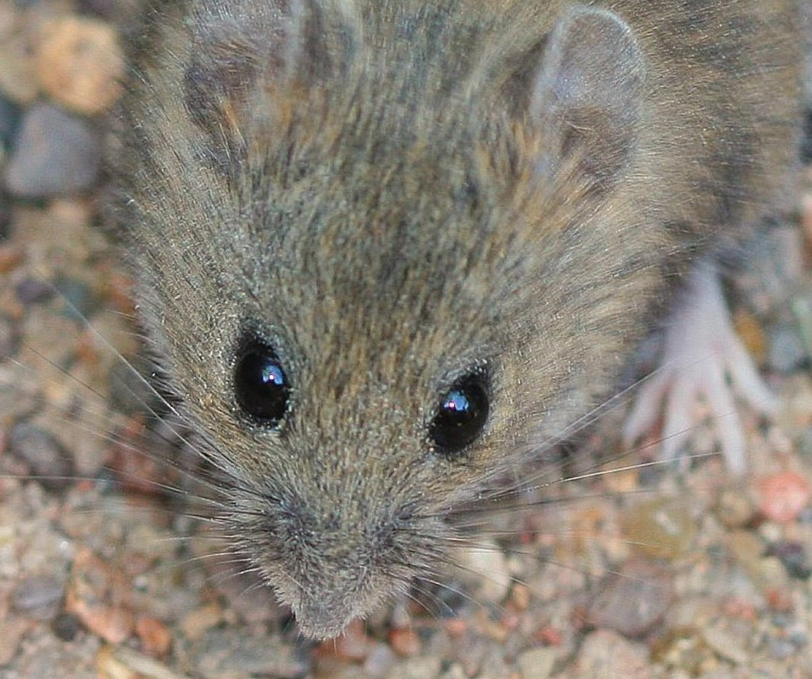

Global health incorporates the evolutionary and ecological contexts of disease

Slide 13
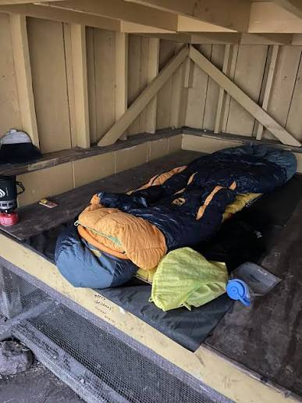
First case brought on board from person who contracted it from exposure to infected small wild rodents that shed the virus in their urine, feces, and saliva
Environmental factors like deforestation, habitat fragmentation, and climate variability significantly influence rodent populations and likelihood of human exposure
Notes:
Hanta virus outbreak on a cruise ship provides an example of all four types of globalization. https://www.cnn.com/us/maps-hantavirus-cruise-outbreak-vis

Slide 14
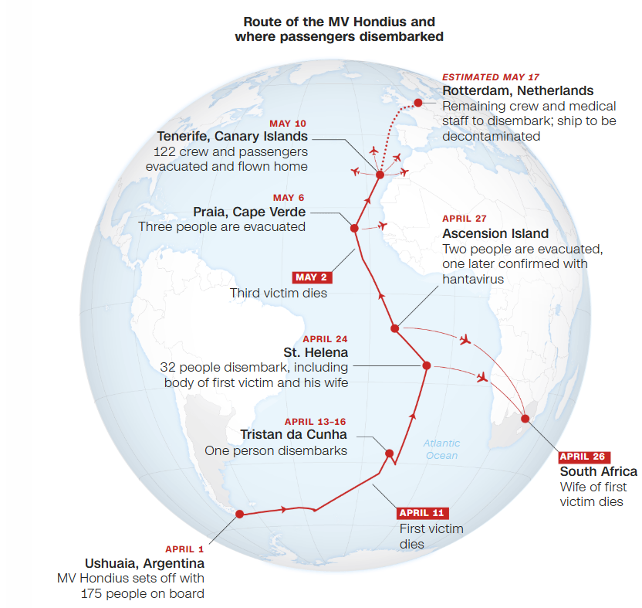
The specific Andes virus strain responsible for the cruise outbreak possesses unique evolutionary capability to spread via limited human-to-human transmission.
Hanta virus variants in the Americas show unique ecological flexibility allowing the virus to adapt and circulate among broader ranges of species before spilling over into humans
Notes:
Hanta virus outbreak on a cruise ship provides an example of all four types of globalization. https://www.cnn.com/us/maps-hantavirus-cruise-outbreak-vis

Slide 15
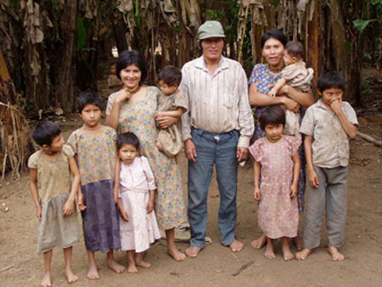
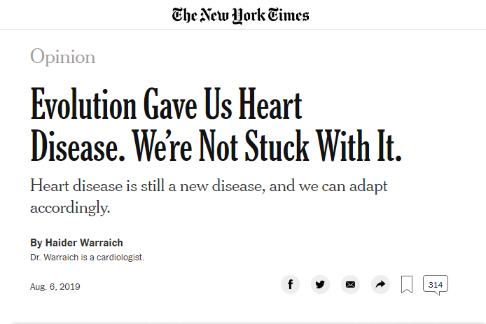
Evolutionary and ecological global dimensions of heart disease
The Tsimane, a remote people living in the Bolivian rain forest. They experience very low levels of atherosclerosis (hardening of the arteries) because of frequent exposures to infectious agents. Their immune systems do not readily trigger the inflammation that underlies the initial stages of atherosclerosis because of these constant environmental exposures.
Notes:
Evolution, ecology, and environment shape global health Even heart disease has an evolutionary explanation
In response to infections, the immune system unleashes a powerful response called inflammation. In extreme forms, such as after catching the flu, inflammation can set the body ablaze and is our best means to keep us sterile and free of infection. Inflammation also plays an important role when someone gets hurt and the barrier between the body and the world outside is breached. Inflammatory cells unleash a cascade that results in blood clots forming to quickly plug nicks and cuts.
After the institution of better public hygiene, inflammation, no longer busy with outsiders, turned inward. Inflammation is responsible for every important step in the story of atherosclerosis, from its birth as fatty streaks in the lining of the blood vessels, to the dramatic eruption of cholesterol-laden plaques in blood vessels supplying the heart, brain and legs, that activate our clotting cascade, leading to blockages that cause heart attacks, strokes and blood-choked limbs needing amputation.
https://www.nytimes.com/2019/08/06/opinion/evolution-heart-disease.html?smid=nytcore-ios-share http://tsimane.anth.ucsb.edu/tsimaneinfo.html
https://doi.org/10.1016/S0140-6736(17)30752-3
Kaplan, H., Thompson, R. C., Trumble, B. C., Wann, L. S., Allam, A. H., Beheim, B., ... & Rodriguez, D. E. (2017). Coronary atherosclerosis in indigenous South American Tsimane: a cross-sectional cohort study. The Lancet, 389(10080), 1730-1739.

Slide 16
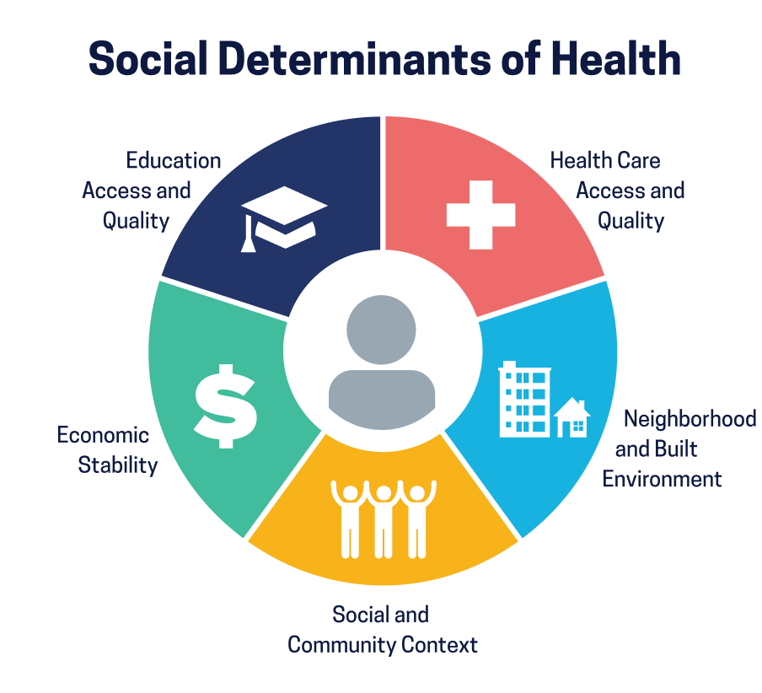
Social determinants of health
Account for how the environment is shaped by social factors that in turn shape health
Black Americans have higher rates of hypertension (high blood pressure)
This disparity shaped largely by social determinants of health — more likely to have less access to healthy food, adequate health insurance, while experiencing more chronic stress.
Disparity should not be treated as a genetic difference between racial groups
Notes:
https://www.nature.com/immersive/d41586-021-00943-x/index.html Social and cultural factors rather than physical racial differences account for health differences Hypertension is high blood pressure

Slide 17
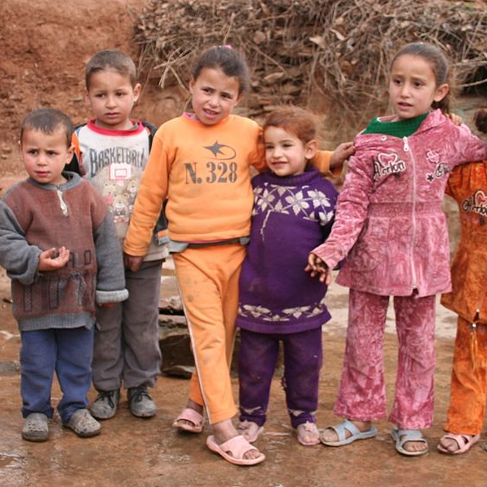
The ‘translational gap’
Effectiveness of medicines and treatments, can be greatly dependent upon an individual’s social determinants of health
For example, even among genetically homogeneous Berber people of Morocco, urban and rural Berber communities had large differences in what genes were expressed due to different diets, exposure to microbes in the environment, and everyday social and psychological stress.
Medicines and treatments may not work uniformly ‘translate’ among all people
Notes:
An example of the resocializing disciplines in global health: the translational gap Randomized controlled trials are useful for developing new drugs, but they tend to downweight individual variability so that more of the drug’s or treatment effects can be discerned
Translational gap here means the distance spanning the objective identification of a drug or treatment and how it might actually work (or not) when you start deploying it in many different contexts of where and how people live
More social knowledge about how people live, and how they live differently, matter for medicine, even medicine that we consider scientific and built on principals of genetics, biochemistry, and physiology. We need to record biographical narratives for individual patients to bridge the ‘translational gap’

Slide 18
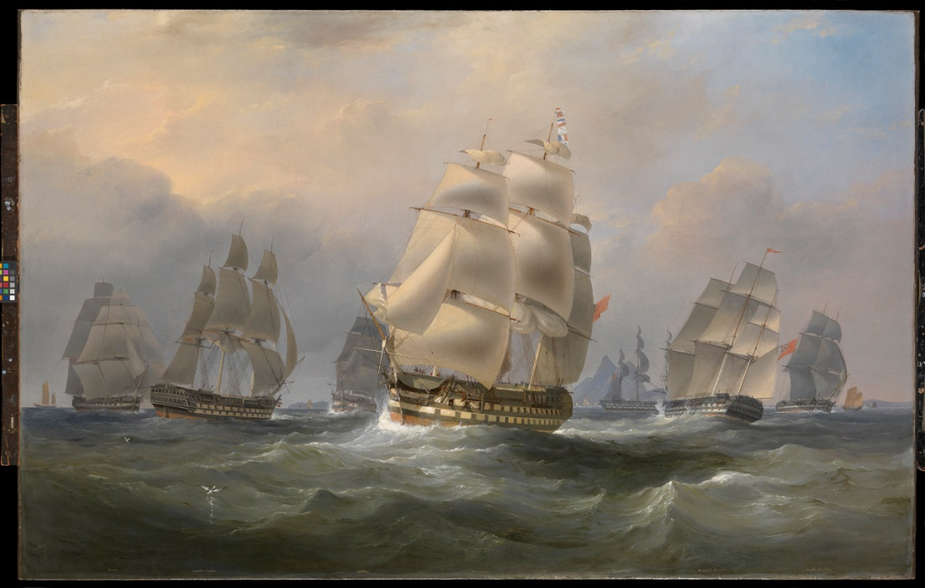
The origins of global health

Slide 19
The origins of global health: European colonization and colonial medicine
Colonial power expanded rapidly in the 15th century with the advent of ocean navigational innovations.
Lands and people in Africa, Central and South America, and the Caribbean fell under the rule of colonial powers emanating from England, France, Germany, Italy, Spain and Portugal, and the U.S. up through the middle of the 20th century
Many of the attributes of global health and medicine today were unintended consequences of the colonial era
.
Notes:
The origins of global health are in colonial era medicine.

Slide 20
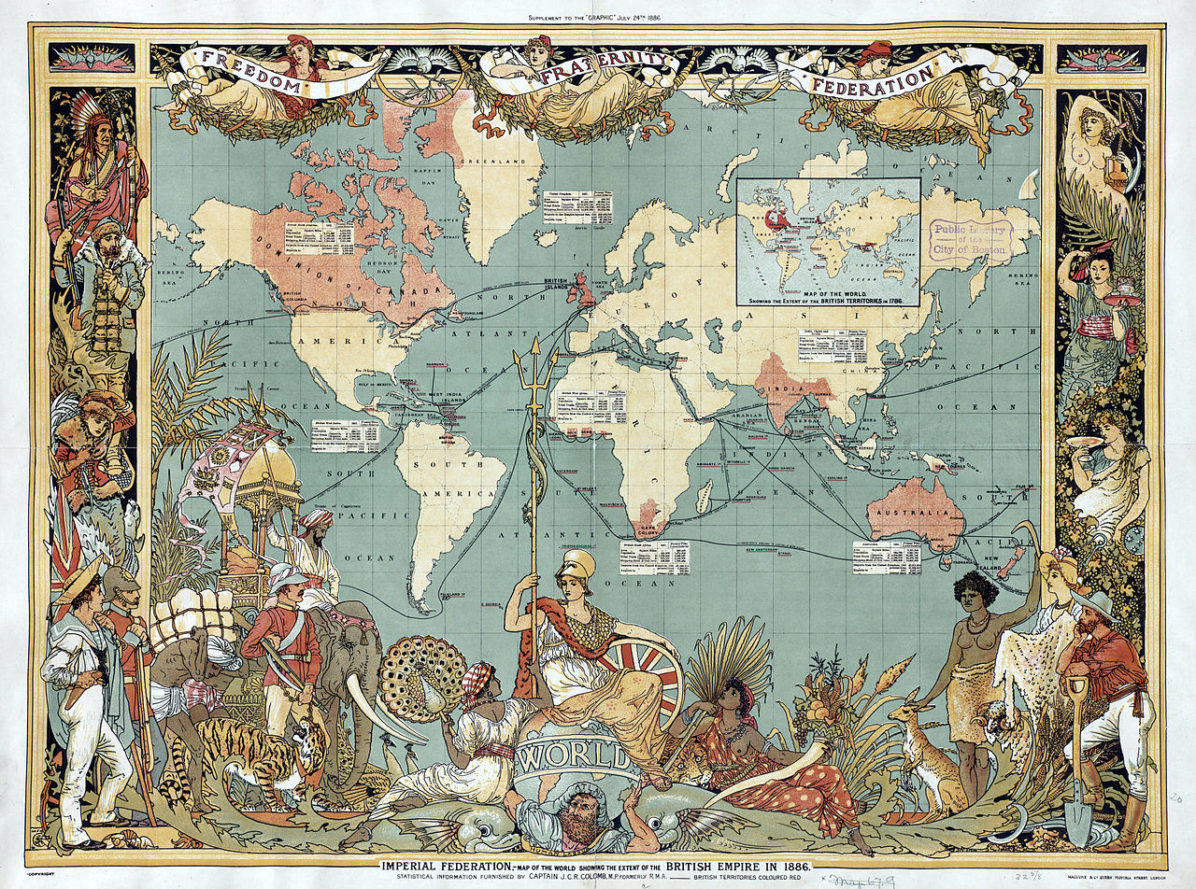
The Columbian Exchange
Refers to the beginning of a transformation of the globe associated with Columbus and early European explorers reaching the Americas.
The Columbian Exchange was a global movement of people, but also of animals, plants, and pathogens as European countries colonized the world
Brought with it the global movement and exchange of disease-causing bacteria and viruses, as well as animals that served as a source of zoonotic diseases

Slide 21
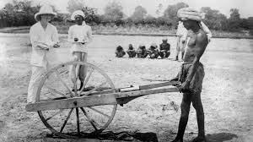
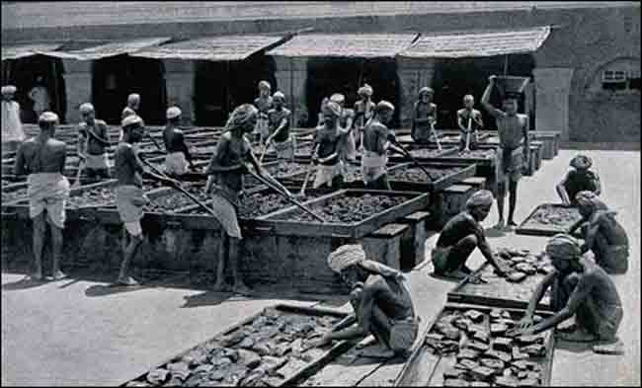
Europeans brought measles, smallpox, and tuberculosis which killed millions in the Americas
However, the indigenous people were also seen as a commodity by the Europeans, whose health was necessary in order to profit from their labor.
This spurred research into how to maintain the health of those that were now ruled over and put into service to their colonial masters.

Slide 22
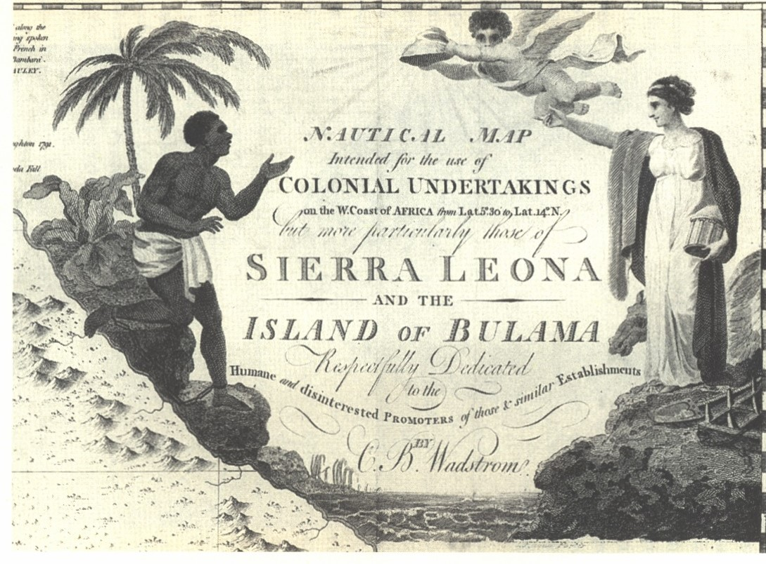
European encountered new tropical diseases as they travelled around the world.
Mortality of Europeans along the Gold Coast of West Africa was 300-700 per 1000 colonizers in early 1800's.
This spurred research into the causes of disease among the colonizers.
.

Slide 23
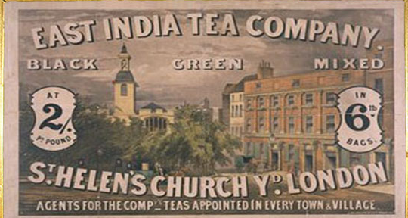
Disease traveled back to Europe from colonized countries in Asia and Africa.
Indian Ocean shipping lanes of the British Empire in the first decades of the 20th century provided new routes for the transmission of cholera.
Cholera that began in India could now impact the manufacturing towns of France and England
Thus the health of others in distant land was realized as being important for the health of others far away.
.

Slide 24
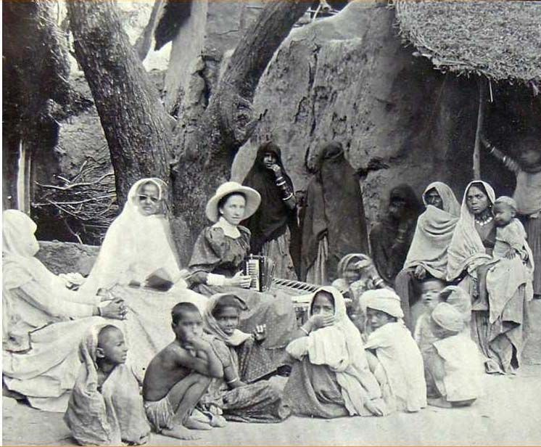
Medicine was used as a pretext for colonial rule
The imperialism as helpful argument
Holds that one of the aims of colonization should be medical.
Colonialism could be presented as beneficial, it helped the locals.
However, colonial medicine became an agent of penetration and pacification.
Often medical care was limited to those who agreed to be ruled or who provided labor and other services readily
Notes:
During the colonial period, the practice of “Doctory” or Western medicine gained momentum in India, buoyed with the support of the British as well as Western-educated Indians. Many Indians were trained in Western medicine and employed by the administration as “native doctors” in the medical service for Indians. However, the superior medical service by and large comprised Europeans.
The Indian and British medical personnel that lived outside of the major colonial cities were the basis for the first field-based public health programs
Saini, A. (2016). Physicians of colonial India (1757–1900). Journal of Family Medicine and Primary Care, 5(3), 528.
Photo of woman missionary in India in 1900s
This paternalistic stance – we will take care of you – was common for many colonial relationships

Slide 25
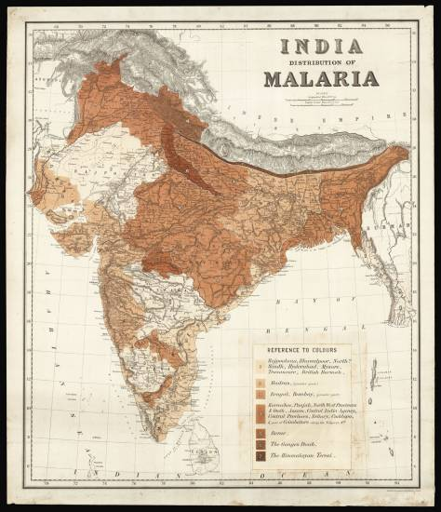
The infrastructure of imperialism argument
Medical care and doctors were needed to keep the military and administrative officers of the ruling power healthy, as well as the ruled citizenry who labored in the service of empire.
Medical care was essential to maintaining power of the colonize
Notes:
https://www.crouchrarebooks.com/maps/view/distribution-of-malaria-in-british-india
Map is from 1880 – malaria was a serious illness for the British in India and in many of their tropical colonies
Formation of the London School of Tropical Medicine in 1899 was meant to foster this kind of imperial medicine.

Slide 26
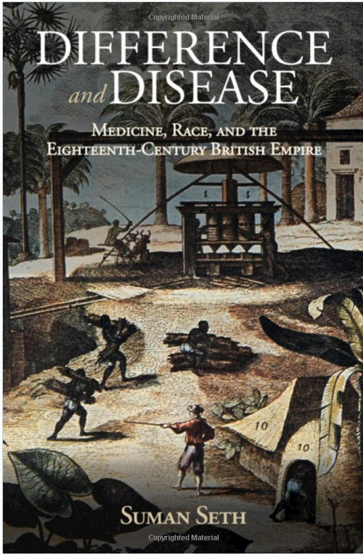
Examples of the discourses about health used to justify the actions of the colonizers
British mortality rates in 1835 were 12:1000 in the United Kingdom, but 500:1000 when stationed in west Africa.
Africans did not have these high mortality rates
This gave way to the discourse that the native bodies were better suited or ‘seasoned’ to labor in these hot climates, in Africa and in the slave trade in the Americas.
Slavery was also justified by the socially-constructed idea that Africans did not feel pain like white people
Even today, myths still remain about racial differences
Notes:
https://news.cornell.edu/stories/2018/10/acclimate-or-die-book-examines-disease-british-empire

Slide 27
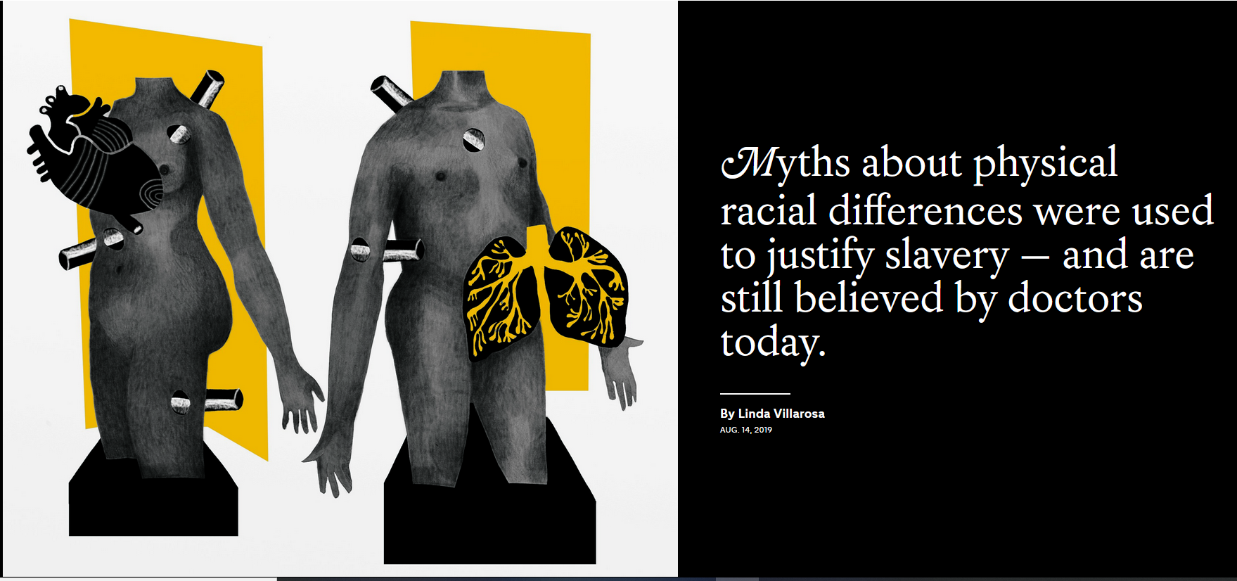
Notes:
https://www.nytimes.com/interactive/2019/08/14/magazine/racial-differences-doctors.html?smid=nytcore-ios-share The pain myth still exists: https://www.nytimes.com/2019/11/25/upshot/opioid-epidemic-blacks.html

Slide 28
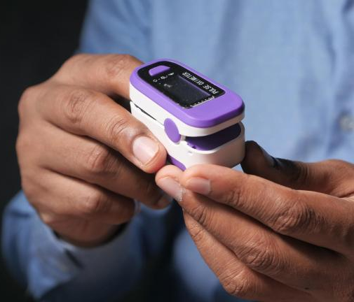
Pulse oximeters
Measure oxygen levels
Variations in skin pigmentation can affect the accuracy of these readings.
Darker skin contains more melanin, which can interfere with the absorption of light
This can lead to overestimation of oxygen saturation and the delay of intervention for people with darker skin
Newer and more sophisticated oximeters do not have this problem
Notes:
Another example of the translational gap, this time for a medical instrument. There are some differences in biology that need to be taken into account, like this failure of the designers of the oximeters to account for skin color, but often it is the social context, and issues of power and inequity, that account for differences in disease more than any biological difference. Just keep in mind that not everything is cultural nor is everything biological, they can each contribute. A study published in the New England Journal of Medicine in 2020 found that Black patients were nearly three times as likely as white patients to have occult hypoxemia (low oxygen levels that are not detected by pulse oximeters). Another study published in the Journal of the American Medical Association (JAMA) in 2022 supported these findings, highlighting the need for improved pulse oximeter technology that accounts for skin pigmentation. Sjoding, M. W., Dickson, R. P., Iwashyna, T. J., Gay, S. E., & Valley, T. S. (2020). Racial Bias in Pulse Oximetry Measurement. New England Journal of Medicine, 383(25), 2477-2478. DOI: 10.1056/NEJMc2029240
Valbuena, V. S. M., Seelye, S., Sjoding, M. W., et al. (2022). Racial Disparities in the Accuracy of Pulse Oximetry and Clinical Outcomes in Patients With COVID-19 Infection. JAMA Internal Medicine. DOI: 10.1001/jamainternmed.2022.1906
https://www.nhlbi.nih.gov/news/2023/updating-pulse-oximeters New ‘green’ light oximeters can accommodate skin color differences

Slide 29
What are specific historical events leading to the emergence of global health?
Through expeditions in Egypt and India, the microbiologist Robert Koch isolated Vibrio cholerae in 1883, proving that heat and humidity were not barriers to tropical colonization – at the time it was thought that the ‘bad air’ of the tropics caused cholera
The still relatively new idea of germ theory developed by Pasteur also implied that addressing the problem of germs would allow new tropical lands to be made more accessible.
Formation of the London School of Tropical Medicine in 1899 was meant to foster this kind of imperial medicine. This is another way in which global health had its origins in colonialism.
Notes:
Imperial medicine aimed to make it safe for Europeans to travel to other parts of the world.

Slide 30
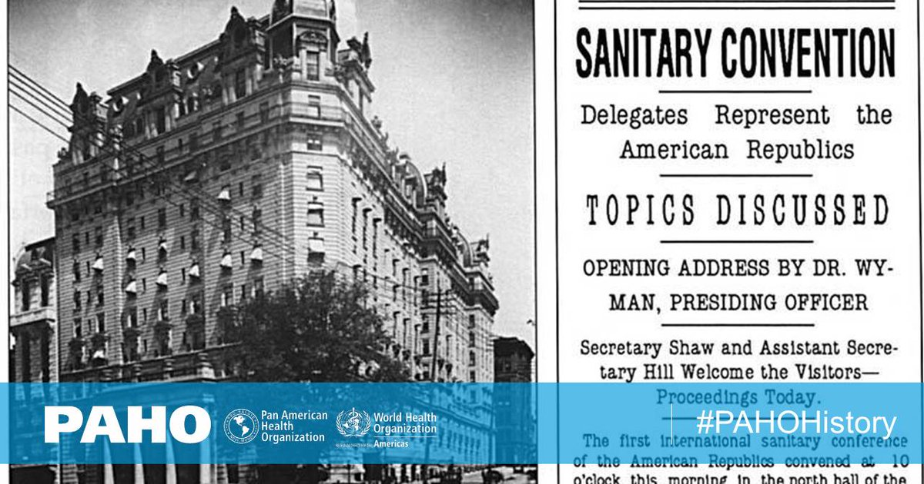
The Pan American Sanitary Bureau (the Pan American Health Organization today) was formed to coordinate the ultimately successful international effort to control yellow fever during the construction of the canal (1903-1914)

Slide 31
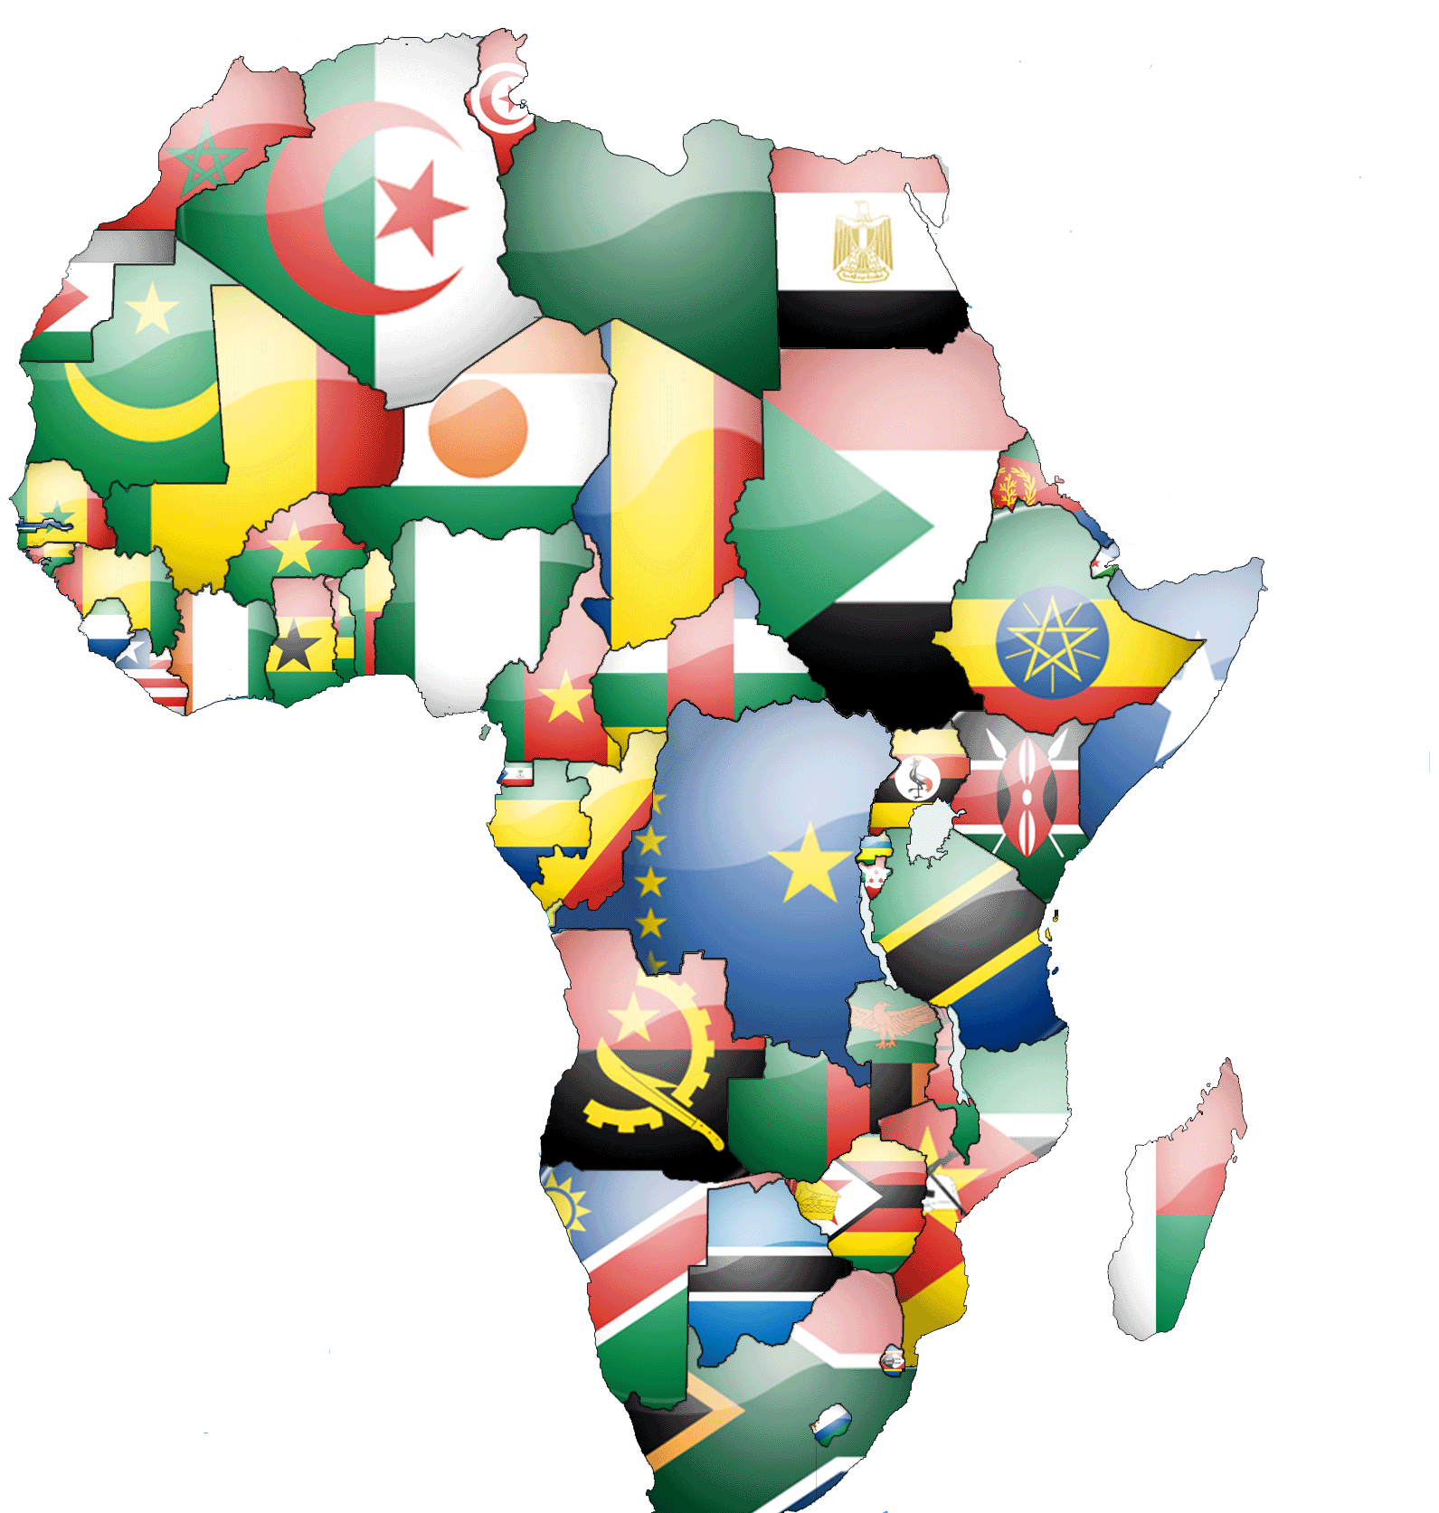
After World War 2, colonial power weakens throughout Asia and Africa and the era of colonial revolutions and self-determination begins.
Global political and economic power becomes focused on contrasts in development among wealthier and more recently formed and poorer countries
Internationalization of health along issues of health equity became more important under the newly formed United Nations in 1945

Slide 32
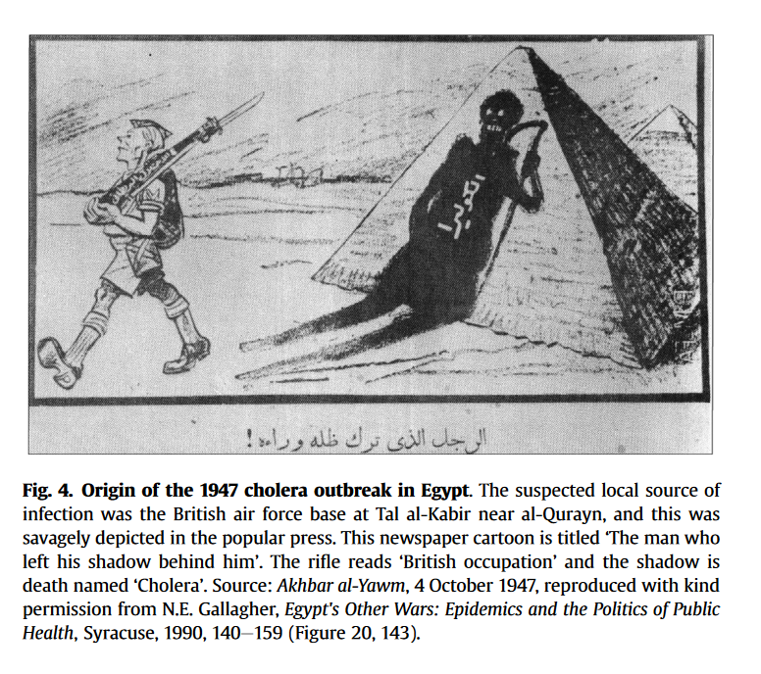
Planning for the World Health Organization began at a 1945 meeting of the United Nations
WHO originally promoted by Brazil and China (not the U.S. or Europe)
WHO aimed to have global membership
1947 saw the first crisis of WHO, a cholera outbreak in Egypt. WHO succeeded in preventing neighboring countries from imposing damaging quarantines; provided rehydration treatments, deployed sanitation measures and vaccination.
Notes:
Smallman-Raynor, M., & Cliff, A. D. (2016). The diffusion of cholera in Egypt, 1947: a time-space analysis of one of the largest single outbreaks in the twentieth century. Journal of Historical Geography, 54, 24-37.

Slide 33
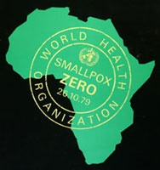
With greater international legitimacy, WHO was formally established in 1948.
1955 WHO proposed global eradication of malaria, a disease most common in tropical countries of former colonies of Africa, Asia, and South America, although this attempt failed
1967 WHO began drive to eradicate smallpox, which was ultimately successful, twelve years later, in 1979

Slide 34
The broad legacies of colonialism in global health
“Command-and-control” top-down administration of responses to global health issues: wealthier countries and global health institutions often dictate terms to poorer countries
Eradication of a disease often stressed more than the long-term efforts to strengthen existing health systems and address the social and economic origins of disease in poor countries
Although wealthier nations now extend health care help in a global context, their former colonial governments aimed to keep developing nations less economically empowered, sometimes for centuries
Call have been made over the past several decades to ‘decolonize’ global health, to invest in the independence of the health care systems of former colonized countries.

Slide 35
The types of colonial institutions differed in how they extracted wealth
Institutions of settler colonies (U.S., Canada, Australia)
Low indigenous population density and low mortality for Europeans, so Europeans settled in large numbers. The colonial countries built inclusive institutions to motivate settlers through the inclusion of property rights and a rule of law. These colonies contributed less wealth to their European rulers.
Institutions of extractive colonies (Congo, India, Peru)
High indigenous population density and high settler mortality due to disease led to fewer European settlers. Goal became to extract resources using local labor with minimal settler involvement. This led to the creation of extractive colonial institutions: coercion, and centralized power in elites. These colonies and their institutions generated large amounts of wealth for the colonizers.

Slide 36
This in turn influenced post-colonial development and public health
In 1500, densely populated regions in South America (Inca), India (Mughal) and Mexico (Aztec) were centers of extractive wealth for the colonizers (Type 2 institution)
Today these formerly rich regions are more often poorer. This is because extractive institutions (mining, labor-intensive agriculture) persisted after independence from colonizers
Type 1 colonial institutions were more likely to facilitate economic growth and innovation in the post-colonial period. No long term intensive extractive industries
Today’s global inequality in health and wealth reflects these path-dependent colonial institutional frameworks

Slide 37
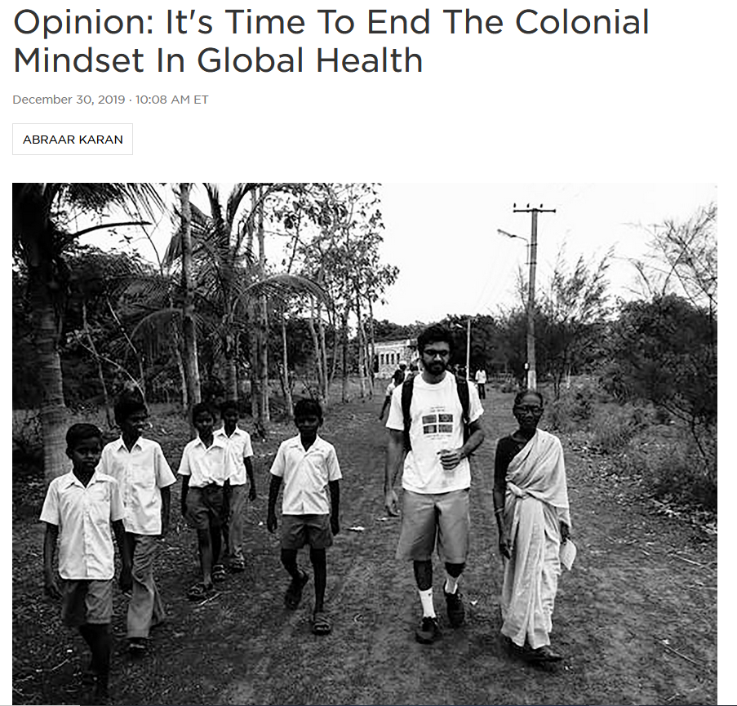
What does “decolonializing” global health mean?
Addressing the legacy of power and control left by colonialism on global health
Global health research largely dominated by Western researchers building their careers off studies of people who may not benefit from their participation
Relationships within global health are still heavily dominated by the idea that the Global North is "helping" the Global South.
Notes:
https://www.npr.org/sections/goatsandsoda/2019/12/30/784392315/opinion-its-time-to-end-the-colonial-mindset-in-global-health

Slide 38
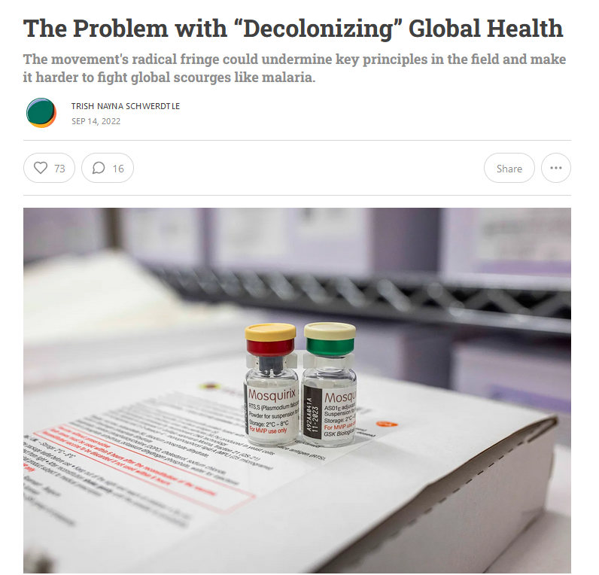
Extreme advocates of the decolonization of global health have gone so far as to call for the field of global health to be dismantled altogether.
They criticize it as being ‘safari science’
The danger is that in efforts to remedy lingering impacts of colonialism, some of the benefits of a global viewpoint on health could be lost
Notes:
https://www.persuasion.community/p/the-problem-with-decolonizing-global

Slide 39
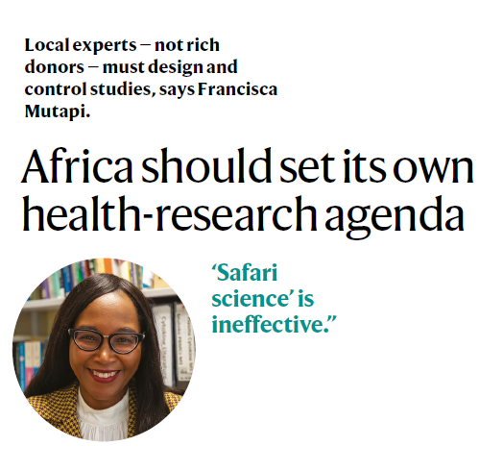
What is ‘safari science’?
Derogatory label given to ‘extractive’ scientific studies that take place in developing world by scientists from wealthier nations
Local investigators in low-income countries (LIC) function more as data collectors and translators than fully vested collaborators.
Funding originates from high-income countries (HIC) and most money goes to researchers and labs of these countries
Research questions guided by agencies in HIC rather than by LIC priorities
Samples and data are extracted and housed outside of the countries where they originated
Benefits may not prioritize the countries where the research took place
Notes:
Mutapi, Francisca. "Africa should set its own health-research agenda." Nature 575.7784 (2019): 567.
https://www.nature.com/articles/d41586-019-03627-9

Slide 40
Global health after 2025: the old model broke
For decades, global health depended on a U.S.-anchored model: USAID, PEPFAR, WHO, Gavi, the Global Fund, and U.S.-backed NGOs kept clinics open, paid health workers, bought drugs, supported surveillance, and coordinated outbreak response.
In 2025, US froze foreign assistance, moved to withdraw from WHO, dismantled much of USAID, cancelled large numbers of global health awards, reduced support for HIV programs, and moved away from vaccine and multilateral health funding.
Contracts stopped, staff were laid off, clinics closed, drug procurement was interrupted, country programs lost technical support, and multilateral agencies had to cut budgets.

Slide 41
Global health after 2025: the old model broke
Other donors did not fill the gap. Many European governments were also cutting aid because of defense spending, Ukraine, domestic budget pressure, migration politics, and a broader turn toward national-interest aid.
Global health initiatives from the US are now organizing around a for-profit model.
Bottom line: global health is no longer organized around predictable U.S.-led internationalism. It has shifted toward a fragmented, underfunded, nationally self-interested system in which low- and middle-income countries are being forced to absorb costs faster than their health systems can adapt.

