Slide 1
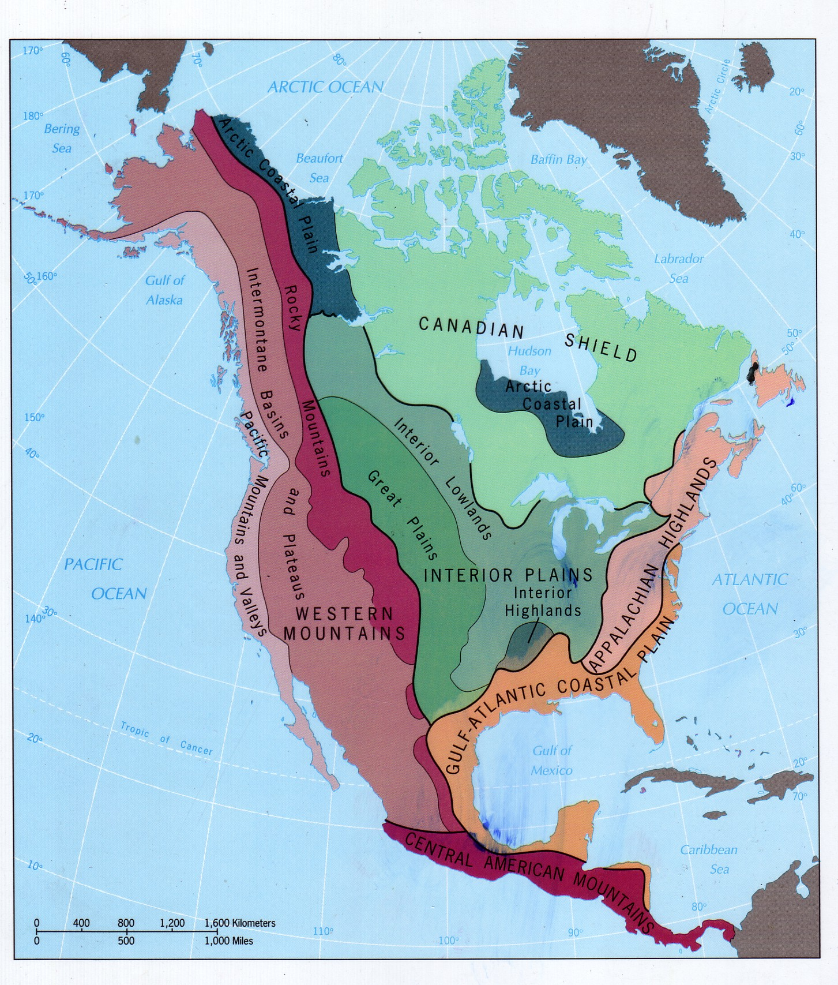

Slide 2
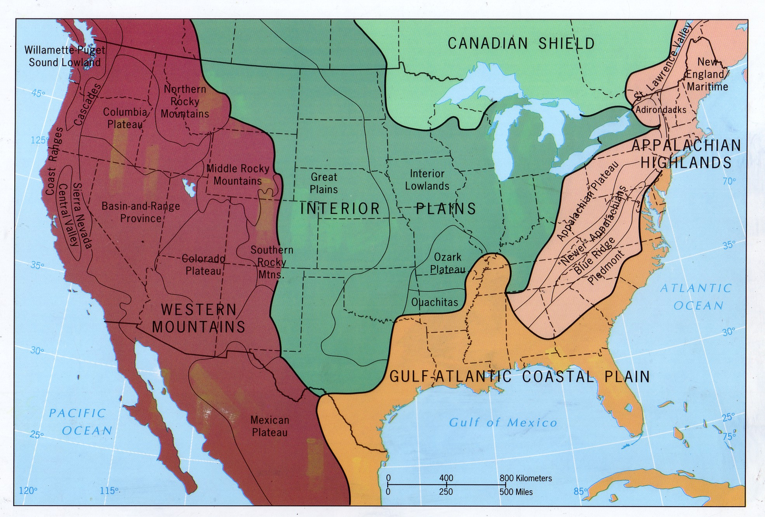

Slide 3
North American Physiographic Provinces
Canadian Shield
Interior Plains
Interior Lowlands
Great Plains
Ozark Plateau
Ouachita Mountains
Gulf-Atlantic Coastal Plain
Appalachian Highlands
Piedmont
Blue Ridge
Newer Appalachians (Valley and Ridge)
New England Maritime
Adirondacks
Appalachian Plateau (contains the Cumberland Plateau)
Southern Rocky Mts
Middle Rocky Mts
Northern Rocky Mts
Basin and Range Province
Pacific Coastal Ranges
Puget Sound Lowlands
Cascade Mountains
Sierra Nevada Mountains
Central Valley
Colorado Plateau
Columbia Plateau
Notes:
Be able to locate and label on a map. You may use a hand-drawn and labelled map on the next test

Slide 4
Erosion
Erosion is not weathering
Erosion is the transport of weathered material
Weathering can occur in the absence of erosion and vice-versa
Erosion is driven by denudational agents that denude, or remove, weathered material
We introduce several erosional processes and landforms in this unit, although we will cover them and the landforms associated with them in more detail in later units

Slide 5
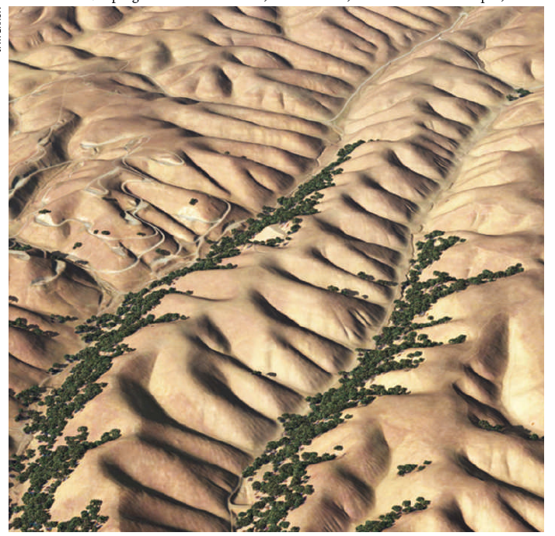
Fluvial erosion
Erosion from water flowing at the surface
Predominant agent shaping secondary landforms, even in arid climates.
Overland flow generates secondary landforms through their erosion of surface rocks and sediments
Flow in river channels transports large volumes of sediment and generates landforms

Slide 6
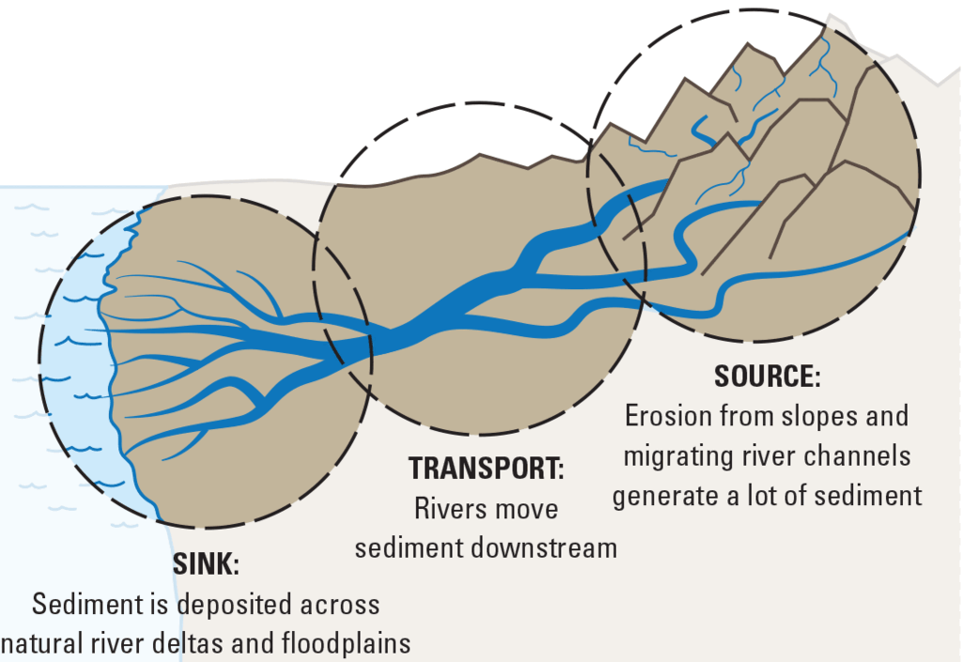

Slide 7
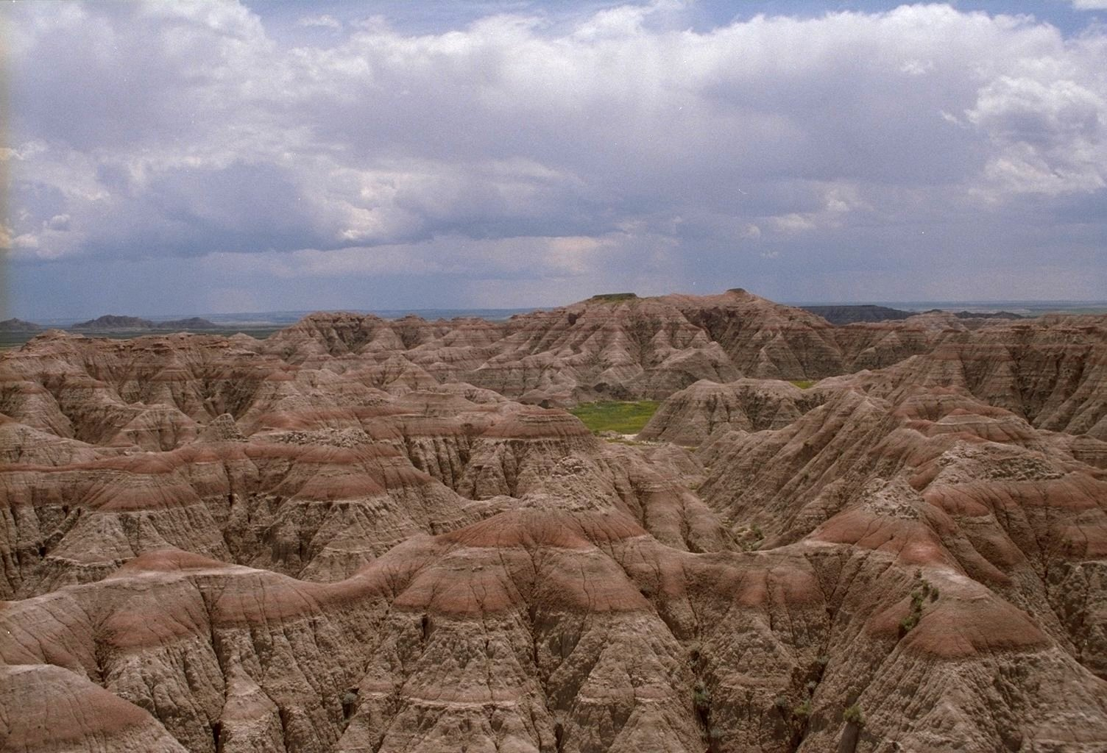
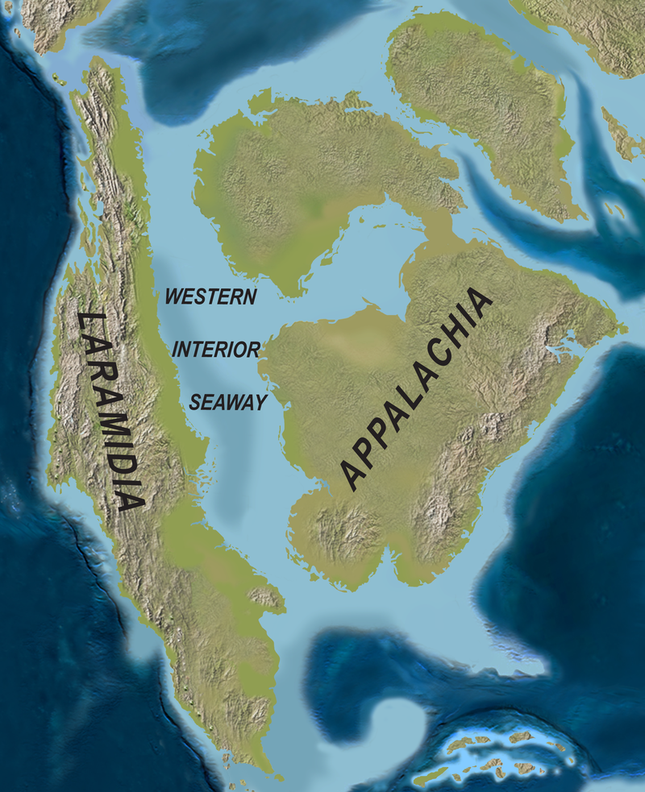
Notes:
Badlands National Park, South Dakota is located in the Great Plains physiographic province. The Great Plains are overlain by horizontal sediments from eroding Rocky Mountains and retreating Cretaceous sea. These sediments are exposed in the deeply eroded Badlands NP.

Slide 8
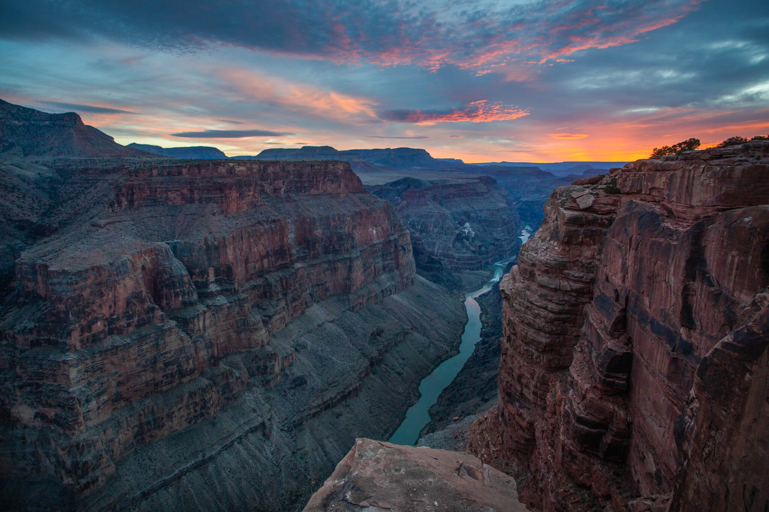
Notes:
Colorado Plateau

Slide 9
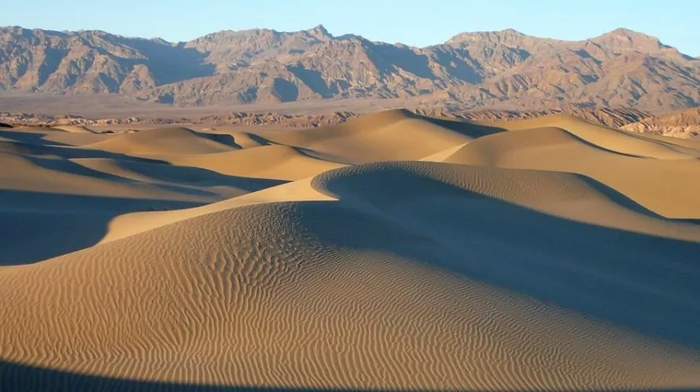
Aeolian (wind) erosion
Sediment eroded by wind can accumulate to great thicknesses depending upon prevailing winds and patterns of deposition
Notes:
Mesquite Flat Sand Dunes in Death Valley National Monument

Slide 10
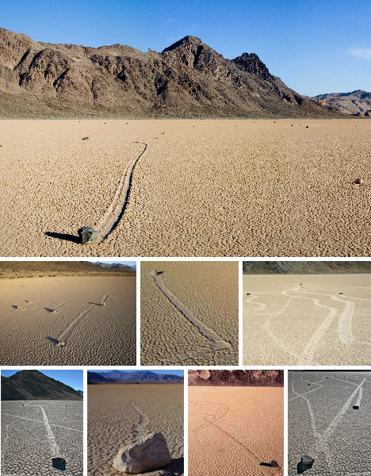

Slide 11
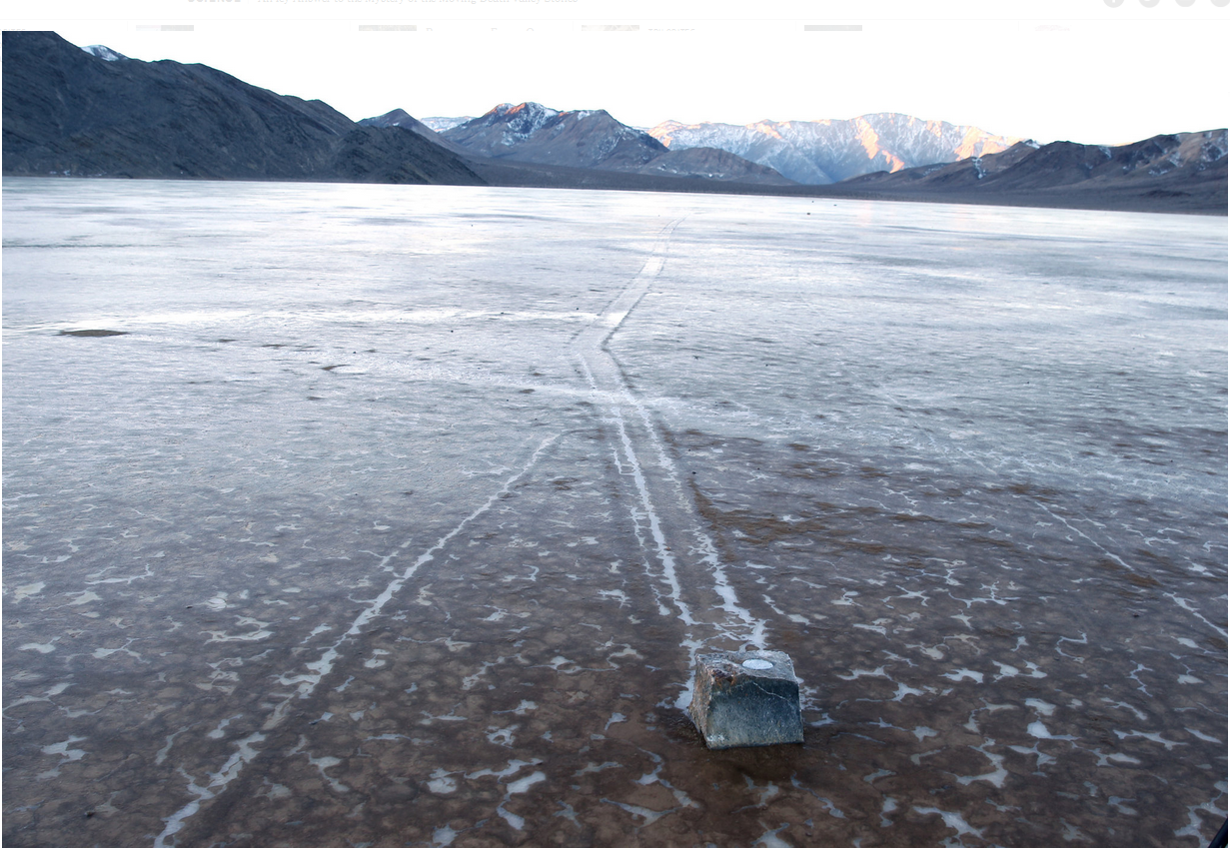

Slide 12
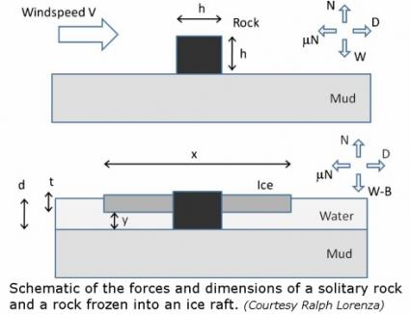

Slide 13
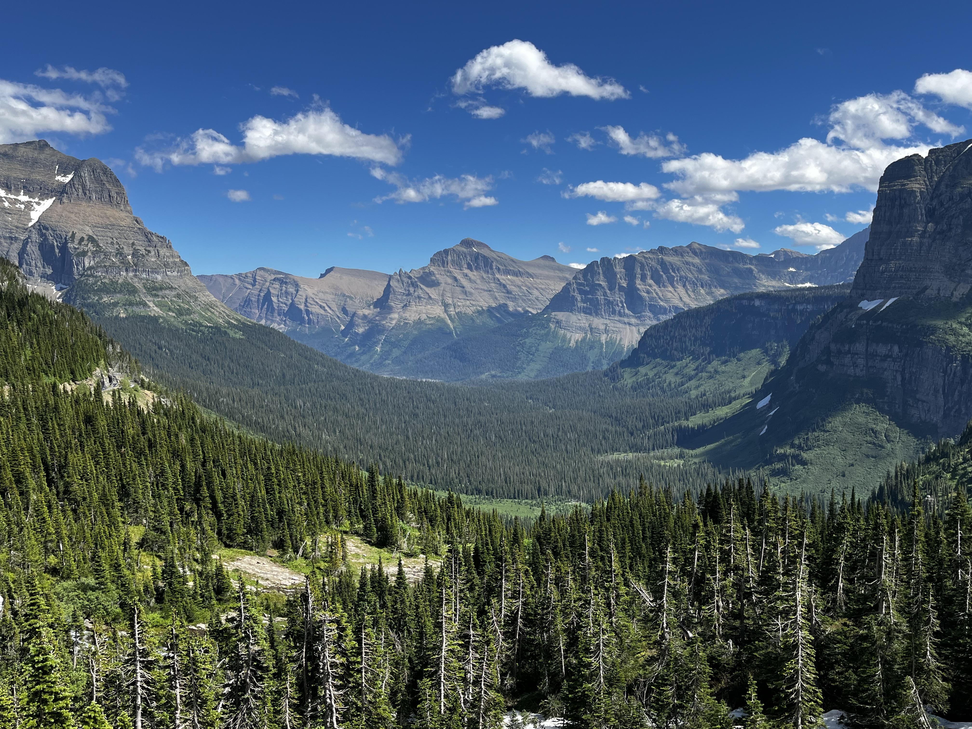
Notes:
Glacial valley in Glacier National Park.

Slide 14
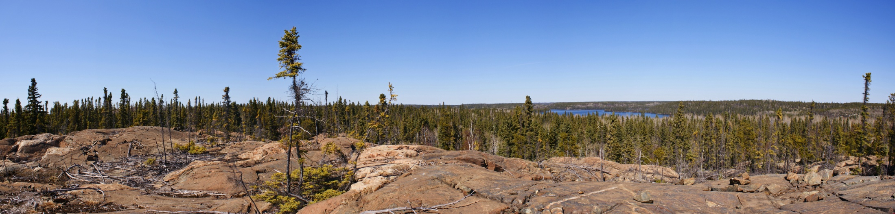
Glacial erosion
Canadian Shield
Scoured to basement rock by glaciers
Rocks and sediments transported by glacial ice and rivers south

Slide 15
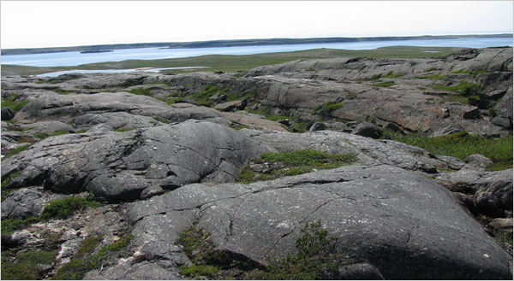
Notes:
Canadian Shield, Eastern Canada

Slide 16
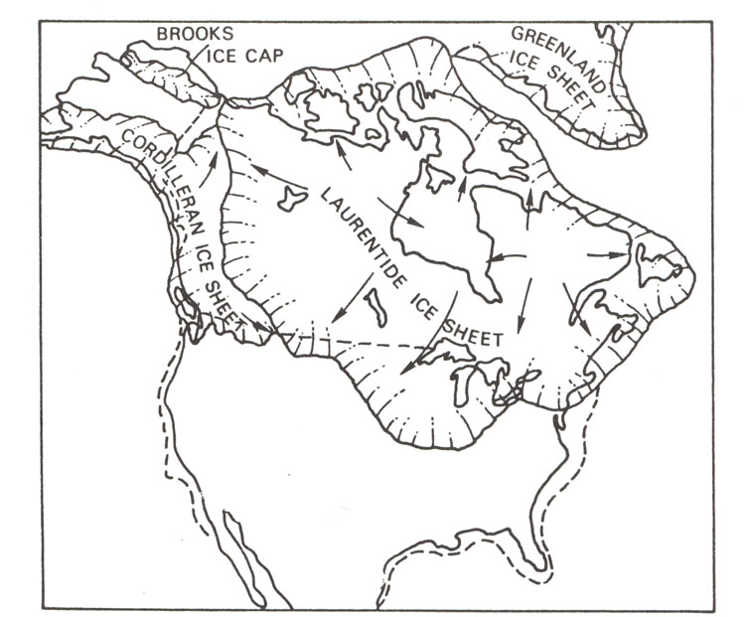
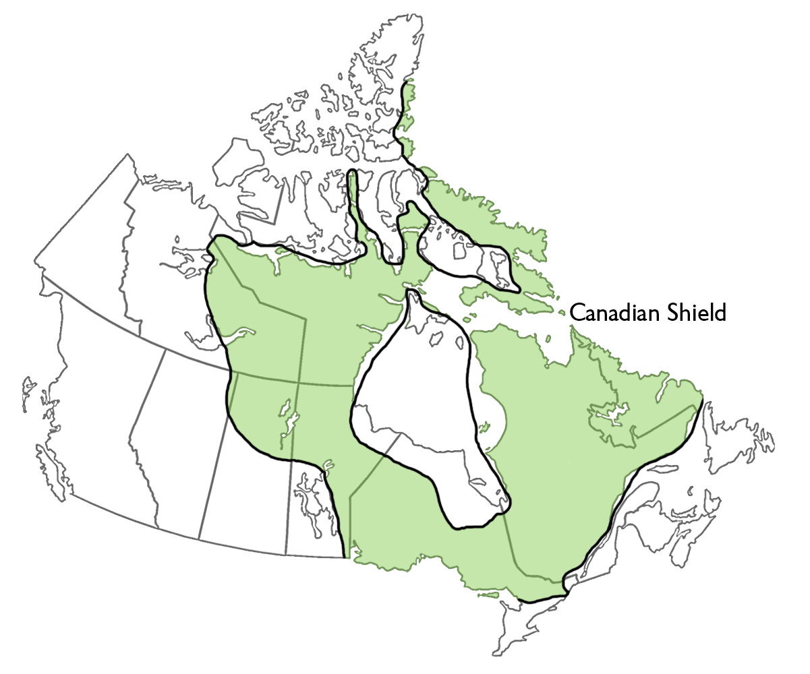
Notes:
The extent of ice sheet cover at the end of the last glacial maximum, approximately 21,000 to 18,000 years ago (right)

Slide 17

Notes:
https://www.nytimes.com/2018/06/05/science/how-the-ice-age-shaped-new-york.html

Slide 18
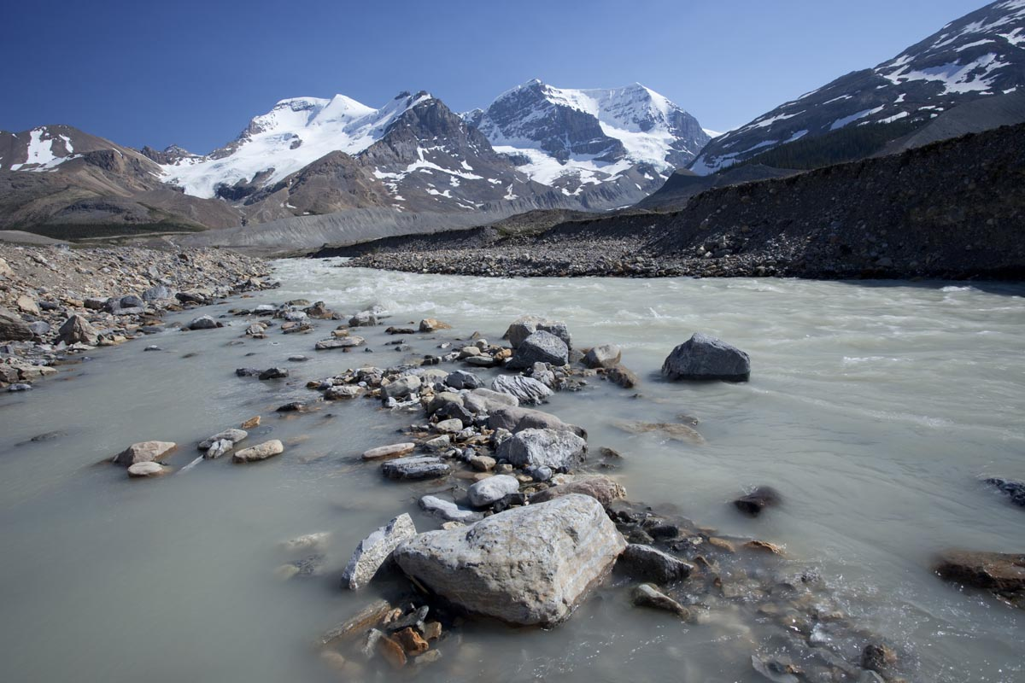
Notes:
Glacial meltwater, coming from the Athabasca Glacier in western Canada in the Northern Rockies.

Slide 19
Interior Lowlands
Low elevations (< 1000 ft)
Begins in US just south terminus of ice sheet 18,000 years ago
Sediments eroded to the north by glaciers deposited in Interior Lowlands
Aeolian and fluvial processes redistributed sediments
Glacial till – heavier materials, poorly sorted, deposited near terminus of glacier
Loess- fine sediments deposits that are transported a long distance from terminus of glaciers

Slide 20
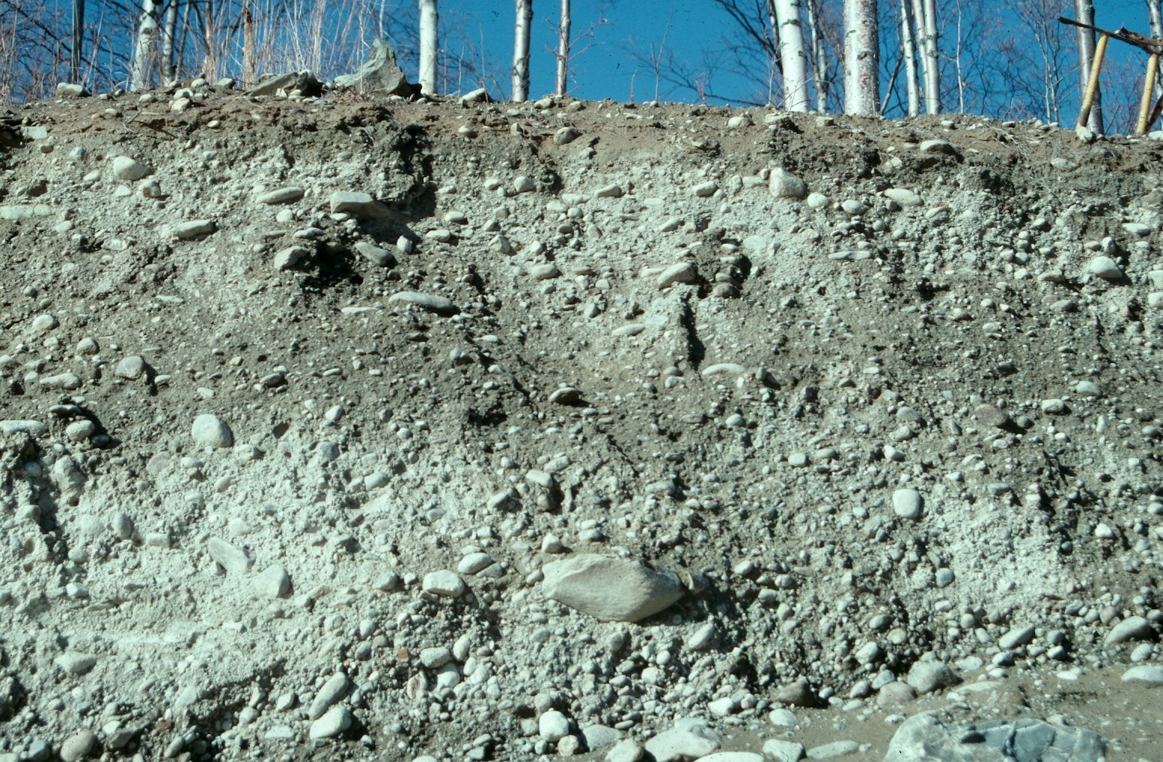
Notes:
Glacial till

Slide 21
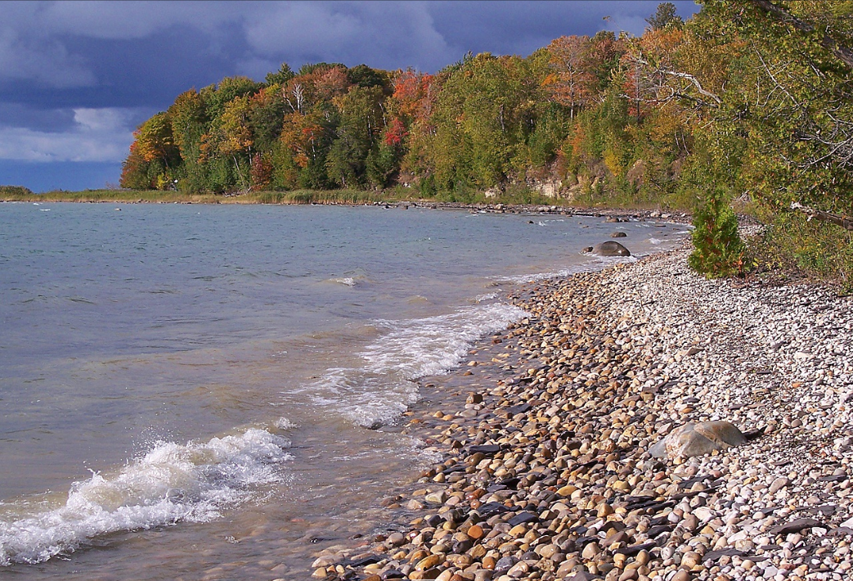
Notes:
Glacial till on the shores of Lake Michigan

Slide 22
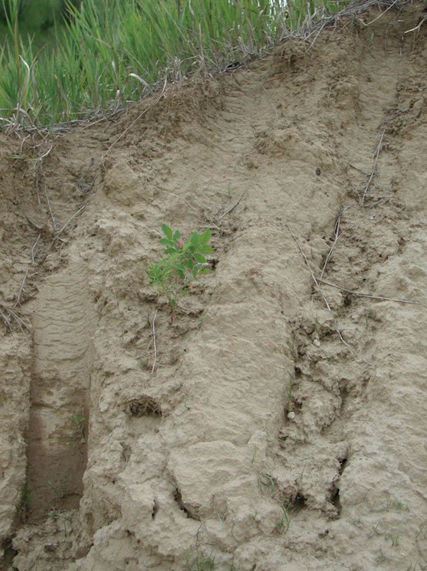
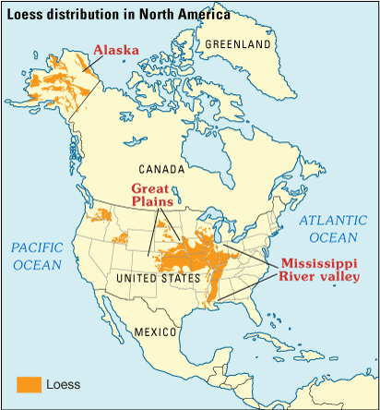
Notes:
Loess deposits, Mississippi Valley

Slide 23
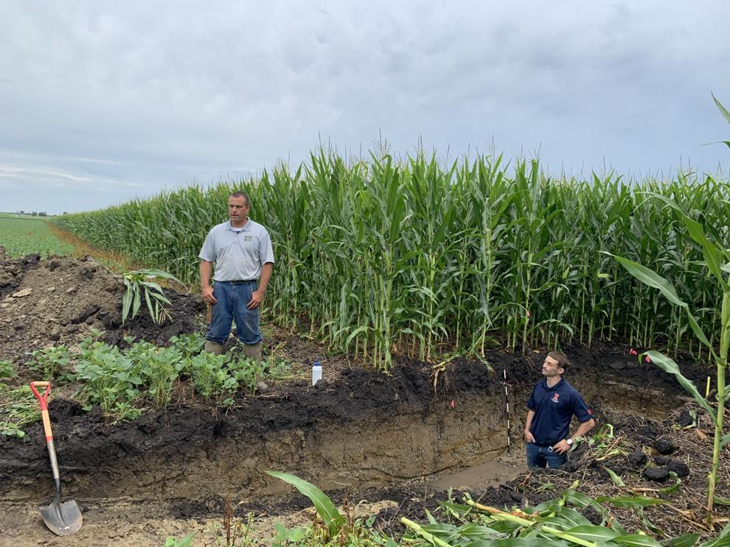
Notes:
Loess soils on a farm in Illinois. These are soil scientists who have exposed soil in order to study it.

Slide 24
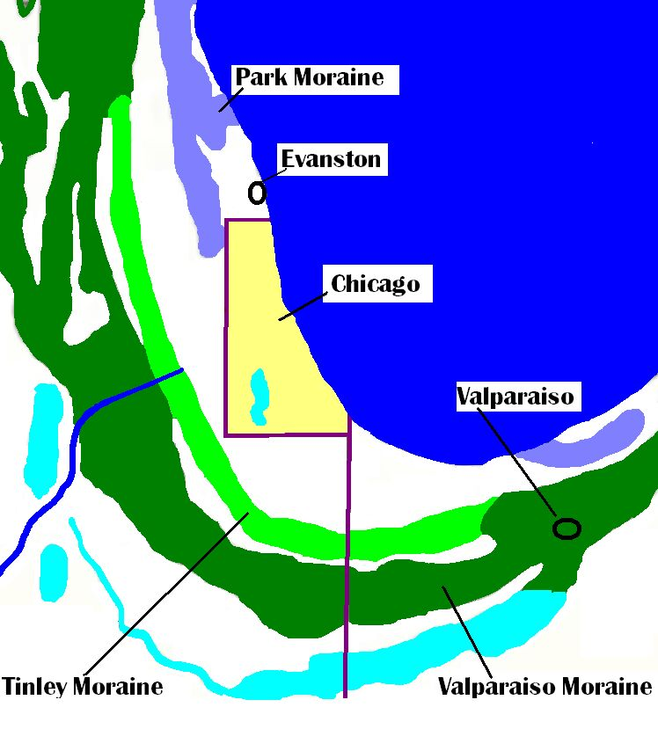
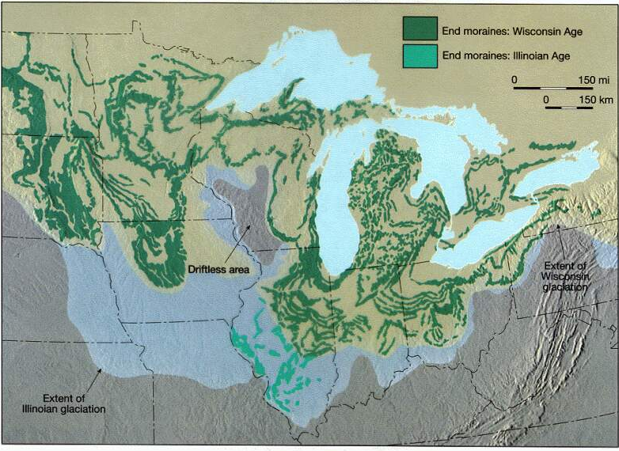
Notes:
The Great Lakes, the way rivers flow, the types of soil, and the distribution of forest types today over much of North America still reflects the last glacial maximum.

Slide 25
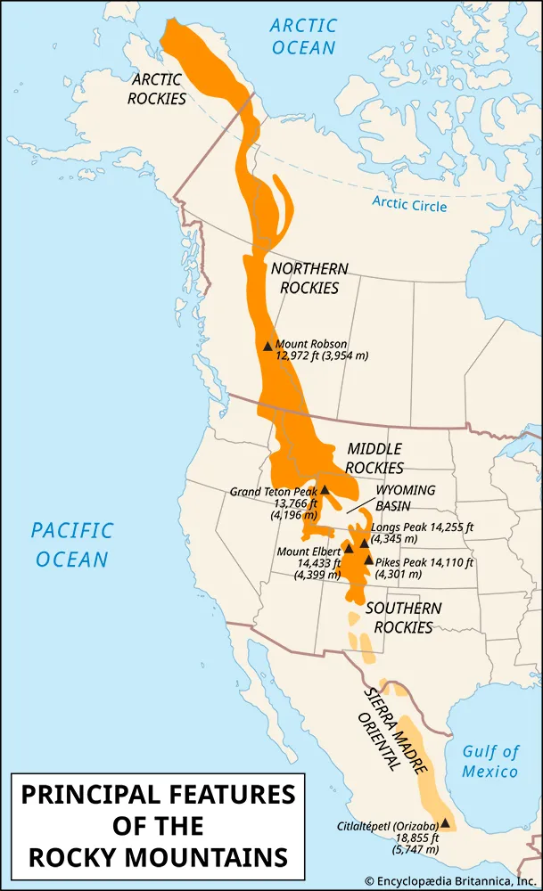
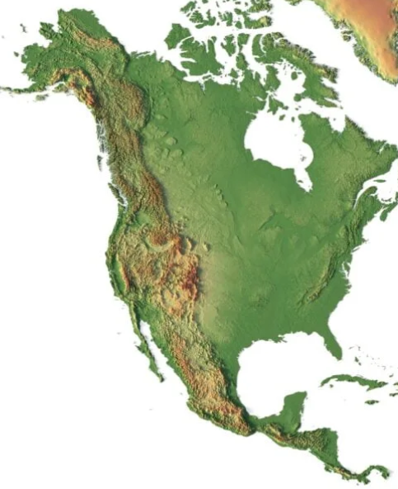
Notes:
The Gulf-Atlantic Coastal Plain contains large volumes of fluvially eroded material from the Appalachians

Slide 26
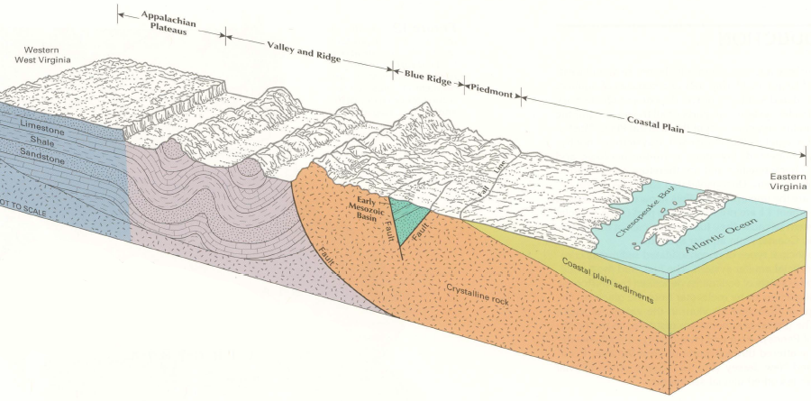
Notes:
Blue Ridge Physiographic Province The Blue Ridge is composed of ancient, highly metamorphosed rocks that date back to an orogeny more than a billion years ago. It was later uplifted during a series of tectonic collisions . The Blue Ridge was thrust over the younger rocks of the Piedmont province during an orogeny. The Blue Ridge Mountains feature rugged peaks and ridges composed of resistant igneous and metamorphic rocks.
Ridge and Valley Physiographic Province The Ridge and Valley province was shaped by the same orogenic events that affected the Blue Ridge. In this region, alternating layers of hard and soft sedimentary rocks (limestone, sandstone, and shale) were folded into anticlines and synclines, creating parallel ridges and valleys. The erosion of these folded layers resulted in a pattern of long, narrow ridges and broad valleys. The softer limestone and shale eroded to form valleys, while harder sandstone and quartzite formed the ridges. Appalachian Plateau Physiographic Province The Appalachian Plateau lies to the west of the Ridge and Valley province and represents a region of relatively undisturbed sedimentary rocks that were uplifted as a large, flat block during an orogency. Unlike the Ridge and Valley, the rocks in the plateau were not significantly folded or faulted. Over time, rivers and streams carved deep
Gulf-Atlantic Coastal Plain Formed from sediments eroded off the Appalachian Mountains. Over millions of years, these sediments were carried by rivers and deposited along the eastern edge of the continent, creating a flat, low-lying region. A wide, flat plain of sedimentary deposits extends from the Piedmont to the Atlantic Ocean. The Fall line represents the topographic break between the Piedmont and the Gulf Atlantic Coastal Plain
The Appalachians formed through a series of orogenies. These events involved collisions of continental plates, causing significant folding, faulting, and metamorphism of rocks across the region. Over the last 200 million years, as the region was uplifted, erosion by wind, water, and ice sculpted the mountains and valleys, producing the distinct physiographic provinces seen today. The varying resistance of rock types (sandstone, shale, limestone, etc.) to erosion played a key role in shaping the landforms in each province. This dynamic process created the distinctive landscapes of the Appalachians, from the rugged peaks of the Blue Ridge to the folded ridges and valleys and the flat-topped plateau further valleys and gorges into the plateau, creating a rugged landscape of flat-topped ridges and steep valleys. This area is known for its coal-bearing formations
Piedmont Physiographic Province The Piedmont lies to the south and east of the Blue Ridge and is composed of metamorphic and igneous rocks that were part of ancient mountain ranges formed during several orogenies. The Piedmont is geologically complex, consisting of deformed and metamorphosed rocks from various periods of mountain-building. The Piedmont is a gently rolling landscape of hills and low ridges. It has been deeply eroded over millions of years, and its elevation gradually slopes downward towards the Gulf-Atlantic Coastal Plain. west.
The Appalachians formed through a series of orogenies. These events involved collisions of continental plates, causing significant folding, faulting, and metamorphism of rocks across the region. Over the last 200 million years, as the region was uplifted, erosion by wind, water, and ice sculpted the mountains and valleys, producing the distinct physiographic provinces seen today. The varying resistance of rock types (sandstone, shale, limestone, etc.) to erosion played a key role in shaping the landforms in each province. This dynamic process created the distinctive landscapes of the Appalachians, from the rugged peaks of the Blue Ridge to the folded ridges and valleys and the flat-topped plateau further west.

Slide 27
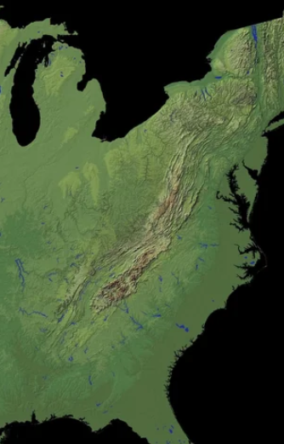
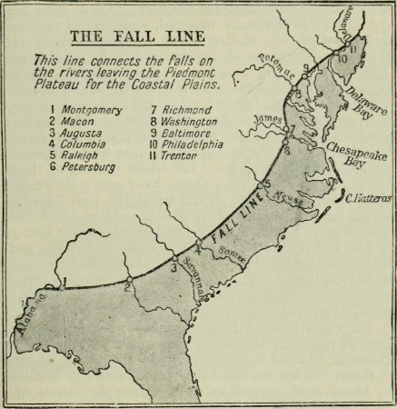

Slide 28
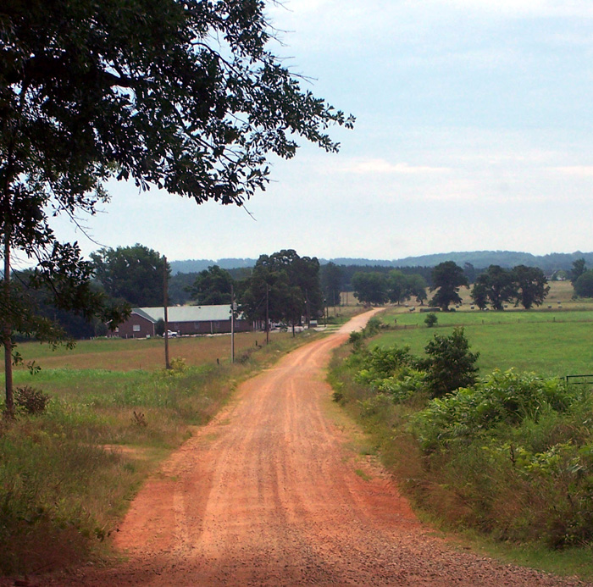
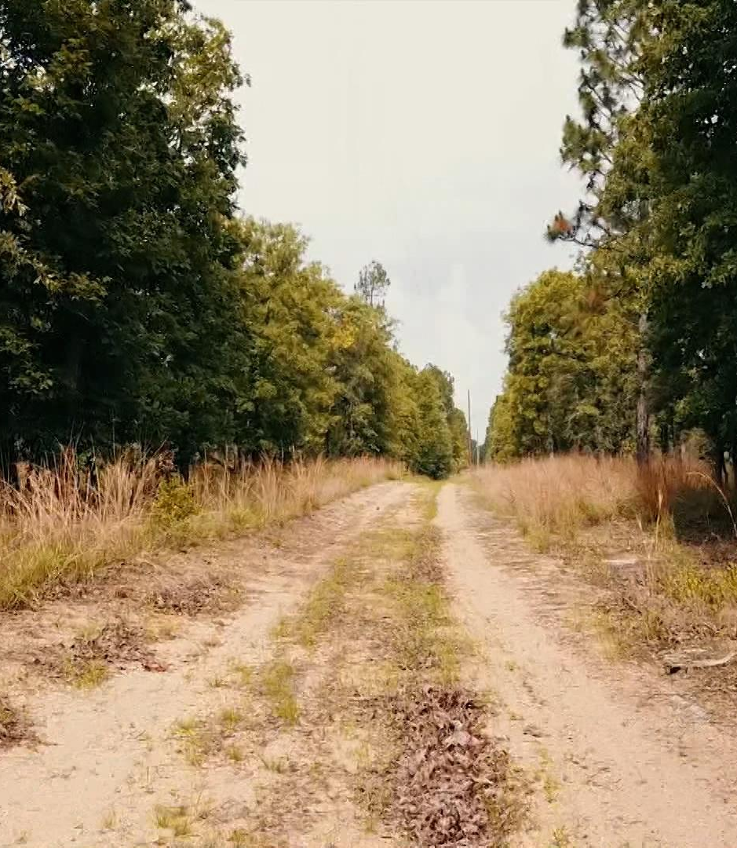
Notes:
Heavily weathered clay soils of the Piedmont (left). Sandy coastal plain sediments of the Gulf-Atlantic Coastal Plain.

Slide 29
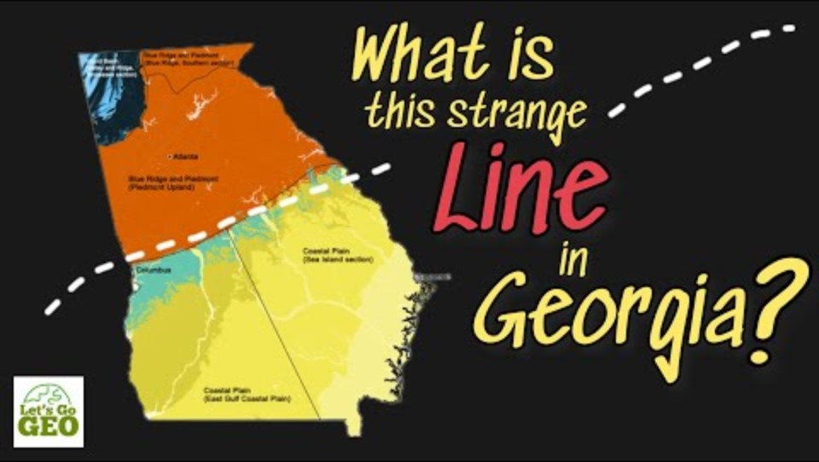

Slide 30
