Slide 1
Crustal motion
Can be very slow (California’s mountains are rising a few cm each year) or very fast (meters in seconds and minutes) in the case of earthquakes. Plate tectonics and internal structure of the Earth are source of energy for these motions:
Gravity anomalies
Crustal heating
Mountain-building (orogenesis)
Non-deformational motion (epeiorogeny)
Folding and faulting

Slide 2
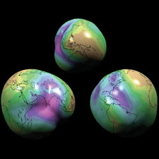
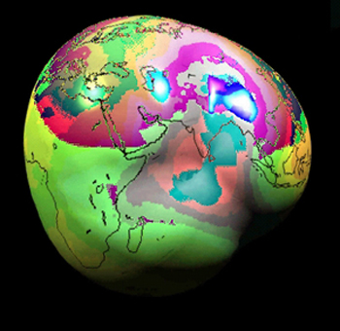
The ‘lumpy’ Earth
Notes:
The lumpy earth

Slide 3
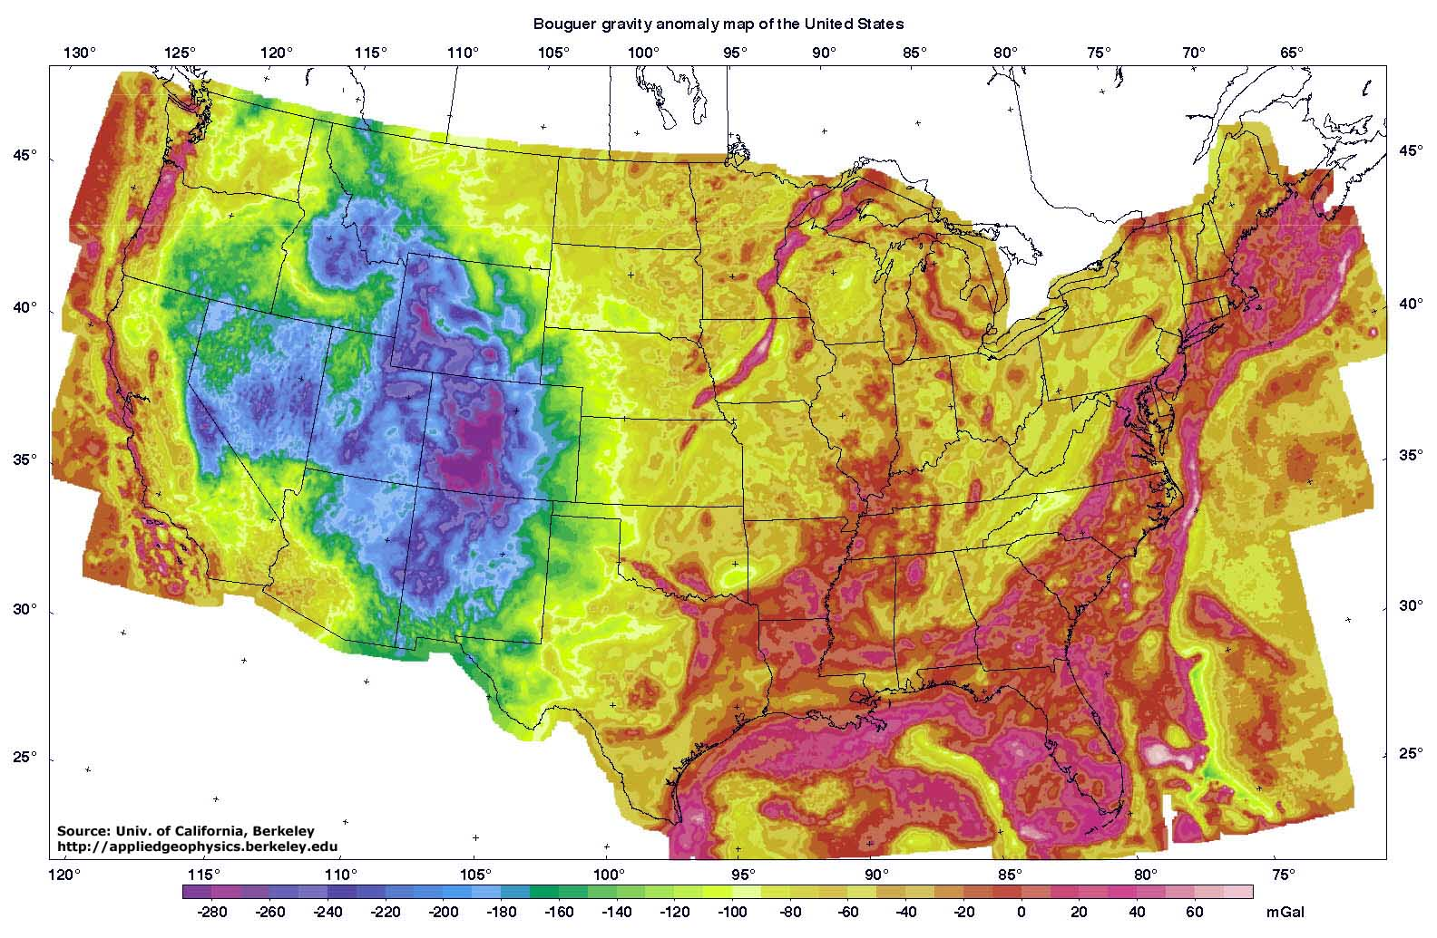
Lumpiness due to variability in force of gravity
Notes:
Force exerted by gravity = mass x acceleration (9.8 meters per second squared)
Mass = density x volume
There are rocks with different densities, hence mass varies per unit volume over the surface of the earth. Thus the force exerted by gravity differs resulting some parts of the crust being pulled more strongly toward the center of the Earth

Slide 4
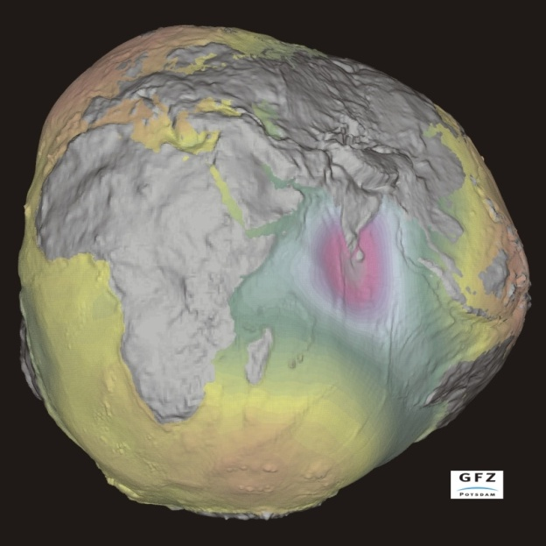
Gravity is not the same everywhere on Earth (but you would not notice it)
Over large areas of the crust, gravity can vary due to the density of the crust which is a function of rock type
The force of gravity is proportional to the density of crustal rock type
Denser rocks have greater gravitational force and are thus pulled downward more
Topographic relief is exaggerated in order to make it more apparent. The world is not this lumpy.
Notes:
Basaltic rocks are more dense (more mass per unit volume) than granitic rocks. Basaltic crust experienced a slightly greater gravitational force and is down deformed downward relative to granitic areas.

Slide 5
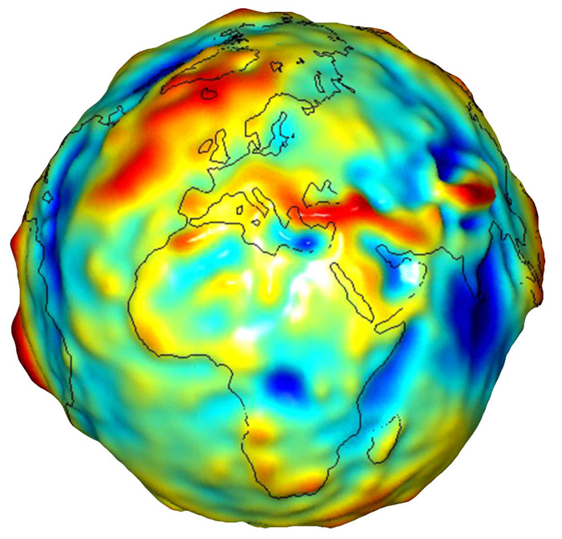
Crustal heating also makes the Earth lumpy
Hotter crust: bulging outward because of lower density
Cooler crust: downwarped because of higher density

Slide 6
Mountain building
A mountain building episode is an orogeny.
Rates of uplift can be on the order of <10 centimeters per year
Uplift must exceed removal of rocks and sediment by weathering and erosion for mountains to rise
Multiple orogenies over time possible

Slide 7
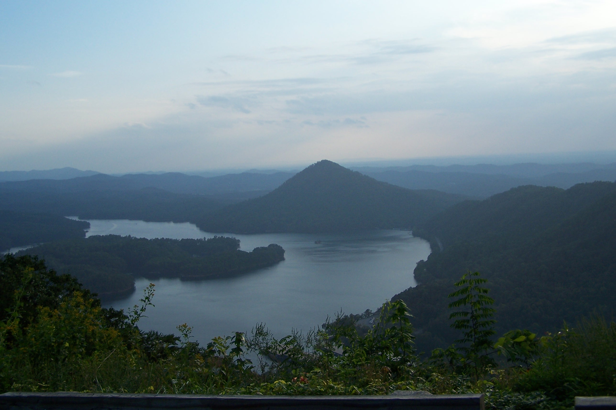
Notes:
Appalachians in Eastern Tennessee

Slide 8
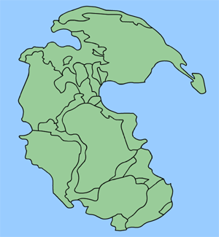
The Appalachians represent several orogenic events occurring intermittently over millions of years, including one that occurred with formation of supercontinent of Pangaea.
Appalachians are one of the oldest mountain ranges: the first orogeny began 400 million years ago. The last orogeny was a period of uplift 30 million years ago
PANGAEA
Notes:
Taconic Orogeny
Ordovician~ 438-505 mya
Acadian Orogeny
Devonian~ 360-408 mya
Alleghenian-Ouachita Orogeny
Permian~ 245-286 mya
Formation of a supercontinent Pangaea.
Uplift of Current Appalachian Mountains
Tertiary~ 20-30 mya

Slide 9
Mountain-building processes
Convergent plate motions that result in compressional forces and uplift.
Specific mechanisms:
Accretionary wedging
Emplacement and exposure of batholiths, an intrusive igneous feature
Thrust faulting
Accumulation of extrusive volcanic materials
Exotic terranes

Slide 10
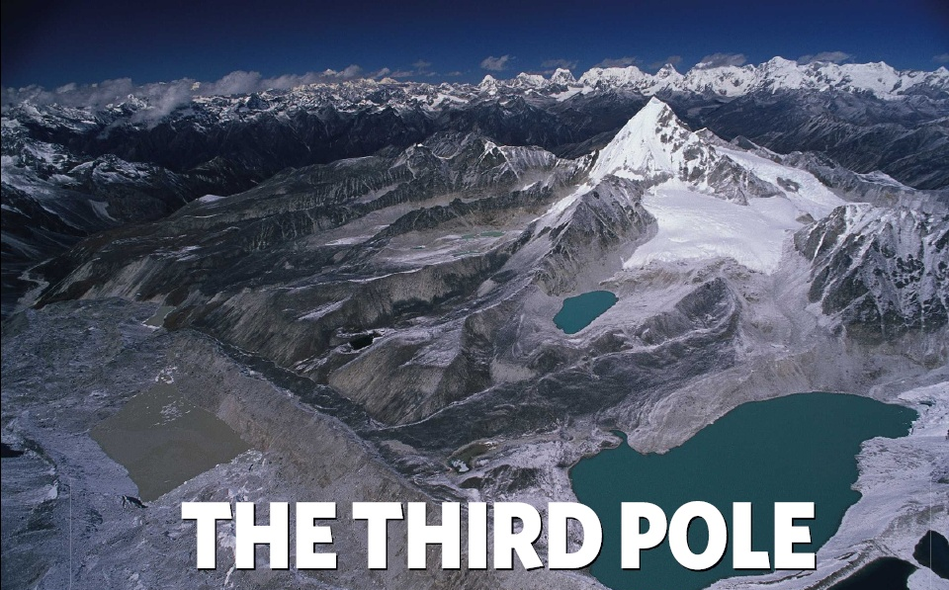

Slide 11
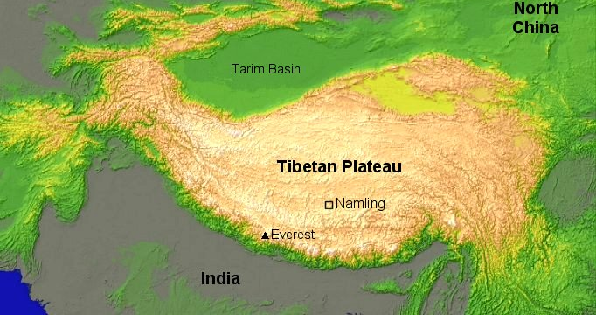
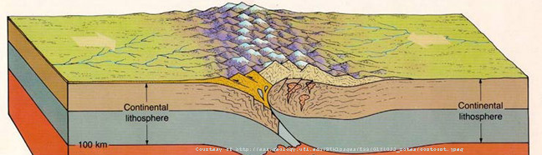
Notes:
The Himalaya and the entire Tibetan Plateau represent the ongoing collision of two continental Plates (the Indian and Asian plates)

Slide 12
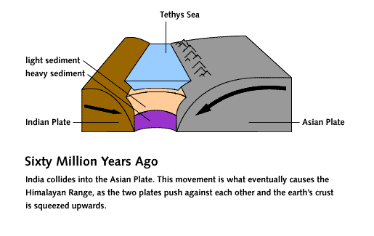
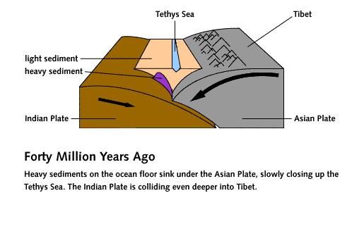
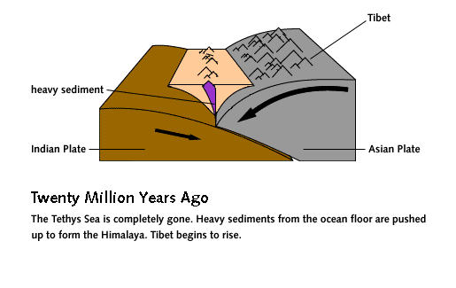
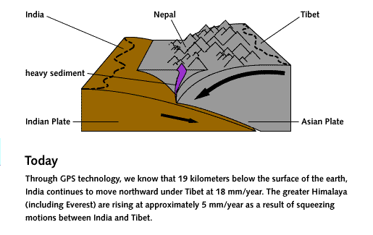
Accretionary wedging in the Himalayas
Notes:
Himalayas, location of many of the world’s highest mountains

Slide 13
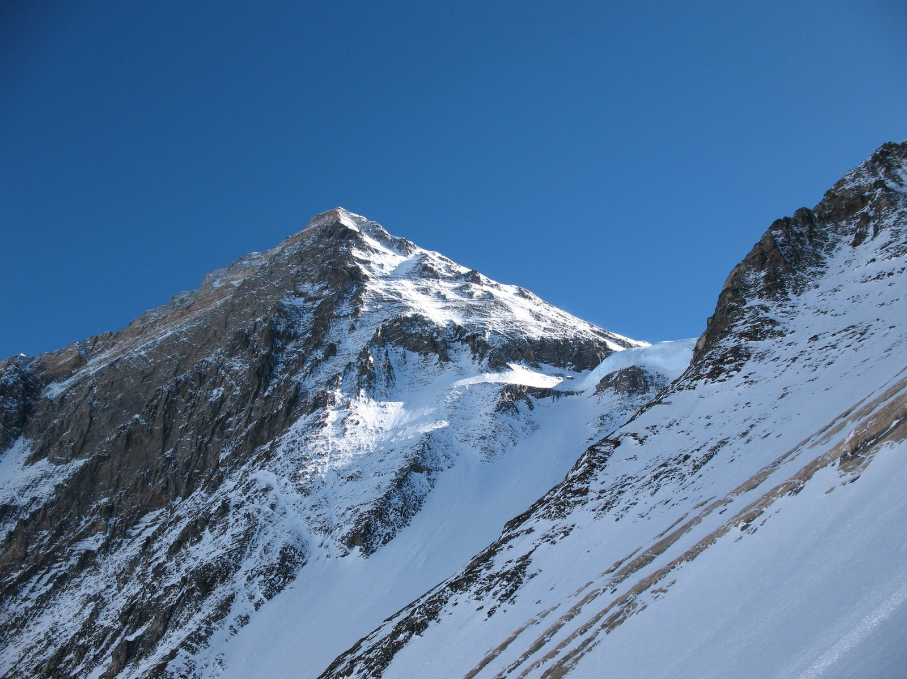
Because the Himalayas formed from the convergence of continental crust, there was little subduction, and hence little extrusive volcanism. Rocks at the highest points on Everest and other Himalayan mountains are comprised of sedimentary rocks that reflect a deep marine sea bottom environment.
Notes:
Geological evidence shows that the top of the Mt. Everest was once the bottom of an ocean. At the summit you will find Mesozoic marine fossils in sedimentary rocks that are about 65 million years old.
There are metamorphic rocks and intrusive igneous rocks, but comparatively little extrusive volcanic rock due to lack of recent subduction

Slide 14
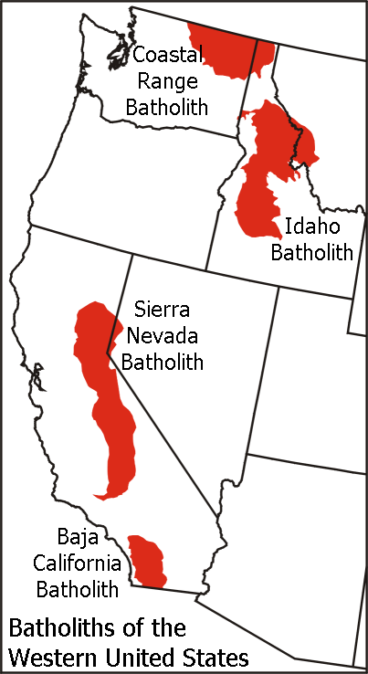
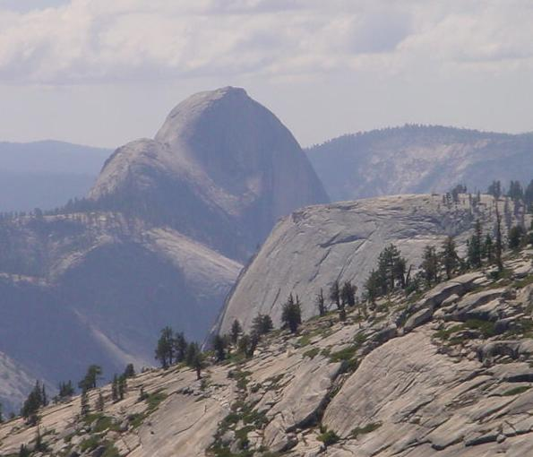
Batholiths: Sierra Nevada Mountains
Half Dome, Yosemite National Park, Sierra Nevada Mountains, CA
Notes:
A batholith is a large mass of intrusive igneous rock (typically granite) that forms deep below the Earth's surface. It is created when magma slowly cools and solidifies beneath the Earth's crust. Over time, erosion can expose these massive rock formations at the surface. Batholiths are often associated with mountain ranges, particularly those formed at convergent tectonic plate boundaries.

Slide 15
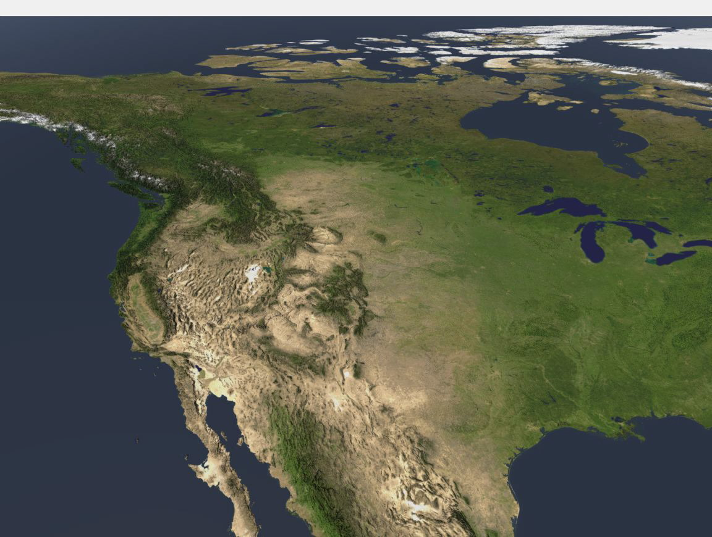
Three mountain ranges in the western US, each with a different predominating mountain-building process: Sierra Nevada Mts (batholiths)
Cascade Mts (extrusive volcanics)
Rocky Mts (thrust faulting)

Slide 16
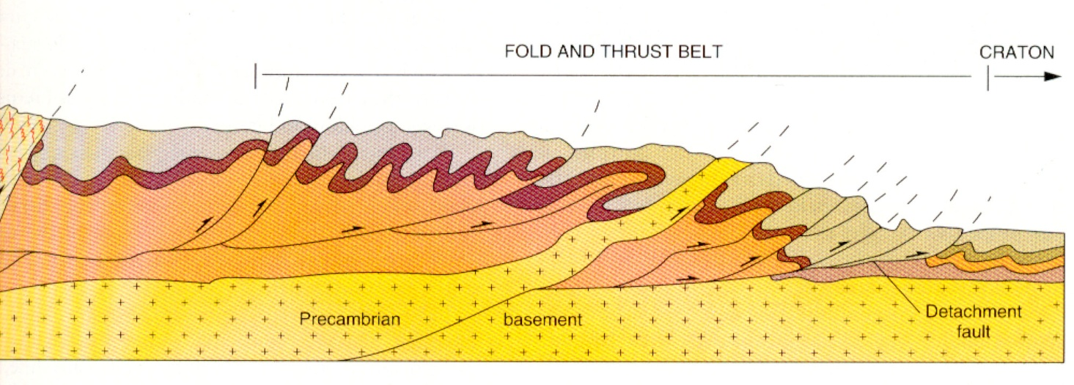
Thrust faults: Rocky Mountains
Notes:
A cross-section showing the fold and thrust belt of the Canadian Rockies. Much of the Rockies are composed of sedimentary and metamorphic rock with little extrusive volcanics.

Slide 17
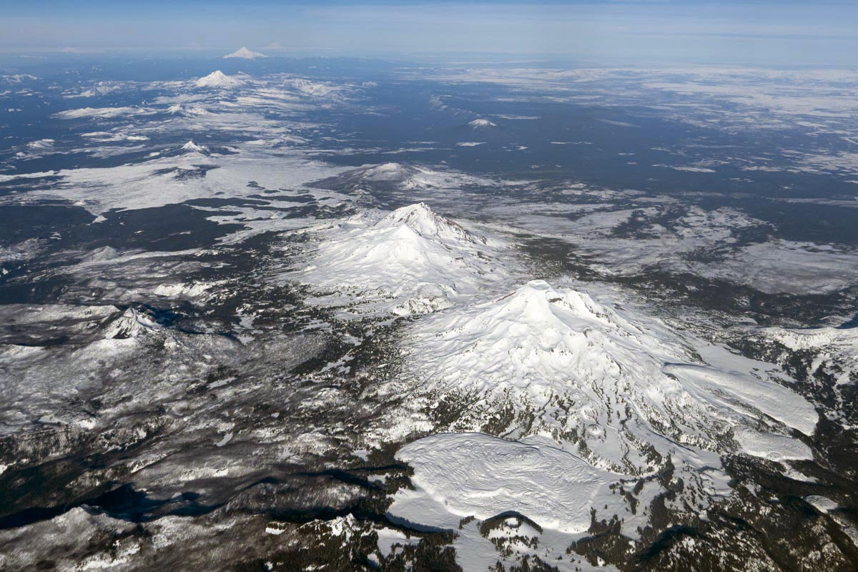
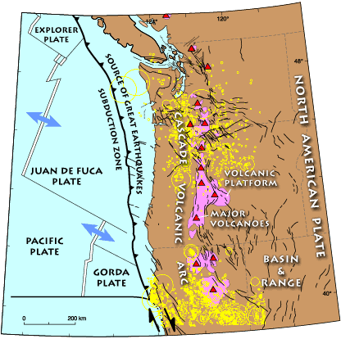
Extrusive volcanics: Cascade Mountains
The Cascades are a continental volcanic arc with active subduction along the coasts of Northern California, Oregon, and Washington
Notes:
The Cascade Mountains consist of several active volcanoes (triangles). These volcanoes are developed above a subduction zone that stretches from northern California to southern British Columbia. The subduction zone involves the Juan de Fuca and related oceanic plates that descend beneath the western edge of North America. Unlike typical subduction zones, no trench is present along the continental margin. Instead, terranes and the accretionary wedge have been uplifted to form a series of coast ranges and exotic mountains

Slide 18
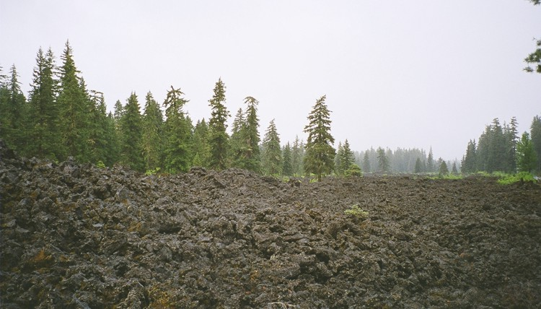
Notes:
Extrusive volcanics, a cooled lava field in the Cascades

Slide 19
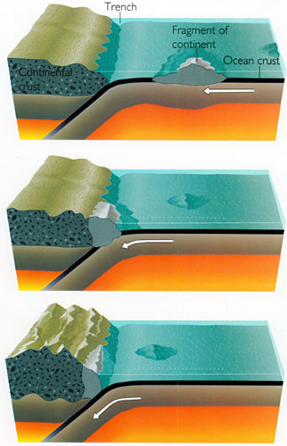
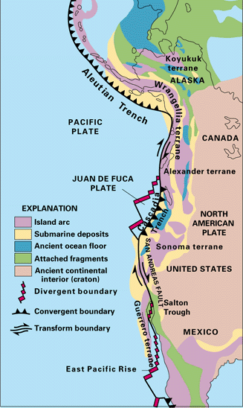
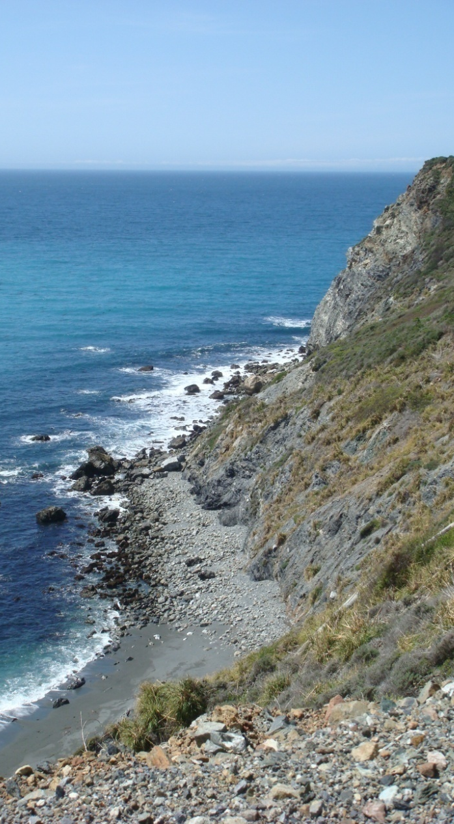
Exotic terranes: Pacific coast coastal mountains
Notes:
Central California Coast
Suturing of microplates along on a convergent plate boundary These exotic terranes are welded to the continent and increase its overall size.

Slide 20
Epeirogeny
Motion is non-deformational
The uplift or subsidence of the crust without significant folding, faulting or fracturing
Can create contrasts in elevation
Isostatic rebound
Mantle drips

Slide 21
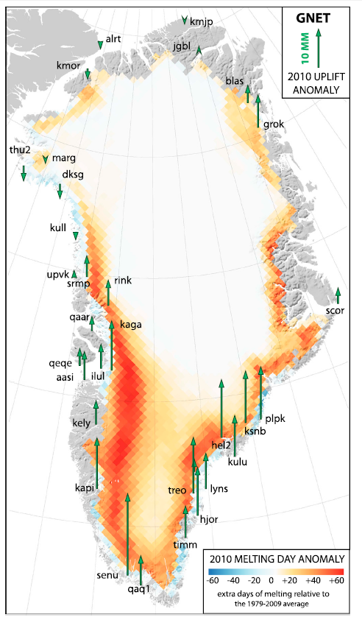
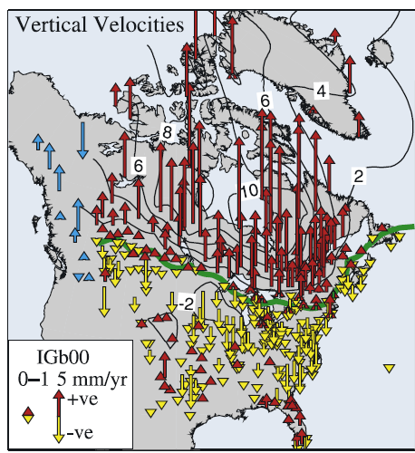

Slide 22
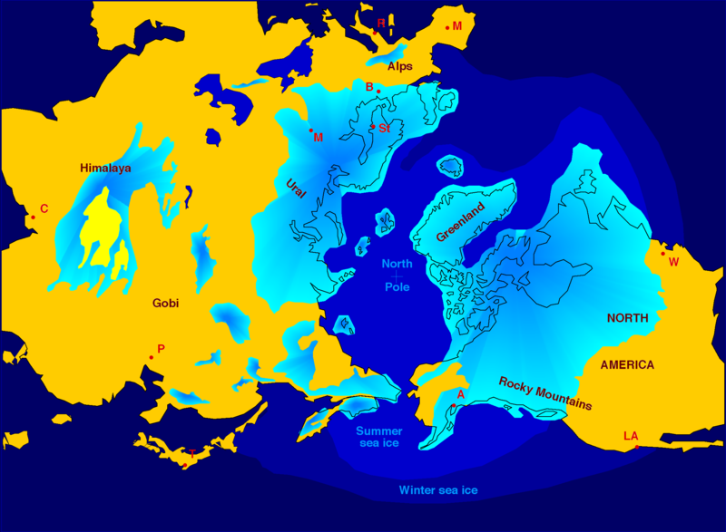
Isostatic rebound
The uplift of land after removal of load resting on top of it
Melting of thick Pleistocene ice sheets on surface since last glacial maximum led to the crust rebounding upward even today.
Notes:
By the end of the last ice age about 11,000 years ago, much of northern Europe and North America was covered by ice sheets up to 3 km thick. At the end of the ice age when the glaciers retreated, the removal of the weight from the depressed land led to a post-glacial rebound. Initially the rebound was rapid, proceeding at about 7.5 cm/year. This phase lasted for about 2,000 years, and took place as the ice was being unloaded. Once deglaciation was complete, uplift slowed to about 2.5 cm/year and decreased exponentially after that. Today, typical uplift rates are of the order of 1 cm/year or less, and studies suggest that rebound will continue for about another 10,000 years.

Slide 23
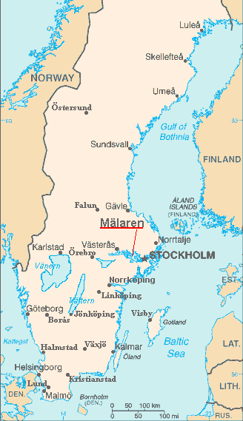
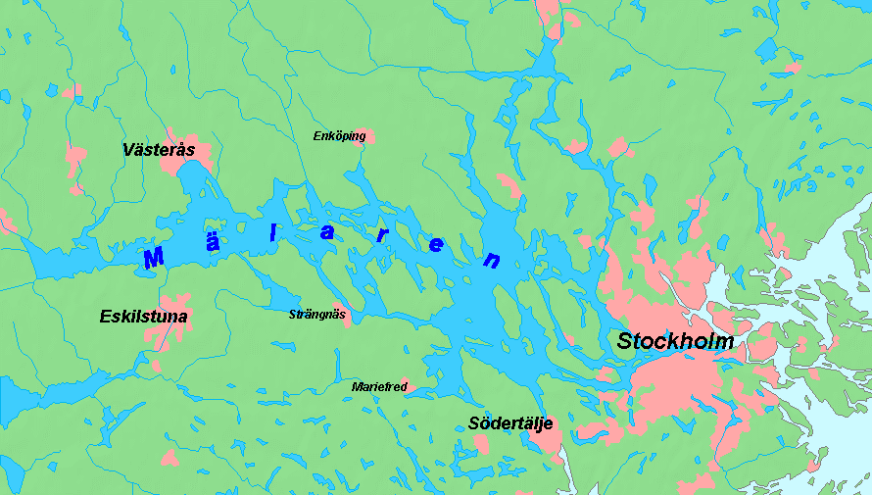
Isostatic rebound due to glacial retreat: Lake Mälaren, Sweden
Notes:
As recently as the Viking Age Mälaren was a bay of the Baltic Sea, and seagoing vessels using it were able to sail far into the interior of Sweden. Due to the post-glacial rebound, the mouth of the bay had become so shallow by about 1200 that ships had to unload their cargos near the entrances, and progressively the bay became a lake. The decline of inland cities led to the subsequent foundation of Stockholm at the choke point. The lake's surface currently averages 0.7 meters above sea level.

Slide 24
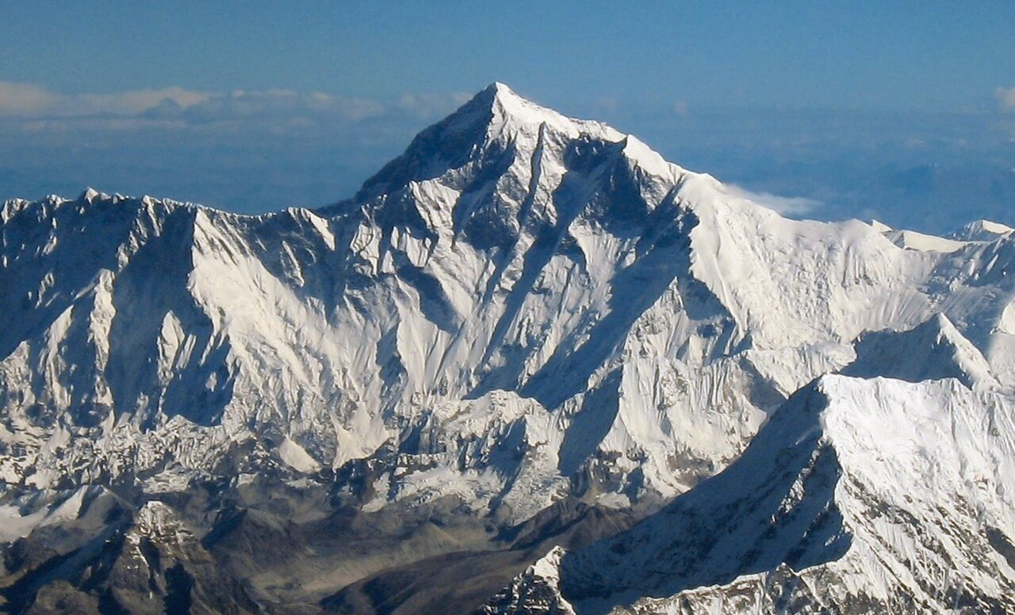
Notes:
Weathering and erosion by rivers in mountainous terrain can speed uplift. As rock and sediments are removed, particularly when these mountains are high enough to intercept rainfall and increase streamflow, the weight of overburden decreases, and tectonic uplift becomes more efficient and faster. Mount Everest exemplifies this feedback between mountain building, uplift, and fluvial (river) erosion. How did Mount Everest come to be the world’s tallest mountain, towering more than 200 metres above the next two highest peaks? Geologists suggest the mountain owespart of its extra height to two ancient rivers that flowed through the Himalayas and merged about 89,000 years ago. The resulting erosion removed so much rock and soil that Everest has rebounded upwards by as much as 50 metres.
Everest, also known as Chomolungma and Sagarmāthā, stands 8,849 metres above sea level, in the Himalayan mountain chain, which also contains the world’s third-highest peak, Kanchenjunga (8,586 metres) and is not far from the second-highest, K2 (8,611metres). The Himalayas have been driven up by the ongoing collision of India with the rest of Asia.

Slide 25
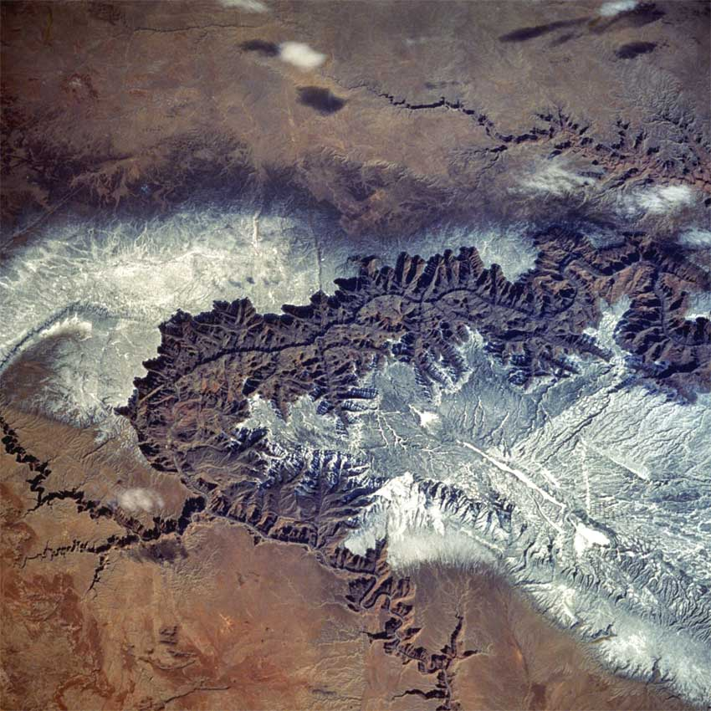
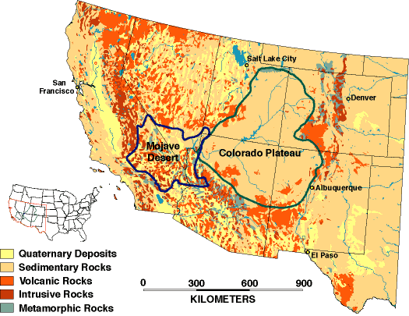
Notes:
The virtually undeformed Colorado plateau of the southwestern United States was uplifted 1.5 to 2 kilometers with some areas reaching 3 kilometers. It was also intruded by diverse magmas, and eroded and deeply incised, creating a dramatic topography that includes the 1.8-km-deep Grand Canyon. In feet: 4900 to 6500 feet in elevation with some locations just over 10,000 feet

Slide 26
The Colorado Plateau
Sedimentary rocks uplifted three kilometers over several millions of years through multiple a couple of uplift events
Elevations of 10,000 ft in some locations
Grand Canyon formed when Colorado River cut down through these gently uplifted sedimentary layers
Formation of the Colorado Plateau and its features is combination of hotspot activity with mantle drips and delamination
Notes:
Grand Canyon is a mile deep in some locations

Slide 27
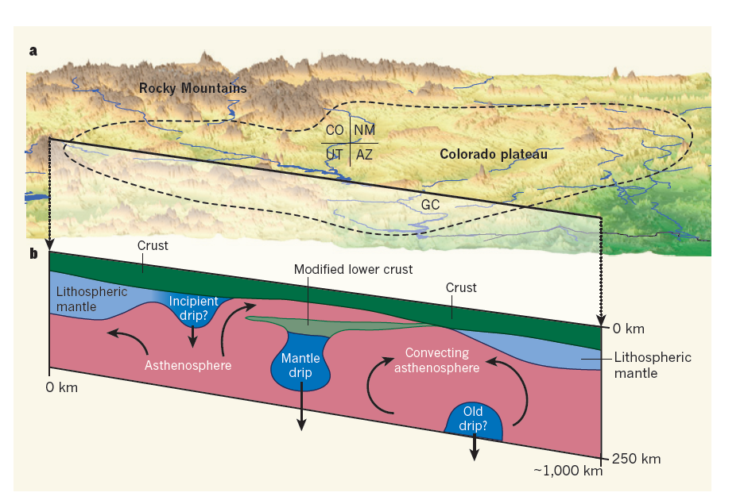
Mantle drips
Notes:
The non-deformational uplift of the Colorado Plateau and its features was caused in part by mantle drips and delamination
As partially molten material expanded, cooled and solidified after flowing upward, it made the mantle portion of the lithosphere it invaded heavy enough to peel away (delamination) and drip down. The more buoyant asthenosphere then filled the space left above, where it expanded and cause the Colorado Plateau to uplift. Delamination refers to the process where a portion of the lithosphere (the rigid outer layer of the Earth, including the crust and the uppermost part of the mantle) becomes detached and sinks or ‘drips’ into the underlying asthenosphere

Slide 28
Folding and faulting (deformational motion)
Tectonic forces reshape position of crustal rocks to create structural landforms smaller than mountain ranges
These structural landforms can be subsequently modified by weathering and erosion to create a diversity of landform types.

Slide 29
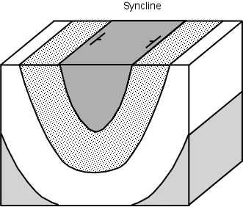
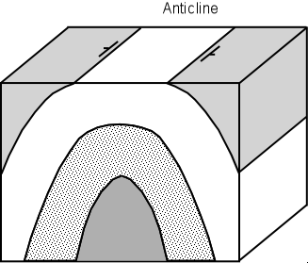
Folding: anticlines and synclines

Slide 30
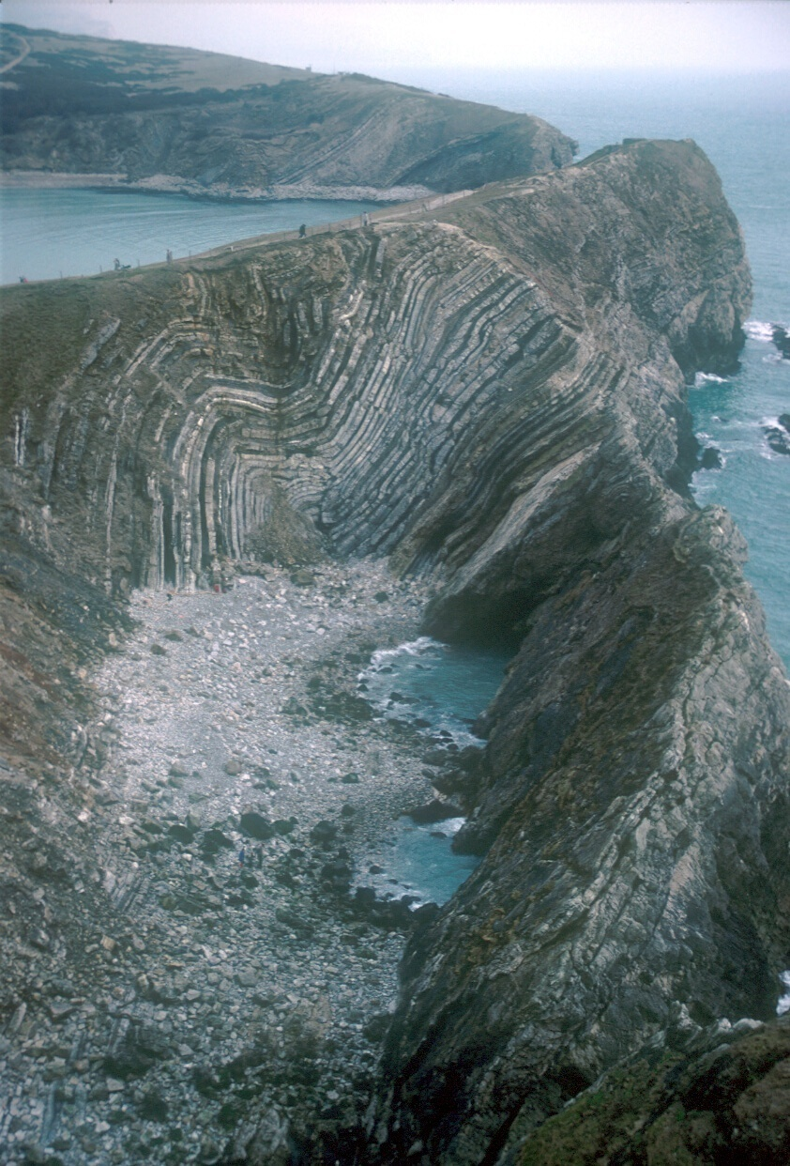
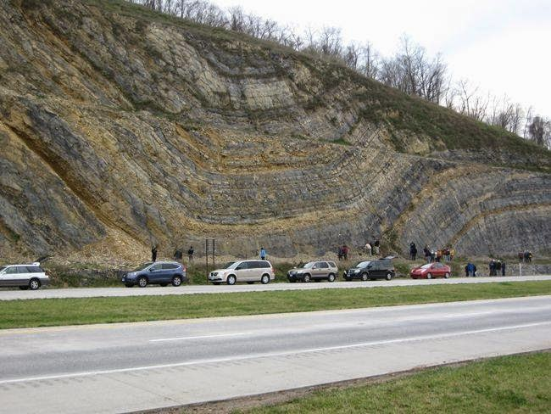
Notes:
Sedimentary rocks, England (right), road cut in West Virginia (left)

Slide 31
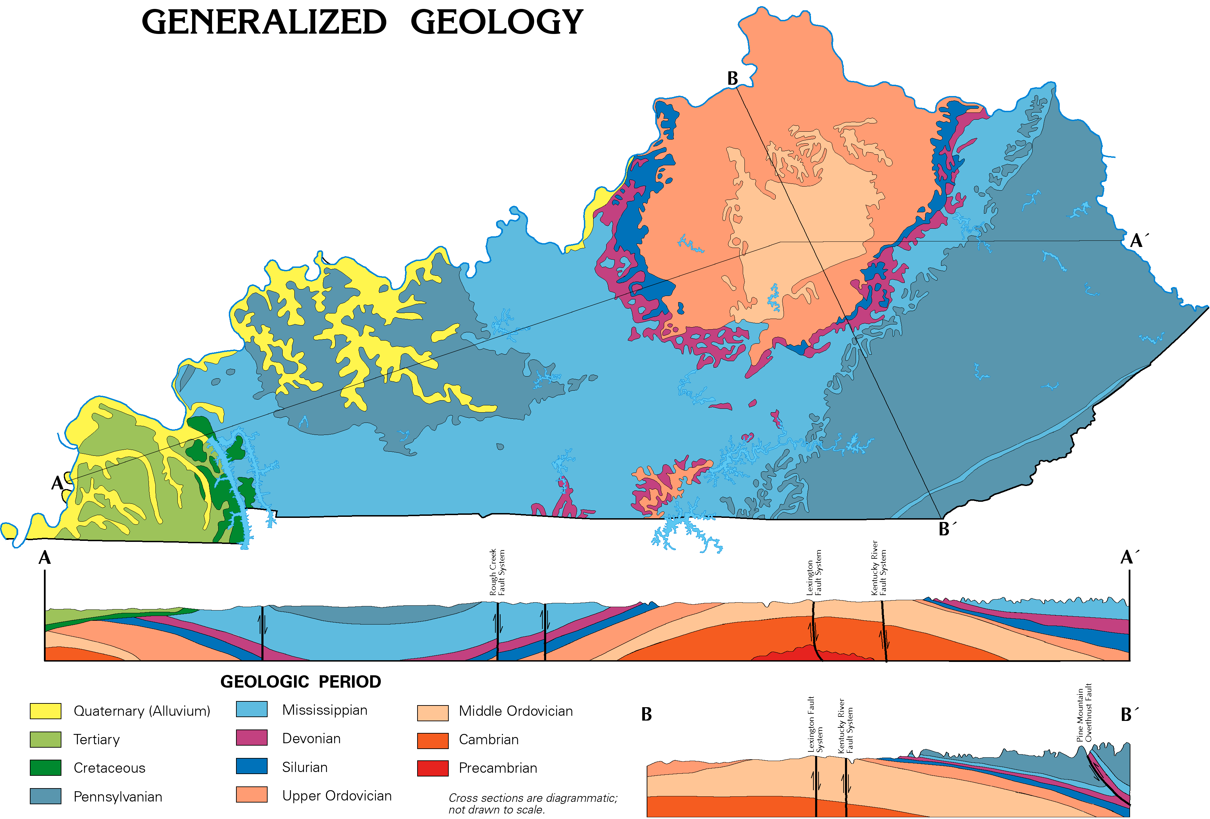

Slide 32
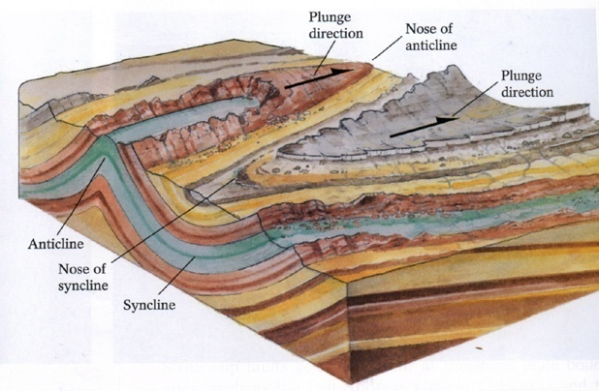
Plunging anticlines and synclines with differential weathering and erosion
Notes:
Appalachian Mountains

Slide 33
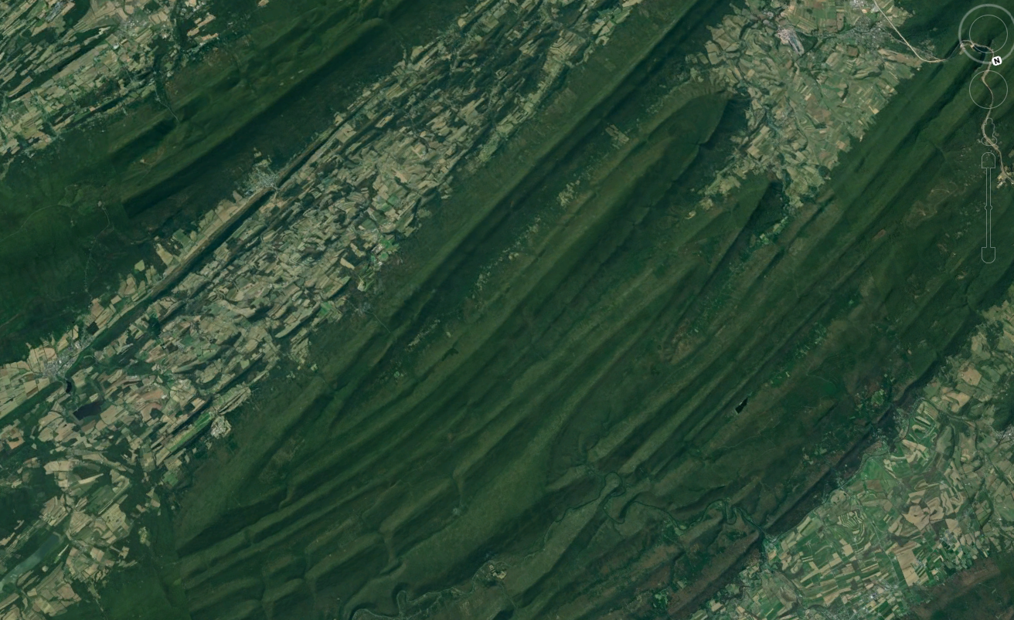
Notes:
Plunging anticlines and synclines of Central Appalachians of Pennsylvania

Slide 34
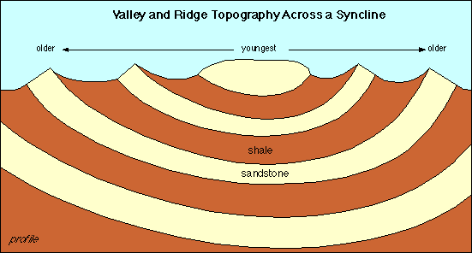
Synclinal ridges with differential weathering and erosion

Slide 35
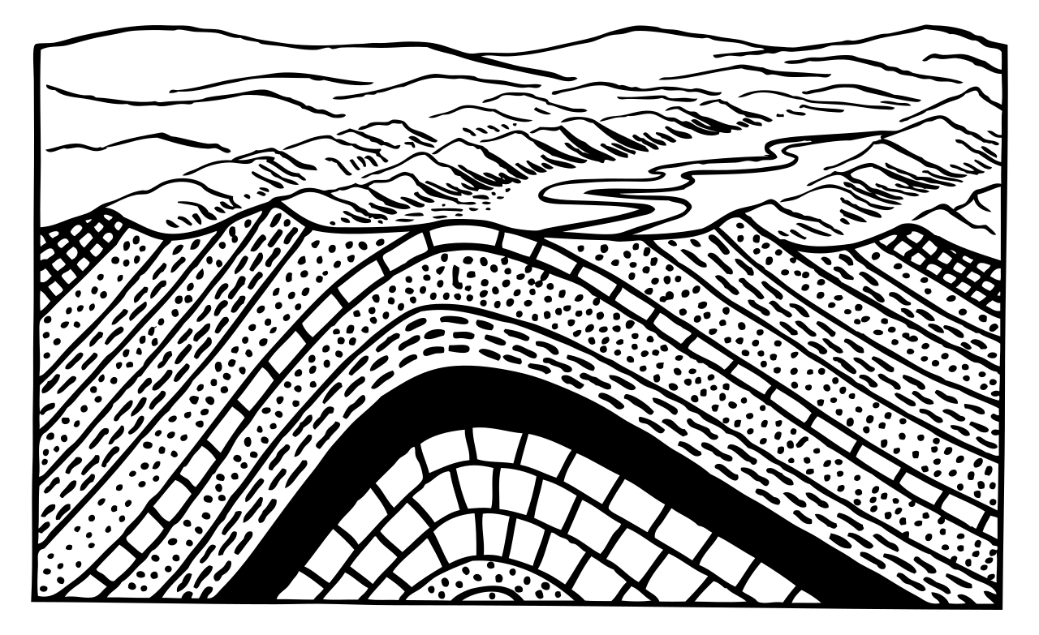
Anticlinal valleys

Slide 36
Faults
Initiate potentially rapid movement in crust
Faults are differentiated by the type of stress, its motion, and the angle
Normal fault
Reverse fault (high-angle)
Thrust fault (low-angle) - leads to mountain building
Strike-slip fault

Slide 37
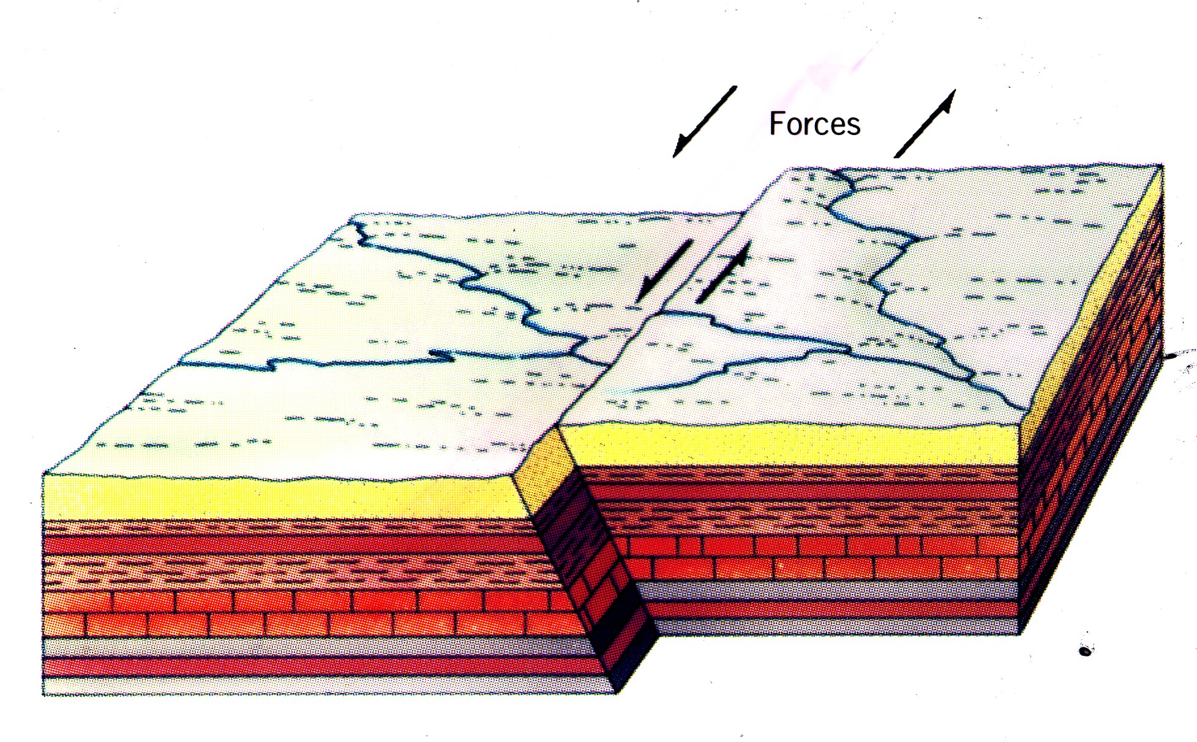
Strike-slip fault
Lateral stresses

Slide 38
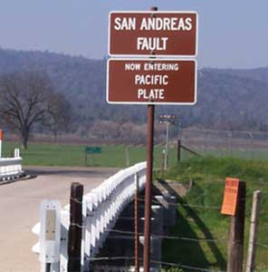
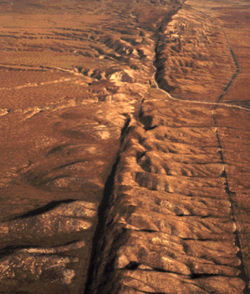

Slide 39
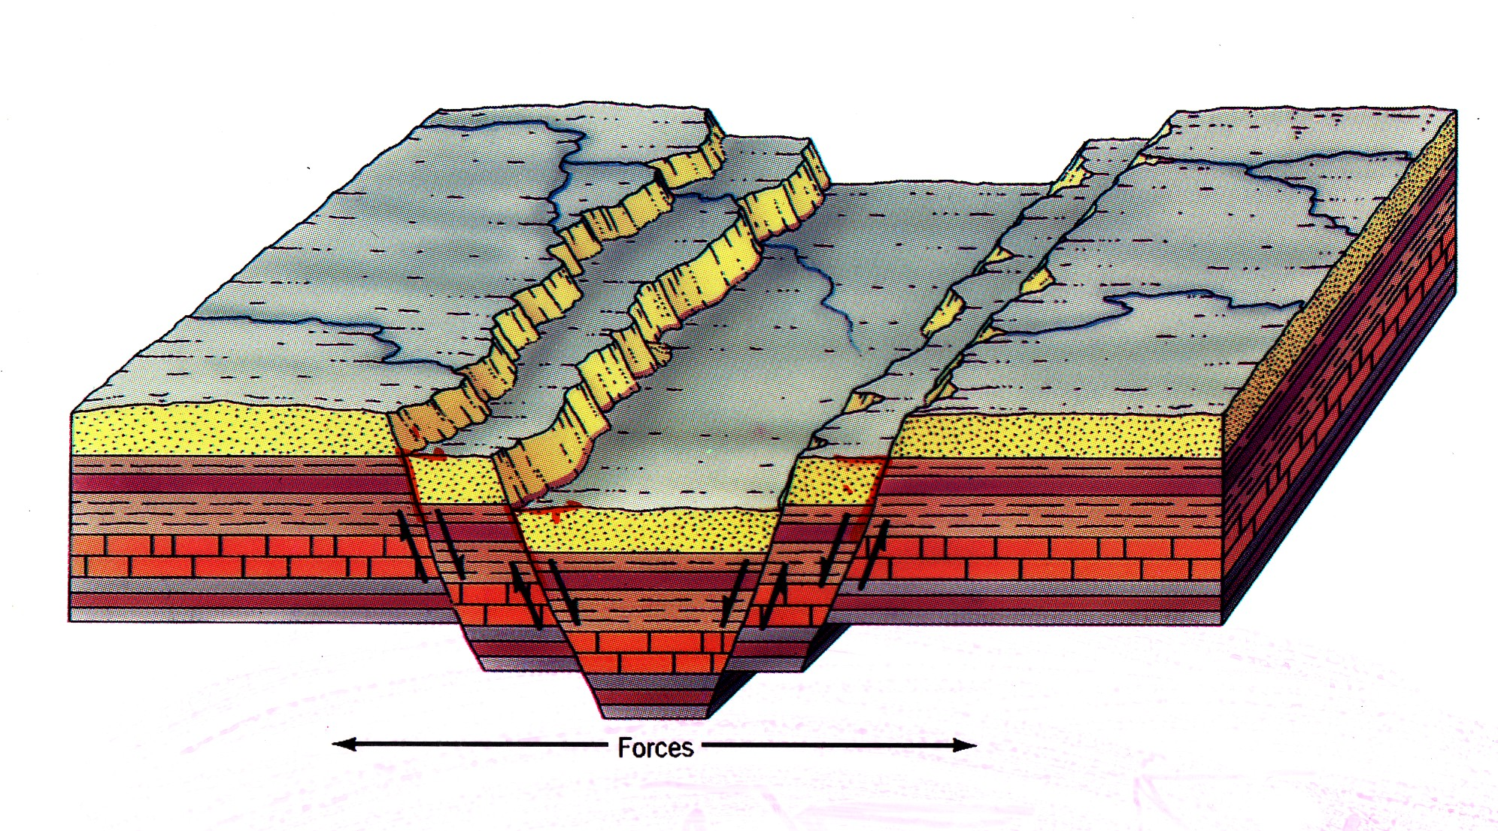
Normal fault
Divergent stress

Slide 40
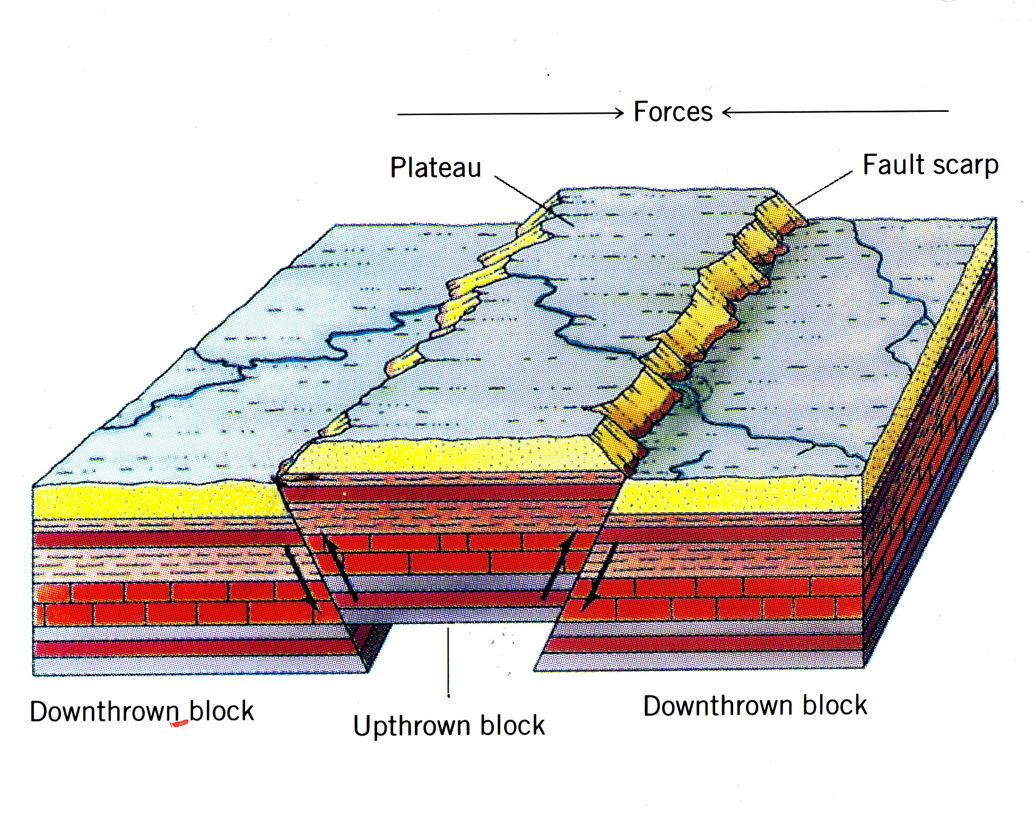
Reverse fault
Convergent stress

Slide 41
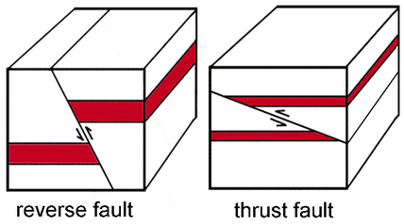
Thrust faults: type of reverse fault associated with mountain building
Notes:
A thrust fault is a reverse fault with a low-angle dip (45 degrees or less), where older rocks are pushed over younger rocks due to compressional tectonic forces, causing crustal shortening. These faults form in zones where one tectonic plate subducts under another, or when two landmasses collide, such as during mountain building events.

Slide 42
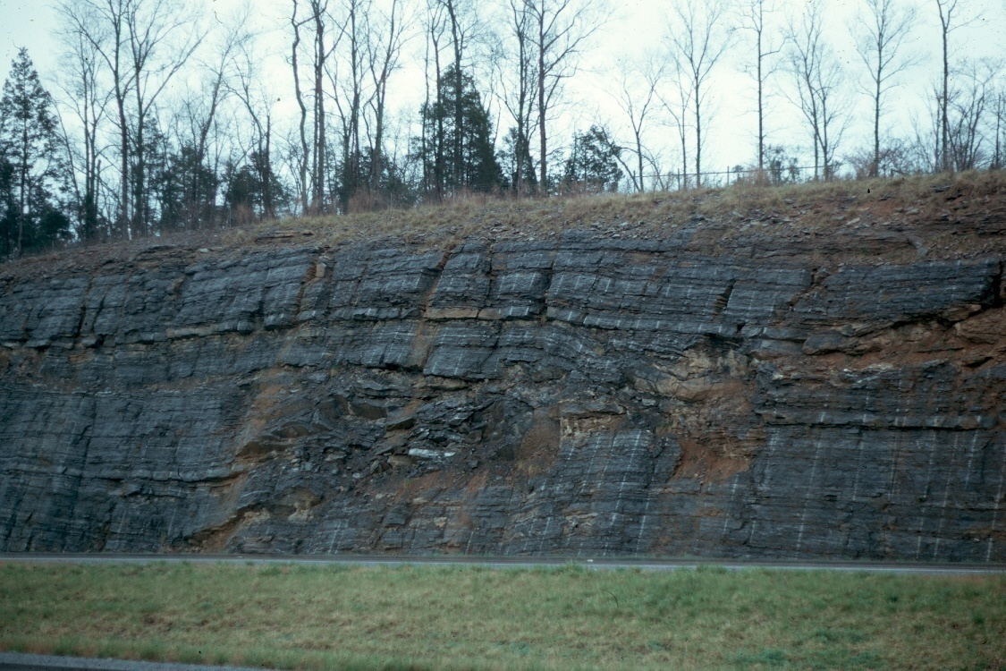
Notes:
42
Thrust fault in limestone, western Pennsylvania. Thrust faults are low angle reverse faults

Slide 43

Notes:
Normal faults in volcanic ashes and paleo-soils, El Salvador

Slide 44

Notes:
Before (top) and after (bottom) photos of Nias Island off the west coast of Sumatra in Indonesia. The island was uplifted more than 8 feet (2.5 meters) during at 2005 earthquake.

Slide 45
Other structural landforms
Cuesta
Hogback
Mesa and plateaus
Horst and graben

Slide 46

Notes:
Cuesta (Italy)

Slide 47



Slide 48

Notes:
Cuesta
Dip angle: Gentle (typically <10°).
Appearance: One side has a long, gentle backslope (dipslope), while the opposite side is a short, steep escarpment.
Formation: Softer layers erode faster than harder caprock, leaving an asymmetrical ridge.
Example: The Cuesta of the Allegheny Plateau in Pennsylvania and New York. Hogback
Dip angle: Steep (generally >30° and often close to vertical).
Appearance: Both slopes are steep and of roughly equal angle, giving it a narrow, sharp ridge shape.
Formation: Hard layers stand up to erosion, while softer ones are stripped away, leaving a jagged spine-like ridge.
Example: The Dakota Hogback along the Front Range in Colorado.

Slide 49


Notes:
https://coloradomtn.edu/gc/grand-hogback/

Slide 50

Notes:
Hogback in foreground. This one is caused by exposure of intrusive igneous rock that is more resistant to weathering.

Slide 51


Basin and Range physiographic province of Nevada
Notes:
The Basin and Range Province is a particular type of topography that covers much of the southwestern United States and northwestern Mexico that is typified by elongate north-south trending arid valleys bounded by mountain ranges which also bound adjacent valleys. Death Valley is a good example of a modified basin and range valley.
The basins are down-fallen blocks of crust and the ranges are relatively uplifted blocks. The normal arrangement in the basin and range system is that each valley (i.e., basin) is bounded on each side by one or more normal faults that are oriented along or sub-parallel to the range front.
This arrangement is very similar to the horsts and grabens seen in divergent plate boundaries such as the Mid-Atlantic Ridge or in failed rifting areas such as the Western Rift of the Great Rift Valley in East Africa. However the extent of the rifting in the Basin and Range is not concentrated into a single valley but is spread out over a very large area creating much smaller grabens laying roughly parallel to each other in a north-south direction (which leads to a rain shadow effect resulting in exceedingly dry conditions in this province).

Slide 52


Slide 53

Notes:
Basin and Range Province

