Slide 1
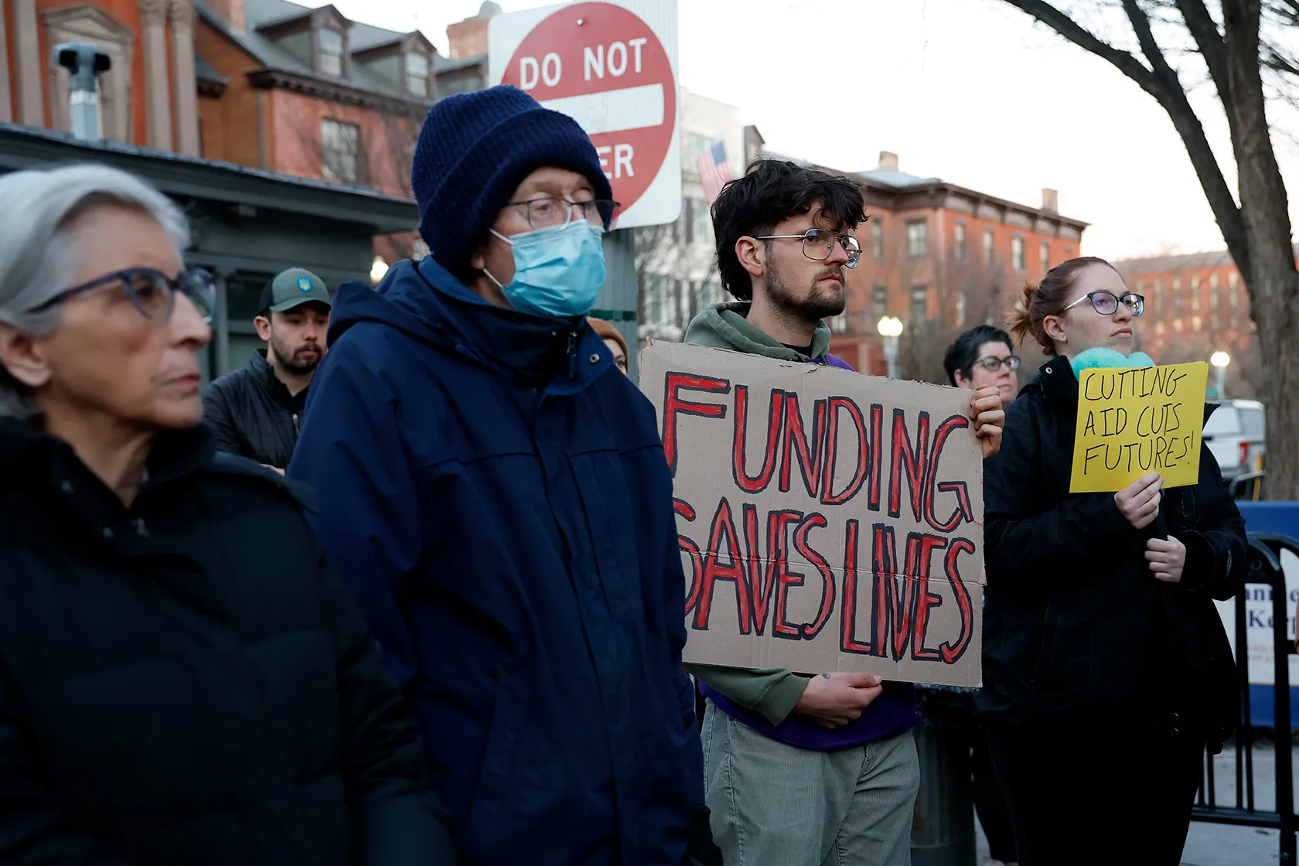
Effects of political instability on health can be indirect
Examples: firings and layoffs at key health organizations, changes in the availability and cost of health insurance, cutting international relief aid to address poverty and disease
These impact health through the structures of governance
They are examples of structural violence
May not be intended to harm but structures of governance can bring it about
Notes:
The United States drove nearly three-quarters of the global drop in international aid, with its total contributions falling 56.9% in 2025. The U.S. Agency for International Development (USAID) was dissolved, resulting in the formal cancellation of 83% of its programs and approximately 5,200 humanitarian contracts.

Slide 2
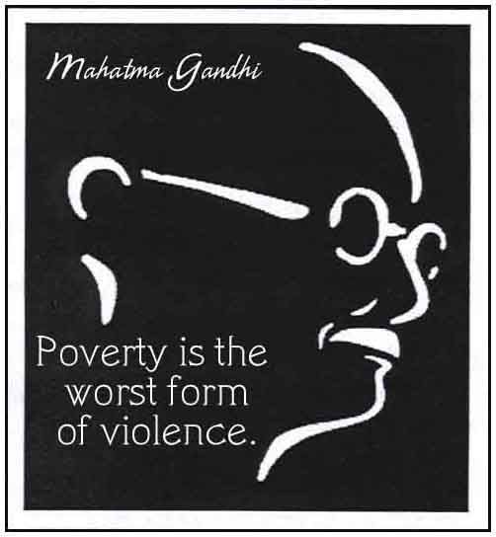
Structural violence
A form of indirect violence wherein rational-legal authority can bring physical, mental, or financial harm
Structural violence is embedded in social structures that have become normalized by institutions
It is often not overt violence
Notes:
Farmer, P. E., Nizeye, B., Stulac, S., & Keshavjee, S. (2006). Structural violence and clinical medicine. PLoS Med, 3(10), e449.
https://doi.org/10.1371/journal.pmed.0030449
Mosquito-borne diseases like malaria and dengue, for example, can be conceived of as structural violence. Systems of governance and planning persist that result in people living in neighborhoods with inadequate stormwater drainage and exposure to malaria-transmitting mosquitoes. But structural violence can also arise in the form of high to criminally high costs for medical drugs and treatments.

Slide 3
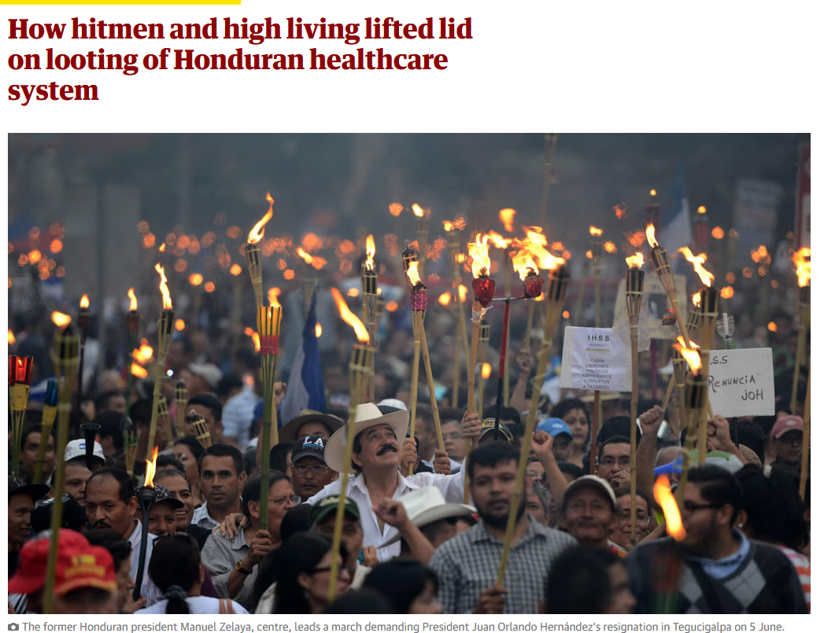
Other forms of health-related structural violence
  Economic inflation
  Corruption
  Criminal activity
  Lack of adequate public funding for health care
  Bureaucratic inefficiency
  Lack of oversight and accountability
  Inefficient collection of health statistics needed to make decisions and policy
Notes:
https://www.theguardian.com/world/2015/jun/10/hit-men-high-living-honduran-corruption-scandal-president

Slide 4
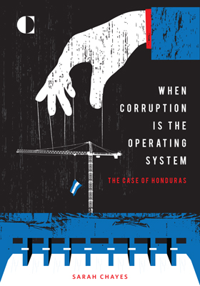
Honduras: corruption in national healthcare governance
High-ranking government officials were involved in the embezzlement of hundreds of millions of dollars from the national health care system
They used a network of fake companies to launder the money and pay themselves
Medicines and hospital services were in short supply because of diverted money
Health system continues to be plagued by corruption and inefficiencies that impact delivery of basic health care

Slide 5
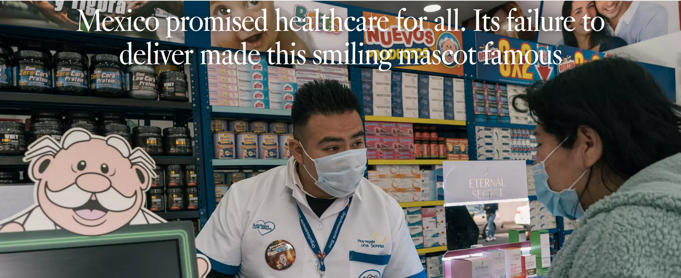
Mexico’s health care system: deficit of public health care funding and services
Notes:
https://www.latimes.com/world-nation/story/2023-03-01/la-fg-mexico-doctor-simi-mascot-healthcare-crisis

Slide 6
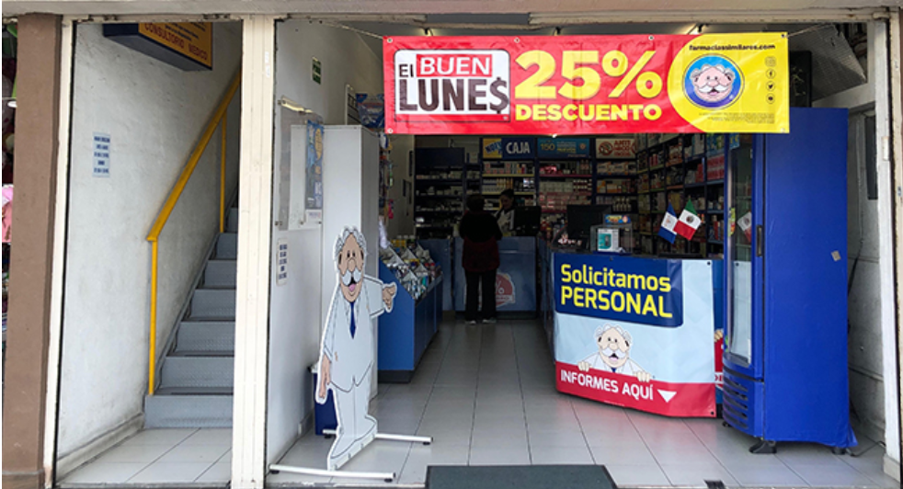
Farmacias Similares
Medicines and basic services are often in short supply in public clinics, where it can take weeks to get an appointment with a primary care doctor.
Farmacias Similares, Mexico’s largest private drugstore chain fills part of the hole left by the failure of the Mexican government to deliver on its promise of healthcare for all.
Notes:
https://www.youtube.com/watch?v=ChueX39bPik

Slide 7

Poor utilize this chain of drugstores because they specialize in generic drugs and offer quick medical consultations
The wealthier use private doctors and pharmacies
Farmacia Similares makes up for lack of public investment in health care
However, Farmacias Similares is not well suited to manage chronic long- term health conditions and provide adequate medical testing, so the poor in particular remain underserved
Notes:
Would you trust your health entirely to a brand?

Slide 8
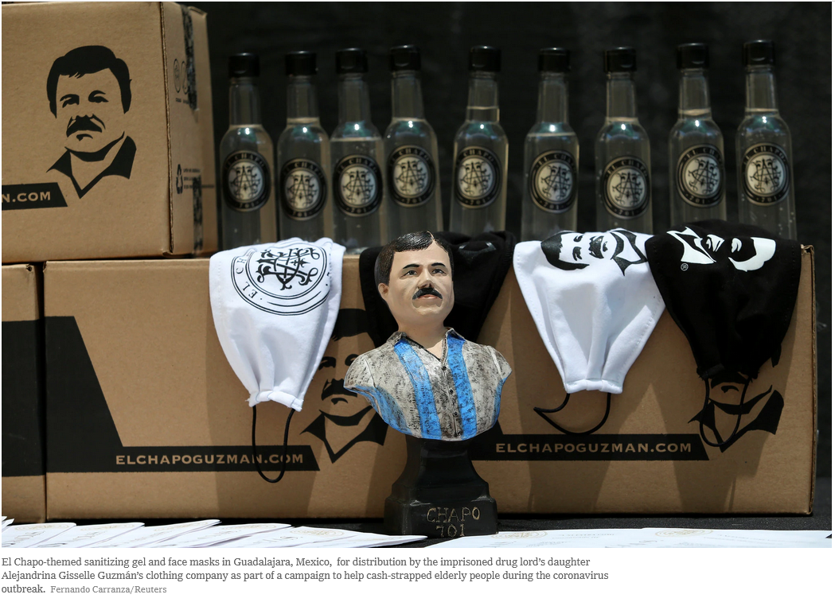
Mexican drug cartels
Because of national health care failures, during Covid, drug cartels provided masks and enforced curfews in some towns
Living in towns where drug cartels are active has health and well-being consequences.
Substantial decrease in birth weight where homicide rates are high.
Especially pronounced among children born to mothers of low socioeconomic status and among children born to mothers who score poorly on a mental health index.
Notes:
In addition to direct violence, there are other ways the operation of the drug cartels impacts public health
Brown, R. (2018). The Mexican drug war and early-life health: The impact of violent crime on birth outcomes. Demography, 55(1), 319-340.
El Chapo-themed sanitizing gel and face masks in Guadalajara, Mexico during Covid were provided by El Chapo’s drug cartel
https://www.nytimes.com/2020/07/07/opinion/sunday/mexico-drug-cartels-coronavirus.html

Slide 9
Political instability impacts health through direct violence: the New Barbarism:
Healthcare and humanitarian workers are increasingly in the crosshairs as hospitals and aid centers have become part of the battlefield.
International humanitarian law contained in the 1949 Geneva Conventions has prohibitions on the targeting of hospitals and medical facilities
Claims are made that the bombings are collateral damage or unintentional targets
Notes:
https://www.csis.org/features/new-barbarianism
https://www.pbs.org/newshour/show/why-are-hospitals-targeted-in-syria-people-lose-hope
Gordon, N., & Perugini, N. (2019). ‘Hospital Shields’ and the Limits of International Law. European Journal of International Law, 30(2), 439-463.
From the war in Afghanistan and the US-backed Saudi intervention in Yemen, to the Israeli occupation of Palestine and the Syrian civil war, hospitals have increasingly been targeted by military forces. The justification for many of these attacks has been uncannily similar: the hospitals were bombed because they were shielding combatants and therefore the attacks do not constitute a violation of international law. Hospitals, in other words, can be classified as if they are equivalent to human shields.

Slide 10
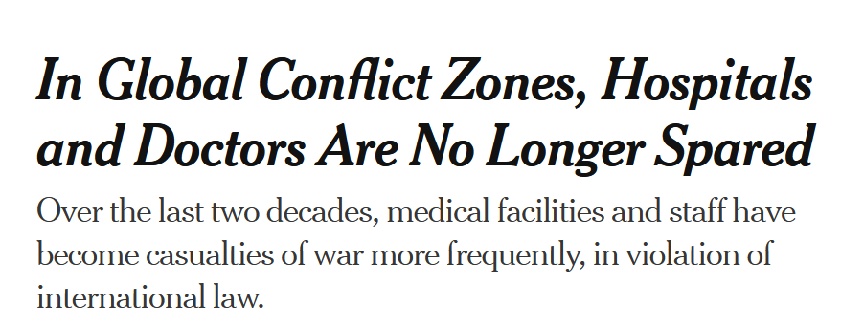
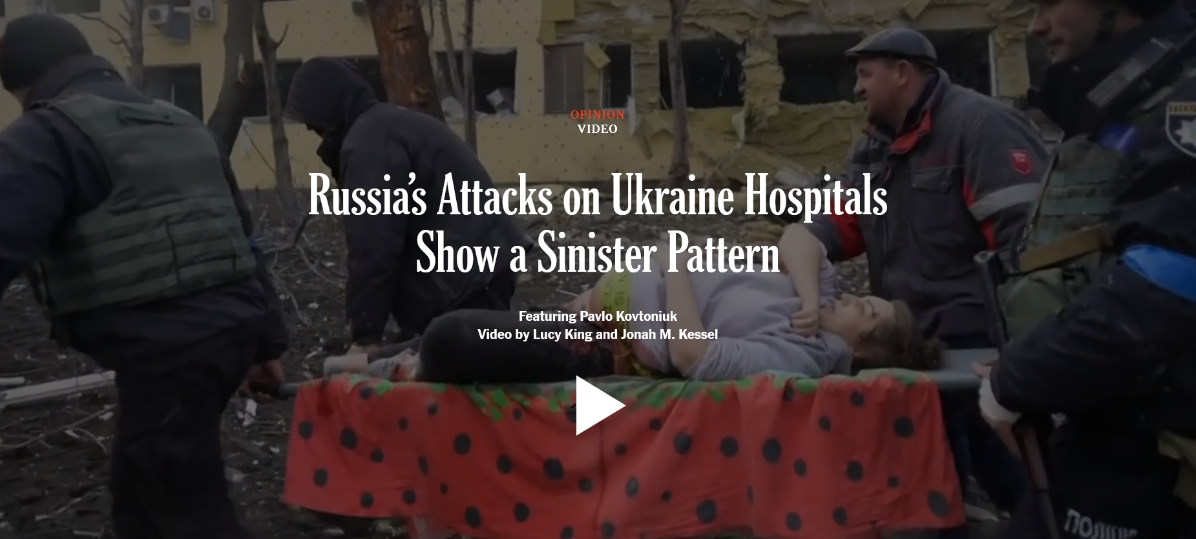
Video/Questions 7

Slide 11
A loophole in the Geneva Convention
The Geneva Convention prohibitions on torture are absolute, applying at all times and circumstances
However, laws relating to bombardment of hospitals are conditional.
In certain “exceptional” situations medical facilities can lose their protected status.
They can be attacked so long as the losses for civilians and combatants are considered “proportional”
Although some armed groups have used hospitals as shields, governments are increasingly invoking “exceptionality” to deploy lethal violence against non-combatants in medical facilities.
Notes:
https://www.justsecurity.org/33712/military-attacks-hospitals-shields-law-partly-blame/
Wording of the law allows the slipperiness of language to permit justification of bombing medical facilities.
Additional Protocol I (Article 12) of the Geneva Convention reinforces the protection of medical units, but also introduces the concept that if a hospital is used to commit "acts harmful to the enemy," it can lose its protection after due warning has been given. However, the concept of proportionality is a key principle, particularly regarding attacks on military objectives that may cause incidental harm to civilians or civilian objects. The principle of proportionality, found in Additional Protocol I (Article 51), requires that attacks causing civilian harm must not be excessive in relation to the anticipated military advantage gained. This concept sometimes comes into play when medical facilities are alleged to be used for military purposes, and an attack might be justified if it’s deemed proportional.

Slide 12
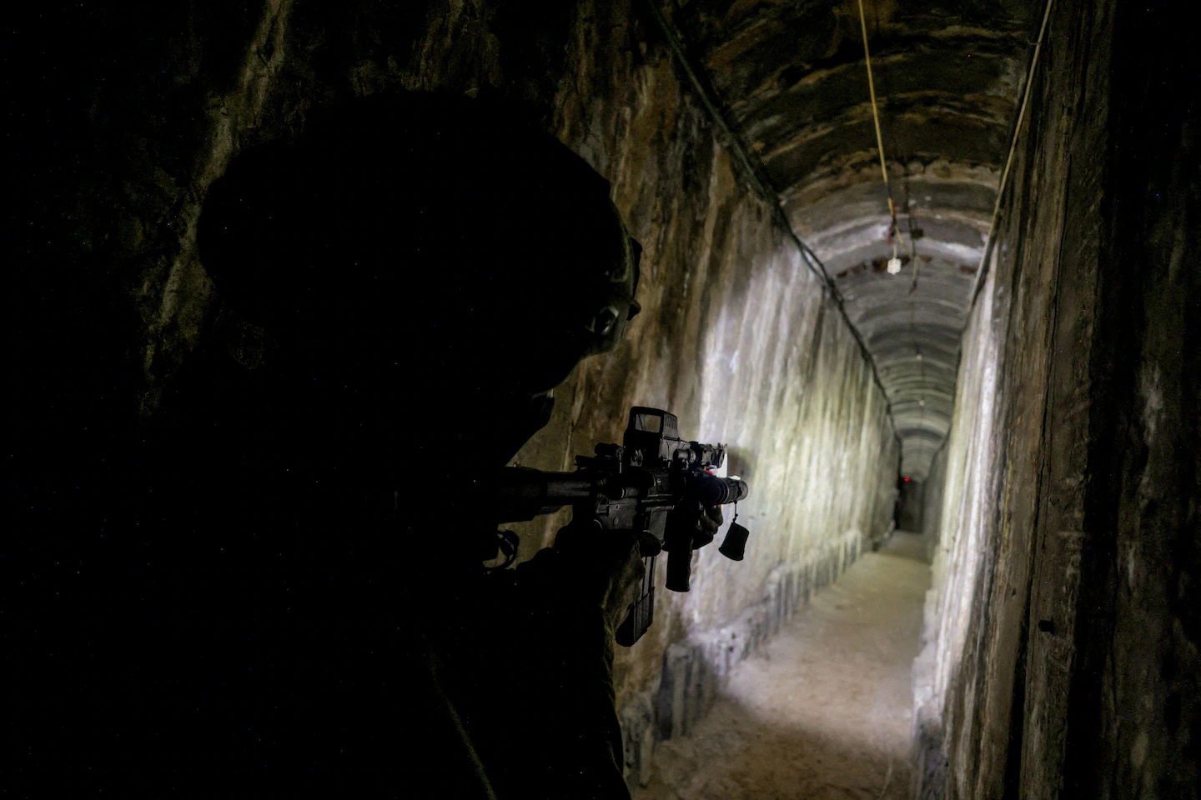
They can be attacked so long as the losses for civilians and combatants are considered “proportional”
If lives saved on one side from bombing a hospital combatants are using for advantage is greater, then exceptionality is met
Although some armed groups have used hospitals as shields, governments are increasingly invoking “exceptionality” to deploy lethal violence against non-combatants in medical facilities.
Notes:
An Israeli soldier secures a tunnel beneath al-Shifa Hospital in Gaza City in November 2023.
https://www.washingtonpost.com/national-security/2024/10/05/hamas-tunnels-weapons-gaza-war-october-7-attacks/

Slide 13
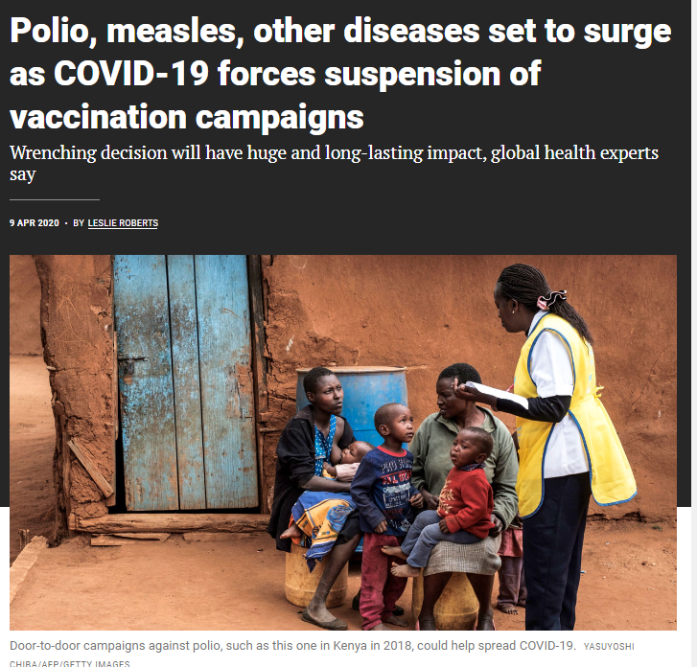
COVID-19 and polio
Childhood immunization fell early in the pandemic
GPEI paused vaccination and surveillance for several months
cVDPV2 later detected in London and New York
Notes:
https://www.science.org/content/article/polio-measles-other-diseases-set-surge-covid-19-forces-suspension-vaccination-campaigns
However, the infrastructure and routines established by immunization programs were also used to kickstart vaccination programs for Covid.

Slide 14
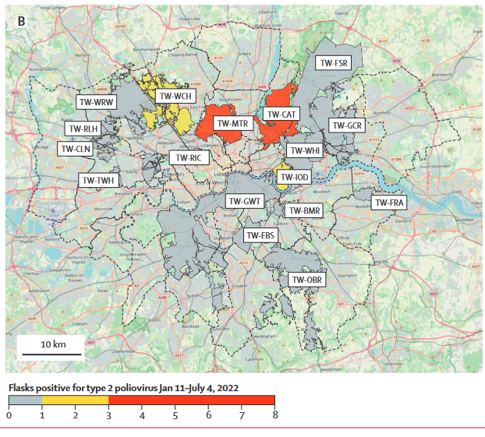
Notes:
https://www.thelancet.com/action/showPdf?pii=S0140-6736%2822%2901804-9
Klapsa, D., Wilton, T., Zealand, A., Bujaki, E., Saxentoff, E., Troman, C., ... & Martin, J. (2022). Sustained detection of type 2 poliovirus in London sewage between February and July, 2022, by enhanced environmental surveillance. The Lancet, 400(10362), 1531-1538.

Slide 15
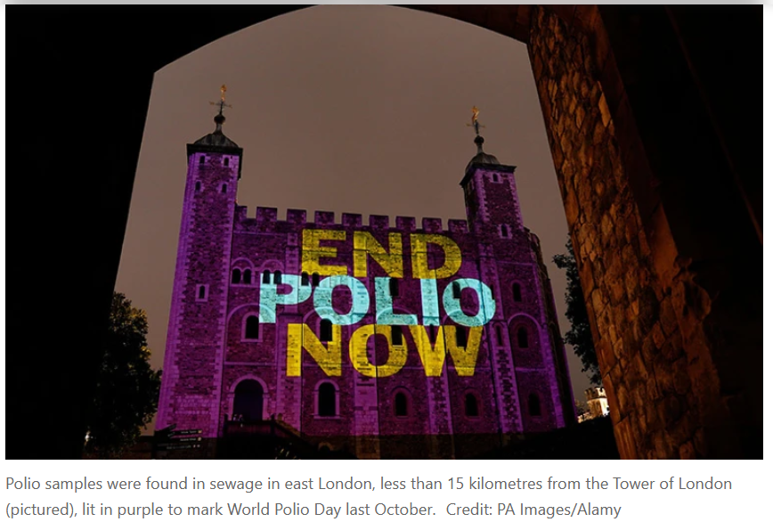
London: cVDPV2 in wastewater (2022)
OPV-derived virus introduced through international travel
Genetic evidence suggested local person-to-person spread
No confirmed symptomatic cases
Low booster coverage increased vulnerability (35% in parts of west London)
Notes:
No people with symptoms of polio — including paralysis — have been reported so far, but health authorities are asking doctors to look out for, and report, any symptoms of the disease.
The last case of wild polio contracted in the United Kingdom was in 1984, and the country was declared polio-free in 2003
86% of people in London vaccinated against polio, rates of vaccination are generally high but fell during the Covid-19 pandemic.
https://doi.org/10.1038/d41586-022-01802-z

Slide 16
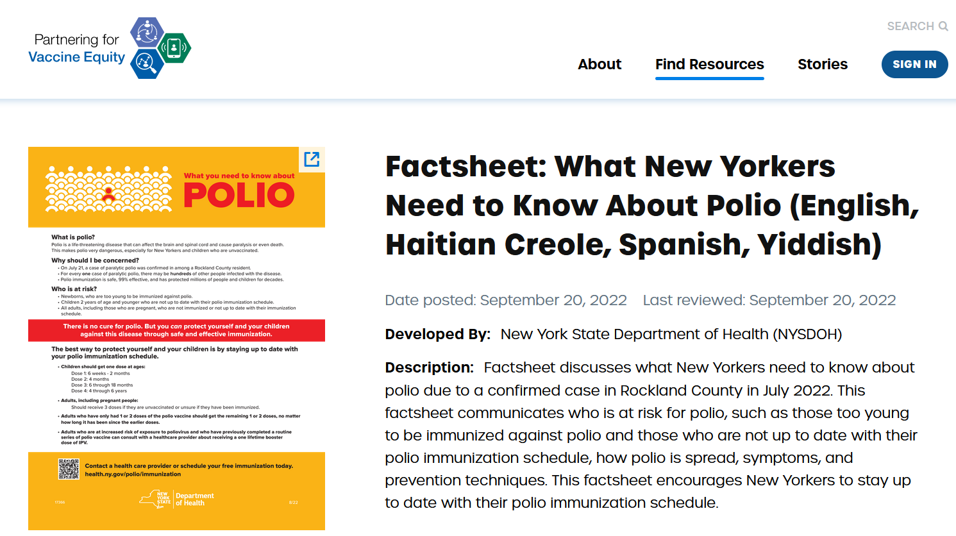
Notes:
https://vaccineresourcehub.org/resource/factsheet-what-new-yorkers-need-know-about-polio-english-haitian-creole-spanish-yiddish

Slide 17
New York: cVDPV2 case (Rockland County, 2022)
First U.S.-origin polio case since 1979; wastewater positive across multiple counties
Patient had not traveled; virus related to London sewage virus
3-dose coverage at age 2: Rockland 60% vs. state 80%
Wastewater detection recurred Mar. 2023; none since
Notes:
The last case of polio in the United States was in 2013, in someone who brought the disease in from abroad. There has not been a case originating in the United States since 1979
OPV has not been administered in the United States since 2000.
Three scenarios
US patient acquired cVDPV2 from the environment
US patient acquired CVDPV2 from a person who acquired it from the environment
cVDPV2 transmitted person-to-person from visitor from London
https://www.nytimes.com/2022/07/21/nyregion/polio-case-new-york.html?referringSource=articleShare

Slide 18
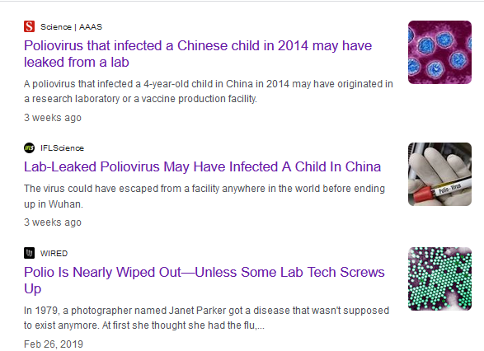
Other poliovirus reservoirs
Vaccine production uses attenuated poliovirus
Research labs also retain virus samples
Since 2000: 21 accidental releases in 8 countries; 16 polio cases
WHO: 74 poliovirus-holding facilities in 22 countries
Notes:
https://www.nature.com/articles/d41586-023-03602-5
Kupferschmidt, K. (2024). Old poliovirus sample hints at recent lab leak. Science (New York, NY), 385(6714), 1152.

Slide 19
Long-term shedding in immunocompromised people
Most people clear OPV virus and develop immunity
Some immune deficiencies allow long-term infection and viral evolution
Documented shedding: up to 20 years
Possible role in the 2019–21 Philippines outbreak
Notes:
https://www.nature.com/articles/d41586-023-03602-5
One person with the condition lives in the United Kingdom and was vaccinated with OPV as a child. For more than 20 years, he asymptomatically carried — and shed —the attenuated virus, which evolved to its disease-causing form. His gut was “essentially a culture vessel” That’s why scientists were surprised to learn that the person’s infection had gone. It disappeared after he received the antiviral drug remdesivir for severe COVID-19 in August 2021. This could be coincidence, but it bolsters the case that antivirals could be used to treat polio infection (two such drugs are being explored as polio treatments).

Slide 20
What holds back eradication?
2 of 3 wild poliovirus types eradicated
cVDPV complicates the endgame: phase out OPV while sustaining immunity
Eradication requires political stability for surveillance and vaccination campaigns
Notes:
Polio can be certified as eradicated when no case observed for three years, and when there is no sign of it in wastewater.

Slide 21
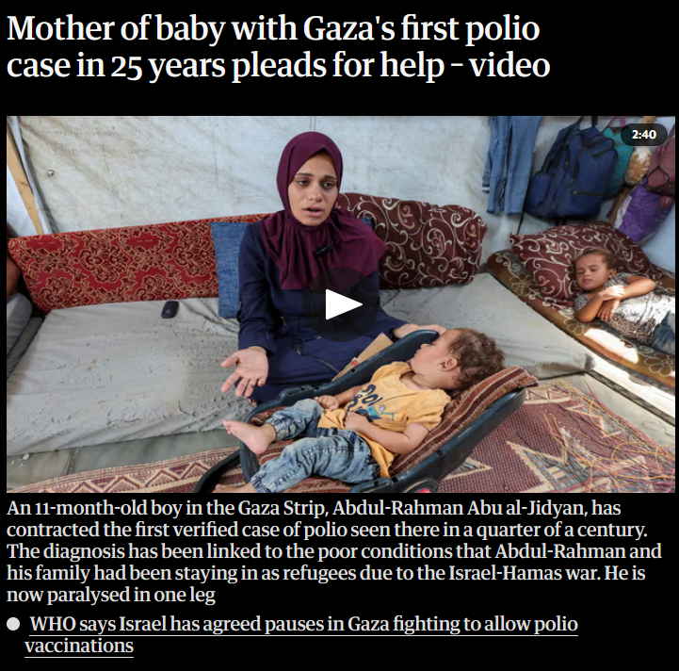
Gaza: paralytic polio (cVDPV2)
First confirmed case in Gaza in 25 years
Displacement disrupted routine vaccination for the affected infant
Other children reported with polio-like symptoms
Brief Israel–Hamas pauses enabled a vaccination campaign
Notes:
https://www.nytimes.com/2024/09/01/world/middleeast/gaza-polio-crisis.html
https://www.nytimes.com/video/world/middleeast/100000009663983/polio-case-mother-gaza-interview.html
About two months ago, he stopped crawling and was feverish. His family took him to a hospital, which sent a sample to a lab in Jordan. A test confirmed health officials’ fears: He had polio.

