Slide 1
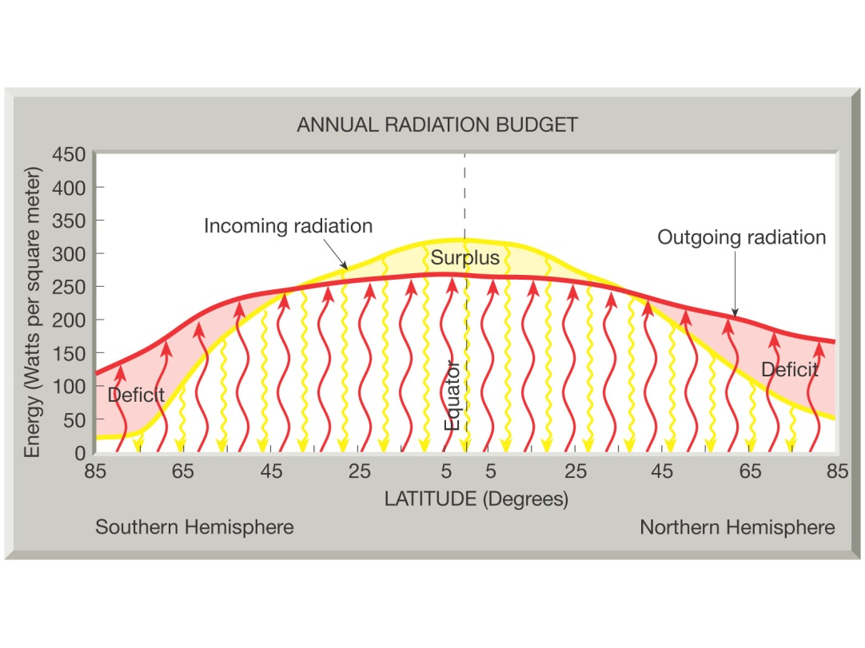
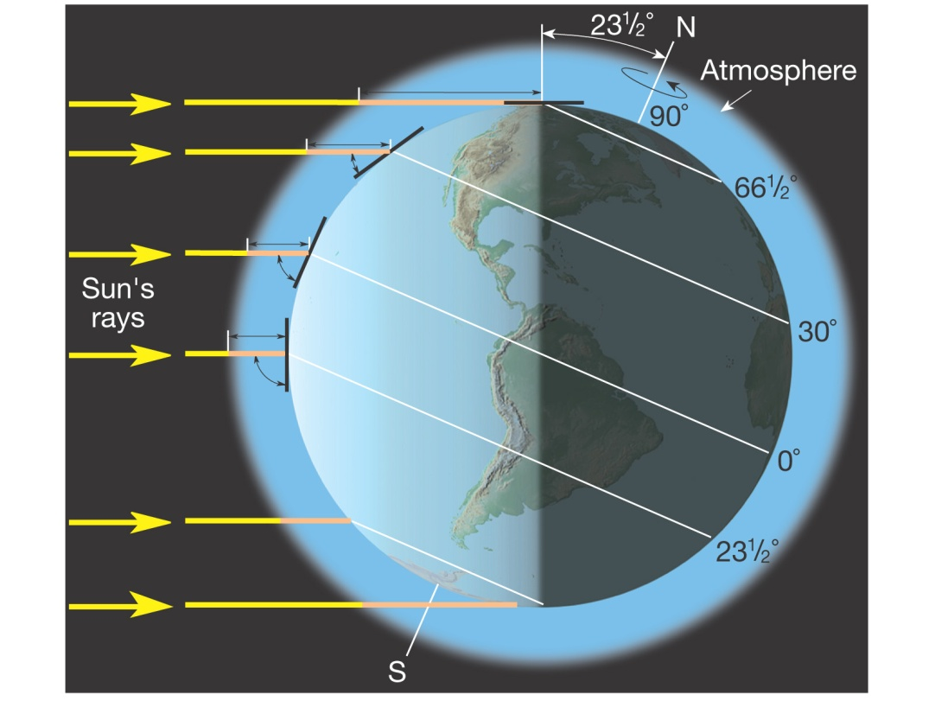
The Earth’s tilt generates the patterns of radiation surplus and deficit at global extents…

Slide 2
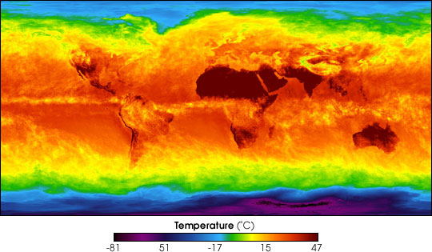
…which in turn shapes global patterns of heat and temperature

Slide 3
…and with the Earth’s revolution around the sun comes the march of the seasons
Notes:
This shifting back and forth throughout the year is what shapes the weather we experience at a broad space and time scale.

Slide 4
Does Earth-Sun geometry and how it shapes the broad shifting distribution of global radiation and temperatures on Earth explain all weather patterns?
The march of the seasons, has within it other processes that cause weather and climate to change on smaller space and time scales
Notes:
No.

Slide 5
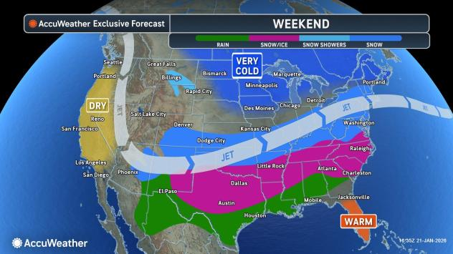
Notes:
Here is an example of how the seasons don’t capture all the variability of temperatures and weather. Even within the variability of the seasons, this past cold air outbreak and winter precipitation was outside of the average. What caused it? It was caused by the way heat is continually being redistributed on Earth because of the radiation and thermal energy imbalance between the tropics and the poles.

Slide 6
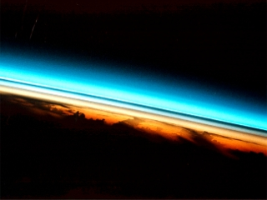
In this unit on radiation and heat:
How does the Sun’s radiation shape heat and temperature closer to the Earth’s surface?
What determines the very dynamic and constantly varying weather property of temperature?
How does the Earth redistribute heat from the tropics to the poles?
It all starts with radiation from the Sun

Slide 7
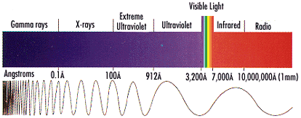
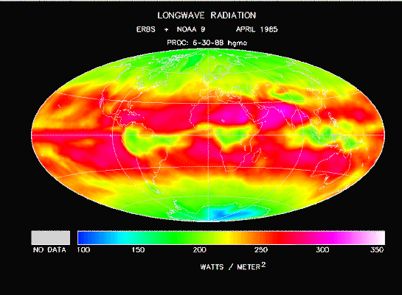
Radiation
Sun
Earth
The Earth emits lower intensity longwave radiation
The Sun emits high intensity shortwave radiation
Notes:
Let’s begin with radiation. All objects and entities have radiation. The arrows indicate the frequency of wavelengths of radiation emitted by the Sun and the Earth.

Slide 8
How does shortwave radiation from the Sun heat Earth?
Through counter-radiation warming, in which the atmosphere is heated from below by longwave radiation emitted by the Earth. A portion of shortwave radiation reaches the Earth's surface, where it is absorbed and reemitted as longwave radiation. This radiation is absorbed by clouds and gases to heat the lowermost layers of the atmosphere that humans experience.
Notes:
Shortwave radiation is more energetic and passes through the atmosphere, although some can get reflected off clouds or absorbed in the atmosphere. When shortwave radiation strikes the surface of Earth it is absorbed and re-emitted as longwave radiation. Longwave radiation is less energetic and can be absorbed by greenhouse gases, thereby warming the Earth. In this sense, the Earth is heated from below.

Slide 9
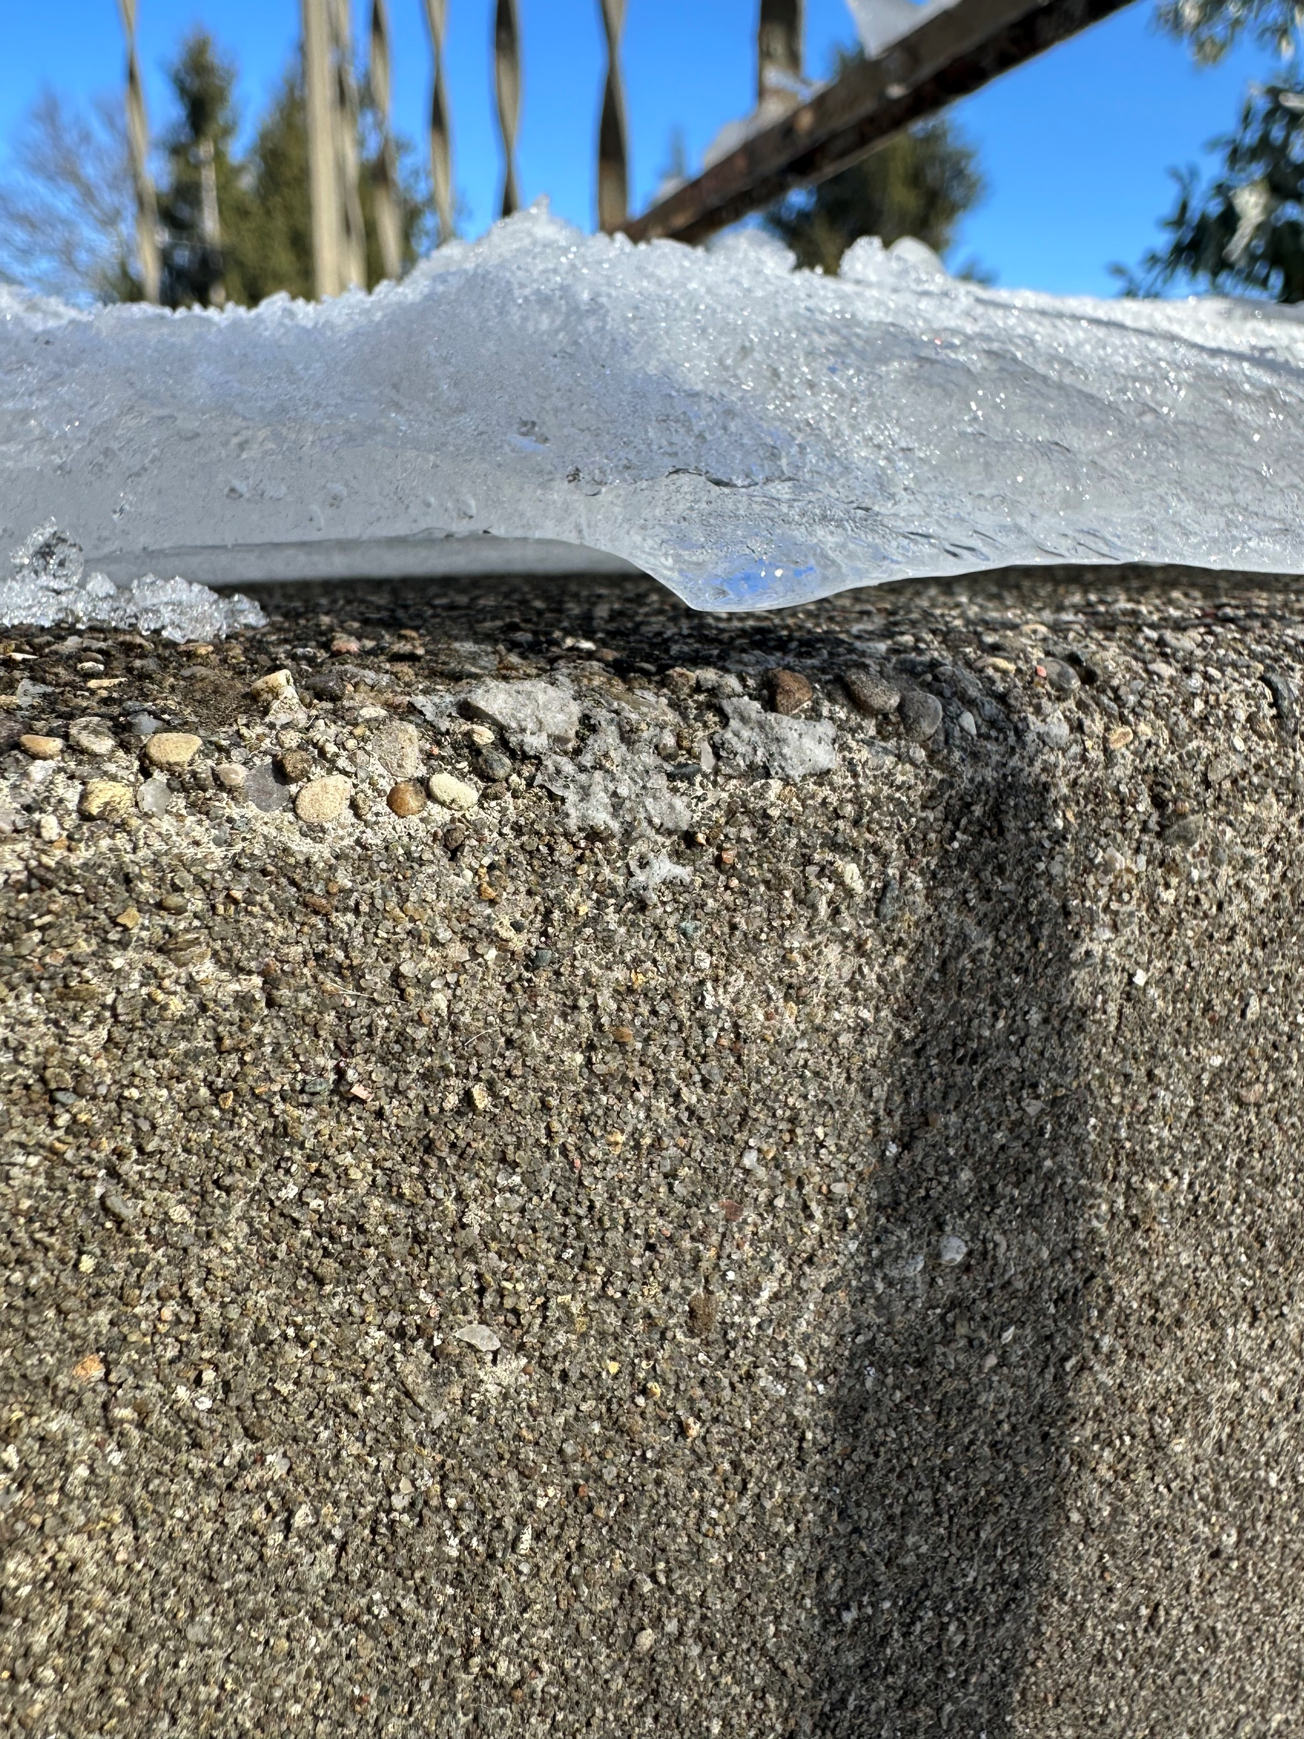

Slide 10
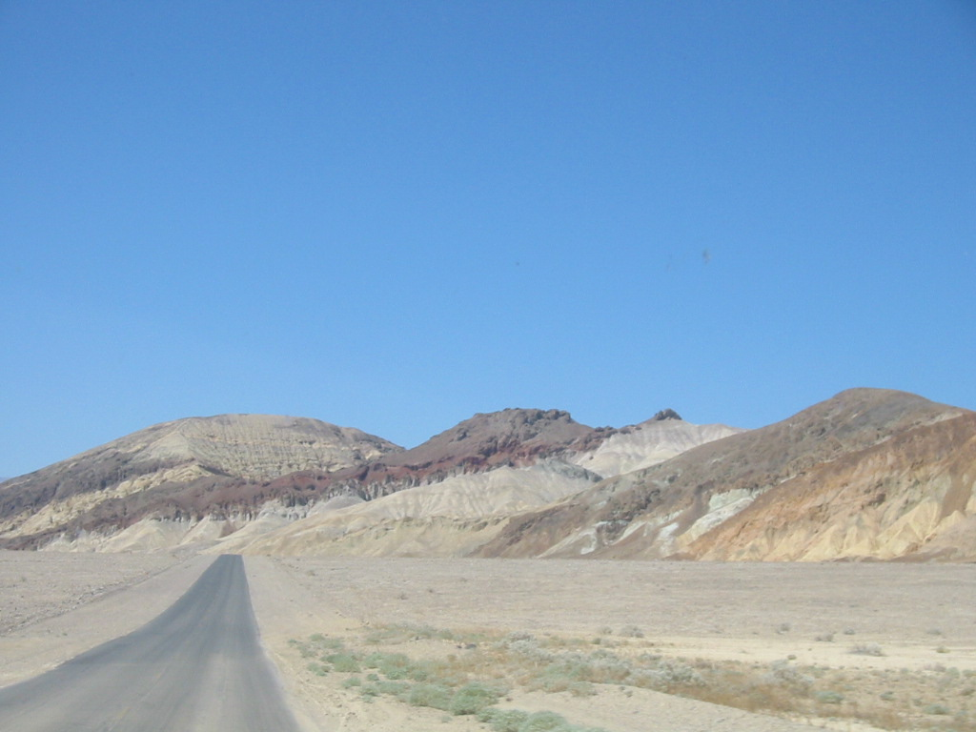
Radiation cooling happens when longwave radiation escapes to space
When are our nights in Lexington the coldest, when it is cloudy or when it is clear?
Why is the desert cold at night?
Notes:
Water vapor is a greenhouse gas

Slide 11
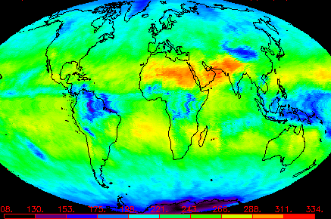
Nighttime longwave radiation emission
Why is it higher over the Saharan desert?
Notes:
Nighttime longwave radiation emission for the month of April What explains the patterns of longwave radiation in this image? The Saharan Desert has very little water vapor to absorb longwave radiation

Slide 12

Radiation budgets
If SW in and LW out balance each other then temperature stays the same (steady state).
If SW in and LW out do not balance, then there is a trend in temperature (dynamic equilibrium)
SW in < LW out = cooling temperatures
SW in > LW out = warming temperatures

Slide 13
Notes:
March 21st – Spring Equinox
June 22 – Summer Solstice
Sept 23 – Autumnal Equinox
Dec 22 – Winter Solstice

Slide 14
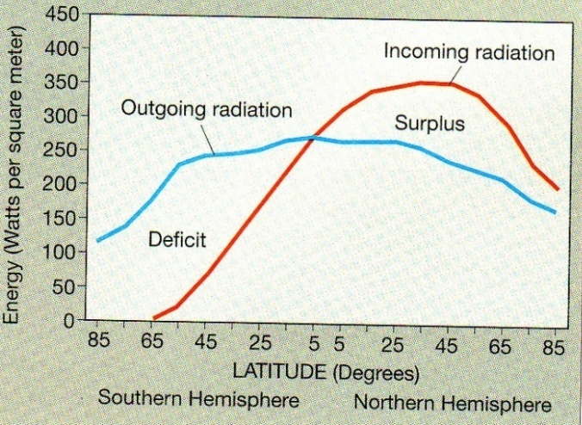
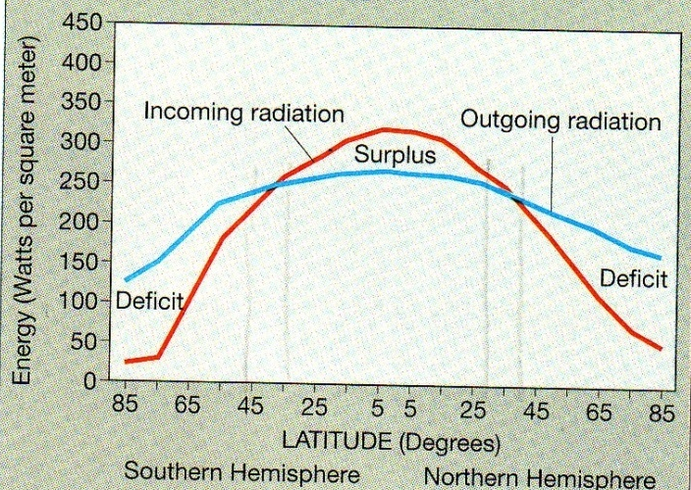
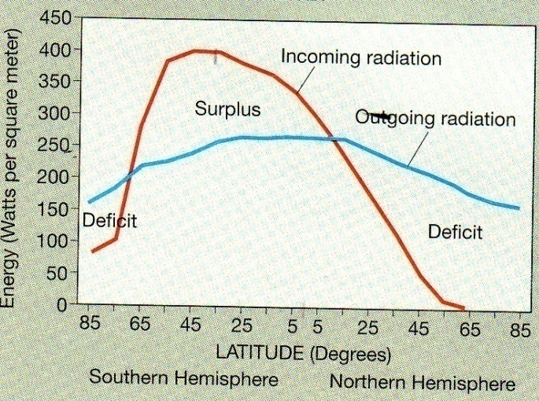
Which plot shows the NH summer? The NH winter? The annual radiation balance?
Notes:
Which plot is our summer? Our winter? Annual radiation balance?

Slide 15
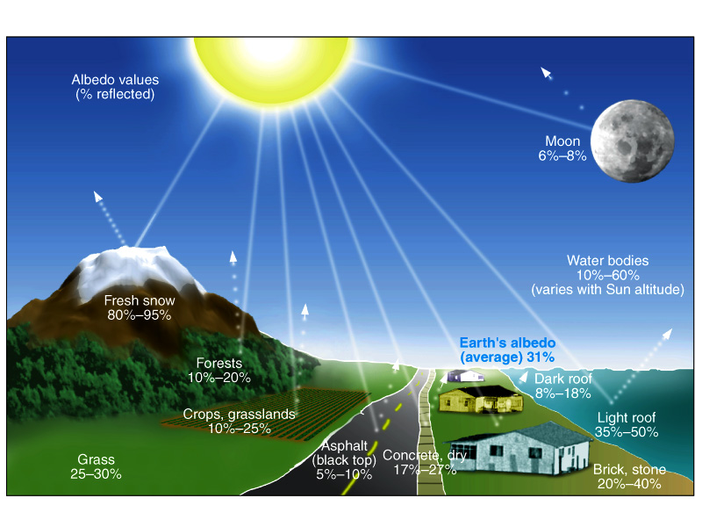
Albedo
Measured as the percent of solar radiation reflected
Fresh snow 80-95%
Forests 10-20%
Asphalt 5-10%
Water bodies 10-60% (depends on sun angle and color of water)
Cirrus clouds 10-30%
Stratus clouds 70-90%
Notes:
Albedo: a measure of how well a surface reflects insolation, it is an important part of the radiation budget

Slide 16
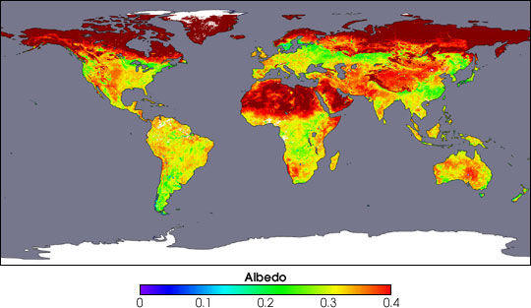
Why is the albedo the same in Siberia as in the Sahara?
Why is albedo low over the central tropical rainforests of Africa?
Notes:
What explains this pattern of albedo?

Slide 17
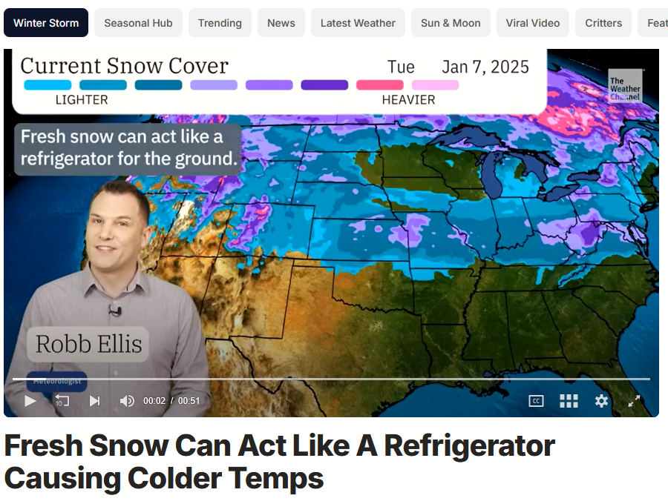
Notes:
https://weather.com/storms/winter/video/fresh-snow-can-act-like-a-refrigerator-causing-colder-temps

Slide 18
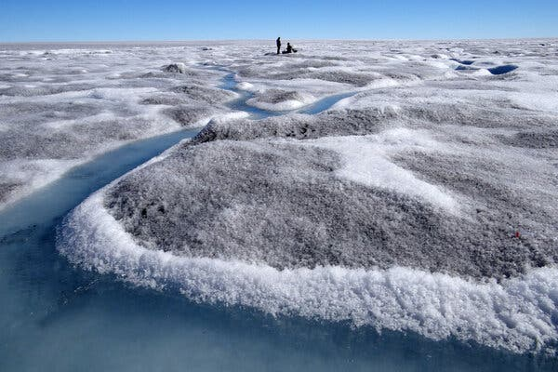
Notes:
https://www.nytimes.com/2026/01/30/climate/greenland-algae-melting-icesheet.html

Slide 19
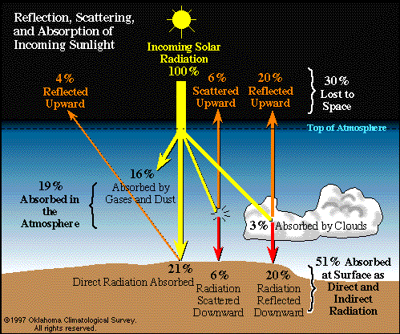
The Earth’s radiation budget
30% of insolation
lost to space
20% of insolation
absorbed by atm
50% of insolation
absorbed at surface
Notes:
Path of incoming solar radiation (100 units) for the Earth Know the 30-20-50 rule at right rather than trying to memorize all the details – 50% of insolation does not make it to the ground.

Slide 20
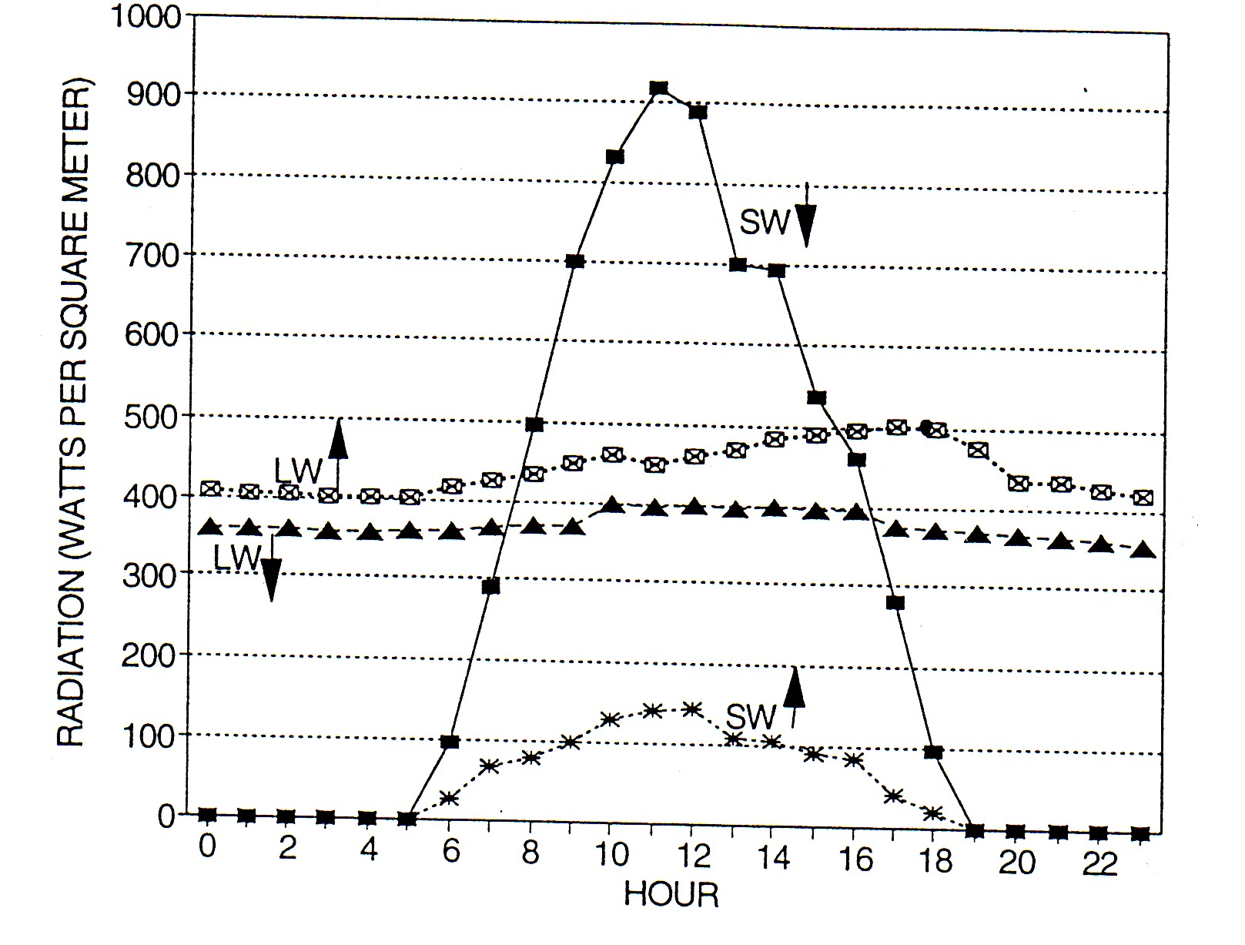
A typical local daily radiation budget
SW in typically peaks midday when sun angle is highest
LW out peaks later, after SW is converted to LW
Local radiation budgets will vary according to location, time of year, and fluctuations in daily weather conditions
Notes:
But how does this relate to temperature?

Slide 21
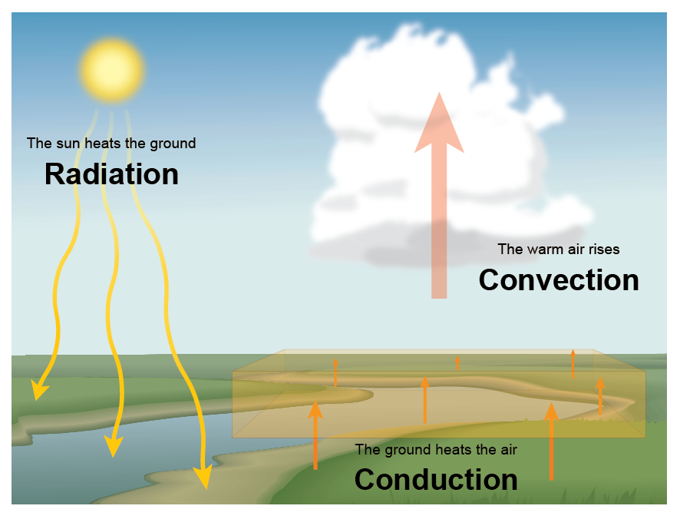
Rules for heat transfer
Energy is not created or destroyed but converted from one form to another
Radiation can be converted into thermal energy. When this energy is transferred, it is called heat, and its effects are observed as changes in temperature.
Notes:
21
Energy in radiation can be converted to thermal energy. Energy in the shortwave radiation from the Sun strikes molecules on the surface or in water or air and sets them into motion. This motion is thermal kinetic energy, which can be measured as temperature. Heat moves between locations due to differences in temperature.
Heat is a manifestation of energy through its ability to do work

Slide 22

Thermal energy is a measure of the total amount of motion of molecules. Temperature is measure of the average speed of the molecules, a sample of thermal energy. Heat is the thermal energy transferred between locations due to temperature difference.
Notes:
22
Shortwave radiation from the Sun is selectively absorbed by the atmosphere, oceans, and land surfaces. Absorbed energy increases molecular motion, warming these surfaces, which then emit longwave radiation. When this radiation is absorbed by surrounding air, land, or water, heat is transferred and can be measured as changes in temperature.
What is the difference between thermal energy and temperature? Compare the same volume of ocean (high thermal energy, low temperature) to that of the outer atmosphere, the thermosphere, on the edge of space, which has few molecules, but they have lots of energy, thus low thermal energy but high temperature (2200 degrees F).

Slide 23
Heat spontaneously flows from warm to cold
Two kinds of heat: sensible and latent
Sensible heat can be sensed and measured. Latent heat cannot be measured directly.
Sensible heat can be transferred by conduction, convection, radiation, and advection
Notes:
23
Latent heat cannot be measured directly because it represents the energy absorbed or released during a phase change of water without a corresponding change in temperature. Traditional thermometers measure temperature, but during a phase transition (e.g., melting, boiling, condensation of water), the temperature remains constant while heat energy is either absorbed or released. When a substance undergoes a phase change (e.g., water turning into steam), energy goes into breaking or forming intermolecular bonds rather than increasing kinetic energy. Since temperature measures kinetic energy, it does not change, making direct measurement impossible with a thermometer.

Slide 24
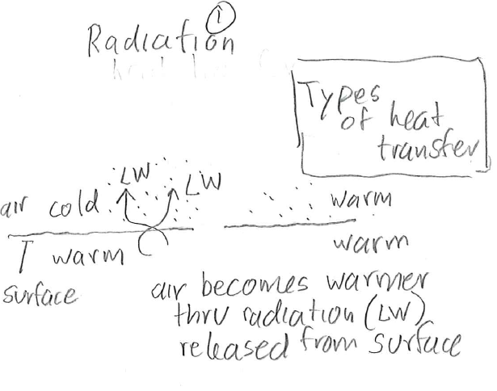
Notes:
24
Radiation is a thing, like shortwave radiation, and it is also a process, as shown here as radiative transfer of heat

Slide 25
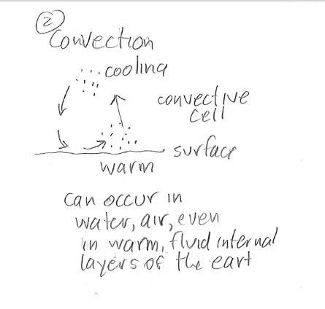

Slide 26
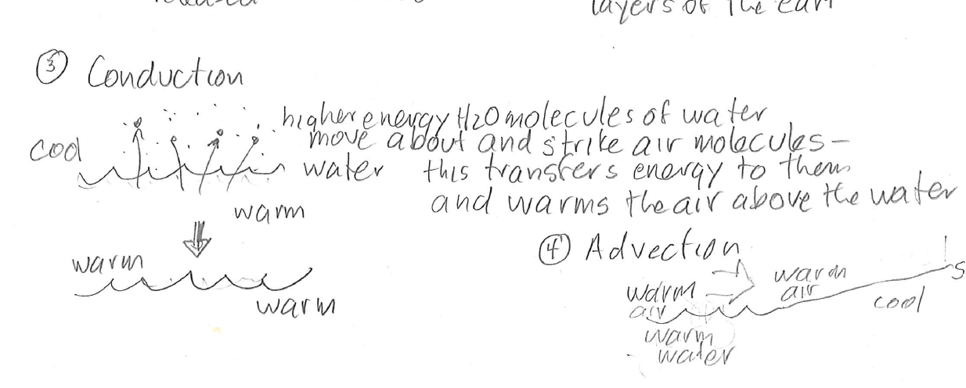

Slide 27
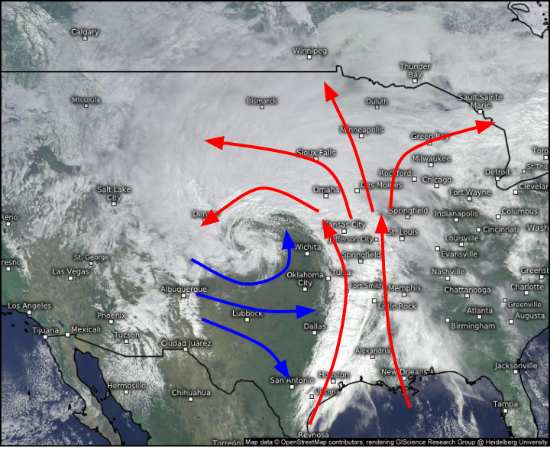
Advection is the horizontal transfer of through atmospheric forces that generate winds
Notes:
Warm and cold air advection associated with a warm front and a cold front

Slide 28
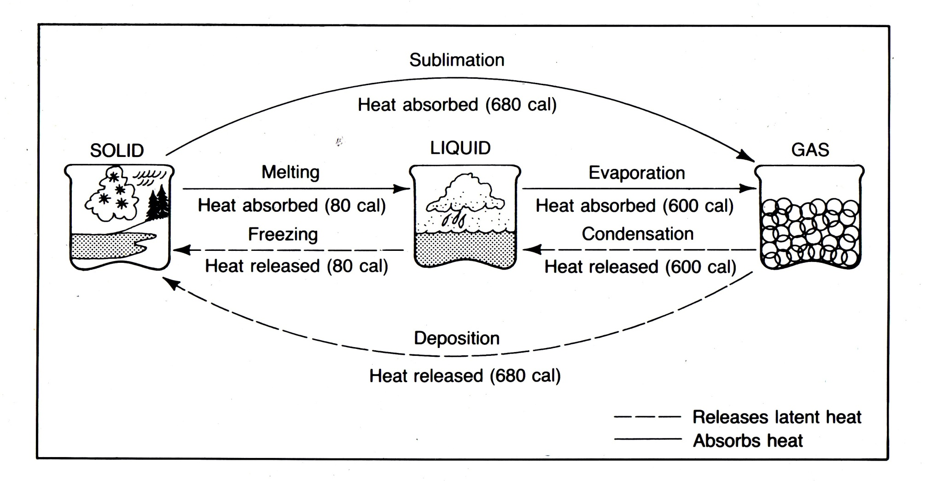
Latent heat is potential energy associated with the phase changes of water
Evaporation cools the environment, condensation warms the environment
Notes:
28
Processes going to the right, like melting, sublimation, and evaporation cool the environment because sensible heat is converted to latent heat and this latent heat is now tied up in the phase changes of water. It is stored as potential energy in liquid water or water vapor. Processes going to the left, like condensation, freezing, or deposition warm the environment because latent heat is converted to sensible heat. The potential energy stored in water vapor or liquid water is released to the environment

Slide 29
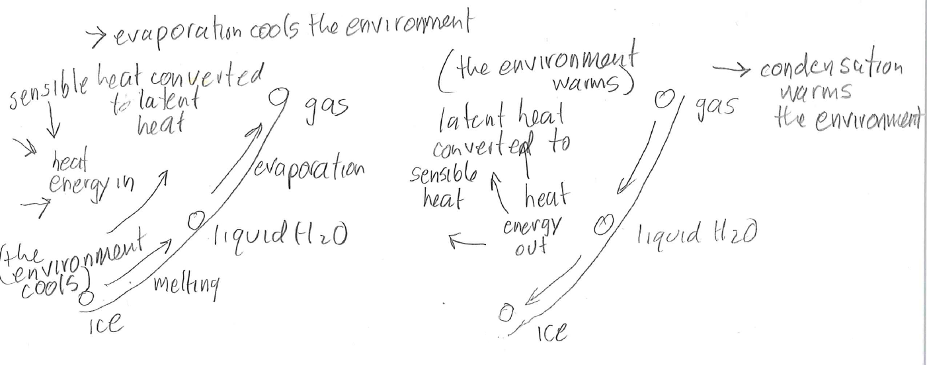

Slide 30


10. Temperature at any one point is determined by the net balance between incoming and outgoing radiation (SW and LW); sensible heat available through conduction, convection, radiation; latent heat transfer; advective heat transport (wind-driven); and the availability of water and in what form (ice, liquid, or solid)
Notes:
30

Slide 31
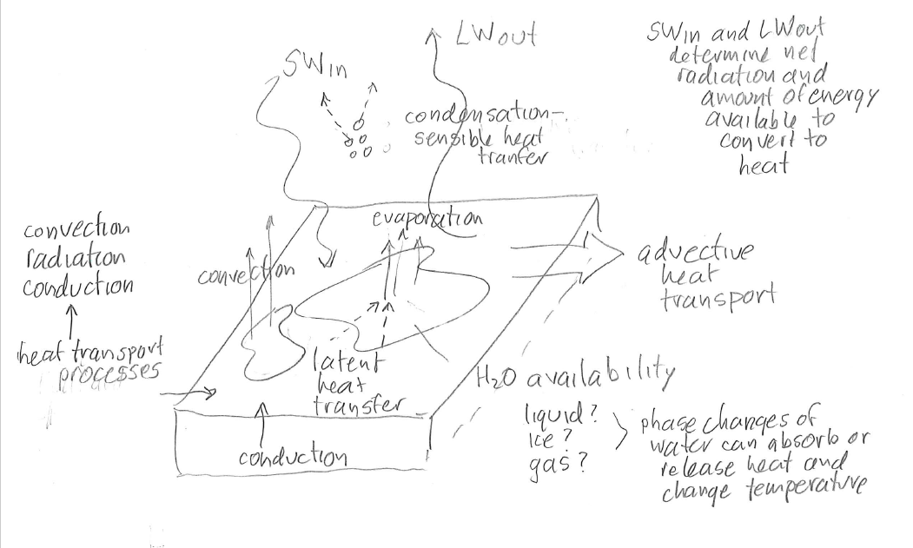

Slide 32
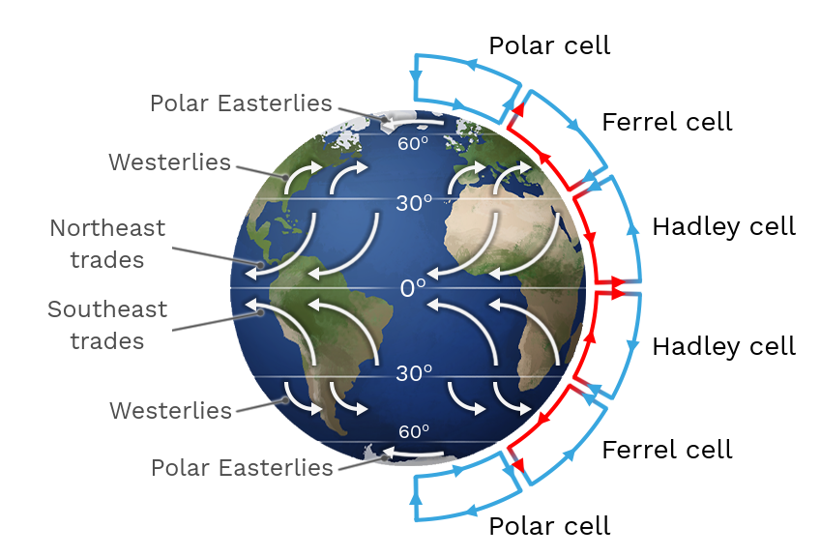
10. Heat is continually redistributed on Earth by radiation budgets, phase changes of water, and global atmospheric circulation
Notes:
32
Weather and climate patterns are the Earth’s way of balancing the radiation and heat budget

Slide 33
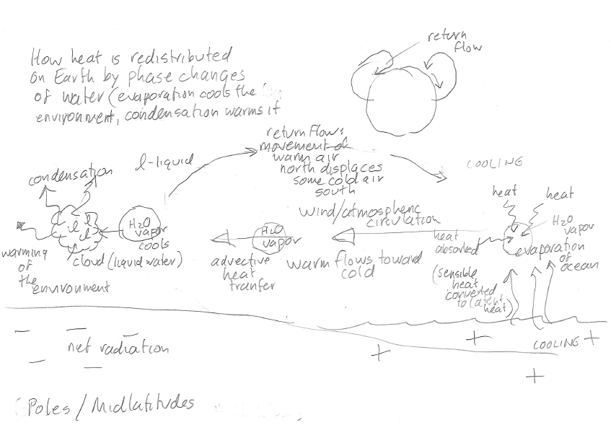

Slide 34
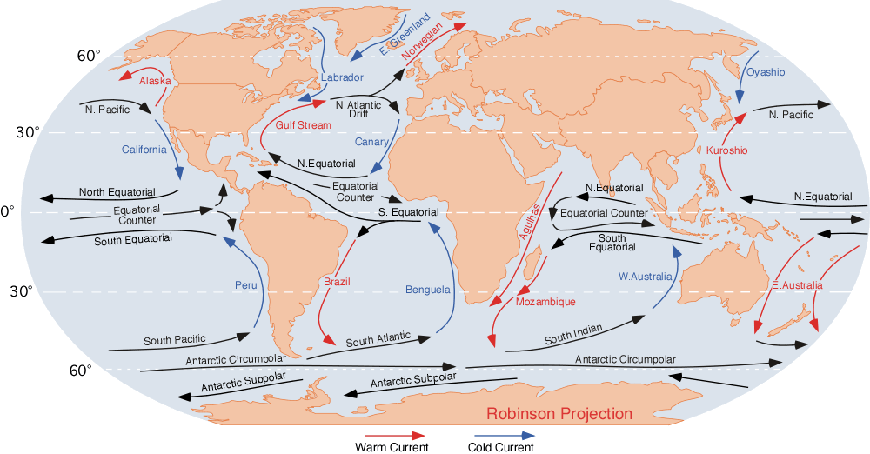
Ocean currents also redistribute heat
Notes:
34
Note how the warm ocean currents tend to flow toward the poles and the cold ocean currents tend to flow toward the equator. The Earth’s movements of heat through air and water happen because of the shifting heat imbalance between the tropics and the poles.

