Slide 1
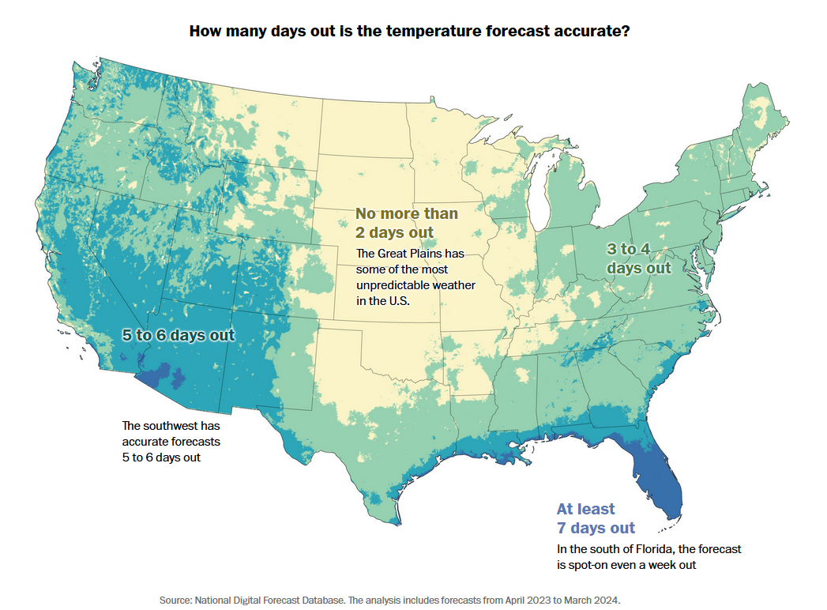
Notes:
https://www.washingtonpost.com/climate-environment/interactive/2024/how-accurate-is-the-weather-forecast/

Slide 2
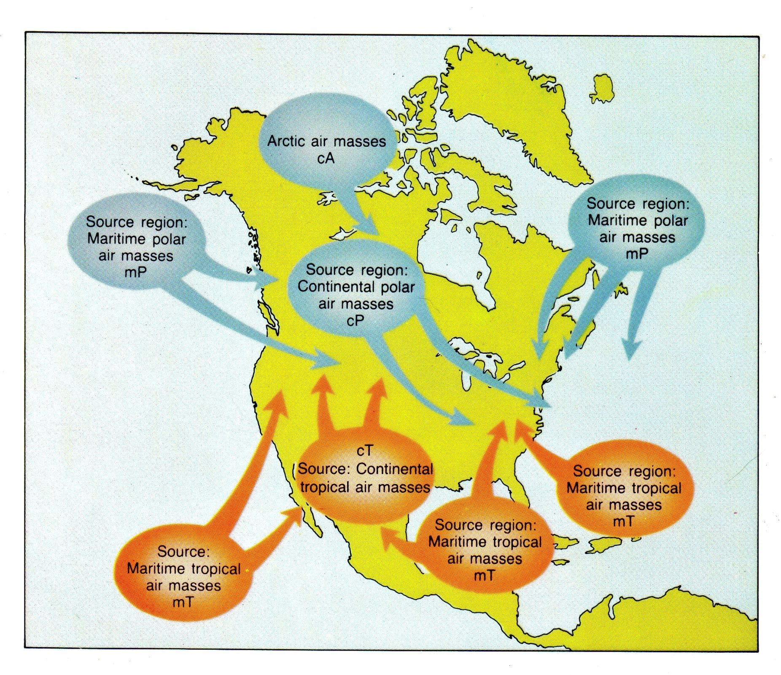

Slide 3
Notes:
Cold front

Slide 4
Notes:
Warm front

Slide 5
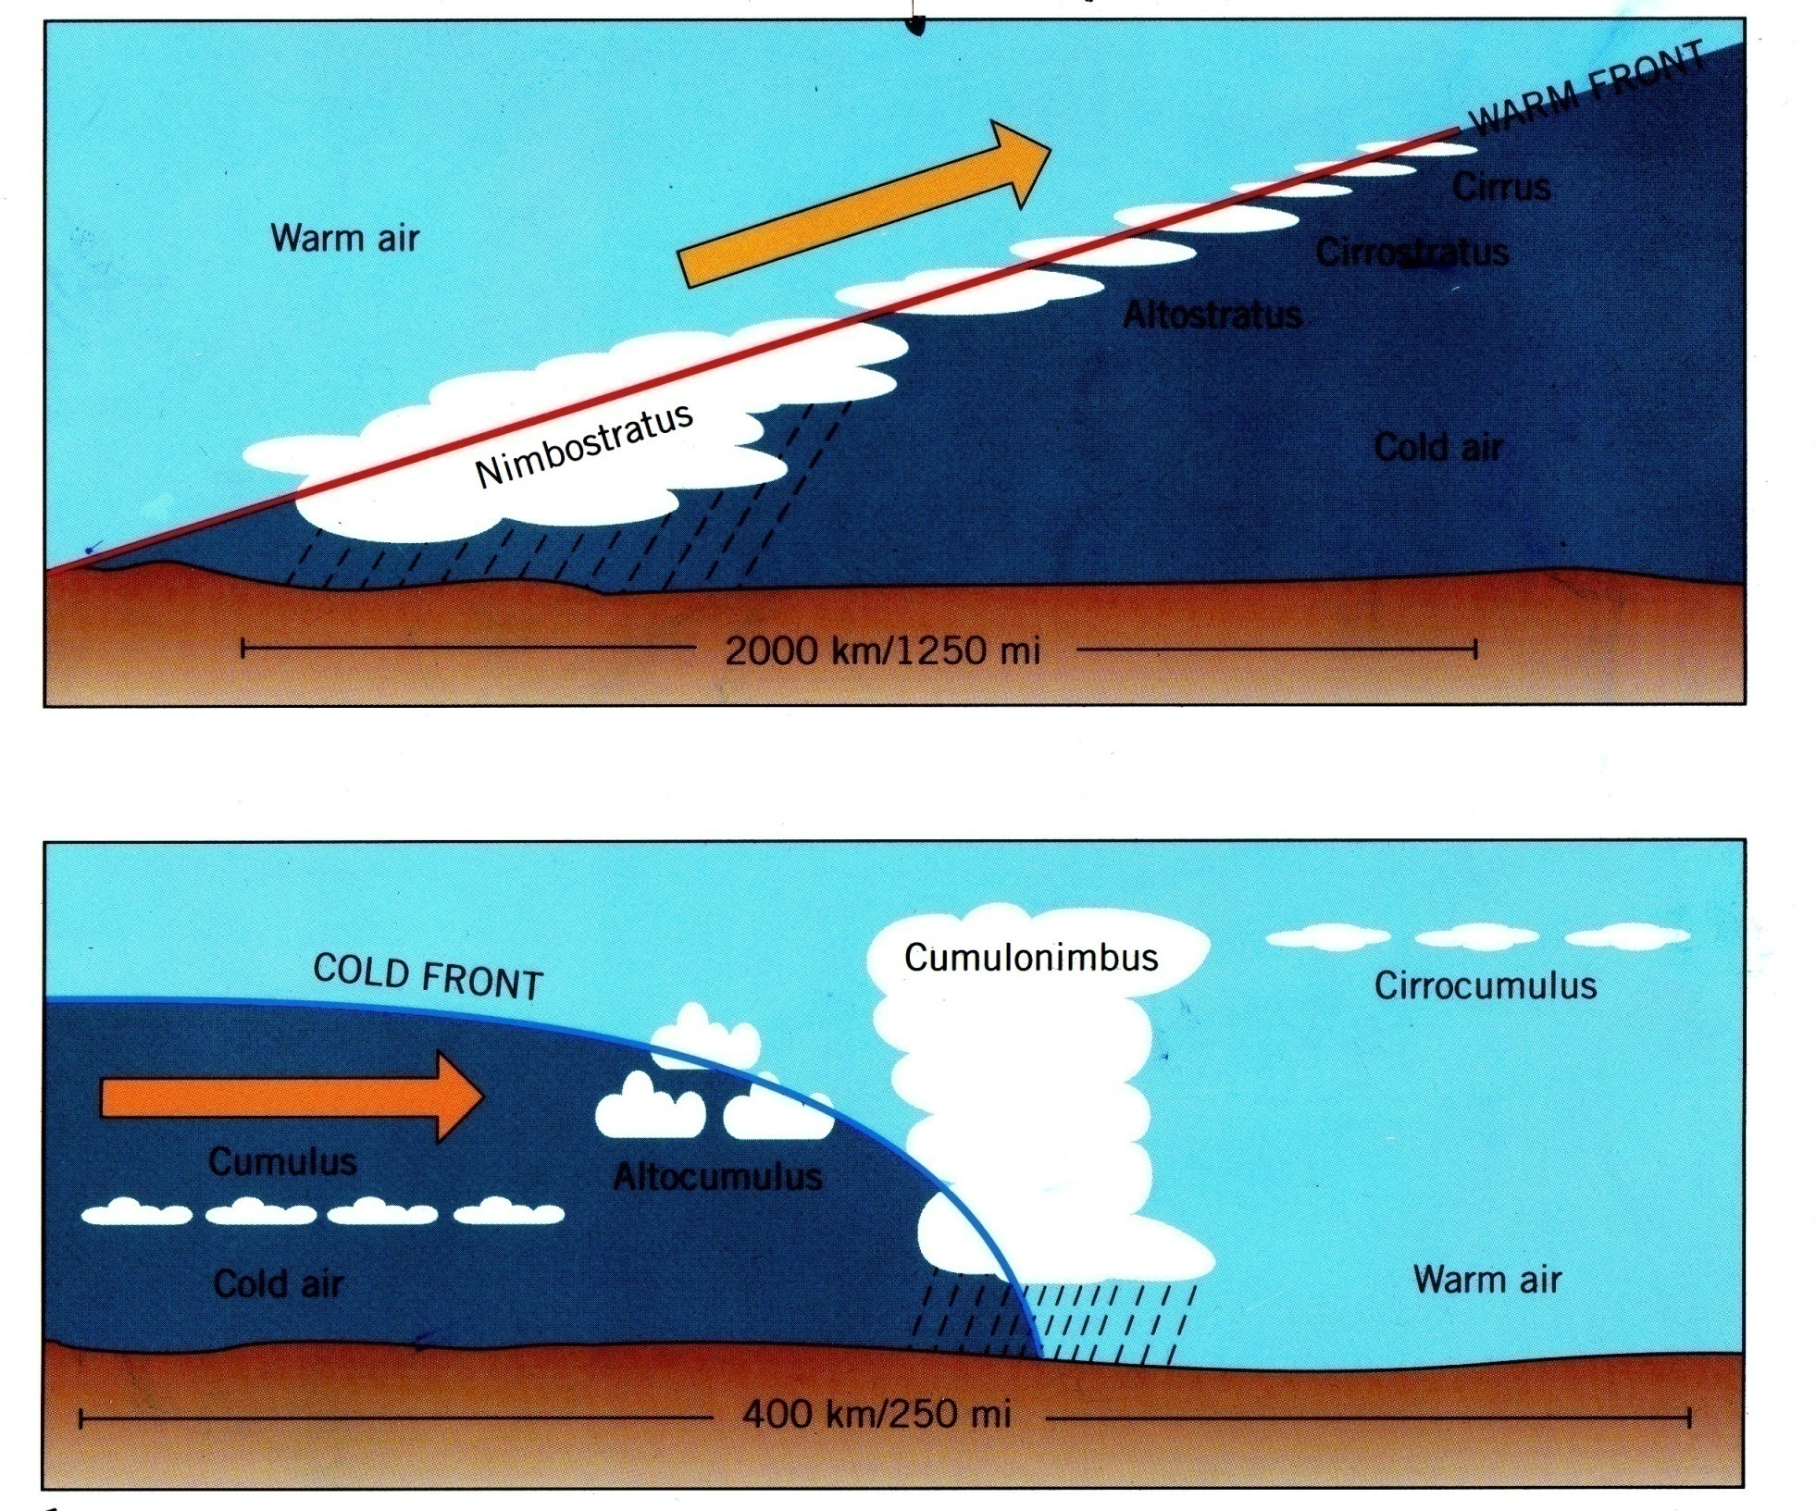
Notes:
Cloud types differ in association with frontal type. Stratus clouds are more often associated with the passage of a warm front. Cumulus clouds are more often associated with the passage of a cold front.

Slide 6
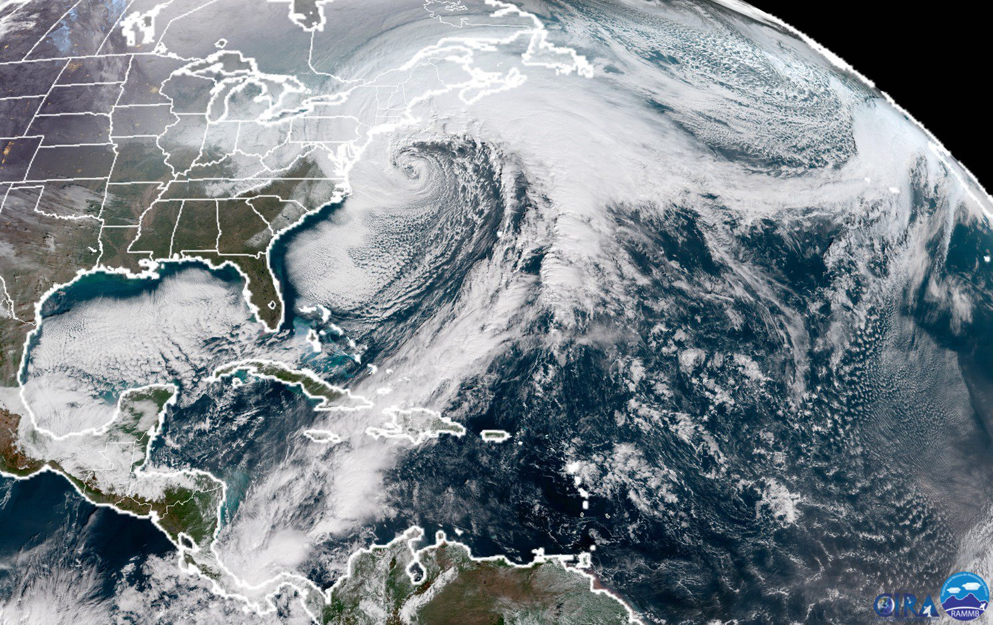
Notes:
Feb 2026 Nor’easter, a strong coastal MLC

Slide 7
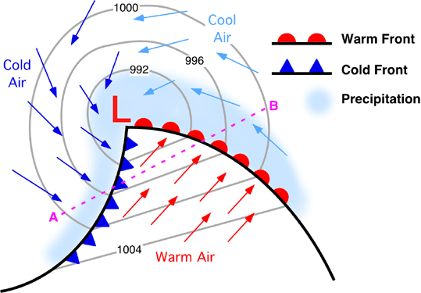

Slide 8
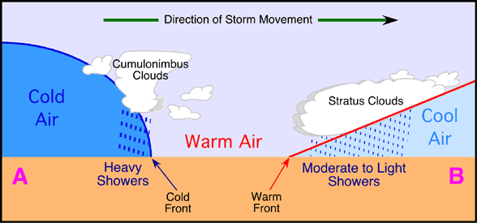

Slide 9
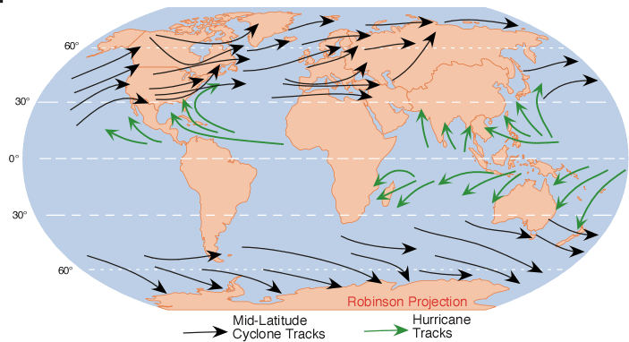
Notes:
Note the differences in where midlatitude (extratropical) storms occur and where hurricanes (tropical storm systems) occur.

Slide 10
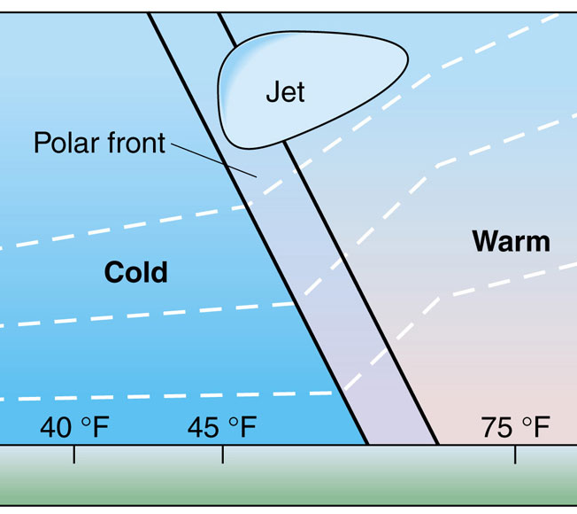

Slide 11
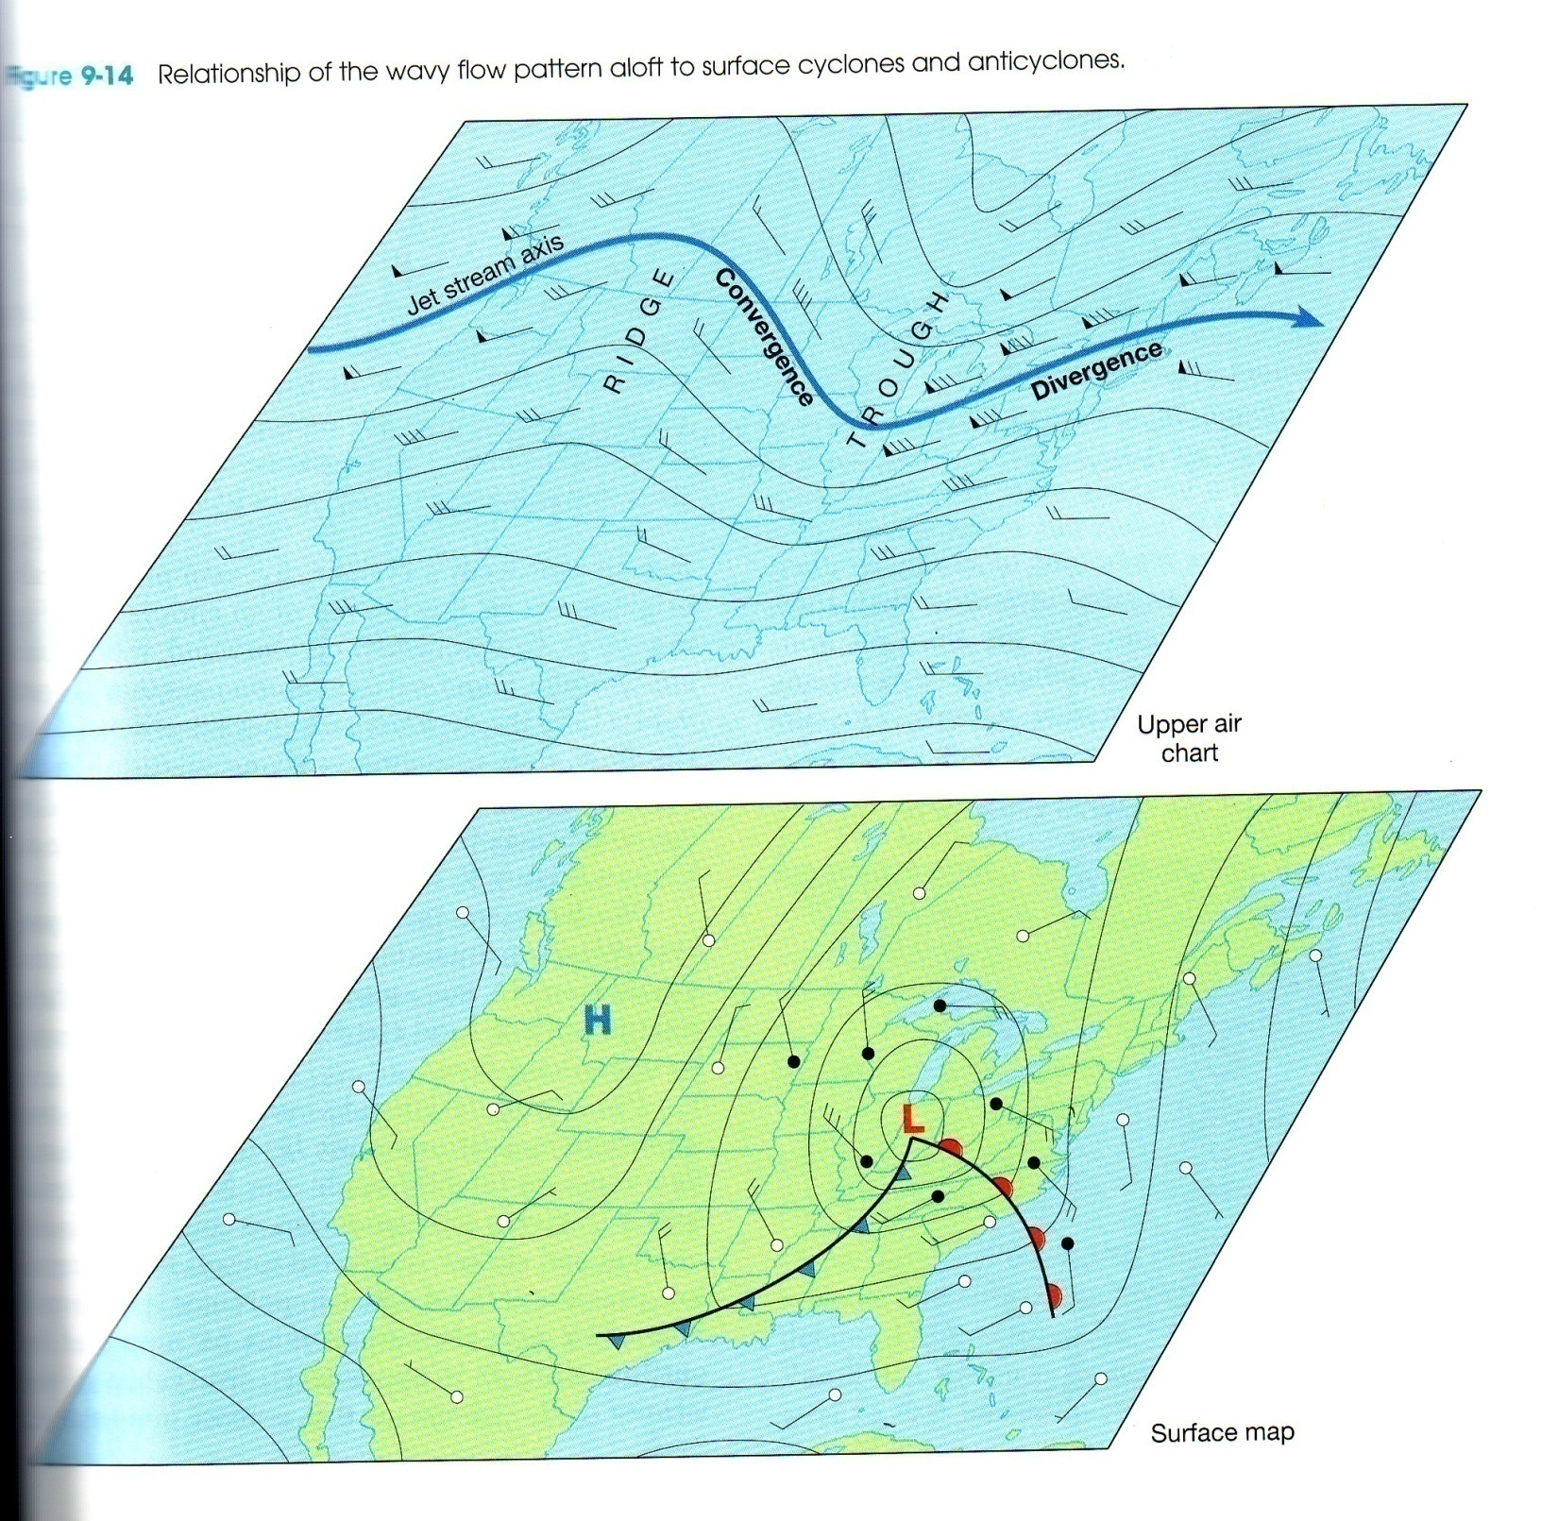
This is a upper level map of showing the heights of a 500 mb constant pressure surface and the position of the polar jet stream
High pressure ridge
Cold air
Warm air
Low pressure trough
The trough creates downstream speed and directional divergence that enhances cyclogenesis
Surface winds on a surface isobaric map
Cold air
Warm air
Notes:
Note that there is an upper level low (known as a trough on a constant pressure surface) and a surface low that are needed to form a midlatitude cyclone.

Slide 12
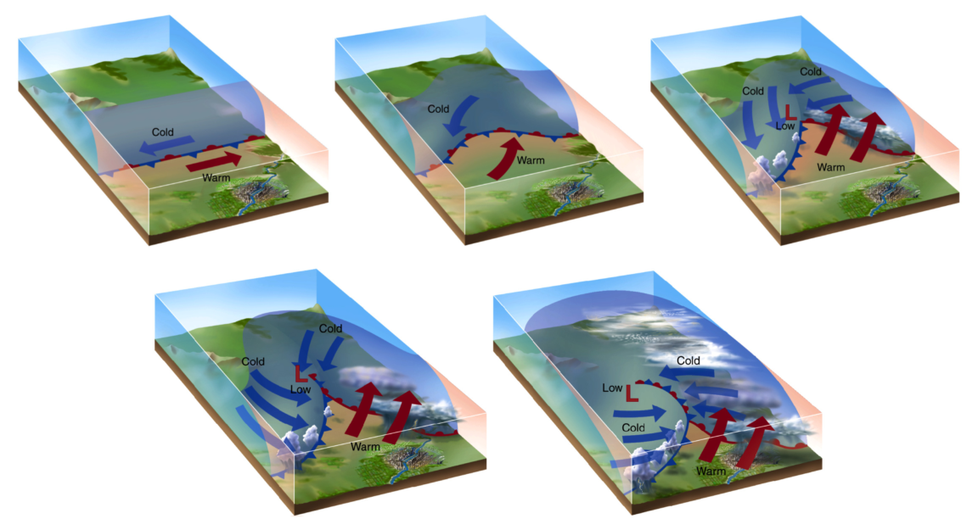
Early stage
Open wave stage
Zone of strong surface baroclinity
Dissipating stage
MLCs lose organization 7-10 days after redistributing the heat that powers them
Occluded stage
Occluded front formation marks a decaying MLC.
Notes:
Note: no upper level support is shown in this image even though a trough in the polar jet stream with speed and directional divergence are required to develop a robust midlatitude cyclone

Slide 13
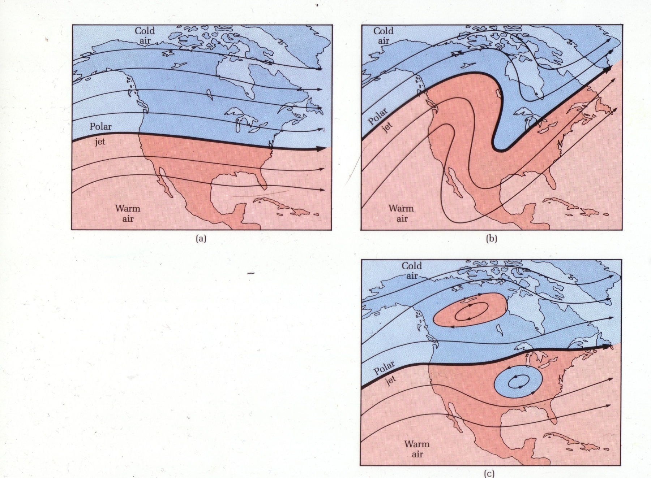

Slide 14
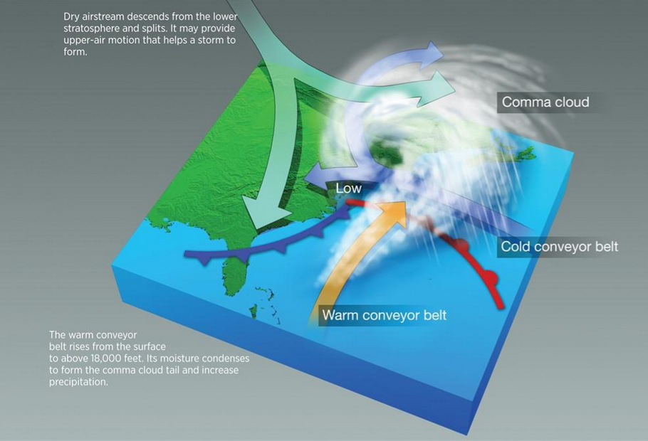
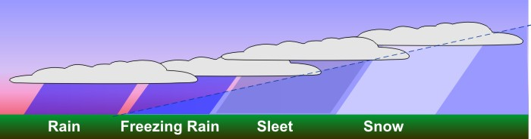

Slide 15
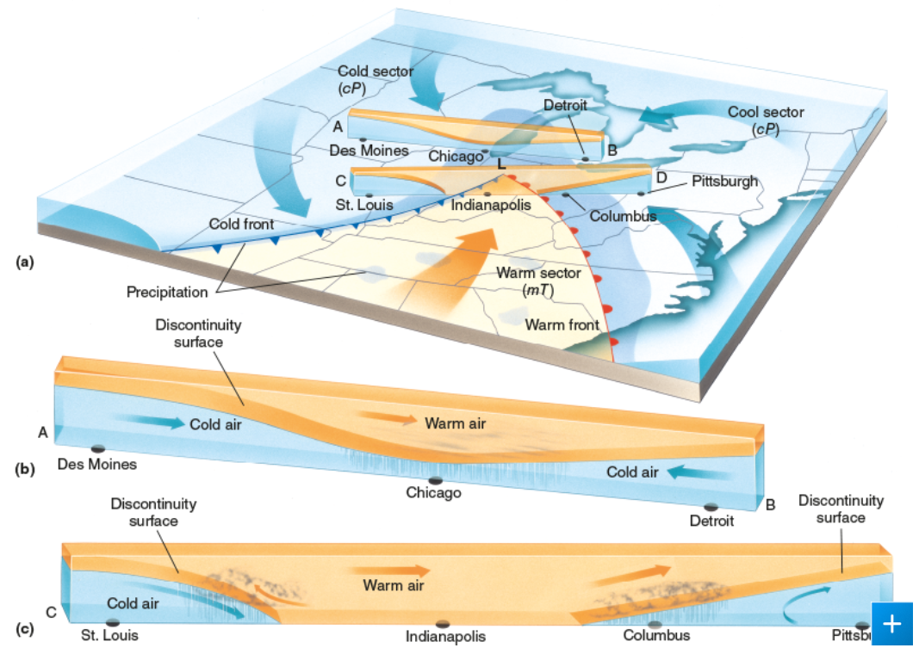

Slide 16
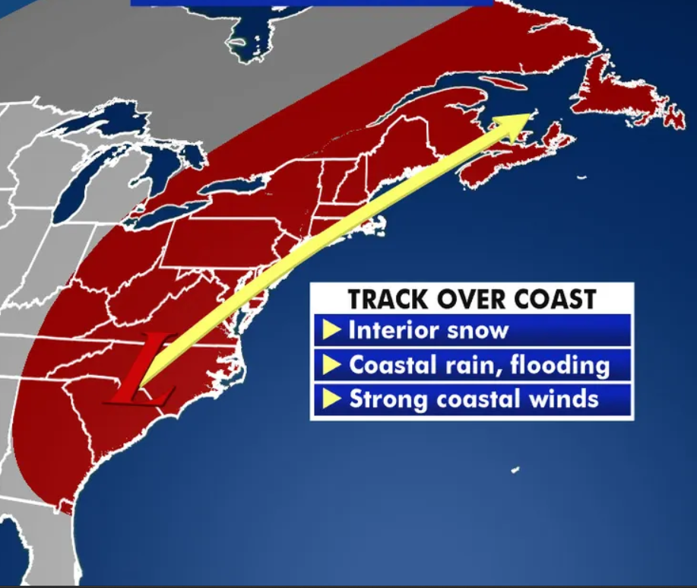

Slide 17
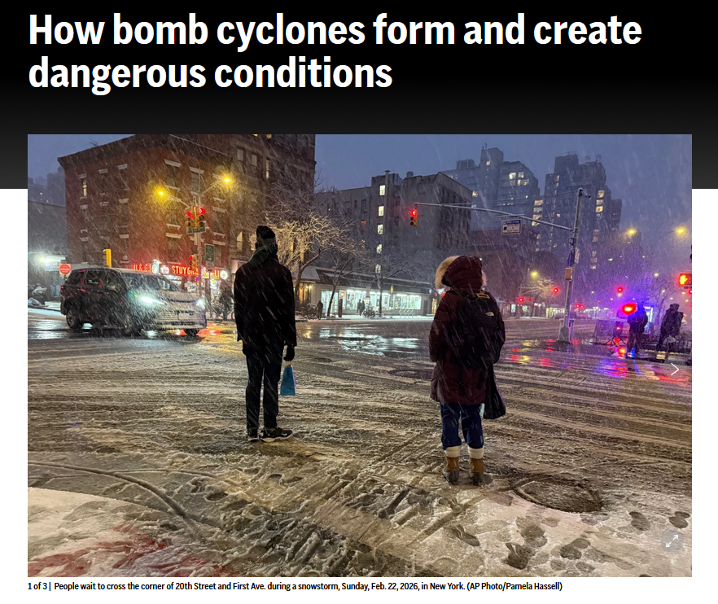
Notes:
https://apnews.com/article/winter-snow-bomb-cyclone-3de11481ad49fc94bafb570467a2f972

Slide 18
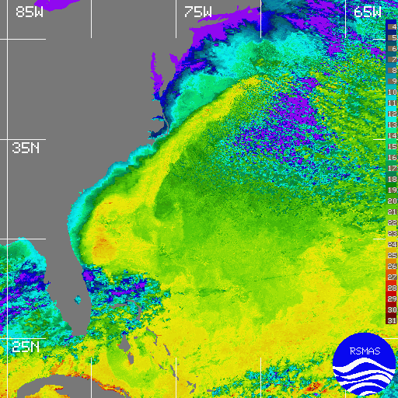

Slide 19
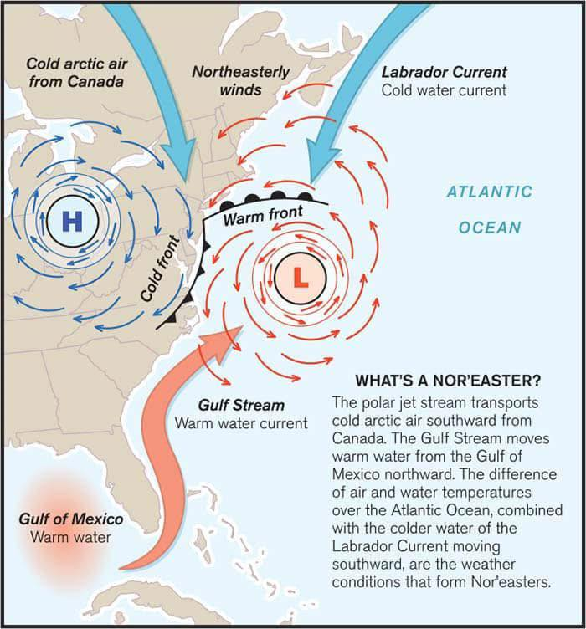

Slide 20
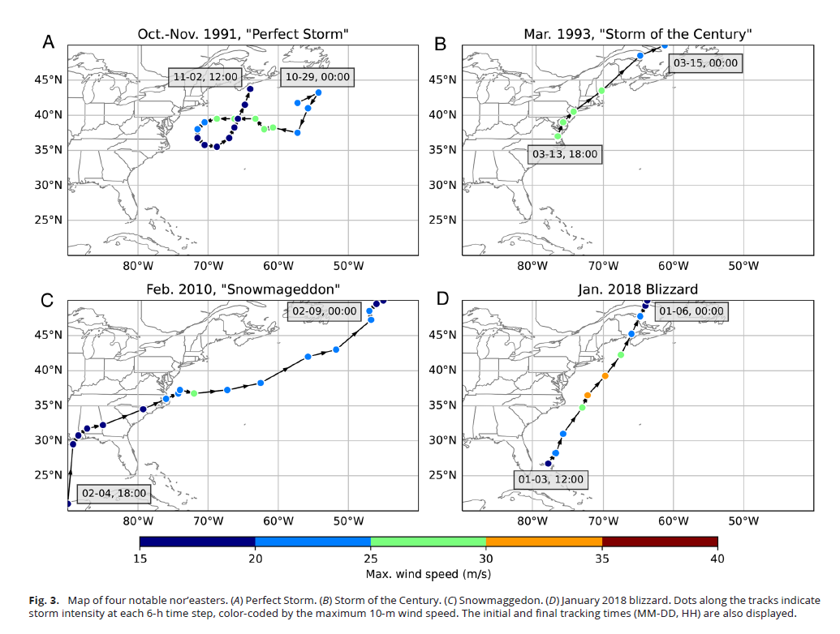

Slide 21
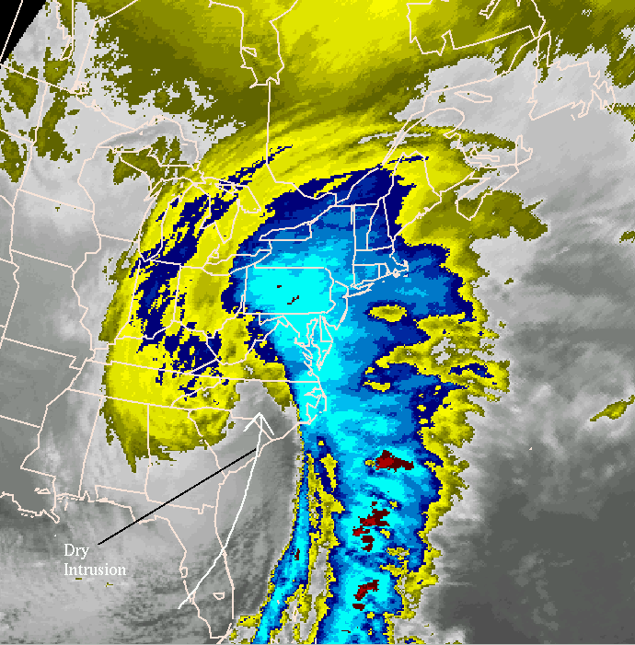

Notes:
Famous nor’easters: The Perfect Storm (1991)
Ash Wednesday Storm (1962) Storm of the Century (1993)

Slide 22
