Slide 1
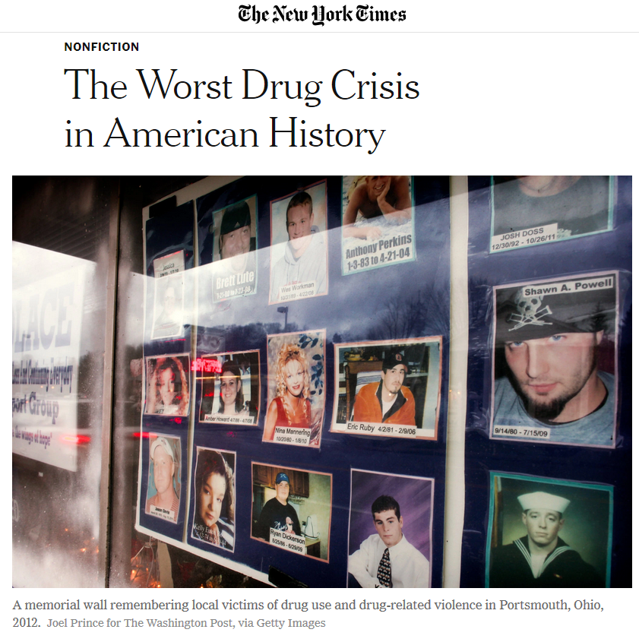
Notes:
The US at one point was dealing with more than 140 opioid-related deaths every day. Deaths from opioid overdoses had slowed until the Covid pandemic, then it picked up again.
More than one million people have died since 1999 from a drug overdose, the majority of them from opioids.
But this is only country. There are many global components of the opioid crisis in the US.

Slide 2
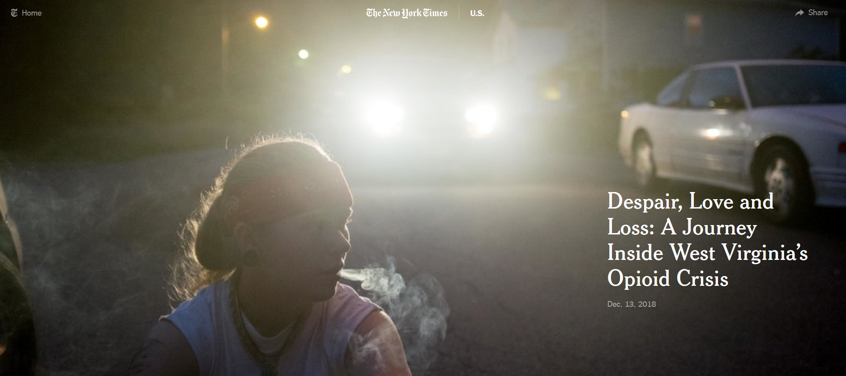
Notes:
Few Americans have not heard of opioids
https://www.nytimes.com/interactive/2018/us/west-virginia-opioids.html

Slide 3
Opiate – derived from opium, as in codeine, morphine, or heroin
Opioid – drugs that work by binding to the same cellular receptors as opiates, but these chemicals do not occur naturally, as in OxyContin, fentanyl, carfentanil
‘Opioid’ has become the umbrella term for all of these terms.
Not opioids: cocaine, methamphetamine
Notes:
Opioids are a class of drugs that act on opioid receptors in the brain. Signals sent to these receptors can block pain and lead to feelings of euphoria.

Slide 4
The opioid epidemic made many companies profitable
Purdue Pharmaceutical invented and held patent to Oxycodone and its family of drugs – but many other companies profited from involvement in the opioid crisis
Overseas companies manufactured about 88% the opioid pills and provided the ingredients to make OxyContin
America’s largest drug companies distributed 76 billion oxycodone and hydrocodone pain pills across the country between 2006 and 2012
Just six companies distributed 75% of the oxycodone and hydrocodone pills during this period, including Walgreens, Cardinal Health, CVS and Walmart
Notes:
Just six companies distributed 75% of the oxycodone and hydrocodone pills during this period: McKesson Corp., Walgreens, Cardinal Health, AmerisourceBergen, CVS and Walmart
Three global companies manufactured about 88% the opioids – these are the pill makers: SpecGx, a subsidiary of Mallinckrodt; Actavis Pharma (purchased by Teva Pharmaceutical); and Par Pharmaceutical, a subsidiary of Endo Pharmaceuticals.

Slide 5
The Global Pain Divide
Estimates range into the billions of people worldwide who have little to no access to essential opioid analgesics, such as codeine or morphine
Worldwide use of opioid analgesics is concentrated in a few countries, in particular, the USA, Canada, Australia, New Zealand, and several European countries
Calls have been made to close this longstanding ‘pain divide’
Notes:
Berterame, S., Erthal, J., Thomas, J., Fellner, S., Vosse, B., Clare, P., ... & Samak, A. K. E. (2016). Use of and barriers to access to opioid analgesics: a worldwide, regional, and national study. The Lancet, 387(10028), 1644-1656.
World Health Organization. (2023). Left behind in pain: extent and causes of global variations in access to morphine for medical use and actions to improve safe access. In Left behind in pain: extent and causes of global variations in access to morphine for medical use and actions to improve safe access.

Slide 6
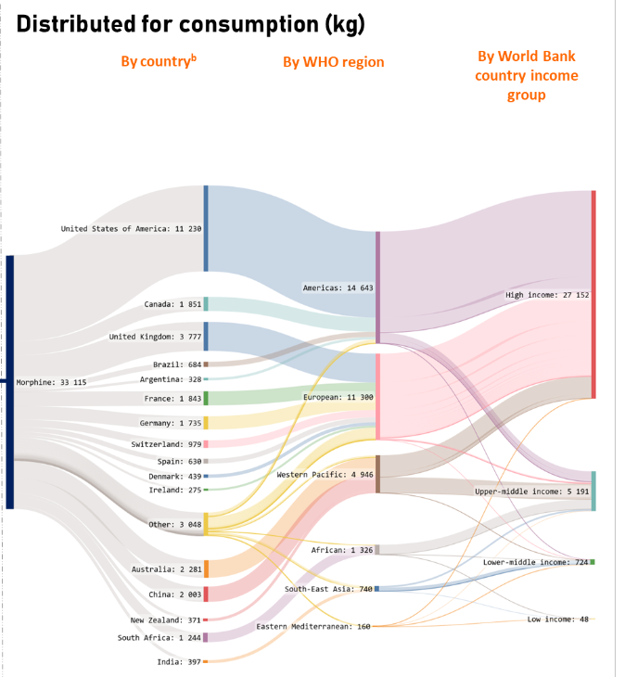
Notes:
World Health Organization (2023)

Slide 7
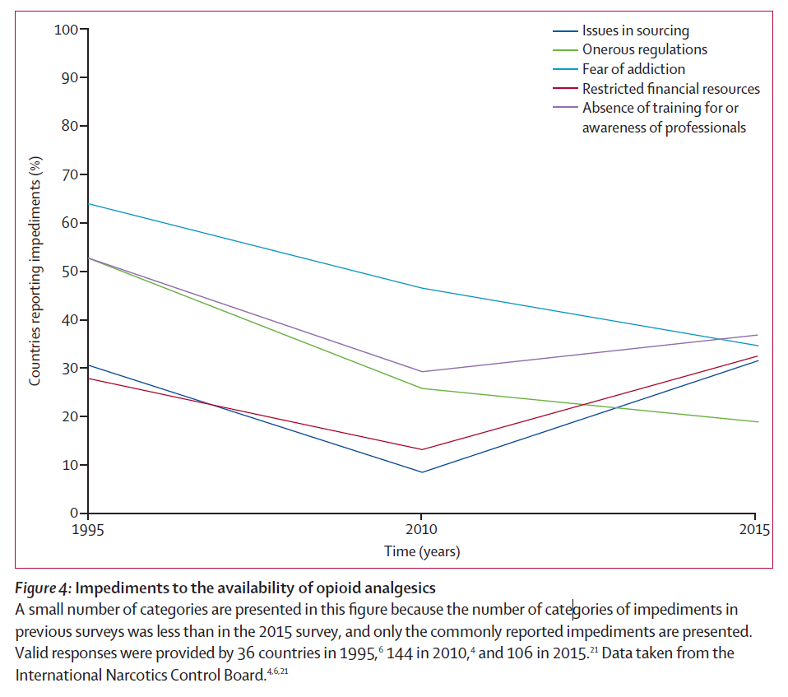
The US opioid crisis worsened the pain divide
Impediments to the availability of opioid medication were going down until the opioid epidemic in the US resulted in a global shortage and increased prices,

Slide 8
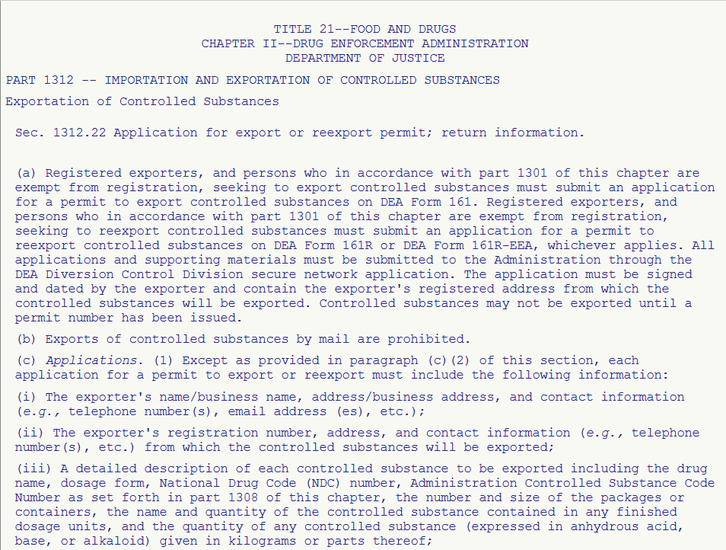
Procuring controlled medicines in low-income countries is complex
Countries must remain in compliance with international conventions on controlled narcotics
Many administrative steps required for obtaining authorization for export and import of controlled narcotics
Complexities of the trade in controlled medicines directly contribute to the lack of access of drugs for treating pain
Notes:
https://doi.org/10.1177/0020731420906748
Vitry, A., Forte, G., & White, J. (2020). Access to Controlled Medicines in Low-Income Countries: Listening to Stakeholders in the Field. International Journal of Health Services, 0020731420906748.

Slide 9
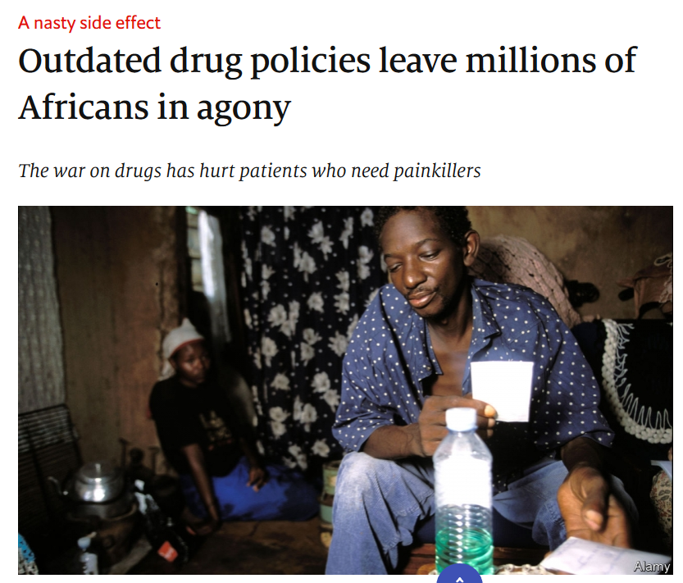
The legacy of the US War on Drugs
Members of the governments in other countries fear falling short of international drug control frameworks that have been influenced by the war on drugs perspective taken by the United States.
Notes:
https://ehospice.com/africa_posts/millions-in-africa-do-not-have-access-to-morphine-and-suffer-unnecessary-preventable-pain/
https://www.economist.com/middle-east-and-africa/2019/02/02/outdated-drug-policies-leave-millions-of-africans-in-agony

Slide 10
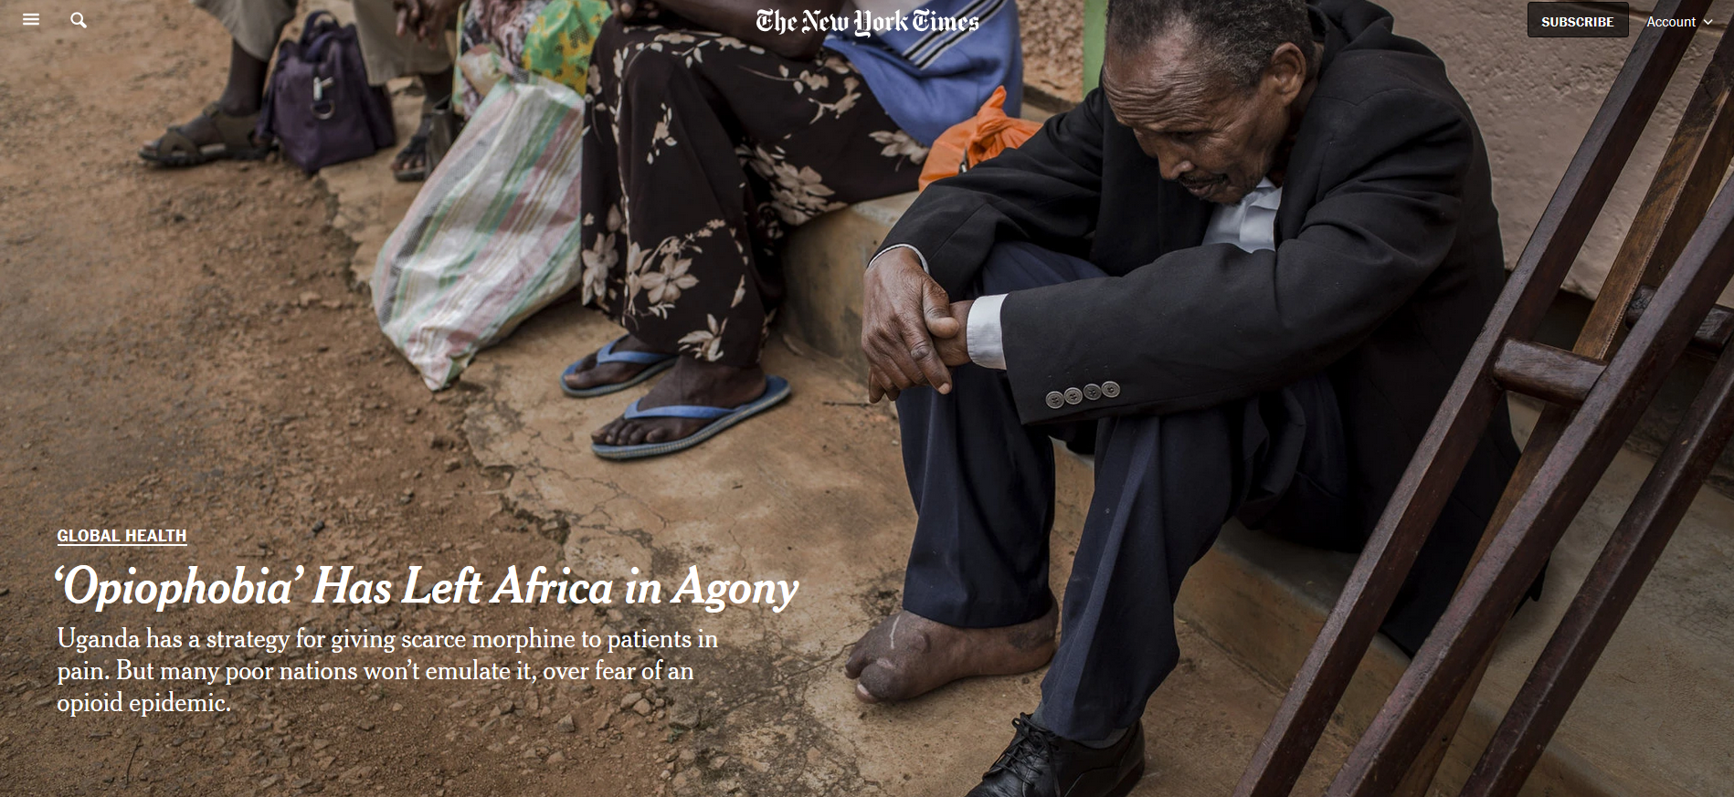
Attitudes toward pain treatment
Doctors in other countries may fear that patients will become addicted, particularly after the visibility of the opioid epidemic in the US.
Tighter regulation of opioid drugs has made them harder to procure in lower-income countries.
Notes:
https://www.nytimes.com/2017/12/04/health/opioids-africa-pain.html
The opioid drugs used for palliative care in Africa—injectable or oral morphine—have a low abuse potential when used appropriately—in this case, under supervision, for the relief of severe pain. The opioid epidemic in the US is complex, but appropriate use of opioids in palliative care is not a major contributor to addiction here, either. Instead, it was fueled by rampant overprescription of drugs like OxyContin, which were sent home with patients in large quantities even after minor surgery or injury. The US situation is making the debate over access to pain medications so much more difficult in Africa.

Slide 11
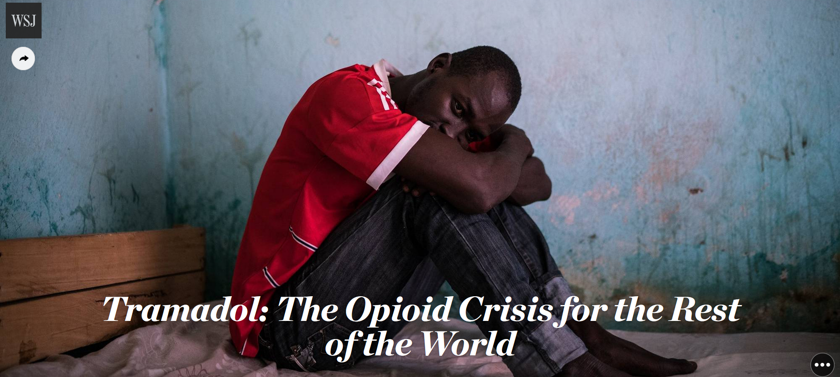
Notes:
https://www.wsj.com/articles/tramadol-the-opioid-crisis-for-the-rest-of-the-world-1476887401

Slide 12

Tramadol
Opioid prescription drug prescribed in developing countries
Legal medication approved to reduce pain
Abused for non-medical purposes in west, central and north Africa and Middle East
Illicitly manufactured in India and south Asia and trafficked to these regions.
Consumed illicitly for its calming and anti-fatigue effects. In large quantities, heroin-like effects
Notes:
https://www.globalhealthnow.org/2019-02/opioid-crisis-grips-gaza-strip
https://mosaicscience.com/story/opioid-epidemic-you-havent-heard-about-tramadol-Togo-Africa/

Slide 13
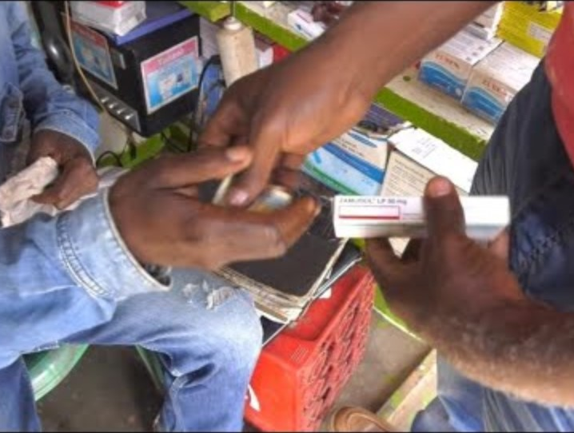
March 2019 UN Commission on Narcotic Drugs declined to add tramadol to its list of scheduled substances.
Its concern was that international controls might make access harder for those in low-income countries who genuinely need the painkiller.
Lack of adequate supplies of other pain medications make Tramadol one of the few options available
Notes:
But because it is not a scheduled controlled substance subject to tighter controls, it is easy to get and abuse

Slide 14

Mundipharma
Notes:
https://www.washingtonpost.com/health/2024/09/17/opioid-epidemic-purdue-pharma-family-mundipharma-global/

Slide 15
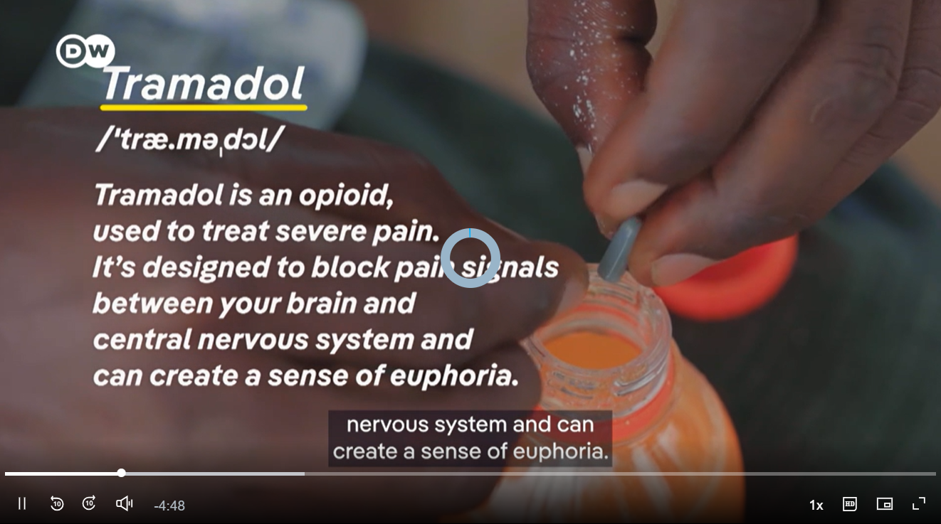

Slide 16
Two worlds of pain treatment and addiction risks
Wealthier medical systems
Lower-resource, weakly
regulated markets
Large quantities of branded or patented opioids can move through formal prescribing systems.
Marketing and expanded prescribing increase availability.
Risk: dependence, diversion, and overdose linked to high-volume medical use.
Example: OxyContin and other prescription opioids in the United States.
Low-cost generic opioids circulate through formal and informal pharmaceutical markets.
Access to other pain medicines may be limited.
Use may extend beyond pain relief to sustain physically demanding work.
Risk: non-medical use, dependence, and trafficking.
Example: tramadol in parts of Africa, the Middle East, and Asia.

