Slide 1
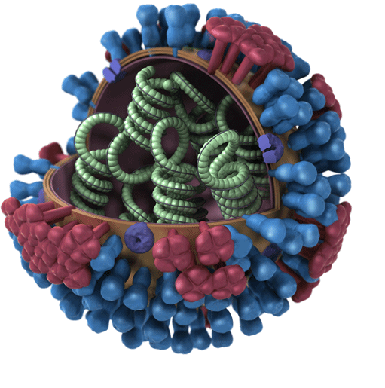
Influenza
Spreads via aerosols from human-to-human, animal- to-human, and human-to-animal contact
Fewer than half of Americans get a flu shot each season
When the vaccine is similar to circulating flu viruses, vaccinations reduce risk of going to doctor by 40-60%.
No cure, only vaccines that lessen severity of the flu and drugs that can slow viral replication
Notes:
The flu is everywhere. It is in all countries, but at different times and seasons.
Image is a flu virus. Like Covid, the influenza virus is an RNA virus. It has RNA as its genome instead of DNA. Some viruses have RNA, some have DNA.

Slide 2
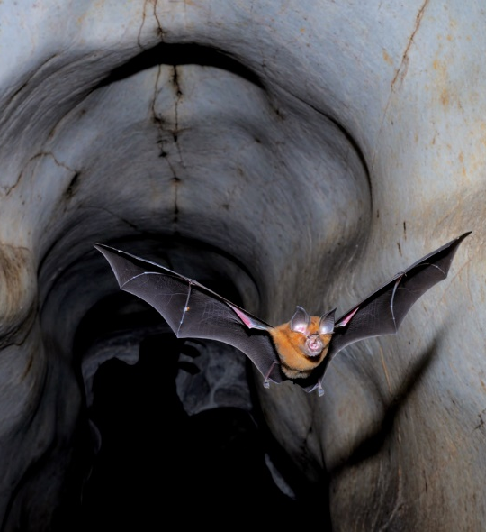
Influenza viruses vs coronaviruses
Different taxonomic viral families with contrasts in what kind of human host cells they infect and use to reproduce
Influenza’s main impact is on the lungs, coronaviruses impact all major organs
Influenza viruses exhibit mutation (drift) and reassortment (shift) up to three times more often than coronaviruses do.
Bats are a major, but not exclusive, reservoir for coronaviruses
Notes:
https://theconversation.com/what-is-the-ace2-receptor-how-is-it-connected-to-coronavirus-and-why-might-it-be-key-to-treating-covid-19-the-experts-explain-136928
Coronaviruses are from the family Coronaviridae, influenza viruses are from the family Orthomyxoviridae
ACE2 is present in all people but the quantity can vary among individuals and in different tissues and cells. Some evidence suggests that ACE2 may be higher in patients with hypertension, diabetes and coronary heart disease
A horseshoe bat (Rhinolophus affinis) exits a cave at dusk, in Perak state in Malaysia, one of the countries where severe acute respiratory syndrome–related viruses may frequently infect people
https://www.science.org/content/article/sars-viruses-may-jump-animals-people-hundreds-thousands-times-year

Slide 3
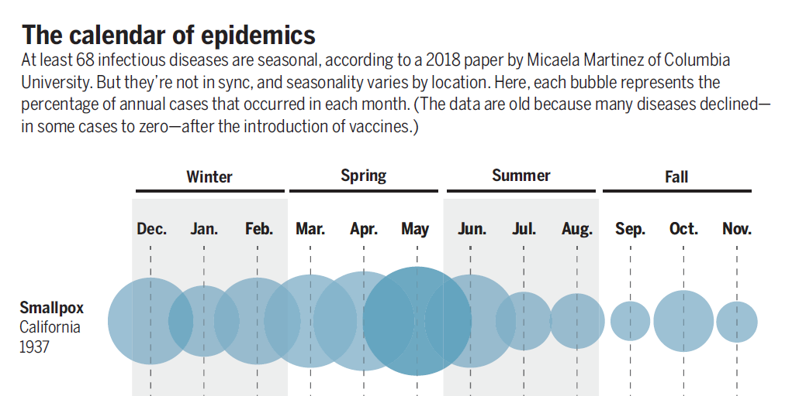
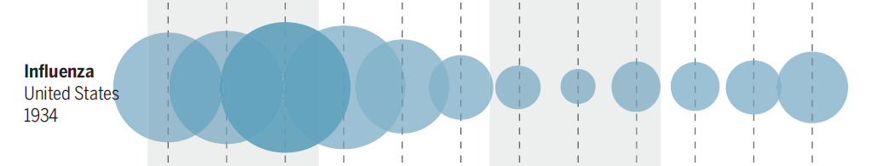
Influenza seasonality
Winter outbreaks of flu occur because:
  Closer contact among humans in winter
  Drying of respiratory tract cells due to warm heated air aids attachment and reproduction of virus
  Drops in humidity associated with onset of flu season
.
Notes:
Participants in a morning versus an afternoon flu vaccine program had significantly higher antibody responses to two of three flu strains in the vaccine
There’s evidence of seasonal variation in the actions of human immune genes as well. In a massive analysis of blood and tissue samples from more than 10,000 people in Europe, the United States, Gambia, and Australia, researchers at the University of Cambridge found some 4000 genes related to immune function that had “seasonal expression profiles.” In one German cohort, expression in white blood cells of nearly one in four genes in the entire genome differed by the seasons. Genes in the Northern Hemisphere tended to switch on when they were switched off south of the equator, and vice versa.
https://www.sciencemag.org/news/2020/03/why-do-dozens-diseases-wax-and-wane-seasons-and-will-covid-19
Cohen, Jon. "Sick time." (2020): 1294-1297.
https://science.sciencemag.org/content/367/6484/1294.summary

Slide 4
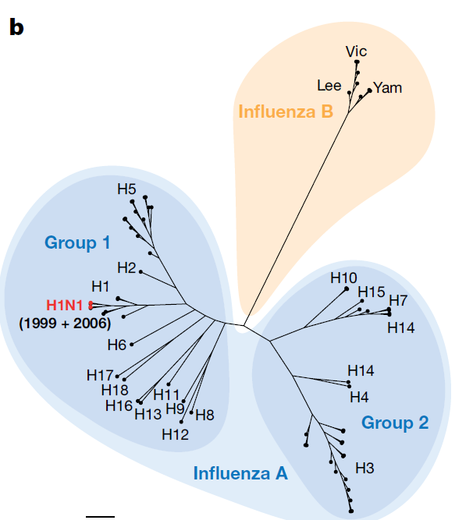
Cross immunity: hemagglutinin antigen (HA) imprinting (first flu)
Response to first flu infection can influence response to future exposures
Human immune cells that bind most strongly to the virus store a memory of it and can recognize and attack viruses that resemble it the next time it strikes.
This cross-protective immunity occurs with influenza through HA imprinting
Two groups (1 and 2) of H antigens for A viruses.
Notes:
All A and B influenza evolved from a common ancestor.
10.1126/science.aak9816
As for potential imprinting mechanisms, favored explanation is the role of antibodies directed toward the base of the HA protein called the HA stem

Slide 5
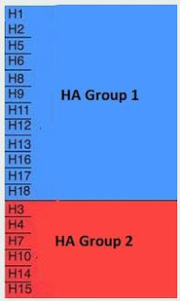
HA imprinting
Two groups of H antigens for A viruses.
Human antibodies that recognize hemagglutinin of one group do not recognize those of the other group.
Imprinting with a virus from one of the two HA groups offers protection against subtypes in the same group
Humans acquire lifelong immunological memory for the HA antigens associated with the ‘first flu’ exposure of their life.
Notes:
Remember, this is for A viruses only
For example, if your first influenza exposure was to H1N1 or H2N2 (Group1) - you may carry some degree of immunity to the H5 viruses (H5N1, H5N6, etc.). If, however, your first exposure was to H3N2 (Group 2), you may carry some protection against H7N9 instead.

Slide 6
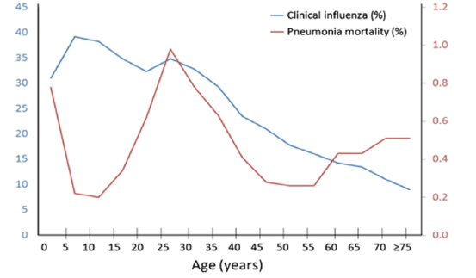
1918 Spanish Influenza: high mortality between 20-40 years of age
Notes:
For most seasonal influenza epidemics, children and the elderly are usually the highest risk populations.
This was not true in the 1918 pandemic.
W-shaped plot of mortality – not just due to a lot of young adults engaged in WW1, although the war effort played a role in the dispersal of the virus globally. This age group likely did not have an imprinting on a HA group 1 virus.
Antiviral Res 2013;99:417-35. doi: 10.1016/j.antiviral.2013.06.018.

Slide 7
HA imprinting in the 1918 H1N1 pandemic
Older adults has previous exposure to pre-1890 HA Group 1 virus
Younger children protected by childhood exposure to a post-1900 HA Group 1 virus
Adults 20-40 years of age in 1918 had likely imprinted on H3N8 (HA Group 2), which they had been exposed to as children a few decades before.
This enhanced susceptibility to the 1918 H1N1 virus

Slide 8
Influenza vaccines
Flu vaccination is a preventative stimulation of your body to produce antibodies to a particular combination of influenza virus A (IVA) and influenza virus B (IBV) predicted to be abundant during flu season.
For healthy adults, annual trivalent (protection from three virus types) or quadrivalent (four types) influenza vaccines have been the major prophylactic prevention mechanism for several decades.
Decisions on vaccines made months in advance (Feb and March for our upcoming flu season)
Notes:
https://www.cdc.gov/flu/season/flu-season-2019-2020.htm

Slide 9
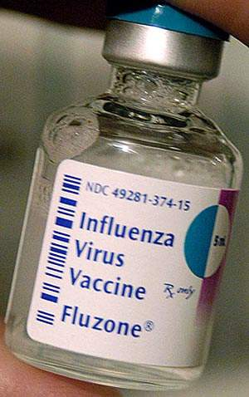
Vaccination rates remain low globally: around 40% in US and Europe, 5-10% or less in many other parts of the world
Effectiveness of vaccine can vary from year to year and for age groups
Influenza A ranged from 27-46% for adults and 46-59% for children, while for influenza B, 64-89% for children and around 60-78% for adults.
Globally, 30 bulk manufacturers of influenza vaccine produce 1.2 billion doses with only a six-month head start.
Most of the demand is in 16 high and middle income countries
Notes:
An impressive feat of biologic manufacturing something for which Big Pharma gets little credit.
Sanofi Pasteur is the world's largest manufacturer of influenza (flu) vaccines
The production and distribution process for a new vaccine takes about six months, however, during which time the circulating strains may shape-shift again. If the vaccines end up matching a given season’s viruses closely, they are up to 60 percent effective at preventing illness, the C.D.C. estimates; when they don’t, their effectiveness has been as low as 10 percent.

Slide 10
Flu vaccinations are not uniformly available globally
Flu vaccines made available through public health funding at low or no cost to public in some but not all countries
Some countries make it available only thru private doctors, often at higher cost than vaccines provided to the public coverage
Vaccine-preventable disease | China | US | UK | Russia | Brazil | India | South Africa
Measles | ✓ | ✓ | ✓ | ✓ | ✓ | ✓ | ✓
Mumps | ✓ | ✓ | ✓ | ✓ | ✓ | — | —
Rubella | ✓ | ✓ | ✓ | ✓ | ✓ | ✓ | ✓
Seasonal influenza | — | ✓ | ✓ | ✓ | ✓ | — | ◐
HPV | ✓ | ✓ | ✓ | — | ✓ | ✓ | ✓
Respiratory syncytial virus (RSV) | — | ◐ | ✓ | — | ✓ | — | —
Legend: ✓ routine national programme / standard target cohort ◐ selective, risk-based, endemic-area, outbreak/epidemic-indication or shared-decision programme — not in a national public vaccination program
Notes:
Zheng, Y., Rodewald, L., Yang, J., Qin, Y., Pang, M., Feng, L., & Yu, H. (2018). The landscape of vaccines in China: history, classification, supply, and price. BMC Infectious Diseases, 18(1), 1-8.
https://doi.org/10.1186/s12879-018-3422-0
Vaccine Preventable Diseases (VPDs) for national immunization program vaccines in China, US, UK, Russia, Brazil, India and South Africa. VPDs indicated with green are EPI vaccines in the respective countries. Gold indicates diseases prevented by national programs in the UK, US, Russia, or Brazil’s NIP but whose vaccines are not included in China’s EPI system.

Slide 11
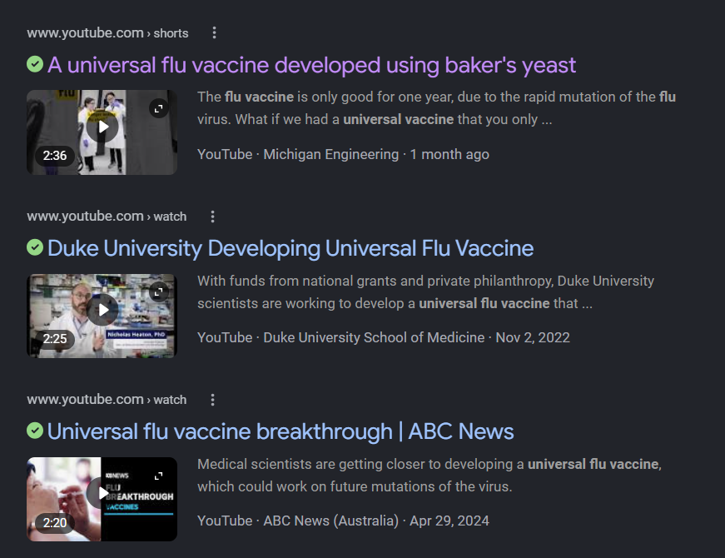
Top-down solutions: universal flu vaccine
Building a vaccine from a part of an A influenza virus that stays the same across many different types of A viruses would allow one vaccine to provide more universal flu protection.
The stem of the influenza viral spike does not change as much as the spike
Notes:
https://www.youtube.com/shorts/1DDF2p7jAHE
Pratha Sah et al. Future epidemiological and economic impacts of universal influenza vaccines, Proceedings of the National Academy of Sciences (2019). DOI: 10.1073/pnas.1909613116
https://www.nih.gov/news-events/news-releases/nih-begins-first-human-trial-universal-influenza-vaccine-candidate
https://www.pbs.org/newshour/show/how-close-are-scientists-to-a-universal-flu-vaccine

Slide 12
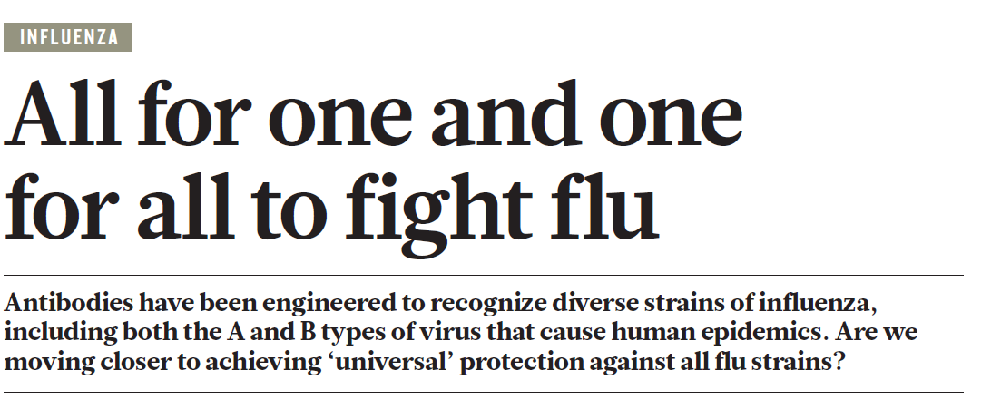
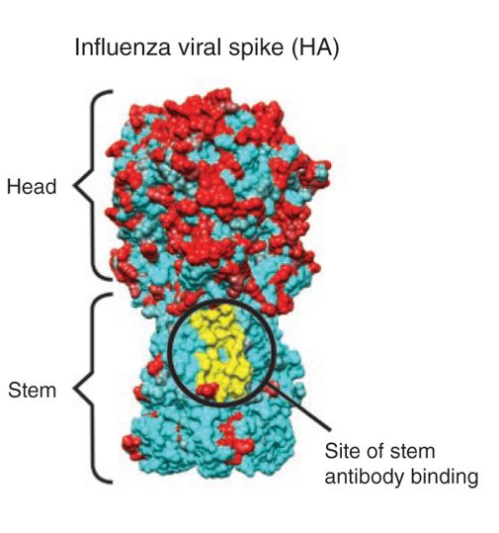
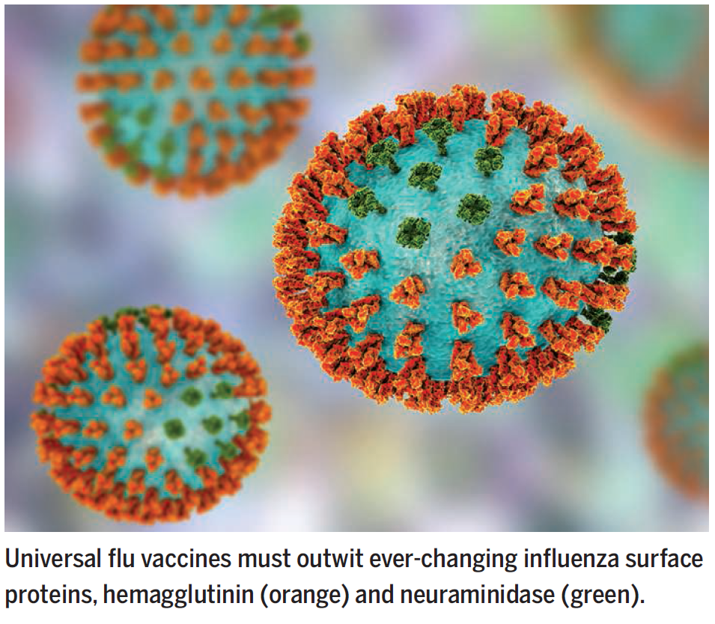
Notes:
Laursen, N. S. et al. Science 362, 598–602 (2018)
The HA proteins have a thin stem and a rounded head, like a lollipop. The head is the part of the protein that binds to our cells, whereas the stem contains the machinery to fuse the viral and cell membranes, making possible the transfer of genetic material. The HA head tends to be the structure our immune system — on its own or prompted by a vaccine — recognizes as an invader and for which it produces neutralizing antibodies. The immune system normally responds to influenza virus by making neutralizing antibodies to regions of the viral spike, the hemagglutinin, that vary year to year. This natural response protects against circulating subtypes but necessitates production of new vaccines annually.
We thought the surface of the flu virus was infinitely variable. But actually, there are some places that rarely change drastically – the stem. By using the stem of the virus to make a vaccine, a vaccine can be immune to many different types of influenza A viruses. Newer vaccine approaches have succeeded in eliciting broadly neutralizing antibodies to highly conserved yet vulnerable stem regions of the hemagglutinin and suggest potential pathways for the development of universal influenza vaccines.

Slide 13
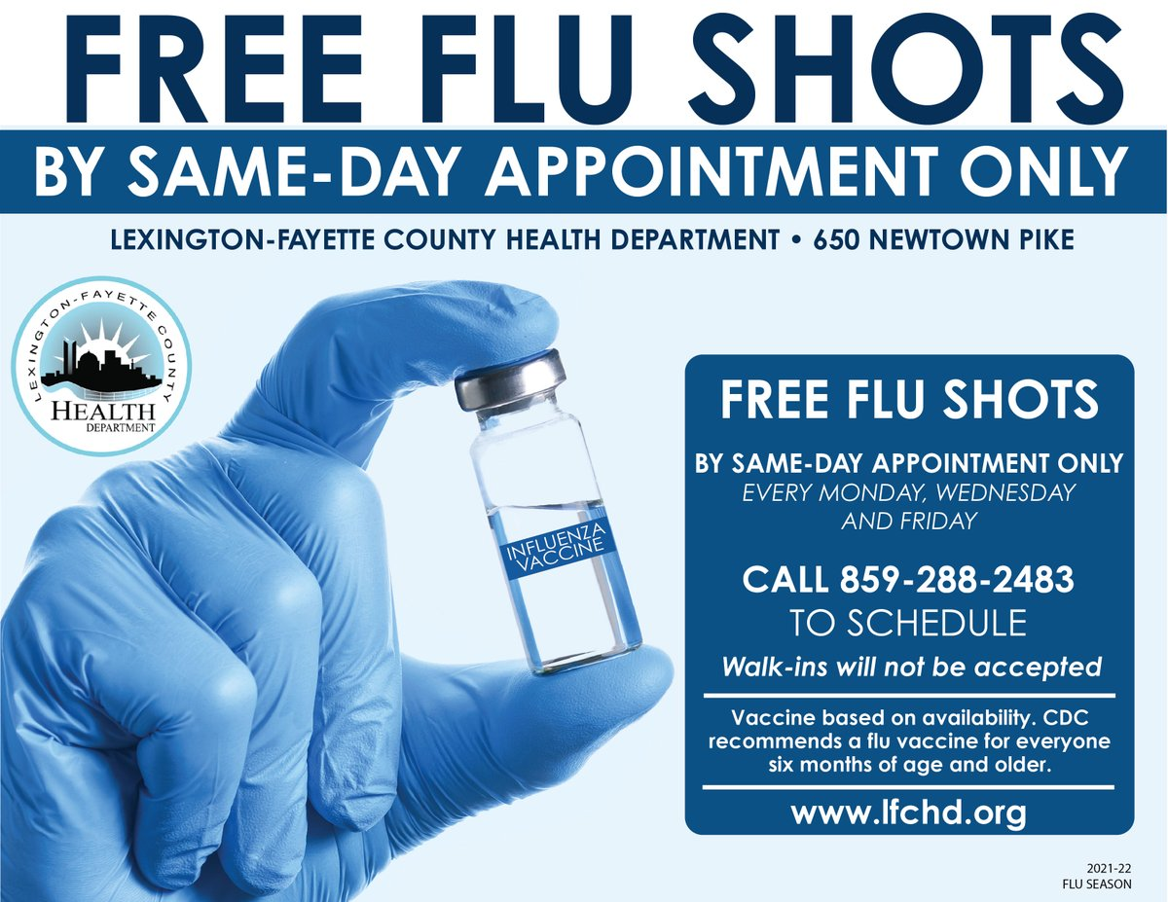
Bottom-up solutions: building preparedness at local levels
Need to build infrastructure to respond to flu with an everyday system that can be scaled up.
This means making sure antiviral drugs like Tamiflu are widely available to patients with the flu
Developing better flu health awareness campaigns in local communities
Getting vaccinations to every individual
Notes:
These approaches can be critical of the big ‘moon-shot’ approaches to develop single bullet solutions. But they don’t always have to be. Both top-down and bottom-up solutions are needed.
https://www.lfchd.org/2021fluseason/

