Slide 1
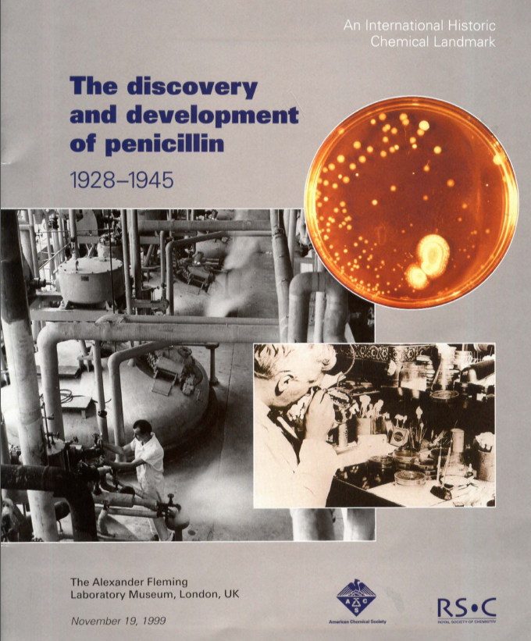
Antimicrobial resistance
(AMR)
Discovery of penicillin by Alexander Fleming in 1928 in United Kingdom
Commercialization of penicillin in the mid-1940’s revolutionized medicine
Led to the Golden Era of antibiotic discovery from 1940s to 1960s
Notes:
In the ‘Golden Age’ of antibiotic discovery, the best source of new agents was from other naturally occurring soil microorganisms. After streptomycin was isolated in 1944 from Streptomyces griseus (a fungal organism found in soil), a worldwide search began. Every effort was made to reach all corners of the globe, but resources were limited. Eli Lilly had the bright idea of asking Christian missionaries to send back a soil sample from every exotic place that they visited. A sample from Borneo sent in 1952 grew Streptomyces orientalis, from which vancomycin was eventually extracted; vancomycin became available for patient use in 1958.
https://www.pbs.org/newshour/health/the-real-story-behind-the-worlds-first-antibiotic

Slide 2

Common infections like urinary tract infections, pneumonia, strep throat, could be cured
Minor cuts and scrapes no longer led to sepsis
Millions of lives could be saved
However, when accepting Nobel Prize in 1945, Fleming gave the first public warning about bacterial resistance
Notes:
https://wwwnc.cdc.gov/eid/article/23/5/16-1556_article

Slide 3
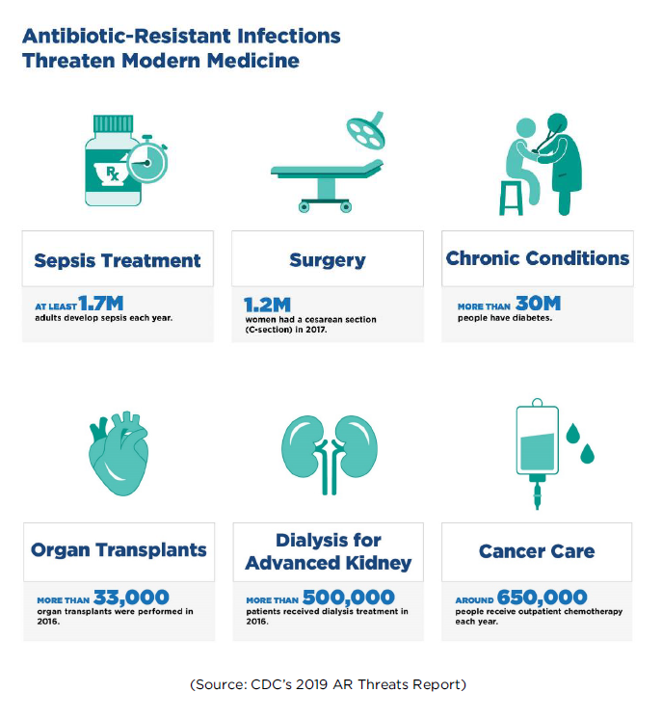
Notes:
Much of modern medicine depends upon antibiotics

Slide 4
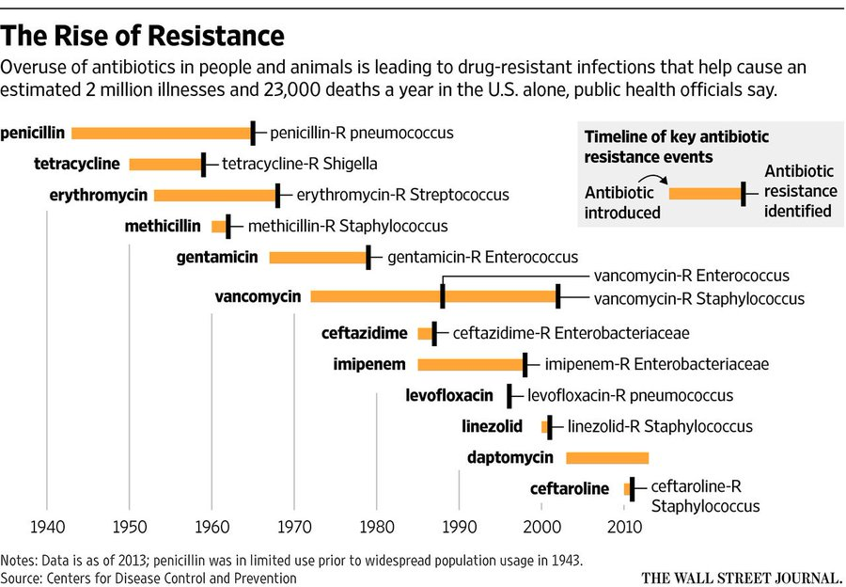
Notes:
By the late 1950’s, resistance to antibiotics was becoming apparent, and scientists looked at new ways to improve on existing agents to combat this obstacle.

Slide 5
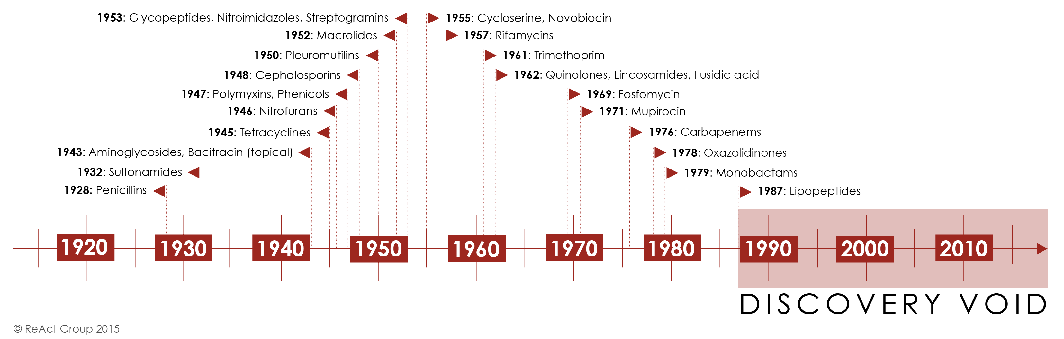
The “discovery void” of new antibiotics
Notes:
https://www.reactgroup.org/toolbox/understand/how-did-we-end-up-here/few-antibiotics-under-development/

Slide 6
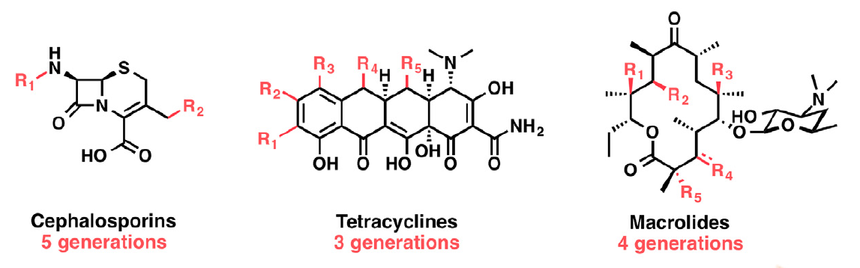
Void or absence of new classes of antibiotics entering the market in last two decades
Many of our antibiotics are modifications of pre-existing ones
Drug resistance is more likely to occur when new antibiotics are variants of existing classes.
Today, a convergence of two problems: AMR and shortage of new effective antibiotics
Notes:
Wencewicz, T. A. (2016). New antibiotics from Nature’s chemical inventory. Bioorganic and Medicinal Chemistry, 24(24), 6227-6252.
By ‘generations’, these imply slight tweaks by scientists to the molecular structure of original antimicrobial. Later generation drugs are not so much a new discovery, but a refinement of a previous one.
In last five years, recent improvements, several new classes have now entered testing phases for final approval
Daptomycin was originally discovered in the early 1980s but was abandoned by Eli Lilly because of its toxicity. It subsequently picked up by another company and redeveloped. Daptomycin is the most successful IV antibiotic ever introduced in the US with annual sales >US$1 billion. It is estimated that >1,000,000 patients have been cured of infections from Gram-positive bacterial pathogens such as Staphylococcus aureus and Enterococcus faecalis

Slide 7
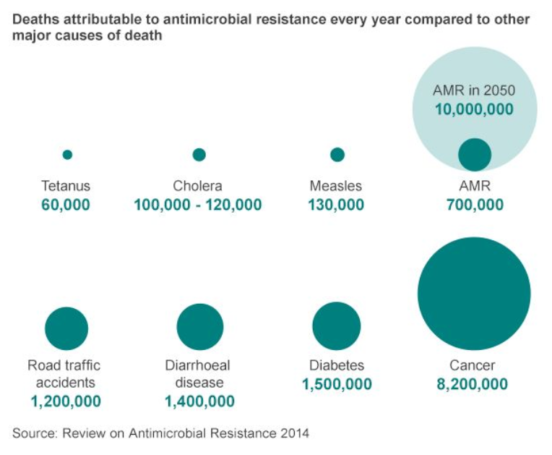
Notes:
http://www.bbc.com/news/health-30416844
AMR will account for an extra 10 million human deaths a year worldwide - more than currently die from cancer - by 2050 unless action is taken.
AMR means antimicrobial resistance. These are antibacterials, antivirals, antifungals, and antiprotozoals

Slide 8

Notes:
In September 1940, that the Oxford police constable, Albert Alexander, 48, provided the first test of the effectiveness of antibiotics. Alexander nicked his face working in his rose garden. The scratch, infected with streptococci and staphylococci, spread to his eyes and scalp. Although Alexander was admitted to the Radcliffe Infirmary and treated with doses of sulfa drugs, the infection worsened and resulted in smoldering abscesses in the eye, lungs and shoulder. Florey and Chain heard about the horrible case at high table one evening and, immediately, asked the Radcliffe physicians if they could try their ”purified” penicillin. After five days of injections, Alexander began to recover. But Chain and Florey did not have enough pure penicillin to eradicate the infection, and Alexander ultimately died.

Slide 9
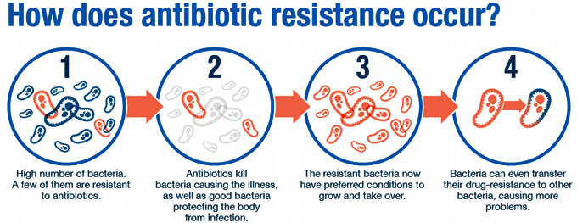
Antimicrobial resistance (AMR)
Resistance occurs in bacteria, viruses and fungal organisms
People aren’t resistant to antibacterial, antiviral, or antifungals drugs
The microbes in people are

Slide 10
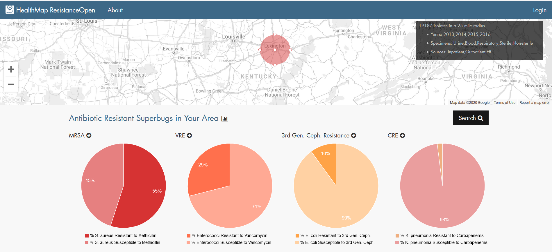
Who is susceptible to AMR?
Notes:
https://resistanceopen.org/

Slide 11
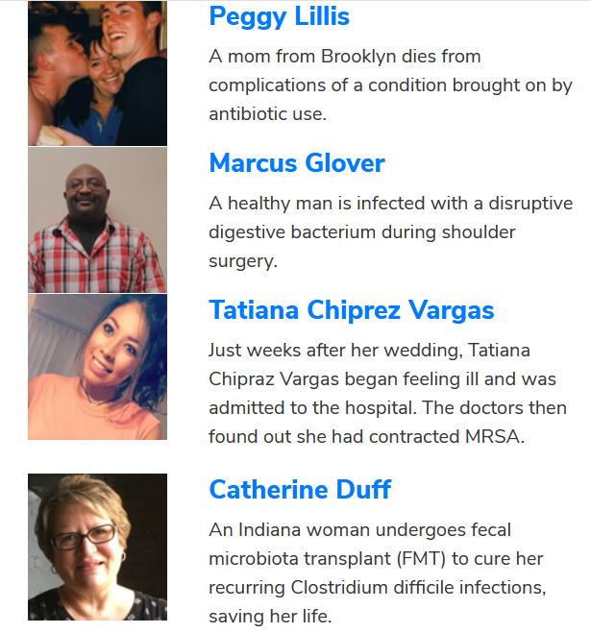
Everyone is susceptible
AMR is a higher risk for patients in hospitals and nursing homes, and those with weak immune systems, which are most often the elderly
However, AMR now threatens people undergoing common modern surgeries and therapies, such as knee replacements, organ transplants and cancer treatments.
Notes:
If you live on Earth, you are susceptible
https://www.idsociety.org/public-health/patient-stories2/

Slide 12
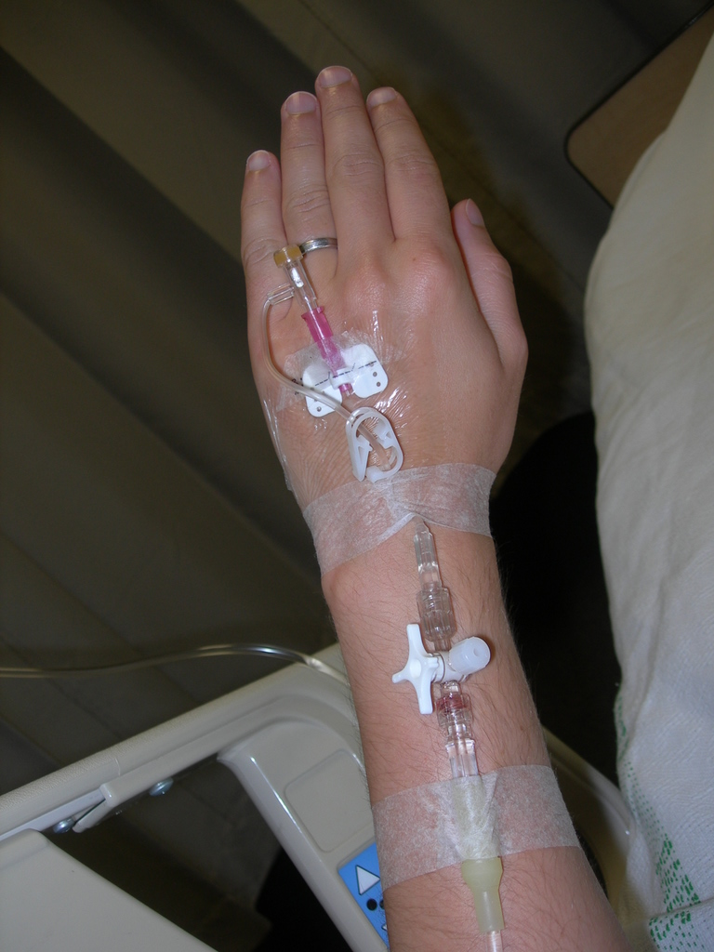
Hospital-acquired infections
Central line bloodstream infections
Catheter-associated urinary tract infections
Surgical site infections
Ventilator-associated pneumonia
Notes:
These kinds of infections are to be expected as patients may be taking large does of antibiotics, be immunocompromised, or undergoing procedures which increase the likelihood of infection

Slide 13
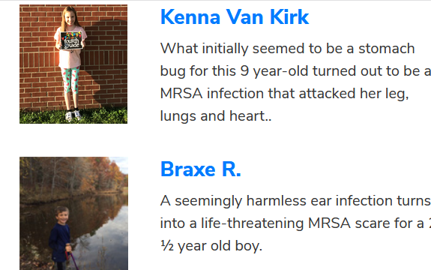
Community-acquired AMR
Increasing numbers of community-acquired cases indicates a broader and more pervasive public health threat.

Slide 14
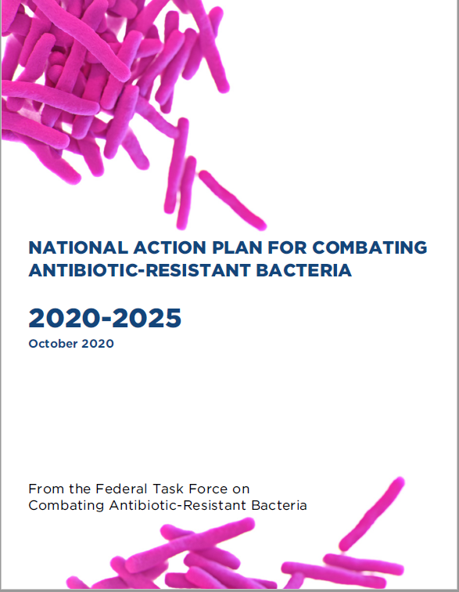
Why has the AMR issue persisted?
Recognition of AMR has been known for decades
Many national and international reports from prominent governmental and non-governmental agencies
Much of the public recognizes the threat
What are the reasons for the AMR problem?
Notes:
https://aspe.hhs.gov/pdf-report/carb-plan-2020-2025
Developed versus developing countries is a false dichotomy. A country could have parts of it that are developed and others developing. The idea of ‘developed’ supposes that a state of advancement is technologically advanced and having a global economy. This falsely assumes that development is only this particular definition and not development in other ways,

Slide 15
Factors contributing to AMR
Rapid microbial adaptation
Overuse and inappropriate use
The tragedy of the antibiotic commons
High volumes of antibiotics used in livestock agriculture
Climate change and growing fungal resistance
Economic disincentives to develop new antibiotics
Social discourses over bacteria and AMR
Consumer expectations
Global mobility of antibiotic-resistant bacteria and their genes

Slide 16
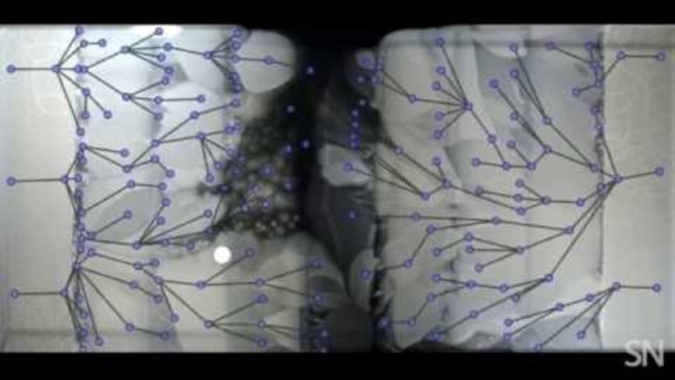
1. Rapid adaptation potential of microbes
Notes:
https://www.youtube.com/watch?v=yybsSqcB7mE

Slide 17
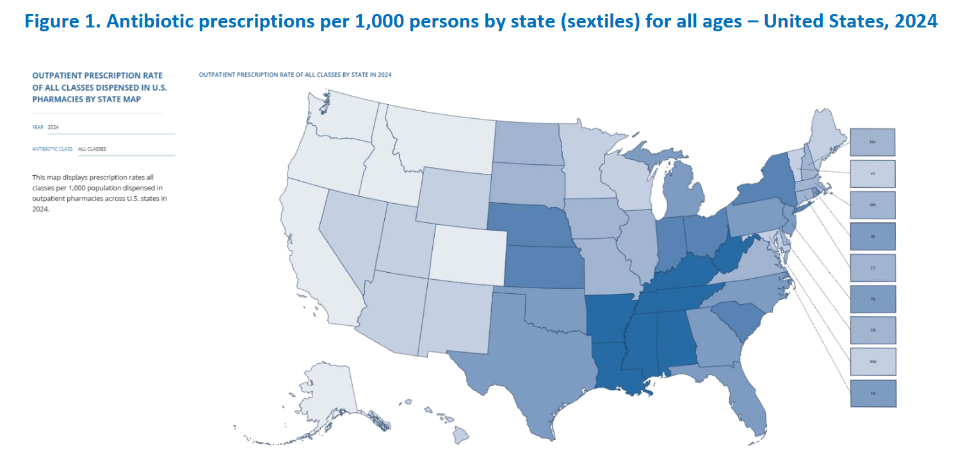
2. Overuse and inappropriate use of antibiotics
Nationally, inappropriate use, inclusive of unnecessary use and inappropriate selection, dosing and duration, may approach 50% of all outpatient antibiotic use
Notes:
https://www.chfs.ky.gov/agencies/dph/dehp/idb/Documents/StateAntibioticReport.pdf

Slide 18
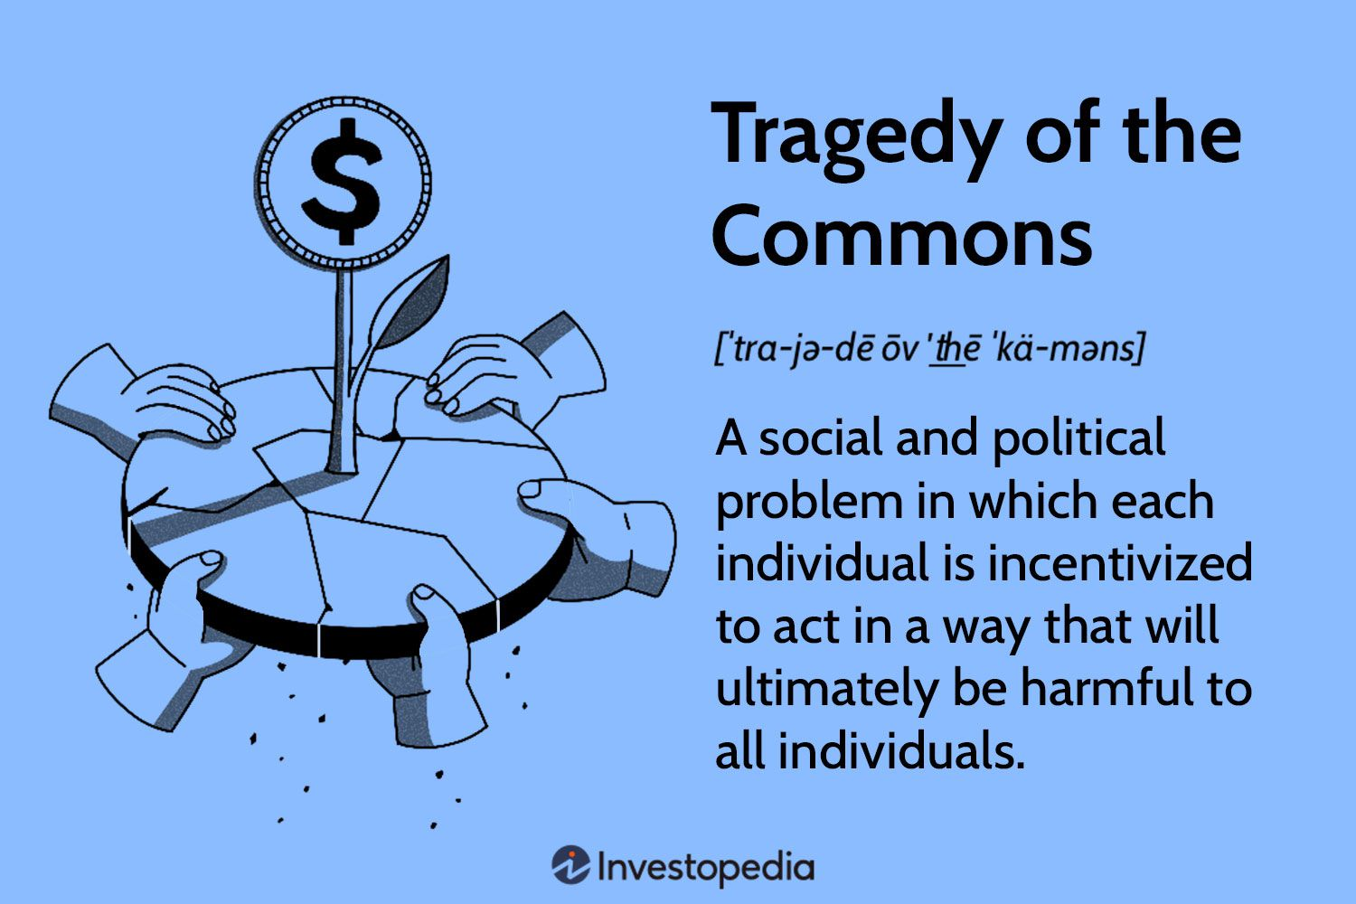
3. The tragedy of the antimicrobial commons
The ‘tragedy of the commons’ refers to conflict between individual interests and the good of the group
  Every person has rational self-interest to take antibiotics if ill
  Doctors feel pressure to prescribe
  However, when all individuals pursue their own self-interests it can impact entire community
  What is good for the individual can be suboptimal for the group
Notes:
The term was made popular by Garrett Hardin in his 1968 essay ‘The Tragedy of the Commons’
http://theconversation.com/antibiotics-why-asking-doctors-to-prescribe-fewer-is-futile-115886
https://www.nature.com/articles/s41598-022-25632-1/figures/1
An individual country will not be able to address AMR effectively. Like global warming it requires a collective agreed upon and coordinated response.
.

Slide 19
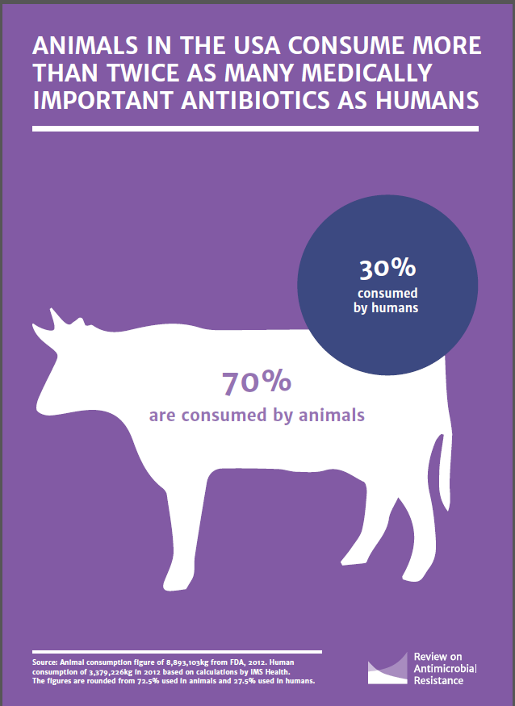
4. High volumes of antibiotics used in livestock industry
Worldwide, bulk of antimicrobials are consumed not by humans but by food animals
Antibiotics are applied to promote weight gain and prevent disease in poultry and livestock
Antibiotics allow more animals to be raised with less land and labor.

Slide 20
Chick-fil-A Modifies Its ‘No Antibiotic’ Chicken Policy
In 2014, Chick-fil-A said it would not serve chicken raised with antibiotics
Their NEA (No Antibiotics Ever) policy was fully implemented in 2019 using chickens raised in the US.
In 2024, Chick-fil-A said it would end NEA and said it would not buy chicken that had been raised using the same antibiotic drugs that humans take - its No Antibiotics Important to Human Medicine (NAIHM) policy
Chick-fil-A’s policy change came in part because of the difficulty in obtaining large amounts of antibiotic-free chicken
Notes:
https://www.nytimes.com/2024/03/25/business/chick-fil-a-antibiotic-chicken.html
Antibiotics are used to raise chicken to “prevent disease and increase feed efficiency”: in other words, to fatten the birds up.
There is no immediate health concern about antibiotics in chicken causing direct harm to a person who consumes them. But eating chicken treated with antibiotics could help promote drug-resistant bacteria, meaning an infection in a person might not respond to antibiotics prescribed by a doctor.

Slide 21


Slide 22
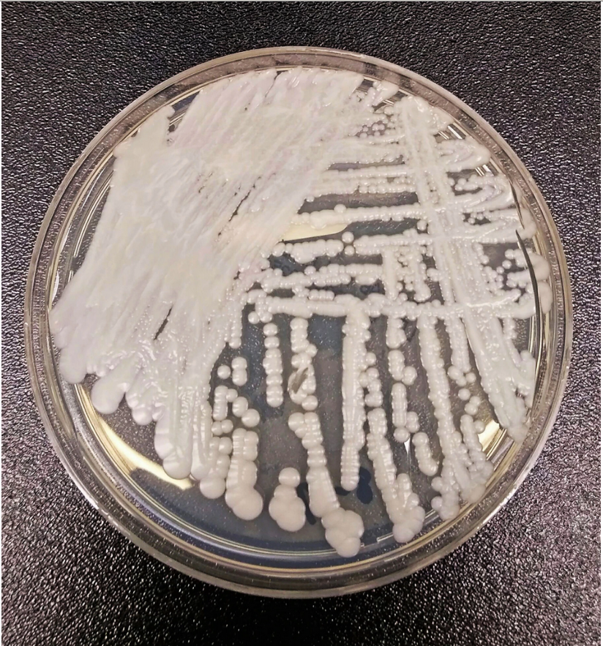
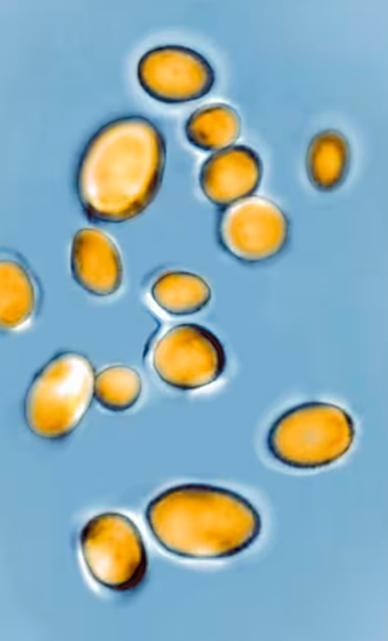
5. Climate change and growing fungal resistance
Tons of antifungal chemicals applied to crops enhances fungal resistance
Fungi do not typically survive at temps of warm-blooded mammals
Warming climates may be selecting for fungi that can survive warmer temperatures, making them more likely to survive in humans
Rising number of fungal infections contributes to greater use of antifungals, which potentially leads to more resistance
Notes:
https://www.nytimes.com/2019/04/06/health/drug-resistant-candida-auris.html
Other prominent strains of the fungus Candida — one of the most common causes of bloodstream infections in hospitals — have not developed significant resistance to drugs, but more than 90 percent of C. auris infections are resistant to at least one drug, and 30 percent are resistant to two or more drugs, the C.D.C. said. Nearly half of patients who contract C. auris die within 90 days, according to the C.D.C.

Slide 23
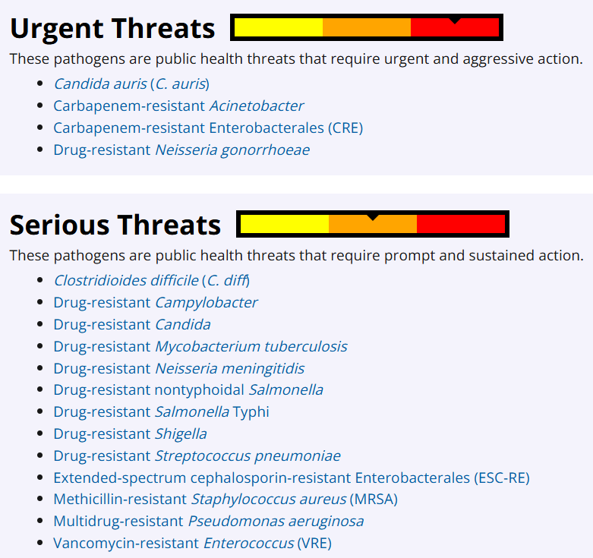

Slide 24
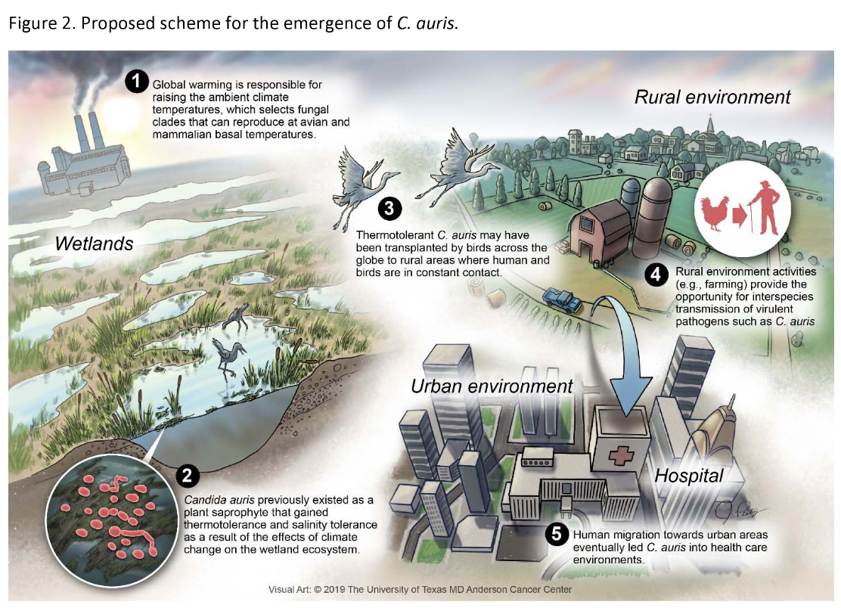
Notes:
While C. auris starts with a highly resistant baseline, its evolution into a "superbug" capable of multi-drug and pan-drug resistance (resistance to all three major classes of antifungals) is an acquired trait actively driven by selective pressures.

Slide 25
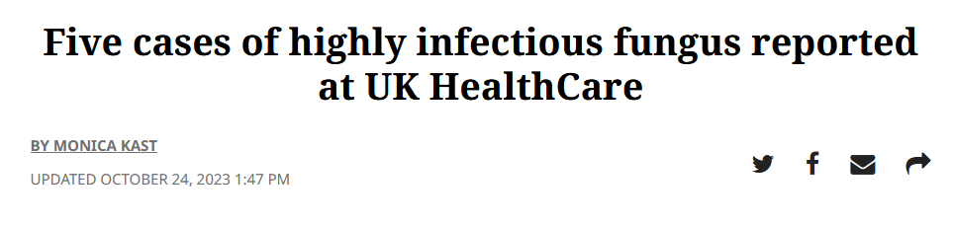
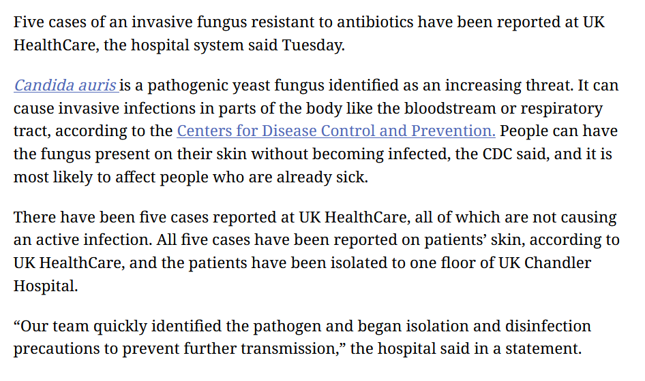
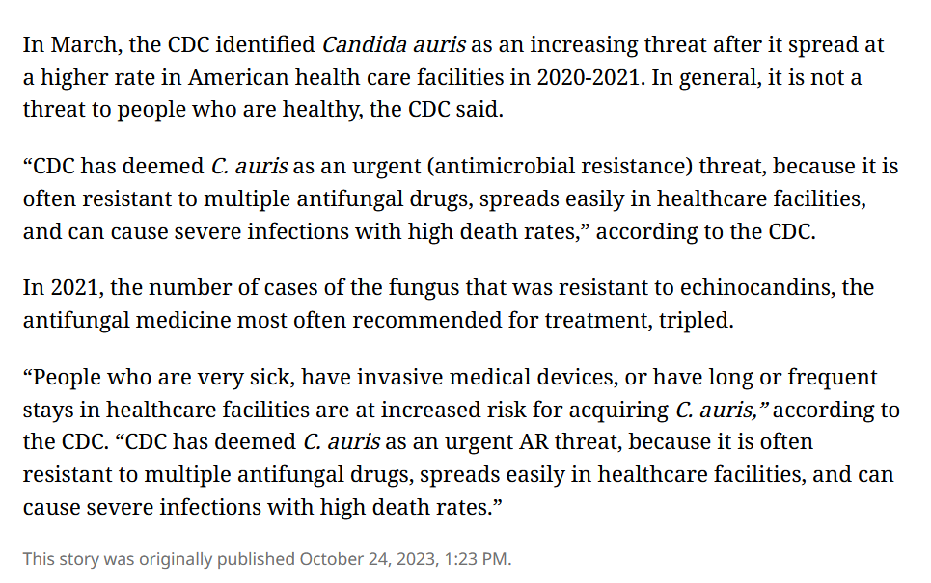

Slide 26
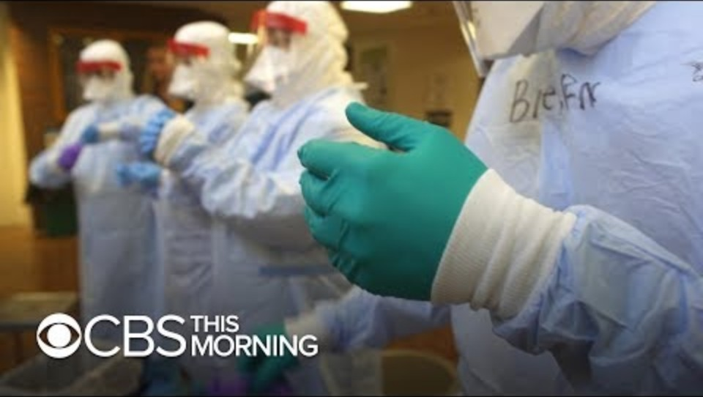

Slide 27

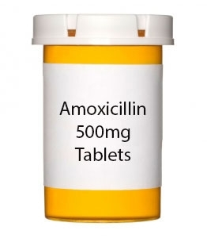
6. Economic disincentives to develop new antibiotics

Slide 28
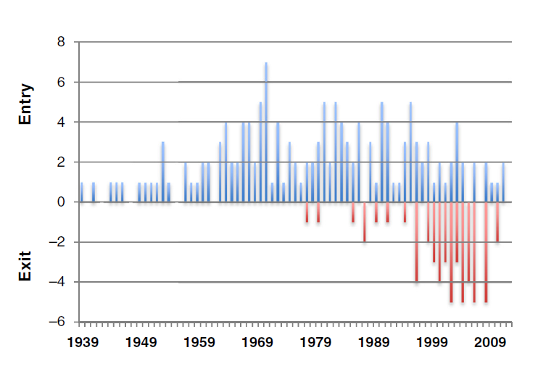
More exits of antibacterial drugs than entries into the marketplace due to resistance
Notes:
Kinch, M. S., Patridge, E., Plummer, M., & Hoyer, D. (2014). An analysis of FDA-approved drugs for infectious disease: antibacterial agents. Drug Discovery today, 19(9), 1283-1287.
Recent collapse of antibacterial new molecular entities (NMEs): the entry (blue) and exit (red; because of obsolescence or resistance) is indicated on an annual basis.

Slide 29
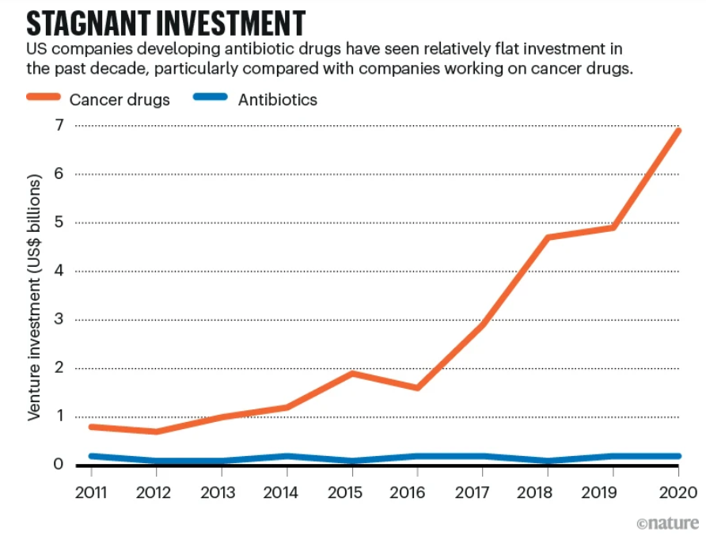
Notes:
Many big legacy pharmaceutical firms have withdrawn from antimicrobial drug discovery, and many of the small biotechnology companies that picked up the torch have gone bankrupt. This achievement with a new antibiotic to treat gonorrhea suggest that non-profits could help to solve the problem of drug access, while fending off the rise of drug-resistant microbes, which contribute to almost five million deaths per year.
https://www.nature.com/articles/d41586-024-00543-5
McKenna, M. (2024). Can non-profits beat antibiotic resistance and soaring drug costs?. Nature, 626(8001), 942-944.

Slide 30
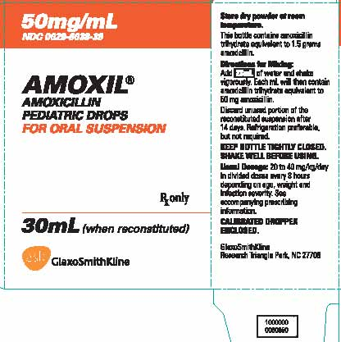
The antibiotic paradox
New antibiotics don’t get used right away as cheaper generic antibiotics are tried first
By the time the new antibiotics start being used, their patents may be close to expiring
Then, when put into frequent use, likelihood of resistance increases
Notes:
New antimicrobials often held in reserve as drug of last choice, delaying returns on investment
Once an antibiotic is put into use, countdown begins for when it will be made into a generic
Built-in economic self-destruct mechanism for antibiotics as bacteria evolve resistance
This is what makes it financially risky to focus on new AMR drugs.
Moreover, antimicrobials viewed as less profitable by pharma companies because taken only for short period and for one course of treatment.
Amoxicillin is the generic name for Amoxil.
Drug patents typically last 20 years before they can be turned into generics, but pharma companies have strategies to extend them including slight changes to the molecular structure of the active ingredients in the drug, which make it different from the one defined in the original patent. Getting a nee patent allows returns on their investment to continue.
Patented drugs are subject to litigation aiming to make them generic earlier. Health care relies on generic antibiotics, which account for about 80% of all prescriptions.
https://www.thelancet.com/journals/laninf/article/PIIS1473-3099(10)70246-2/fulltext
https://www.theatlantic.com/health/archive/2015/03/generic-drugs-the-same-but-not/388592/
https://www.nytimes.com/2020/01/17/health/antibiotics-resistance-new-drugs.html

Slide 31
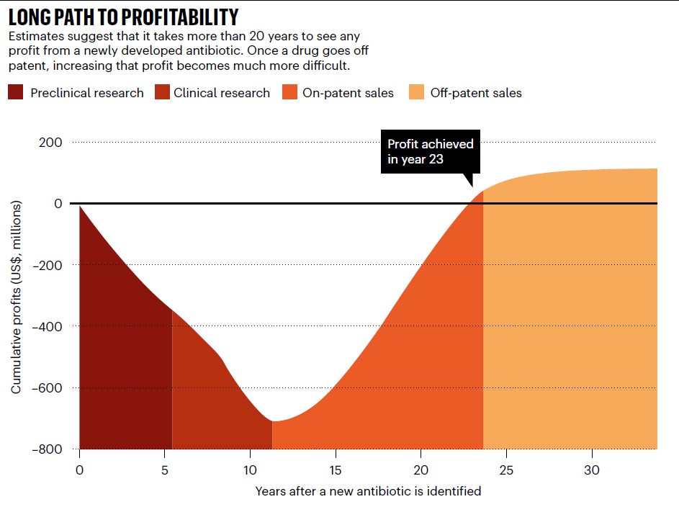
The antibiotic valley of death
Notes:
https://www.nature.com/articles/d41586-020-02418-x
It can take up to two decades to earn returns on investments and small companies often can’t wait that long

Slide 32

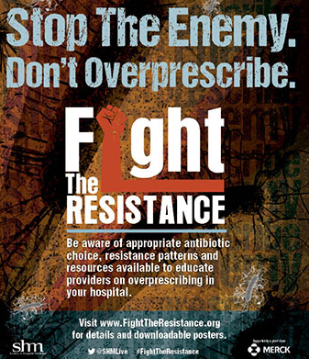

7. Social discourses about bacteria and resistance challenge responses to AMR
Discourses encompass the way we use language and the way we rationalize, normalize, and perform certain behaviors and attitudes
Notes:
AMR: Antimicrobial resistance
Discourses: words we use and the way we rationalize and normalize certain behaviors and attitudes, in this case, with antibiotics

Slide 33
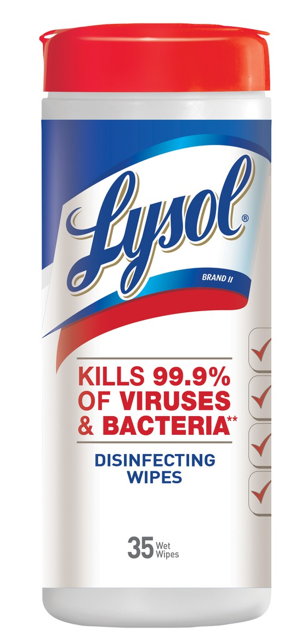
Common discourse is to represent bacteria as bad…
We use war metaphors to describe our relationship with bacteria – bacteria need to be ‘killed’,, we are at ‘war’
However, killing of large numbers of bacteria with broad-spectrum antibiotic are what allow resistant bacteria to increase
Framing bacteria as always bad and using war metaphors justifies using more antibiotics – and creates more resistance
Notes:
War metaphors and catastrophe representations dominate the discourse about antibiotic resistance. Much of this rhetoric has pitched humans in a fight against bacteria. Frequent references are made to ‘the war against superbugs’, or the ‘fight against AMR’.
However, the war analogy undermines the case for integrated and comprehensive AMR policy and interventions. Analogies to battle and war justify continued antibiotic development at the expense of incentivizing more adroit multi-pronged strategies.

Slide 34


…when they are also good
Relationship we have with bacteria are often mutually beneficial
We provide warmth and nutrients, and bacteria help us to digest our food, make vitamins and hormones, effect our mood, and acts as a barrier to foreign bacteria.
Our gut microbiome, the largest in the human body, has properties of an organ
Notes:
Kombucha tea is made out of bacteria

Slide 35
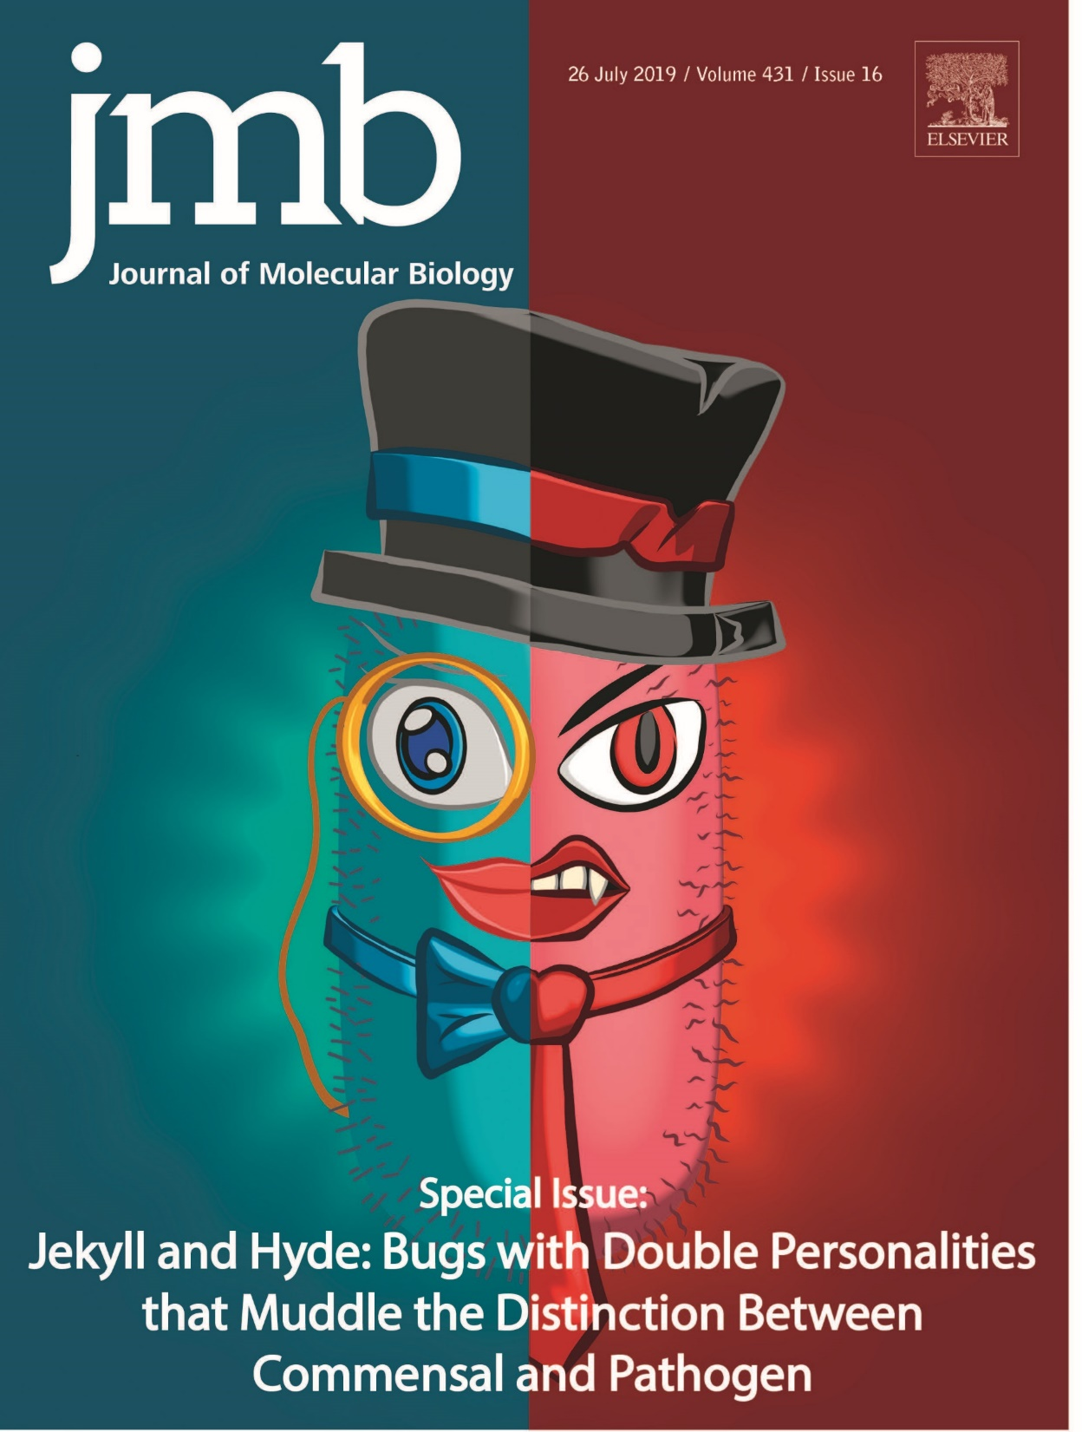
Yet even good vs bad bacteria is a simplifying discourse
A specific kind of bacteria can be helpful or harmful based on your state of health or changes in body chemistry
Some bacteria may be good in one context and bad in another.
Notes:
Commensal organisms are cooperative and participate in a reciprocating relationship with their host; a pathogen denotes an organism that has deleterious effects on its host
https://www.childrensmn.org/educationmaterials/childrensmn/article/15814/mrsa-colonization-a-guide-for-parents/

Slide 36
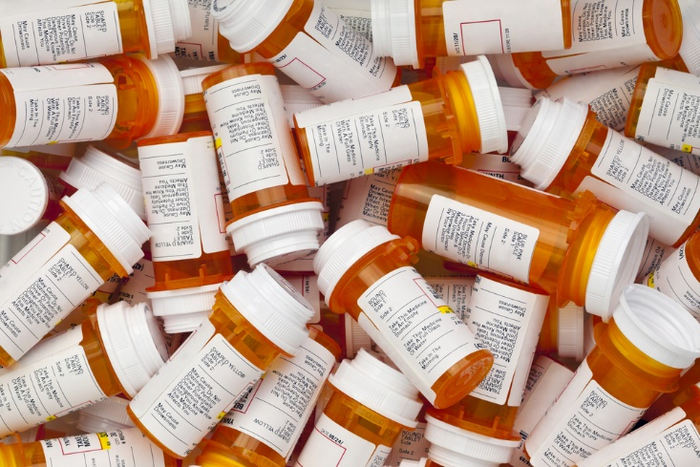

8. Consumer expectations make AMR worse
From doctors and pharmacists we expect inexpensive, readily available antibiotics (which are more likely to be overprescribed)
We also expect inexpensive meat from industrial-scale food production systems that rely upon many of the same antibiotics (reinforcing their continued use).

Slide 37
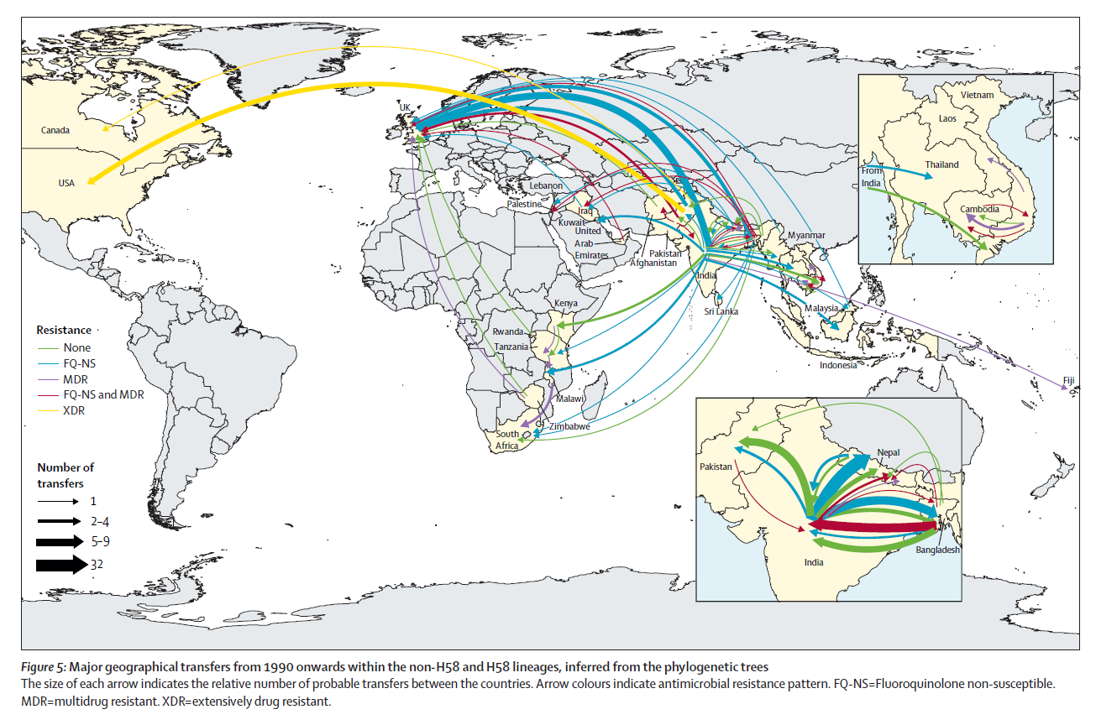
9. Global mobility of antibiotic-resistant bacteria
Notes:
Resistance genes travel with them. MDR – multidrug resistance

Slide 38
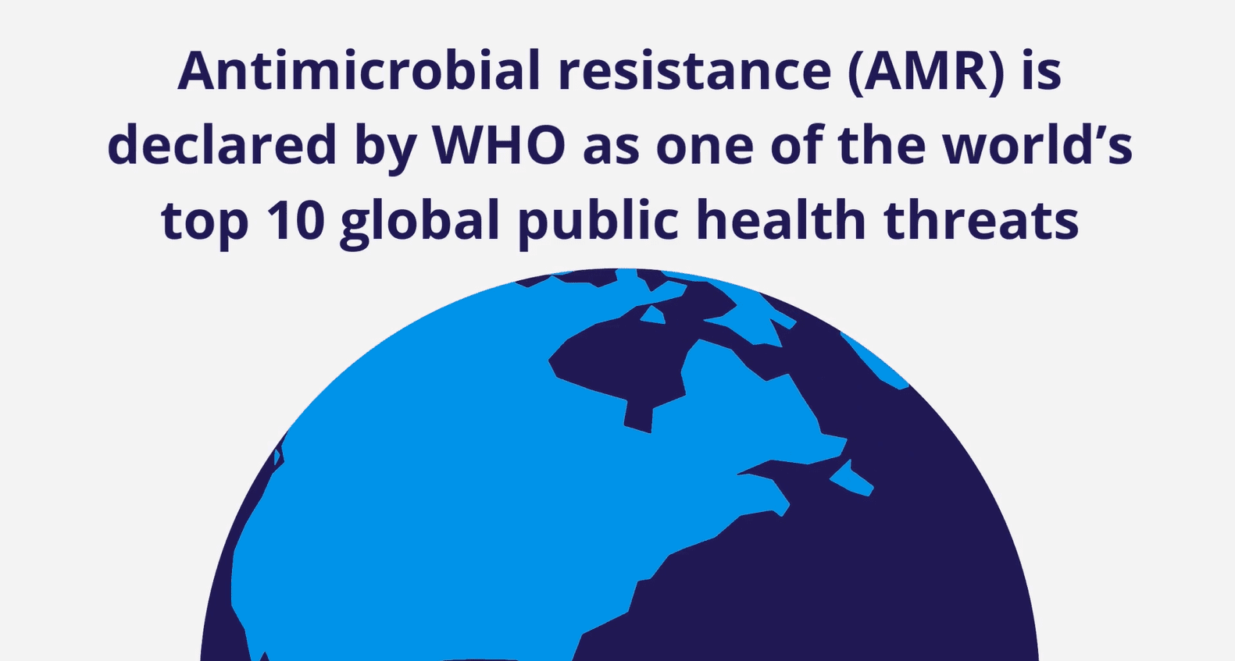

Slide 39
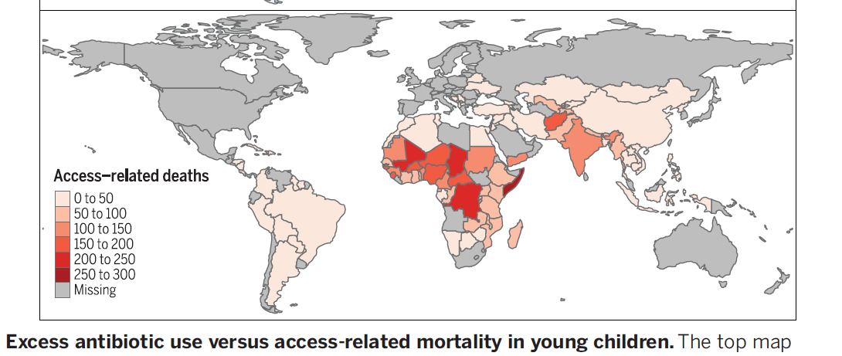
Globally, the lack of antibiotics causes more childhood deaths than AMR
In low and middle income countries (LMIC) lack of antibiotics still results in more childhood deaths than antibiotic resistance (but gap is narrowing)
More than 1 million children with untreated pneumonia, diarrhea, and sepsis die annually.
Modeled estimates of annual deaths from community-acquired bacterial
pneumonia, expressed per 100,000 children under the age of 5, which could
be averted with universal access to antibiotics.
Notes:
Universal provision of antibiotics could avert 75% of 590,000 annual deaths from pneumonia in children under the age of 5

Slide 40
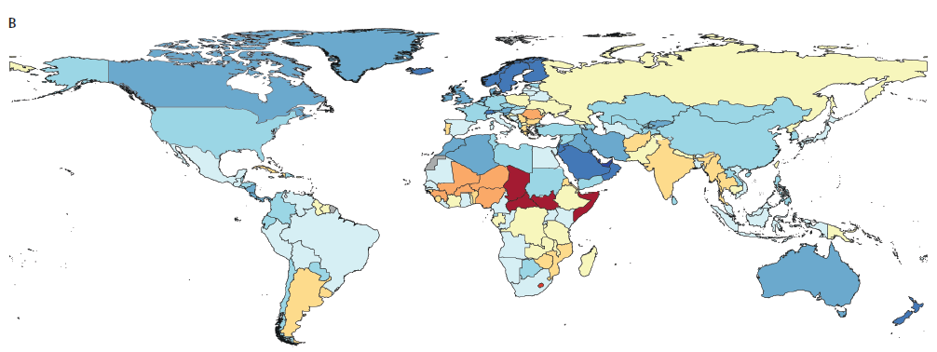
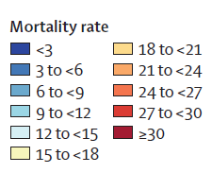
Some LMIC countries have higher rates of mortality from AMR than HIC
Death rates per 100 000 attributable to AMR, all ages, 2021
Notes:
Death rates per 100 000 attributable to AMR, all ages, 2021.
Higher mortality rates than high income countries
Naghavi, M., Vollset, S. E., Ikuta, K. S., Swetschinski, L. R., Gray, A. P., Wool, E. E., ... & Dekker, D. M. (2024). Global burden of bacterial antimicrobial resistance 1990–2021: a systematic analysis with forecasts to 2050. The Lancet, 404(10459), 1199-1226.

Slide 41
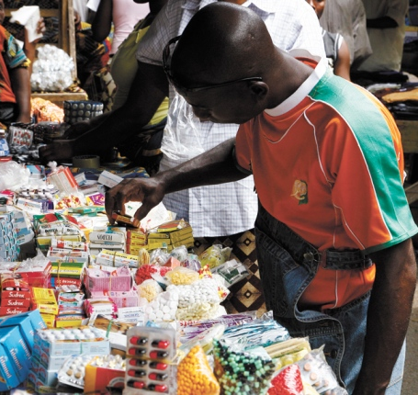
LMICs and high AMR mortality rates
Higher infectious disease burdens and unequal access to healthcare increase vulnerability.
Antibiotics are often sold without prescriptions despite formal regulations.
Limited access to physicians, diagnostics, and affordable healthcare encourages self-treatment.
Inappropriate antibiotic use promotes resistance, while inadequate access to effective treatment increases mortality.
Notes:
https://www.who.int/antimicrobial-resistance/interagency-coordination-group/IACG_final_report_EN.pdf?ua=1
‘Paper tiger’ initiatives to address AMR which are not enforced, such as bans on over-the-counter sales

Slide 42
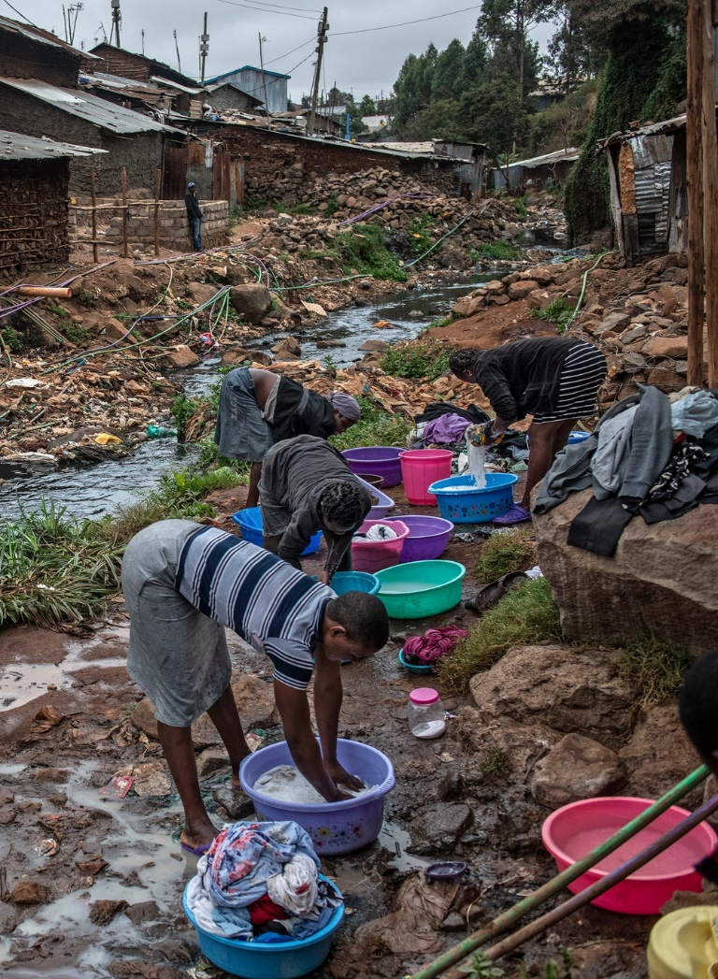
Feedbacks between environment, infection, and AMR
Inadequate sanitation and infection prevention
Greater exposure to bacterial infections
Increased demand for antibiotics and opportunities for inappropriate use
Selection and spread of resistant bacteria
Harder-to-treat infections and continued environmental transmission
Notes:
Women wash clothes just outside a river polluted with sewage and waste in the Kibera neighborhood of Nairobi, Kenya. The rate of drug-resistant infections in the community is high.
https://www.nytimes.com/2019/04/29/health/un-drug-resistance-antibiotics.html?rref=collection%2Fseriescollection%2Fdeadly-germs-lost-cures&action=click&contentCollection=health&region=stream&module=stream_unit&version=latest&contentPlacement=4&pgtype=collection
The WHO's 2025 surveillance estimates found the highest proportions of antibiotic resistance in its South-East Asia and Eastern Mediterranean regions, whereas estimates of AMR mortality for 2021 found the highest mortality rates in sub-Saharan Africa

