Slide 1
CBC WEC Missions Evening Welcome!
29th March 2020

Slide 2
Programme
Worship song
Introduction to WEC
The Gospel in Europe
Worship song
A testimony from our time in Senegal
Points for prayer
How to pray for unreached people
Worship song
Closing prayer

Slide 3
Song 1: Our God reigns
This song is based on Isaiah 52:7-10. You can see the lyrics in your Bible.
Click on this link and sing along.
https://www.youtube.com/watch?v=QPq1Gf6SNPU

Slide 4
What is WEC International?
WEC stands for Worldwide Evangelisation for Christ. The organisation was started in 1913 by CT Studd, a very wealthy and privileged young man who gave away most of his fortune and served as a missionary overseas in China, India and Africa.
Today WEC has 1800 workers engaged in taking the Gospel to the unreached peoples of the world.
A bit of homework for later…..Go to this link, scroll down and click on the map to see more information about WEC’s work across the globe. https://www.wecinternational.org/

Slide 5
God is at work in Europe
We have chosen to focus on Europe tonight. Back in September, Steve attended Eurocon, a conference for all of our European branches which was held in Spain.
On the next few slides we will share some information that we hope will encourage you. Let’s praise God – He is at work in Europe, often described as ‘the forgotten mission field’.
Many ministries are conducted face-to-face and have therefore closed temporarily due to Covid 19. They are continuing online where possible.

Slide 6
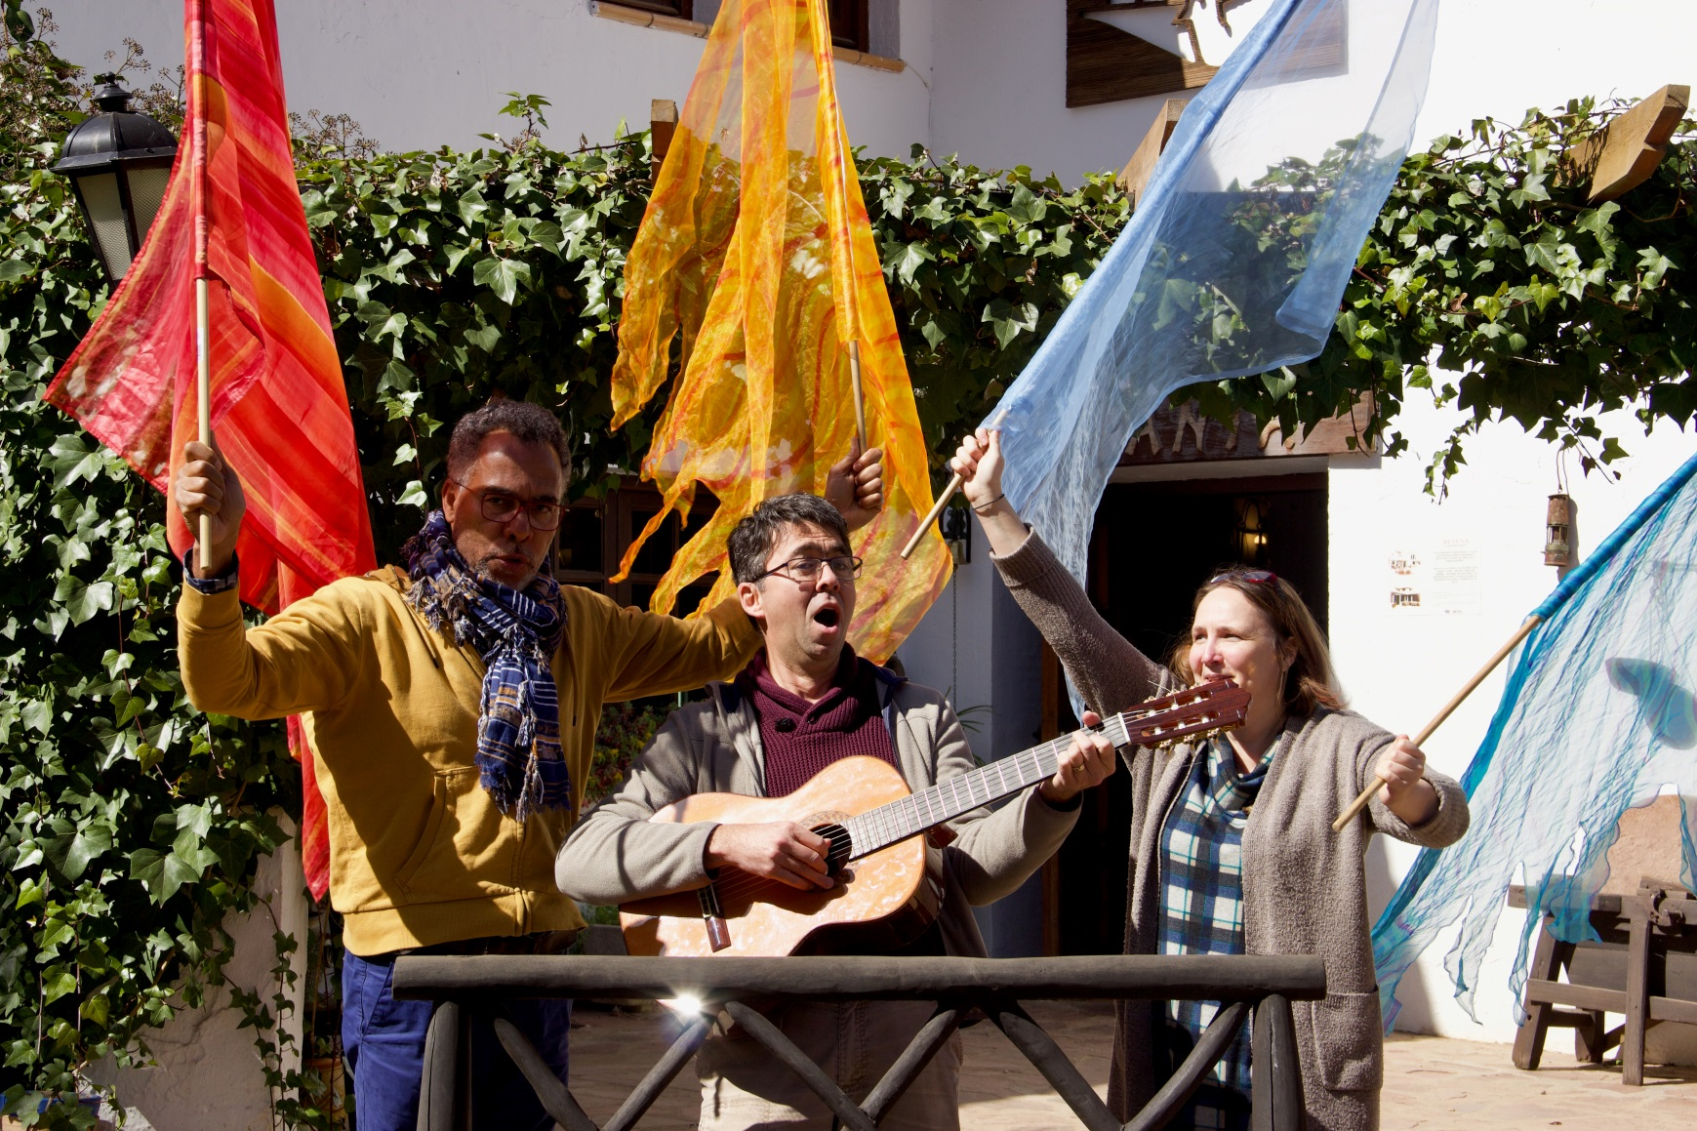
France
Church planting and evangelism, northern France
Student ministry in Mulhouse
Outreach through arts and music, southwest France

Slide 7
Spain and Italy
Planting new churches
Outreach to migrants
Outreach to pilgrims on their way to places such as Santiago de Compostela. This is done by a performing arts team called Arts Release.
Work with vulnerable children

Slide 8
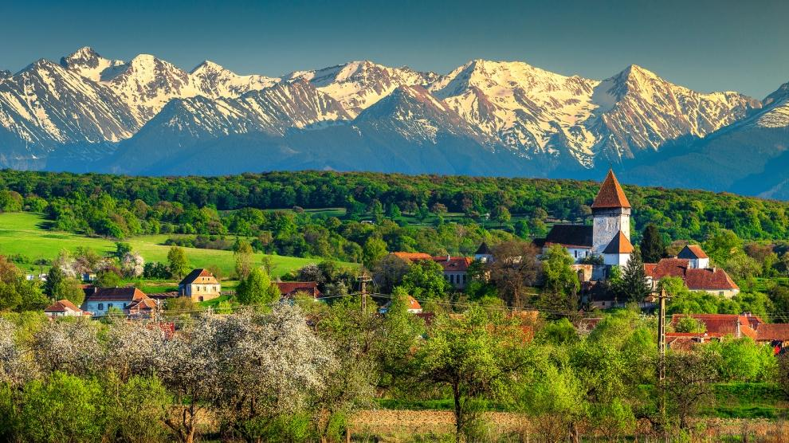
Romania
There is still much need in Romania. There are significant areas of poverty, and most pastors are part-time.
However WEC is now beginning to send missionaries from Romania.

Slide 9
Europe-wide ministries
All over Europe our WEC branches are involved in outreach to migrants and refugees.
There are ministries to children at risk.
Betel, a ministry of WEC, runs drug rehabilitation centres in numerous cities across Europe and the rest of the world. For more information see this web link:
https://www.betel.uk/

Slide 10
WEC in the UK
Ministries include:
The sending office which deals with vital administration, finance and member care
Over 40 workers reaching settled communities of immigrants as well as recent migrants
Betel in major cities – the most recent is Motherwell, Scotland.
Children’s camps each summer – not sure what will happen this year!

Slide 11
New churches
WEC has planted many new churches in Europe in the last few years. (Our definition of ‘church’ includes quite small groups that meet in in homes.)
Examples:
3 in France
5 in Spain
Numerous groups in the UK
Many groups in the Netherlands, with a lot of individuals seeking and ‘on the way’ to finding Jesus.

Slide 12
Pray for WEC in Europe
Let’s take 5 minutes to pray now.
Give thanks for all of the ministry that is going on in Europe.
Pray for all of those involved in these ministries, as they adapt to the new restrictions and seek to develop ways to reach the unreached online. Pray for wide interest in the Jesus film and other online resources, especially as Easter approaches.
Pray for protection and encouragement for WEC’s workers in Europe, especially those currently living under heavy restrictions. Some have young families and live in apartment blocks with no gardens.

Slide 13
Song 2: We have an anchor
This song is based on Hebrews 6:19.
Sing along with Robin Mark at this link:
https://www.youtube.com/watch?v=PrjKUII-V18
The words will appear on the screen.

Slide 14
A testimony from our time in Africa
We have written a short testimony for your encouragement, available on the church website: Click here
We went through some very challenging times in Senegal, with a family of three children, but God brought us through it . You can choose to read it now, or save it for later.

Slide 15
Steve and Gill’s prayer requests
We need your prayers in the next few weeks and months. You could pray for us now for a few minutes if you would like to. Our work is continuing as so much of it is done online. We are especially grateful for technology at this time. Here are a few key points:
Bourofaye Christian School in Senegal and Grace International School in Chiang Mai, Thailand have both closed. For some boarding students this presented huge logistical challenges as their parents were in another country. Pray for all of the families and school staff whose lives have been disrupted. Many of the staff members currently at BCS came to Corsham for their training.
Pray for teachers seeing to provide online education. This is only effective in countries where the technology works well.
Pray that families will be able to make the most of having more time together at home.

Slide 16
Steve and Gill’s prayer requests 2
A number of our colleagues are stuck in the wrong country right now. Please pray for God's provision and protection for them, especially if separated from other family members
Some families are in tight lockdown. Gill has put together an extra Educare edition (e-magazine) with some activities and ideas to help families. This has been appreciated around the world so she is seeking to create more resources. Pray for inspiration.
We are looking at ways of delivering training online instead of some of the face-to-face activities we had planned. Steve will be working on some safeguarding training for leaders across Europe, scheduled for early June.
The MK Staff Training course that CBC has hosted since 2017 will now be going online. Pray for us as we seek to develop a good interactive course in the next few months.
Praise God that our three sons and two daughters-in-law are well.

Slide 17
Song 3: Tell out my soul
You can join in this one at the link below. The words will appear on the screen.
https://www.youtube.com/watch?v=qf3mgRUZkAk

Slide 18
Pray for unreached people
You can make a difference with your prayers! Remember that 42% of the world’s people groups do not have access to the Gospel. Some of them live hundreds of miles from the nearest Christians. Did you know that there is an App to help you pray each day for an unreached people group? It only takes 2 or 3 minutes and you will learn so much while you are doing it.
Go to this link:
https://joshuaproject.net/pray/unreachedoftheday

Slide 19
Closing Prayer
Thank you so much for joining us tonight. Let’s pray.
Lord, these are such challenging times for all of us. We thank you that you are still at work around the world even in the midst of the coronavirus, and that your desire is that men, women and children of all nations come to know you. Help us to continue to pray and work towards this.
May the God of peace fill us with all joy and peace as we trust in Him, so that we may overflow with hope by the power of the Holy Spirit. At this time, may we find new ways of blessing others, building up our families and loving our neighbours.
Thank you that your Word says that nothing can separate us from Your love. (Romans 8: 38-39). We give glory and praise to You.
Amen
God bless you!

