Slide 1
accident shield - IoT based smart crash detection system

Slide 2
INTRODUCTION
Accident Shield – An IoT Based Smart Crash Detection System
Accidents occurs almost everyday in a daily basis and many victim lose their lives due to the lack of help and timely responses.
Rider may get unconscious.
No immediate alert system.
Delayed response are the major problems.

Slide 3
PROBLEM STATEMENT
Accidents are often unnoticed .
Rider may not be able to call for help.
Delayed in emergency responses.

Slide 4
existing SOLUTION
Depends on people nearby.
No automatic emergency response.
More delay may be life risking.
OUR SOLUTION
Detect accident automatically by sudden tilt or abnormal activity.
Sends live location of the accident place automatically
Activate buzzer .

Slide 5
Working principle
When vehicle tilt ,crash or impact occurs, the MPU6050 detects and then ESP32 process to confirm the accident and shares live location and then buzzer is activated.
For every 10 mins / secs the buzzer activates .
We’re using impact threshold above 4g acceleration and 150 – 400 Hz transition spike, so normal road vibrations are ignored.
Frequency alone is not sufficient, so we correlate it with acceleration magnitude.

Slide 6
Components used
ESP32
MPU6050
BUZZER
JUMPER WIRES
CONNECTION MODULE

Slide 7
How it works
Motion Monitoring: the accelerometer sensor connected to the ESP32 continuously monitor the vehicle movement.
Impact Confirmation: It does not detect false detections. When the vehicle is tends to sudden tilt or abnormal only it detects.
Alert Trigger: If the accident is detected the buzzer is on and activated the emergency mode to send location through blynk app.
Emergency Notification: It sends signal as location to the blynk app and sends alerts to the user.

Slide 8
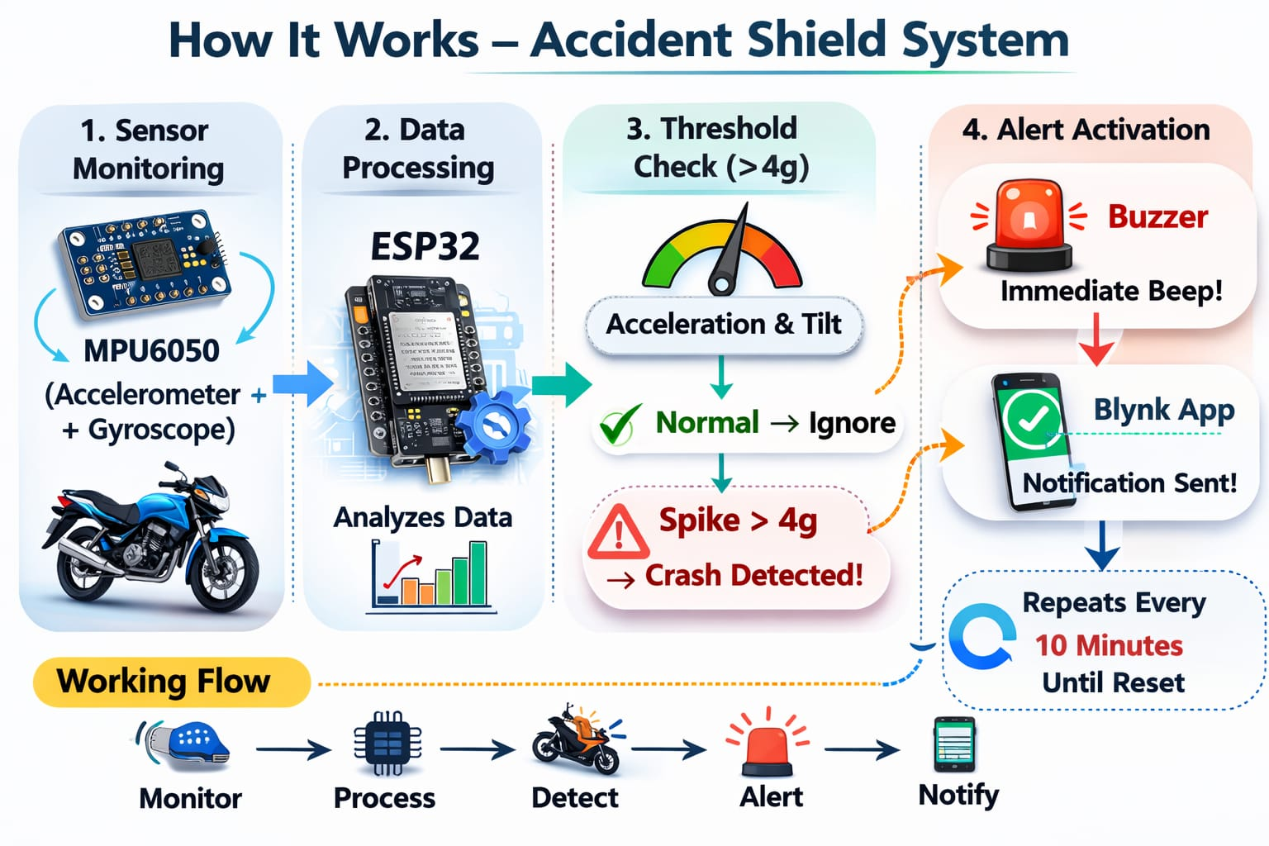

Slide 9
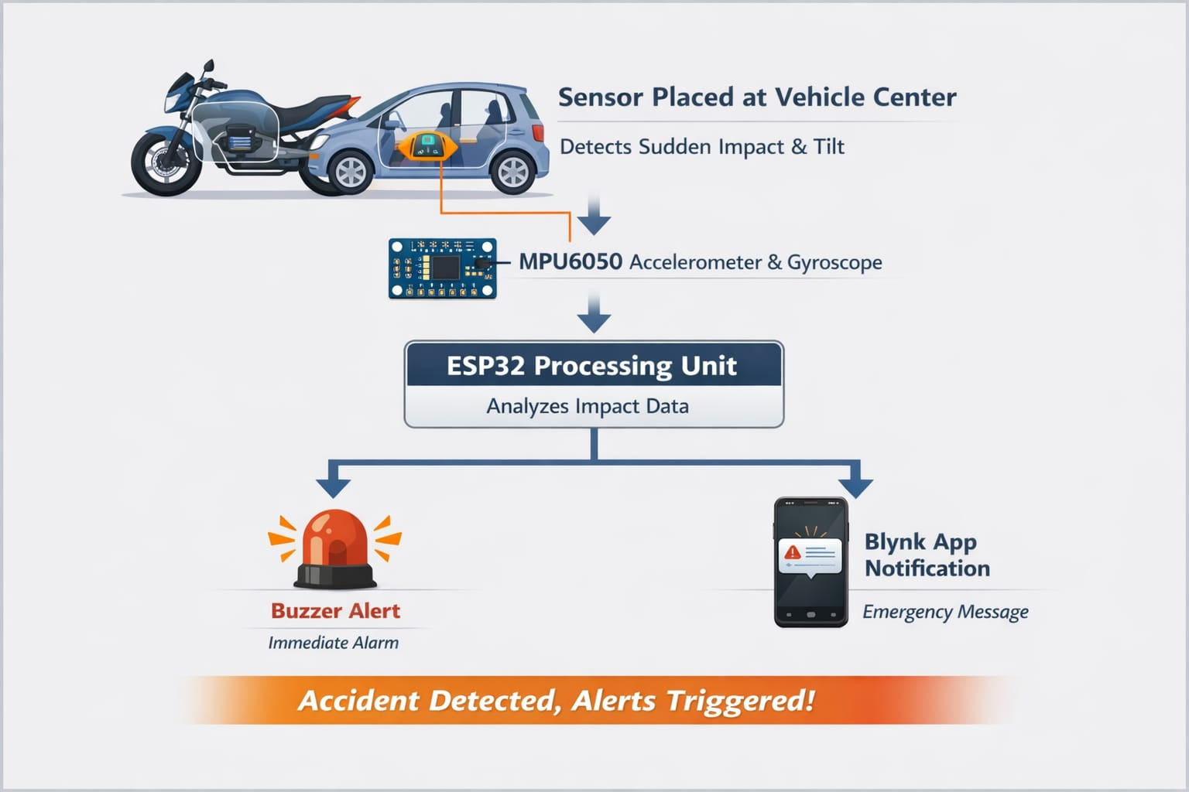
System architecture
The architecture integrates sensing, processing, alerting and communication modules.

Slide 10
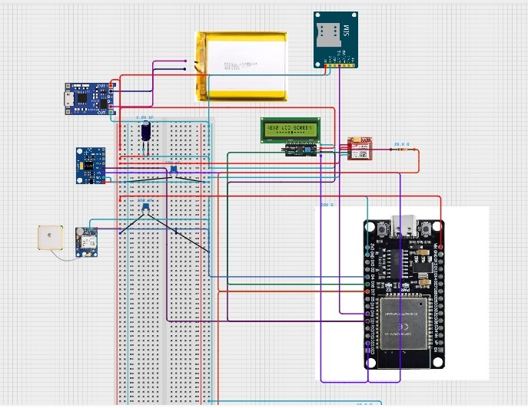
Components layout

Slide 11
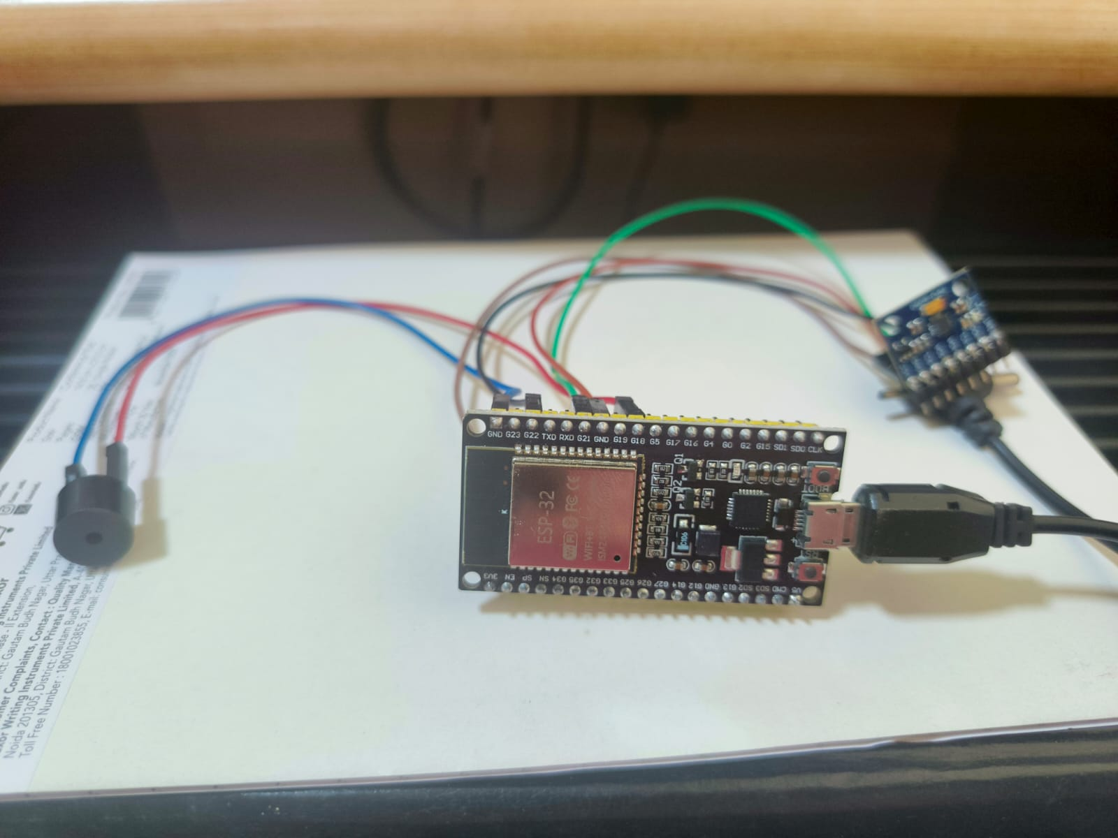
Initial prototype

Slide 12
limitations
Cannot detect minor falls
Works only when power is on.
Needs power supply for function.
Possible false alerts on severe bumps along with sudden tilt.
Accuracy depends upon proper sensor placement.
This system is impact based and not motion-based.

Slide 13
advantages
Instant accident detection.
Automatic emergency alert.
Improves survival during golden hour.
Low – cost implementation.
Works without human intervention.
Easy to install in bikes.
Real – time response system.

Slide 14
Future scope
Add GPS for live location tracking.
AI based accident validation.
Auto ambulance notification.
Mobile app integration.
Cloud data storage.
Helmet – based rider safety detection.

Slide 15
Thank you
“Safety should not wait for human reaction”
TEAM NAME: Next Gen Ninjas
TEAM MEMBERS: S G Srinidhi
Thevaharinysha A R L
Madhumitha K

