Slide 1
Better战队
吕磊
黄潇
王相
高海涛
基于Binlog的Fast-PITR
Fast point in time recovery
A truly meaningful product

Slide 2
CONTENTS
Fast point in time recovery
01
备份意义
04
方案介绍
The meaning of backup
Introduction of the project
02
现状痛点
05
源码解析
Current pain point
Introduction of source code
03
方案选型
06
成果展示
Design and selection
Achievement

Slide 3
PART 01
备份意义
The meaning of backup

Slide 4

备份的意义
The meaning of backup
硬件故障
Hardware Problem
软件故障
Software Problem
操作失误&恶意篡改
Drop table, Drop database, update table, delete data
自然灾难
Disaster

Slide 5



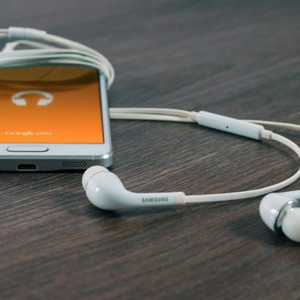
对数据备份的强需求
The meaning of backup
金融行业
银行
传统行业
交易场景

Slide 6
PART 02
现状痛点
Current pain point

Slide 7
现状痛点
Current pain point
现状痛点
磁盘成本: TiDB上的业务，数据量都非常大
数据量大
备份恢复时间长
时间成本: 逻辑备份恢复，时间太长
开发成本: Binlog格式与mysql不兼容，需要开发一系列工具来提供上下游服务
风险成本: 目前没有一个完善可靠的备份恢复体系
Binlog格式不兼容Mysql
没有一个完善的备份恢复体系

Slide 8
现状痛点
Current pain point
备恢复体系的缺失
严重阻碍了TiDB的推广和在关键业务领域的作用！！！
The lack of recovery system has seriously hindered the promotion of TiDB and its role in key business areas!!!

Slide 9
PART 03
方案选型
Design and selection

Slide 10

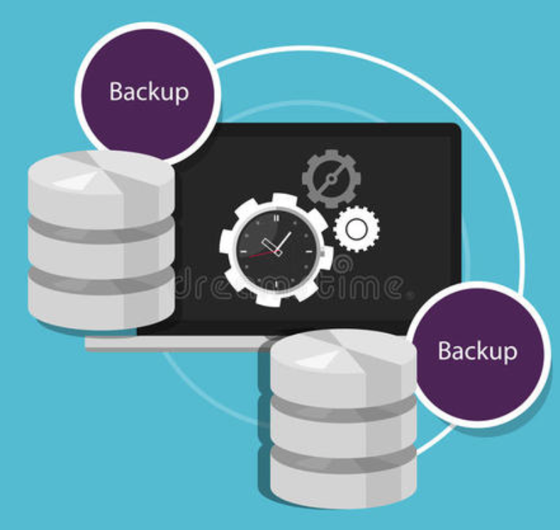
方案选型
Design and selection
优点:
备份方式灵活
表级恢复
缺点:
恢复时间长
占用磁盘空间大
影响数据库性能
优点:
备份速度快
恢复速度快
对数据库性能影响小
缺点:
占用磁盘空间大
分布式系统实现困难
逻辑备份
物理备份

Slide 11

方案选型
Design and selection
mydumper+loader&lighting+reparo&arbiter
raft log
回放成binlog?
mydumper+loader&lighting
无法进行时间点的恢复
备份时间长，恢复时间长
耗费空间
不灵活
备份时间长，恢复时间长
耗费空间
不灵活

Slide 12
PART 04
方案介绍
Introduction of the project

Slide 13
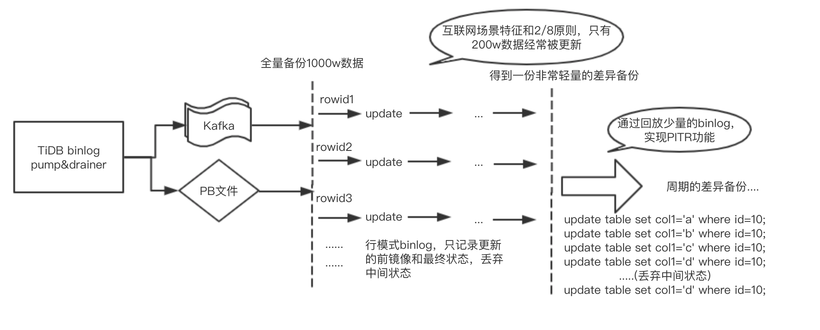
方案介绍
Introduction of the project

Slide 14
兼容TiDB生态的所有组件
Introduction of the project
Loader
Drainer
TiDB-lighting
TiDB-server
Mydumper
Pump
Arbiter
Reparo

Slide 15
当前方案
Introduction of the project
y
Full backup
回放binlog实现PITR？
Binlog
0
day1
day2
day3
day4
x

Slide 16
我们的方案
Introduction of the project
y
Full backup
合并
合并
合并
行级并发回放
通过回放少量的 binlog实现PITR
增量备份集
增量备份集
增量备份集
Binlog
Binlog
0
day1
day2
day3
day4
x

Slide 17
我们的优化方案
Introduction of the project
y
Full backup
Binlog
合并
合并
合并
通过回放少量的 binlog实现PITR
新备份集
增量备份集
增量备份集
增量备份集
0
day1
day2
day3
day4
x

Slide 18
理想方案
Introduction of the project
y
Full backup
Binlog
新备份集
Tikv cluster
合并
TiDB lighting
Tikv
Tikv
全量备份集
Tikv
Tikv
0
day1
day2
day3
day4
x
Tikv
Tikv

Slide 19
方案的优势
Fast point in time recovery
01
可靠性高
04
节省空间
备份集和Binlog之间是互备的，即使损坏也能再生成
不需要频繁的full backup
02
备份效率高
05
表级备份&恢复
备份集之间可以互相合并
更灵活的备份恢复速度
03
恢复速度快
06
兼容性好
和TiDB lighting配合，将备份集恢复成sst直接ingest到TiKV集群
兼容TiDB binlog生态

Slide 20
DDL的处理
Introduction of the project
处理binlog文件过程中，遇到DDL理论上需要生成savepoint，重置起点
为了提高恢复速度，我们尽量避免因为DDL而中断进程，生成两份备份集
通过PD获取
Schema信息
1. Create table
2. Drop table
3. Drop index(非唯一)
Add Index(非唯一)
Binlog

Slide 21
PART 05
源码解析
Introduction of source code

Slide 22
PART 06
成果展示
Achievement

Slide 23
管理总结考核
The user can demonstrate on a projector or computer, or print the presentation and make it into a film to be used in a wider field The user can demonstrate
$562
$859
$478
$268
标题文字添加
标题文字添加
标题文字添加
标题文字添加
The user can demonstrate on a projector or computer, or print the presentation and make it into a film to be used in a wider field. Using PowerPoint,
The user can demonstrate on a projector or computer, or print the presentation and make it into a film to be used in a wider field. Using PowerPoint,
The user can demonstrate on a projector or computer, or print the presentation and make it into a film to be used in a wider field. Using PowerPoint,
The user can demonstrate on a projector or computer, or print the presentation and make it into a film to be used in a wider field. Using PowerPoint,

Slide 24
管理总结考核
The user can demonstrate on a projector or computer, or print the presentation and make it into a film to be used in a wider field The user can demonstrate
80%
77%
76%
70%
62%
50%
36%
文字添加
文字添加
文字添加
文字添加
文字添加
文字添加
文字添加
The user can demonstrate on a projector or computer, or print the presentation and make it into a film to be used in a wider field. Using PowerPoint, The user can demonstrate on a projector or computer, or print the presentation and make it into a film to be used in a wider field. Using PowerPoint, The user can demonstrate on a projector or computer, or print the presentation and make it into a film to be used in a wider field. Using PowerPoint, The user can demonstrate on a projector or computer, or print the presentation

Slide 25
管理总结考核
The user can demonstrate on a projector or computer, or print the presentation and make it into a film to be used in a wider field The user can demonstrate
标题文字添加
标题文字添加
标题文字添加
标题文字添加
The user can demonstrate on a projector or computer, or print the presentation and make it into a film to be used in a wider field. Using PowerPoint,
The user can demonstrate on a projector or computer, or print the presentation and make it into a film to be used in a wider field. Using PowerPoint,
The user can demonstrate on a projector or computer, or print the presentation and make it into a film to be used in a wider field. Using PowerPoint,
The user can demonstrate on a projector or computer, or print the presentation and make it into a film to be used in a wider field. Using PowerPoint,

Slide 26
管理总结考核
The user can demonstrate on a projector or computer, or print the presentation and make it into a film to be used in a wider field The user can demonstrate
标题文字添加
标题文字添加
标题文字添加
The user can demonstrate on a projector or computer
The user can demonstrate on a projector or computer
The user can demonstrate on a projector or computer
标题文字添加
标题文字添加
The user can demonstrate on a projector or computer
The user can demonstrate on a projector or computer

Slide 27
Better
吕磊
黄潇
王相
海涛
感谢您的投票
Thanks for your vote!!!

Slide 28

备份的意义
The meaning of backup
标题文字添加
The user can demonstrate on a projector or computer, or print the presentation and make it into a film to be used in a wider field. Using PowerPoint, The user can demonstrate on a projector or computer, or print the presentation and make it into a film to be used in a wider field. Using PowerPoint, The user can demonstrate on a projector or computer, or print the presentation and make it into a film to be used in a wider field. Using PowerPoint, The user can demonstrate on a projector or computer, or print the presentation and make it into a film to be used in a wider field. Using PowerPoint,
The user can demonstrate on a projector or computer, or print the presentation and make it into a film to be used in a wider field. Using PowerPoint, The user can demonstrate on a projector or computer, or print the presentation and make it into a film to be used in a wider field. Using PowerPoint, The user can demonstrate on a projector or computer, or print the presentation and make it into a film to be used in a wider field. Using PowerPoint, The user can demonstrate on a projector or computer, or print the presentation and make it into a film to be used in a wider field. Using PowerPoint,

Slide 29


目标计划概要
The user can demonstrate on a projector or computer, or print the presentation and make it into a film to be used in a wider field The user can demonstrate
The user can demonstrate on a projector or computer, or print the presentation and make it into a film to be used in a wider field. Using PowerPoint, The user can demonstrate on a projector or computer, or print the presentation and make it into a film to be used in a wider field. Using PowerPoint,
The user can demonstrate on a projector or computer, or print the presentation and make it into a film to be used in a wider field. Using PowerPoint, The user can demonstrate on a projector or computer, or print the presentation and make it into a film to be used in a wider field. Using PowerPoint,
标题文字添加
标题文字添加

Slide 30


目标计划概要
The user can demonstrate on a projector or computer, or print the presentation and make it into a film to be used in a wider field The user can demonstrate
标题文字添加
The user can demonstrate on a projector or computer, or print the presentation and make it into a film to be used in a wider field. Using PowerPoint,
The user can demonstrate on a projector or computer, or print the presentation and make it into a film to be used in a wider field. Using PowerPoint,
The user can demonstrate on a projector or computer, or print the presentation and make it into a film to be used in a wider field. Using PowerPoint,
The user can demonstrate on a projector or computer, or print the presentation and make it into a film to be used in a wider field. Using PowerPoint,

Slide 31
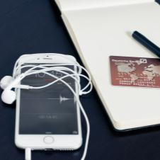
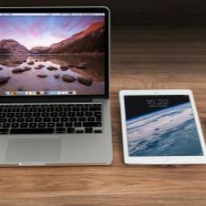






目标计划概要
The user can demonstrate on a projector or computer, or print the presentation and make it into a film to be used in a wider field The user can demonstrate
标题文字添加
标题文字添加
标题文字添加
标题文字添加
The user can demonstrate on a projector or computer
The user can demonstrate on a projector or computer
The user can demonstrate on a projector or computer
The user can demonstrate on a projector or computer
标题文字添加
标题文字添加
标题文字添加
标题文字添加
The user can demonstrate on a projector or computer
The user can demonstrate on a projector or computer
The user can demonstrate on a projector or computer
The user can demonstrate on a projector or computer

Slide 32
目标计划程序
The user can demonstrate on a projector or computer, or print the presentation and make it into a film to be used in a wider field The user can demonstrate
The user can demonstrate on a projector or computer, or print the presentation and make it into a film to be used in a wider field. Using PowerPoint, The user can demonstrate on a projector or computer, or print the presentation and make it into a film to be used in a wider field. Using PowerPoint, The user can demonstrate on a projector or computer, or print the presentation and make it into a film to be used in a wider field. Using PowerPoint, The user can demonstrate on a projector or computer, or print the presentation

Slide 33
目标计划程序
The user can demonstrate on a projector or computer, or print the presentation and make it into a film to be used in a wider field The user can demonstrate
标题文字添加
标题文字添加
标题文字添加
The user can demonstrate on a projector or computer
The user can demonstrate on a projector or computer
The user can demonstrate on a projector or computer
标题文字添加
标题文字添加
标题文字添加
The user can demonstrate on a projector or computer
The user can demonstrate on a projector or computer
The user can demonstrate on a projector or computer
The user can demonstrate on a projector or computer, or print the presentation and make it into a film to be used in a wider field. Using PowerPoint, The user can demonstrate on a projector or computer, or print the presentation and make it into a film to be used in a wider field. Using PowerPoint, The user can demonstrate on a projector or computer, or print the presentation and make it into a film to be used in a wider field. Using PowerPoint, The user can demonstrate on a projector or computer, or print the presentation and make it into a film to be used in a wider field. Using PowerPoint,

Slide 34

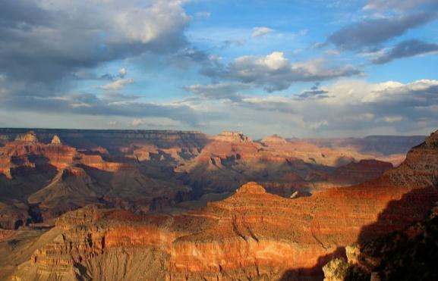

目标计划程序
The user can demonstrate on a projector or computer, or print the presentation and make it into a film to be used in a wider field The user can demonstrate
标题文字添加
标题文字添加
标题文字添加
The user can demonstrate on a projector or computer, or print the presentation and make it into a film to be used in a wider field. Using PowerPoint,
The user can demonstrate on a projector or computer, or print the presentation and make it into a film to be used in a wider field. Using PowerPoint,
The user can demonstrate on a projector or computer, or print the presentation and make it into a film to be used in a wider field. Using PowerPoint,

Slide 35

目标计划管控
The user can demonstrate on a projector or computer, or print the presentation and make it into a film to be used in a wider field The user can demonstrate
标题文字添加
The user can demonstrate on a projector or computer, or print the presentation and make it into a film to be used in a wider field. Using PowerPoint, The user can demonstrate on a projector or computer, or print the presentation and make it into a film to be used in a wider field. Using PowerPoint,
标题文字添加
74%
标题文字添加
标题文字添加
68%
The user can demonstrate on a projector or computer, or print the presentation and make it into a film to be used in a wider field. Using PowerPoint,
标题文字添加
86%

Slide 36


目标计划管控
The user can demonstrate on a projector or computer, or print the presentation and make it into a film to be used in a wider field The user can demonstrate
标题文字添加
The user can demonstrate on a projector or computer, or print the presentation and make it into a film to be used in a wider field. Using PowerPoint,
The user can demonstrate on a projector or computer, or print the presentation and make it into a film to be used in a wider field. Using PowerPoint, The user can demonstrate on a projector or computer, or print the presentation and make it into a film to be used in a wider field. Using PowerPoint, The user can demonstrate on a projector or computer, or print the presentation and make it into a film to be used in a wider field. Using PowerPoint, The user can demonstrate on a projector or computer, or print the presentation and make it into a film to be used in a wider field. Using PowerPoint,

Slide 37



目标计划管控
The user can demonstrate on a projector or computer, or print the presentation and make it into a film to be used in a wider field The user can demonstrate
标题文字
添加
The user can demonstrate on a projector or computer, or print the presentation and make it into a film to be used in a wider field. Using PowerPoint, The user can demonstrate on a projector or computer, or print the presentation and make it into a film to be used in a wider field. Using PowerPoint,
标题文字
添加
The user can demonstrate on a projector or computer, or print the presentation and make it into a film to be used in a wider field. Using PowerPoint, The user can demonstrate on a projector or computer, or print the presentation and make it into a film to be used in a wider field. Using PowerPoint,
The user can demonstrate on a projector or computer, or print the presentation and make it into a film to be used in a wider field. Using PowerPoint, The user can demonstrate on a projector or computer, or print the presentation and make it into a film to be used in a wider field. Using PowerPoint,
标题文字
添加

