Slide 1
Heroes of CSS

Slide 2
Admin Work

Slide 3
Homework Assignment
Also, at this point everyone should have access to the class repository in GitHub. https://uci.bootcampcontent.com/UCI-Coding-Bootcamp/UCIRV201903FSF2-FT
Homework Assignment #1 is Due:
Friday March 8th 2019

Slide 4
Homework Assignment
Really, work hard on this assignment! This assignment introduces you to fundamental concepts that we’ll be building the entire course-long.
Review In Class Material, especially Exercises: https://uci.bootcampcontent.com/UCI-Coding-Bootcamp/UCIRV201903FSF2-FT
Work with your peers! It’s much better than screaming at your computer alone.
Ask Questions on Slack! Your peers, TAs, and Instructors are all here to help when they can.

Slide 5

Most Important of All….
Just Submit SOMETHING (even if it seems pretty crummy)!

Slide 6
Warning!

Slide 7
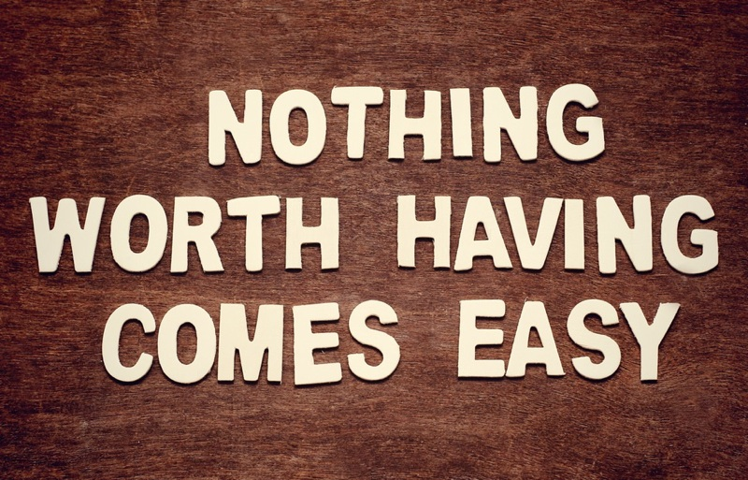
Brace Yourselves
Today is going to be a bit tough.
But trust us!
It will all look easy a few weeks from now.

Slide 8
Brace Yourselves
Don’t expect to understand EVERYTHING at once.
Today is all about getting immersed.

Slide 9
CSS Recap

Slide 10
Critical Question
What is “CSS?”

Slide 11
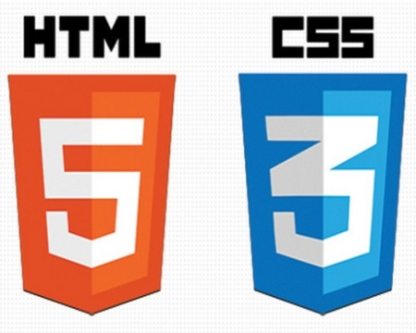

HTML / CSS Definitions (*yawn* unimportant)
HTML: Hypertext Markup Language – (Content)
CSS: Cascading Style Sheets – (Appearance)
HTML/CSS are the “languages of the web.” Together they define both the content and the aesthetics of a webpage – handling everything from the layouts, colors, fonts, and content placement. (JavaScript is the third – handling logic, animation, etc.)

Slide 12


HTML / CSS Analogy
HTML Alone
Like writing papers in “Notepad.”
Can only write unformatted text.
HTML / CSS
Like writing papers in Microsoft Word.
Can format text, page settings, alignment, etc. based on “highlighting” and menu options.

Slide 13
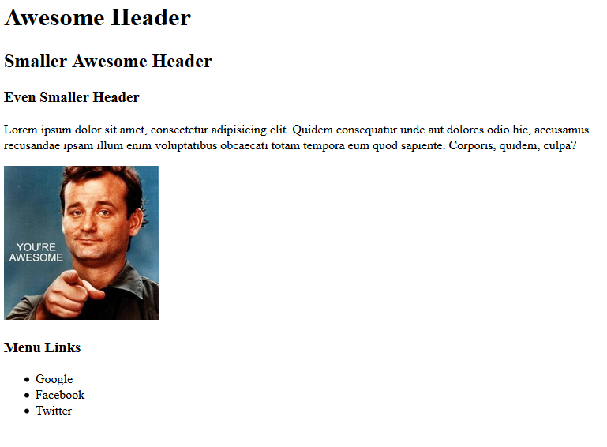
Basic HTML Page - Result

Slide 14
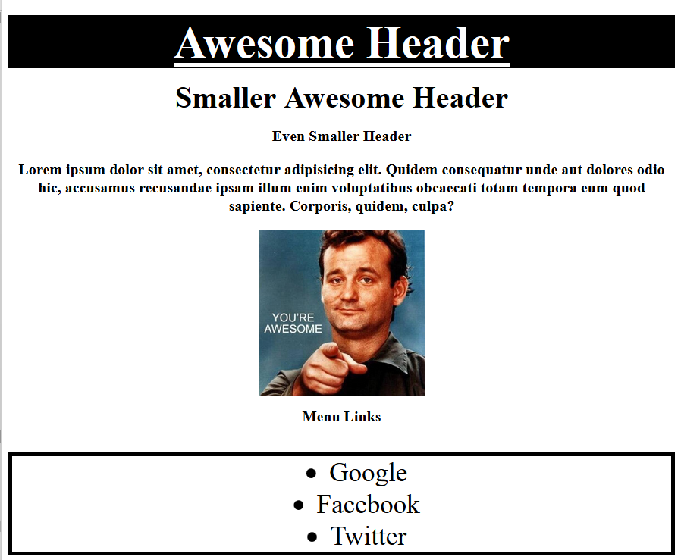
Enter CSS - Result

Slide 15
Critical Question
How do we style HTML…
Elements?
Classes?
IDs?

Slide 16
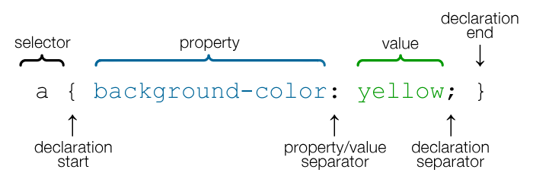
CSS Syntax
CSS works by hooking onto selectors added into HTML using classes and identifiers.
Classes use .classname, IDs use #idname, and elements use just their name.
Once hooked, we apply styles to those HTML elements using CSS.

Slide 17
Lingering Questions
Questions so far?

Slide 18
CSS Positioning

Slide 19
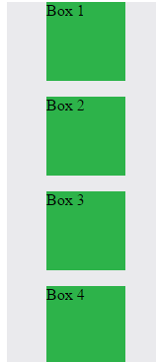
Position: Static (Default)
Four boxes placed statically (default)

Slide 20
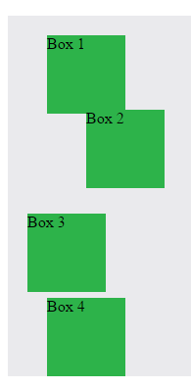
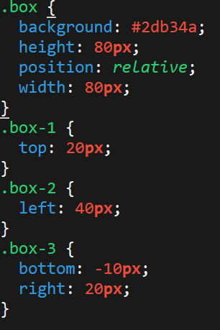
Position: Relative
Switching the boxes to relative will nudge the boxes in relation to their “original” location.

Slide 21
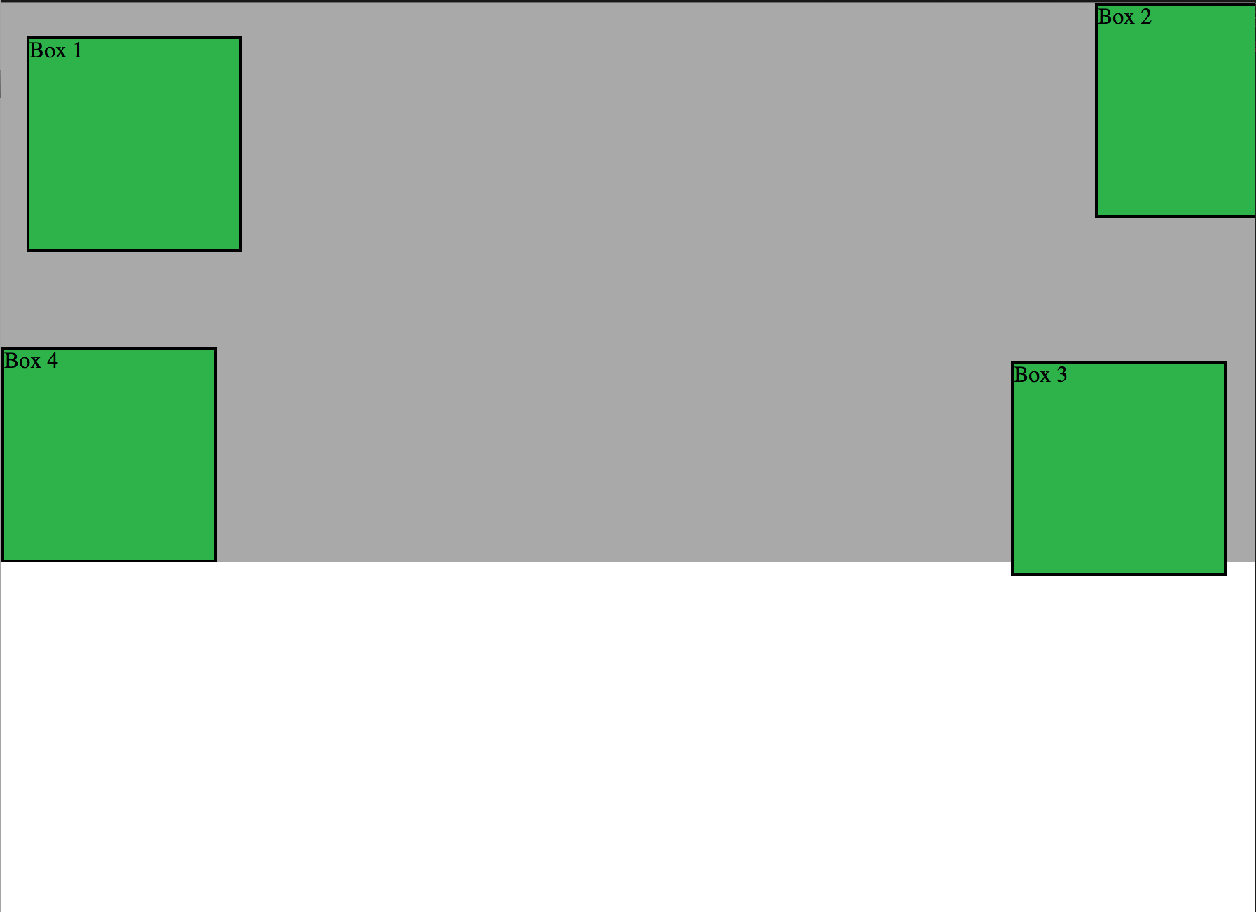
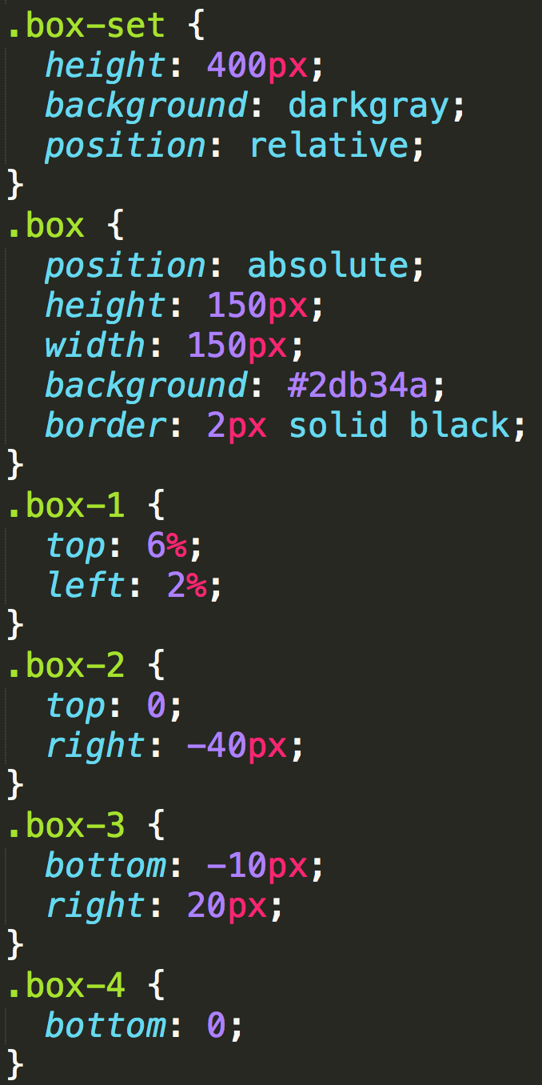
Position: Absolute
Positioned relative to nearest positioned ancestor
Notes:
An element that is positioned absolutely is taken out of the flow and thus takes up no space when placing other elements.
The absolutely positioned element is positioned relative to nearest positioned ancestor (non-static).
If a positioned ancestor doesn't exist, the initial container (body) is used.

Slide 22
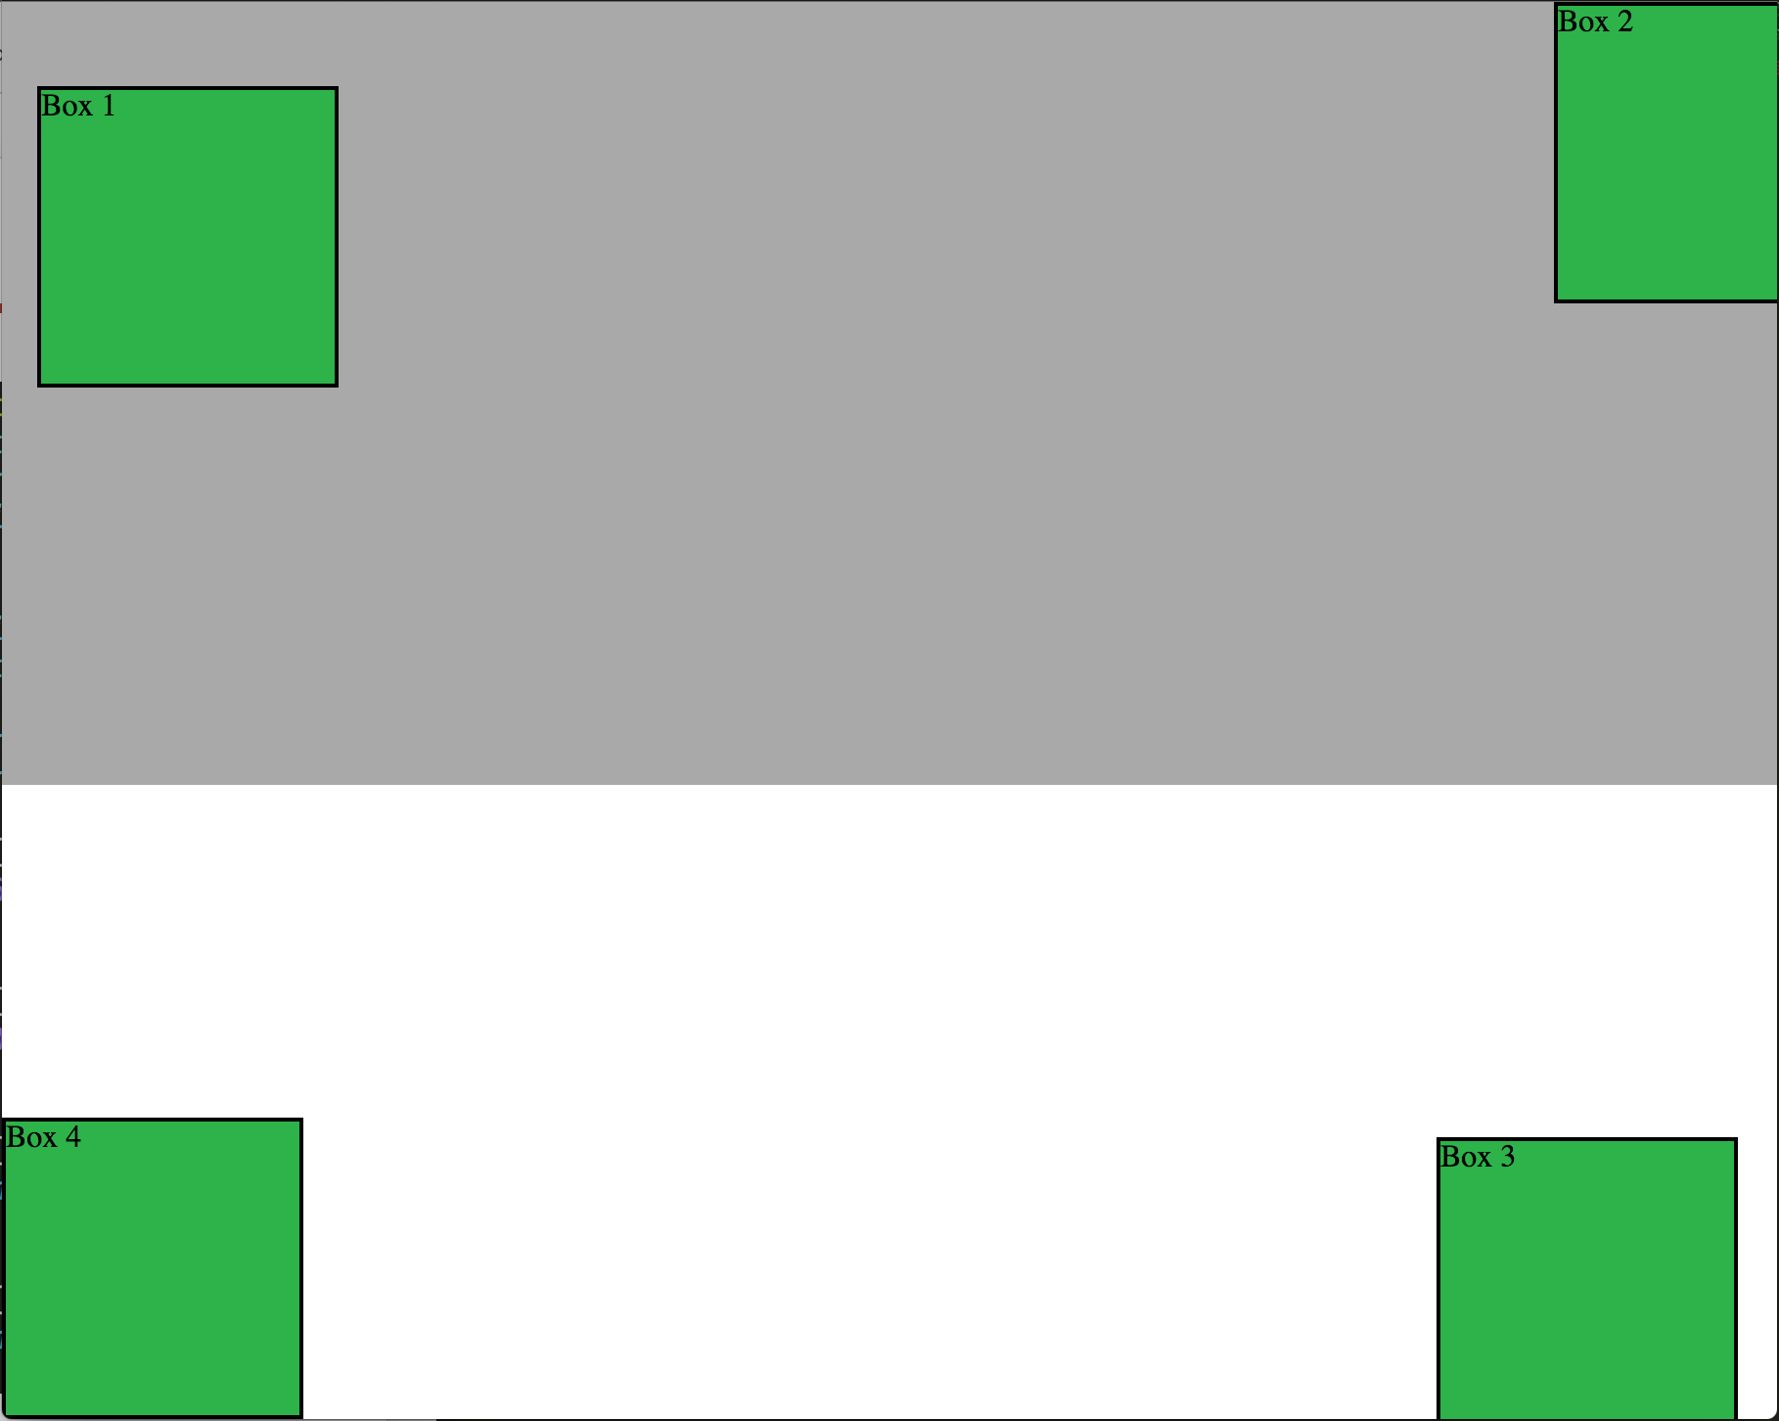
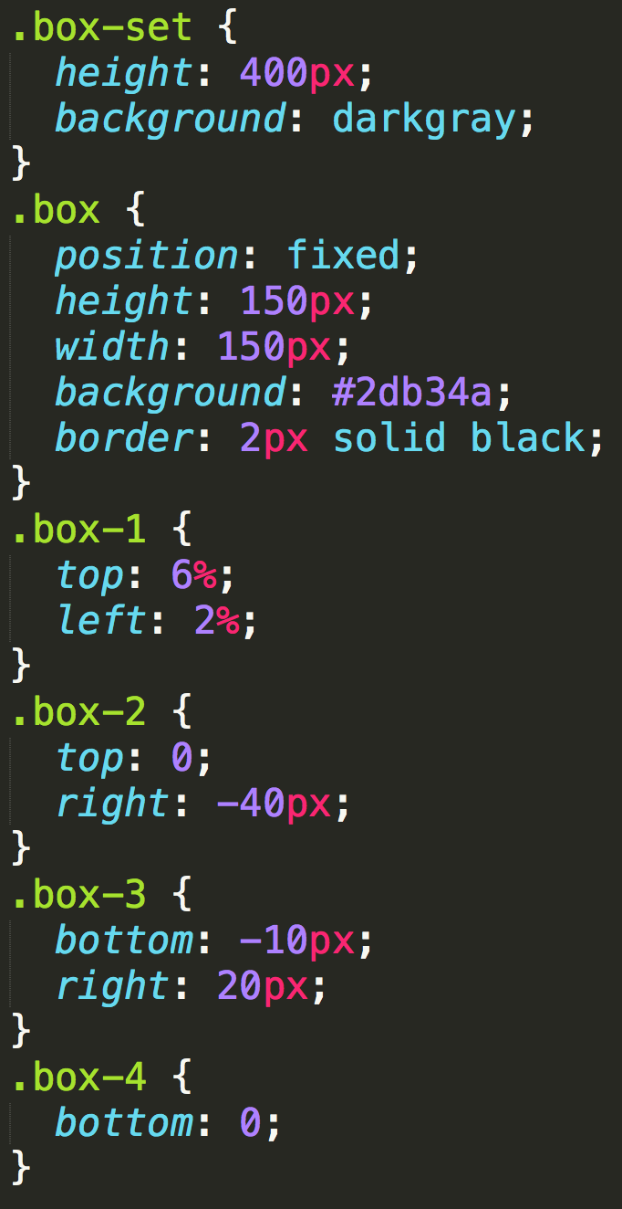
Position: Fixed
Position with exact coordinates to the browser window

Slide 23
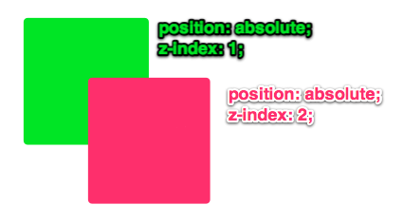
Layering with Z-Index
Z-Index allows you to layer elements on top of each other when they’re positioned.
Notes:
The elements must be positioned (any position other than static)

Slide 24
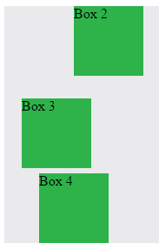
Hiding Things
“Display: none” allows us to hide elements from view.
This will become useful in later sections, when we’ll be hiding and revealing specific HTML elements of our choice.

Slide 25
Quick Demo
Instructor: Demo
(10-CSS_PositionedLayout)

Slide 26
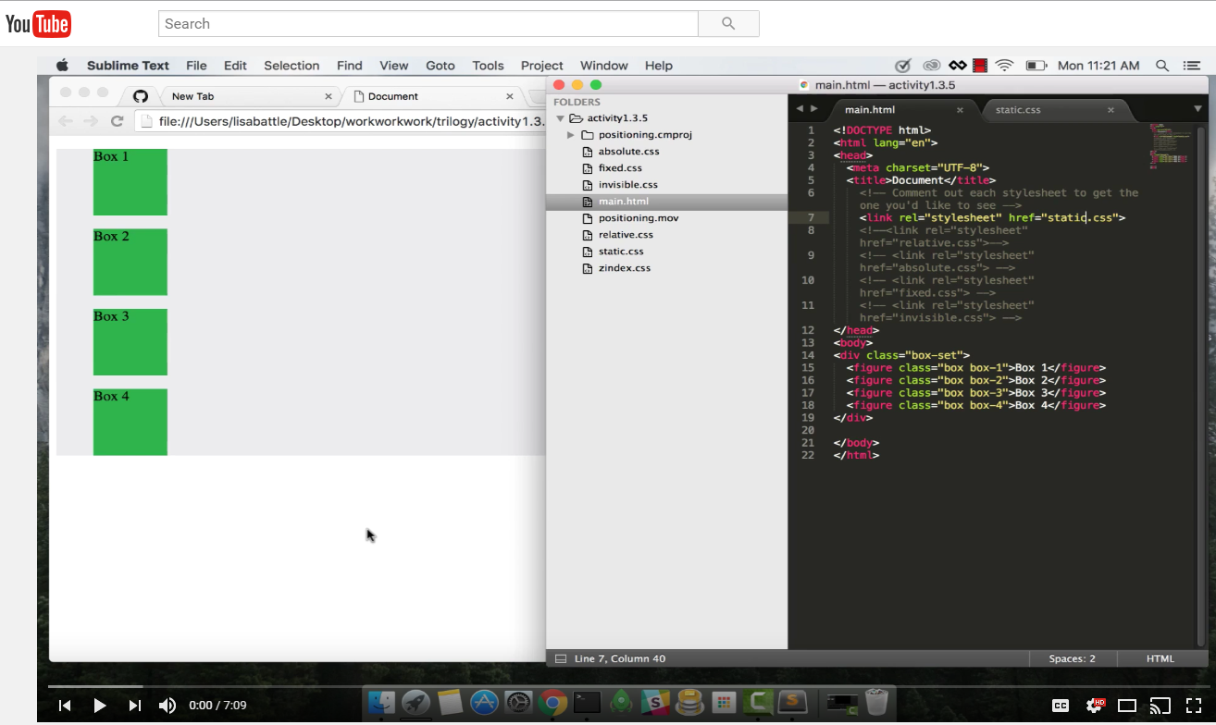
Video Walkthrough!
Video Link: https://youtu.be/sHfJn0jqBro

Slide 27
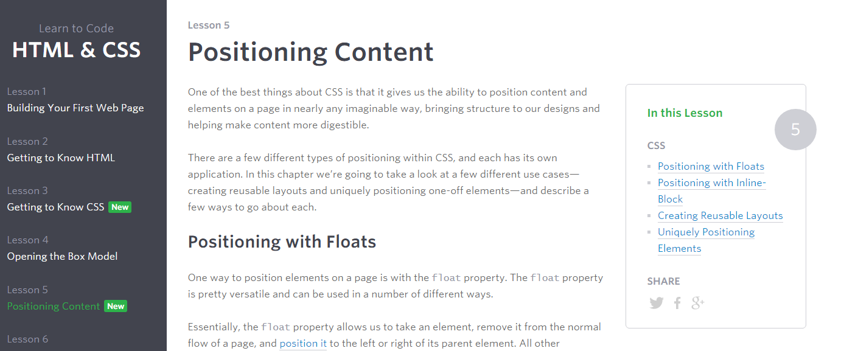
Great Resource
Another great read for front-end developers: http://learn.shayhowe.com/html-css/positioning-content/

Slide 28
> YOUR TURN!!
11-CSS_Positioned_Activity | Suggested Time: 30 min
Assignment
In this activity, you’ll flex your newfound positioning skills by creating another conceptual layout. Eyeball the design to your best ability.
Check your Slack for additional instructions.

Slide 29
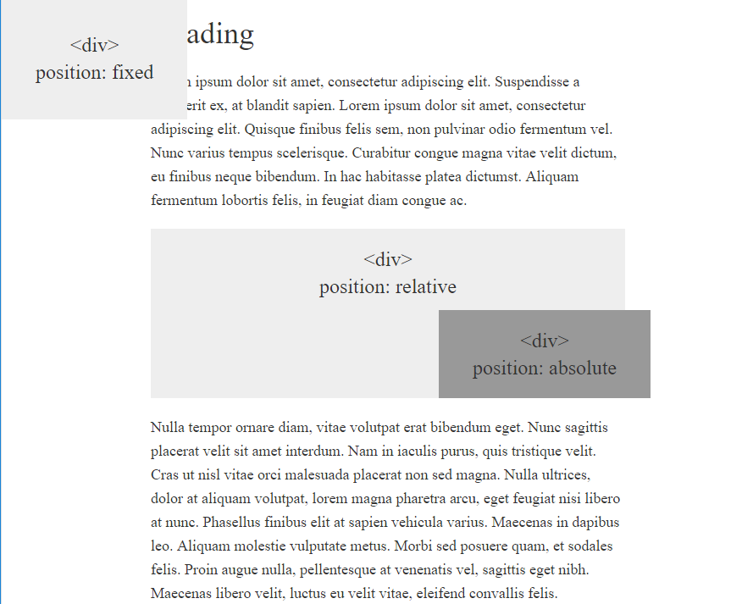
> YOUR TURN!!

Slide 30
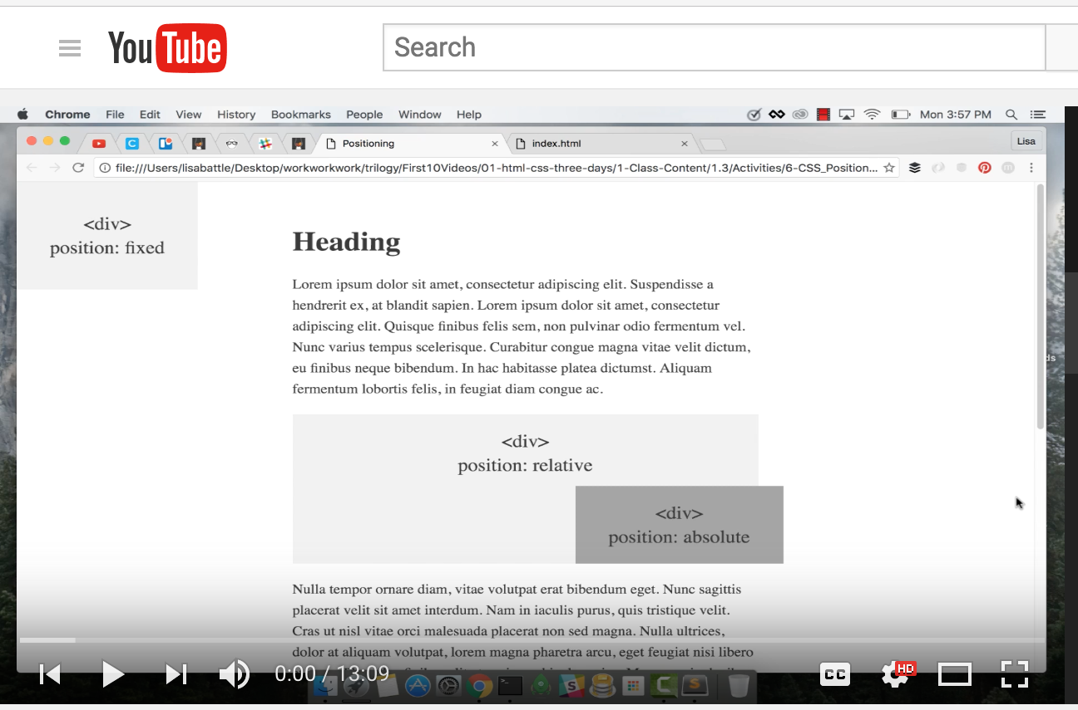
Video Walkthrough!
Video Link: https://youtu.be/yWXgnQaWSW0

Slide 31
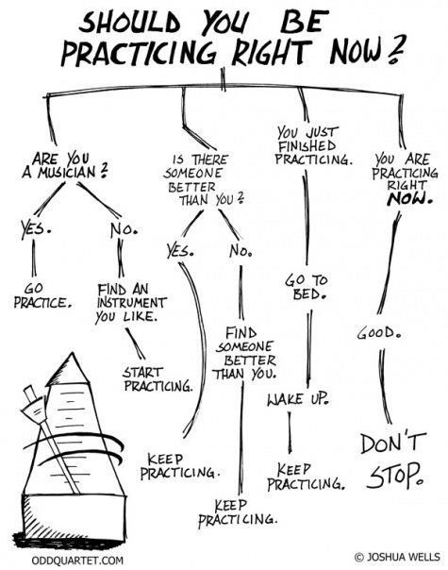
Advice
Re-do this at home. We designed this exercise
to firm up your HTML/CSS skills.
REMEMBER:
The best way to learn
web development
is to PRACTICE!

Slide 32
Chrome Inspector

Slide 33
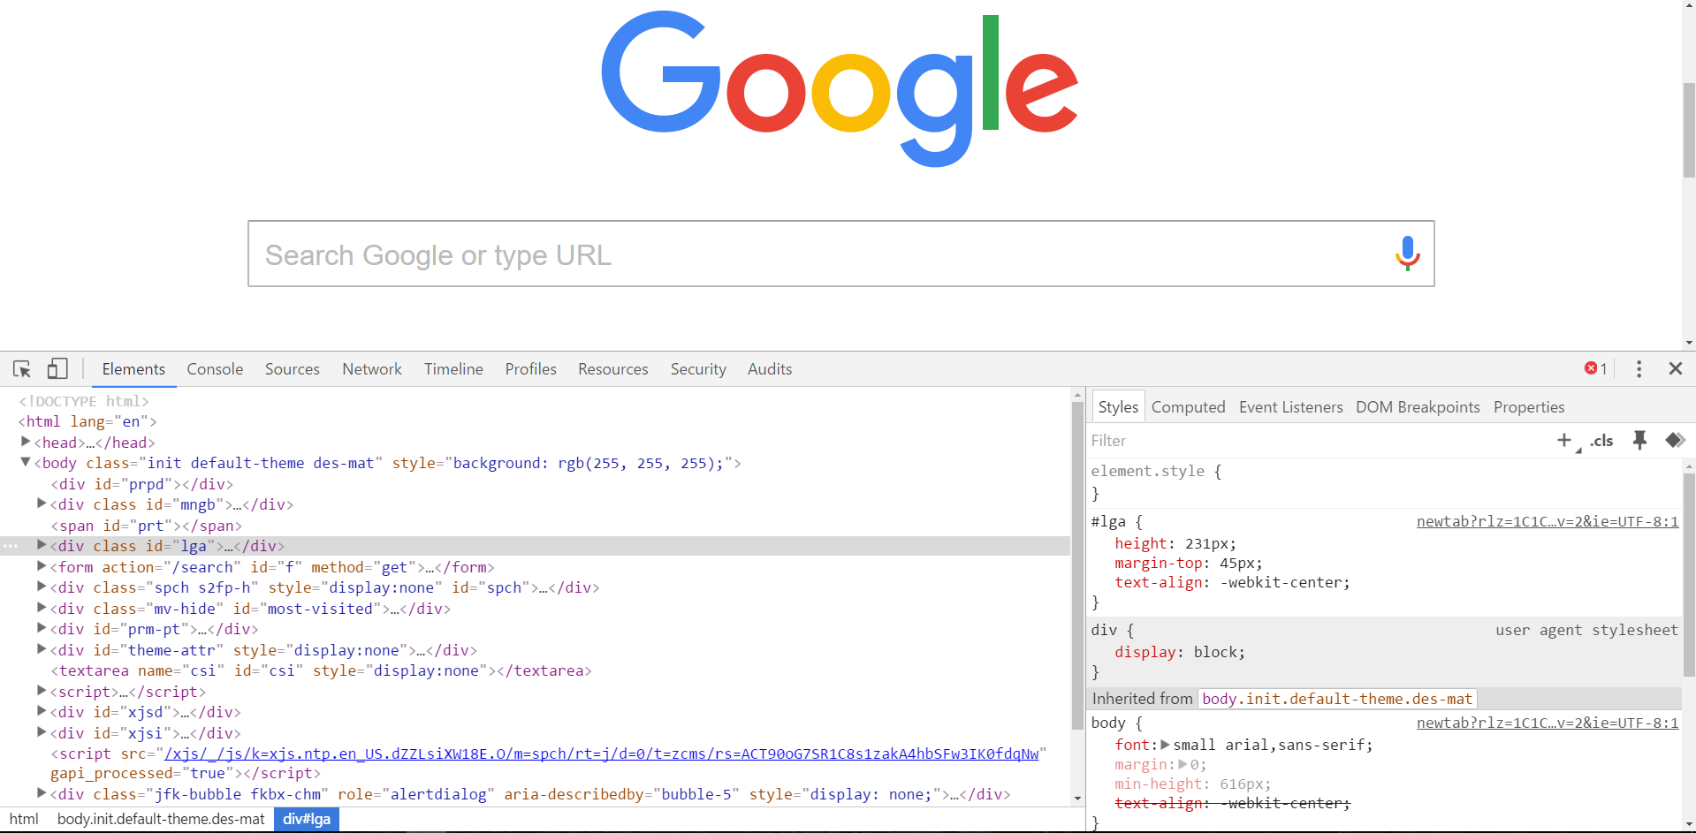
Chrome Inspector is Your Friend
To access chrome inspector, right click on a page. Then hit “Inspect.”
It will allow you to inspect the HTML, CSS and more!

Slide 34
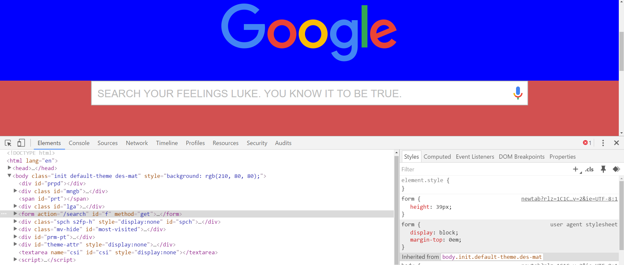
Chrome Inspector is Your Friend
You can even edit the HTML/CSS of a webpage and instantly view your changes in the browser!
This works on any website, whether yours or not.

Slide 35
Coming Soon!
We’ll be coming back to this
after the break.

Slide 36
LUNCH (30 mins)

Slide 37
Chrome Inspector Part Duex

Slide 38
Modifying Sites
You can edit any page’s HTML and CSS with Chrome Developer Tools.
Plus, you’ll see your results instantly.

Slide 39
INSTRUCTOR DEMO!
Instructor: Demo
(Chrome Developer Tools)
Notes:
39

Slide 40
> YOUR TURN!!
Suggested Time: 15 min
Assignment
For the next 15 minutes, take a website you commonly use (Amazon, Google, Huff Po, etc.) and heavily modify it using the Chrome Developer Tools.
Be sure to at least modify:
Content (Change words)
Colors
Spacing
Send a screenshot to the class’s slack profile when you’re done.

Slide 41
> YOUR TURN!!
Suggested Time: 10 min
Assignment
For the next 10 minutes, edit any site that you’ve been working on in-class or for homework with Chrome Developer Tools.
Be sure to at least modify:
Content (Change words)
Colors
Spacing

Slide 42
CSS Resets
Notes:
42

Slide 43
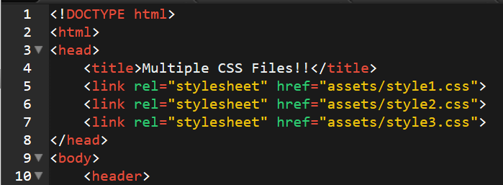
Loading Multiple CSS Files
***(Very Important!!!)***
An incredibly powerful technique: deploying multiple CSS files simultaneously.
This lets developers to create complex designs made up of abounding design elements.
Just remember: the loading order matters!!!
Notes:
43

Slide 44
INSTRUCTOR DEMO!
Instructor: Demo
(1-3_CSSFiles.html | 03-MultipleCSS)
Notes:
44

Slide 45
What Browser?
By a show of hands…
Which browser do you use?
Notes:
45

Slide 46

Battle of the Browsers
Under the hood, web browsers often render web pages differently than their competition.
These disparities could mean HTML/CSS displaying differently in each web client.
Because of these potential divergences, web developers need to make their websites cross-browser compatible.
Notes:
46

Slide 47
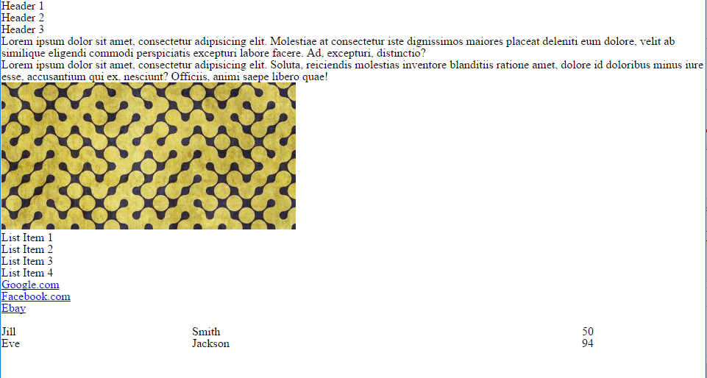
Reset.css (or Normalize.css)
Reset.css will “reset” all browser-specific CSS. This means your site will appear the same in all browsers.
However, you will have to re-style everything yourself.
Notes:
47

Slide 48
INSTRUCTOR DEMO!
Instructor: Demo
(example.html | 04-ResetCSS)
Notes:
48

Slide 49
Why CSS Resets Matter
It’s important for creating browser-compatible websites
It’s an example of using someone else’s CSS in your website!!!
It’s a common Front-End Developer Interview question.
Notes:
49

Slide 50
> YOUR TURN!!
Suggested Time: 10 min
Assignment
Follow the instructions given via Slack to incorporate a reset.css file into a basic HTML file.
Note the impact the reset file makes after its inclusion.

Slide 51
To the Web with GitHub!
Notes:
51

Slide 52

The Internet
A deep and complex diagram above on how the internet works.
Notes:
52

Slide 53
The World Will See Our Greatness!
GitHub provides hosting for static websites – which means we can deploy our websites and applications onto their servers for the world to see.
Notes:
53

Slide 54
Together Now…
Let’s all login to GitHub
Notes:
54

Slide 55
INSTRUCTOR DEMO!
Instructor: Demo
(GitHub Pages Deployment - Personal)
Notes:
55

Slide 56
Deploying Static Personal Site – GitHub Pages
Basic Steps:
Create a new repo that is named `_username_.github.io`
Navigate into a folder and clone the repo into it
Build your files
Add, commit, and push your changes into the repository

Slide 57
> YOUR TURN!!
Suggested Time: 15 min
Assignment
Time to take your newfangled website and deploy it to the cloud (in this case, GitHub Pages).
Additional instructions to be sent via Slack.

Slide 58
INSTRUCTOR DEMO!
Instructor: Demo
(GitHub Pages Deployment - Project)
Notes:
58

Slide 59
Deploying a Static Project Site – GitHub Pages
Basic Steps:
1. Create a new repository on your GitHub account. You can name this repository whatever you would like.
2. Once inside of the repository, create a new file and name it `index.html`
3. Add some very basic HTML into this file, save it, and then navigate into your repository's Settings tab.
4. Scroll down to the GitHub Pages section and then, in the section labeled "Source", select that you would like to use the master branch as your source.
5. Navigate to `<username>.github.io/<repositoryname>` and you will find that your new web page has gone live!

Slide 60
> YOUR TURN!!
Suggested Time: 15 min
Assignment
Build a newfangled website, and deploy it to GitHub Pages as a project instead of a personal site.
Additional instructions to be sent via Slack.

Slide 61
Recap + Reassurances

Slide 62


Slide 63
Questions?

