Slide 1
React Week 3

Slide 2
Giving Context

Slide 3
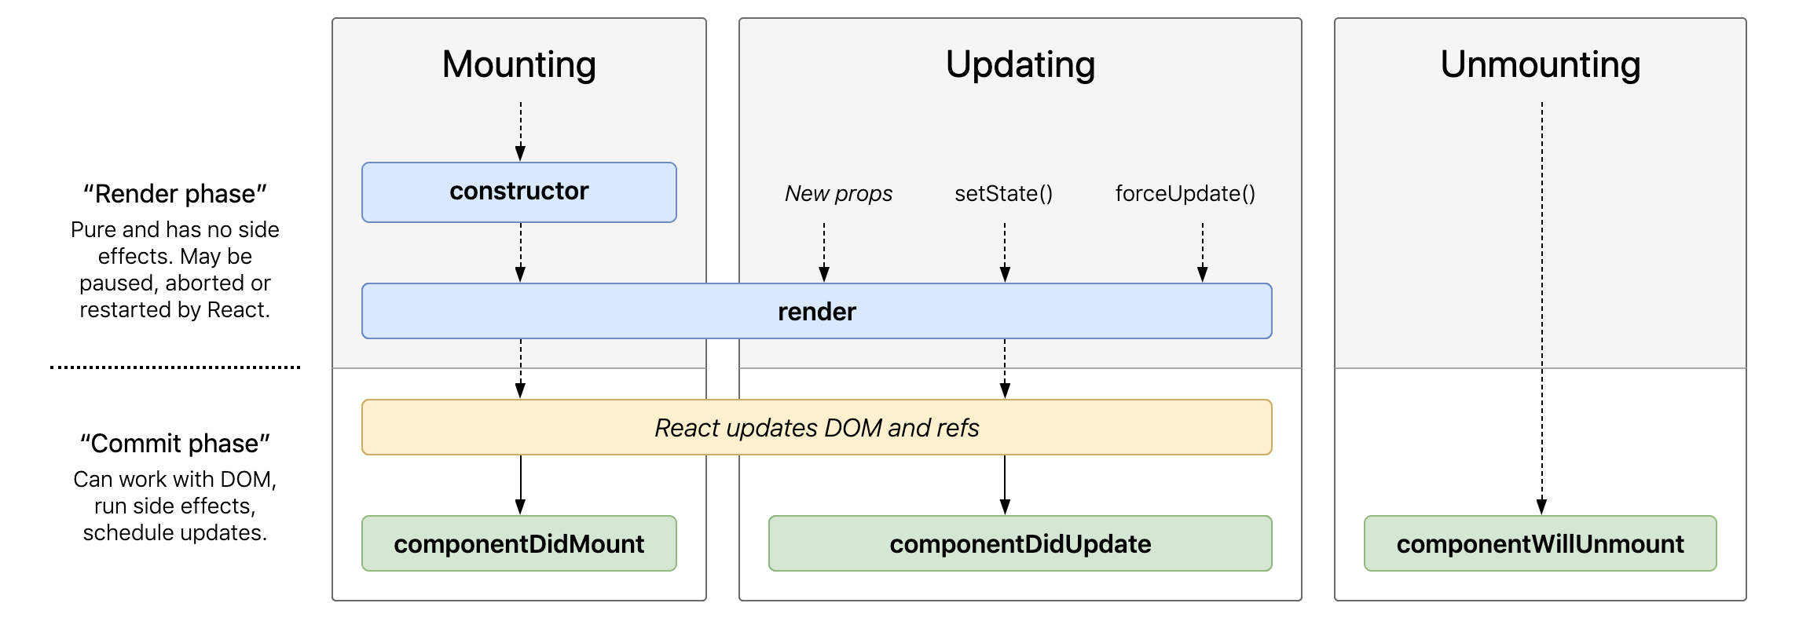
Remember this?
Individual React components each have their own lifecycles.
The most common ways to update a component include passing new props, setState, componentDidMount, and componentDidUpdate.

Slide 4
Our first activity triggered multiple renders
Page Component
Image Component
Image
Image
Image
Gallery Component
Card Component

Slide 5
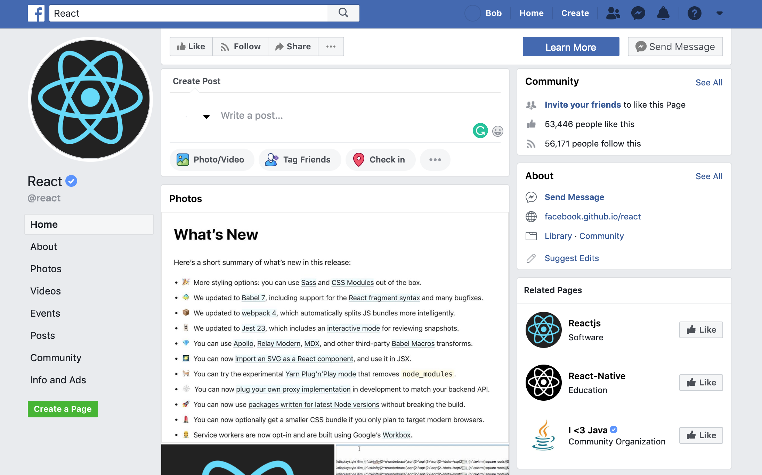
Imagine how complicated passing state could get…
• In larger applications, passing props down several levels quickly adds layers of complexity to your app.

Slide 6
Introducing… Prop Drilling
Prop Drilling, a phrase coined by Kent Dodds, is the process you have to go through to get data to parts of the React Component tree.
Although it seems tedious, prop drilling is often necessary to avoid complicating the global state of your application
• Remember, it’s often best to keep our state as close to where it’s relevant as possible.

Slide 7
Why can’t we just add state to the lowest level component?
(Image component from our activity)

Slide 8


You have ONE job…
Well… You could. But that would defeat the purpose of our Presentational Component. • We want to separate concerns, so it’s important that the Image Component has one simple job: Show the image.
Separate the logic and the looks

Slide 9
Give it some context!
To avoid adding in unnecessary state, we can use a feature called the React Context API. The Context API consists of 2 key parts:
The Provider, which wraps our presentational component, stores data within its state.
The Consumer, which goes inside the presentational component, allows us to grab values from the provider.
The technique of passing data directly into a component is known as dependency injection.

Slide 10
Before we begin…
Utilizing the Context API can be very helpful, but it comes at a cost. Adding stateful logic to a component creates a dependent relationship to another component. This is known as coupling.
When writing applications, it is best to keep components loosely coupled so that you can change one without affecting the other. This also helps ensure reusability.

Slide 11
What does this all mean?
Try to be mindful of how often you’re using the Context API.
If you find yourself using the Context API throughout several components, it may be time to consider using Redux or another state management library.
REMEMBER: There’s no “perfect” way to structure your application. Sometimes, you may be late into development before you realize that you need to use the Context API. This is completely normal!

Slide 12
Let’s see it in action!

