Slide 1
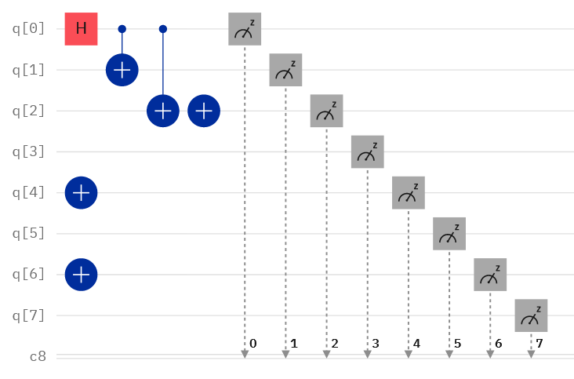


Initials exercise - example
T → 84 (ASCII) → 01010100 (BIN)
S → 83 (ASCII) → 01010011 (BIN)
Real quantum computer (noise)
Simulator (ideal)
© 2024 IBM Corporation

Slide 2




IBM Quantum Challenge 2024
The IBM Quantum Challenge is the annual code challenge focused on using Qiskit. It consists of a series of Jupyter notebooks that ask you to learn new features, use Qiskit, and solve problems.
Jun 05 — Jun 14, 2024
Sign up using your IBM Quantum Network email address → challenges.quantum.ibm.com
Participation is free, so join and take part in the IBM Quantum Challenge. Or better yet, get a group and solve it together!
Learn how to use Qiskit 1.0 and build toward utility-scale quantum experiments.
Key information
Adapt to utility-scale workloads by shifting away from the IBM Quantum Lab and instead running your code locally.
Earn a Credly badge to showcase your achievement by completing the challenge.
Read more here → https://www.ibm.com/quantum/blog/2024-quantum-challenge

