Slide 1
Optimize Beer Delivery Routes
A Toronto brewery case study

Slide 2
Business problem
I own a small brewery in downtown Toronto.
I just started bottling my beer and want to distribute it to restaurants in downtown Toronto. A few constraints: I only have one delivery truck, I can only support delivery of 50 venues a week (each once a week), and I can only distribute within 5 kilometers of my brewery (because my truck is not refrigerated).
How can I optimize my route selection by day of the week so that I delivery beer to restaurants within the same areas of Toronto on the same days?
Target audience
The target audience for this data is business owners, distributors, and sales representatives who want to optimize their route selection for sales and delivery of their products. Routes can be filtered and refined in numerous ways to meet the needs of the specific customer. In this case a brewery owner is trying to understand distribution routes for his product with a limited delivery capacity.

Slide 3
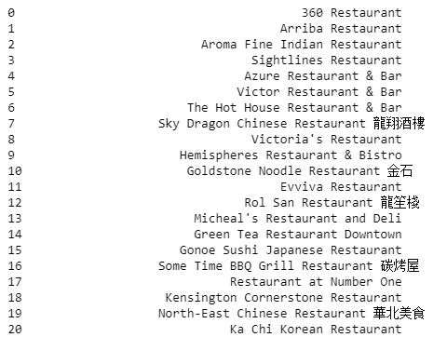
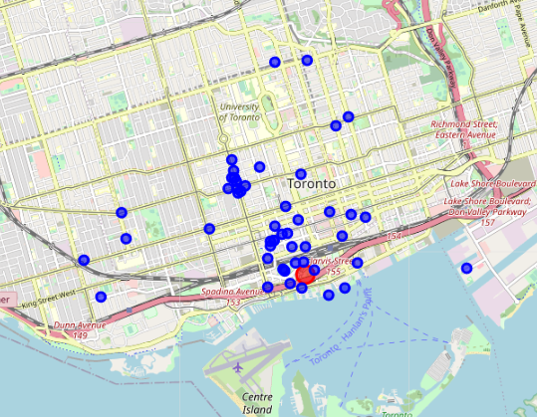
Data methodology
The data I will need for this project will come from Foursquare API.
I will filter search results by the following criteria: within 5 km of the brewery; only include "restaurant" in search query; and pick the top 50 venues.
Once the data points have been collected, I will segment the stores into 5 geographic clusters, one for each day of the week (Monday through Friday). The clusters will define the separate routes for the one delivery truck each day (the stores only receive one delivery per week).
Data analysis
Foursquare API data collection for restaurants
50 restaurants in downtown Toronto (blue), the brewery (red)

Slide 4
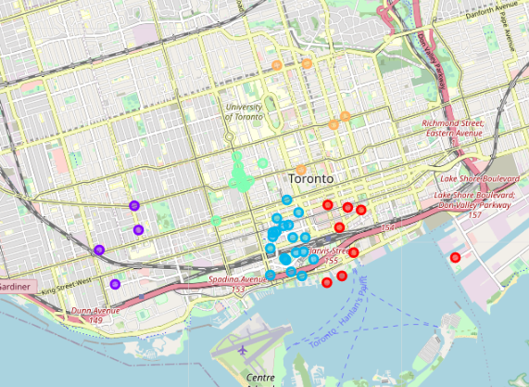
Results
Five colored clusters, one for each day of the week (Monday – Friday)
Clustering based on geographic location from the brewery
Effective optimization of a potential sales route based on venues and radius.

Slide 5
Discussion
Additional variables can be added to make the route selection more complex, such as traffic pattern along the route, hours of business for the venues, and average size of the weekly delivery for each cluster.
This is a proof of concept and demonstrates that larger geographic size and increased venues can provide effective results for sales routes.
Conclusion
The target audience for this type of project is sales representatives and organizations engaged in all types of commerce and distribution. Collecting location data and clustering select data can optimize a single sales representative's daily sales route, as well as improving an entire beverage distributor's bottom-line by reducing items such as the following: cost of gas; wear and tear on trucks; accidents on the road; and driver over-time pay. This one project demonstrated the successful execution of a concept that can be broadened in size and variables to provide value for many different businesses.

