Slide 1
Elastic Metaspace (Upstream Sales Pitch)
Thomas Stüfe, SAP
March 2020

Slide 2
Agenda
  Motivation
  Basics
  Current implementation
  New implementation proposal

Slide 3
Motivation
  Reduce Memory Footprint
  Keep Metaspace coding maintainable

Slide 4
Basics

Slide 5
Metadata lifecycle
  Metadata are typically allocated when classes are loaded
  Accumulated metadata is freed after class loader has been collected
    Bulk free scenario -> No need to track individual allocations -> arena style allocation
  Exceptions: premature deallocation possible but atypical

Slide 6
Metadata allocation / deallocation histogram (blocks/word size)
- Taken during a wildfly startup (standalone, no apps running)
- Small block allocations dominate. Only about 1% of allocations larger than 40 words.
- Deallocation: about 1:1000, similar curve.

Slide 7
Why bother?
Why not use a general purpose allocator (malloc, dlmalloc, boost etc?)
We think we can do better:
    Arena style allocation is fast and memory efficient.
    We know the size distribution of typical allocations
  malloc in particular would not work anyway:
    CompressedClassSpace
    Platform specific limitations (e.g. sbrk hits java heap)

Slide 8
Current implementation

Slide 9
Metaspace, very simplified, on one slide
- Lowest level: a series of memory regions, mmap‘d, grows on demand, committed on demand.
- Class loaders allocate largish chunks from those regions.
- Metadata memory is allocated from those chunks via pointer bump.
- When a loader dies, its chunks are returned to a global freelist and may be reused.

Slide 10
Lowest level: VirtualSpaceList and VirtualSpaceNode
Commit HWM
Klass structures
„Compressed“ class space
K1
K2
“class” VirtualSpaceList
-XX:CompressedClassSpaceSize
Everything else
D1
D2
D2
…
“non-class” VirtualSpaceList
Sizes per class:
~1K Klass (500+ … 500K)
~6K non-class (~2K … xxK)
VirtualSpaceNode

Slide 11
Current implementation
(much simplified)
Loader B
MetaChunk
Loader
top
ClassLoaderMetaspace
(owned by CLD)
Loader owns a chunk of memory.
Allocates from it via pointer bump.
  Remember: we do not need to track individual allocations for freeing.

Slide 12
Current implementation (2)
(much simplified)
Loader B
leftover space
Loader
„Retired chunks“
Current chunk
If chunk is used up, Loader acquires a new one from the metaspace allocator.
Retired chunks are kept in list
Leftover space is kept for later reuse

Slide 13
Current implementation (3)
(much simplified)
Loader B
VirtualSpaceNode
Reserved
Loader A
A
A
A
A
A
A
A
Loader B
B
B
B
B
B
Loader C
C
C
C
Committed
B
Used
Chunks are carved from VirtualSpaceNode as they are allocated.
VirtualSpaceNode is committed on demand, never gets uncommitted.
A
B
C
B
A
C
C
B
B
A
A
B
A
A
A

Slide 14
Current implementation (4)
(much simplified)
Loader B
Reserved
Loader A
A
A
A
A
A
A
A
Committed
Loader B
B
B
B
B
B
Loader C
C
C
C
B
Used
When a loader dies, its chunks are marked as free…
A
B
C
B
A
C
C
B
B
A
A
B
A
A
A

Slide 15
Current implementation (5)
(very much simplified)
Loader B
Reserved
Loader A
A
A
A
A
A
A
A
Loader C
Committed
C
C
C
Chunk Freelists
Used
ChunkManager
A
B
C
A
C
C
A
A
A
A
A
…and added to global freelists (ChunkManager), sorted by size. VirtualSpaceNode is potentially unmapped.

Slide 16
Deallocations
  Premature release of metadata
    1 Class redefinitions, Profile Counters, partly loaded metadata on Class loading errors ..
    2 But also: remains of retired chunks (usually larger blocks)
  Typically very rare (~ 1:1000 dealloc:alloc). But may happen more often in pathological cases
    Instrumentation?
  Deallocated metadata are still owned by class loader
  We attempt to reuse them for follow up metadata allocation, to varying degrees of success
  Deallocation histogram: similar to allocation but higher number of larger chunks due to (2)

Slide 17
Deallocations: BlockFreeList
  Two parts
    „SmallBlocks“ - a ordered vector of linked lists of free metadata, for small sizes (up to 13 blocks)
      O(1) insert/retrieval
    „BlockTreeDictionary“ - a BST for larger blocks
      BinaryTreeDictionary
      Unbalanced
  Note: blocks/tree nodes in place
  Whats not good:
    Smallblocks does not search for larger blocks
    Dictionary: too large blocks are retrieved and inserted back unnecessarily
    We are afraid and don‘t use it
    Complicated code

Slide 18
Classes
Loader B
Humongous Chunk
Dictionary
BlockFreeList
MetaChunk
(retired)
Per class loader
MetaChunk
(retired)
MetaChunk
(retired)
CLD
CLMS
SpaceManager
MetaChunk
(current chunk)
MetaChunk
(current chunk)
VirtualSpaceList
VirtualSpaceList
VirtualSpaceNode
ReservedSpace
VirtualSpaceNode
VirtualSpaceNode
VirtualSpaceNode
OccupancyMap
Global
ChunkManager
MetaChunk
(free)
MetaChunk
(retired)
MetaChunk
(retired)

Slide 19
..with CompressedClassPointers
Loader B
Per class loader
BlockFreeList
MetaChunk
(retired)
Class metadata
MetaChunk
(retired)
CLD
CLMS
MetaChunk
(retired)
SpaceManager
MetaChunk
(current chunk)
BlockFreeList
MetaChunk
(retired)
“non-class” metadata
MetaChunk
(retired)
“non-class” metadata
MetaChunk
(retired)
SpaceManager
MetaChunk
(current chunk)
VirtualSpaceList
VirtualSpaceNode
(Note: 1)
ReservedSpace
Class VSlist (note: really just one element).
OccupancyMap
VirtualSpaceList
VirtualSpaceNode
ReservedSpace
Non-Class VSlist
Global
VirtualSpaceNode
VirtualSpaceNode
VirtualSpaceNode
OccupancyMap
MetaChunk
Class ChunkManager
ChunkManager
MetaChunk
MetaChunk
MetaChunk
Non-Class ChunkManager
ChunkManager
MetaChunk
MetaChunk

Slide 20
Chunk sizes
  Class space: 1K (“special”), 2K (“small”), 32K(“medium”)
  Non-class space: 1K, 4K, 64K
  And humongous chunks: larger than medium and variable sized

Slide 21
Metachunk coalescation
  The „chunk size choking problem“
  JDK-8198423
  Since then chunks can be merged and split, within limits
    4x1K chunks -> 4K
    16x4K chunks -> 64K
  Basically the whole thing is now a weird buddy allocator
    A bit inefficient due to the odd chunk geometry
    But it solved the problem
    But I was afraid to touch too much, so the whole patch is one gigantic band aid
    Ugly and difficult to maintain :-(

Slide 22
Concern: „Micro Loaders“
  Some loaders / CLDs only ever load one class:
    Anonymous classes
    Reflection delegators
  Not optimal.
    In class space, only one InstanceClass is allocated, but needs a whole chunk
    In non-class space, ~10-20 allocations

Slide 23
Main waste areas
  Freelists can get huge.
    We have seen used:free ratios of 1:3 and worse
    =>Metaspace is not really elastic.
  Intra-chunk waste
    At some point loader typically stops loading classes; remaining chunk space (and deallocated space waiting for reuse) is wasted
    Worse with micro loaders, if there are a lot

Slide 24
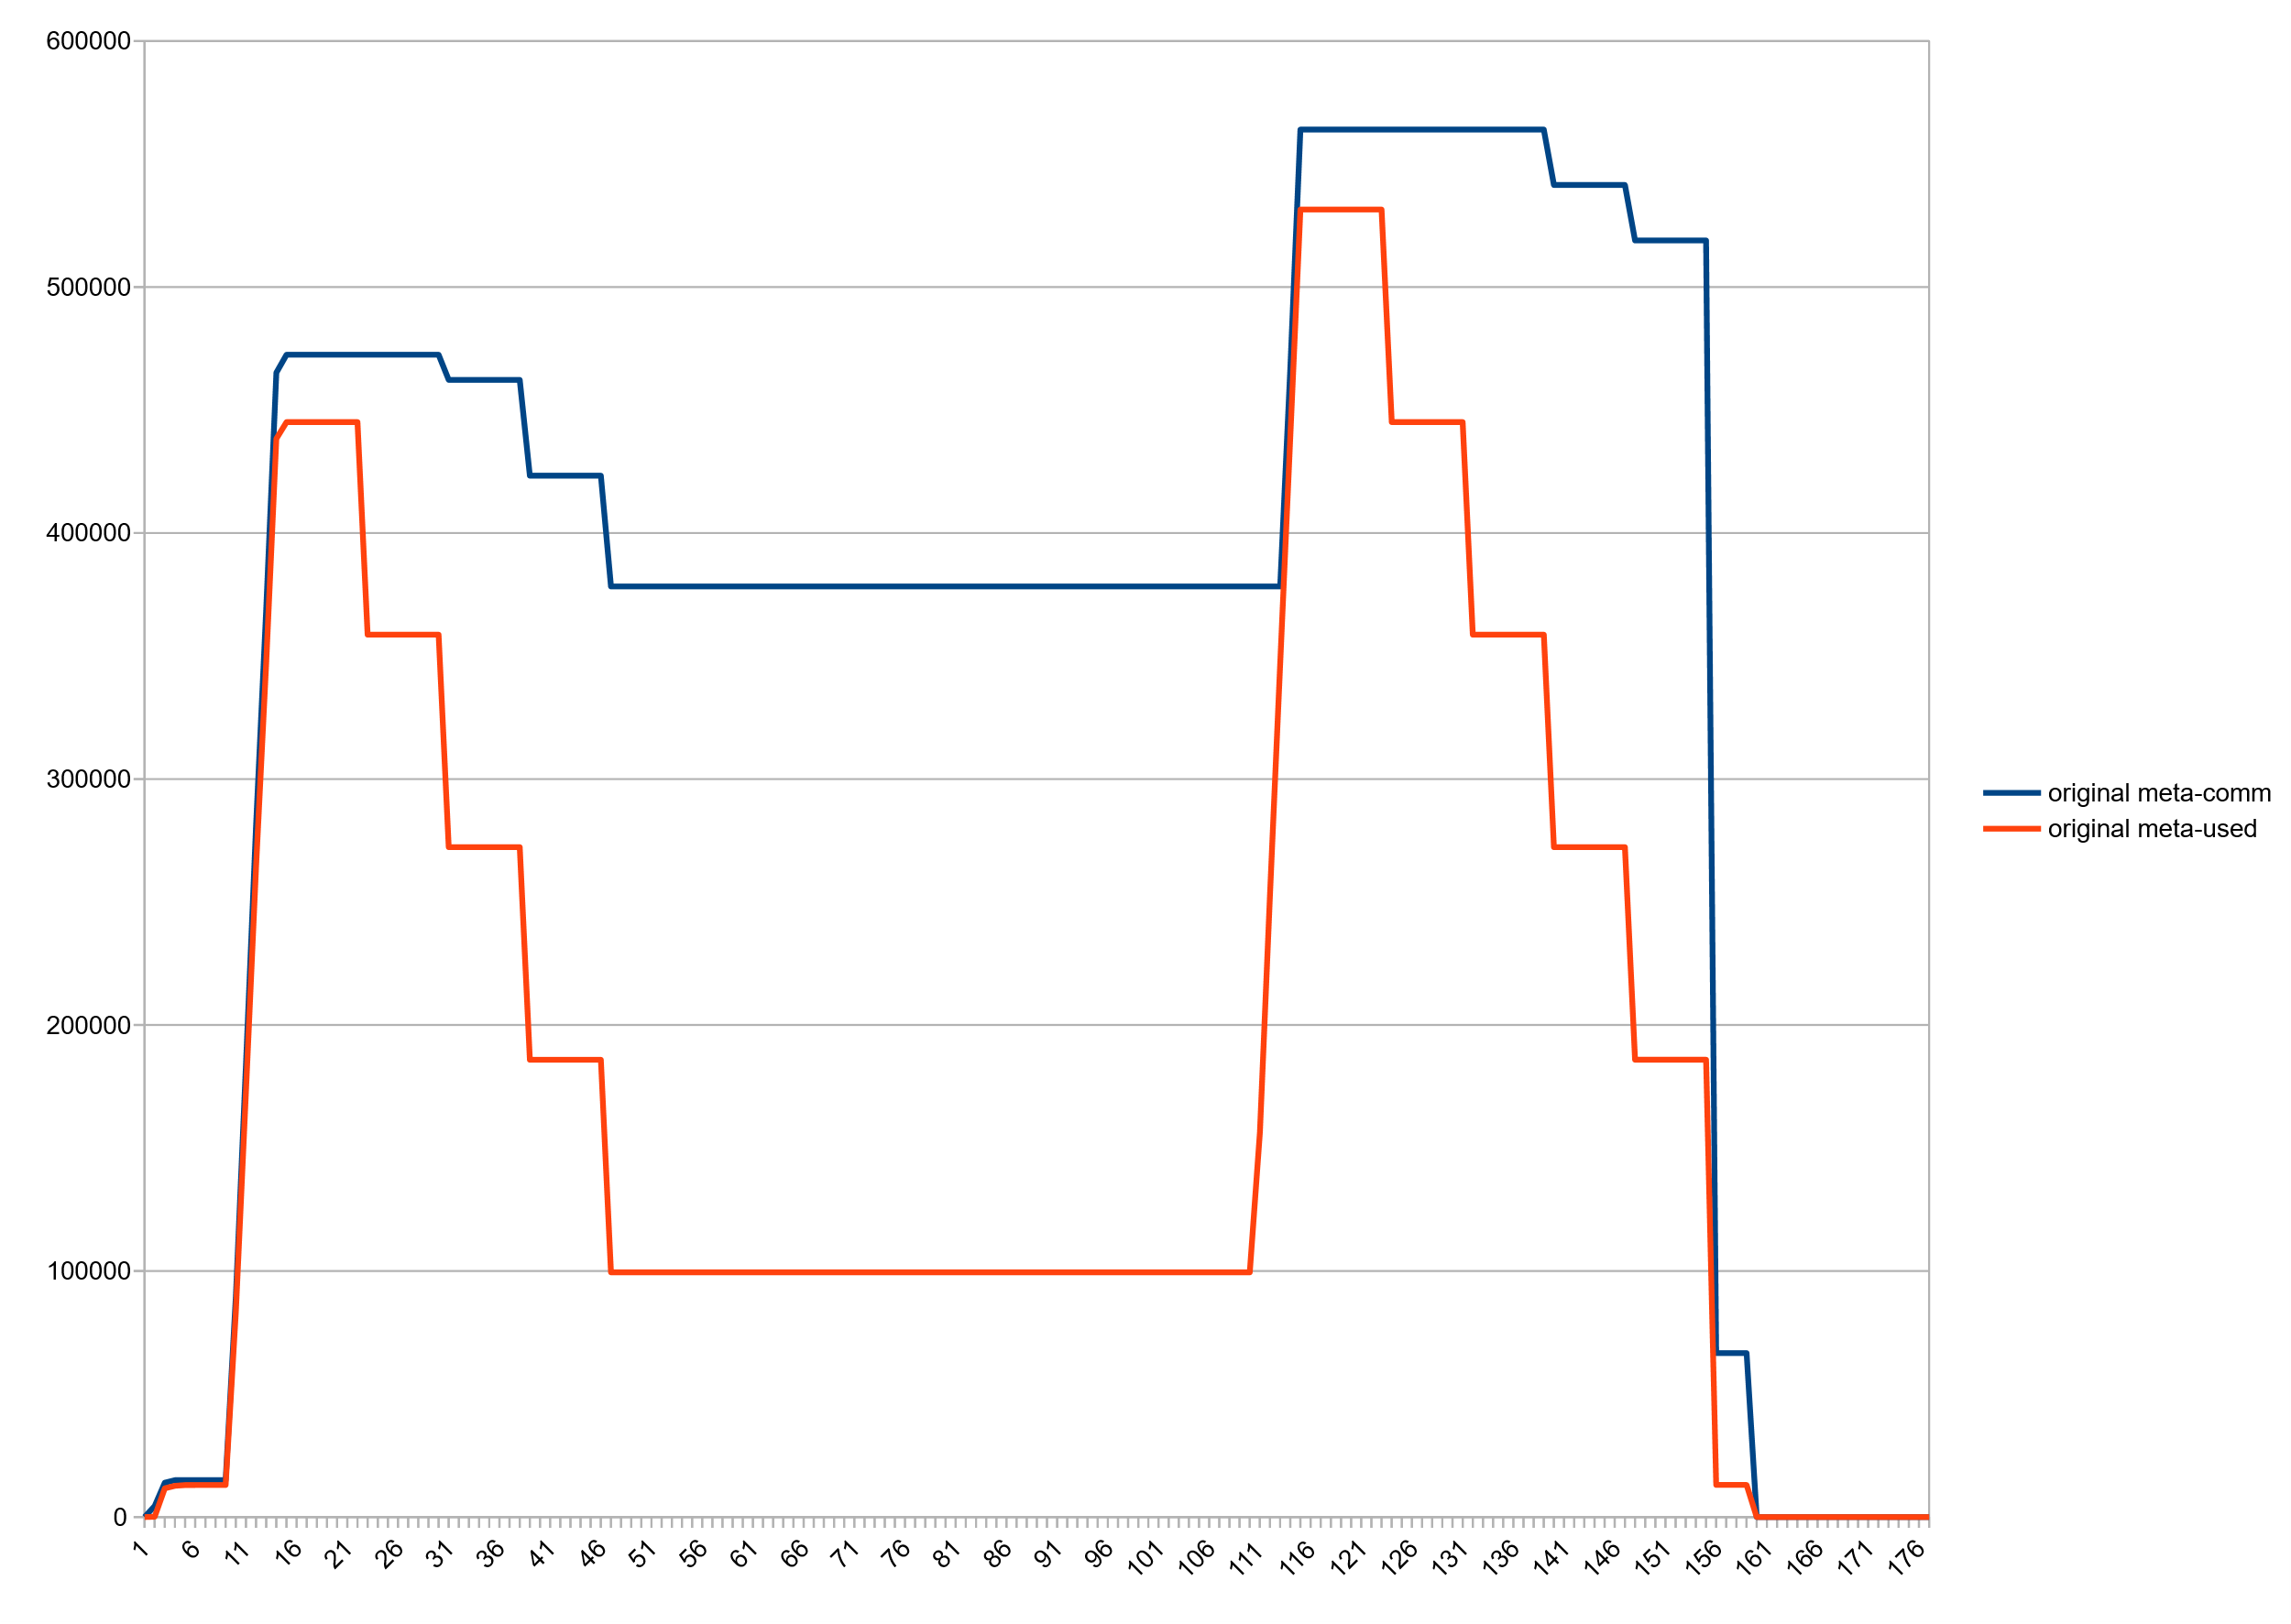
Huge freelists: Committed vs used space, after class unloading
~270M
:(

Slide 25
Huge Freelists (jcmd VM.metaspace output)
jcmd 27265 VM.metaspace
27265:
…
Waste (percentages refer to total committed size 373,48 MB):
Committed unused: 280,00 KB ( <1%)
Waste in chunks in use: 2,45 KB ( <1%)
Free in chunks in use: 6,34 MB ( 2%)
Overhead in chunks in use: 186,75 KB ( <1%)
In free chunks: 269,56 MB ( 72%)
Deallocated from chunks in use: 998,98 KB ( <1%) (1763 blocks)
-total-: 277,33 MB ( 74%)

Slide 26
Eat up! - Intrachunk waste from idle loaders
  Most loaders stop loading at some point. Remainder space in current chunk as well as deallocated blocks remain unused, effectively wasted.
  How large a chunk do we give to a loader?
    Too small: high fragmentation and contention on central allocator parts
    Too large: wasted space
    → we try to guess future loading behavior. We may guess wrong and suffer.
  We have tuned these areas a lot (see e.g. Zhengyu Yu's work on JDK-8190729 and JDK-8191924) but the solutions are far from optimal

Slide 27
Reimplementation

Slide 28
Basic idea
  Chunks in freelists can be uncommitted
  Delay committing chunks until they are actually used
    Partly commit them piece wise (like a thread stack)
    Removes the penalty of handing out large chunks to class loaders

Slide 29
Commit granules
commit HWM
Before:
Now:
Granule size
Adjustable, defaults to 64k

Slide 30
Current chunk allocation scheme unsuited for uncommitting chunks
  Odd chunk geometry
    Difficult to merge and split
    High fragmentation
    Complex code
  Chunk headers are a problem

Slide 31
Pow 2 based buddy allocator for chunks
  We need a better, cleaner chunk geometry scheme.
  Power 2 based buddy allocation is a nice fit.
  Chunks sized from 1K … 4M in pow2 steps (13 sizes in total).
  Dead simple to split and merge.
  Low external defragmentation -> Leads to larger free contiguous areas.
  Standard algorithm widely known

Slide 32
Pow 2 based buddy allocator for chunks
// Each chunk has a level; the level corresponds to its position in the tree
// and describes its size.
//
// The largest chunks are called root chunks, of 4MB in size, and have level 0.
// From there on it goes:
//
// size level
// 4MB 0
// 2MB 1
// 1MB 2
// 512K 3
// 256K 4
// 128K 5
// 64K 6
// 32K 7
// 16K 8
// 8K 9
// 4K 10
// 2K 11
// 1K 12

Slide 33
Buddy allocator: Allocation
4M
256K
256K
512K
1M
2M
  Remove chunk from freelist
  Optionally split until desired size is reached
  Return result chunk; put splinter chunks back to freelist

Slide 34
Buddy allocator: Deallocation
64K
64K
128K
256K
64K
64K
64K
64K
256K
512K
64K
64K
64K
64K
256K
  Mark chunk as free
  If buddy chunk is free and unsplit: remove from freelist and merge with chunk
    Repeat until root chunk sized reached or until buddy is not free
  Return result chunk to free list

Slide 35
New VirtualSpaceNode
  Metaspace is now segmented into “root chunk areas”: 4MB sized, aligned to 4MB
  VirtualSpaceNode:
    now only allocates root chunks → much simplified code.
    Does not commit! But provides committing as service to upper layers.
    Keeps a bitmap to keep track of committed/uncommitted granules.

Slide 36
New Chunk Manager
  ChunkManager keeps 13 freelists, one per chunk level
  Allocation flow:
    SpaceManager to ChunkManager: give me chunk of level X
    ChunkManager: have one in freelist(X) – ok.
      Have none? Search upward in freelists(X+1,2…)
      Found a larger chunk? Split it buddy style; return chunk of level X; put splinter chunks back into respective freelists
      Found no larger chunk? Ask underlying VirtualSpaceNode for new root chunk. Proceed as described above.

Slide 37
Granules and chunks – putting it all together
1:n
n:1
Chunks
256K
16K
16K
32K
64K
128K
Granules
  A larger chunk can span multiple granules (1:n)
  Multiple small chunks can cover a single granule (n:1)

Slide 38
Granules and chunks – putting it together
Chunks
256K
16K
16K
32K
64K
128K
Granules
  Free chunks spanning 1+ granules can be uncommitted
  A chunk spanning >1 granules can be committed in parts, on demand

Slide 39
Larger chunks can be committed on demand
256K
16K
16K
32K
64K
128K
256K
16K
16K
32K
64K
128K
  Removes penalty for guessing wrong in the “how large a chunk should I give him” guessing game at least for larger chunks (e.g. for the boot loader).

Slide 40
Chunk headers needed to go
Before
page
page
page
page
Header
Now
page
page
page
page
ChunkHeaderPool

Slide 41
New Deallocation handling („LeftOverManager“)
Bin list (similar to SmallBlocks) + a newly written BST
  New binlist covers more sizes (atm 32) and searches also upward
  The new BST is similar to the old one, but much reduced in code size and much simpler.
  New BST knows its largest node size.
  Note: we do not need the binaryTreeDictionary anymore :)
We now split blocks where it makes sense.
Possible further improvement: make it an RB tree.

Slide 42
What else changed
Got rid of humongous chunks :)
Got rid of occupancy map
Nice: Chunks can now grow in-place
  Saves overhead and reduces intrachunk waste
Code cleaner and more maintainable; better separation of concerns and testability.
Lots of new gtests

Slide 43
More improvements possible
  Improve error analysis for overwrites in Metaspace
    Simple: Buffer zones, canaries, disabling deallocation
    Costly but possible: guard pages
  Better micro loader handling

Slide 44
Concern 1: keep number of virtual memory areas low
  (Linux):
    Higher commit/uncommit fragmentation results in higher number of VMAs
    Kernel keeps vma structures in list and rb tree
    Too many of them may affect vma lookup
    And we may hit process limits
  So: keep an eye on commit granularity
  Solution: commit granule size is adjustable. Larger granules → lower fragmentation at the cost of lower memory returns.

Slide 45
Concern 2: uncommit speed
  Matters only to GCs which have no concurrent class unloading
  (Linux):
    Page table has to be unrolled & deallocated. How expensive this is depends on population of uncommitted area: how many pages had been committed before, and their size.
    Hence indirectly on size of uncommit region
    And also on number of vma in committed region, although in our case it should always be one.
  Currently I see no problems in practice, but a fall-back plan would be to uncommit concurrently. Not that complicated if we keep current locking scheme

Slide 46
Result: Committed vs used, Stock JDK14
~270M

Slide 47
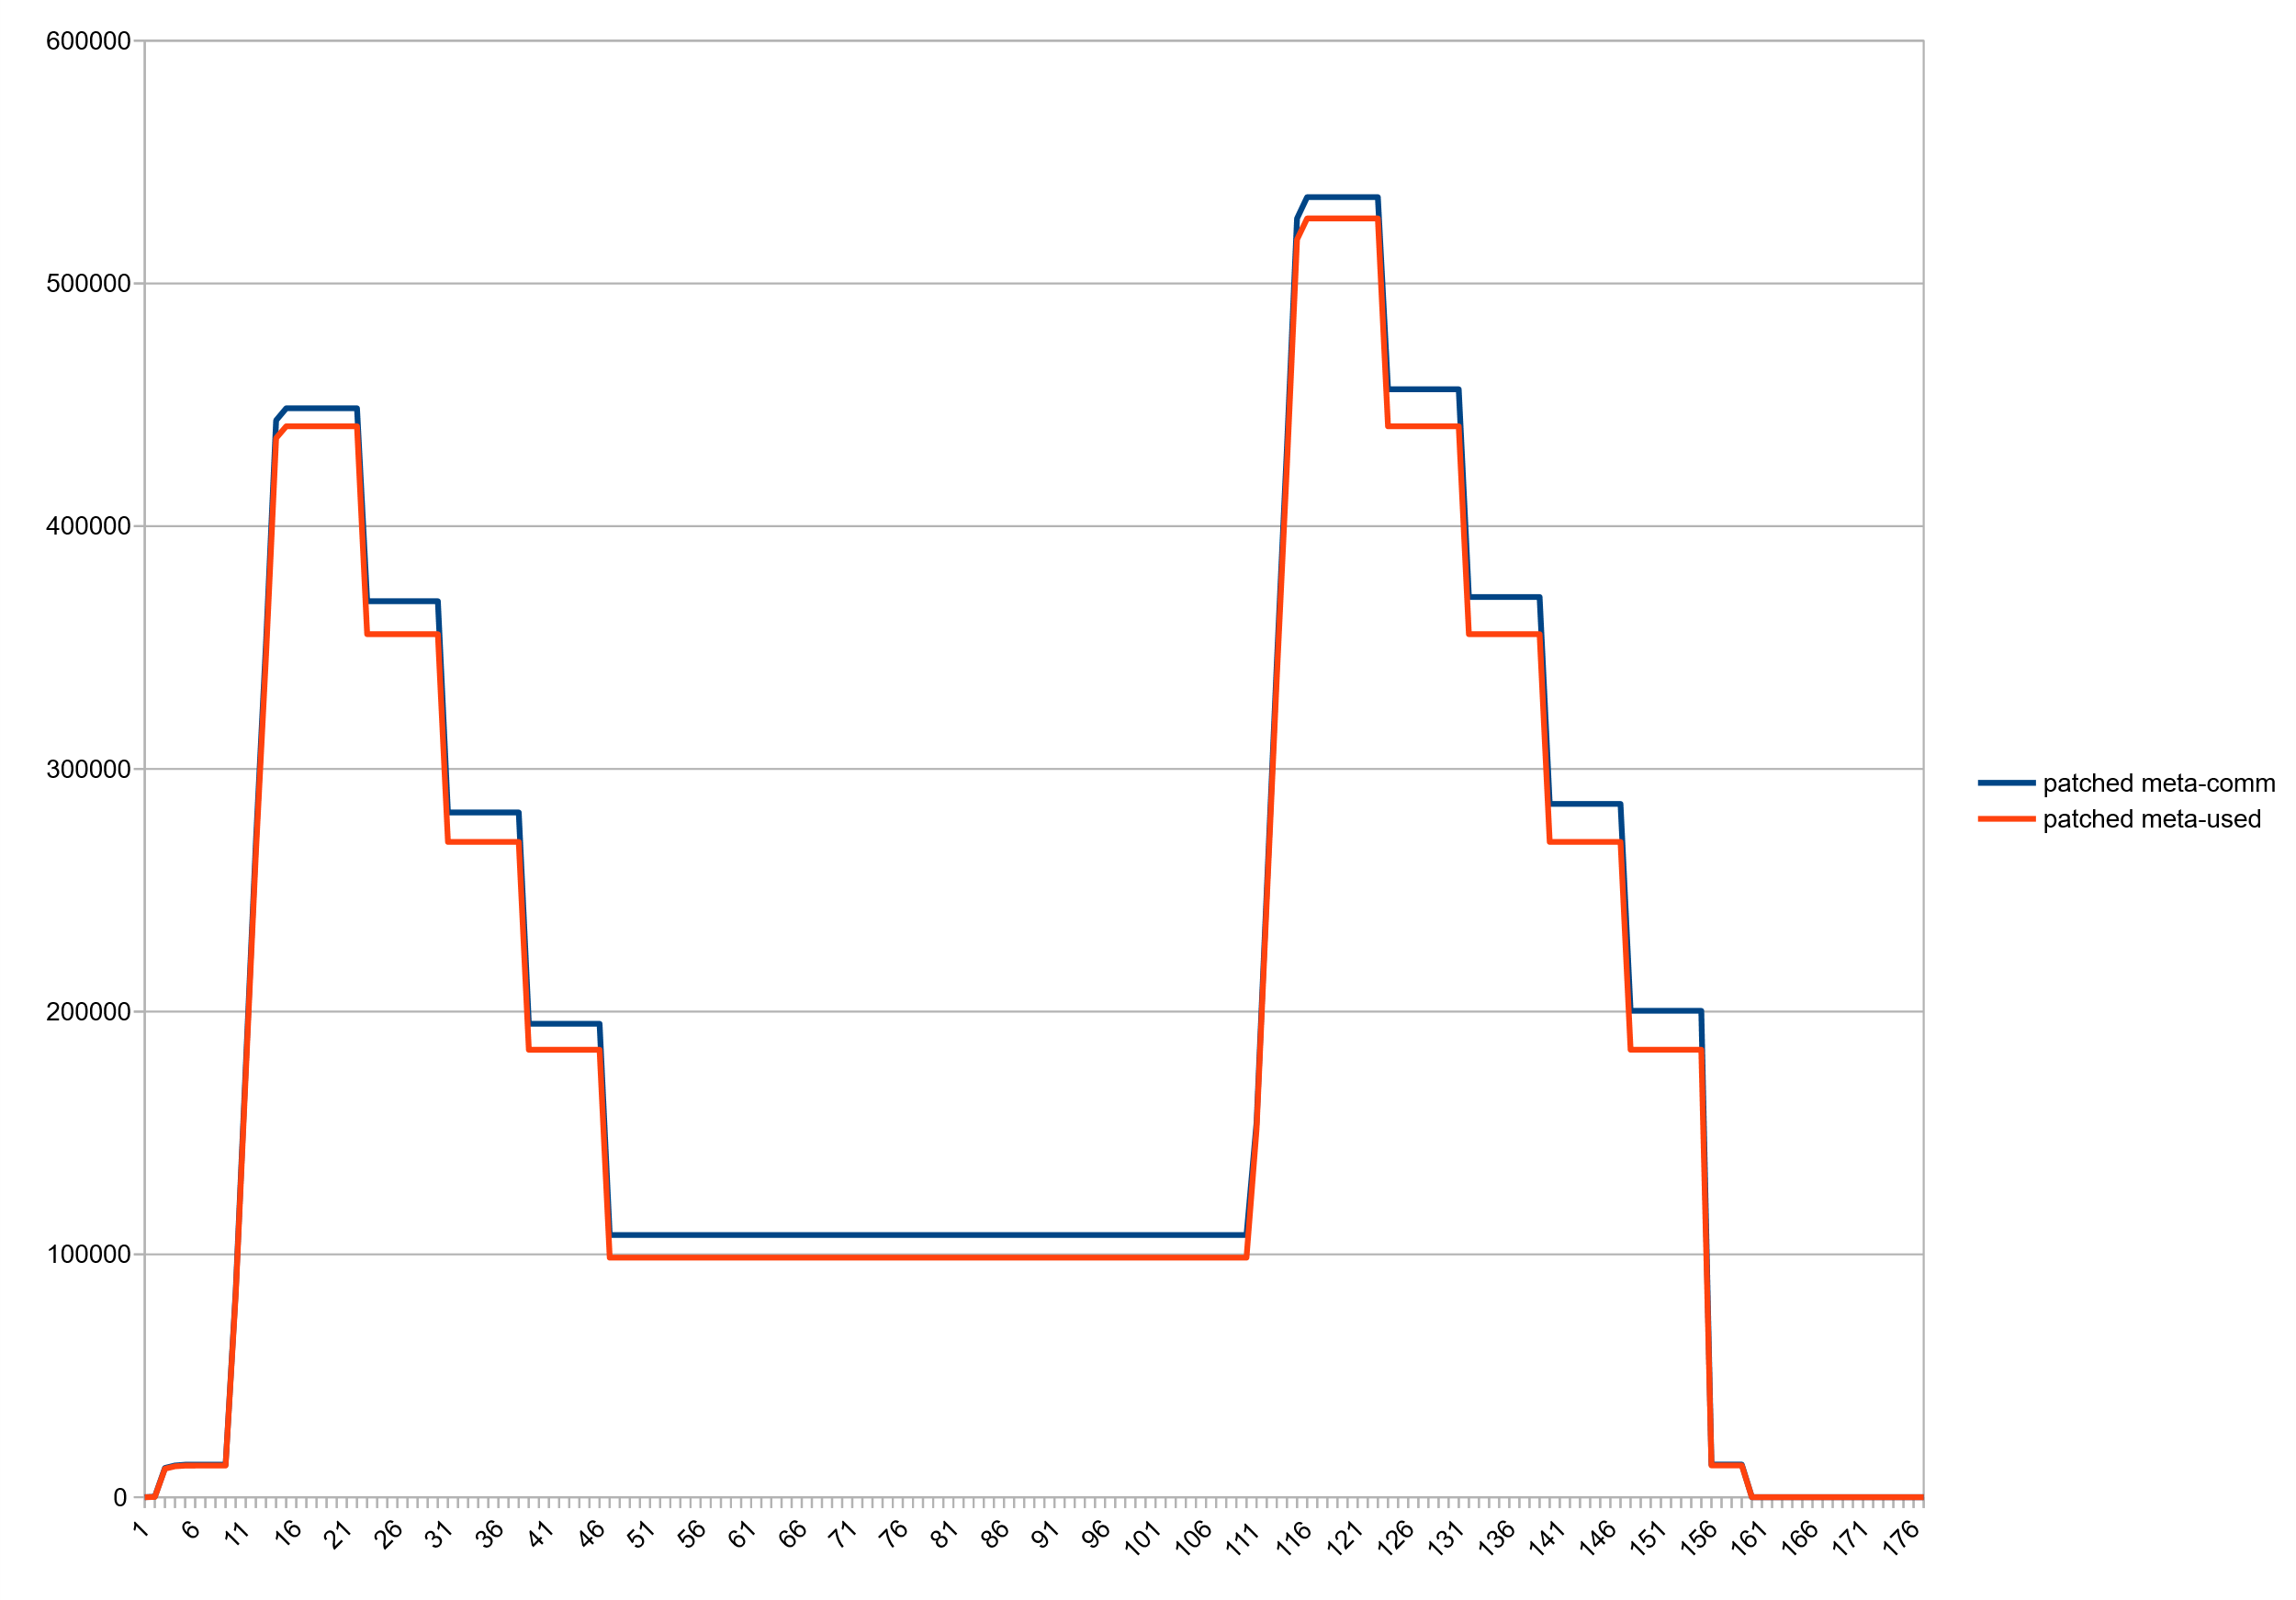
Result: Committed vs used, Patched JDK14

Slide 48
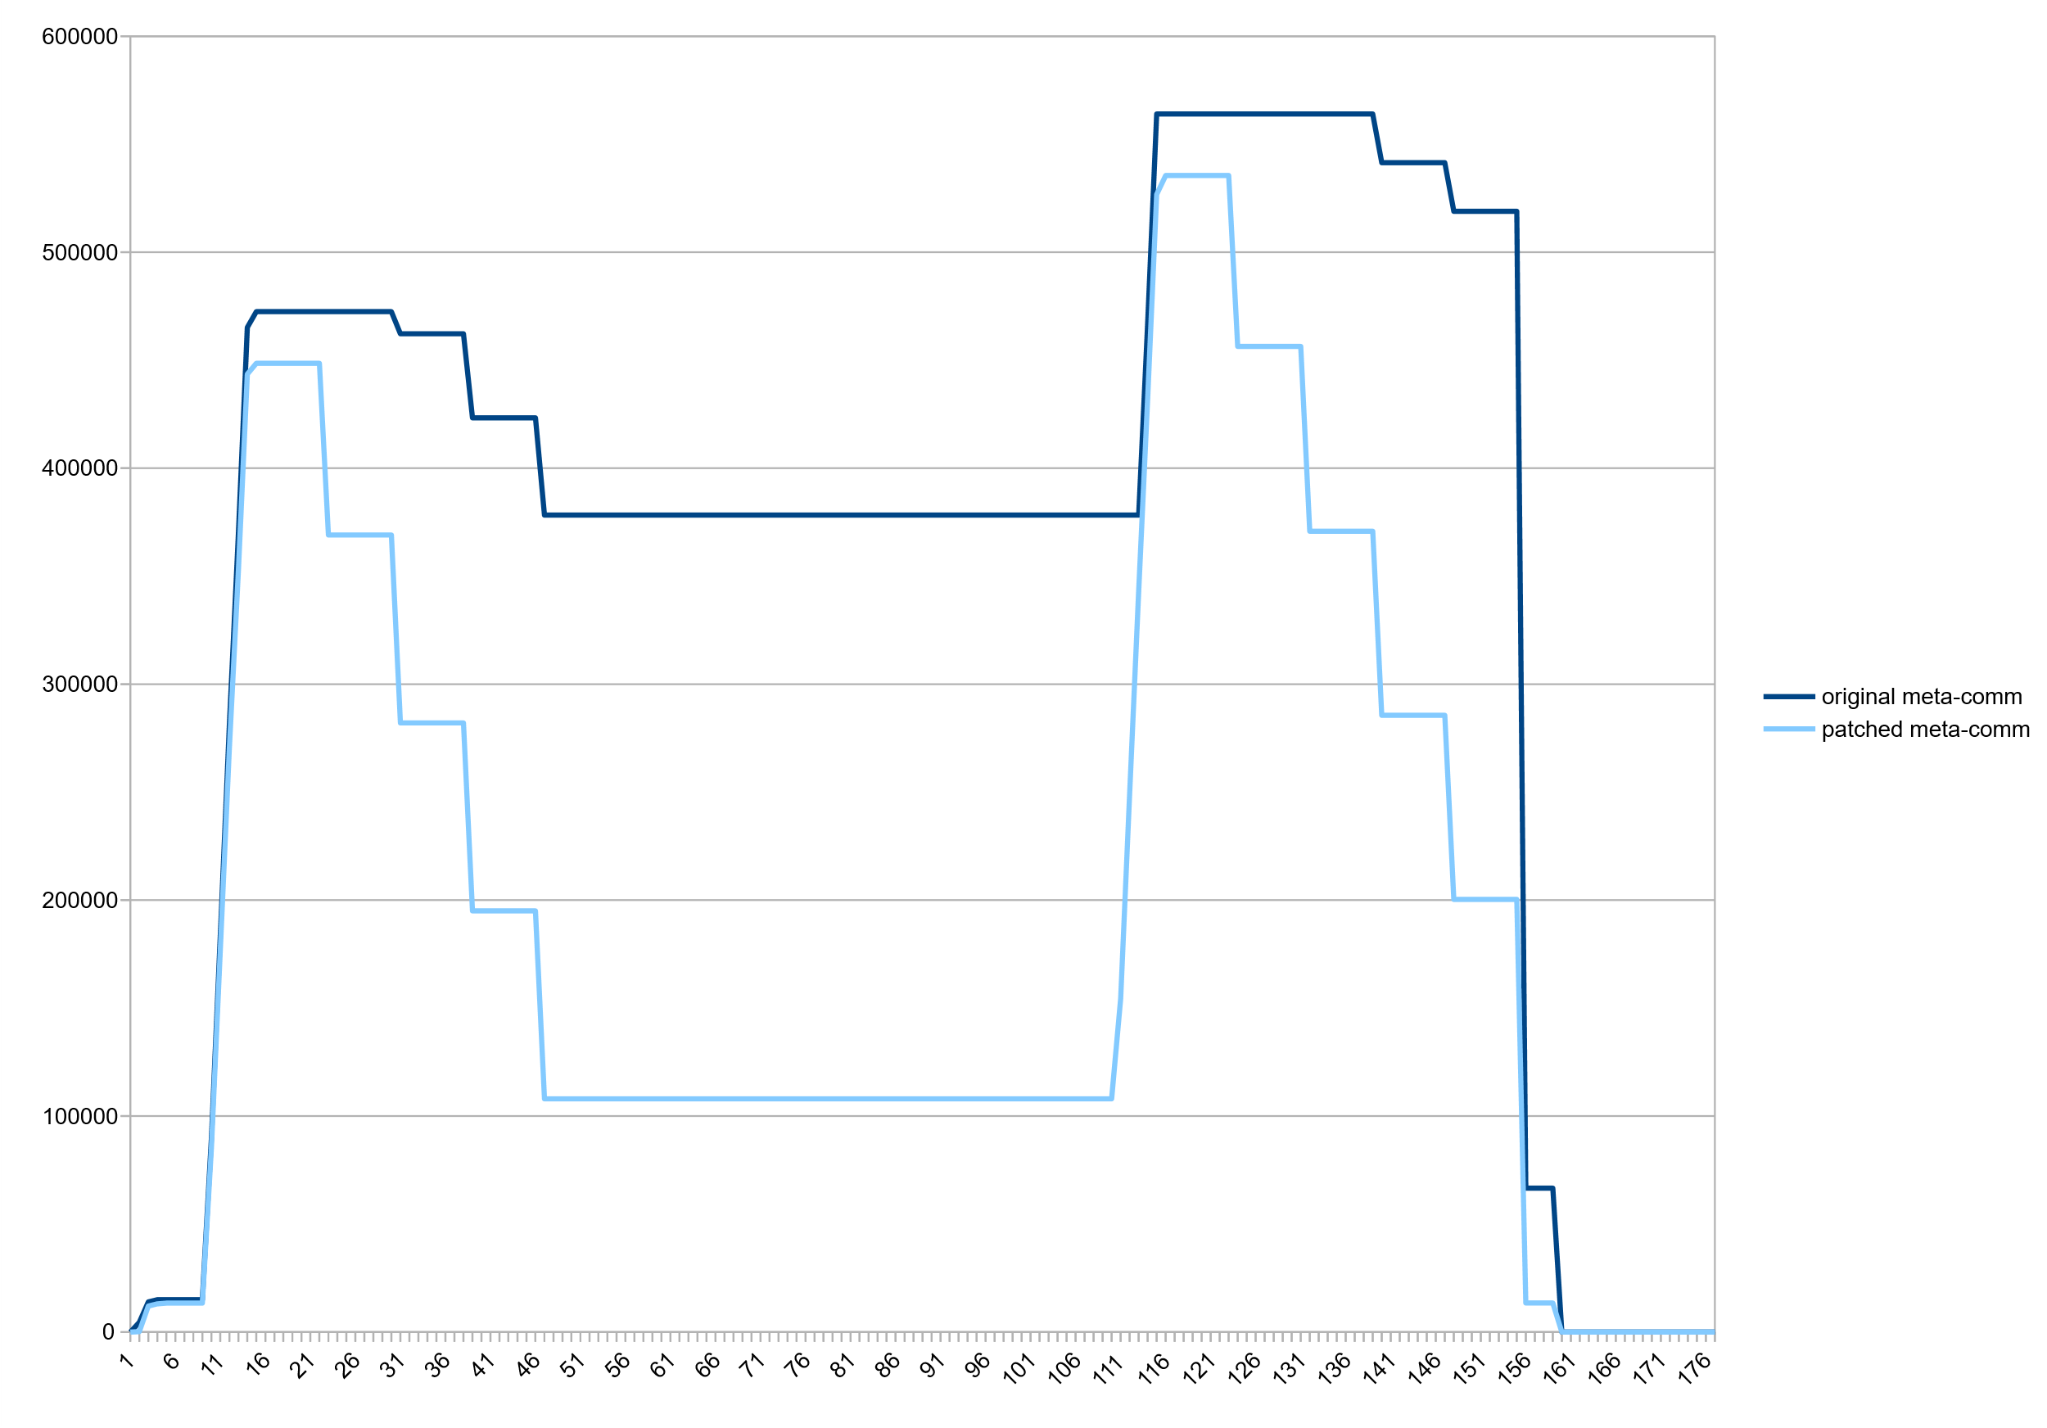
Result: committed Metaspace, Stock vs Patched VM

Slide 49
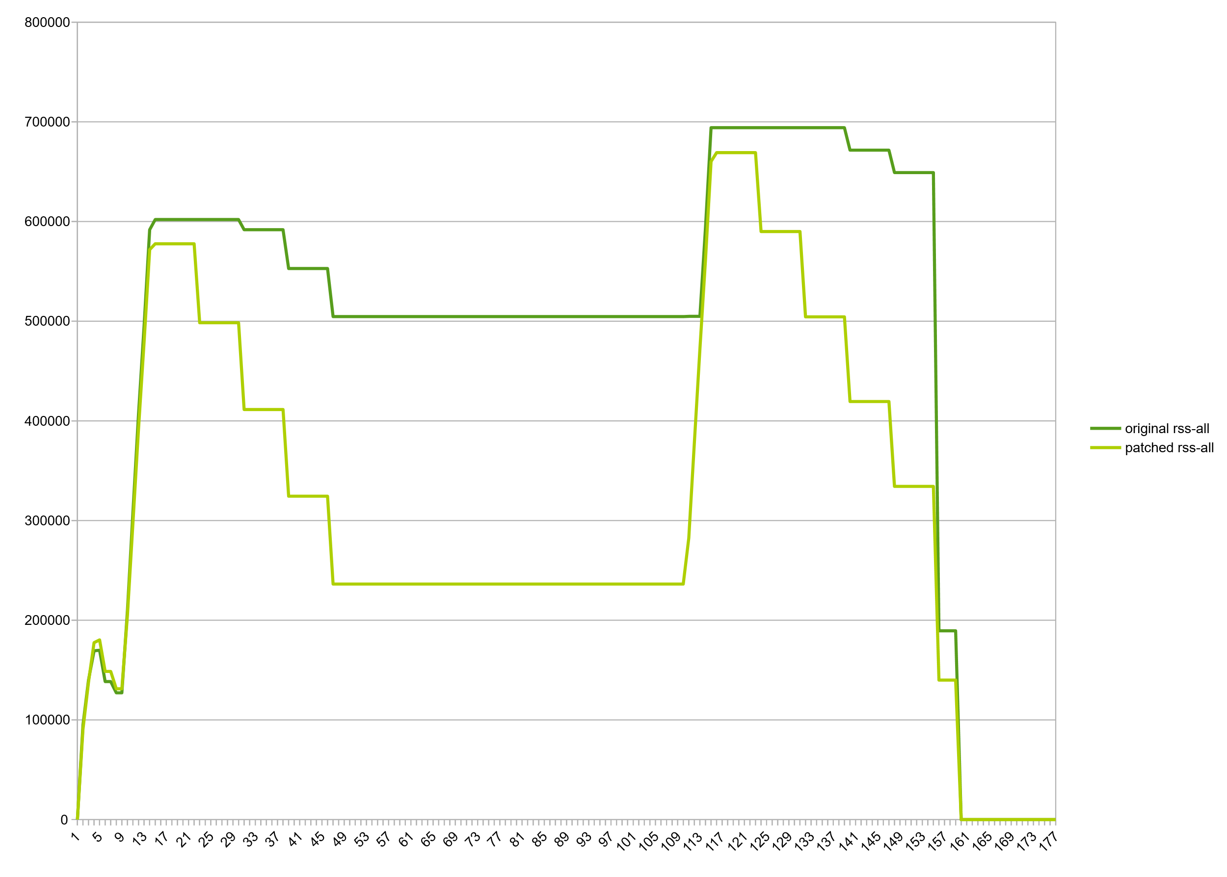
Result: RSS, Stock vs Patched VM

Slide 50
Modest decrease in consumption beyond class unloading
  Wildfly standalone after startup: 61m->54m, -7m, (11%)
  Eclipse CDT, hotspot project after C++ indexing: 138m->129m, -9m (12%)
  jruby helloworld.rb (invokedynamic, compile=FORCE): 41m->38m, -3m, (1.2%)

Slide 51
How do we go from here?
  Patch is stable. Needs more tests and smaller fixes but it works.
  Patch lives in jdk/sandbox repository, branch "stuefe-new-metaspace-branch“
    http://hg.openjdk.java.net/jdk/sandbox/
  JEP exists in Draft state (“Elastic Metaspace”: https://openjdk.java.net/jeps/8221173 )
  JDK15?
  A good candidate for backporting
    Would make a lot of sense in 11/8
    Large patch but Metaspace is quite isolated. Should not be too much of a hassle.

Slide 52
Thank you.
Contact information:
Thomas Stüfe
@tstuefe
thomas.stuefe@sap.com
stuefe.de

