Slide 1
Interleaved Loaders Test:
- Load 40000 classes
- release them randomly in 5 steps
- observe Metaspace used and committed size
Original test sources: https://github.com/tstuefe/ojdk-repros/blob/master/repros8/src/main/java/de/stuefe/repros/metaspace/InterleavedLoaders2.java
Raw test results:
https://github.com/tstuefe/JEP-Improve-Metaspace-Allocator/tree/master/test/test1

Slide 2
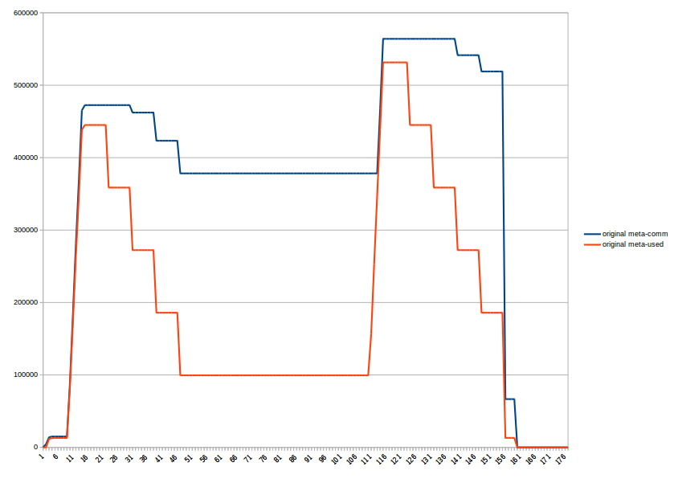
Stock VM (jdk 14), Metaspace used (red) vs committed (blue)
- Spikes in used metaspace carry over
- After the first spike, almost 300M of unused data retained

Slide 3
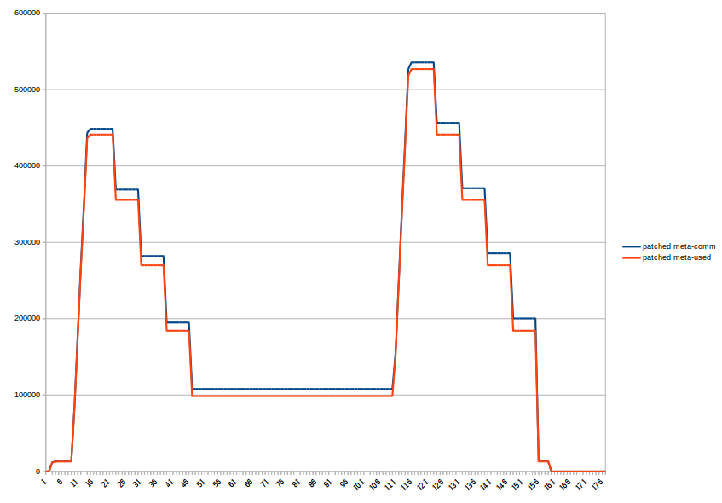
Patched VM (jdk 14), Metaspace used (red) vs committed (blue)
(default settings with 64K commit granule size)
- We recover almost completely from the spikes

Slide 4
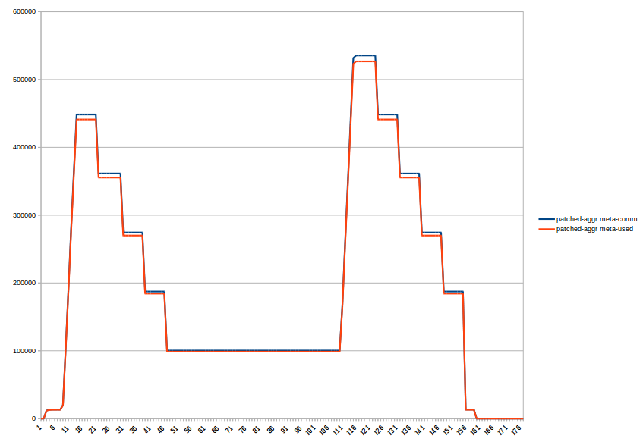
Patched VM (jdk 14), Metaspace used (red) vs committed (blue)
(aggressive settings with 16K commit granule size)
- In this scenario, almost no discernable advantage over default settings

Slide 5
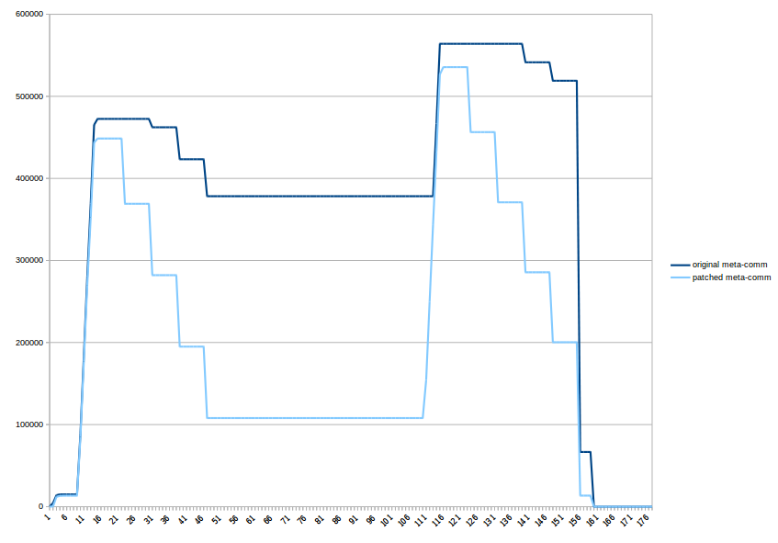
Metaspace committed – Stock VM (dark blue) vs Patched VM (light blue)
B
B
A
C
- (A) After releasing 4/5th of the test classes, we retain about 260M (~70%) less memory than the stock VM
- (B) Spikes are about 5% lower
- (C) After the test ran, we are back to base line, Stock VM is not.

Slide 6
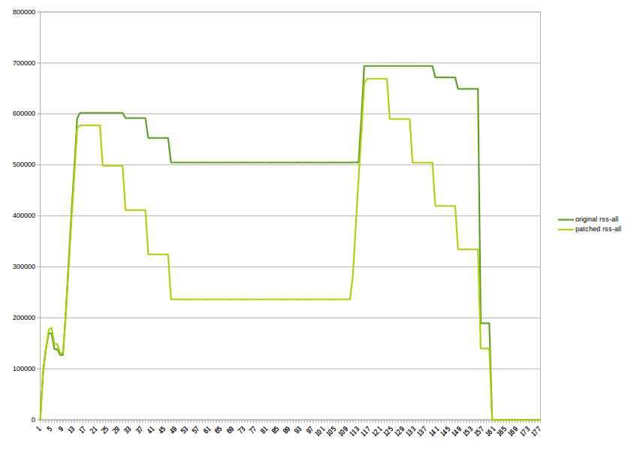
RSS – Stock VM (dark green) vs Patched VM (light green)
- measured with AlwaysPreLoad
- RSS shows the same reduction by ~260M - so no hidden costs :)

Slide 7
Stock VM, jcmd VM.metaspace output, after unloading 4/5 of all classes
27265:
Total Usage - 291 loaders, 10982 classes (972 shared):
<snip>
Virtual space:
Non-class space: 332,00 MB reserved, 331,26 MB (>99%) committed
Class space: 1,00 GB reserved, 42,22 MB ( 4%) committed
Both: 1,32 GB reserved, 373,48 MB ( 28%) committed
<snip>
Waste (percentages refer to total committed size 373,48 MB):
Committed unused: 280,00 KB ( <1%)
Waste in chunks in use: 2,45 KB ( <1%)
Free in chunks in use: 6,34 MB ( 2%)
Overhead in chunks in use: 186,75 KB ( <1%)
In free chunks: 269,56 MB ( 72%)
Deallocated from chunks in use: 998,98 KB ( <1%) (1763 blocks)
-total-: 277,33 MB ( 74%)

Slide 8
Patched VM, jcmd VM.metaspace output, after unloading 4/5 of all classes
27149:
Total Usage - 291 loaders, 10986 classes (980 shared):
<snip>
Virtual space:
Non-class space: 408,00 MB reserved, 94,06 MB ( 23%) committed, 51 nodes.
Class space: 1,00 GB reserved, 11,38 MB ( 1%) committed, 1 nodes.
Both: 1,40 GB reserved, 105,44 MB ( 7%) committed.
<snip>
Waste (unused committed space):(percentages refer to total committed size 105,44 MB):
Waste in chunks in use: 15,86 KB ( <1%)
Free in chunks in use: 1,59 MB ( 2%)
In free chunks: 11,14 MB ( 11%)
Deallocated from chunks in use: 194,36 KB ( <1%) (2085 blocks)
-total-: 12,93 MB ( 12%)

