Slide 1
Elastic Metaspace (Reviewer Sales Pitch)
Thomas Stüfe, SAP
March 2020

Slide 3
Why this project ?
  We use too much space for metaspace and it is not elastic – small to moderate to (sometimes) large savings possible
  Code needs a loving rewrite. Has gotten too complicated, no one likes it anymore (including me).

Slide 4
Basics

Slide 5
Metadata lifecycle
  Metadata are typically allocated when classes are loaded
  Accumulated metadata is freed after class loader has been collected
    Bulk free scenario -> No need to track individual allocations -> arena style allocation
  Exceptions: premature deallocation possible but atypical

Slide 6
Metadata allocation / deallocation histogram (blocks/word size)
- from a wildfly startup
- allocation: only about 1% above 40 words
- deallocation: similar, but higher number of larger blocks

Slide 7
Why bother?
Why not a general purpose allocator?
We think we can do better:
    Arena style allocation is fast and memory efficient.
    We know the size distribution of typical allocations
  Case against malloc in particular:
    CompressedClassSpace
    Platform specific limitations (e.g. sbrk hits java heap)

Slide 8
Current implementation

Slide 9
Metaspace has two parts
Commit HWM
Klass structures
„Compressed“ class space
K1
K2
-XX:CompressedClassSpaceSize
Everything else
D1
D2
D2
…
„non class“ Metaspace
Sizes per class:
~1K Klass (500+ … 500K)
~6K non-class (~2K … xxK)

Slide 10
Metaspace has two parts
VirtualSpaceNode
Commit HWM
Klass structures
„Compressed“ class space
K1
K2
„VirtualSpaceList“
-XX:CompressedClassSpaceSize
Everything else
D1
D2
D2
…
„non class“ Metaspace
VirtualSpaceList
Sizes per class:
~1K Klass (500+ … 500K)
~6K non-class (~2K … xxK)

Slide 11
Current implementation (1)
(much simplified)
Loader B
Loader
top
Loader owns a chunk of memory.
Allocates from it via pointer bump.

Slide 12
Current implementation (1)
(much simplified)
Loader B
MetaChunk
Loader
top
ClassLoaderMetaspace
(owned by CLD)
Loader owns a chunk of memory.
Allocates from it via pointer bump.
  Remember: we do not need to track individual allocations for freeing.

Slide 13
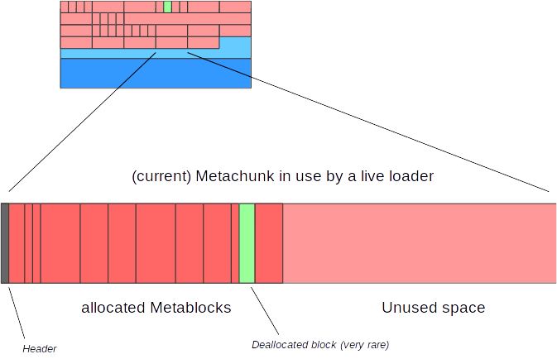
MetaChunk
Loader B

Slide 14
Current implementation (2)
(much simplified)
Loader B
leftover space
Loader
„Retired chunks“
Current chunk
If chunk is used up, Loader aquires a new one from the metaspace allocator.
Retired chunks are kept in list
Leftover space is kept for later reuse

Slide 15
Current implementation (3)
(much simplified)
Loader B
VirtualSpaceNode
Reserved
Loader A
A
A
A
A
A
A
A
Loader B
B
B
B
B
B
Loader C
C
C
C
Committed
B
Used
Chunks are carved from VirtualSpaceNode as they are allocated.
VirtualSpaceNode is committed on demand, never gets uncommitted.
A
B
C
B
A
C
C
B
B
A
A
B
A
A
A

Slide 16
Current implementation (4)
(much simplified)
Loader B
Reserved
Loader A
A
A
A
A
A
A
A
Commited
Loader B
B
B
B
B
B
Loader C
C
C
C
B
Used
When a loader dies, its chunks are marked as free…
A
B
C
B
A
C
C
B
B
A
A
B
A
A
A

Slide 17
Current implementation (5)
(very much simplified)
Loader B
Reserved
Loader A
A
A
A
A
A
A
A
Loader C
Commited
C
C
C
Chunk Freelists
Used
ChunkManager
A
B
C
A
C
C
A
A
A
A
A
…and added to global freelists (ChunkManager), sorted by size. VirtualSpaceNode is potentially unmapped.

Slide 18
Classes
Loader B
Humongous Chunk
Dictionary
BlockFreeList
MetaChunk
(retired)
Per class loader
MetaChunk
(retired)
MetaChunk
(retired)
CLD
CLMS
SpaceManager
MetaChunk
(current chunk)
MetaChunk
(current chunk)
VirtualSpaceList
VirtualSpaceList
VirtualSpaceNode
ReservedSpace
VirtualSpaceNode
VirtualSpaceNode
VirtualSpaceNode
OccupancyMap
Global
ChunkManager
MetaChunk
(free)
MetaChunk
(retired)
MetaChunk
(retired)

Slide 19
..with CompressedClassPointers
Loader B
Per class loader
BlockFreeList
MetaChunk
(retired)
Class metadata
MetaChunk
(retired)
CLD
CLMS
MetaChunk
(retired)
SpaceManager
MetaChunk
(current chunk)
BlockFreeList
MetaChunk
(retired)
“non-class” metadata
MetaChunk
(retired)
“non-class” metadata
MetaChunk
(retired)
SpaceManager
MetaChunk
(current chunk)
VirtualSpaceList
VirtualSpaceNode
(Note: 1)
ReservedSpace
Class VSlist (note: really just one element).
OccupancyMap
VirtualSpaceList
VirtualSpaceNode
ReservedSpace
Non-Class VSlist
Global
VirtualSpaceNode
VirtualSpaceNode
VirtualSpaceNode
OccupancyMap
MetaChunk
Class ChunkManager
ChunkManager
MetaChunk
MetaChunk
MetaChunk
Non-Class ChunkManager
ChunkManager
MetaChunk
MetaChunk

Slide 20
Deallocations
  Premature release of metadata
    1 Class redefinitions, Profile Counters, partly loaded metadata on Class loading errors ..
    2 But also: remains of retired chunks (usually larger blocks)
  Typically very rare. But may happen often in pathological cases
    Instrumentation?
  Deallocated metadata are still owned by class loader
  We attempt to reuse them for follow up metadata allocation, to varying degrees of success
  Deallocation histogram: similar to allocation but higher number of larger chunks due to (2)

Slide 21
Metadata allocation / deallocation histogram (blocks/word size)
- from a wildfly startup
- allocation: only about 1% above 40 words
- deallocation: similar, but higher number of larger blocks

Slide 22
BlockFreeList
  Two parts
    „SmallBlocks“ - a ordered vector of linked lists of free metadata, for small sizes (up to 13 blocks)
      O(1) insert/retrieval
    „BlockTreeDictionary“ - a BST for larger blocks
      BinaryTreeDictionary
      Unbalanced
  Note: blocks/tree nodes in place
  Whats not good:
    Smallblocks does not search for larger blocks
    Dictionary: too large blocks are retrieved and inserted back unnecessarily
    We are afraid and don‘t use it
    Complicated code

Slide 23
„Micro Loaders“
  Some loaders / CLDs only ever load one class:
    Anonymous classes
    Reflection delegator glue
  Not optimal.
    In class space, only one InstanceClass is allocated, but needs a whole chunk
    In non-class space, ~10-20 allocations

Slide 24
Eat your plate up!
  The “eat your plate up” problem: how large a chunk do we give to the class loader?
    Too small: high fragmentation and contention on central parts
    Too large: wasted space
    Often guesswork and can be wrong
  A function of chunk allocation history
  Micro loaders get small chunks

Slide 25
Chunk sizes
  Class space: 1K (“special”), 2K (“small”), 32K(“medium”)
  Non-class space: 1K, 4K, 64K
  And humongous chunks: larger than medium and variable sized

Slide 26
11 – metachunk coalescation
  The „chunk size choking problem“
  JDK-8198423
  Chunks can be merged and split now
    4x1K chunks -> 4K
    16x4K chunks -> 64K
  Basically the whole thing is now a crooked buddy allocator
    A bit inefficient
    But it solved the problem
    But I was afraid to touch too much, so the whole patch is one gigantic band aid
    Ugly and difficult to maintain :-(

Slide 27
Bottomline: Main problems with current implementation
  Freelists can get huge.
    We have seen used:free ratios of 1:3 and worse
    =>Metaspace is not really elastic.
  Intra-chunk waste
    At some point loader typically stops loading classes; remaining chunk space is wasted
    Worse with many tiny loaders (reflection delegator classes, lambda anonymous classes)
  Code bloat
    Expensive to maintain.
    Code base grew over time and has gotten overly complicated.

Slide 28
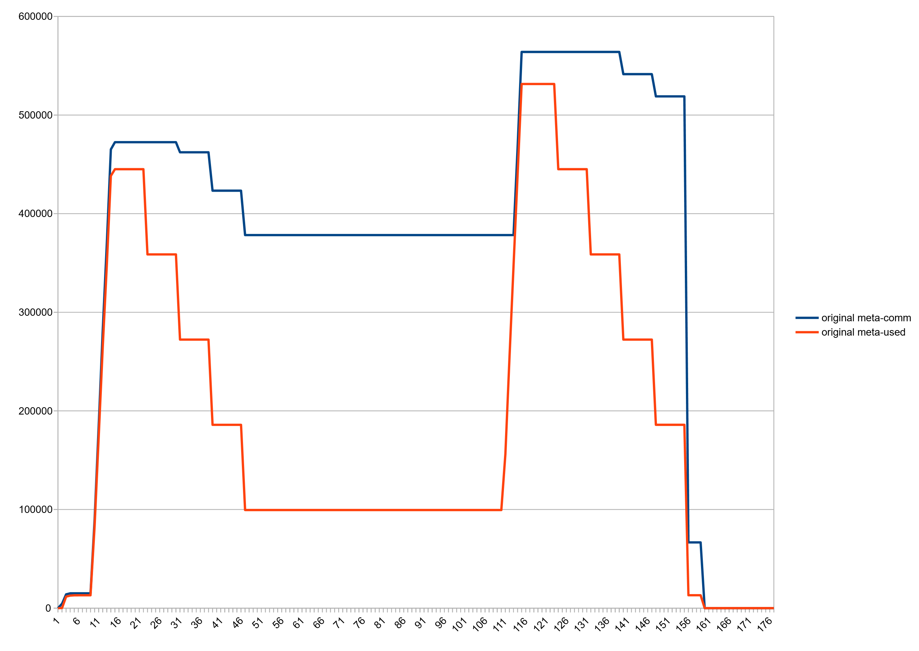
Huge freelists: Committed vs used space, after class unloading
~270M ☹

Slide 29
Huge Freelists (jcmd VM.metaspace output)
jcmd 27265 VM.metaspace
27265:
…
Waste (percentages refer to total committed size 373,48 MB):
Committed unused: 280,00 KB ( <1%)
Waste in chunks in use: 2,45 KB ( <1%)
Free in chunks in use: 6,34 MB ( 2%)
Overhead in chunks in use: 186,75 KB ( <1%)
In free chunks: 269,56 MB ( 72%)
Deallocated from chunks in use: 998,98 KB ( <1%) (1763 blocks)
-total-: 277,33 MB ( 74%)

Slide 30
Reimplementation

Slide 31
Basic idea
  Uncommit chunks in freelists
  Delay committing chunks until they are actually used
    Partly commit them piece wise (like a thread stack)
    Removes the penalty of handing out large chunks to class loaders
  Clean up / simplify code

Slide 32
Concern 1: keep number of virtual memory areas low
  (Linux):
    Higher commit/uncommit fragmentation results in higher number of VMAs
    Kernel keeps vma structures in list and rb tree
    Too many of them may affect vma lookup
    And we may hit process limits
  So: keep an eye on commit granularity

Slide 33
Concern 2: uncommit speed
  Matters for Gcs which unload classes in pause
  (Linux):
    This depends on population of uncommitted area: how many pages in which size had been committed before
    Hence indirectly on size
    And also on number of vma s in committed region, although in our case its always 1
  Currently I see no problems in practice, but a fallback plan would be to uncommit concurrently.
      Not that complicated if we keep locking scheme

Slide 34
Commit granules
commit HWM
Before:
Now:
Granule size
Adjustable, defaults to 64k

Slide 35
Current chunk allocation scheme unsuited for uncommitting chunks
  Odd chunk geometry
    Difficult to merge and split
    High fragmentation
    Complex code
  Chunk headers are a problem

Slide 36
Pow 2 based buddy allocator for chunks
  Power 2 based buddy allocation scheme
  Chunks sized from 1K … 4M in pow2 steps
  Dead simple to split and merge.
  Low external defragmentation -> Leads to larger free contiguous areas.
  Standard algorithm widely known

Slide 37
Pow 2 based buddy allocator for chunks
// Each chunk has a level; the level corresponds to its position in the tree
// and describes its size.
//
// The largest chunks are called root chunks, of 4MB in size, and have level 0.
// From there on it goes:
//
// size level
// 4MB 0
// 2MB 1
// 1MB 2
// 512K 3
// 256K 4
// 128K 5
// 64K 6
// 32K 7
// 16K 8
// 8K 9
// 4K 10
// 2K 11
// 1K 12

Slide 38
Pow 2 based buddy allocator for chunks
  The whole memory range is now segmented into “root chunk areas” of 4MB size, is aligned at 4MB and gets committed with 4MB grain
  VirtualSpaceNode now only allocates root chunks → much simplified code
  ChunkManager now has 13 free lists, one for each chunk level
  Allocation:
    To ChunkManager: do we have a chunk of level x?
    ChunkManager: looks in freelist(x) – yes → return
    No→ look for larger chunk in freelists(x++) and, if found, split chunk. Add splinter chunks back to freelist.
    If not found: ask VirtualSpaceNode for a new root chunk, and proceed as above

Slide 39
Buddy allocator: Allocation
1M
64K
64K
128K
256K
512K
  Remove chunk from freelist
  Optionally split until desired size is reached
  Return result chunk; put splinter chunks back to freelist

Slide 40
Buddy allocator: Deallocation
64K
64K
128K
256K
64K
64K
64K
64K
256K
512K
64K
64K
64K
64K
256K
  Mark chunk as free
  If buddy chunk is free and unsplit: remove from freelist and merge with chunk
    Repeat until root chunk sized reached or until buddy is not free
  Return result chunk to free list

Slide 41
Chunk headers needed to go
Before
page
page
page
page
Header
Now
page
page
page
page
ChunkHeaderPool

Slide 42
Granules and chunks
1:n
n:1
Chunks
256K
16K
16K
32K
64K
128K
Granules
  A larger chunk can span multiple granules (1:n)
  Multiple small chunks can cover a single granule (n:1)

Slide 43
Granules and chunks
Chunks
256K
16K
16K
32K
64K
128K
Granules
  Free chunks spanning 1+ granules can be uncommitted
  A chunk spanning >1 granules can be committed in parts, on demand

Slide 44
Deallocation handling („LeftOverManager“)
Combination of bin list (similar to SmallBlocks) and a newly written BST
  We can get rid of binaryTreeDictionary since now all users are gone
  The new binlist covers more sizes (atm 32) and searches upward too
  The new BST is similar to the old one but much reduced in code size and very much simpler.
    Still unbalanced though, making this an RB tree would be nice
  New BST knows its largest node size.
We now split blocks where it makes sense.
Other changes:
  We call into LeftOverManager for every allocation. This prevents pop buildup.
  Recent deallocations are just rolled back in the chunk

Slide 45
What else changed
Got rid of humongous chunks :)
Got rid of occupancy map
Better deallocation management
Chunks can now often grow in-place
  Saves overhead and reduces intrachunk waste
Code is cleaner and more maintainable; better separation of concerns and testability.

Slide 46
Result: Committed vs used, Stock JDK14
~270M ☹

Slide 47
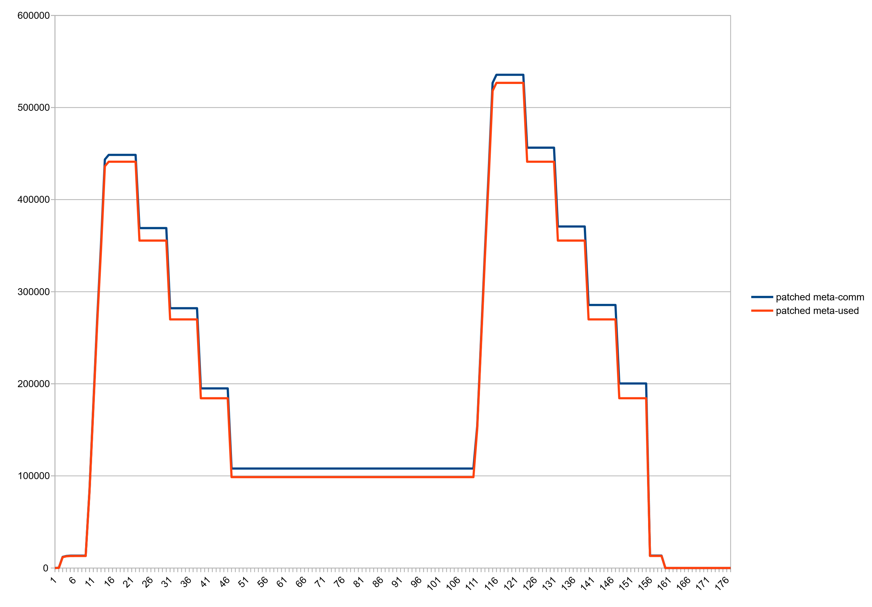
Result: Committed vs used, Patched JDK14

Slide 48
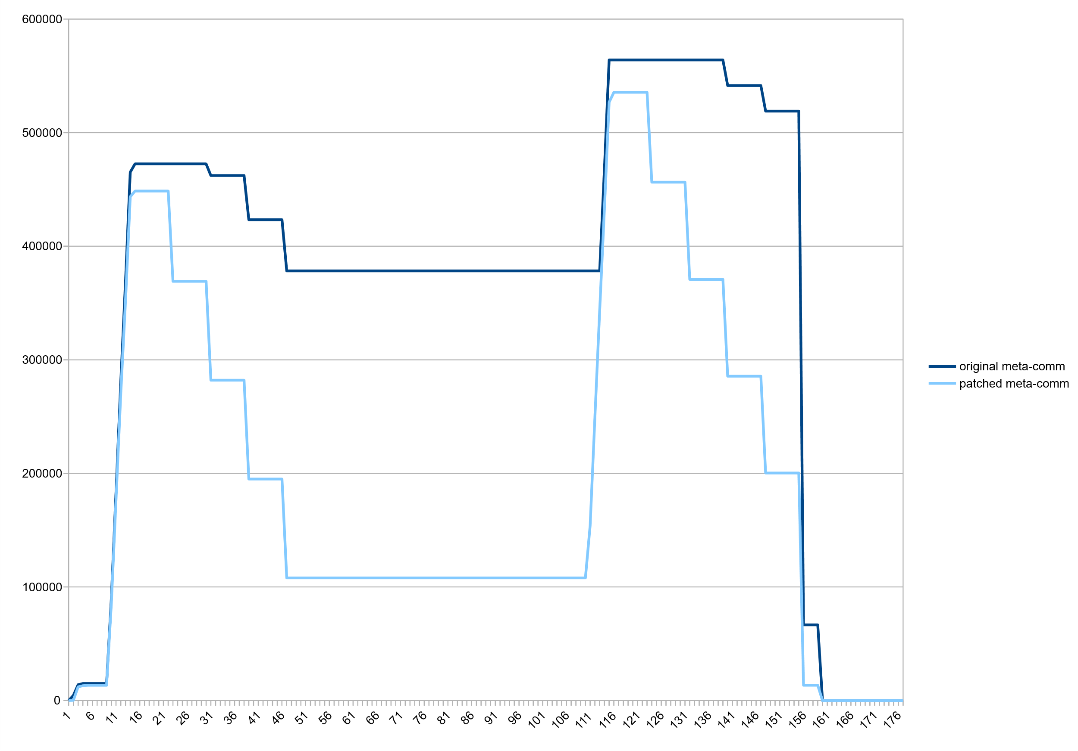
Result: committed Metaspace, Stock vs Patched VM

Slide 49
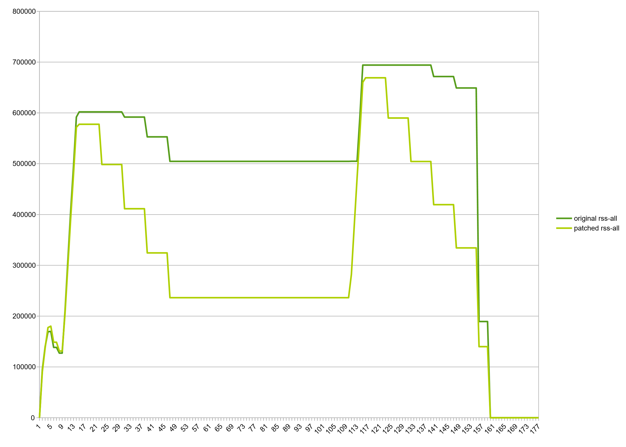
Result: RSS, Stock vs Patched VM

Slide 50
Modest decrease in consumption beyond class unloading
  Wildfly standalone after startup: 61m->54m, -7m, (11%)
  Eclipse CDT, hotspot project after C++ indexing: 138m->129m, -9m (12%)
  jruby helloworld.rb (invokedynamic, compile=FORCE): 41m->38m, -3m, (1.2%)

Slide 51
How do we go from here?
  Patch is stable. Needs more tests and may need smaller fixes but it works.
  Patch lives in jdk/sandbox repository, branch "stuefe-new-metaspace-branch“
    http://hg.openjdk.java.net/jdk/sandbox/
  JEP exists in Draft state (“Elastic Metaspace”: https://openjdk.java.net/jeps/8221173 )
  JDK15?
  A good candidate for backporting!
    Would make a lot of sense in 11/8
    Large patch but Metaspace is quite isolated. Should not be too much of a hassle.

Slide 52
Thank you.
Contact information:
Thomas Stüfe
@tstuefe
thomas.stuefe@sap.com
stuefe.de

