Slide 1
Lilliput: Tiny Classpointers
A 10-minute speed run
Thomas Stüfe
Principal Engineer
tstuefe@redhat.com
Notes:
Who am i, who am I working for
One of multiple efforts
Little time, need to oversimplify

Slide 2
Motivation
Preface
63
32
31
0
Class Pointer
Hash
Age
Fwd
Lck
Class Pointers take a lot of space…

Slide 3
Motivation
Preface
63
32
31
0
Class Pointer
Hash
Age
Fwd
Lck
…we need to make them smaller

Slide 4
What is a Class Pointer ?

Slide 5
Class and Class Metadata
Klass and Class Pointer
Java Heap
Native Memory (Metaspace)
Method
CP
Byte codes
Header
Klass
yes, with a ‘K’
Method
Byte codes
Method
Byte codes
Object
Annotations
Counters
Annotations
Counters
Annotations
Counters
Class
var-sized…

Slide 6
We already compress Class Pointers (since JDK 8)
Klass and Class Pointer
Klass* is 64-bit - too much.
We split Klass* into 64-bit base and 32-bit offset. We only store the offset in the object headers.
64-bit Klass*
64-bit Base
32-bit Offset
“Encoding Base”
Runtime-constant, determined at VM start
“Narrow” or “Compressed” Class pointer

Slide 7
Class Space
Klass and Class Pointer
32-bit offset?
⇒ all Klass must be confined to a 4GB(*) range.
⇒ class space : a “pen” for Klass structures
… 64-bit address space …
… 64-bit address space …
Class Space
Base
Klass Encoding Range
Base + 4G
(*) Yes, I am ignoring the encoding shift

Slide 8
… and CDS
Klass and Class Pointer
Same goes for CDS.
We place CDS archived metadata close to the class space.
… 64-bit address space …
… 64-bit address space …
CDS
Class Space
Base
Klass Encoding Range
Base + 4G

Slide 9
Decoding
Klass and Class Pointer
Raw Klass Pointer = Encoding Base + Offset (narrow Klass Pointer) (*)
C++ : Base is a runtime value
JIT: Base is a constant (64-bit immediate)
Many optimizations exists per CPU that depend on a “good” Base.
(*) still ignoring encoding shift

Slide 10
CPU-specific encoding bases
Klass and Class Pointer
RiscV: bits set only in [12-32) (for lui) or [32-44) (addiw+slli)
Arm64: Either a logical immediate aligned to 4GB (eor) or bits in the third quadrant only (movk)
S390: Prefer <4GB addresses (algfi) or bits restricted to a single quadrant
x64: Prefer < 4GB for the short form of mov immediate
PPC: Restrict bits to as few quadrants as possible

Slide 11
Optimization Example: unscaled encoding
Klass and Class Pointer
If base is zero, we can omit the load immediate altogether.
JVM tries really hard to reserve class space in low address regions (even harder in JDK 22+).
… 64-bit address space …
Class Space
0 == Base
Klass Encoding Range
0x1_0000_0000

Slide 12
Lilliput: 22-bit

Slide 13
Side Goals
22-bit narrow Klass Pointers
Address “enough” classes
Contain invasiveness of patch:
Lilliput will need to coexist with legacy JVM for some time
⇒ Keep Klass layout (for now)
⇒ Keep using CDS + Metaspace
Notes:
Must be switchable as experimental option

Slide 14
How many classes can we address today?
22-bit narrow Klass Pointers
~5 million classes (*)
3GB class space
Average Klass size ~6xx bytes
Using 3 GB class space would cost ~30 GB of Non-Class Metaspace!
(* without CDS)
Notes:
Note:

Slide 15
How many classes do we need to address?
22-bit narrow Klass Pointers
Normal case: x*100 .. x*1000, very large applications: x*100_000.
But we need to cater to weird corner cases too (generator cases).
Anything in the multi-million range is fine.
⇒ don’t reduce (for now) Klass encoding range size. Keep it at 4GB.
Notes:
Note:

Slide 16
Increase Alignment
22-bit narrow Klass Pointers
We can increase Klass* alignment and re-purpose the alignment shadow bits:
31
16
15
10
9
0
xxxxxxxx-xxxxxxxx-xxxxxx00-00000000
Notes:
Note:

Slide 17
10-bit alignment
22-bit narrow Klass Pointers
Why 10 bit (1 KB) ?
On average:
>80% of Klass between 512 byte and 1K;
>95% of Klass smaller than 1K.
Notes:
Note:

Slide 18
22-bit Class Pointers
22-bit narrow Klass Pointers
22 bits let us address 3 million classes (*)
⇒ Klass needs 1 KB on average
⇒ Class space capped at 3 GB
(* without CDS)
Notes:
Note:

Slide 19
Class Space morphs into a Table
22-bit narrow Klass Pointers
Class Space
CDS
Klass
Klass
K..
Klass
Klass
K..
Klass
Klass
K..
nKlass
1
2
3
4
…
Klass
Klass
K..
Klass
Klass
K..
Klass
Klass
K..
1K
1K
1K
1K
1K
1K
1K
1K
1K

Slide 20
… but fragmentation hurts
22-bit narrow Klass Pointers
Class Space
CDS
Klass
Klass
K..
Klass
Klass
K..
Klass
Klass
K..
nKlass
1
2
3
4
…
Klass
Klass
K..
Klass
Klass
K..
Klass
Klass
K..
1K
1K
1K
1K
1K
1K
1K
1K
1K

Slide 21
Make Metaspace alignment-aware
22-bit narrow Klass Pointers
Class Space
Klass
Klass
K..
Klass
Before
Non-class Metaspace
Class Space
Klass
Klass
K..
Klass
Now
Non-class Metaspace
FreeBlockTree
It works beautifully: (almost) zero footprint degradation.

Slide 22
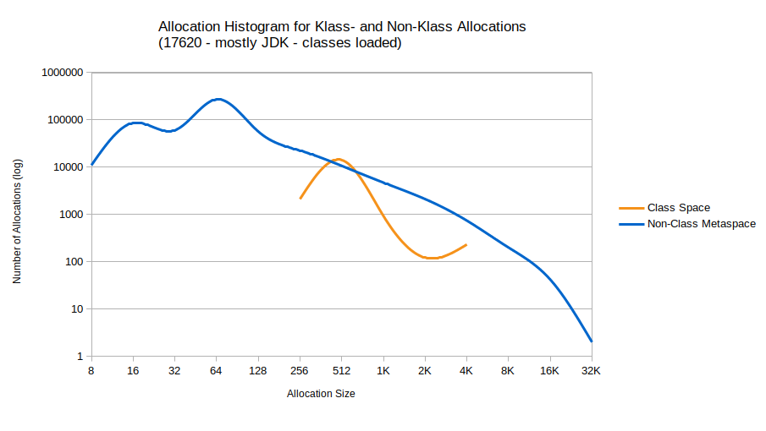
Statistics
22-bit narrow Klass Pointers
Klass: Few (relatively), coarse-grained
Non-Klass: Numerous, fine-grained

Slide 23
New Markword Layout (for now…)
22-bit narrow Klass Pointers
63
32 31
0
32-bit Class Pointer
25-bit Hash
Age
Fwd
Lck
Before:
63
42 41
32 31
0
22-bit Class Pointer
31-bit Hash
free
Age
Fwd
Lck
Now (for now):
Notes:
Obviously not ideal.

Slide 24
To Do Next
22-bit narrow Klass Pointers
Analyze cache effects of hyper-aligning
Split up Klass?
Vary cadence by cache line size?
32-bit
Not technically difficult, just messy and onerous

Slide 25
Lilliput: 16-bit ?

Slide 26
16-bit Classpointers are possible
16-bit narrow Klass Pointers
First 65k classes: objects use 16-bit nKlass in mark word
Later-class-objects: append nKlass (or, Klass*) to mark word
⇒ Variable-sized header
63
48 47
0
0x1 .. 0xFFFE
Markword
Object fields…
63
48 47
0
0xFFFF
0x10000 .. x
Markword
Object fields…

Slide 27
Summary

Slide 28
Result
22-bit narrow Klass Pointers
10 bits free
Restored ihash to 31-bit, 4 spare bits
nKlass Pointer ⇒ nKlass ID
Costs:
Addressable classes ~5 → ~3 mio
Slightly more complex decoding
Notes:
This was a large part of the development effort

Slide 29
Result (2)
22-bit narrow Klass Pointers
Side benefits for Stock JVM (JDK 22+)
Improved class space setup, e.g. much higher chance for unscaled or zero-based encoding, with ASLR
Optimized klass decoding for RiscV and (to a lesser extent) Arm64 and X64
Notes:
This was a large part of the development effort

Slide 30
Thank you!

