Slide 1
Taming Metaspace
Thomas Stüfe, SAP
Feb 01, 2020

Slide 3
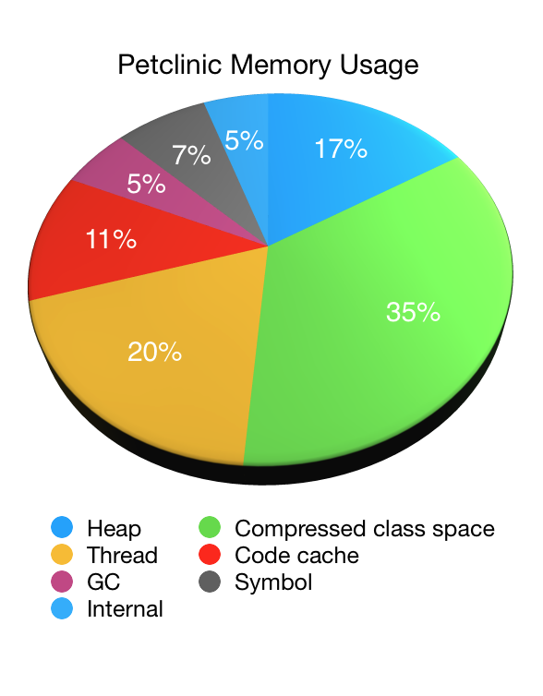
Why do we care?
From https://spring.io/blog/2019/03/11/memory-footprint-of-the-jvm
(Note: Metaspace mislabeled as Compressed Class Space)
Metaspace can make out a large chunk of native memory consumption.
Can we improve that? Yes, within reason.

Slide 4
How did we get here?
Pre JDK8: Permanent Generation
JDK8: Permgen removal
2008: Oracle bought BEA -> JRockit VM
JRockit kept class metadata in native memory
JEP 122: “JEP 122: Remove the Permanent Generation”
Promise: easier configuration and development
Since its inception, Metaspace has caused problems for SAP customers
Large monoliths, lots of class loading/unloading
SAP contributions:
JDK11: JDK-8198423, chunk coalescation patch to fix chunk size starving
Analysis tools: jcmd VM.metaspace
many smaller fixes/cleanups
JDK15 (?): rewrite

Slide 5
Basics

Slide 6
Metaspace
Metaspace contains class metadata
Klass, Constant Pool, Method, Annotations, Bytecode etc.
JIT Counters
JDK8: PermGen Removal (Java Heap -> Native Memory)
JEP 122: “JEP 122: Remove the Permanent Generation”
SAP involvement:
JDK11: JDK-8198423, chunk coalescation patch to fix chunk size starving
Analysis tools: jcmd VM.metaspace
many smaller fixes/cleanups

Slide 7
Metadata lifecycle
Metadata are usually allocated when classes are loaded
Metadata are freed in bulk when associated loader is collected
may be deallocated earlier (class redefinition, load errors etc) but that’s uncommon
Bulk delete:
No need to track individual allocations
Arena based allocation sufficient

Slide 8
Compressed Class Space (1)
Heap
Metaspace
Java object
Mark word
64bit Klass*
Klass
vtable
itable
…

Slide 9
Compressed Class Space (2)
Heap
base
Shared classes
Java object
Mark word
32bit index
Klass
Compressed Class Space
vtable
itable
…
Klass* = (base + 32 bit index) [<< 3]

Slide 10
Metaspace has two parts
Commit HWM
Klass structures
K1
K2
„Compressed“ class space
-XX:CompressedClassSpaceSize
Everything else
D1
D2
D2
…
„non class“ Metaspace
Sizes per class:
~1K Klass (500+ … 500K)
~6K non-class (~2K … xxK)

Slide 11
Limits
CompressedClassSpaceSize:
Reserved size of compressed class space. Max 3G.
Has to be specified. If omitted, defaults to 1G (~ 1 million classes)
MaxMetaspaceSize
Limits sum of all committed space (class + nonclass)
Default infinite.
Sizing:
Undersizing can hurt (OOMs, GCs)
Oversizing is usually not a problem. When in doubt, keep the defaults.

Slide 12
Metaspace induced GCs
GC is blind to Metaspace consumption, so we need to periodically check if classes can be collected
When sum of committed Metaspace reaches a threshold, further allocations are delayed until a GC is done. Maybe we can collect some loaders and release their Metaspace?
Threshold may go up or down depending on how the GC went
We also attempt a GC before throwing a Metaspace OOM
MetaspaceSize sets the initial threshold value
Set to a large value (e.g. max) to disable threshold

Slide 13
Current implementation

Slide 14
Current implementation (1) (much simplified)
Loader B
Loader
top
Loader owns a chunk of memory.
Allocates from it via pointer bump.
Remember: we do not need to track individual allocations for freeing.

Slide 15
Current implementation (2) (much simplified)
Loader B
leftover space
Loader
„Retired chunks“
Current chunk
If chunk is used up, Loader aquires a new one from the metaspace allocator.
Retired chunks are kept in list
Leftover space is kept for later reuse

Slide 16
Current implementation (3) (much simplified)
Loader B
Reserved
Loader A
A
A
A
A
A
A
A
Loader B
B
B
B
B
B
Loader C
C
C
C
Committed
B
Used
Chunks are carved from metaspace memory as they are allocated.
A
B
C
B
A
C
C
B
B
A
A
B
A
A
A

Slide 17
Current implementation (4) (much simplified)
Loader B
Reserved
Loader A
A
A
A
A
A
A
A
Commited
Loader B
B
B
B
B
B
Loader C
C
C
C
B
Used
When a loader dies, its chunks are marked as free…
A
B
C
B
A
C
C
B
B
A
A
B
A
A
A

Slide 18
Current implementation (5) (very much simplified)
Loader B
Reserved
Loader A
A
A
A
A
A
A
A
Loader C
Commited
C
C
C
Chunk Freelists
Used
A
B
C
A
C
C
A
A
A
A
A
…and added to global freelists, sorted by size.

Slide 19
Monitoring with jcmd VM.metaspace (since JDK11)
Detailed analysis of Metaspace occupancy
Usage stats, chunk statistics and -geometry, freelists, …
Show all loaders and/or all loaded classes and their space consumption
Detailed summary waste section
Help is your friend (jcmd help VM.Metaspace)

Slide 20
Problems with the current implementation
Freelists can get huge.
We have seen used:free ratios of 1:3 and worse
=>Metaspace is not really elastic.
Intra-chunk waste
At some point loader typically stops loading classes; remaining chunk space is wasted
Worse with many tiny loaders (reflection delegator classes, lambda anonymous classes)
Code bloat
Expensive to maintain.
Code base grew over time and has gotten overly complicated.

Slide 21
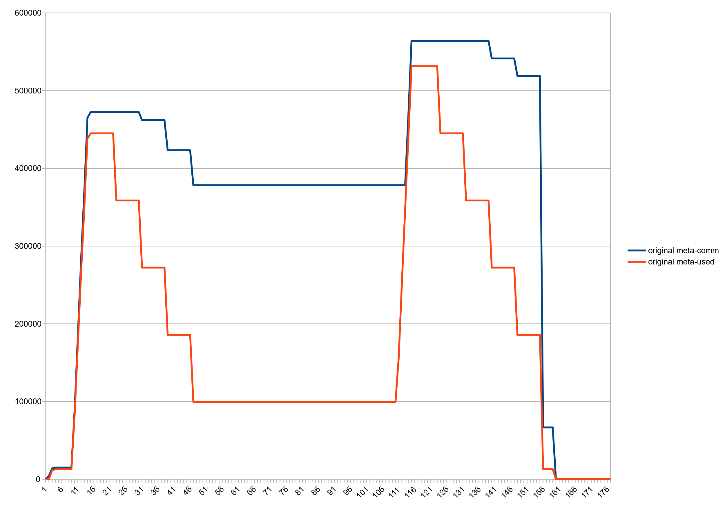
Huge freelists: Committed vs used space, after class unloading
~270M ☹

Slide 22
Huge Freelists (jcmd VM.metaspace output)
jcmd 27265 VM.metaspace
27265:
…
Waste (percentages refer to total committed size 373,48 MB):
Committed unused: 280,00 KB ( <1%)
Waste in chunks in use: 2,45 KB ( <1%)
Free in chunks in use: 6,34 MB ( 2%)
Overhead in chunks in use: 186,75 KB ( <1%)
In free chunks: 269,56 MB ( 72%)
Deallocated from chunks in use: 998,98 KB ( <1%) (1763 blocks)
-total-: 277,33 MB ( 74%)

Slide 23
Reimplementation

Slide 24
Basic idea
Uncommit chunks in freelists
Delay committing chunks until they are actually used
Partly commit them piece wise (like a thread stack)
Removes the penalty of handing out large chunks to class loaders

Slide 25
Concern: keep number of vm areas low
(Linux): we decommit with mmap(MAP_NORESERVE) && mprotect(PROT_NONE)
May create a new vma (or, two)
Kernel keeps vma structures in list and tree
Too many of them may affect vma lookup
And we may hit process limits
Hence: avoid fine-grained decommits

Slide 26
Commit granules
commit HWM
Before:
Now:
Granule size
Adjustable, defaults to 64k

Slide 27
Pow 2 based buddy allocator for chunks
Power 2 based buddy allocation scheme
Chunks sized from 1K … 4M in pow2 steps
Dead simple to split and merge.
Low external defragmentation -> Leads to larger free contiguous areas.
Standard algorithm widely known

Slide 28
Buddy allocator: Allocation
1M
64K
64K
128K
256K
512K
Remove chunk from freelist
Optionally split until desired size is reached
Return result chunk; put splinter chunks back to freelist

Slide 29
Buddy allocator: Deallocation
64K
64K
128K
256K
64K
64K
64K
64K
256K
512K
64K
64K
64K
64K
256K
Mark chunk as free
If buddy chunk is free and unsplit: remove from freelist and merge with chunk
Repeat until root chunk sized reached or until buddy is not free
Return result chunk to free list

Slide 30
Chunk headers needed to go
Before
page
page
page
page
Header
Now
page
page
page
page
ChunkHeaderPool

Slide 31
Granules and chunks
1:n
n:1
Chunks
256K
16K
16K
32K
64K
128K
Granules
A larger chunk can span multiple granules (1:n)
Multiple small chunks can cover a single granule (n:1)

Slide 32
Granules and chunks
Chunks
256K
16K
16K
32K
64K
128K
Granules
Free chunks spanning 1+ granules can be uncommitted
A chunk spanning >1 granules can be committed on demand

Slide 33
Other Changes
Got rid of humongous chunks :)
Got rid of occupancy map
Better leftover management
Chunks can now often grow in-place
Saves overhead and reduces intrachunk waste
Code is cleaner and more maintainable; better separation of concerns and testability.

Slide 34
Result: Committed vs used, Stock JDK14
~270M ☹

Slide 35
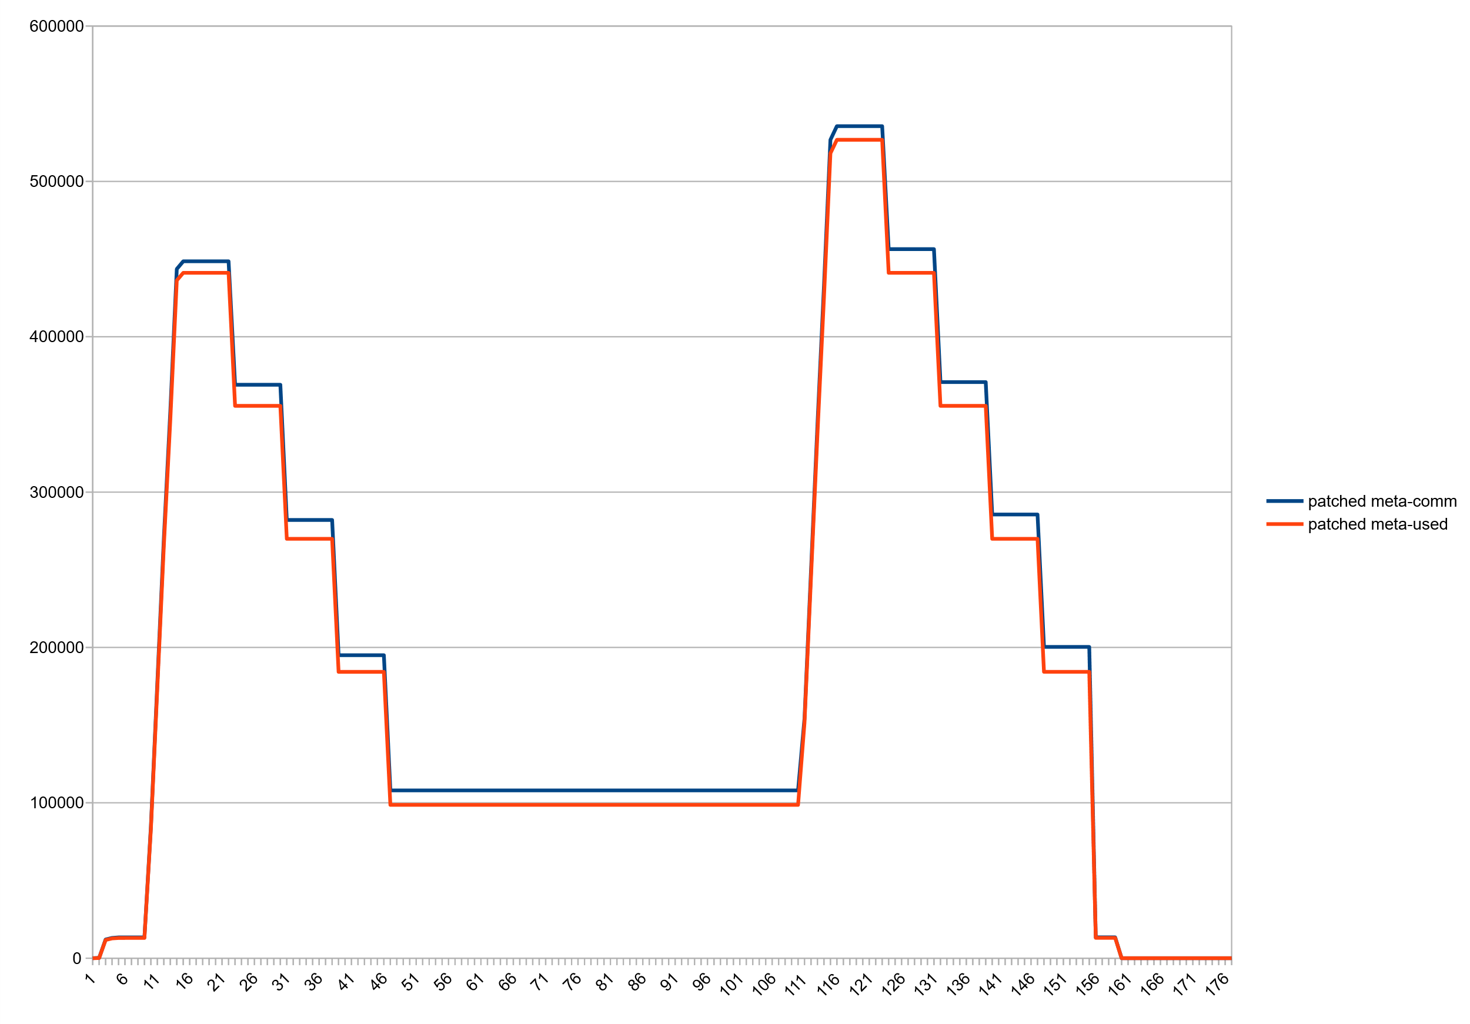
Result: Committed vs used, Patched JDK14

Slide 36
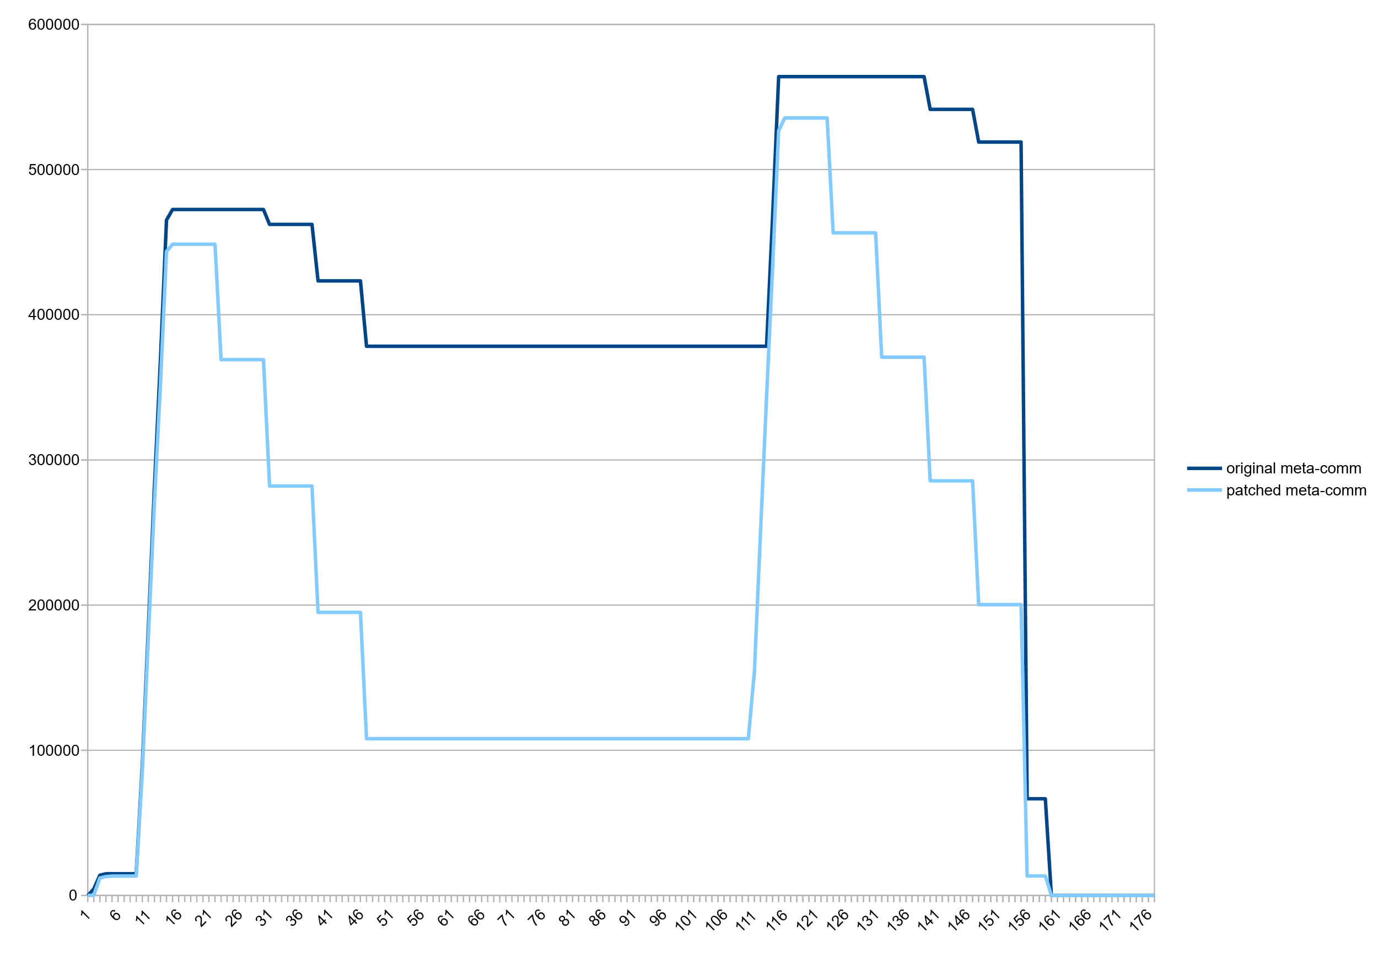
Result: committed Metaspace, Stock vs Patched VM

Slide 37
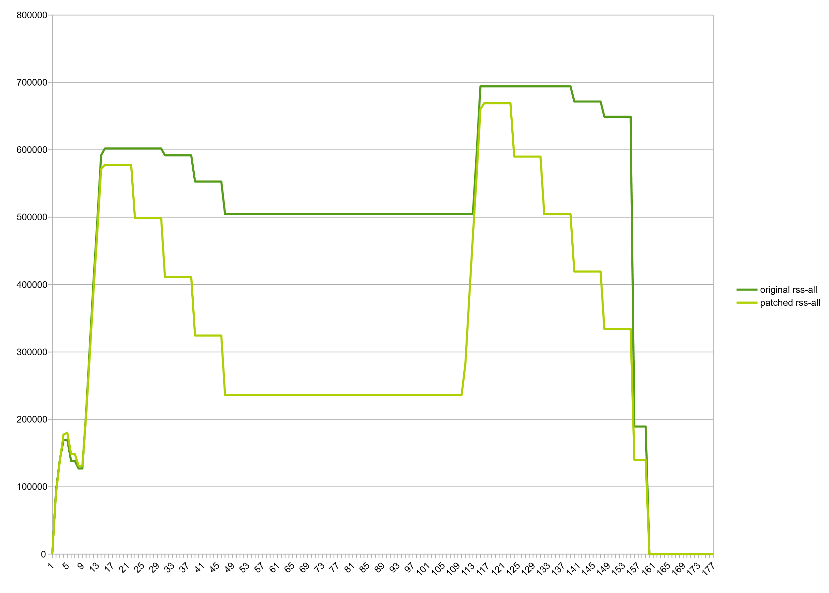
Result: RSS, Stock vs Patched VM

Slide 38
Modest decrease in consumption beyond class unloading:
Wildfly standalone, after startup: 61m -> 54m
Eclipse CDS (OpenJDK project open, after C++ indexer ran): 151m -> 131m
Minecraft 1.14: 74m -> 70m

Slide 39
Show me the code
http://hg.openjdk.java.net/jdk/sandbox/
branch "stuefe-new-metaspace-branch“
~20kloc

Slide 40
How do we go from here?
Patch is stable. Needs more TLC but it works.
JDK15?
Very difficult to bring such a large patch upstream :(
A JEP exists in Draft state (“Elastic Metaspace”: https://openjdk.java.net/jeps/8221173 )
A good candidate for backporting!
Would make a lot of sense in 11/8
Large patch but Metaspace is quite isolated. Should not be too much of a hassle.

Slide 41
Thank you.
Contact information:
Thomas Stüfe
@tstuefe
thomas.stuefe@sap.com
stuefe.de

Slide 42
Q/A

