Slide 1
Taming Metaspace
Thomas Stüfe, SAP
Feb 01, 2020

Slide 3
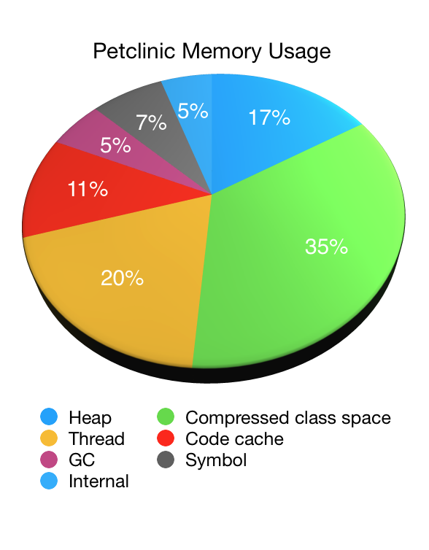
Why do we care?
From https://spring.io/blog/2019/03/11/memory-footprint-of-the-jvm
(Note: Metaspace mislabeled as Compressed Class Space)
Metaspace can make out a large portion of non-heap memory consumption.
Can we improve that? Yes, within reason.

Slide 4
How did we get here?
Pre JDK8: Permanent Generation
JDK8: Permgen removal
2008: Oracle bought BEA -> JRockit VM
JRockit kept class metadata in native memory
JEP 122: “JEP 122: Remove the Permanent Generation”
Promise: easier configuration and development
Since its inception, Metaspace has caused problems for SAP customers
Large monoliths, lots of class loading/unloading
SAP contributions:
JDK11: JDK-8198423, chunk coalescation patch to fix chunk size starving
Analysis tools: jcmd VM.metaspace
many smaller fixes/cleanups
JDK15 (?): rewrite

Slide 5
Metaspace
Metaspace contains class metadata
Klass, Constant Pool, Method, Annotations, Bytecode, JIT Counters etc.
Used to live in Java Heap (Permanent Generation) pre JDK 8
JDK 8: PermGen Removal -> Metaspace is born
Inspired by JRockit VM
JEP 122: “JEP 122: Remove the Permanent Generation”
SAP involvement:
JDK 11: partial rework (chunk coalescation, JDK-8198423)
Analysis tools: jcmd VM.metaspace, VM.classloaders
many smaller fixes/cleanups
JDK 15 (?): rewrite

Slide 6
Basics

Slide 7
Metadata lifecycle
Metadata are usually allocated when classes are loaded
All metadata a loader accumulated is freed in bulk after the loader has been collected
Exception: Metadata may be deallocated earlier (class redefinition, load errors etc) but that’s uncommon.
Deallocated space still belongs to the loader.

Slide 8
Why write a customized allocator?
Bulk delete allows arena style allocation!
No need to track individual allocations
Simple pointer bump allocation possible: cheap and allows tight packing
We know the size distribution of typical allocations
Case against malloc:
CompressedClassSpace
Platform specific limitations (e.g. sbrk hits java heap)

Slide 9
Compressed Class Space
Compressed Class Space is a (small) part of Metaspace
Optimization for 64bit platforms
Only on 64bit, if –XX:+UseCompressedClassPointers (on by default)

Slide 10
Compressed Class Space
Heap
Metaspace
Java object
Mark word
64bit Klass*
Klass
vtable
itable
…

Slide 11
Compressed Class Space
Heap
base
Shared classes
Java object
Mark word
32bit index
Klass
Compressed Class Space
vtable
itable
…
Klass* = (base + 32 bit index) [<< 3]

Slide 12
Metaspace has two parts
Commit HWM
Klass structures
K1
K2
„Compressed“ class space
-XX:CompressedClassSpaceSize
Everything else
D1
D2
D2
…
„non class“ Metaspace
Sizes per class:
~1K Klass (500+ … 500K)
~6K non-class (~2K … xxK)

Slide 13
Limits
CompressedClassSpaceSize:
Reserved size of compressed class space. Max 3G.
Has to be specified. If omitted, defaults to 1G (~ 1 million classes)
MaxMetaspaceSize
Limits sum of all committed space (class + nonclass)
Default infinite.
Sizing:
Undersizing can hurt (OOMs, GCs)
Oversizing is usually not a problem. When in doubt, keep the defaults.

Slide 14
Metaspace induced GCs
GC is blind to Metaspace consumption, so we check periodically if classes can be collected
GC threshold:
When sum of committed space reaches threshold, a GC is done to check if loaders are collectable and Metaspace can be released.
Threshold may go up or down depending on how the GC went
We also attempt a GC before throwing a Metaspace OOM
MetaspaceSize sets the initial threshold value
Set to a large value (e.g. max) to disable threshold

Slide 15
Current implementation

Slide 16
Current implementation (1) (much simplified)
Loader B
Loader
top
Loader owns a chunk of memory.
Allocates from it via pointer bump.
Remember: we do not need to track individual allocations for freeing.

Slide 17
Current implementation (2) (much simplified)
Loader B
leftover space
Loader
„Retired chunks“
Current chunk
If chunk is used up, Loader aquires a new one from the metaspace allocator.
Retired chunks are kept in list
Leftover space is kept for later reuse

Slide 18
Current implementation (3) (much simplified)
Loader B
Reserved
Loader A
A
A
A
A
A
A
A
Loader B
B
B
B
B
B
Loader C
C
C
C
Committed
B
Used
Chunks are carved from metaspace memory as they are allocated.
A
B
C
B
A
C
C
B
B
A
A
B
A
A
A

Slide 19
Current implementation (4) (much simplified)
Loader B
Reserved
Loader A
A
A
A
A
A
A
A
Commited
Loader B
B
B
B
B
B
Loader C
C
C
C
B
Used
When a loader dies, its chunks are marked as free…
A
B
C
B
A
C
C
B
B
A
A
B
A
A
A

Slide 20
Current implementation (5) (very much simplified)
Loader B
Reserved
Loader A
A
A
A
A
A
A
A
Loader C
Commited
C
C
C
Chunk Freelists
Used
A
B
C
A
C
C
A
A
A
A
A
…and added to global freelists, sorted by size.

Slide 21
Problems with the current implementation
Freelists can get huge.
We have seen used:free ratios of 1:3 and worse
=>Metaspace is not really elastic.
Intra-chunk waste
At some point loader typically stops loading classes; remaining chunk space is wasted
Worse with many tiny loaders (reflection delegator classes, lambda anonymous classes)
Code bloat
Expensive to maintain.
Code base grew over time and has gotten overly complicated.

Slide 22
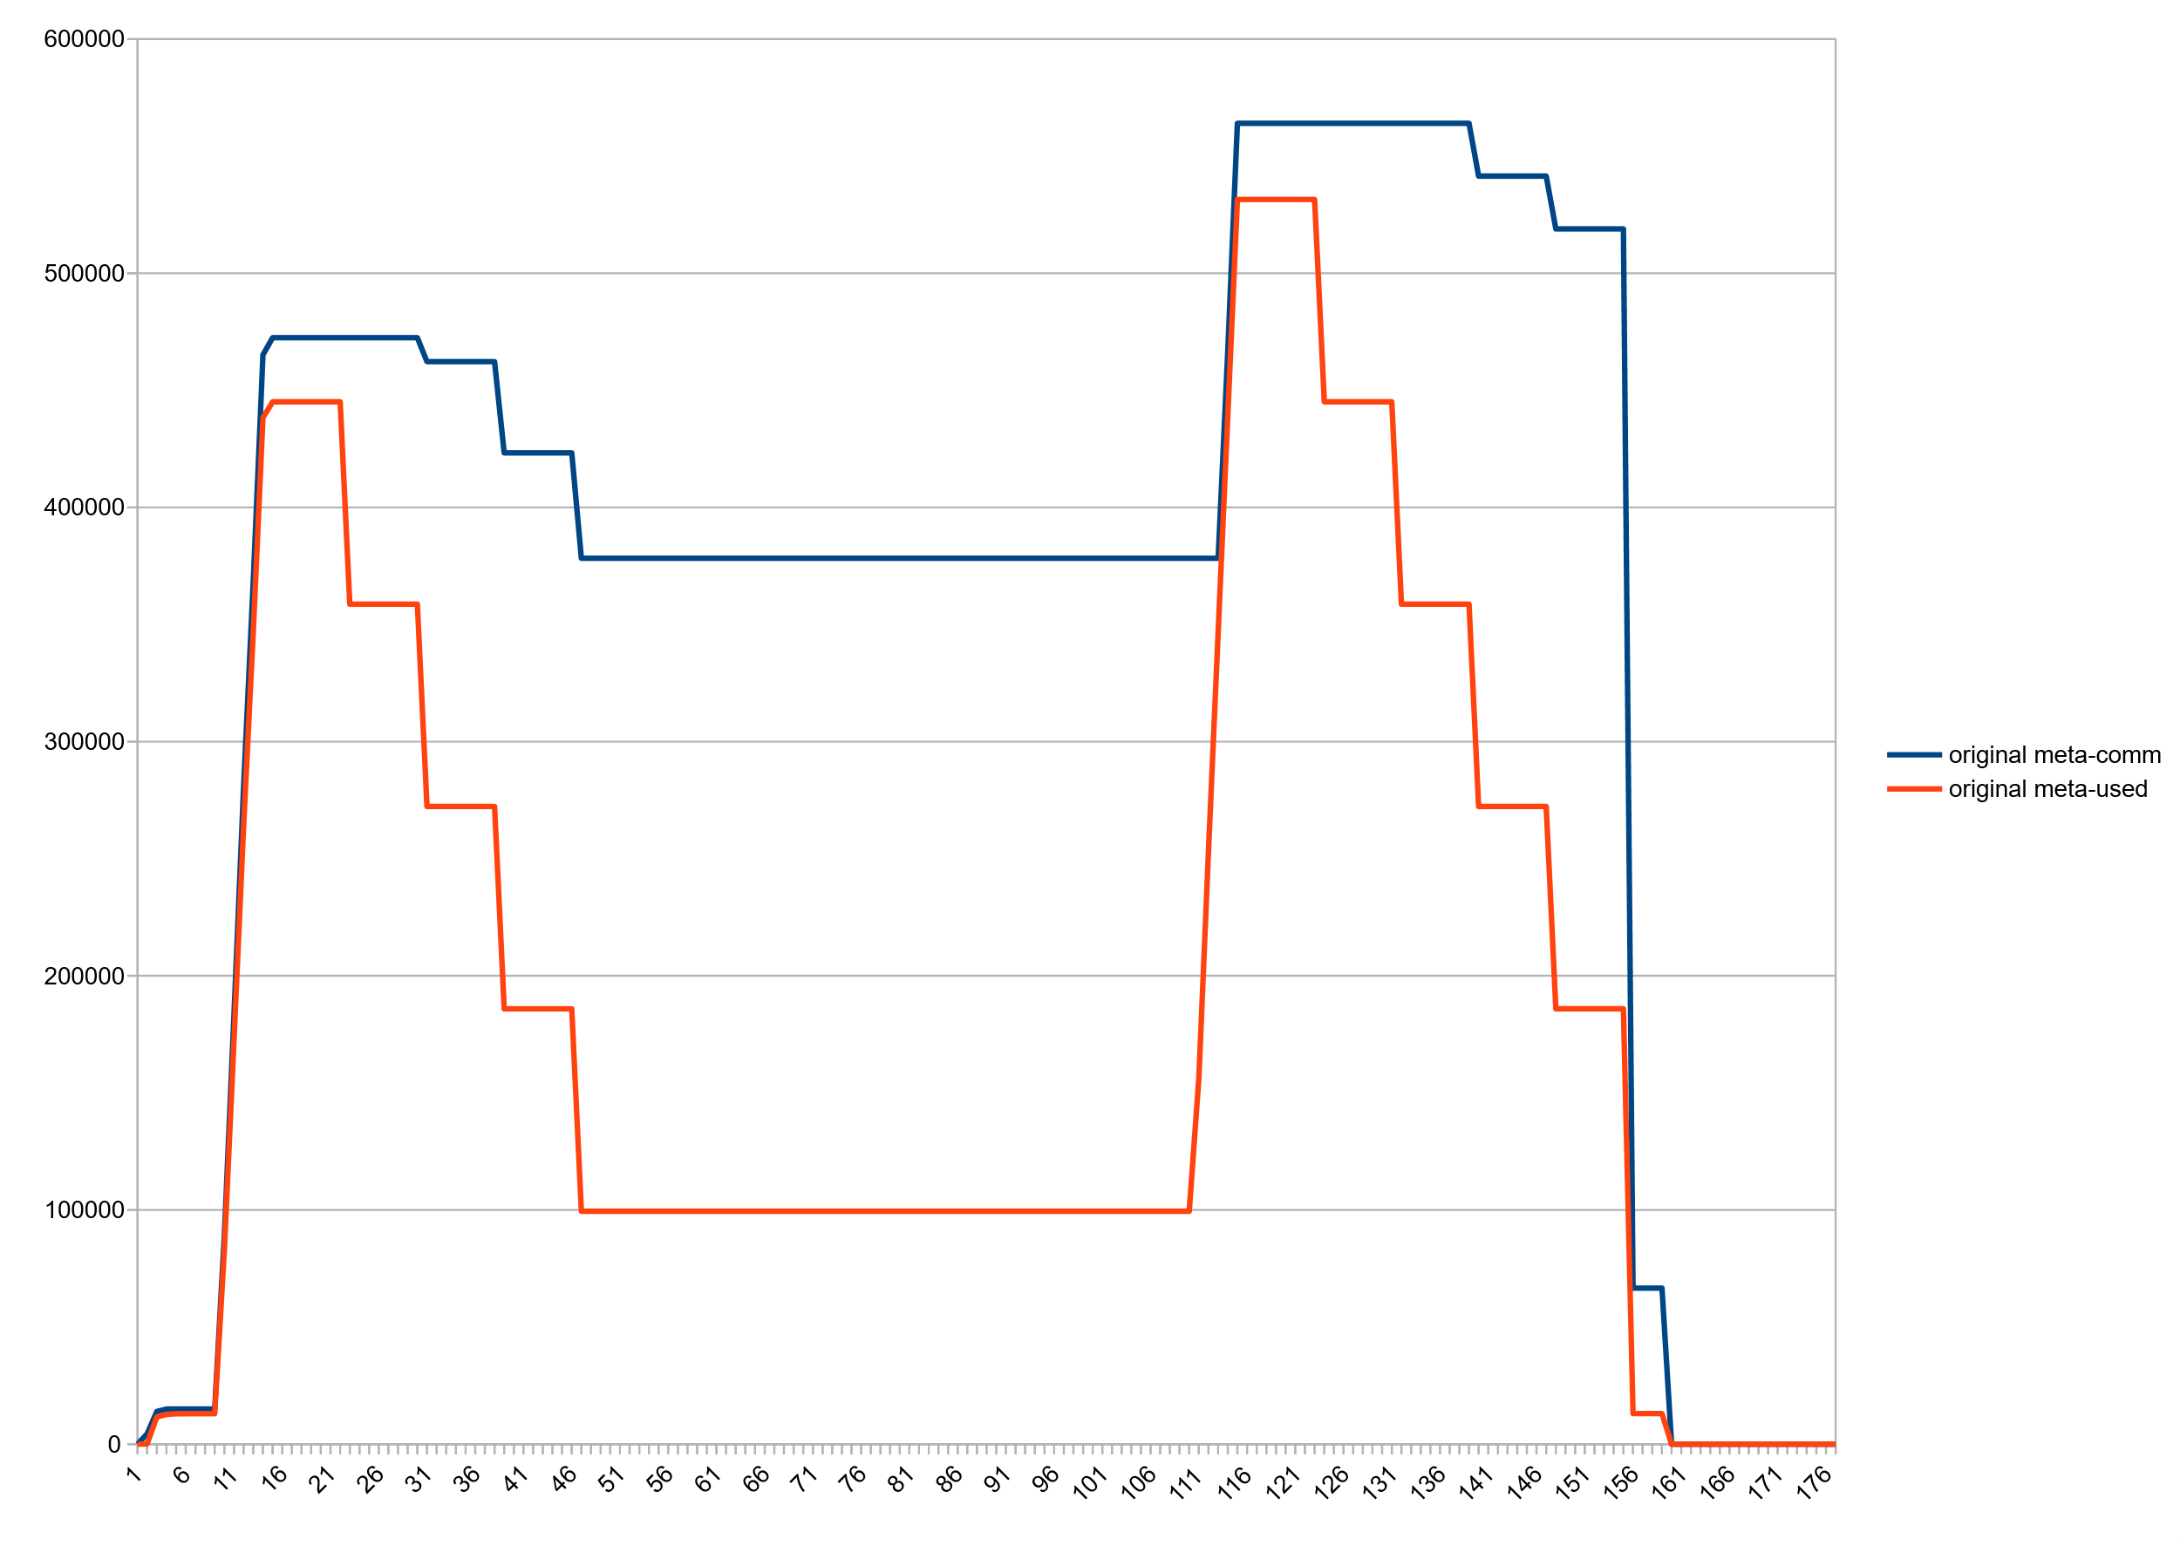
Huge freelists: Committed vs used space, after class unloading
~270M ☹

Slide 23
Huge Freelists (jcmd VM.metaspace output)
jcmd 27265 VM.metaspace
27265:
…
Waste (percentages refer to total committed size 373,48 MB):
Committed unused: 280,00 KB ( <1%)
Waste in chunks in use: 2,45 KB ( <1%)
Free in chunks in use: 6,34 MB ( 2%)
Overhead in chunks in use: 186,75 KB ( <1%)
In free chunks: 269,56 MB ( 72%)
Deallocated from chunks in use: 998,98 KB ( <1%) (1763 blocks)
-total-: 277,33 MB ( 74%)

Slide 24
Monitoring with jcmd VM.metaspace (since JDK11)
Detailed analysis of Metaspace occupancy
Usage stats, chunk statistics and -geometry, freelists, …
Show all loaders and/or all loaded classes and their space consumption
Detailed summary waste section
Help is your friend (jcmd help VM.Metaspace)

Slide 25
Reimplementation

Slide 26
Basic idea
Uncommit chunks in freelists
Delay committing chunks until they are actually used
Partly commit them piece wise (like a thread stack)
Removes the penalty of handing out large chunks to class loaders

Slide 27
Concern: keep number of virtual memory areas low
(Linux): we decommit with mmap(MAP_NORESERVE) && mprotect(PROT_NONE)
Higher commit/uncommit fragmentation results in higher number of VMAs
Kernel keeps vma structures in list and rb tree
Too many of them may affect vma lookup
And we may hit process limits
So: keep an eye on commit granularity

Slide 28
Commit granules
commit HWM
Before:
Now:
Granule size
Adjustable, defaults to 64k

Slide 29
Current chunk allocation scheme unsuited for uncommitting chunks
Odd chunk geometry
Difficult to merge and split
High fragmentation
Complex code
Chunk headers are a problem

Slide 30
Pow 2 based buddy allocator for chunks
Power 2 based buddy allocation scheme
Chunks sized from 1K … 4M in pow2 steps
Dead simple to split and merge.
Low external defragmentation -> Leads to larger free contiguous areas.
Standard algorithm widely known

Slide 31
Buddy allocator: Allocation
1M
64K
64K
128K
256K
512K
Remove chunk from freelist
Optionally split until desired size is reached
Return result chunk; put splinter chunks back to freelist

Slide 32
Buddy allocator: Deallocation
64K
64K
128K
256K
64K
64K
64K
64K
256K
512K
64K
64K
64K
64K
256K
Mark chunk as free
If buddy chunk is free and unsplit: remove from freelist and merge with chunk
Repeat until root chunk sized reached or until buddy is not free
Return result chunk to free list

Slide 33
Chunk headers needed to go
Before
page
page
page
page
Header
Now
page
page
page
page
ChunkHeaderPool

Slide 34
Granules and chunks
1:n
n:1
Chunks
256K
16K
16K
32K
64K
128K
Granules
A larger chunk can span multiple granules (1:n)
Multiple small chunks can cover a single granule (n:1)

Slide 35
Granules and chunks
Chunks
256K
16K
16K
32K
64K
128K
Granules
Free chunks spanning 1+ granules can be uncommitted
A chunk spanning >1 granules can be committed on demand

Slide 36
What else changed
Got rid of humongous chunks :)
Got rid of occupancy map
Better deallocation management
Chunks can now often grow in-place
Saves overhead and reduces intrachunk waste
Code is cleaner and more maintainable; better separation of concerns and testability.

Slide 37
Result: Committed vs used, Stock JDK14
~270M ☹

Slide 38
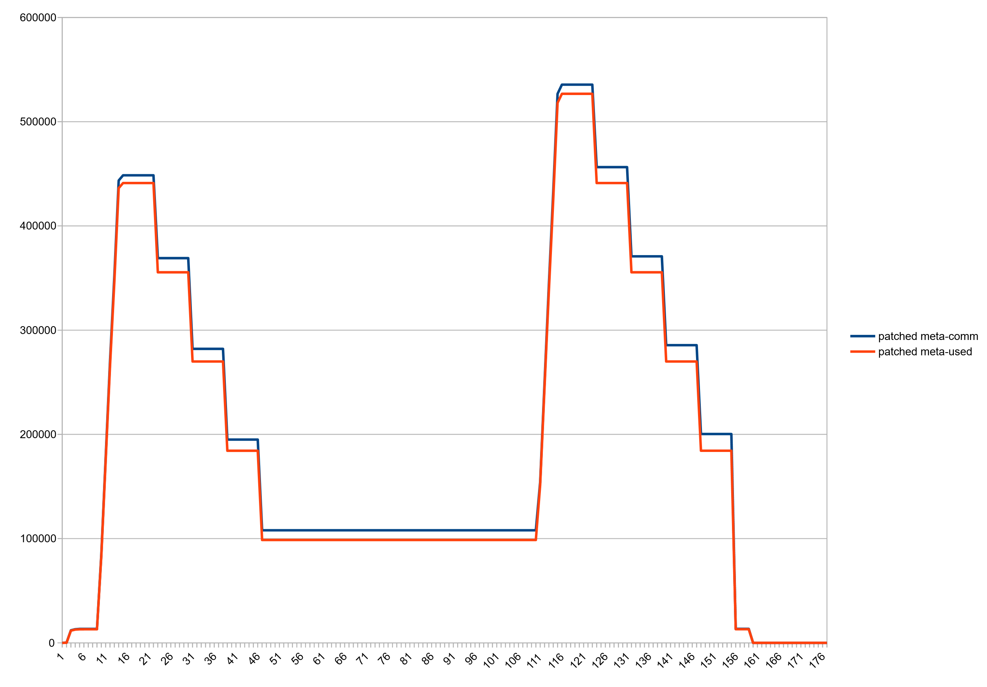
Result: Committed vs used, Patched JDK14

Slide 39
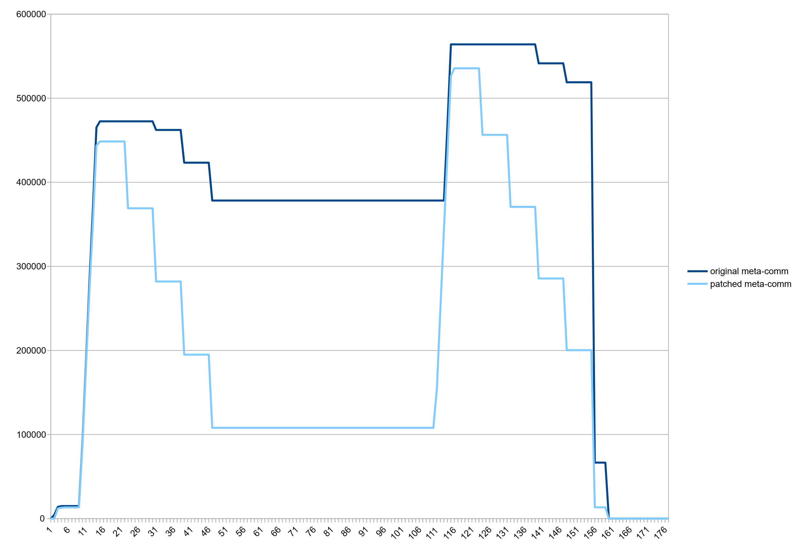
Result: committed Metaspace, Stock vs Patched VM

Slide 40
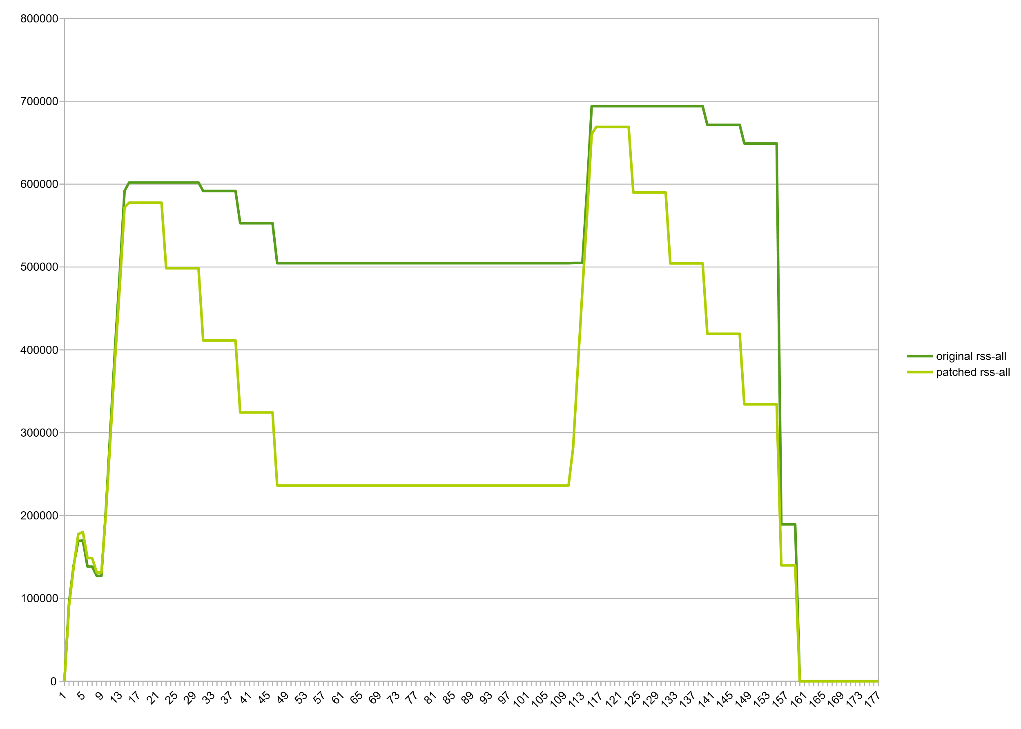
Result: RSS, Stock vs Patched VM

Slide 41
Modest decrease in consumption beyond class unloading
Wildfly standalone after startup: 61m->54m, -7m, (11%)
Eclipse CDT, hotspot project after C++ indexing: 138m->129m, -9m (12%)
jruby helloworld.rb (invokedynamic, compile=FORCE): 41m->38m, -3m, (1.2%)

Slide 42
How do we go from here?
Patch is stable. Needs more tests and may need smaller fixes but it works.
Patch lives in jdk/sandbox repository, branch "stuefe-new-metaspace-branch“
http://hg.openjdk.java.net/jdk/sandbox/
JEP exists in Draft state (“Elastic Metaspace”: https://openjdk.java.net/jeps/8221173 )
JDK15?
Very difficult to bring such a large patch upstream
A good candidate for backporting!
Would make a lot of sense in 11/8
Large patch but Metaspace is quite isolated. Should not be too much of a hassle.

Slide 43
Thank you.
Contact information:
Thomas Stüfe
@tstuefe
thomas.stuefe@sap.com
stuefe.de

Slide 44
Q/A

