Slide 1
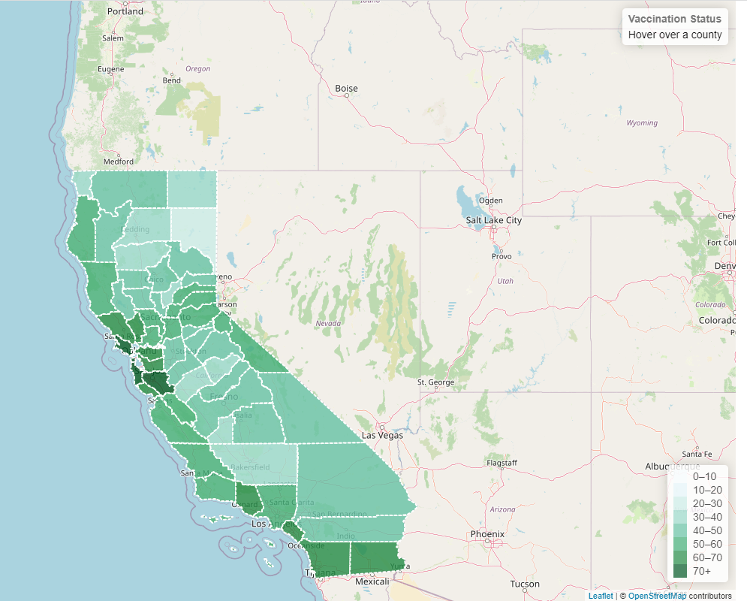
Covid-19 Vaccination Status
California Counties
Project – 3
Data Visualization
Prepared by:
TIKRAM SUBEDY

Slide 2
Purpose of the Project:
Create a dashboard with web based interactive charts, data, and maps using the database created in the previous project of ETL.

Slide 3
Data Sources, Collection and Processing:
Data Sources:
California department of public health
https://data.chhs.ca.gov/dataset/vaccine-progress-dashboard
World Population Review
https://worldpopulationreview.com/us-counties/states/ca
Github:
https://github.com/codeforgermany/click_that_hood/blob/main/public/data/california-counties.geojson

Slide 4
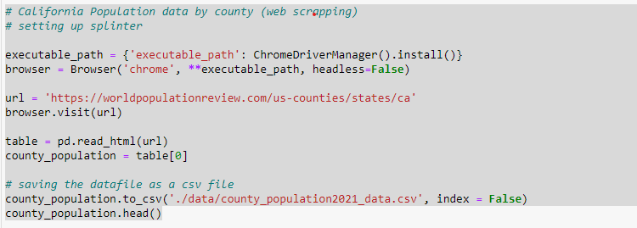
Data Sources, Collection and Processing:
Data Extraction:
Web scraping
Downloading datafiles

Slide 5
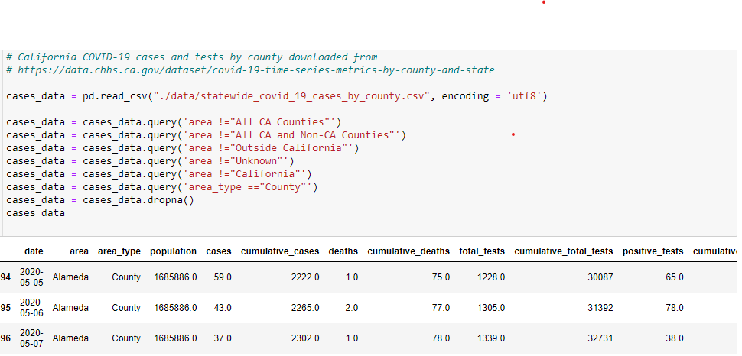
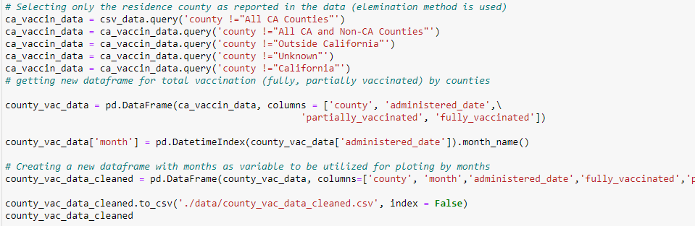
Data Sources, Collection and Processing:
Data Processing:
Python Pandas

Slide 6
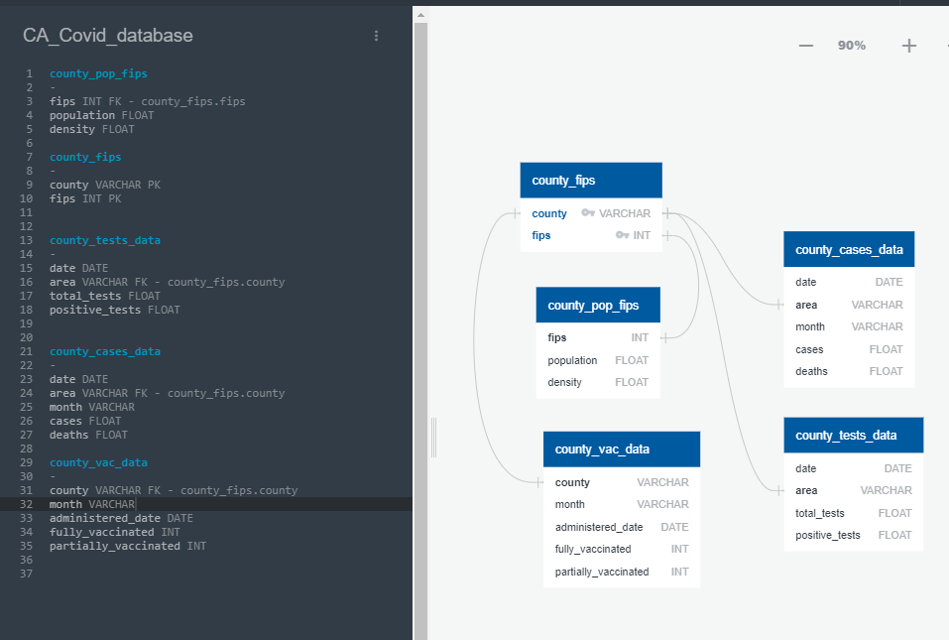
Data Sources, Collection and Processing:
Creating Database (Relational):
ERD, SQL (Postgres, PgAdmin)

Slide 7
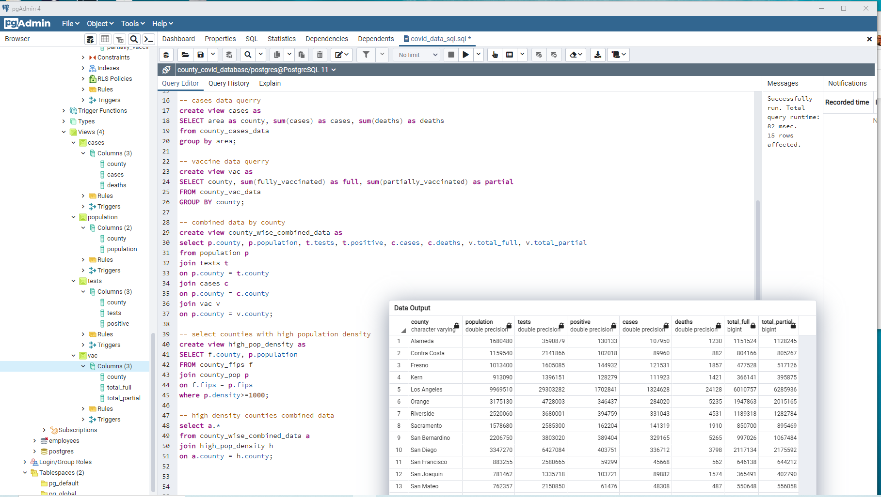
Data Sources, Collection and Processing:
Creating Database (Relational):
ERD, SQL (Postgres, PgAdmin)

Slide 8

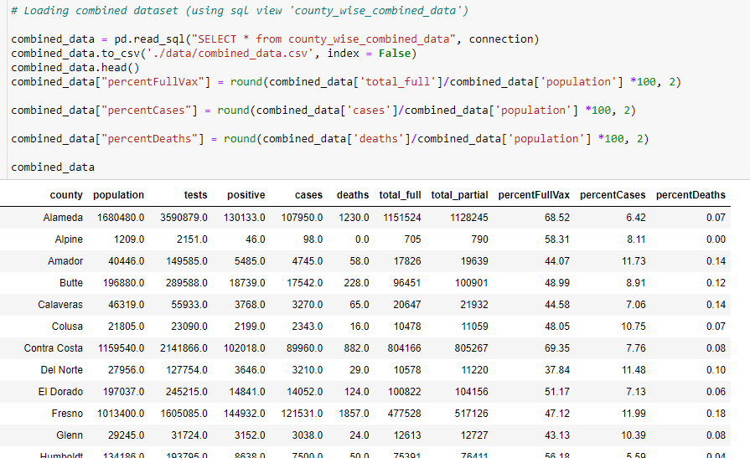
Data Sources, Collection and Processing:
Loading Database:
SQLAlchemy

Slide 9
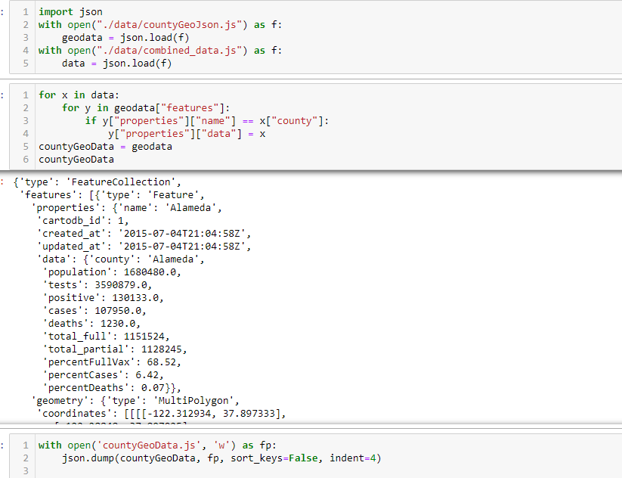
Data Sources, Collection and Processing:
Loading Data:
GeoJson

Slide 10
Data Sources, Collection and Processing:
Data Visualization:
Javascript,
Plotly,
Leaflets
HTML, CSS

Slide 11
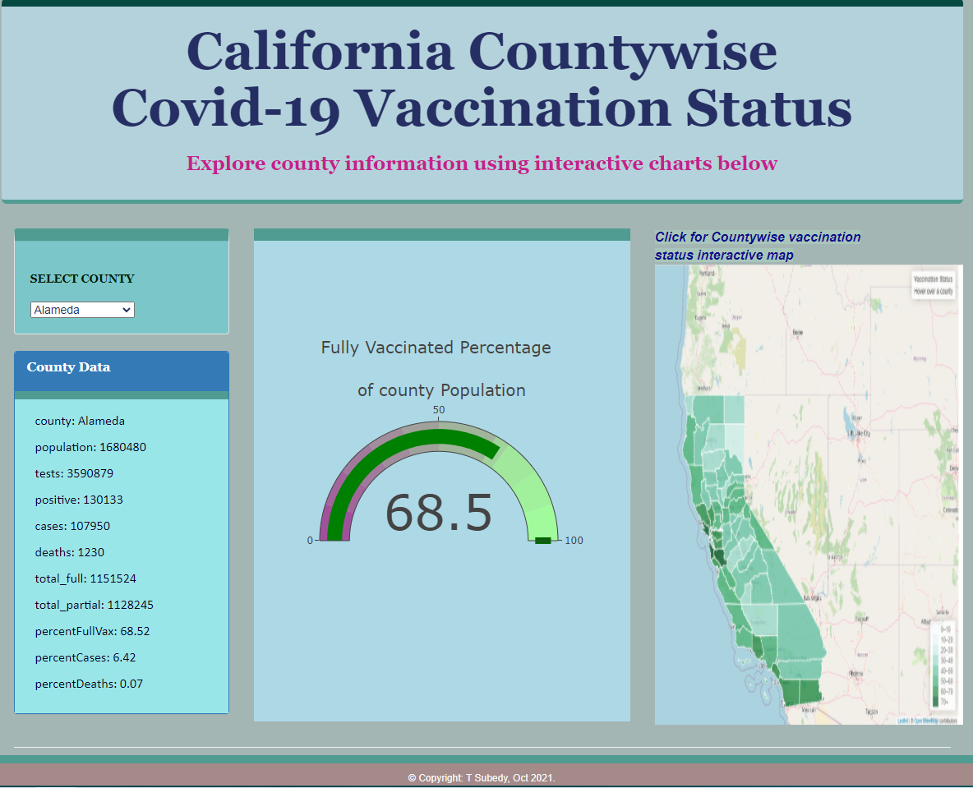
Dashboard and Data Visualization:
Dashboard:
Javascript
Plotly
Html/ CSS
Mapping
Leaflets
https://tsubedy.github.io/Project_3/

Slide 12
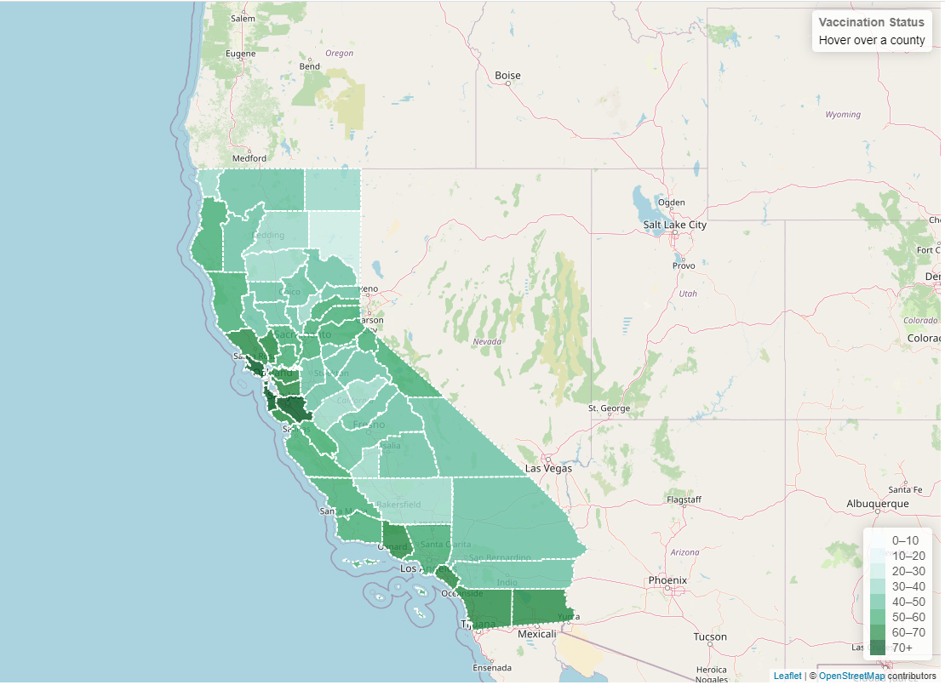
Dashboard and Data Visualization:
Dashboard:
Javascript
Plotly
Html/ CSS
Mapping
Leaflets

Slide 13
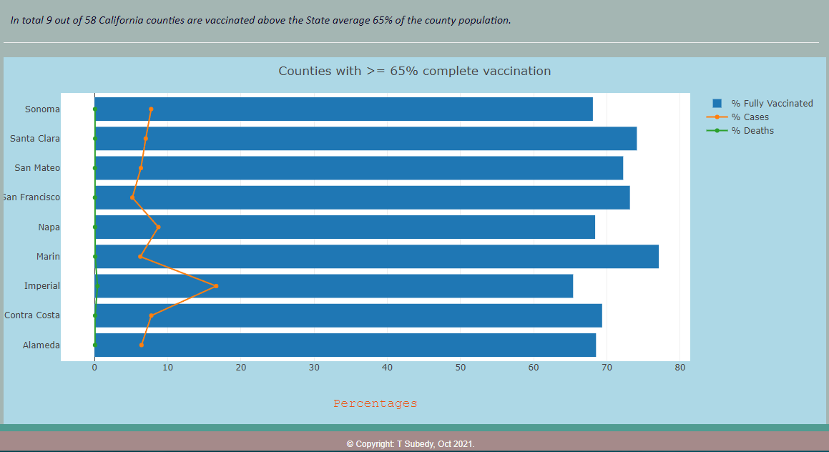
Dashboard and Data Visualization:
Dashboard:
Javascript
Plotly
Html/ CSS
Mapping
Leaflets

Slide 14
Limitations:
The project is a part of the assignments from the class of Data Analytics Bootcamp and is limited to demonstrate the technical skills learned so far in the class.
Some of data used for this project are not up to date as they were downloaded as csv files from the source sites.
Data analyses are not included as it is beyond the scope of this project.

Slide 15
Questions:
? ? ?
THANK YOU !!!

