Slide 1


Getting started
Getting ready for
AI and GitHub
Save one image, invite your instructor,
and complete initial registration.
Joining after the first class? Use the same steps.
AI and Data Literacy for University Students
Initial setup
tsuchiyatakahiro.com
Notes:
Teaching notes — Getting started
Set today’s goal: save an image, write a short use record, invite the instructor, and complete initial registration. Use the AI service, instructor account, and submission links specified for this course.
Course adaptation: specify the instructor username, student template, registration form, permitted account, and student-ID format for your university. Late joiners use the same preparation steps.
References
https://tsuchiyatakahiro.com/images/logo-full.png.
Icons: see assets/icons/lucide/LICENSE.txt for the Lucide license.

Slide 2


Getting started
Your setup checklist
1
Check your accounts
Open the course page and GitHub.
2
Create your repository
Copy the template as Private.
3
Save an image and record
Save one image and a short record.
4
Invite your instructor
Invite them to your repository.
5
Register your repository
Connect your student details and GitHub.
Skip completed steps. Late joiners follow the same checklist.
AI and Data Literacy Initial setup
02 / 37
Notes:
Teaching notes — Your setup checklist
Show the five stages first. These stage numbers are not weekly submission numbers. Late joiners can use the supplementary pages.
Course adaptation: specify the instructor username, student template, registration form, permitted account, and student-ID format for your university. Late joiners use the same preparation steps.
References
https://tsuchiyatakahiro.com/images/logo-full.png.
Icons: see assets/icons/lucide/LICENSE.txt for the Lucide license.

Slide 3



Getting started
Setup checklist
What you need
A computer
Your course account
An AI you can use
Open a browser.
Have your charger ready.
Use it to open
the course page
and submission form.
Open an AI available
for your course,
or one you usually use.
Send a short question.
A paid plan is optional. You can use the supplied image instead of generating one.
AI and Data Literacy Initial setup
03 / 37
Notes:
Teaching notes — What you need
Have everyone send one short question using an available AI service. The supplied image is an equally valid option when image generation is unavailable.
Course adaptation: specify the instructor username, student template, registration form, permitted account, and student-ID format for your university. Late joiners use the same preparation steps.
References
https://tsuchiyatakahiro.com/images/logo-full.png.
Icons: see assets/icons/lucide/LICENSE.txt for the Lucide license.

Slide 4



Getting started
Setup checklist
Where to read, save and submit
1. Read the task
2. Save your work
3. Submit the link
Read the instructions
in the course materials.
Put your images and
text in your repository.
Send the required URL
through your course
submission form.
Initial registration uses a repository URL. Weekly submissions use a saved commit.
Read the instructor's materials. Save your own work in your own repository.
AI and Data Literacy Initial setup
04 / 37
Notes:
Teaching notes — Where to read, save and submit
Distinguish the instructor’s reading materials, the student’s editable README, and the submission form. Students work in their own private repository.
Course adaptation: specify the instructor username, student template, registration form, permitted account, and student-ID format for your university. Late joiners use the same preparation steps.
References
https://tsuchiyatakahiro.com/images/logo-full.png.
Icons: see assets/icons/lucide/LICENSE.txt for the Lucide license.

Slide 5
1 / 5 Accounts
Setup checklist
Your course account
1
Open the course page and check the account at the top right.
Check that the email matches the account specified for this course.
2
Switch accounts if you are signed in with the wrong one.
Use the specified account before requesting access.
3
Open the course page again.
If it still fails, show your instructor the error message.
When you can open the course page and form, continue to GitHub.
AI and Data Literacy Initial setup
05 / 37
Notes:
Teaching notes — Your course account
Switch to the account specified by the course when access fails. Never ask students to reveal passwords or verification codes.
Course adaptation: specify the instructor username, student template, registration form, permitted account, and student-ID format for your university. Late joiners use the same preparation steps.
References
https://tsuchiyatakahiro.com/images/logo-full.png.
Icons: see assets/icons/lucide/LICENSE.txt for the Lucide license.

Slide 6

1 / 5 Accounts
Setup checklist
Your GitHub account is separate
New to GitHub?
Already have an account?
Sign up on the next slide.
Use your university email
and confirm the message.
Use your current account.
Add and verify your
university email.
Keep your student ID and university email out of your public profile.
AI and Data Literacy Initial setup
06 / 37
Notes:
Teaching notes — Your GitHub account is separate
Students with an existing GitHub account should keep it. Follow the new-account or existing-account route as appropriate.
Course adaptation: specify the instructor username, student template, registration form, permitted account, and student-ID format for your university. Late joiners use the same preparation steps.
References
https://tsuchiyatakahiro.com/images/logo-full.png.
Icons: see assets/icons/lucide/LICENSE.txt for the Lucide license.

Slide 7
1 / 5 Accounts
Setup checklist
Signing up for GitHub
GitHub / Sign up
1
Open GitHub Sign up.
Email
2
Enter your email,
username and password.
Your university email
Username
A username you choose
3
Follow the prompts.
Confirm your
university email.
Diagram showing the fields to use
Already registered? Use Sign in with your existing account.
AI and Data Literacy Initial setup
07 / 37
Notes:
Teaching notes — Signing up for GitHub
This registration diagram is a schematic, not a screenshot of the current service. Follow the on-screen registration instructions.
Course adaptation: specify the instructor username, student template, registration form, permitted account, and student-ID format for your university. Late joiners use the same preparation steps.
References
https://tsuchiyatakahiro.com/images/logo-full.png.
Icons: see assets/icons/lucide/LICENSE.txt for the Lucide license.

Slide 8
1 / 5 Accounts
Setup checklist
Email verification and privacy
1
Open Settings from your profile menu at the top right.
These are settings for your whole GitHub account.
2
In Emails, add and verify your university email.
Enter it in Add email address, select Add, then confirm the email.
Skip this if your university email is already your Primary email address.
3
Check Keep my email addresses private.
Tick the box and check that your university email shows Verified.
You can keep your usual primary email address.
AI and Data Literacy Initial setup
08 / 37
Notes:
Teaching notes — Email verification and privacy
If adding a university email address, complete email verification. Do not add it twice or require a change to the student’s usual primary address.
Course adaptation: specify the instructor username, student template, registration form, permitted account, and student-ID format for your university. Late joiners use the same preparation steps.
References
https://tsuchiyatakahiro.com/images/logo-full.png.
https://docs.github.com/en/account-and-profile/how-tos/email-preferences/adding-an-email-address-to-your-github-account
Icons: see assets/icons/lucide/LICENSE.txt for the Lucide license.

Slide 9

1 / 5 Accounts
Setup checklist
Finding your username
Profile
1
Open Profile at the top right.
Your profile URL
The last part of the URL
is your username.
2
github.com/example-student
Name to enter in registration
example-student
3
Write down your username.
You will use it
for registration.
Diagram showing the fields to use
Use the name at the end of your profile URL, rather than your display name or email.
AI and Data Literacy Initial setup
09 / 37
Notes:
Teaching notes — Finding your username
Explain the difference between the username at the end of the profile URL, the display name, and the email address. example-student is fictional.
Course adaptation: specify the instructor username, student template, registration form, permitted account, and student-ID format for your university. Late joiners use the same preparation steps.
References
https://github.com/tsuchiyatakahirolab/ai-data-literacy/blob/main/assets/setup/screens/ATTRIBUTION.md
https://github.com/tsuchiyatakahirolab/ai-data-literacy-student-template
https://tsuchiyatakahiro.com/images/logo-full.png.
https://github.blog/changelog/2025-09-04-profile-menu-enhancements-in-global-navigation/
https://docs.github.com/en/account-and-profile/how-tos/email-preferences/remembering-your-github-username-or-email
Icons: see assets/icons/lucide/LICENSE.txt for the Lucide license.

Slide 10
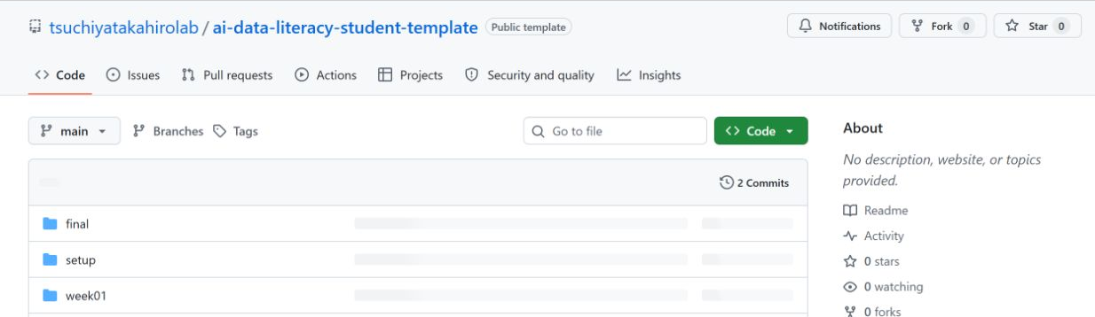
2 / 5 Repository
Setup checklist
Your course's student template
This is the instructor's public template. Sign in, then make your own copy.
1
Open the student template.
2
Find setup and the other folders.
Copy the template into your own repository before editing it.
AI and Data Literacy Initial setup
10 / 37
Notes:
Teaching notes — Your course's student template
Open the template specified for the course. The screenshot shows a public template while logged out. Sign in and reopen it if Use this template is missing. The English edition supplies an English blank template.
Course adaptation: specify the instructor username, student template, registration form, permitted account, and student-ID format for your university. Late joiners use the same preparation steps.
References
https://github.com/tsuchiyatakahirolab/ai-data-literacy/blob/main/assets/setup/screens/ATTRIBUTION.md
https://github.com/tsuchiyatakahirolab/ai-data-literacy-student-template
https://tsuchiyatakahiro.com/images/logo-full.png.
Icons: see assets/icons/lucide/LICENSE.txt for the Lucide license.

Slide 11

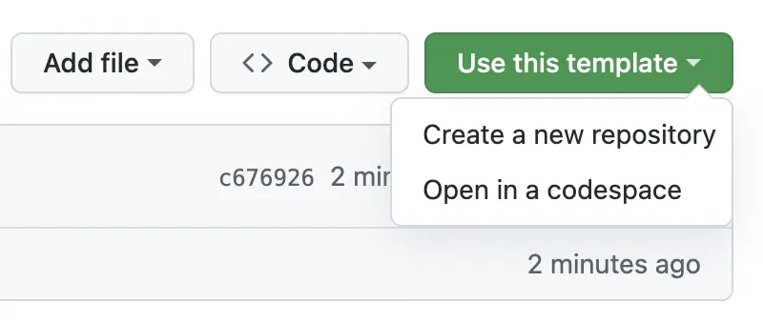
2 / 5 Repository
Setup checklist
Copying with Use this template
1
Select Use this template.
Sign in to GitHub first.
2
Select Create a new
repository.
This opens the form
for your own repository.
Example from GitHub Docs
Already created ai-learning? Keep it and go to slide 14.
AI and Data Literacy Initial setup
11 / 37
Notes:
Teaching notes — Copying with Use this template
Use Use this template. Sign in and reopen the template if the button is missing. This screenshot comes from GitHub documentation; placement may change.
Course adaptation: specify the instructor username, student template, registration form, permitted account, and student-ID format for your university. Late joiners use the same preparation steps.
References
https://github.com/tsuchiyatakahirolab/ai-data-literacy/blob/main/assets/setup/screens/ATTRIBUTION.md
https://github.com/tsuchiyatakahirolab/ai-data-literacy-student-template
https://tsuchiyatakahiro.com/images/logo-full.png.
Icons: see assets/icons/lucide/LICENSE.txt for the Lucide license.

Slide 12
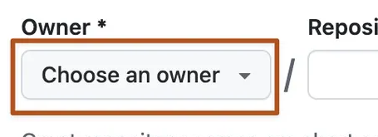
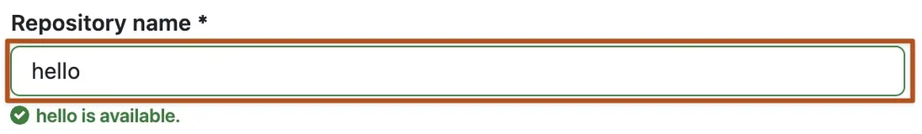
2 / 5 Repository
Setup checklist
Owner and repository name
1
Choose your own
account as Owner.
2
Enter ai-learning
in Repository name.
3
Use ai-learning rather
than hello or your student ID.
Official example. Use the values shown on the right.
A repository stores your files and their change history.
AI and Data Literacy Initial setup
12 / 37
Notes:
Teaching notes — Owner and repository name
Owner must be the student’s own account, and Repository name is ai-learning. Use the actual student account rather than copying the screenshot’s owner. This screenshot comes from GitHub documentation.
Course adaptation: specify the instructor username, student template, registration form, permitted account, and student-ID format for your university. Late joiners use the same preparation steps.
References
https://github.com/tsuchiyatakahirolab/ai-data-literacy/blob/main/assets/setup/screens/ATTRIBUTION.md
https://github.com/tsuchiyatakahirolab/ai-data-literacy-student-template
https://tsuchiyatakahiro.com/images/logo-full.png.
Icons: see assets/icons/lucide/LICENSE.txt for the Lucide license.

Slide 13

2 / 5 Repository
Setup checklist
Creating a Private repository
Create a new repository
1
Select Private.
Repository name
2
Check the Owner
and repository name.
ai-learning
Visibility
3
Select Create repository.
Private
Diagram showing the fields to use
Check that the repository visibility is Private.
AI and Data Literacy Initial setup
13 / 37
Notes:
Teaching notes — Creating a Private repository
Keep the repository Private. The creation diagram is a schematic rather than a current service screenshot.
Course adaptation: specify the instructor username, student template, registration form, permitted account, and student-ID format for your university. Late joiners use the same preparation steps.
References
https://github.com/tsuchiyatakahirolab/ai-data-literacy/blob/main/assets/setup/screens/ATTRIBUTION.md
https://github.com/tsuchiyatakahirolab/ai-data-literacy-student-template
https://tsuchiyatakahiro.com/images/logo-full.png.
Icons: see assets/icons/lucide/LICENSE.txt for the Lucide license.

Slide 14
2 / 5 Repository
Setup checklist
Checking your new repository
your-username / ai-learning
Private
Diagram of the page header. Check that the username is yours.
1
Find the setup folder.
You will save your image and short record here.
2
Find week01 and the later folders.
Save each week's work in the corresponding folder.
Check your username, ai-learning and Private before continuing.
AI and Data Literacy Initial setup
14 / 37
Notes:
Teaching notes — Checking your new repository
Pause and check the student’s own username and Private label. Upload into the student’s private repository. This folder diagram is a schematic.
Course adaptation: specify the instructor username, student template, registration form, permitted account, and student-ID format for your university. Late joiners use the same preparation steps.
References
https://github.com/tsuchiyatakahirolab/ai-data-literacy/blob/main/assets/setup/screens/ATTRIBUTION.md
https://github.com/tsuchiyatakahirolab/ai-data-literacy-student-template
https://tsuchiyatakahiro.com/images/logo-full.png.
Icons: see assets/icons/lucide/LICENSE.txt for the Lucide license.

Slide 15

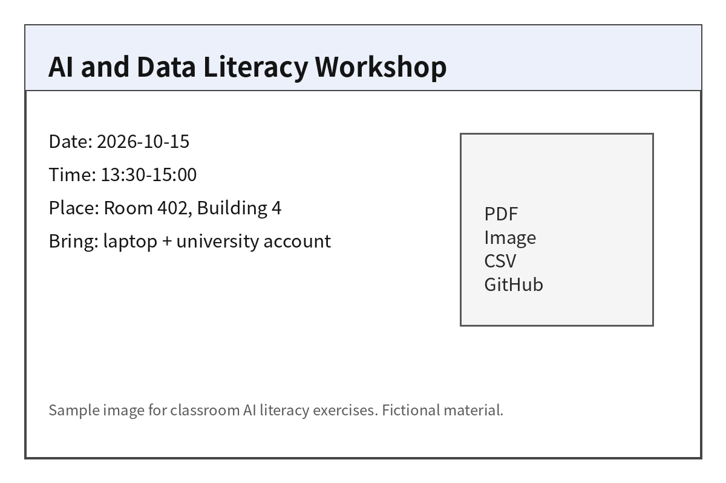
3 / 5 Image and record
Setup checklist
Preparing one practice image
Generate an image
Create an image and save it.
Use the supplied image
Save practice.png.
Example of the supplied practice image
Either image works. Follow the same upload steps.
AI and Data Literacy Initial setup
15 / 37
Notes:
Teaching notes — Preparing one practice image
An original generated image and the supplied image are both acceptable. Image quality and paid subscriptions are not completion criteria. The sample event is fictional.
Course adaptation: specify the instructor username, student template, registration form, permitted account, and student-ID format for your university. Late joiners use the same preparation steps.
References
https://github.com/tsuchiyatakahirolab/ai-data-literacy/blob/main/assets/setup/screens/ATTRIBUTION.md
https://github.com/tsuchiyatakahirolab/ai-data-literacy-student-template
https://tsuchiyatakahiro.com/images/logo-full.png.
Icons: see assets/icons/lucide/LICENSE.txt for the Lucide license.

Slide 16
3 / 5 Image and record
Setup checklist
Saving the actual image file
1
Open the supplied image page.
Open assets/setup/practice.png.
2
Select Download raw file to save the image.
Use the down arrow at the top right. For an AI image, use that AI's download control.
3
Open the saved file on your computer.
Look in Downloads or your chosen folder. Check that it is a PNG or JPEG.
Save the image file itself. Copying the page URL will not save the image.
AI and Data Literacy Initial setup
16 / 37
Notes:
Teaching notes — Saving the actual image file
The supplied image is assets/setup/practice.png. Open its link from the course page. For generated images, use the service’s own download function.
Course adaptation: specify the instructor username, student template, registration form, permitted account, and student-ID format for your university. Late joiners use the same preparation steps.
References
https://tsuchiyatakahiro.com/images/logo-full.png.
Icons: see assets/icons/lucide/LICENSE.txt for the Lucide license.

Slide 17
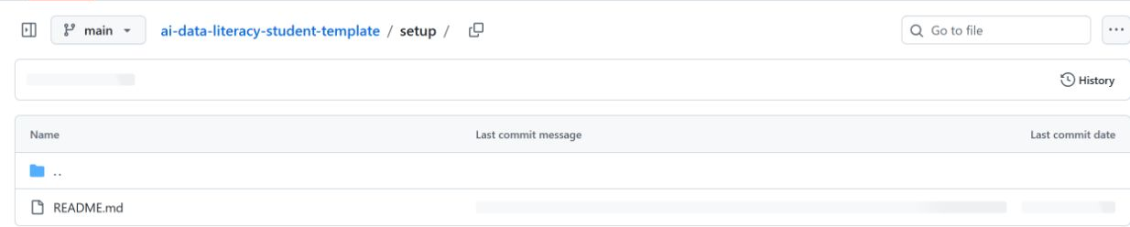
3 / 5 Image and record
Setup checklist
Opening setup in your ai-learning
The screenshot shows the instructor's template. Work in your own Private copy.
1
Open your own ai-learning.
2
Find setup/README.md.
Use the top-right menu, Your repositories, then ai-learning to return to your copy.
AI and Data Literacy Initial setup
17 / 37
Notes:
Teaching notes — Opening setup in your ai-learning
The screenshot shows the public teaching template. Students must return to their own private repository; its owner and name will differ.
Course adaptation: specify the instructor username, student template, registration form, permitted account, and student-ID format for your university. Late joiners use the same preparation steps.
References
https://github.com/tsuchiyatakahirolab/ai-data-literacy/blob/main/assets/setup/screens/ATTRIBUTION.md
https://github.com/tsuchiyatakahirolab/ai-data-literacy-student-template
https://tsuchiyatakahiro.com/images/logo-full.png.
Icons: see assets/icons/lucide/LICENSE.txt for the Lucide license.

Slide 18
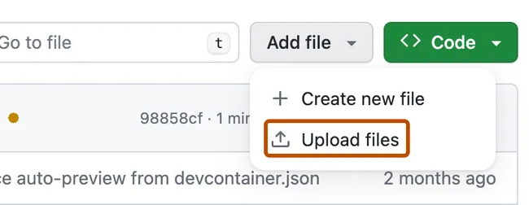
3 / 5 Image and record
Setup checklist
Uploading an image with Add file
1
Select Add file.
Work in your own
setup folder.
2
Select Upload files.
This opens the
file selection page.
Cropped example from GitHub Docs
After selecting Upload files, choose the image saved on your computer.
AI and Data Literacy Initial setup
18 / 37
Notes:
Teaching notes — Uploading an image with Add file
Find Add file, then Upload files. Wait for students to reach the upload screen. This screenshot comes from GitHub documentation.
Course adaptation: specify the instructor username, student template, registration form, permitted account, and student-ID format for your university. Late joiners use the same preparation steps.
References
https://github.com/tsuchiyatakahirolab/ai-data-literacy/blob/main/assets/setup/screens/ATTRIBUTION.md
https://github.com/tsuchiyatakahirolab/ai-data-literacy-student-template
https://tsuchiyatakahiro.com/images/logo-full.png.
Icons: see assets/icons/lucide/LICENSE.txt for the Lucide license.

Slide 19

3 / 5 Image and record
Setup checklist
Saving with Commit changes
ai-learning / setup / Upload files
1
Use choose your files
to select one image.
File to upload
One PNG or JPEG image
2
Enter Add a practice image
as the commit message.
Commit message
Add a practice image
3
Select Commit changes
at the bottom to save.
Diagram showing the fields to use
Return to setup. If the image filename appears, it is saved. Open it next.
AI and Data Literacy Initial setup
19 / 37
Notes:
Teaching notes — Saving with Commit changes
Choose the image, upload it, and save with Commit changes. This upload diagram is a schematic.
Course adaptation: specify the instructor username, student template, registration form, permitted account, and student-ID format for your university. Late joiners use the same preparation steps.
References
https://github.com/tsuchiyatakahirolab/ai-data-literacy/blob/main/assets/setup/screens/ATTRIBUTION.md
https://github.com/tsuchiyatakahirolab/ai-data-literacy-student-template
https://tsuchiyatakahiro.com/images/logo-full.png.
https://docs.github.com/en/repositories/working-with-files/managing-files/adding-a-file-to-a-repository
Icons: see assets/icons/lucide/LICENSE.txt for the Lucide license.

Slide 20
3 / 5 Image and record
Setup checklist
Checking the image on GitHub
1
Select the image filename in setup.
Open the file you just uploaded.
2
Compare it with the image on your computer.
Check that the same image appears.
3
If it fails to display, check the original file.
Check that the image opens locally before uploading it again.
Once the image displays, add a short record in the same setup folder.
AI and Data Literacy Initial setup
20 / 37
Notes:
Teaching notes — Checking the image on GitHub
Open the uploaded image rather than checking only its filename. The supplied image supports the same technical check.
Course adaptation: specify the instructor username, student template, registration form, permitted account, and student-ID format for your university. Late joiners use the same preparation steps.
References
https://tsuchiyatakahiro.com/images/logo-full.png.
Icons: see assets/icons/lucide/LICENSE.txt for the Lucide license.

Slide 21
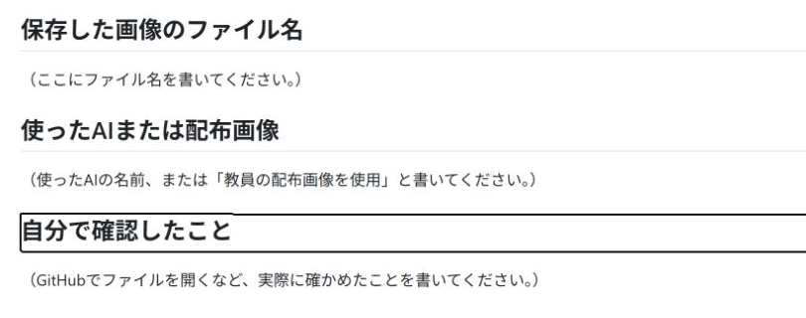
3 / 5 Image and record
Setup checklist
Your setup README
The README stores your short record. The screenshot is a Japanese template example.
1
Return to your own setup.
2
Open README.md.
Use the README inside setup, rather than the one at the repository root.
AI and Data Literacy Initial setup
21 / 37
Notes:
Teaching notes — Your setup README
Write the image filename, how it was obtained or used, and what the student checked in setup/README.md. The screenshot contains a Japanese example; English students use the English fields in their own template. Learning goals are optional.
Course adaptation: specify the instructor username, student template, registration form, permitted account, and student-ID format for your university. Late joiners use the same preparation steps.
References
https://github.com/tsuchiyatakahirolab/ai-data-literacy/blob/main/assets/setup/screens/ATTRIBUTION.md
https://github.com/tsuchiyatakahirolab/ai-data-literacy-student-template
https://tsuchiyatakahiro.com/images/logo-full.png.
Icons: see assets/icons/lucide/LICENSE.txt for the Lucide license.

Slide 22
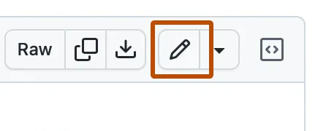
3 / 5 Image and record
Setup checklist
Editing with the pencil button
1
Select the pencil button.
This opens README.md
for editing.
2
Replace the instructions
with your own record.
Keep the headings.
Fill in the next slide's fields.
Cropped example from GitHub Docs
Keep full AI conversations, your name and student ID out of this record.
AI and Data Literacy Initial setup
22 / 37
Notes:
Teaching notes — Editing with the pencil button
Find the README edit icon. The screenshot’s text does not need to be copied. This screenshot comes from GitHub documentation.
Course adaptation: specify the instructor username, student template, registration form, permitted account, and student-ID format for your university. Late joiners use the same preparation steps.
References
https://github.com/tsuchiyatakahirolab/ai-data-literacy/blob/main/assets/setup/screens/ATTRIBUTION.md
https://github.com/tsuchiyatakahirolab/ai-data-literacy-student-template
https://tsuchiyatakahiro.com/images/logo-full.png.
Icons: see assets/icons/lucide/LICENSE.txt for the Lucide license.

Slide 23
3 / 5 Image and record
Setup checklist
Recording what you actually did
Saved image
filename
practice.png
AI or supplied image used
Used the instructor's supplied image
What I checked myself
I opened the image on GitHub and confirmed
that it matched the file on my computer.
Keep the three headings. Replace the examples with your actual filename, use and checks.
AI and Data Literacy Initial setup
23 / 37
Notes:
Teaching notes — Recording what you actually did
Use the real filename and describe actual use. If no AI was used, write that the supplied course image was used.
Course adaptation: specify the instructor username, student template, registration form, permitted account, and student-ID format for your university. Late joiners use the same preparation steps.
References
https://tsuchiyatakahiro.com/images/logo-full.png.
Icons: see assets/icons/lucide/LICENSE.txt for the Lucide license.

Slide 24

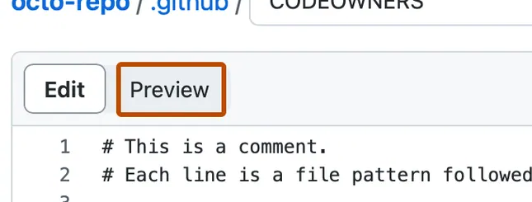
3 / 5 Image and record
Setup checklist
Checking the Preview
1
Select Preview.
Check how your
record displays.
2
Read all three fields.
Check the filename.
Remove any remaining
instruction text.
Cropped example from GitHub Docs
Preview does not save changes. Confirm the save on the next slide.
AI and Data Literacy Initial setup
24 / 37
Notes:
Teaching notes — Checking the Preview
Preview checks the display but does not save changes. Continue to Commit changes. This screenshot comes from GitHub documentation.
Course adaptation: specify the instructor username, student template, registration form, permitted account, and student-ID format for your university. Late joiners use the same preparation steps.
References
https://github.com/tsuchiyatakahirolab/ai-data-literacy/blob/main/assets/setup/screens/ATTRIBUTION.md
https://github.com/tsuchiyatakahirolab/ai-data-literacy-student-template
https://tsuchiyatakahiro.com/images/logo-full.png.
Icons: see assets/icons/lucide/LICENSE.txt for the Lucide license.

Slide 25
3 / 5 Image and record
Setup checklist
Saving your setup record
Commit changes
1
Select Commit changes
to start saving.
Commit message
Add an initial setup record
2
Write a commit message.
Choose to save to main.
Save to
Commit directly to the main branch
3
Select Commit changes
again to confirm the save.
Diagram showing the fields to use
Return to the README. Check that your own record appears under all three headings.
AI and Data Literacy Initial setup
25 / 37
Notes:
Teaching notes — Saving your setup record
Commit changes in the browser saves directly to GitHub; a separate push is unnecessary in this setup route. Use the branch specified by the course. This save diagram is a schematic.
Course adaptation: specify the instructor username, student template, registration form, permitted account, and student-ID format for your university. Late joiners use the same preparation steps.
References
https://github.com/tsuchiyatakahirolab/ai-data-literacy/blob/main/assets/setup/screens/ATTRIBUTION.md
https://github.com/tsuchiyatakahirolab/ai-data-literacy-student-template
https://tsuchiyatakahiro.com/images/logo-full.png.
https://docs.github.com/en/repositories/working-with-files/managing-files/editing-files
Icons: see assets/icons/lucide/LICENSE.txt for the Lucide license.

Slide 26
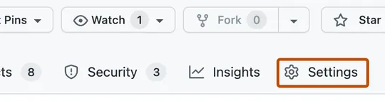
4 / 5 Instructor invitation
Setup checklist
Your repository's Settings
1
Open your own
ai-learning.
Check the Owner
and Private visibility.
2
Select Settings.
Use Settings above
the repository file list.
Cropped example from GitHub Docs
If Settings is hidden, check the three-dot menu at the right.
AI and Data Literacy Initial setup
26 / 37
Notes:
Teaching notes — Your repository's Settings
Distinguish repository Settings from account Settings. Repository access settings are reached from a different place than email settings. This screenshot comes from GitHub documentation.
Course adaptation: specify the instructor username, student template, registration form, permitted account, and student-ID format for your university. Late joiners use the same preparation steps.
References
https://github.com/tsuchiyatakahirolab/ai-data-literacy/blob/main/assets/setup/screens/ATTRIBUTION.md
https://github.com/tsuchiyatakahirolab/ai-data-literacy-student-template
https://tsuchiyatakahiro.com/images/logo-full.png.
Icons: see assets/icons/lucide/LICENSE.txt for the Lucide license.

Slide 27
4 / 5 Instructor invitation
Setup checklist
Inviting your instructor's account
ai-learning / Settings
1
In Collaborators,
select Add people.
Access management
Collaborators → Add people
2
Select the result with
the exact username.
Username to invite (ask your instructor)
tsuchiyatakahirolab
3
Select Add ... to ai-learning
to send the invitation.
For another course, replace this example
with that instructor's username.
Diagram showing the fields to use
Continue once the invitation is pending or the instructor is listed. Keep login codes private.
AI and Data Literacy Initial setup
27 / 37
Notes:
Teaching notes — Inviting your instructor's account
Verify the full instructor username before selecting and inviting it. tsuchiyatakahirolab is the author’s example; other instructors replace it with their own account. Pending invitation is sufficient for the student to continue. Personal-repository collaborators also have write access, so instructors should avoid modifying student files. This invitation diagram is a schematic.
Course adaptation: specify the instructor username, student template, registration form, permitted account, and student-ID format for your university. Late joiners use the same preparation steps.
References
https://github.com/tsuchiyatakahirolab/ai-data-literacy/blob/main/assets/setup/screens/ATTRIBUTION.md
https://github.com/tsuchiyatakahirolab/ai-data-literacy-student-template
https://tsuchiyatakahiro.com/images/logo-full.png.
https://docs.github.com/en/repositories/managing-your-repositorys-settings-and-features/repository-access-and-collaboration/inviting-collaborators-to-a-personal-repository
Icons: see assets/icons/lucide/LICENSE.txt for the Lucide license.

Slide 28
5 / 5 Initial registration
Setup checklist
Copying your repository URL
https://github.com/example-student/ai-learning
Check that example-student is replaced with your own username.
1
Open the root of your own ai-learning.
Select ai-learning at the top to return to the Code file list.
2
Copy the URL from your browser's address bar.
On Windows, use Ctrl+L, then Ctrl+C. Paste with Ctrl+V in the form.
Use the URL ending in /ai-learning for initial registration. Omit /tree/, /blob/ and /commit/.
AI and Data Literacy Initial setup
28 / 37
Notes:
Teaching notes — Copying your repository URL
Initial registration uses the repository URL, not the profile URL or a commit URL. The example-student URL is a fictional structure example.
Course adaptation: specify the instructor username, student template, registration form, permitted account, and student-ID format for your university. Late joiners use the same preparation steps.
References
https://github.com/tsuchiyatakahirolab/ai-data-literacy/blob/main/assets/setup/screens/ATTRIBUTION.md
https://github.com/tsuchiyatakahirolab/ai-data-literacy-student-template
https://tsuchiyatakahiro.com/images/logo-full.png.
Icons: see assets/icons/lucide/LICENSE.txt for the Lucide license.

Slide 29
5 / 5 Initial registration
Setup checklist
Your university's student ID format
Example format
Errors in this example format
2026GT0001
26GT0001
Year shortened
2026gt0001
This example has 10 ASCII characters.
Use the full student ID format
required by your university.
Lowercase letters
２０２６ＧＴ０００１
Full-width characters
Enter your student ID in the course form. Keep it out of your public GitHub profile.
AI and Data Literacy Initial setup
29 / 37
Notes:
Teaching notes — Your university's student ID format
2026GT0001 is only an example of a student-ID format. Use the full format required by the student’s university; neither length nor entry year is universal.
Course adaptation: specify the instructor username, student template, registration form, permitted account, and student-ID format for your university. Late joiners use the same preparation steps.
References
https://tsuchiyatakahiro.com/images/logo-full.png.
Icons: see assets/icons/lucide/LICENSE.txt for the Lucide license.

Slide 30
5 / 5 Initial registration
Setup checklist
Connecting your details and GitHub
1
Open initial registration from your course page.
Check the signed-in account and the email shown in the form.
2
Enter your student ID, username and repository URL.
Complete any other required fields as the form instructs.
3
Submit and check the confirmation screen.
The confirmation screen shows it was received. Keep your repository URL for later.
Initial registration uses your repository URL. Full AI conversations are unnecessary.
AI and Data Literacy Initial setup
30 / 37
Notes:
Teaching notes — Connecting your details and GitHub
Use the existing initial registration form supplied by the instructor. Enter student ID, university email, GitHub username, and repository URL in the same response. Follow the actual form’s fields and rules.
Course adaptation: specify the instructor username, student template, registration form, permitted account, and student-ID format for your university. Late joiners use the same preparation steps.
References
https://tsuchiyatakahiro.com/images/logo-full.png.
Icons: see assets/icons/lucide/LICENSE.txt for the Lucide license.

Slide 31
5 / 5 Initial registration
Setup checklist
Your setup and the instructor's check
Your part
The instructor's check
Save your image and record.
Invite your instructor.
Submit initial registration.
The instructor checks your
registration and repository.
Follow the course page
to find your results.
Wait for the check. You do not need to resubmit just because the results have not arrived.
AI and Data Literacy Initial setup
31 / 37
Notes:
Teaching notes — Your setup and the instructor's check
The course page explains how to view check results. Students need not wait for invitation acceptance or a personal comment. Follow any correction instructions.
Course adaptation: specify the instructor username, student template, registration form, permitted account, and student-ID format for your university. Late joiners use the same preparation steps.
References
https://tsuchiyatakahiro.com/images/logo-full.png.
Icons: see assets/icons/lucide/LICENSE.txt for the Lucide license.

Slide 32
5 / 5 Initial registration
Setup checklist
Your setup is complete when...
Your ai-learning repository is Private.
An image in setup opens on GitHub.
Your own short record is saved in setup/README.md.
You have sent an invitation to your instructor's account.
You have submitted initial registration and seen the confirmation.
Check the results later. If asked to revise something, update that part.
AI and Data Literacy Initial setup
32 / 37
Notes:
Teaching notes — Your setup is complete when...
Check only items that students can verify themselves. Instructor acceptance of the invitation is not a condition for completing the student’s steps.
Course adaptation: specify the instructor username, student template, registration form, permitted account, and student-ID format for your university. Late joiners use the same preparation steps.
References
https://tsuchiyatakahiro.com/images/logo-full.png.
Icons: see assets/icons/lucide/LICENSE.txt for the Lucide license.

Slide 33
Submitting and continuing
Setup checklist
Your weekly submission
1
Save that week's work and short AI-use record in your repository.
Read the course handout. Write your answers in your own week01/README.md.
2
In Code, open commits, then select the latest commit message.
Return to your ai-learning and open the history above the file list.
3
Copy the commit URL into that week's submission form.
Check for /commit/ and a long string of letters and numbers in the URL.
Before submitting, use Browse files to check that the commit contains all required files.
AI and Data Literacy Initial setup
33 / 37
Notes:
Teaching notes — Your weekly submission
Distinguish initial registration from weekly submission. Refer to the weekly instructions for obtaining the final commit URL.
Course adaptation: specify the instructor username, student template, registration form, permitted account, and student-ID format for your university. Late joiners use the same preparation steps.
References
https://tsuchiyatakahiro.com/images/logo-full.png.
Icons: see assets/icons/lucide/LICENSE.txt for the Lucide license.

Slide 34
Submitting and continuing
Setup checklist
Joining or continuing later
Starting now
Continuing
Making corrections
Follow the setup steps.
Use the same initial
registration form.
Keep your ai-learning.
Continue from your
first unfinished step.
No need to recreate it.
Update your image or record.
Correct registration too
if your username or
repository URL was wrong.
Image or record edits need no new registration. Ask your instructor about past deadlines.
AI and Data Literacy Initial setup
34 / 37
Notes:
Teaching notes — Joining or continuing later
Late joiners use the same template, registration form, and preparation materials. Reuse existing files and history. Earlier assignments and deadlines follow the instructor’s policy.
Course adaptation: specify the instructor username, student template, registration form, permitted account, and student-ID format for your university. Late joiners use the same preparation steps.
References
https://tsuchiyatakahiro.com/images/logo-full.png.
Icons: see assets/icons/lucide/LICENSE.txt for the Lucide license.

Slide 35

Submitting and continuing
Setup checklist
When you get stuck
Cannot sign in
Cannot edit
Cannot save
Course: specified account.
GitHub: separate account.
Check slides 5 to 8.
Check that you are
in your own repository.
Make your edits there,
not in the template.
Tell your instructor
the error message
and this guide's
slide number.
Hide passwords, login codes and personal details before sharing your screen.
AI and Data Literacy Initial setup
35 / 37
Notes:
Teaching notes — When you get stuck
Prevent access requests sent from the wrong account. When asking for help, share the step number and error with confidential information hidden.
Course adaptation: specify the instructor username, student template, registration form, permitted account, and student-ID format for your university. Late joiners use the same preparation steps.
References
https://tsuchiyatakahiro.com/images/logo-full.png.
Icons: see assets/icons/lucide/LICENSE.txt for the Lucide license.

Slide 36
Optional steps
Setup checklist
Student benefits and bookmarks
Student benefits
Easy access to materials
Check GitHub Education
for current benefits.
You can join class while
your application is pending.
Bookmark the course
in your browser for
easy access next time.
GitHub Stars are optional.
Student benefits, Stars and paid plans are optional. They do not determine setup completion.
AI and Data Literacy Initial setup
36 / 37
Notes:
Teaching notes — Student benefits and bookmarks
Student benefits, paid AI, and Star are optional. Check official eligibility and terms; they are not participation or grading requirements.
Course adaptation: specify the instructor username, student template, registration form, permitted account, and student-ID format for your university. Late joiners use the same preparation steps.
References
https://tsuchiyatakahiro.com/images/logo-full.png.
Icons: see assets/icons/lucide/LICENSE.txt for the Lucide license.

Slide 37
Optional steps
Setup checklist
An optional two-line learning goal
1
Open the README.md
at the repository root.
ai-learning / README.md
What I want to try in this course
2
Select the pencil button.
Write two lines about
your learning goal.
I want to use AI to read documents.
I want to learn how to check its answers.
3
Commit your changes.
Registration need not be resent.
This is optional. Finish the image, record, invitation and registration first.
AI and Data Literacy Initial setup
37 / 37
Notes:
Teaching notes — An optional two-line learning goal
Learning goals are optional. Keep them separate from the required image filename, use method, and checks. The goal-writing example is illustrative.
Course adaptation: specify the instructor username, student template, registration form, permitted account, and student-ID format for your university. Late joiners use the same preparation steps.
References
https://tsuchiyatakahiro.com/images/logo-full.png.
Icons: see assets/icons/lucide/LICENSE.txt for the Lucide license.

