Slide 1

GitHub Hands-on Practice
Your repository, saved README, and course submission
Practice 15 actions, then check your own screen.
Includes three videos and an ordered self-check sheet.
Takahiro Tsuchiya · tsuchiyatakahiro.com
Notes:
Students perform one action at a time and show its cue on their own screen. Keep existing repositories. After this cover come action steps 01–15, followed by self-checks 01–08. Action numbers differ from PDF page numbers. Instructors specify their own username and course/form links.

Slide 2

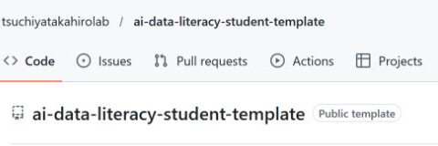
Which repository is open?
Open
The owner and name at the top
Do this now
Check your own username.
Read the instructor material there.
Check before continuing
If you already own ai-learning,
continue in that repository.
Public template example. Use your own repository.
GitHub hands-on clinic
tsuchiyatakahiro.com
01 / 15
Notes:
Look at the name to the left of the slash at the top. It identifies the repository owner. Opening the instructor material does not create your own repository. If you already own ai-learning, continue there. Pause and check the owner.
Teaching: pause while students perform this action. Check the completion cue on their own screen and help those who stopped. Do not ask for passwords or sign-in codes. Keep the existing assessment and deadline policy.
Sources: https://github.com/tsuchiyatakahirolab/ai-data-literacy-student-template (public example captured 2026-10-14; not a student private repository)

Slide 3
Sign in to GitHub
Open
Checking the operation
Sign in on GitHub.
New users choose Sign up.
University course page
GitHub
Check each sign-in separately
Do this now
Keep an existing account.
New users verify their email.
Check before continuing
You know your username.
Your required email is verified.
Check your own screen before continuing.
GitHub hands-on clinic
tsuchiyatakahiro.com
02 / 15
Notes:
GitHub is a separate account from your university page or Google account. Keep your existing account. New users sign up and follow the verification email. Open Profile and note the username in its address. Enter passwords and sign-in codes yourself. Pause to finish this step.
Teaching: pause while students perform this action. Check the completion cue on their own screen and help those who stopped. Do not ask for passwords or sign-in codes. Keep the existing assessment and deadline policy.
Sources:

Slide 4
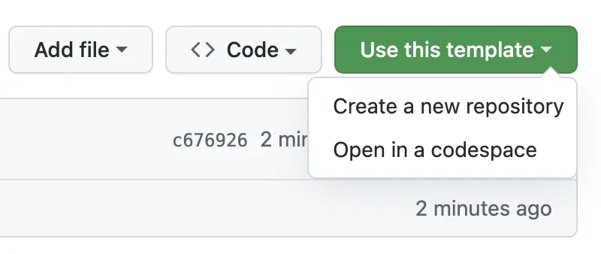
Create from the template
Open
The course student template
Do this now
Use this template
Create a new repository
Check before continuing
The creation form opens.
Skip this if already created.
GitHub Docs example. Values are examples.
GitHub hands-on clinic
tsuchiyatakahiro.com
03 / 15
Notes:
Open the course student template. Choose Use this template, then Create a new repository. A star or a browser bookmark does not create your repository. If the button is missing, check that you are signed in. Skip creation if you already have your own repository. Pause before continuing.
Teaching: pause while students perform this action. Check the completion cue on their own screen and help those who stopped. Do not ask for passwords or sign-in codes. Keep the existing assessment and deadline policy.
Sources: https://docs.github.com/en/repositories/working-with-files/managing-files/editing-files; https://docs.github.com/en/repositories/creating-and-managing-repositories/creating-a-repository-from-a-template; https://docs.github.com/en/repositories/managing-your-repositorys-settings-and-features/repository-access-and-collaboration/inviting-collaborators-to-a-personal-repository (checked 2026-10-14; source screenshot capture date unknown)

Slide 5
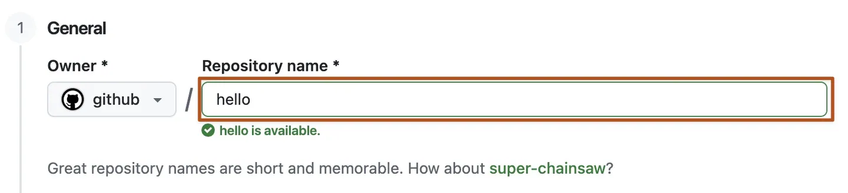
Owner, name, and visibility
Open
Owner and repository name
Do this now
Your Owner, ai-learning.
Choose Private and create.
Check before continuing
Your username / ai-learning
and Private appear.
GitHub Docs example. Values are examples.
GitHub hands-on clinic
tsuchiyatakahiro.com
04 / 15
Notes:
Choose your own account as Owner, enter ai-learning, and select Private. Use Create repository from template, or the equivalent creation button shown. The image contains example values; do not copy github or hello. After creation, check your username and the Private label. Pause here.
Teaching: pause while students perform this action. Check the completion cue on their own screen and help those who stopped. Do not ask for passwords or sign-in codes. Keep the existing assessment and deadline policy.
Sources: https://docs.github.com/en/repositories/working-with-files/managing-files/editing-files; https://docs.github.com/en/repositories/creating-and-managing-repositories/creating-a-repository-from-a-template; https://docs.github.com/en/repositories/managing-your-repositorys-settings-and-features/repository-access-and-collaboration/inviting-collaborators-to-a-personal-repository (checked 2026-10-14; source screenshot capture date unknown)

Slide 6
Check your own repository
Open
Checking the operation
Code in your own ai-learning
Your username / ai-learning
Private
setup, week01, …, final
Do this now
Find setup and week folders.
Bookmark your repository URL.
Check before continuing
The folders belong to you.
Use this URL for registration.
Check your own screen before continuing.
GitHub hands-on clinic
tsuchiyatakahiro.com
05 / 15
Notes:
Open Code in your own ai-learning and find setup and the week folders. If they are missing, ask your instructor before recreating anything. Preserve existing work. The repository address is used for initial registration, which is separate from invitation and weekly submission. Pause and bookmark your repository.
Teaching: pause while students perform this action. Check the completion cue on their own screen and help those who stopped. Do not ask for passwords or sign-in codes. Keep the existing assessment and deadline policy.
Sources:

Slide 7
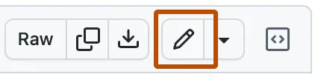
Open your README
Open
Your ai-learning.
The week your instructor chose.
Do this now
Open README.md.
Click the pencil icon.
Check before continuing
The editor opens.
The repository owner is you.
GitHub Docs example. Values are examples.
GitHub hands-on clinic
tsuchiyatakahiro.com
06 / 15
Notes:
Open README.md in the week folder chosen by your instructor, in your own ai-learning. Read the teaching material in the instructor repository and write in your own file. Click the pencil. If it is missing, check ownership and sign-in. If you are asked to fork or propose changes, stop and ask for help.
Teaching: pause while students perform this action. Check the completion cue on their own screen and help those who stopped. Do not ask for passwords or sign-in codes. Keep the existing assessment and deadline policy.
Sources: https://docs.github.com/en/repositories/working-with-files/managing-files/editing-files; https://docs.github.com/en/repositories/creating-and-managing-repositories/creating-a-repository-from-a-template; https://docs.github.com/en/repositories/managing-your-repositorys-settings-and-features/repository-access-and-collaboration/inviting-collaborators-to-a-personal-repository (checked 2026-10-14; source screenshot capture date unknown)

Slide 8
Add a short record
Open
Checking the operation
The README editor
Example checking record
I reopened the file and
checked my saved sentence.
Do this now
Keep the existing work.
Add one true checking record.
Check before continuing
Your sentence is in the editor.
It has not been saved yet.
Check your own screen before continuing.
GitHub hands-on clinic
tsuchiyatakahiro.com
07 / 15
Notes:
Keep the headings and existing work. Add one sentence about a check you actually performed, under your own checking record. Do not claim a check you did not perform. Text in the editor is not yet saved. Pause and write your sentence in your own words.
Teaching: pause while students perform this action. Check the completion cue on their own screen and help those who stopped. Do not ask for passwords or sign-in codes. Keep the existing assessment and deadline policy.
Sources:

Slide 9
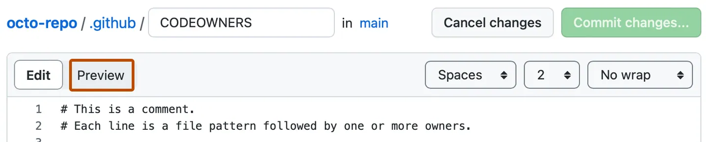
Check the Preview
Open
Preview in the editor
Do this now
Check the displayed text.
Return to Edit if needed.
Check before continuing
You can read your sentence.
Preview has not saved it.
GitHub Docs example. Values are examples.
GitHub hands-on clinic
tsuchiyatakahiro.com
08 / 15
Notes:
Choose Preview and check how the text appears to a reader. Confirm your sentence and headings are readable. Return to Edit if you need a correction. Preview checks the appearance; it does not save the change. Pause and inspect it.
Teaching: pause while students perform this action. Check the completion cue on their own screen and help those who stopped. Do not ask for passwords or sign-in codes. Keep the existing assessment and deadline policy.
Sources: https://docs.github.com/en/repositories/working-with-files/managing-files/editing-files; https://docs.github.com/en/repositories/creating-and-managing-repositories/creating-a-repository-from-a-template; https://docs.github.com/en/repositories/managing-your-repositorys-settings-and-features/repository-access-and-collaboration/inviting-collaborators-to-a-personal-repository (checked 2026-10-14; source screenshot capture date unknown)

Slide 10
Save with Commit changes
Open
Checking the operation
Commit changes… in the editor
1 Commit changes…
2 Check the message and main
3 Confirm Commit changes
4 Reopen README
Do this now
Enter a save message.
Commit directly to main. Confirm.
Check before continuing
Reopen README and find
your saved sentence.
Check your own screen before continuing.
GitHub hands-on clinic
tsuchiyatakahiro.com
09 / 15
Notes:
Click Commit changes to open the save dialog. Enter a brief message, such as Add checking record. In your own course repository, choose Commit directly to the main branch and confirm with the final Commit changes button. Reopen README to check that your sentence remains. Browser saving needs no separate push. Pause and reopen the file.
Teaching: pause while students perform this action. Check the completion cue on their own screen and help those who stopped. Do not ask for passwords or sign-in codes. Keep the existing assessment and deadline policy.
Sources:

Slide 11
Invite your instructor
Open
Settings in your ai-learning
Do this now
Collaborators, Add people.
Invite the specified username.
Check before continuing
The instructor is listed
as pending or accepted.
GitHub Docs example. Values are examples.
GitHub hands-on clinic
tsuchiyatakahiro.com
10 / 15
Notes:
Sending a Private repository URL alone does not give your instructor access. In your repository Settings, choose Collaborators and Add people. Check the full course instructor username, select the match, and confirm the final Add button. Pending means your invitation was sent, while instructor access still awaits acceptance. Do not repeat an accepted invitation. Pause to check the list.
Teaching: pause while students perform this action. Check the completion cue on their own screen and help those who stopped. Do not ask for passwords or sign-in codes. Keep the existing assessment and deadline policy.
Sources: https://docs.github.com/en/repositories/working-with-files/managing-files/editing-files; https://docs.github.com/en/repositories/creating-and-managing-repositories/creating-a-repository-from-a-template; https://docs.github.com/en/repositories/managing-your-repositorys-settings-and-features/repository-access-and-collaboration/inviting-collaborators-to-a-personal-repository (checked 2026-10-14; source screenshot capture date unknown)

Slide 12
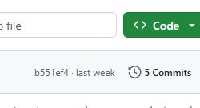
Find the commit history
Open
Code at your repository root
Do this now
Use the clock icon and
the number beside Commits.
Check before continuing
The Commits list opens
in your own repository.
Public template example. Use your own repository.
GitHub hands-on clinic
tsuchiyatakahiro.com
11 / 15
Notes:
Save all required files, then return to Code at the root of your repository. At the upper right of the file list, click the clock icon and the number beside Commits. A narrow screen may show only the icon. This is not the global menu or Insights. Pause and open your own history.
Teaching: pause while students perform this action. Check the completion cue on their own screen and help those who stopped. Do not ask for passwords or sign-in codes. Keep the existing assessment and deadline policy.
Sources: https://github.com/tsuchiyatakahirolab/ai-data-literacy-student-template (public example captured 2026-10-14; not a student private repository)

Slide 13
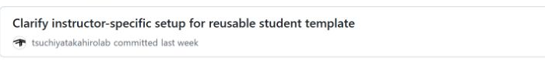
Open the final commit
Open
The Commits list
Do this now
Click the newest message
after all your files were saved.
Check before continuing
The URL contains /commit/
and the commit identifier.
Public template example. Use your own repository.
GitHub hands-on clinic
tsuchiyatakahiro.com
12 / 15
Notes:
Click the newest message after all your required files were saved. The address contains slash commit slash followed by the commit identifier. Check the author, time, and save message. The Copy SHA button copies only the identifier, not the full submission URL. Pause and open the commit page.
Teaching: pause while students perform this action. Check the completion cue on their own screen and help those who stopped. Do not ask for passwords or sign-in codes. Keep the existing assessment and deadline policy.
Sources: https://github.com/tsuchiyatakahirolab/ai-data-literacy-student-template (public example captured 2026-10-14; not a student private repository)

Slide 14
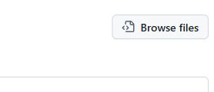
Check the submitted version
Open
Browse files on the commit page
Do this now
Open that version of weekXX.
Check README and artifacts.
Check before continuing
All required files are there.
Use a newer commit if corrected.
Public template example. Use your own repository.
GitHub hands-on clinic
tsuchiyatakahiro.com
13 / 15
Notes:
A commit page mainly shows changes. Use Browse files at the upper right to inspect the complete file list at that version. Check the required README and artifacts in the chosen week folder. If a file is missing, add and save it, then use the newer final commit. Return to the commit page to copy its address.
Teaching: pause while students perform this action. Check the completion cue on their own screen and help those who stopped. Do not ask for passwords or sign-in codes. Keep the existing assessment and deadline policy.
Sources: https://github.com/tsuchiyatakahirolab/ai-data-literacy-student-template (public example captured 2026-10-14; not a student private repository)

Slide 15
Submit through the course form
Open
Checking the operation
The checked commit page.
Your weekly course form.
Initial registration
Repository URL
Weekly and final work
A URL containing /commit/
Do this now
Copy the full address bar URL.
Choose the week and submit.
Check before continuing
The form confirms receipt.
This is separate from saving.
Check your own screen before continuing.
GitHub hands-on clinic
tsuchiyatakahiro.com
14 / 15
Notes:
Return to the checked commit page. On Windows, use Control L to select the address bar and Control C to copy the full URL. Open the weekly form from your course page, check the account, week, and URL, then submit. Check the form confirmation. Saving on GitHub alone has not submitted the form.
Teaching: pause while students perform this action. Check the completion cue on their own screen and help those who stopped. Do not ask for passwords or sign-in codes. Keep the existing assessment and deadline policy.
Sources:

Slide 16
Check each completion state
Open
Checking the operation
Your repository and receipt
Your Private repository
Saved files you can reopen
Instructor invitation sent
Course form receipt
Do this now
Check ownership, saved files,
instructor invite, and form receipt.
Check before continuing
Explain setup, saving, invitation,
and submission separately.
Check your own screen before continuing.
GitHub hands-on clinic
tsuchiyatakahiro.com
15 / 15
Notes:
Check four things separately. Do you own a Private repository? Can you reopen the saved text? Is the instructor invitation listed? Did the form confirm receipt? The Verified badge on a commit is not instructor review or submission confirmation. Tell your instructor which check stopped you. These checks describe your operation, not your grade.
Teaching: pause while students perform this action. Check the completion cue on their own screen and help those who stopped. Do not ask for passwords or sign-in codes. Keep the existing assessment and deadline policy.
Sources:

Slide 17
Self-check 1: Account and setup
Open each screen in order → check it → mark completed items.
01 Sign-in and username
Open Profile and read the username in its URL.
You can name your username. If incomplete: step 02
02 Your Private repository
Open Code in your own ai-learning repository.
Own Owner, Private, folders present. If incomplete: steps 03–05
03 Setup image and short record
Open the setup image and setup/README.md separately.
The image opens and your record is readable. Use the setup guide.
04 Instructor invitation
Settings → Collaborators: check the specified instructor.
Describe pending or accepted. If incomplete: step 10
Return to the indicated step. If unsure, tell the instructor the item and screen message.
tsuchiyatakahiro.com
Self-check 1 / 2
Notes:
Use en/handouts/github_self_check.md and mark only items checked on your own screen. This is separate from grading and instructor access verification. Use the existing setup guide for the image and short record. If the form receipt is uncertain, ask the instructor before sending again. Keep pending and accepted distinct. Do not project personal information or secrets.
01 Sign-in and username
Open Profile and read the username in its URL.
You can name your username. If incomplete: step 02
02 Your Private repository
Open Code in your own ai-learning repository.
Own Owner, Private, folders present. If incomplete: steps 03–05
03 Setup image and short record
Open the setup image and setup/README.md separately.
The image opens and your record is readable. Use the setup guide.
04 Instructor invitation
Settings → Collaborators: check the specified instructor.
Describe pending or accepted. If incomplete: step 10

Slide 18
Self-check 2: Saved work and submission
Open each screen in order → check it → mark completed items.
05 Saved README
Reopen this week’s README.md and read your added text.
Your text remains outside the editor. If incomplete: steps 06–09
06 Files in the submitted version
Latest commit → Browse files: open all required weekly files.
All required files are present. If incomplete: steps 11–13
07 Initial registration receipt
Check your repository URL and initial form confirmation.
Receipt confirmed. If uncertain, ask your instructor: guide C2
08 Weekly submission receipt
Check the full /commit/ URL and weekly form confirmation.
Correct week and receipt confirmed. If incomplete: step 14
Return to the indicated step. If unsure, tell the instructor the item and screen message.
tsuchiyatakahiro.com
Self-check 2 / 2
Notes:
Use en/handouts/github_self_check.md and mark only items checked on your own screen. This is separate from grading and instructor access verification. Use the existing setup guide for the image and short record. If the form receipt is uncertain, ask the instructor before sending again. Keep pending and accepted distinct. Do not project personal information or secrets.
05 Saved README
Reopen this week’s README.md and read your added text.
Your text remains outside the editor. If incomplete: steps 06–09
06 Files in the submitted version
Latest commit → Browse files: open all required weekly files.
All required files are present. If incomplete: steps 11–13
07 Initial registration receipt
Check your repository URL and initial form confirmation.
Receipt confirmed. If uncertain, ask your instructor: guide C2
08 Weekly submission receipt
Check the full /commit/ URL and weekly form confirmation.
Correct week and receipt confirmed. If incomplete: step 14

