Slide 1
Where is the release package

Slide 2
My plan
Make camera frame
Set up the Orin environment
Try the existing program
Solve the problems
Combine with SLAM
←I am here.

Slide 3
Previous problems
Jetson flash isn't working properly
It seems the display wasn't designed to show properly unless it was a DP terminal display.
➞The issue was resolved by seizing Mr. Matsuyama's display

Slide 4
Recent problems
Browser isn’t working properly in Jetson
It seems like I don't have permission to access the directory where browser data is stored
➞Control the main PC via VNC
The release package cannot be found
I checked the purchase page but only found a download form for documentation-related items
➞I'll send an email to inquire

Slide 5
Remotely control a PC

Slide 6
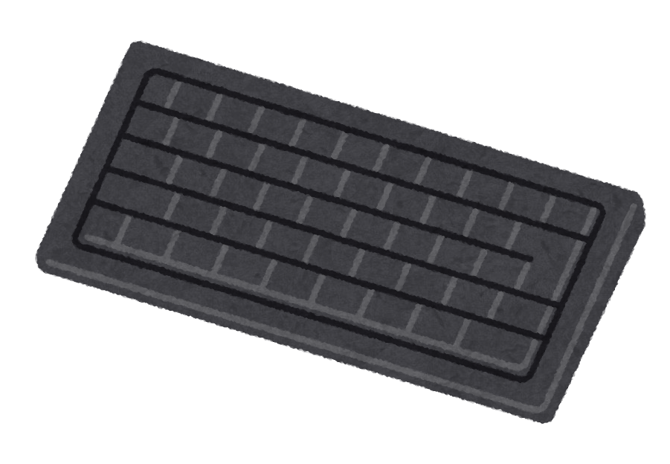

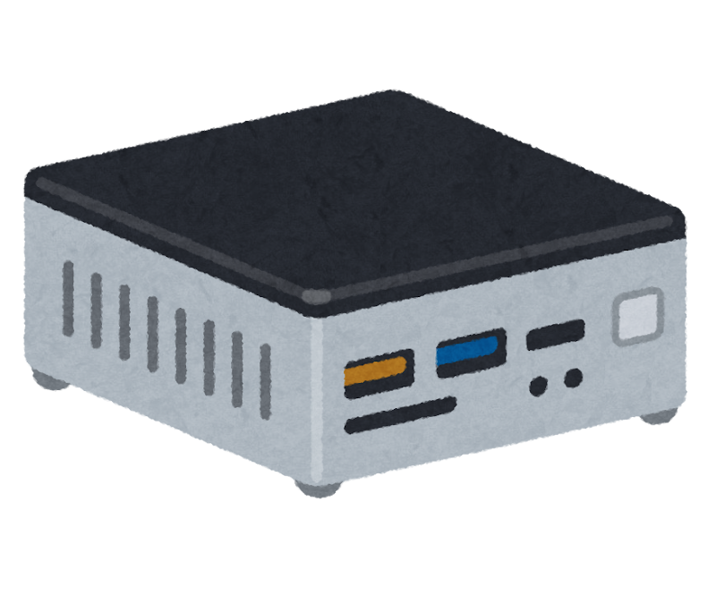

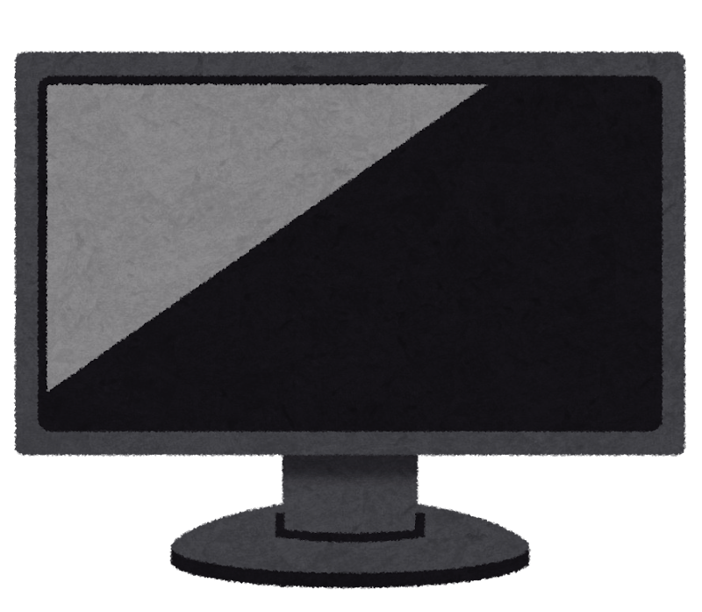


When will it be needed?
there are not enough devices
collaborating on a single PC
Access!

Slide 7
Agenda
RDP
SSH
VNC

Slide 8
Agenda
RDP
SSH
VNC

Slide 9
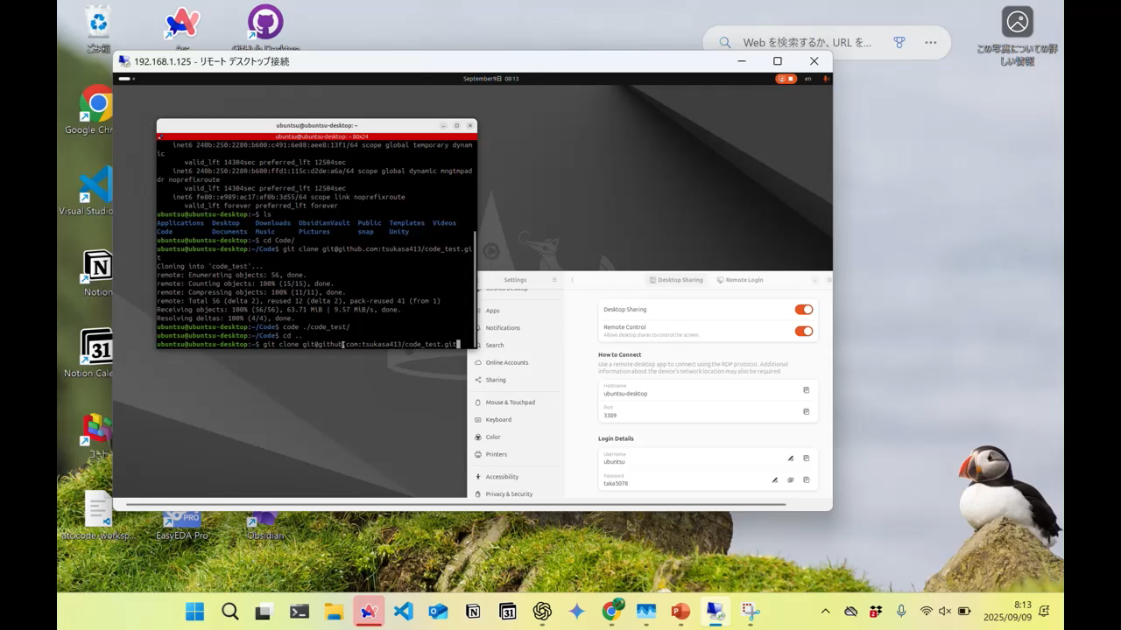
RDP(Remote Desktop Protocol)
〇Easy for connecting
Connection is possible only via the IP address of the connected PC.
〇Easy to operate
Because it can be operated visually.
× Primarily for Windows
×It often slows down

Slide 10
Agenda
RDP
SSH
VNC

Slide 11
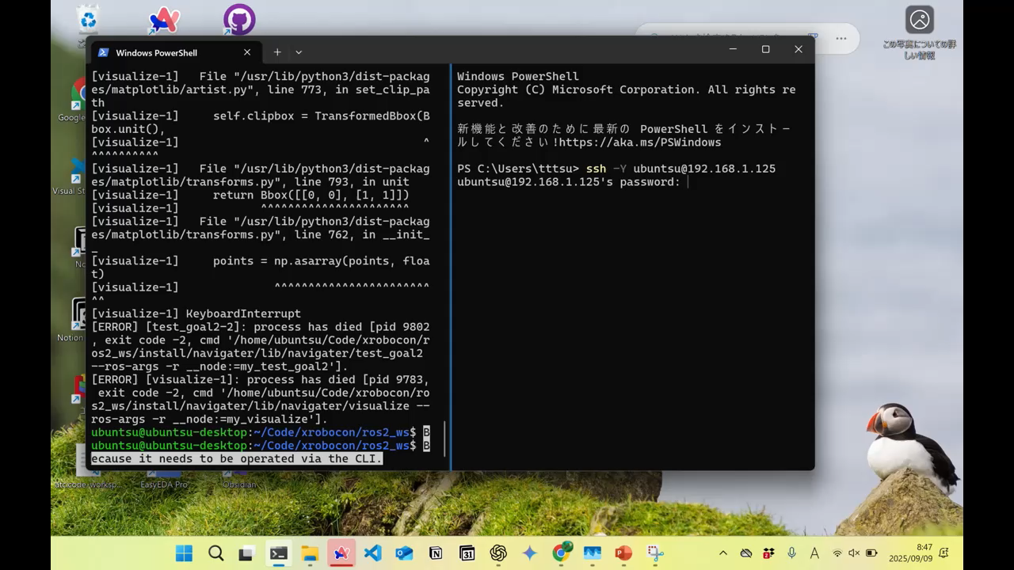
SSH(Secure SHell)
〇Extremely lightweight in operation
Because it only sends commands.
〇Compatible with any operating system
〇Quite safe
×It's a bit difficult to operate
Because it needs to be operated via the CLI.

Slide 12
Agenda
RDP
SSH
VNC

Slide 13

VNC(Virtual Network Computing)
〇Easy to operate
Because it can be operated visually.
〇Compatible with any operating system
×Not very safe
×It often slows down

Slide 14
Conclusion
 | RDP | SSH | VNC
Usability | 〇 | × | 〇
Security | △ | 〇 | ×
OS | △ | 〇 | 〇
Lightweight operation | △ | 〇 | ×

