Slide 1
System Control Lab Self Introduction
Tsukasa Takagishi

Slide 2
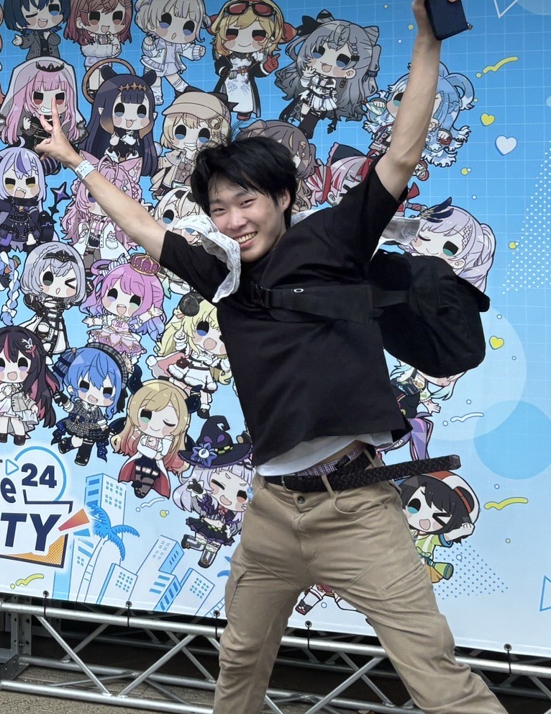
About me
Name
Tsukasa Takagishi
School
Kansai University
From
Osaka
Hobby
Comic
Movie
Skills
Programming
CAD
Experience
Robot Contest

Slide 3

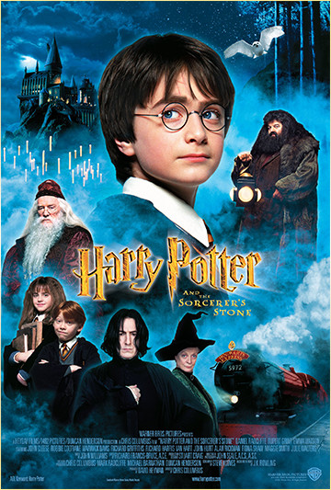

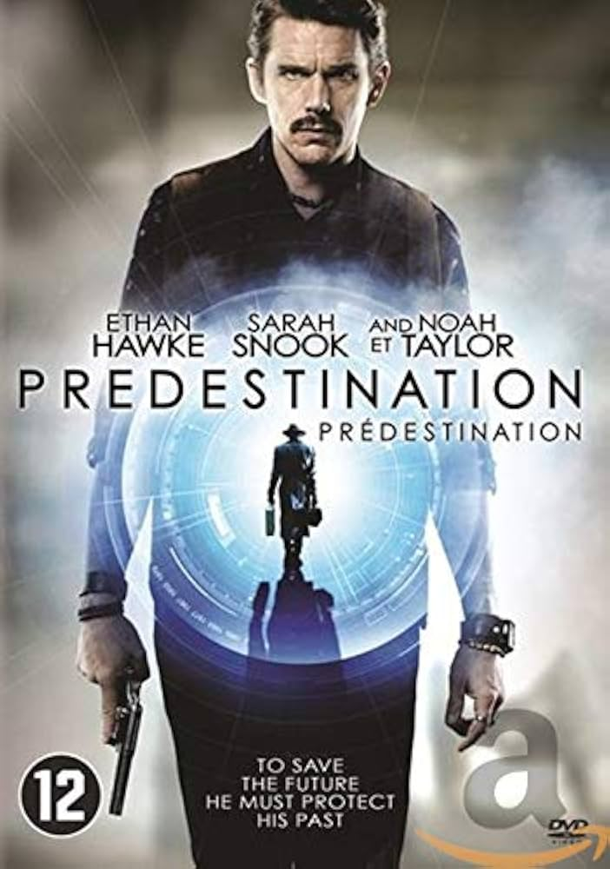

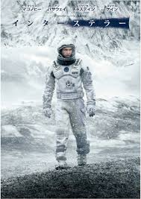





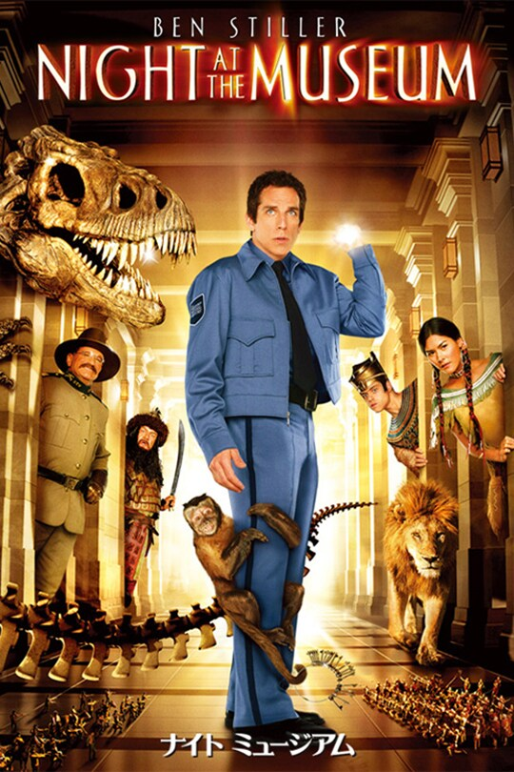
My Hobby
Comic
Movie

Slide 4
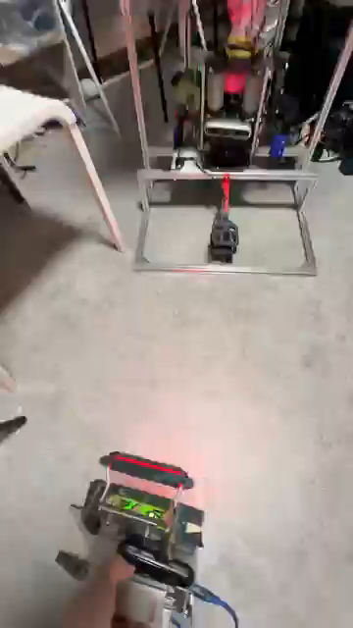
CoRE2025
What is CoRE
The Championship of Robotics Engineers
The rules are similar to RoboMaster
My work on the autopilot robot
Image analysis
Robot decision-making part
Gunfire routine
Technology used
Image analysis using YOLOv11
Predicting the future using linear regression analysis
pandas
ROS2
引用：https://www.youtube.com/shorts/QCqioxtO2EI

Slide 5
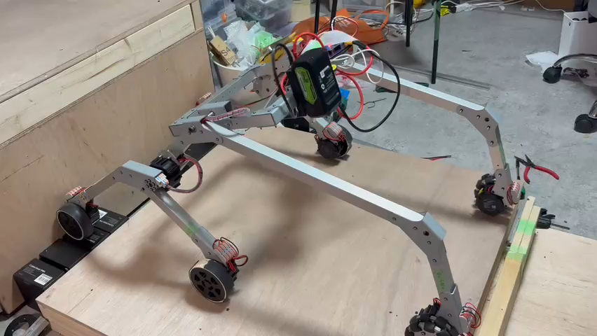
Next is XRobocon

Slide 6
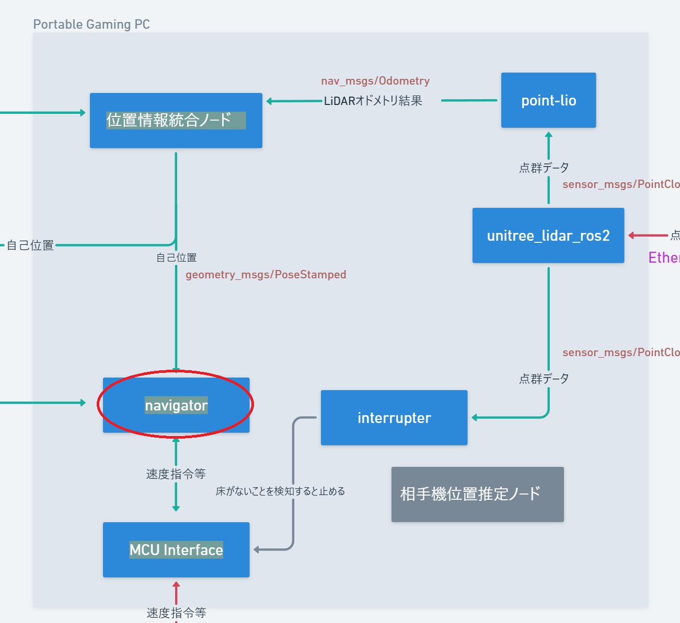
This is

Slide 7
Thank you for listening!!

