Slide 1

Efficient Solver for
Dynamic Puzzle Games:
Baba Is Y’all
Instructor：Jialin Liu, Ziqi Wang
Member：Xianqing Zeng, Yuhang Lin
2023/6/15

Slide 2

Content
Introduction
Search Algorithm
RL Algorithm
Experiments & Analysis
Conclusion & Future

Slide 3


1
Introduction

Slide 4


Baba Is You: Jam version
https://hempuli.itch.io/baba-is-you

Slide 5
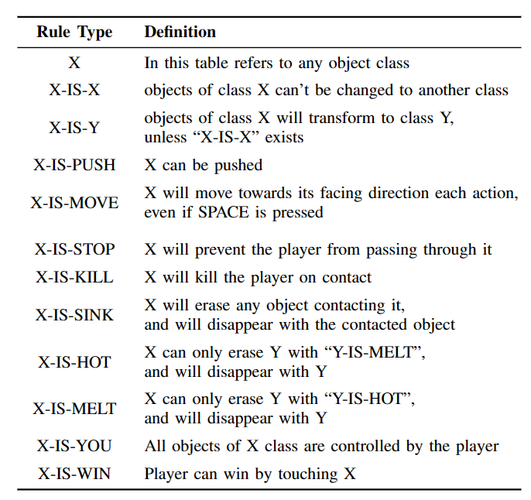
Win & Lose conditions

Slide 6
Win & Lose conditions

Slide 7

Baba Is Y’all: framework
http://equius.gil.engineering.nyu.edu/map_home.php#rate_screen

Slide 8
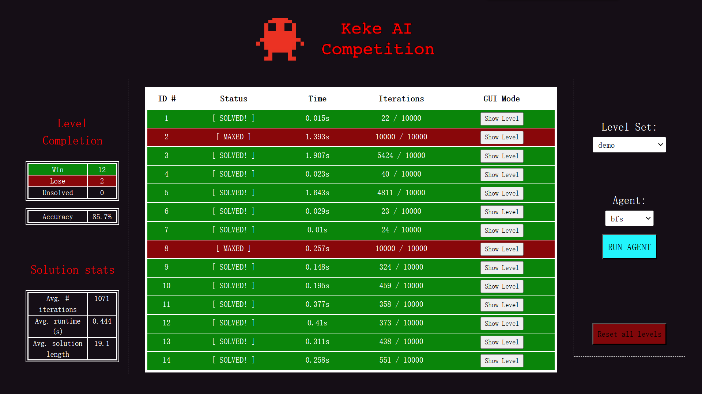
Keke AI Competition
https://github.com/MasterMilkX/KekeCompetition/wiki

Slide 9
2
Search Algorithm

Slide 10
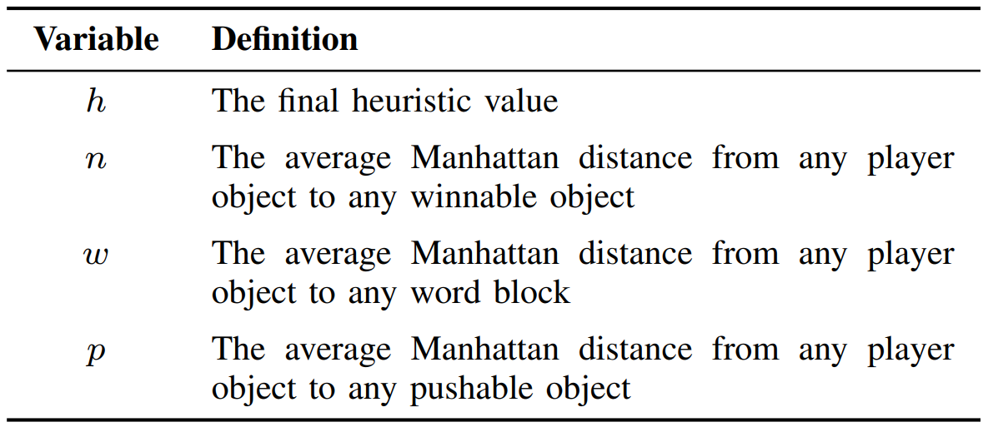
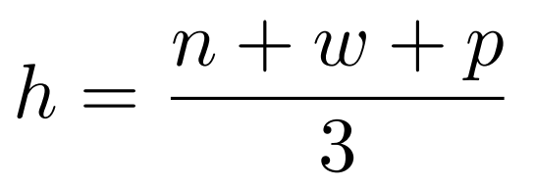
Baseline - Default
↑
→
→
→
→
→
→
→
→
→
→
→
→
→
↑
↑
↑
↑
↑
↑
↑
←
→
↓

Slide 11
RHEA - Process
0
1
2
0
1
2
0
1
2
0
1
2
.
Step 1
4
1
2
0
1
3
4
1
0
0
1
3
.
4
1
2
0
3
2
0
2
2
4
1
0
.
0
1
2
0
1
2
0
1
2
0
1
2
.
……… fitness_1
0
1
evaluate
current_state
next_state
next_state
…
final_state
fitness
Step 2
4
1
2
0
1
3
4
1
0
0
1
3
.
……… fitness_2
4
1
2
0
3
2
0
2
2
4
1
0
.
……… fitness_3

Slide 12
RHEA - Process
0
1
2
0
1
2
0
1
2
0
1
2
.
……… fitness_1
sort & pick_best
Step 3
0
4
1
2
0
1
3
4
1
0
0
1
3
.
……… fitness_2
4
1
2
0
3
2
0
2
2
4
1
0
.
……… fitness_3
0
1
2
0
1
2
0
1
2
0
1
2
.
……… fitness_1
Step 4
pick & produce
4
1
2
0
1
3
4
1
0
0
1
3
.
……… fitness_2
next population
crossover & mutate
4
1
2
0
3
2
0
2
2
4
1
0
.
……… fitness_3
pick some best individuals

Slide 13
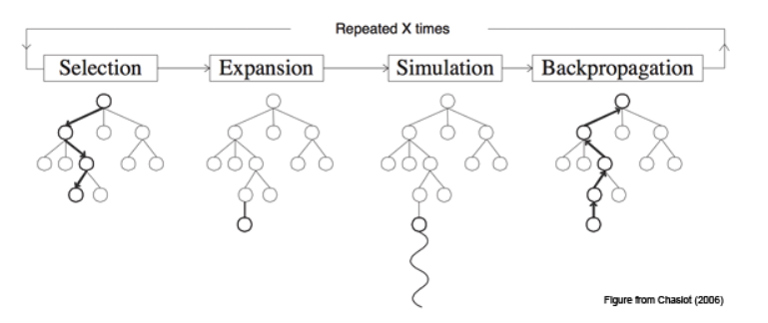
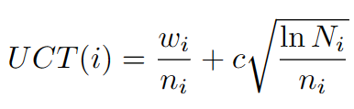
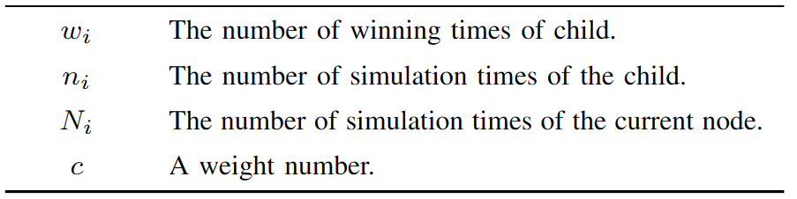
MCTS- Process

Slide 14
3
RL Algorithm

Slide 15

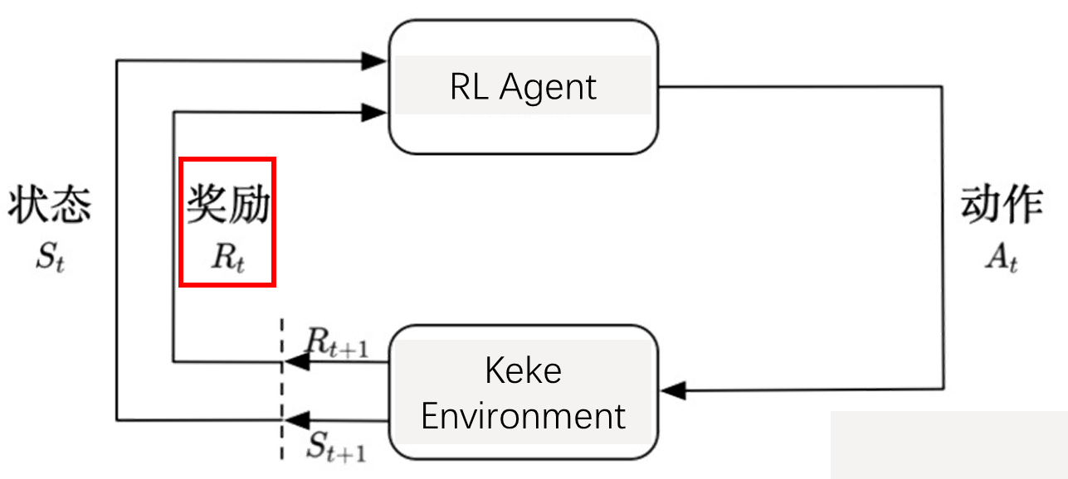
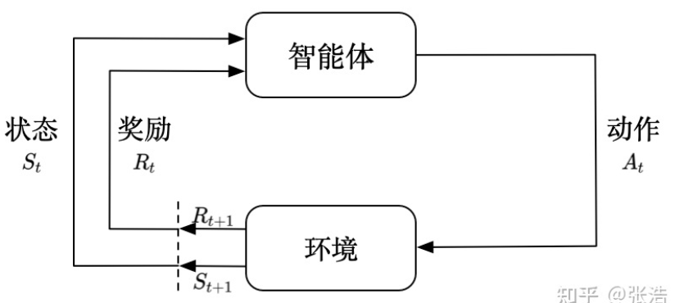
Reinforcement Learning
3
BABBB BABAB
Policy: A 30% B 70%

Slide 16
Reward Function
Estimate how good an action is
Better reward function → faster learning speed
→ higher accuracy

Slide 17
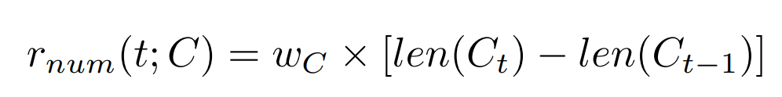
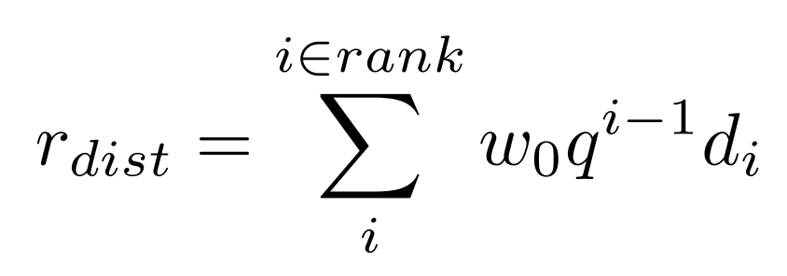


Reward Function
More is better:
Increase, not decrease:
Closer / Further:
R-0
R-d
$$q=1$$
$$q≠1$$

Slide 18
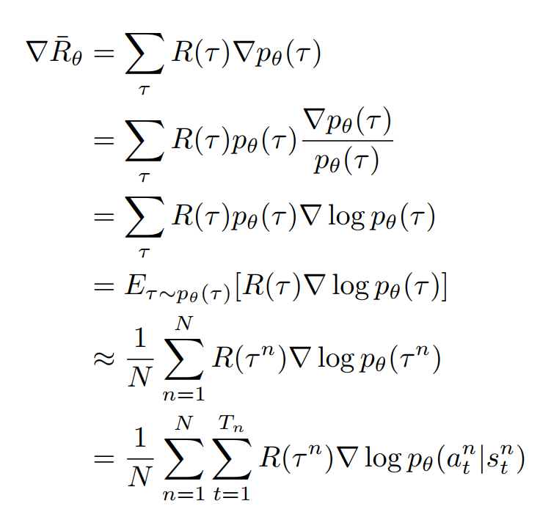
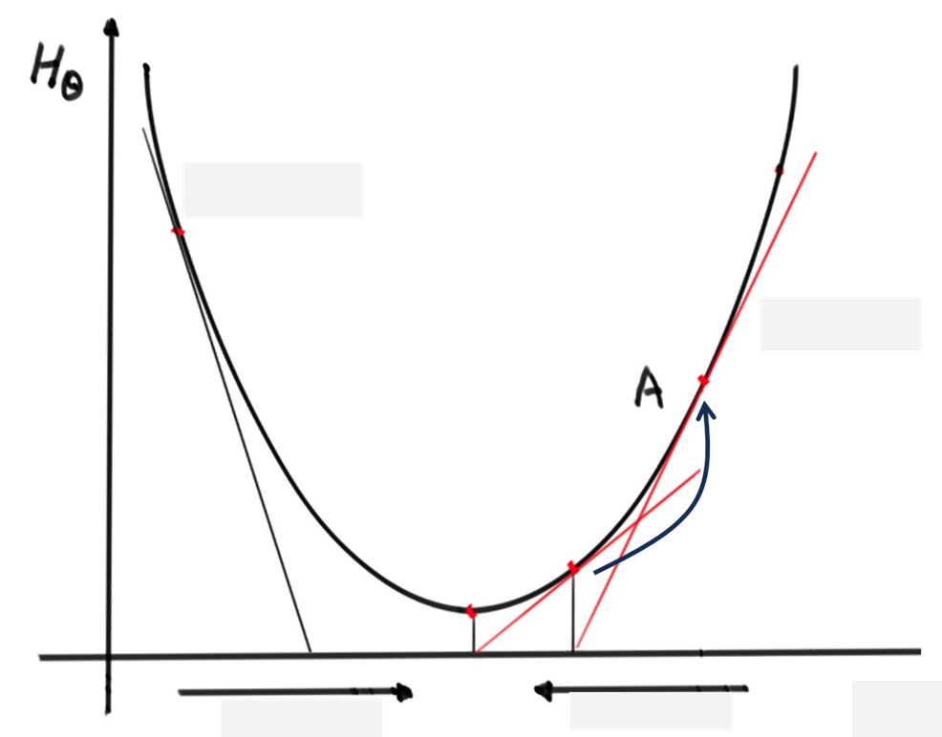
Policy Gradient
Optimized
PPO

Slide 19
JS→PY
1. js2py
完全脱离 JS 环境，直接将 JS 代码转换为 Python 代码
限制：不支持ES6及之后的JS特性
2. PyExecJS
在本地 JS 环境下运行 JS 代码支持的 JS 环境
限制：仅支持调用单文件方法
3. PyV8
将 Chrome V8 引擎用 Python 封装的依赖库
4. Node.js
使用 Python 的os.popen执行 node 命令，执行 JS 脚本

Slide 20
调用JS函数的问题
源代码内具有相同引用地址的变量会随着一处修改一起变动，但在PyExecJS库传递参数时每个变量都具有不同引用地址
解决：
1. 修改JS源码，额外处理判断变量相等以及修改变量等操作
2. 在调用nextMove()函数时传入字符串，将其解析成state后继续操作

Slide 21
调用JS函数的问题
源代码传入初始字符串地图（无重叠）并解析为复杂状态，但在游戏过程中会出现物品重叠
解决：
1. 除字符串外，传入当前状态的“obj_map”, “back_map”，并将其转换为原始字符表示
2. 在解析状态时针对编码后的 “obj_map”, “back_map”，分别解析，并额外进行对重叠物品的处理

Slide 22
简单关卡的测试
Input:
action = ['up', 'right', 'right', 'down'] init_pos = (2, 2)
level1 = [
['_', '_', '_', '_', '_', '_', '_', '_', '_', '_'],
['_’, '_', '_', '_', '_', '_', '_', ‘v', '_', '_'],
['_', '_', 'b’, '_', 'f', '_', '_', '_', '_', '_'],
['_', '_', '_', '_', '_', '_', '_', '_', '_', '_'],
['_', '_', '_', '_', '_', '_', '_', '_', '_', '_'],
['_', '_', '_', '_', '_', '_', '_', '_', '_', '_'],
['_', '_', 'B', '1', '2', '_', '_', '_', 'F', '_'],
['_', '_', '_', '_', '_', '_', '_', '_', '1', '_'],
['_', '_', '_', '_', '_', '_', '_', '_', '3', '_'],
['_', '_', '_', '_', '_', '_', '_', '_', '_', '_']
]
Output:
player [{'type': 'phys', 'name': 'baba', 'x': 2, 'y': 1,}]
reward: 0.136 done: False
player [{'type': 'phys', 'name': 'baba', 'x': 3, 'y': 1,}]
reward: 0.148 done: False
player [{'type': 'phys', 'name': 'baba', 'x': 4, 'y': 1}]
reward: 0.158 done: False
player [{'type': 'phys', 'name': 'baba', 'x': 4, 'y': 2,}]
reward: 0.176 done: True

Slide 23
4
Experiments & Analysis

Slide 24
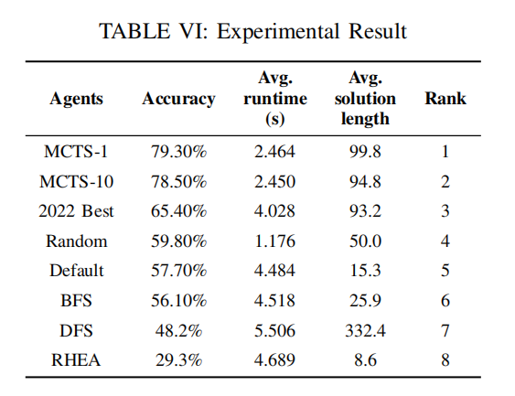
Experiments (Test cases: 246)

Slide 25
Analysis
Baseline
Own approximate accuracy
Random without search process
-> minimal runtime
BFS prefer less breath
-> shorter length and higher accuracy than DFS
Default agent with heuristic function
-> outperforms other baselines

Slide 26
Analysis
MCTS (reaches the highest accuracy)
Search efficiently
evaluates the value of each action by simulating random games rather than searching the entire game tree
Stronger exploration ability
employs random simulation to explore different decision paths extensively

Slide 27
Analysis
RHEA (reaches the lowest accuracy)
Inadaptability
originally applies to general video games, emphasis on immediacy
Poor relationship between solutions
introduces new individuals randomly
parents of cross-over are still randomly generated

Slide 28
Analysis
RL (reaches the lowest accuracy)
Sparse reward problem
need to make a sequence of correct moves to achieve a goal, but rewards are not necessarily immediate
Long-term dependencies
game may require a series of specific actions to reach the goal
lack of explicit memory mechanism(LSTM)
Expensive environment interaction
env interations(JS->PY) actually spend lots of time
7 fps in practice

Slide 29

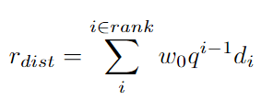
Analysis
RL Algorithms
RL
standard reward judged by single state
RL-0
desgined reward with domain knowledge
RL-d
based on RL-0
weighted distance

Slide 30
Analysis
RL Algorithms
RL
standard reward judged by single state
RL-0
desgined reward with domain knowledge
RL-d
based on RL-0
weighted distance

Slide 31
Analysis
MCTS vs RL
Balance exploration and exploitation:
MCTS implements powerful UCT policy
PPO relies on its policy update rules
Handling Sparse Rewards
better for MCTS which not relying on reward signals for search
challenging for PPO as a policy gradient methods
Long-term Planning
MCTS builds a search tree -> conducts explicit long-term planning
PPO make planning by useful value function

Slide 32
5
Conclusion & Future

Slide 33
Conclusion
First Phase
Clarified the game’s rules
configuring the game simulation environment
Run several of the given baselines agents
Second Phase
Implemented two search algorithms,
RHEA and MCTS
Do experiments among all algorithms on a full level set
Compare and analysis the results

Slide 34
Conclusion
Third Phase
Configure cross-language enrivronment and build gym env
Invoke JavaScript functions in Python
Apply DRL algorithm PPO and collect the experiment results
Compare the results of search algorithms and learning algorithms on dynamic mechanism games ‘baba is you’

Slide 35
Future
Combine PPO and MCTS (like AlphaGo)
PPO learn a heuristic policy and value function -> guide the search in MCTS
MCTS intensive search results -> train the policy network and the value network
Potential Benefit
the sample efficiency and the capacity to generalize of PPO
powerful search capabilities of MCTS

