Slide 1
Possible problems in cellular network
Presenter: Po-Hsun Lin
Advisor: Wanjiun Liao

Slide 2
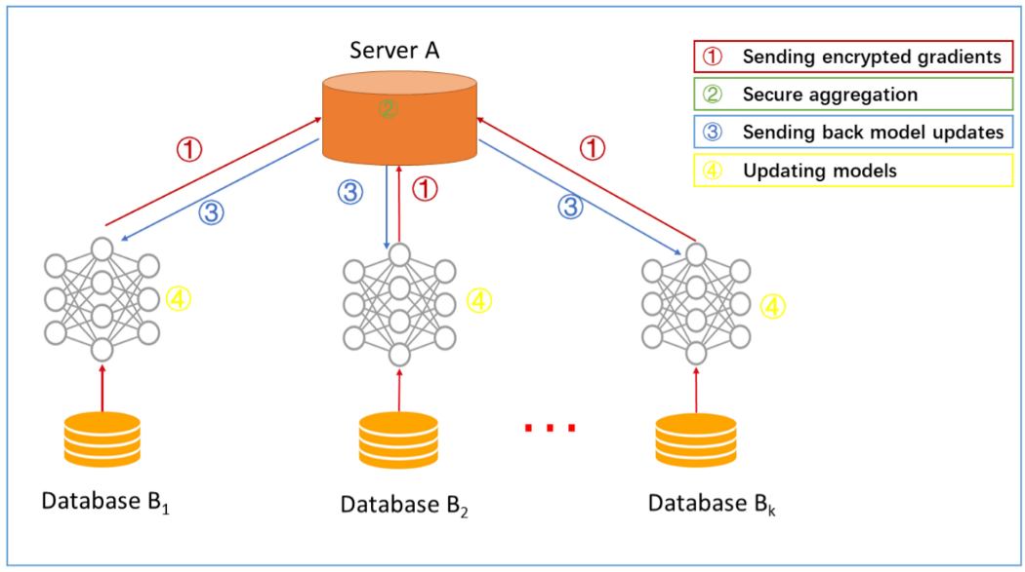
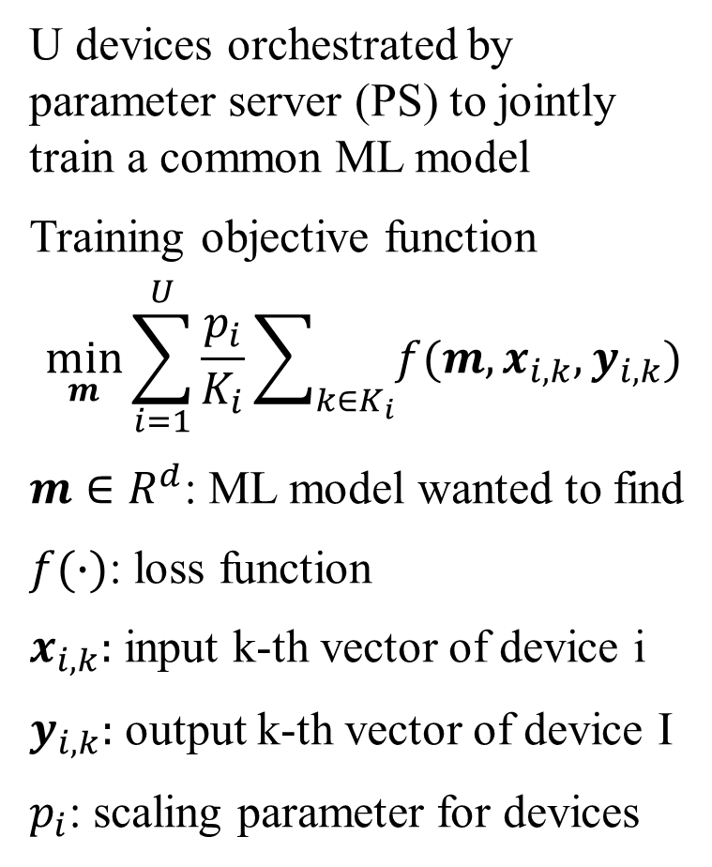
Federated Learning common federated learning
U devices orchestrated by parameter server (PS) to jointly train a common ML model
Training objective function
$$\min_{m}{\sum_{i=1}^{U}{\frac{p_{i}}{K_{i}}\sum_{k∈K_{i}}{f(m,x_{i,k},y_{i,k})}}}$$
$m∈R^{d}$: ML model wanted to find
$f(∙)$: loss function
$x_{i,k}:$ input k-th vector of device i
$y_{i,k}:$ output k-th vector of device I
$p_{i}$: scaling parameter for devices
arXiv:1902.04885 [cs.AI]
arXiv:2104.02151 [cs.LG]

Slide 3
Federated Learning possible problems
1. Convergence Analysis
How many learning steps required to converge considering wireless channels(data rate), device mobility (leave/in)?
2. Wireless Resource Management
2-1 Resource allocation based on mobility patterns of devices
2-2 Optimize the resource allocation with the consideration of QoS
arXiv:2104.02151 [cs.LG]

Slide 4
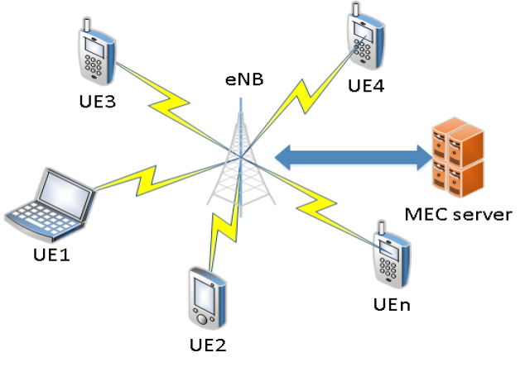
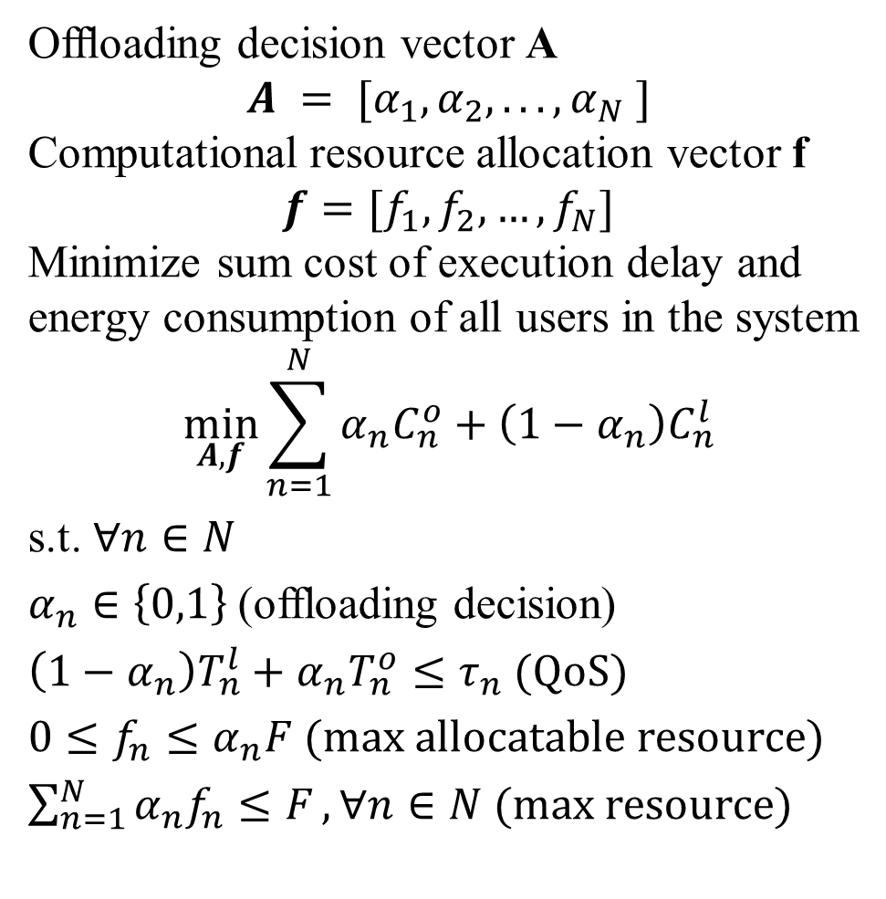
MEC Offloading Control reinforcement learning approach
Ofﬂoading decision vector A
$$A = [α_{1},α_{2}, . . . , α_{N} ]$$
Computational resource allocation vector f
$$f=[f_{1},f_{2},…,f_{N}]$$
Minimize sum cost of execution delay and energy consumption of all users in the system
$$\min_{A,f}{\sum_{n=1}^{N}{α_{n}C_{n}^{o}+\left(1−α_{n}\right)C_{n}^{l}}}$$
s.t. $∀n∈N$
$α_{n}∈\left\{0,1\right\}$(offloading decision)
$\left(1−α_{n}\right)T_{n}^{l}+α_{n}T_{n}^{o}≤τ_{n}$ (QoS)
$0≤f_{n}≤α_{n}F$ (max allocatable resource)
$\sum_{n=1}^{N}{α_{n}f_{n}≤F}, ∀n∈N$ (max resource)
J. Li, H. Gao, T. Lv and Y. Lu, "Deep reinforcement learning based computation offloading and resource allocation for MEC," 2018 IEEE Wireless Communications and Networking Conference (WCNC), 2018, pp. 1-6, doi: 10.1109/WCNC.2018.8377343.

Slide 5
MEC offloading control possible problems
1. Include actions to apply cloud computation in the simulation
Researches mainly focus on edge/local offloading condition, none of edge/local/cloud has been discussed.
2. Include run time (model size) of RL/ML in the simulation
Many articles state that using RL/ML models require unneglectable computation time and local data storage, but none of them are considered in the simulation.
Ex: use RL to find RL models that can have bearable computation time while satisfying the required QoS and power consumption (important in distributed systems)

Slide 6
Reinforcement learning in cellular network possible problems
Collaborative multiagent reinforcement learning should consider
(1) optimization of RB allocation and device scheduling for RL parameter transmission
(2) reliable and energy efficient RL parameter transmission
in the simulation.
arXiv:2104.02151 [cs.LG]

Slide 7
Deep learning in wireless network possible problems
1. Congestion control for multi-queues:
If a centralized server collects queue information (size, input trafﬁc rate, outgoing trafﬁc rate) from every nodes, then the DL models are able to relieve the congestion, which may be better than traditional methods.
2. Distributed learning:
Which node is responsible for the ﬁnal DL output layer assembly?
Q. Mao, F. Hu and Q. Hao, "Deep Learning for Intelligent Wireless Networks: A Comprehensive Survey," in IEEE Communications Surveys & Tutorials, vol. 20, no. 4, pp. 2595-2621, Fourthquarter 2018, doi: 10.1109/COMST.2018.2846401.

Slide 8
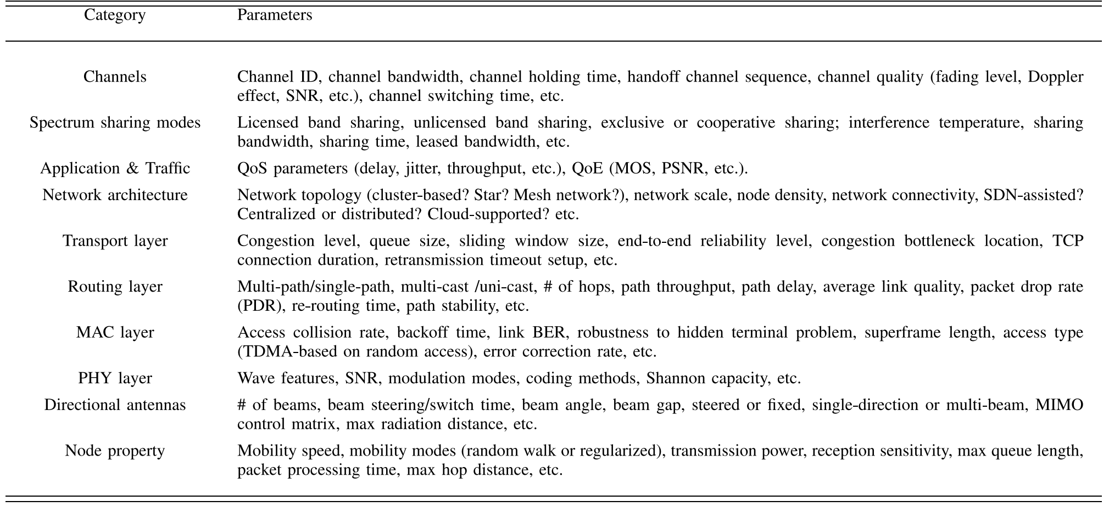
Deep learning in wireless network possible problems
The combination of cross-layer design and deep learning can achieve better QoS, and can explain how one factor in one layer affects factors in another layer.
Q. Mao, F. Hu and Q. Hao, "Deep Learning for Intelligent Wireless Networks: A Comprehensive Survey," in IEEE Communications Surveys & Tutorials, vol. 20, no. 4, pp. 2595-2621, Fourthquarter 2018, doi: 10.1109/COMST.2018.2846401.

Slide 9
Thanks for your listening !

