Slide 1
Completed Items
BeagleBone functionality
Modified Angstrom Kernel, boot time ~ 8 seconds. Minimal Ubuntu in ~2 seconds
Communication to Watchdog AVR
GPS Streaming, location parsing, time recognition and forwarding
PCB schematic and layout, arrives by March 15
BOM ordered, arrives by March 15
Graphics AVR functionality
Speed/Distance calculation using reed-switch
Communication from Watchdog AVR
HR Monitoring
Trip feature
Watchdog AVR functionality
Real Time Clock
Communication from BeagleBone, to Graphics AVR
Battery Monitoring and power distribution
Temperature Sensing

Slide 2
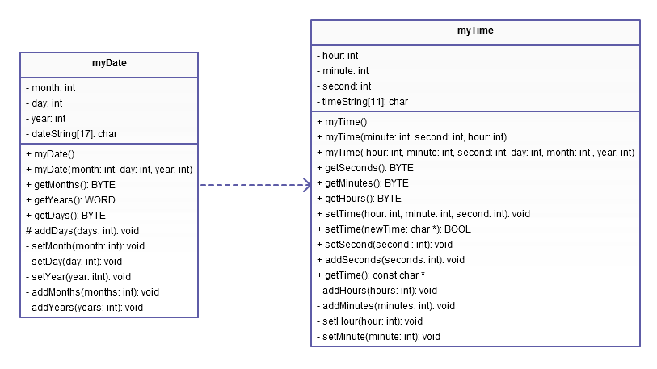
Real Time Clock UML

Slide 3
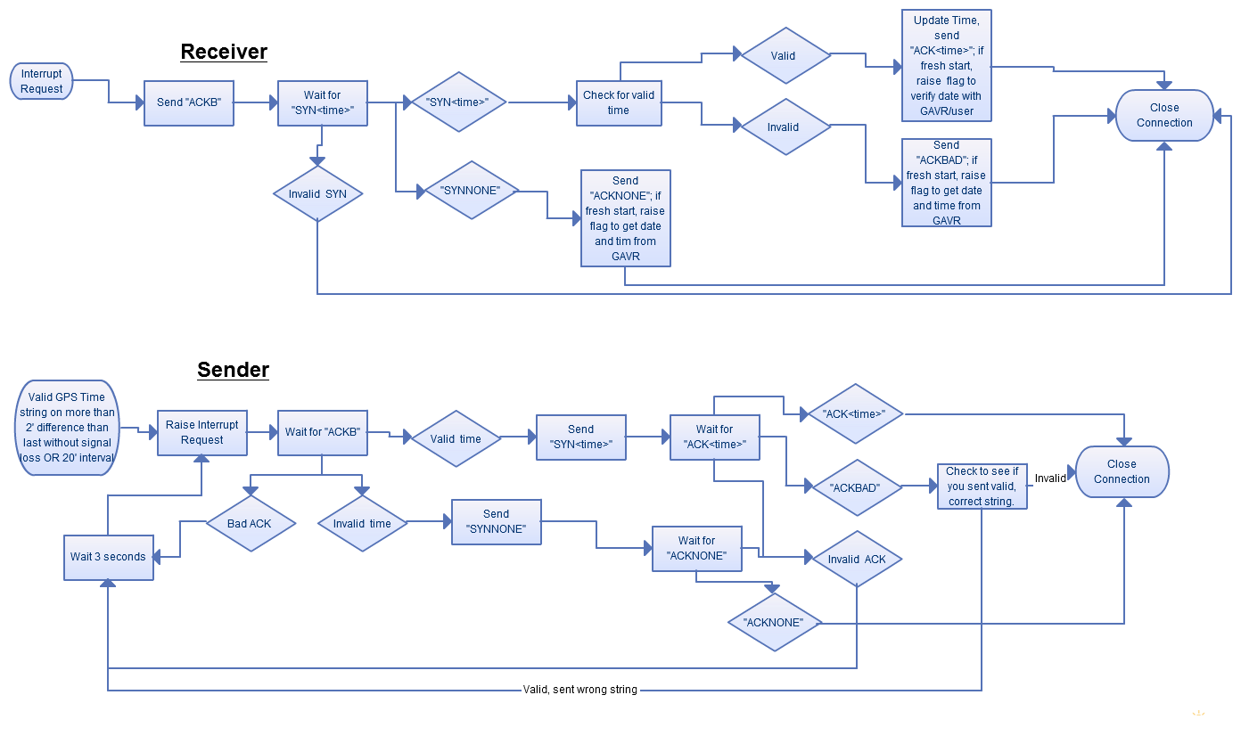
Bone to WAVR Communication

Slide 4
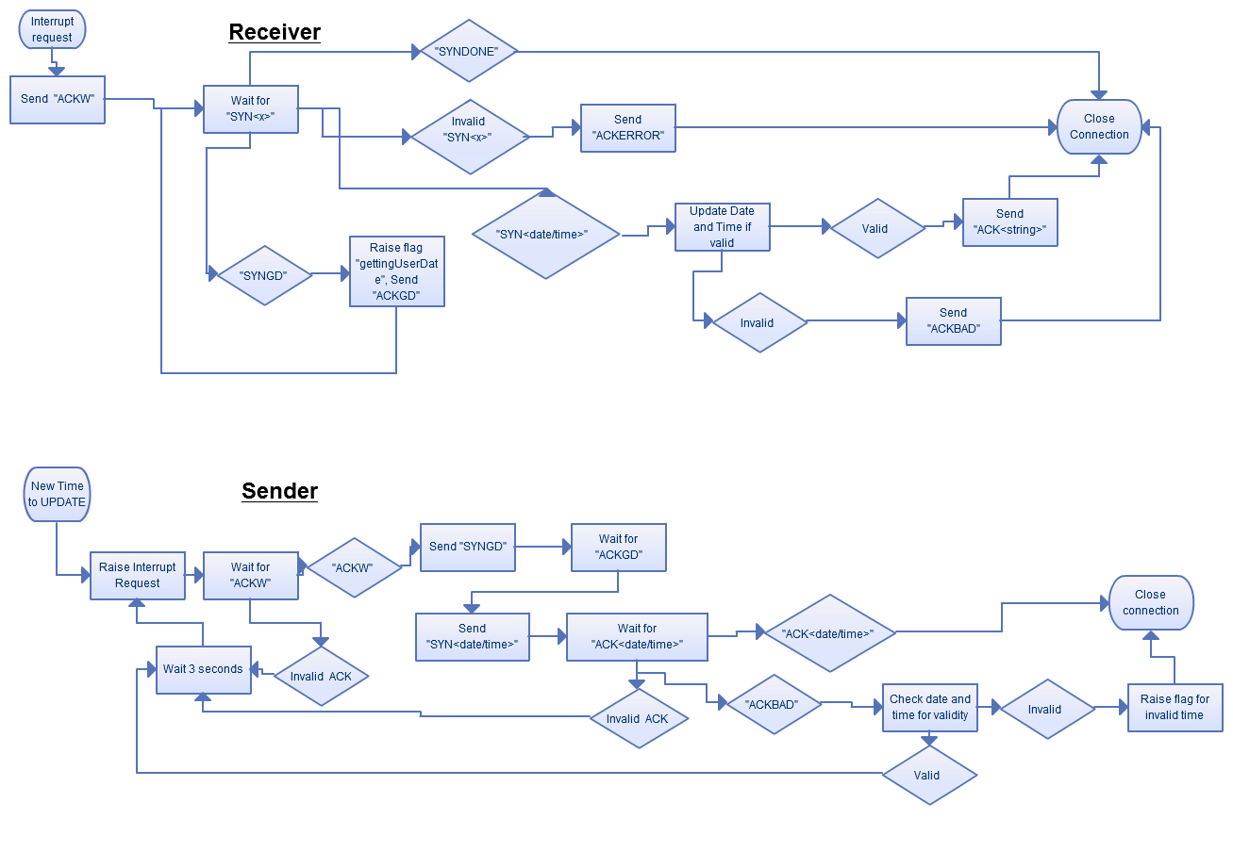
WAVR to GAVR Communication

Slide 5
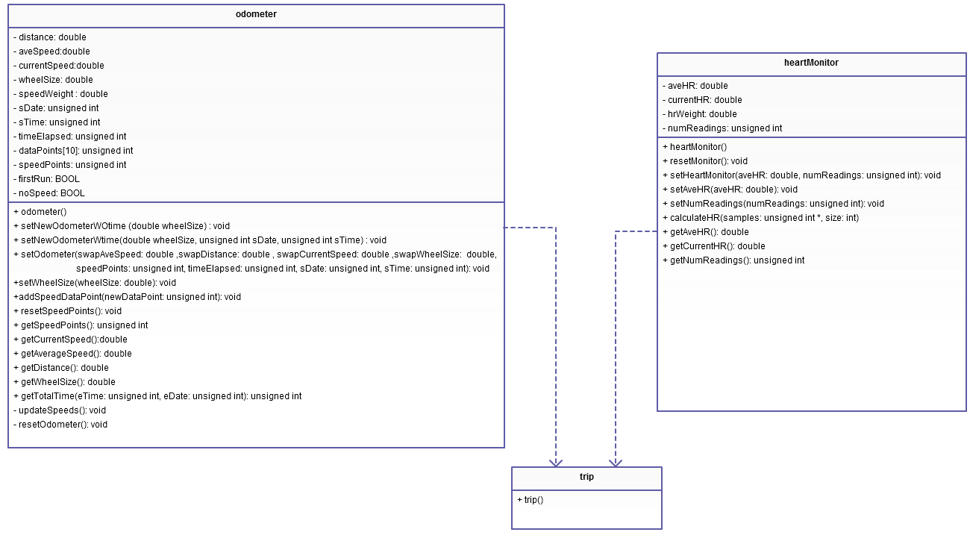
Trip Feature UML

Slide 6
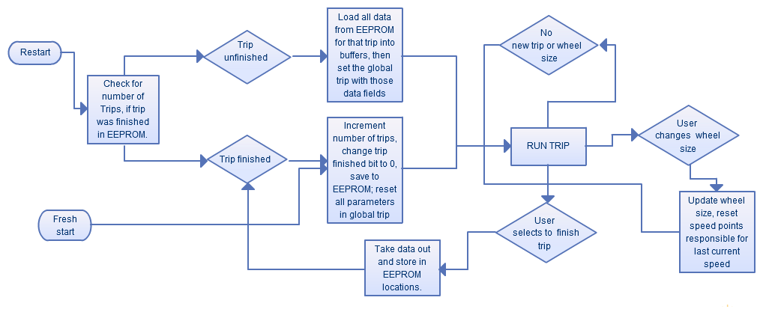
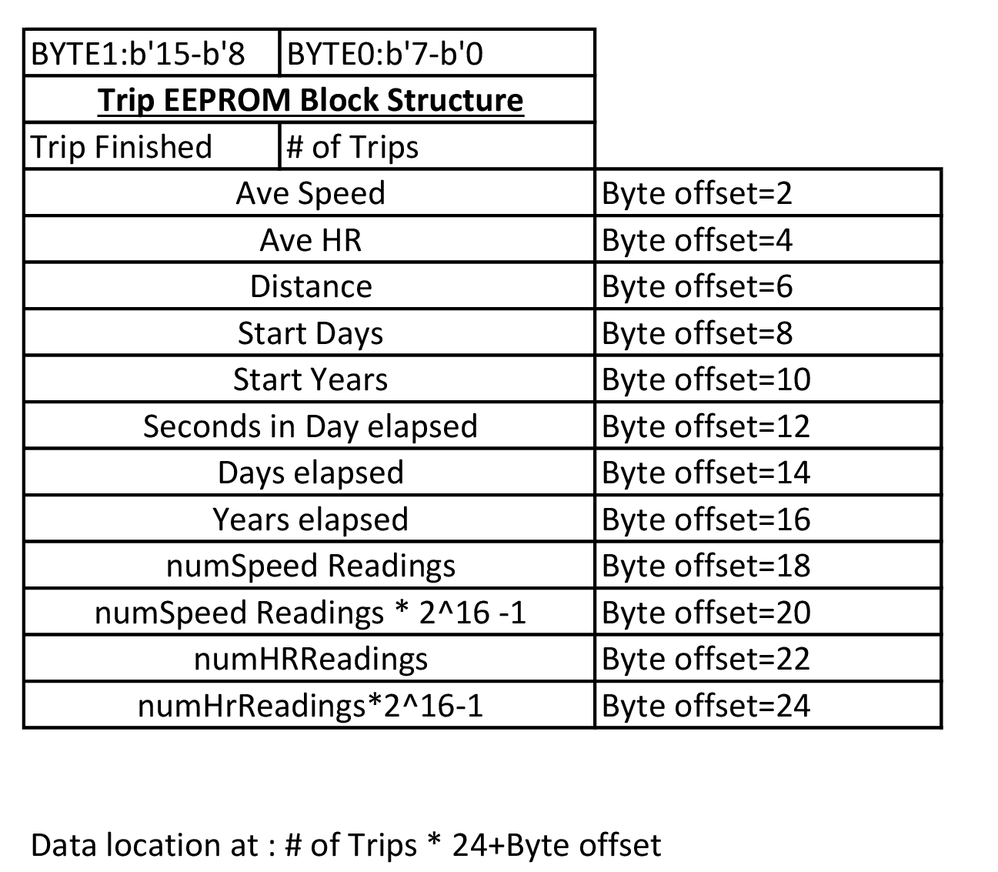
Trip Flow and Data Structure

Slide 7
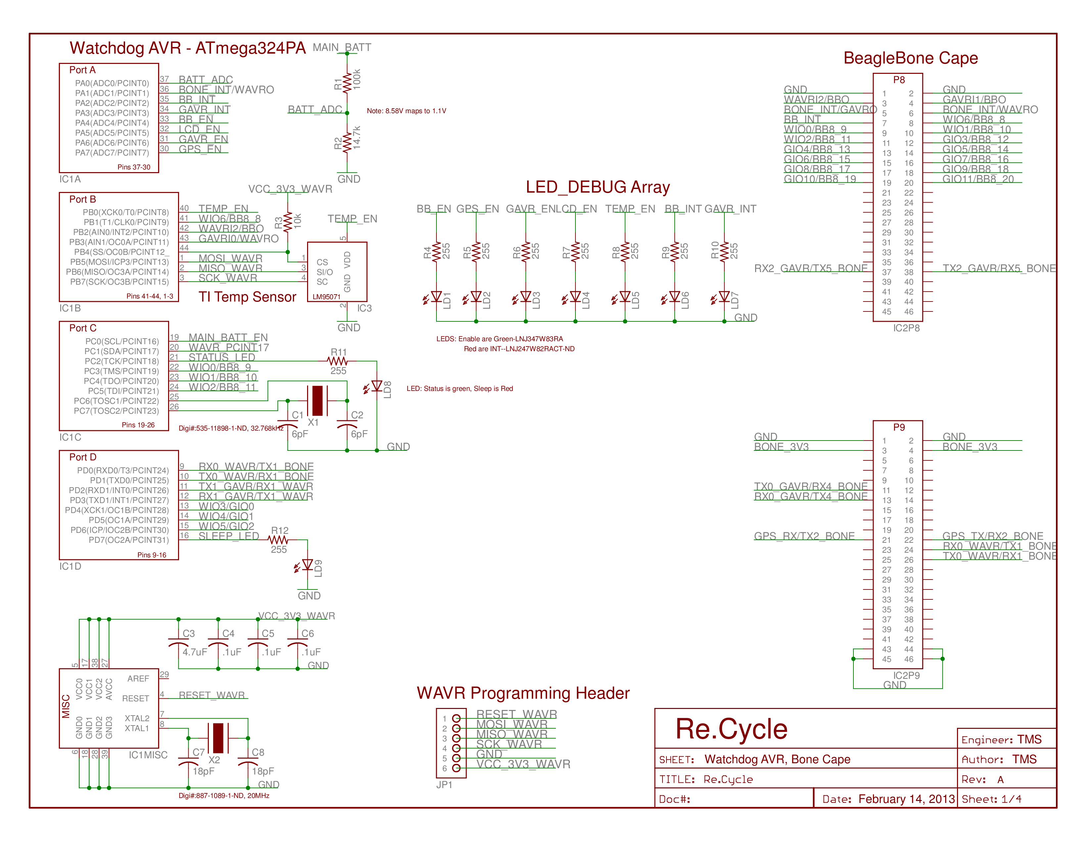

Slide 8
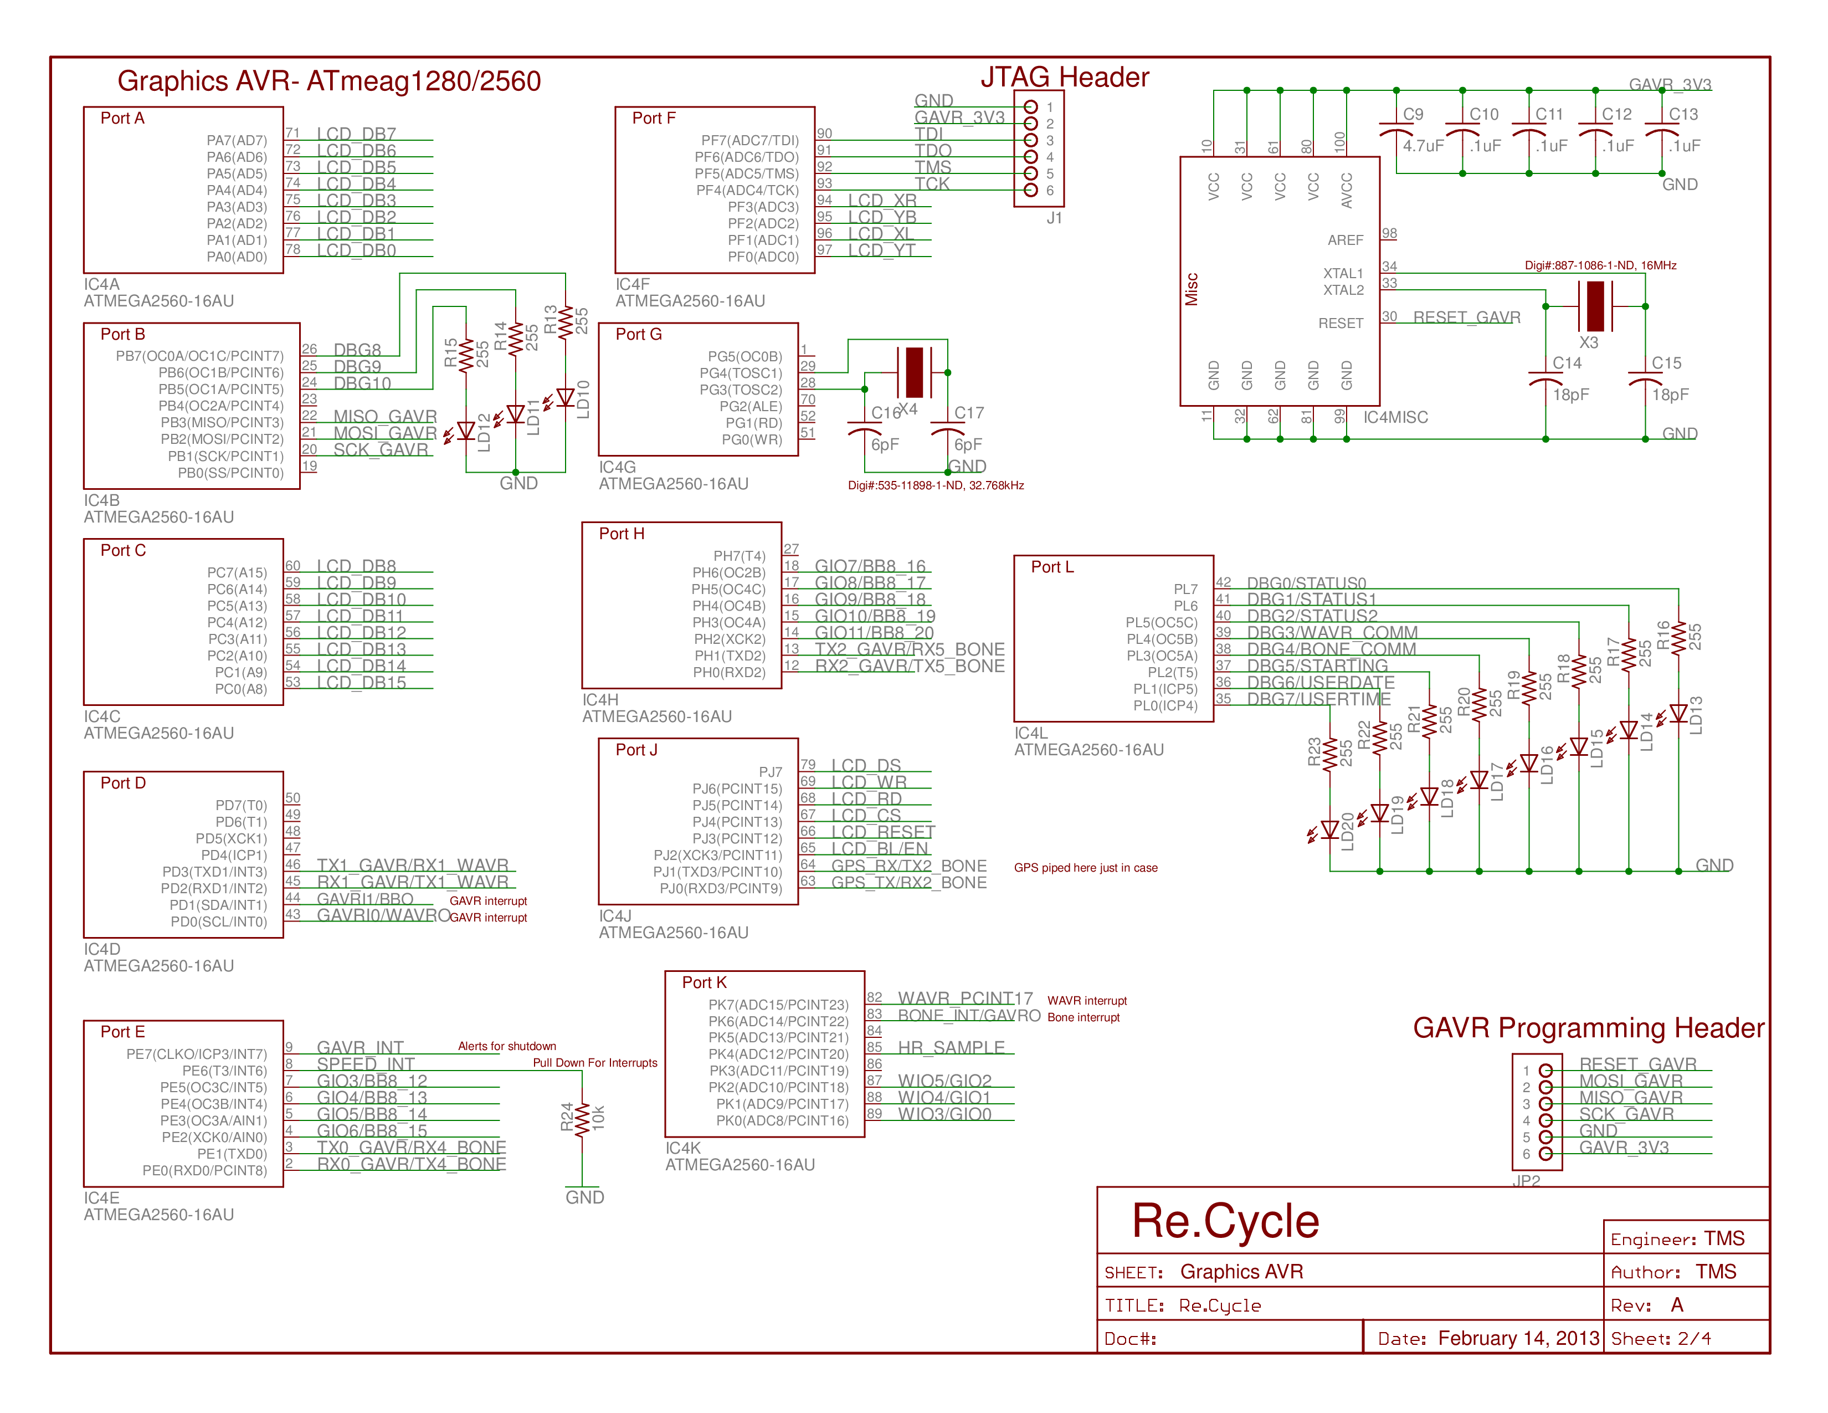

Slide 9
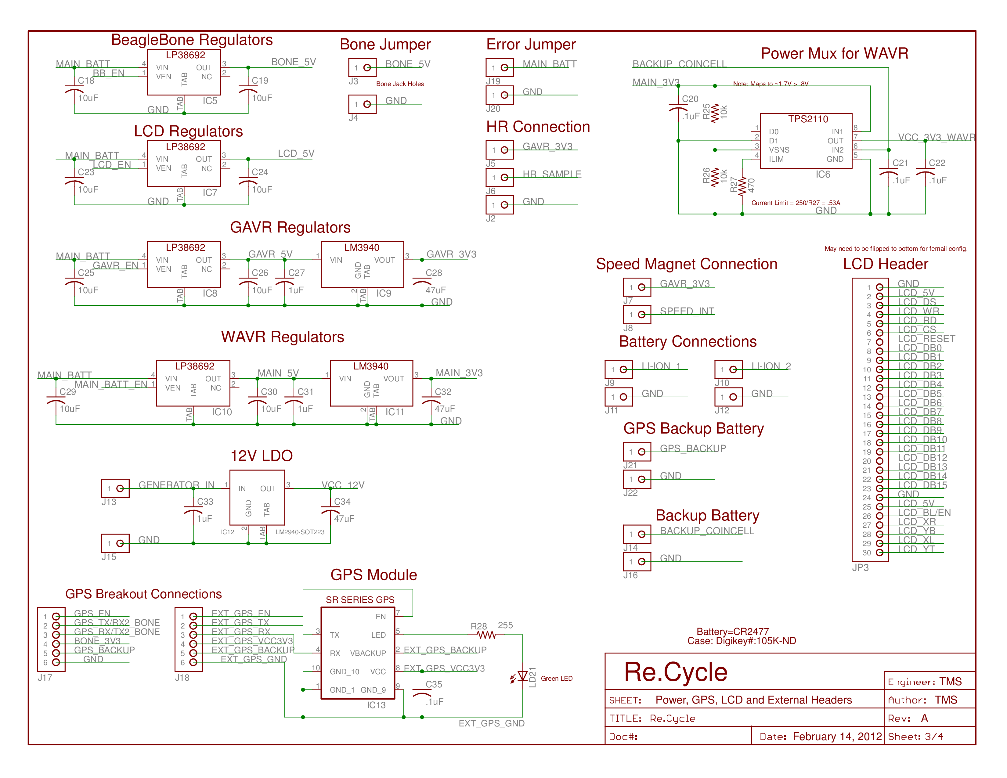

Slide 10
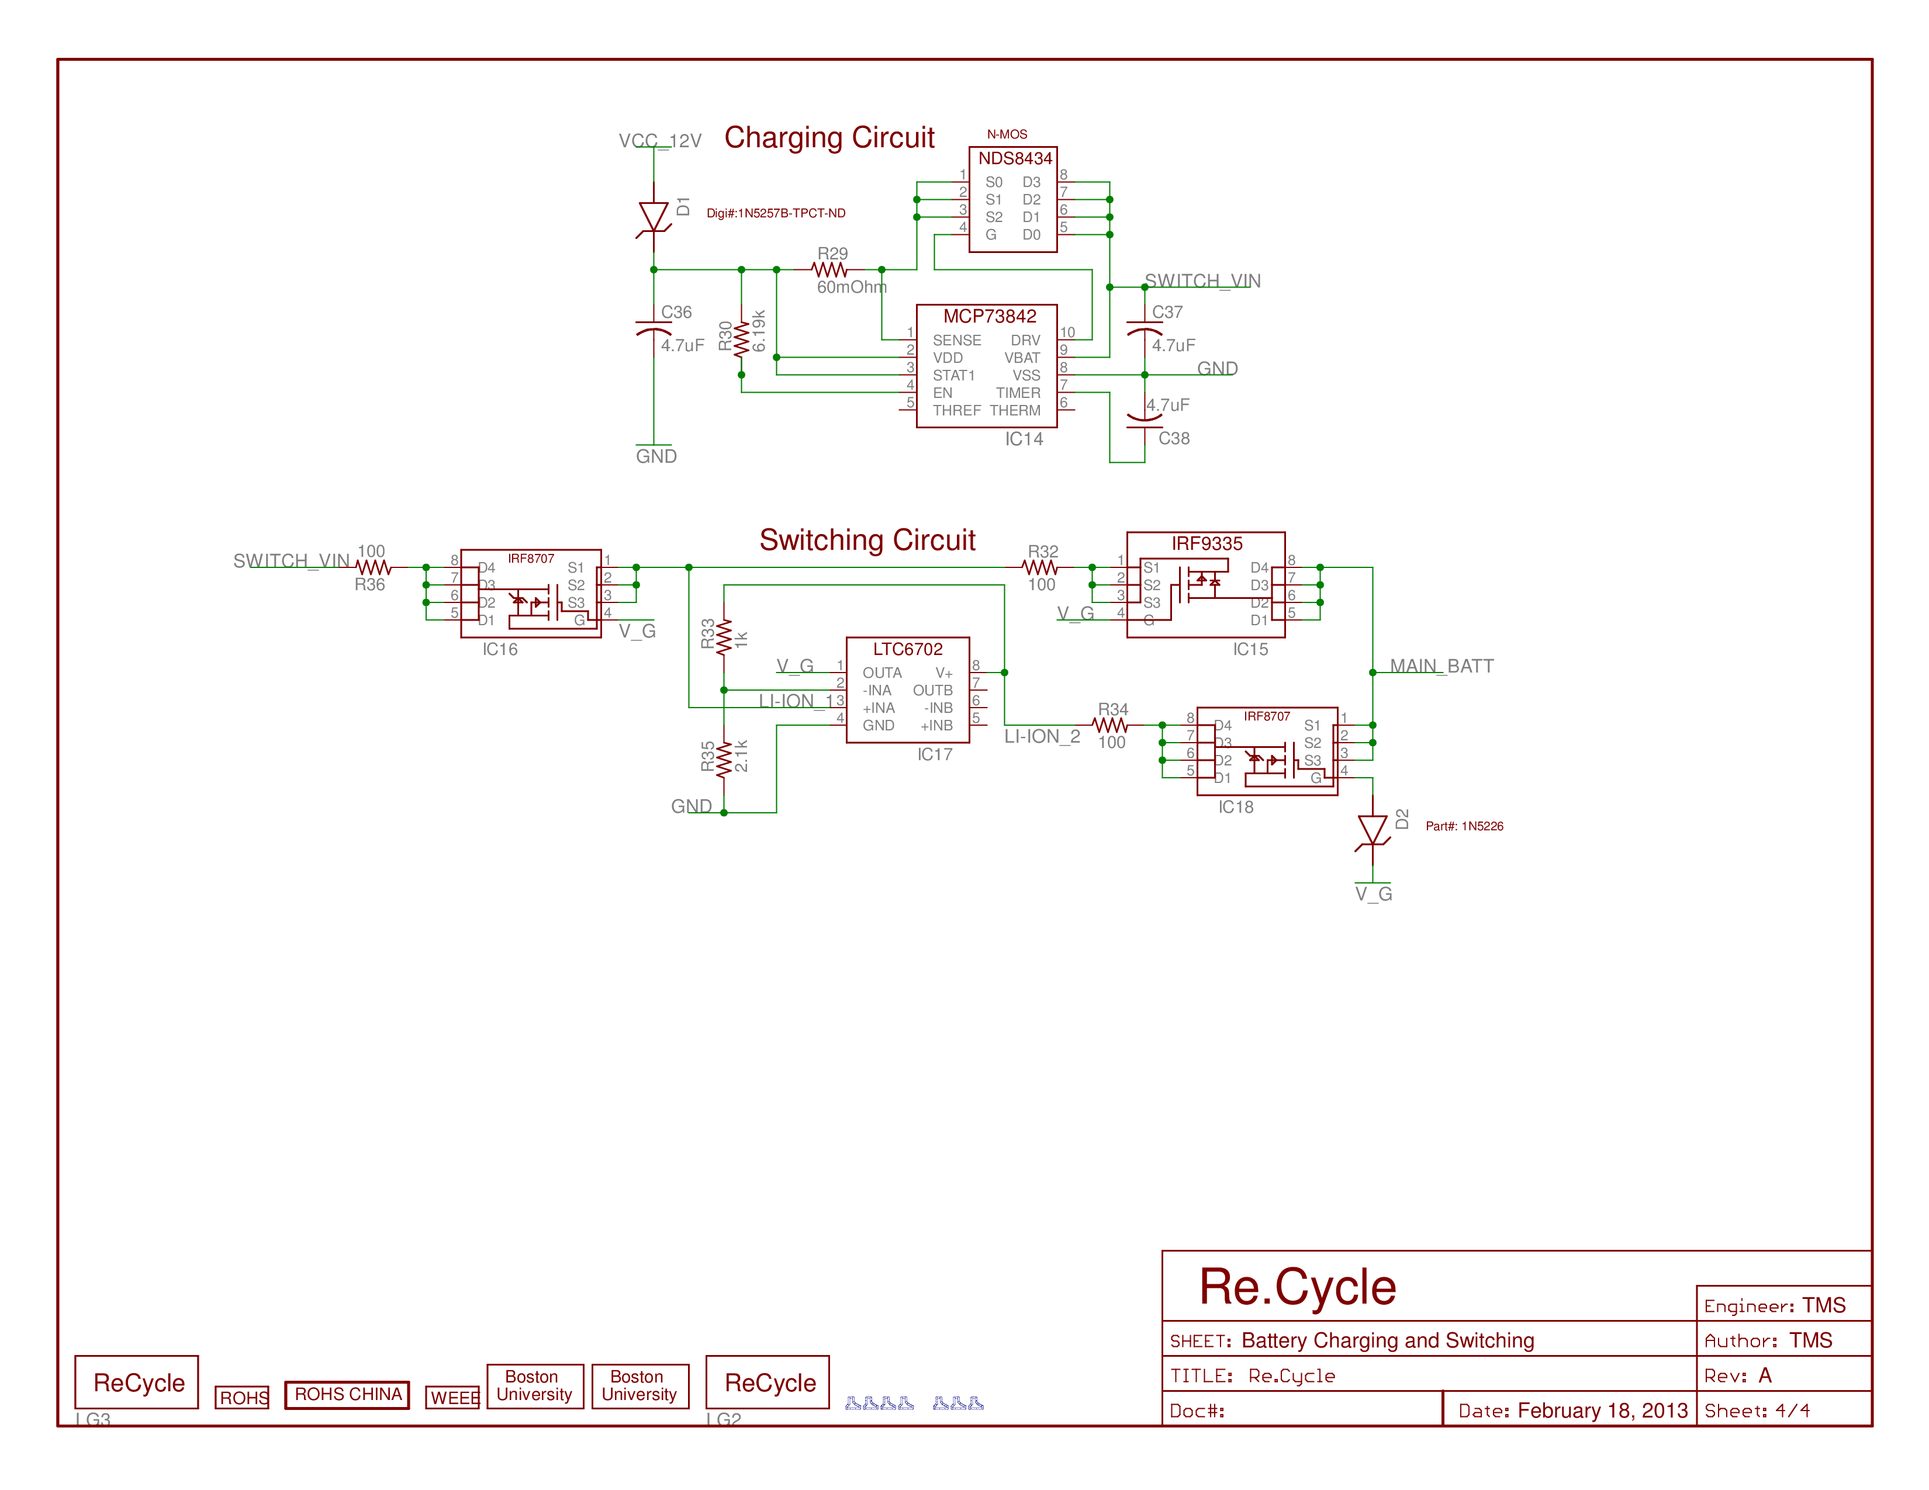

Slide 11
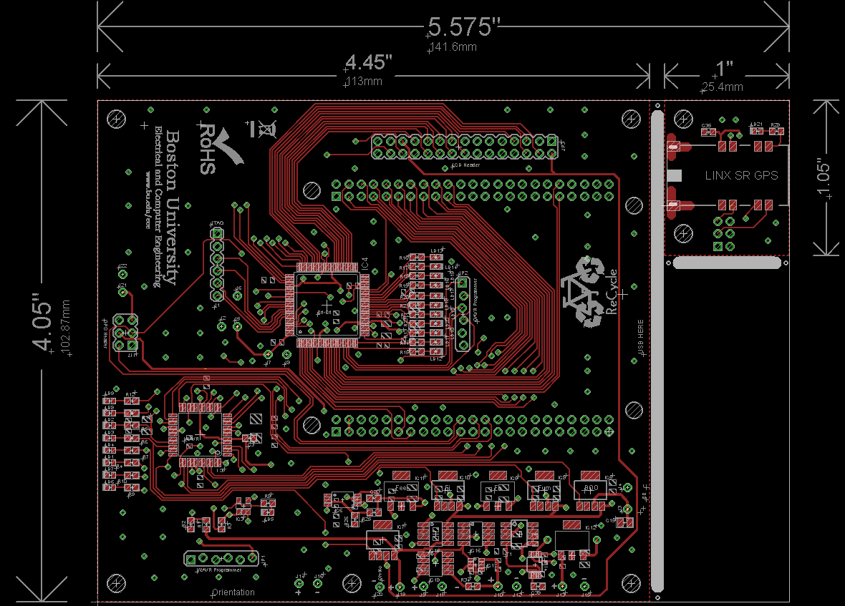

Slide 12
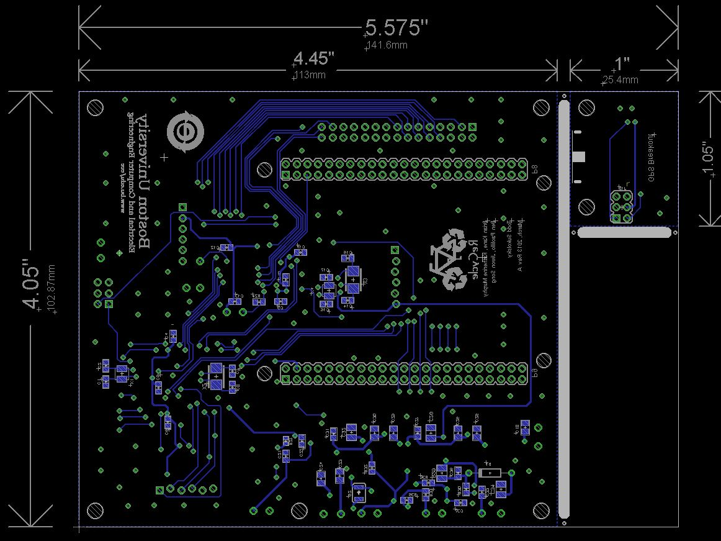

Slide 13
In Progress Items…
Watchdog AVR
Communication from Graphics AVR
Graphics AVR
Communication to Graphics AVR, two-way communication with BeagleBone
Restart procedure for trip data stored in EEPROM
Full integration of all modules, currently two or three run together instead of all six or seven
BeagleBone
Final implementation of communication usb-dump scripts in startup sequence.
Communication with GAVR
PCB population and testing
Casing

Slide 14
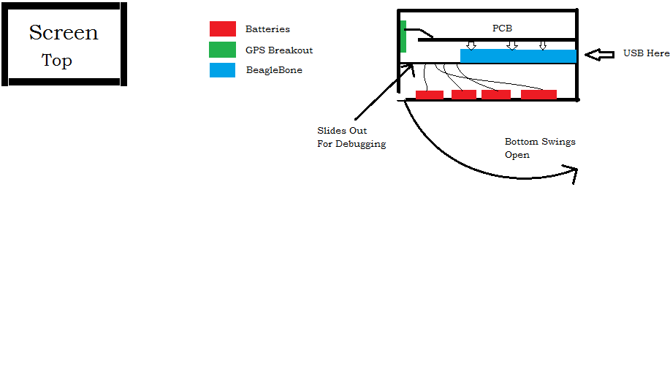
Casing
Six sheets of ¼” thick Polycarbonate
Machined in BU Machine Shop
Designed in Solidworks
Bottom swings out to allow easy access for batteries, BeagleBone mounted on inner sheet that slides out for debugging.

Slide 15
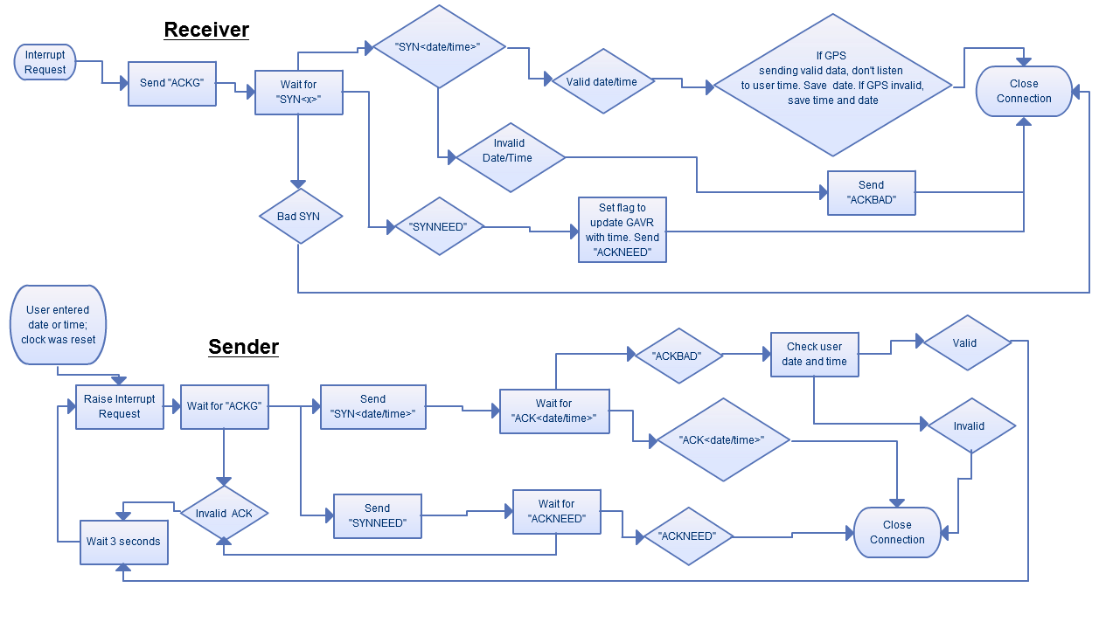
GAVR to WAVR Communication

