Slide 1


14
Nima Dehmamy
Jiwon Song
Katherine Murphy
Ben Paolillo
Brian Kane
Todd Sukolsky

Slide 2
14
Nima Dehmamy
Objective
Create an embedded system for cyclists, powered by clean, renewable energy
Eliminate the need for multiple devices
Increase situational awareness of biker
Final Cost less than $300

Slide 3
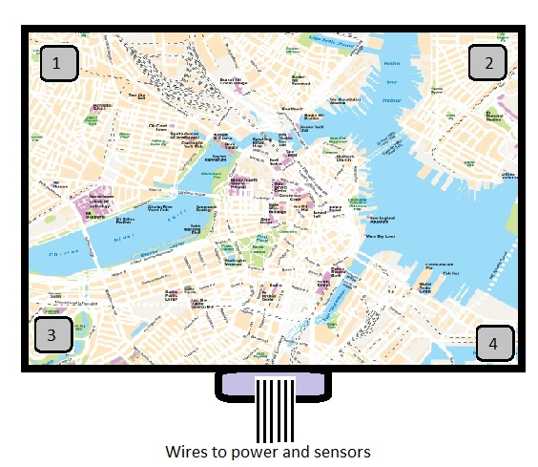
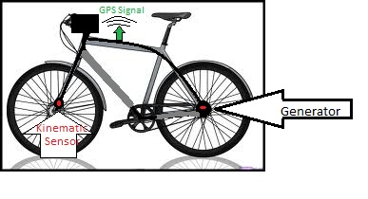
14
Nima Dehmamy
Visualization

Slide 4
14
Nima Dehmamy
Deliverables
Prototype of the detachable main module
on a working bicycle
Demo graphical user interface with
screens for maps, bicycle diagnostics,
user statistics
Power management system
implementing environmental/user
supplied power
Heart Rate system

Slide 5
14
Nima Dehmamy
Requirements
Bicycle statistics- Odometer, speed, stopwatch with current time elapsed. Speed accurate to within one mile per hour.
GPS- GPS streaming of current location within three yards.
Heart Rate Monitoring- Accomplished via pads, handlebars or heart rate belt. Accurate to within four beats per minute
“Trips”- Feature used to track specific rides and/or time elapsed events. Log the trips in onboard memory. Up to 20 hours stored with ability to clear all or individual trip data. Data includes odometer, time, average speed, heart rate average and max.
Rechargeable power- Wall chargable in under twelve hours. Main functions powered for at least sixty minutes, supplemented by at least 50% through the environment (solar or turbine).
Backup battery- Preserve date and time for up to five days when main module is detached from main battery. AAA or watch battery.

Slide 6
14
Nima Dehmamy
Requirements
Continuity- All features should run simultaneously, multitasking.
External Storage- USB 2.0 Specifications, system must be able to dump memory/trip data onto external USB drive with up to twenty hours of data in .csv, excel, or text file. Trips and aggregate data dumped.
Non-obtrusive layout- Detachable model that can be disassembled within two minutes. Requires custom port for wire connectivity. Maximum dimensions
  4.25”x4.25”x2”.
Touch screen LCD Panel- Minimum 4” full color LCD panel, minimum color depth of 18 bits and refresh rate of 60 Hz. Resistive touch screen.
GUI- Well designed, displays all features using different layouts. User has ability select which screen to go to from current screen with tap.
Safety- Screen will default to a clock when rider is travelling above four miles per hour.

Slide 7
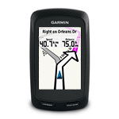
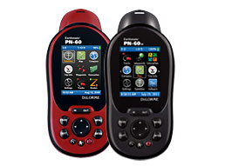
14
Nima Dehmamy
Competing Technologies / Patents / Other Products
Garmin Edge Series: $149-$449
https://buy.garmin.com/shop/shop.do?pID=331&ra=true
Delorme Earthmate: $299-$599 https://shop.delorme.com/OA_HTML/DELibeCCtpSctDspRte.jsp?section=10043

Slide 8
Standards
14
Nima Dehmamy
IEEE USB 2.0 Specifications
Massachusetts State and City of Boston bike laws http://www.cityofboston.gov/bikes/bikesafety/laws.asp

Slide 9
14
Nima Dehmamy
Objective
Create an embedded system for cyclists, powered by clean, renewable
energy
Eliminate the need for multiple devices
Increase situational awareness of biker
Final Cost $300
VISUALIZATION
Deliverables
Prototype of the detachable main module on a working bicycle
Demo graphical user interface with screens for maps, bicycle diagnostics,
user statistics
Power management system implementing environmental/user supplied power
Heart Rate system
Technical Approach
Schedule
Wait until Concept Review
Wait until Concept Review
Budget / Resources

