Slide 1
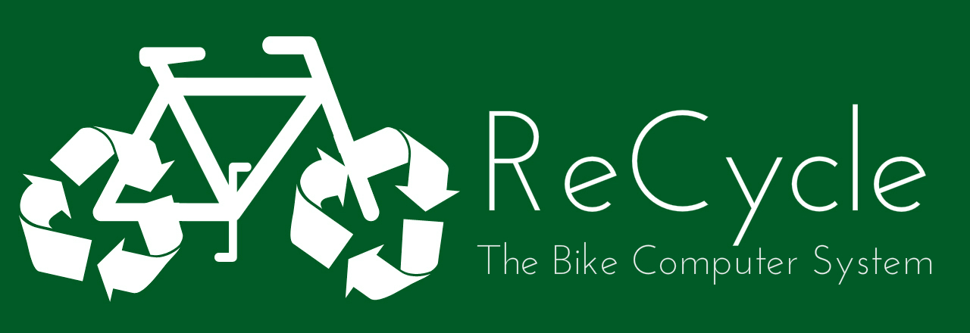
Brian Kane
Katherine Murphy
Ben Paolillo
Jiwon Song
Todd Sukolsky
Boston University - Senior Design II - 2013

Slide 2

ReCycle
Objective
Create an embedded system for cyclists, powered by clean, renewable energy
Eliminate the need for multiple devices: GPS, Heart Rate monitor, cyclocomputer
Increase situational awareness of biker
Final Cost: $300
2
Boston University - Senior Design II - 2013

Slide 3
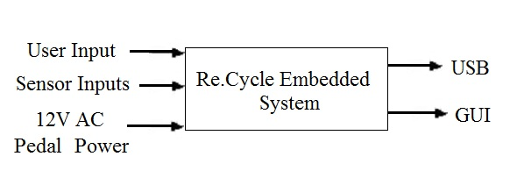
ReCycle
ReCycle
Level 0 Block Diagram
Module | ReCycle Embedded System
Inputs | User Input: Selection of desired trip/cyclist info; cyclist’s pulse when desired; time/date input once by user Power: 12V AC RMS from pedal-power generator Sensor Inputs
Outputs | Trip/cyclist diagnostics as chosen by user for viewing; USB dump and PC Trip GUI
Functionality | Use battery power and user supplied pedal power to run the device which shows user heart rate, distance traveled, and speed as selected
3
Notes:
3

Slide 4
4
ReCycle
ReCycle
Charging / Switching
Boston University - Senior Design II - 2013
Notes:
4

Slide 5
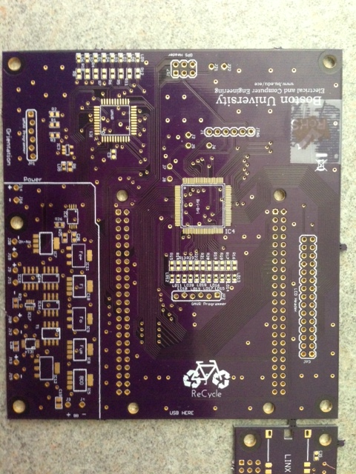
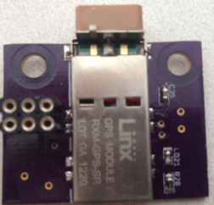
ReCycle
ReCycle
Boston University - Senior Design II - 2013
5

Slide 6
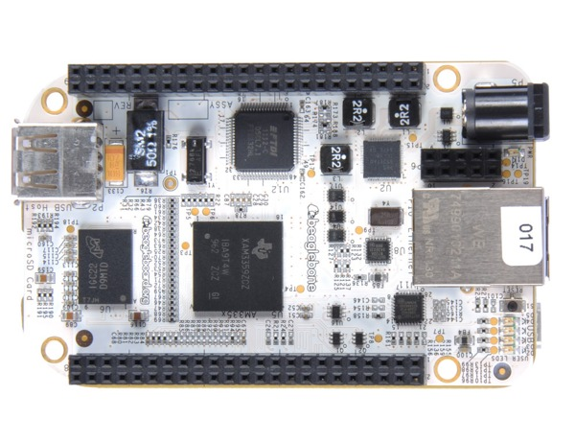
ReCycle
ReCycle
Boston University - Senior Design II - 2013
6

Slide 7
ReCycle
ReCycle
Trips-Overview
Trip Data comprised of:
Current Speed- Reed Switch, interrupt driven
Average Speed- Reed Switch
Current HR- Pulse HR Monitor, Analog to Digital Conversion
Average HR- Pulse HR Monitor
Distance- Reed Switch, incremented on interrupt
Time Elapsed- Internal RTC, only increases when system is “up”
Start Day- Internal RTC/User
GPS location data
Management Options w/ or w/o USB attached:
Delete on-board trip, start/end a trip, view all on-board trips
w/USB attached:
Offload on-board trip, view USB stored trips, delete USB stored trip
Boston University - Senior Design II - 2013
7

Slide 8
ReCycle
ReCycle
Trips-Implementation
On-board trip data:
Stored in EEPROM of Graphics uC
Roughly 100 trip storage space, each trip can last up to 65535 years, total trip storage in years ~6553500 years.
Low power shutoff and restart procedure
USB trip data:
Stored in two sub-directories, “gps” and “Trips” with respective data in text files corresponding to trip number.
Folders made, if not pre-existing, on USB mount
GPS data:
Streamed from GPS module connected to PCB
NMEA strings stored on the BeagleBone in a temporary file.
New trip triggers storage of last GPS stream
Offloaded to USB on command
Boston University - Senior Design II - 2013
8

Slide 9
ReCycle
ReCycle
LCD
Boston University - Senior Design II - 2013
9

Slide 10
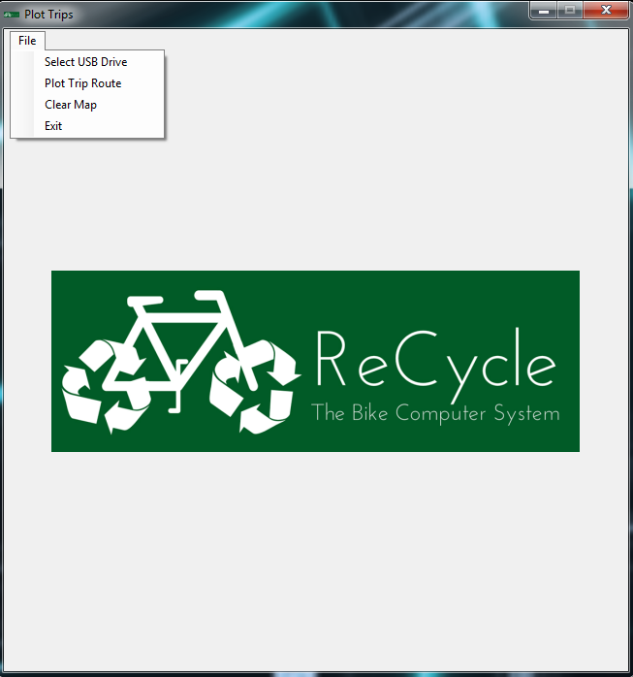
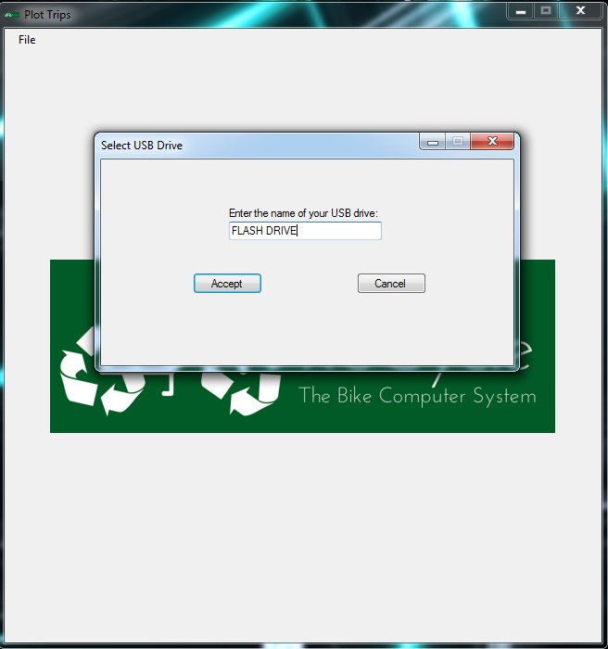
ReCycle
ReCycle
PC Software / Application
Figure 1: This is the main screen of the PC application with all File options shown.
Figure 2: Select USB Drive Dialog. For example, if your USB drive is labeled FLASH DRIVE (F:) in Windows Explorer, simply enter FLASH DRIVE.
10

Slide 11
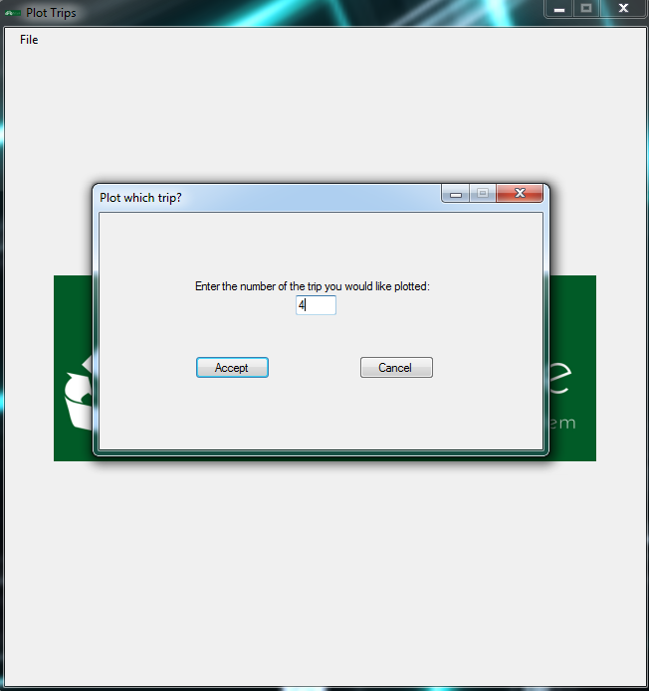
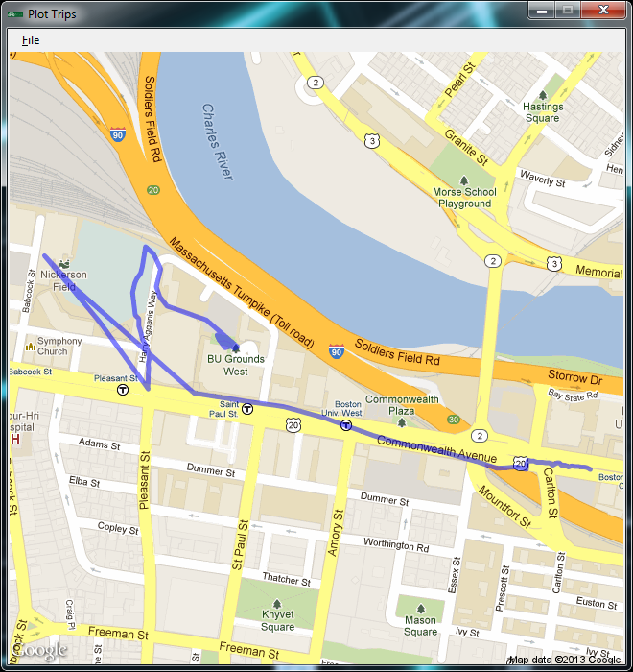
ReCycle
ReCycle
PC Software / Application
Figure 3: Plot Trip Route Dialog. For example, if you wish to plot trip number 4, simply enter the number 4.
Figure 4: An example of a successfully plotted route on Google Maps.
11

Slide 12
ReCycle
ReCycle
Total Cost
BeagleBone | 45
GPS | 44
Battery Management | 9.79
Power Generator | 40
Heart Rate | 25
Speed Sensors | 2.35
LCD Screen | 45
PCB w/ components | 75
Total: | 285.14
12
Boston University - Senior Design II - 2013

Slide 13
ReCycle
ReCycle
Electrical Characteristics
Full Power Mode
Consumer | Amps | Voltage | Watts
BeagleBone | 170mA in idle, 300mA on boot | 5V | .85W
LCD Screen | ~350mA | 5V | 1.75W
PCB and Peripherals | 130 mA peak, 100mA average | 5V, 3.3V | ~.5W
Total: | ~750mA | 7.4V | 5.55W
Note: Voltage is regulated down from 7.4 to 5V, 3.3V
Main Power from two 7.4V Li-Po batteries with capacity of 1500mAh each.
Estimated longevity ~ 3 hours.
Tested without LCD screen, longevity > 8 hours
Real Time Clock backup power provided by 3V coin cell
System draws ~10uA in RTC only mode
13
Boston University - Senior Design II - 2013

Slide 14
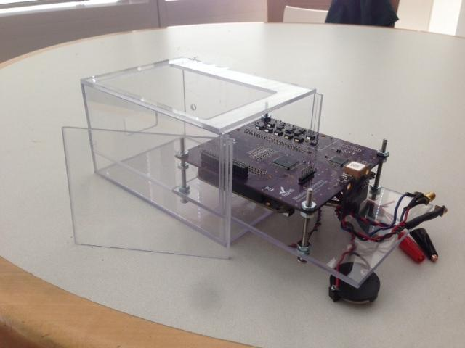
ReCycle
ReCycle
Casing
Made from 1/8” thick Polycarbonate.
Sliding PCB debug level, sliding door to remove batteries and debug level
SMA drill holes on front facing side for SMA connectors to peripherals
Top opening for LCD Screen, side hole for USB input
14
Boston University - Senior Design II - 2013
Notes:
14

Slide 15
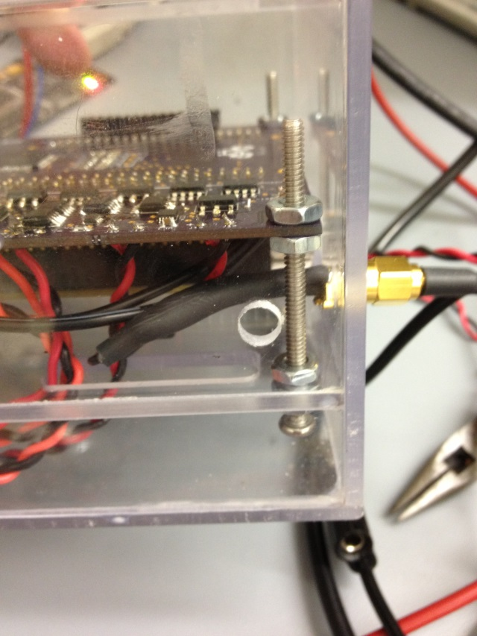
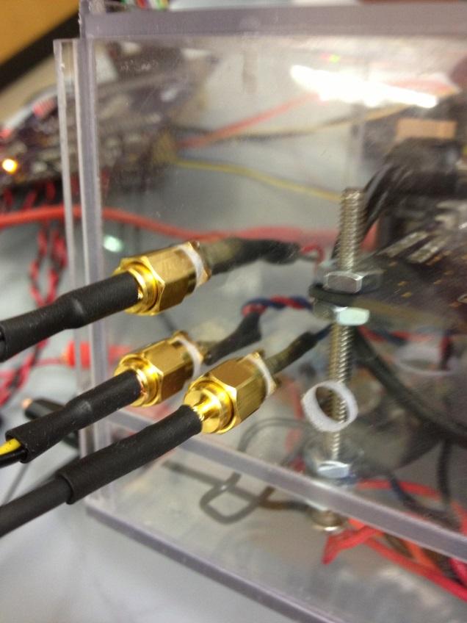
ReCycle
ReCycle
Connections
Four SMA connections for fast installation and disassembly:
Heart Sensor power and ground
Heart Sensor sampling line
Reed Switch power and interrupt line
Generator power and ground
15
Boston University - Senior Design II - 2013
Notes:
15

Slide 16
ReCycle
Future Improvements
Add on-board flash chip to store trip data. More data storage, more protection
against corruption. EEPROM limited to 100,000 reads/writes.
Eliminate Graphics uC and integrate LCD solely with BeagleBone.
New BeagleBone OS
Shallower casing
Boston University - Senior Design II - 2013

Slide 17
ReCycle
ReCycle
Questions?
17
Boston University - Senior Design II - 2013
Notes:
17

