Slide 1

On the Implications of Choosing Average versus Marginal Carbon Intensity Signals on Carbon-aware Optimizations
Thanathorn Sukprasert, *Noman Bashir, Abel Souza,
David Irwin, Prashant Shenoy
University of Massachusetts, *Massachusetts Institute of Technology

Slide 2





Energy Mix and Carbon Intensity
Electricity demand is served by different energy mix
Each energy source has different carbon intensity
1kWh
coal
carbon emissions per kWh of electricity (gCO₂eq/kWh)
Electricity Demand
Energy Demand
solar
Time
Notes:
To get us started, let’s look into the energy mix and carbon intensity.
Suppose we some hypothertical electricity demand that varies through time and the energy demand is served by different energy mix.
For example, in the first time slot, the energy demand is served by gas. As the energy demand increases and there is solar availability, the solar energy is also part of the energy mix. In the next time slot where the demand is still increasing, the energy demand is fulfilled by gas, solar and coal.
With the energy mix, each each energy source has different carbon intensity. The definition of carbon intensity is amount of carbon emissions per kilowatt hour of electricity and the carbon emissions is measured in grams.
For example, to produce 1kWh of electricity, solar energy has lower carbon emissions as compared to coal. What this means is that solar has lower carbon intensity as compared to coal
f

Slide 3


Average and Marginal Carbon Intensity
Average carbon Intensity
Weighted average of carbon emissions and their productions
Marginal carbon Intensity
Carbon intensity with respect to the change in demand
Current demand
Next
demand
Gas: 100 gCO₂eq/kWh, 900 kWh
Solar: 20 gCO₂eq/kWh, 100 kWh
coal
CO₂ Intensity (gCO₂eq/kWh)
$$\frac{\left(100∙900\right)+(20∙100)}{900+100}$$
gas
= 92 $\text{gCO}\text{2}\text{eq}\text{/}\text{kWh}$
solar
Production (kW)
Notes:
When the generators serve the eletrici ty demand, there are two methods of calculating carbon intensity, namely average and marginal carbon intensity.
The average carbon intensity is the weighted average of carbon emissions of the sources weighted their productions to fulfill the electricity demand. For example, here, the two sources that serve the current demand are solar and coal and the average carbon intensity takes the weighted average of the two sources.
Meanwhile, the marginal carbon intensity, is the carbon intensity with respect to the change in demand. For example, here, the coal generator serves next unit of demand. Hence, the marginal carbon intensity is the carbon intensity of coal.
It is worth noting that, when calculating the average carbon intensity, when the increased demand triggers the the next generator with higher emissions, increased in emissions are uniformly distributed across all units of existing demand, including the added demand.

Slide 4
Research Question
What are the implications of the carbon intensity signal on carbon-aware optimizations?
Notes:
The two carbon intensity signals are used in many different decarbonization efforts, including workload shifting to shift the demand to when and where low-carbon electricity is available.
Such carbon-aware optimizations are enabled by the emergence of the third-party services such as Electricity Maps and WattTime, that provide carbon intensity of electricity across regions worldwide.
And so far, we have discussed how the average and marginal carbon intensity signals are calculated differently. Therefore, our research question focuses on the implications of the choice of carbon intensity signal on carbon-aware optimizations.

Slide 5

Methodology
2 carbon-aware optimization techniques
Temporal and Spatial workload shifting
65 regions from Electricity Maps
From year 2022
Notes:
To answer our research question, we look into two carbon-aware optimization techniques, namely temporal and spatial workload shifting.
We used the marginal and average dataset consist of 65 regions from Electricity Maps from the year 2022 to conduct these analyses.

Slide 6

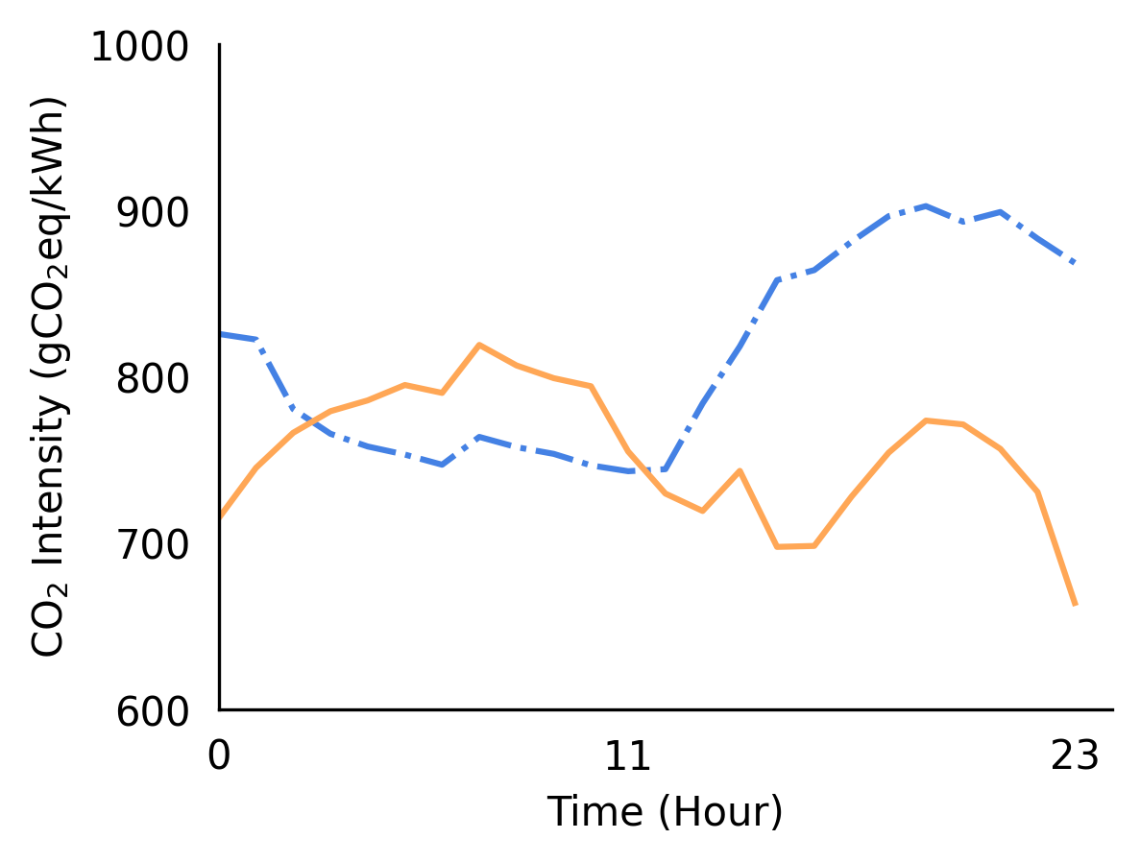
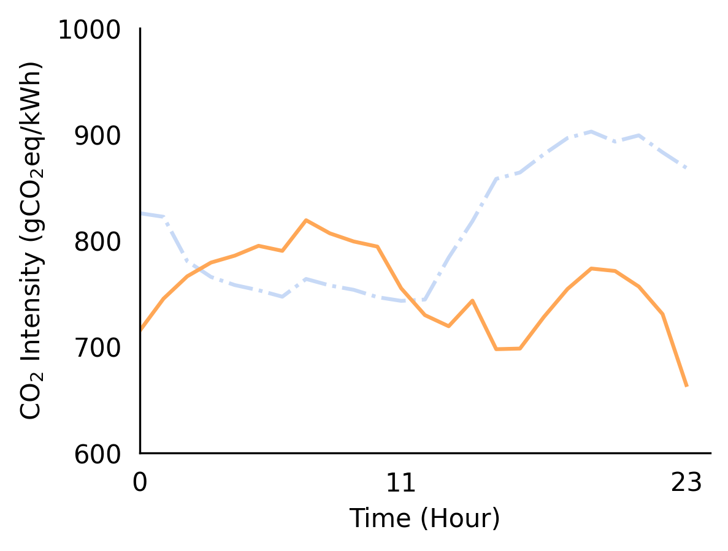
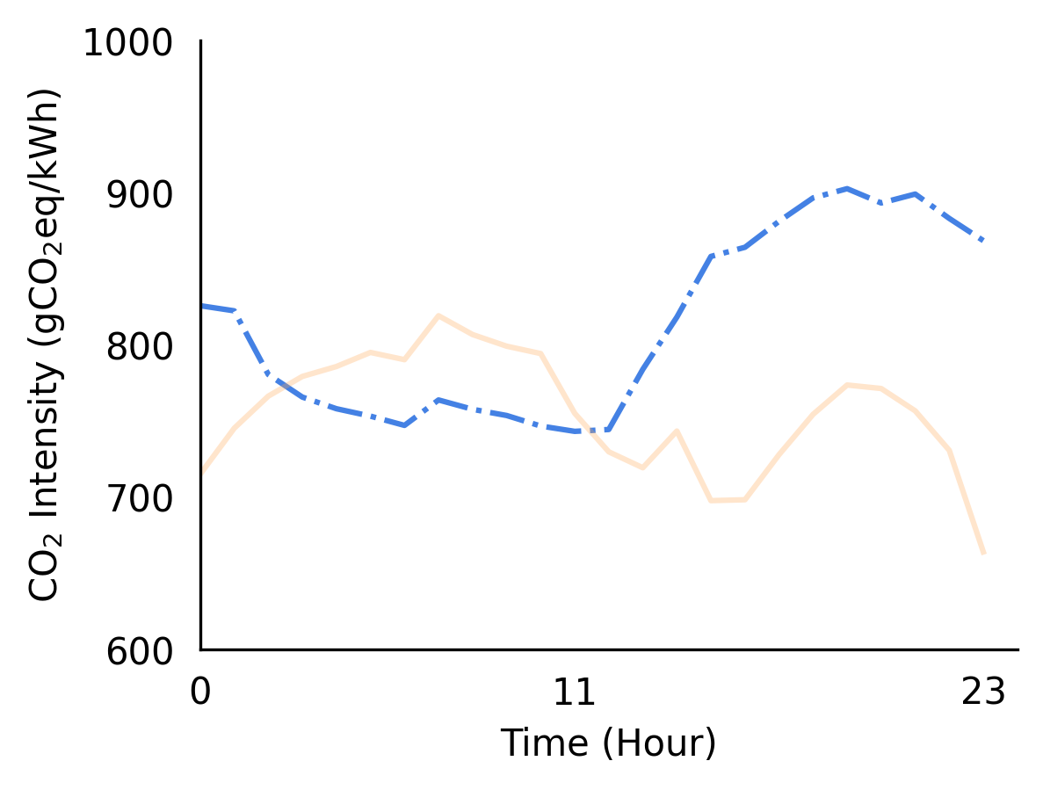
Temporal Shifting
Average carbon intensity as the scheduling signal
Marginal carbon intensity as the scheduling signal
Wyoming
Notes:
Let’s us look into temporal shifting by looking at the example average and marginal carbon intensity traces of Wyoming. Here, we can use either the average or marginal carbon intensity signal as the scheduling signal and it turns out two different signals ca n result in two different decisions.
With the average carbon intensity signal as the scheduling signal, when shifting the workload to low-carbon period based on the average carbon intensity signal, it could be high carbon period from the perspective of the marginal carbon intensity signal.
Similarly, when the marginal carbon intensity signal is used as the scheduling signal, the low-carbon period of the marginal carbon intensity might be the high carbon-period of the average carbon intensity signal.

Slide 7
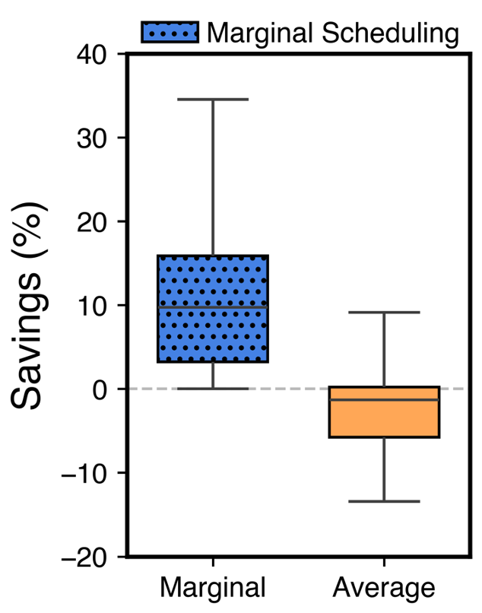
Impacts of Temporal Shifting
Marginal carbon intensity as the scheduling signal
Mean savings across 65 regions: 11%
Higher emissions from the
non-scheduling signal’s perspective
Notes:
Now, let's look into the impacts of temporal shifting. The result on the right here shows the carbon savings when the marginal carbon intensity signal is used as the scheduling signal. With the marginal signal as the scheduling signal mean savings across 65 regions is 11%.
However, from the perspective of the average signal, the mean savings are negative, and what this means is there is an increase in carbon emissions. The takeaway of this result is that scheduling with one signal generally results in higher emissions when looking from other’s signal’s perspective.
While the result only shows when the marginal carbon intensity signal is used as the scheduling signal, using the average carbon intensity as the scheduling signal yields similar result and more details can be found in the paper.

Slide 8

Spatial Shifting
Origin X
Average: 100 gCO₂eq/kWh
Marginal: 75 gCO₂eq/kWh
Region A
Region B
Average: 59 gCO₂eq/kWh
Average: 90 gCO₂eq/kWh
Marginal: 70 gCO₂eq/kWh
Marginal: 45 gCO₂eq/kWh
Notes:
Next, let’s look into spatial shifting. Let’s us suppose we have a workload at origin X and we want to reduce the carbon footprint of the workload using spatial migration and we have to regions that we can migrate the workload to, namely region A and B. Now consider the case where the average carbon intensity is the scheduling signal, we would migrate the workload to region A with lower carbon intensity. On the other hand, if the marginal carbon intensity is the scheduling signal, we would migrate the workload to region B

Slide 9
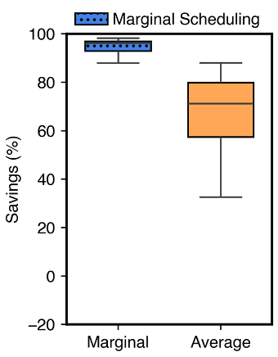
Impacts of Spatial Shifting
Selecting the destination based on the marginal carbon intensity
Mean savings across 65 regions: 87%
Lower carbon savings from the
non-scheduling signal’s perspective
Notes:
With different scheduling decisions, let's look into the impacts of spatial shifting. The result on the right here shows the carbon savings when the marginal carbon intensity signal is used as the scheduling signal. When the marginal carbon intensity signal is used as the scheduling signal, the mean savings across 65 regions is 87% from the perspective of the marginal carbon intensity.
However, from the perspective of the average signal, the mean savings across 65 regions are lower. While the result only shows when the marginal carbon intensity signal is used as the scheduling signal, using the marginal carbon intensity as the scheduling signal yields similar result of having carbon savings around 87%, but lower carbon savings from the perspective of the marginal signal, more details can be found in the paper.

Slide 10
Summary and Conclusions
Perform temporal and spatial workload scheduling
Different scheduling decisions
Different carbon savings
Which signal is the best?
The signal that gives the largest system-wide carbon reduction
Notes:
To summarize,
In this work we perform temporal and spatial workload scheduling and show you that the two carbon intensity signals result in different scheduling decisions as well as different carbon savings.
So which signal is the best? at this point it is still unclear and this an open research question given that the two signals have different characteristics. A related question is how might we evaluate these two different signals to determine which one is best? The answer is that we would want to select the signal that result in the largest system-wide carbon reduction. To do this, we would need to examine the system globally rather than each individual user.

Slide 11
Thank you Questions?
On the Implications of Choosing Average versus Marginal Carbon Intensity Signals on Carbon-aware Optimizations
Thanathorn Sukprasert
tsukprasert@umass.edu

