Slide 1
IT Behavior 2017

Slide 2

IT Survey result: Finding
We are happy with our management team (IT)
We do not think that we are being properly trained
We are not too sure about promotion process and KPIs
We are not too satisfied with our benefit
We do not have the clear communication from Company

Slide 3









IT Vision: Business Plan
Strategize
People:
Engage
Translating
IT Business Plan
IT Re-Focus 2017
Capability Design
of IT Organization
Into
Innovation:
Engineer
Change Programmes:
Deliver
Service
Brilliant at the Basics:

Slide 4
IT Capability Mapping: Re-focus 2017
Capabilities
 |  | Strategize | Engage | Engineer | Deliver | Service
Roles
Head of IT |  | Overall Accountability
Strategy and Solution Delivery |  | Deliver strategies to enable the Gulf Business on Key strategies and ambitions | Partnering with key stakeholders to drive the changes of IT initiatives |  |  | Governance on Risk and Compliance
 | System Admin and IT support |  |  |  |  | Manage Issues, escalation and Vendor interaction
Application Team Lead |  | Manage App service team strategies |  | Create/ develop solutions for business based on defined processes.
 | Application Support |  |  | Create/ develop solutions for business based on defined processes. |  | Manage Issues, escalation and Vendor interaction
Project Management Office (Vacant) |  |  |  |  | Project Manage, Develop project plans specifying goals, deliverables, resources
High Involvement
Moderate Involvement
Light Involvement

Slide 5
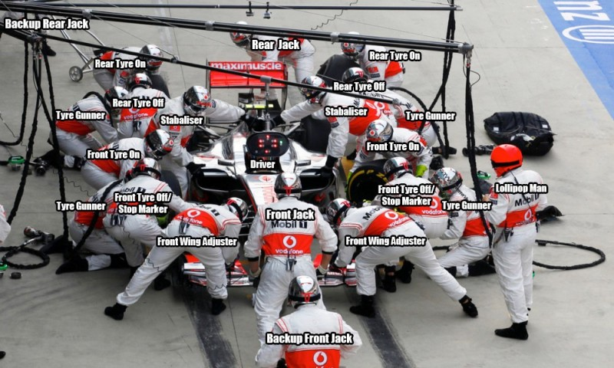
IT Proposed Organization: Driving Performance
IT Re-Focus 2017
Driving Performance in Execution

Slide 6
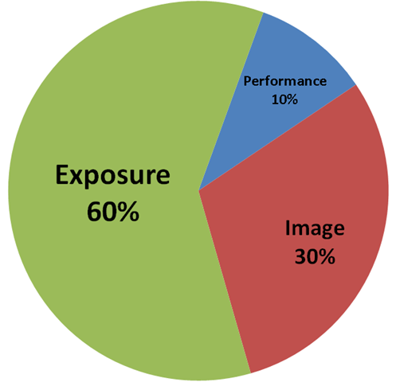
IT Proposed Organization: Positive working environment of IT
3 Keys to Career Success: The Pieces of PIE (VIP)
Visibility or

Slide 7




IT Proposed Organization: Positive working environment of IT
IT Re-Focus 2017
Praise good work, Reward success
And avoid blaming
Fun and Flexible working environment
Acknowledge Strengths and Weaknesses to establish development plan
Help each other
Grow professionally
Open Discussion and network of sharing
Internally and externally
Trust and respect each others
Highly Engaging team
Always excited to generate New Initiatives

