Slide 1



IT Monthly Report
As of 30 June 17

Slide 2
Contents
1
Executive Summary
2
Key Highlights
3
IT Project Status
4
IT Services /Infrastructure

Slide 3



IT Monthly Report: Executive Summary as of (30-Jun-2017)
Key Updates
Financial Business Intelligence Dashboard has gone live to business users to review before launching to management
CRM is now in the process of development and testing
External Website is now pending for CI adjustment and Investor relation.
HR e-recruitment development process and Iteration 1 testing has been done and now in the process of testing Iteration 2.
Video Conference solution design has been completed on vendor selection, now in the process of procurement.
E-Bidding is now in the process of development and testing.
Asset Management for Office furniture , IT Equipment and Spare part is now in the process of requirement gathering.
IP Tel - Telephone number selection and IVR workflow has been completed and now in the process of PO approval and network preparation.
Look Ahead
IP phone: to be launched in August 2017
IT Hot desk: IT to introduce the hotline number with the new IP phone project to enhance the service touchpoint.
VDO Conference: now in the procurement process after network setting up. Device to be ready in Jul-Aug
E-Bidding: to be launched in the month of July to enhance the process of procurement bidding
IT Services
Summary from Ticketing system (308 in Total)
Key challenges | Mitigation plan
Low adoption rate of “WorkChat” on Mobile App (14%) | Encourage people to download and use Workchat by posting on Workplace and sending an email reminder with manual and instruction
External website final design pending on CI adjustment | IT to go ahead with current design of the website in order to meet the IPO date and change request to be made to cope with the CI adjustment
%SLA average (How fast IT solve your tickets) | 95.86%
%VOC (How happy are you with our services) | 98.29%
Data as of 30 June 17
Notes:
Key highlight
Key challenges
Budget
People

Slide 4
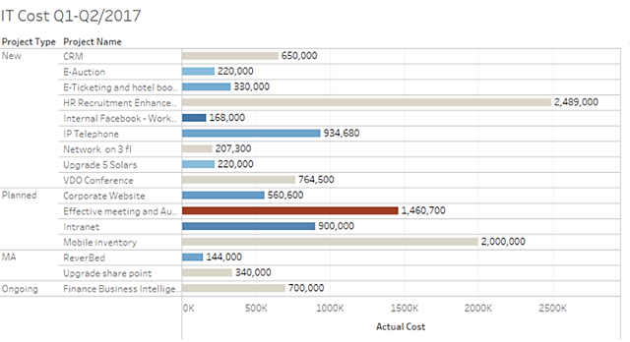
IT Monthly Report: Budget as of (30-Jun-2017)
Budget (THB)
Overall Status
2017 Budget : 74,537,604
YTD Budget : 60,524,939
YTD Actual : 41,820,568
YTD Run Rate : 69%
Annual Run Rate : 56%
Meet budget
Under Budget/Cost saving
Over budget
Notes:
Budget YTD vs. on-going chart
People

Slide 5
IT Monthly Report: People Management as of (30-Jun-2017)
Resource Allocation 15 Total headcounts |  | Aticha A. | Ply S. | Surachai S. | Thanatip N. | Sakulrat T. | Sunonthacha P. | Methawan S. | Suveecha P. | Preecha J. | Nuntawat W. | Khomkorn K. | Suwatchai K. | Somnuek H. | Suleeporn C. | Poempon S.
 | IT Strategy
 | IT Compliance and Audit
 | IT Budget
On-going projects | Social Media Activities
 | Corporate Website
 | CRM
 | Business Intelligence
 | Intranet
 | HR Recruitment
 | E-Bidding
 | IP Tel
 | Audio and Video Con
 | Asset Management
Service Mgt. | Network Management
 | DMS and engineer system
 | SAP and other FIN systems
 | HR System Management
 | Service Management
 | IT Administration
 | Ad-hoc Activities
 | Current month estimated utilization (%) | 95
Ppl Development in progress
Ply S. is attending “Coaching for performance” by HR
Sunonthacha S. is attending “Coaching leadership” by HR
Khomkorn is attending “Building leadership foundation”
Nuntawat W. to join IT (transferred from HR) to understand the new job scope and development plan
Ppl Development look ahead
Nuntawat W. to start working on SAP logistics module apart from HR.
Suveecha to get into system development on top of her current role
Supervise role
High involvement/ Leading role
Moderate Involvement
Light Involvement

Slide 6
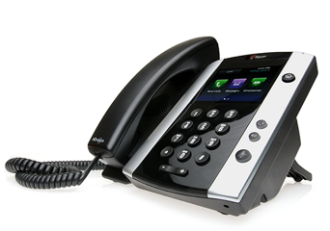
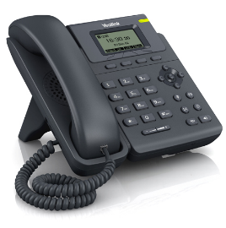
IT Monthly Report: Key Highlights>> IP Phone
IP Phone
Objectives
To implement IP Phone and change company phone number to “02-080-4xxx”
Accomplishment
Vendor selection and approach
Requirements gathering done
Design done
Next Steps
PO Approval process
Set up IP phone and Network
Risks
N/a
Current Phase | Executing
Overall Status
Budget status
Project End date | Jul-17
Data as of 30 June 17

Slide 7
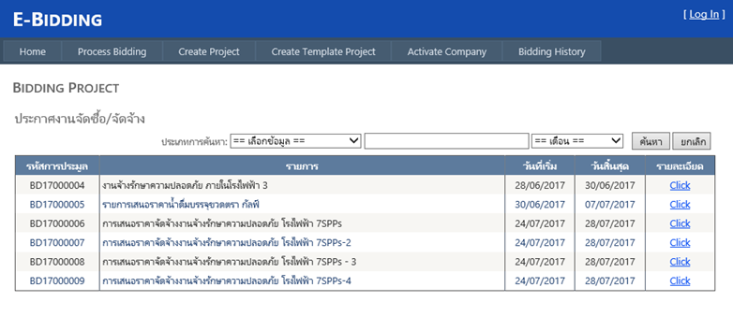
IT Monthly Report: Key Highlights>> E-Bidding
E-Bidding
Objectives
To improve Bidding process and make it easy for CSC team and vendor to real-time access bidding information by developing E-bidding website
Accomplishment
Project Governance board setup
Requirements gathering done
Design done
Next Steps
Develop website and test by July
Risks
N/a
Current Phase | Executing
Overall Status
Budget status
Project End date | Jul-17
Data as of 30 June 17

Slide 8
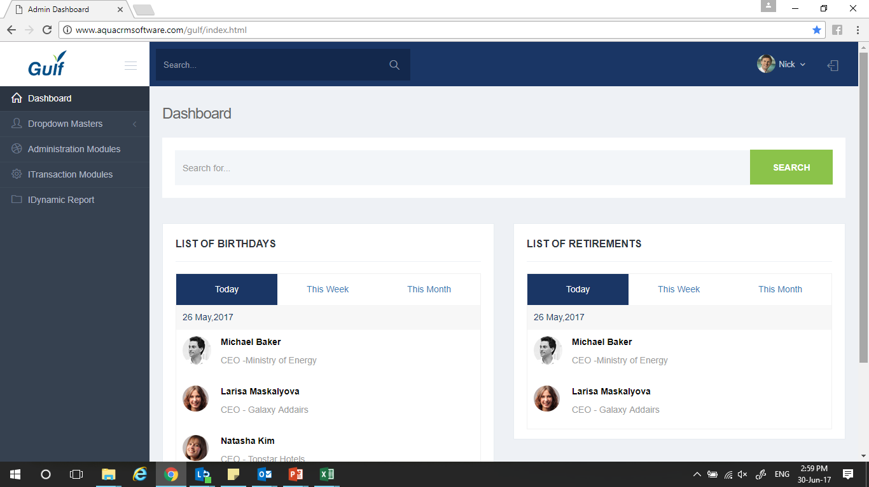
IT Monthly Report: Key Highlights>> Customer Relationship Management
CRM
Objectives
To develop CRM web responsive for collecting customer information and making relationship and activity timeline more visible
Accomplishment
Project Governance board setup
Requirements gathering done
Design done
Next Steps
Develop website and test by July
Risks
Source data may not be updated
Current Phase | Executing
Overall Status
Budget status
Project End date | Aug-17
Data as of 30 June 17

Slide 9
IT Monthly Report: IT Project Status (On-going)
On-Going Projects
Projects/Initiatives | Biz owner |  | Overall Status | Completion
Corporate Website | Comm. |  |  | TBC Rebranding
SPPs IT Infrastructure for GTS1/GTS2 | IT |  |  | 30-May-17
Intranet | Comm. |  |  | 31-Jul-17
IP Telephone | IT |  |  | 31-Jul-17
E-Bidding | CSC |  |  | 31-Jul-17
VDO Conference | IT |  |  | 01-Aug-17
CRM : Customer Relationship Mag. | CEO Office |  |  | 01-Aug-17
SAP Mobility feasibility (PR/PO approval) | AMD - Purchase |  |  | 01-Oct-17
Asset Management | Acct, IT, Plants |  |  | 01-Oct-17
HR Recruitment Enhancement | HR |  |  | 01-Oct-17
AMD Business Intelligence | AMD |  |  | 31-Dec-17
50%
70%
50%
50%
80%
50%
50%
50%
5%
35%
50%
5%
Key Challenges
Corporate Website is pending on re-branding corporate identity and include scope of Investor Relation.
Data as of 30 June 17

Slide 10
IT Monthly Report: IT Project Status (Completed)
Completed Projects
Projects/Initiatives | Biz owner |  | Remarks
Financial Business Intelligence (Report) | FIN and ACC |  | Reports completed and launched.
Workplace by Facebook | Comm. |  | Workplace successfully launched, and change management in process
SAP for Gulf Solar | IT & ACC |  | SAP system for 5 Gulf Solar group
IPO Audit (P&L) | IT |  | Improve IT standard to comply with IPO Audit
Window 10 deployment | IT |  | Able to use new features of Window 10
Audio Conference | IT |  | Launched in May-17
SPPs IT Infrastructure for GVTP | IT |  | Launched in May-17
E-Reservation and hotel booking | CSC |  | Launched in May-17
Revise Workflow and TOA on K2, Maximo, SAP Open Text | IT |  | Launched in May-17
Financial BI (Dashboard) | FIN & ACC |  | Launched in June-17
100%
100%
100%
100%
100%
100%
100%
100%
100%
100%
Data as of 30 June 17

Slide 11
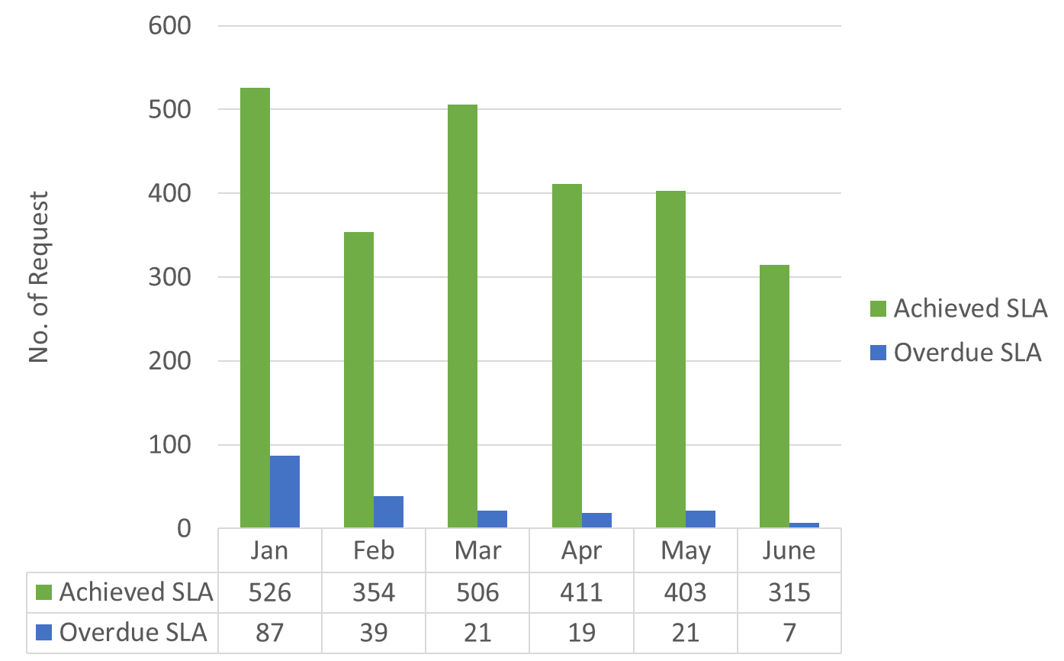
IT Monthly Report: IT Services (Speed and quality on solving issues)
Current Month
Year to Date
IT Services
Summary from Ticketing system
(308 in Total)
%SLA average (How fast IT solve your tickets) | 95.86%
%VOC (How happy are you with our services) | 98.29%
%SLA | +9%
%VOC | +4%
Data as of 30 June 17

Slide 12

IT Monthly Report: Infrastructure
Overall Status
All of the servers are performing as expected resulting in all healthy status for all Gulf’s Server for the month of June 17
DMS Server
Mail Server
File Share
Key Challenges
There is no Challenges as of this month for key server.
SAP FI Server
SAP HR Server
Summary of June-17 : 100% system availability
Data as of 30 June 17

