Slide 1
Simplerium
Tim Sullins

Slide 2
Summary
The mission statement
3 key processes
System overview

Slide 3
Three Key processes
Create a user and sign in
Add a property and add transactions to the property
View property visualizations

Slide 4
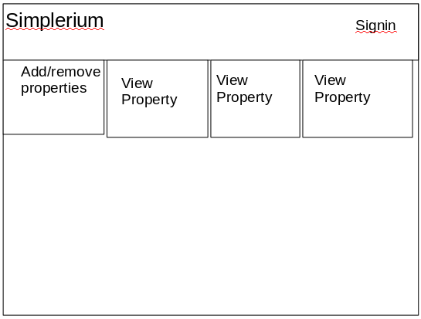
Session.get('content') == 'properties-grid';

Slide 5
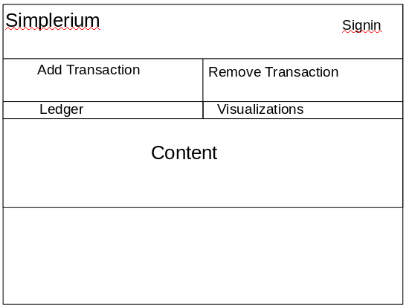
Session.get('content') == 'property-main';

Slide 6
System Collections
Properties
Users

Slide 7
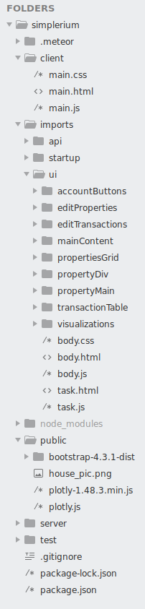
System Folder Structure

