Slide 1
3D Touch & Bluetooth Scale app for iOS
By Tyler Sulsenti and James Spaniak

Slide 2
Functionality
This app is designed to allow a user to weigh things and store their weights for a later use.
The app uses an iPhone with the 3D touch feature to turn its display into a digital scale by measuring the force pressed down upon the screen and converting it into a weight.
On-the-go measurments
Through simple math conversions, many units of weight are able to be used.
Do not use with a screen protector!

Slide 3
Functionality
The app also is IoT enabled and uses Bluetooth to connect to a Bluetooth-enabled scale to take measurements of larger things since the iPhone has a limit. (380 grams)
Both scales can be recorded to the app to save and keep track of measurements.
Bluetooth scale must be able to work without a third party app for connection
We found that many scales will only connect to the iPhone if a third party app is installed.
Xiaomi Smart Scale Bluetooth Digital was choice

Slide 4
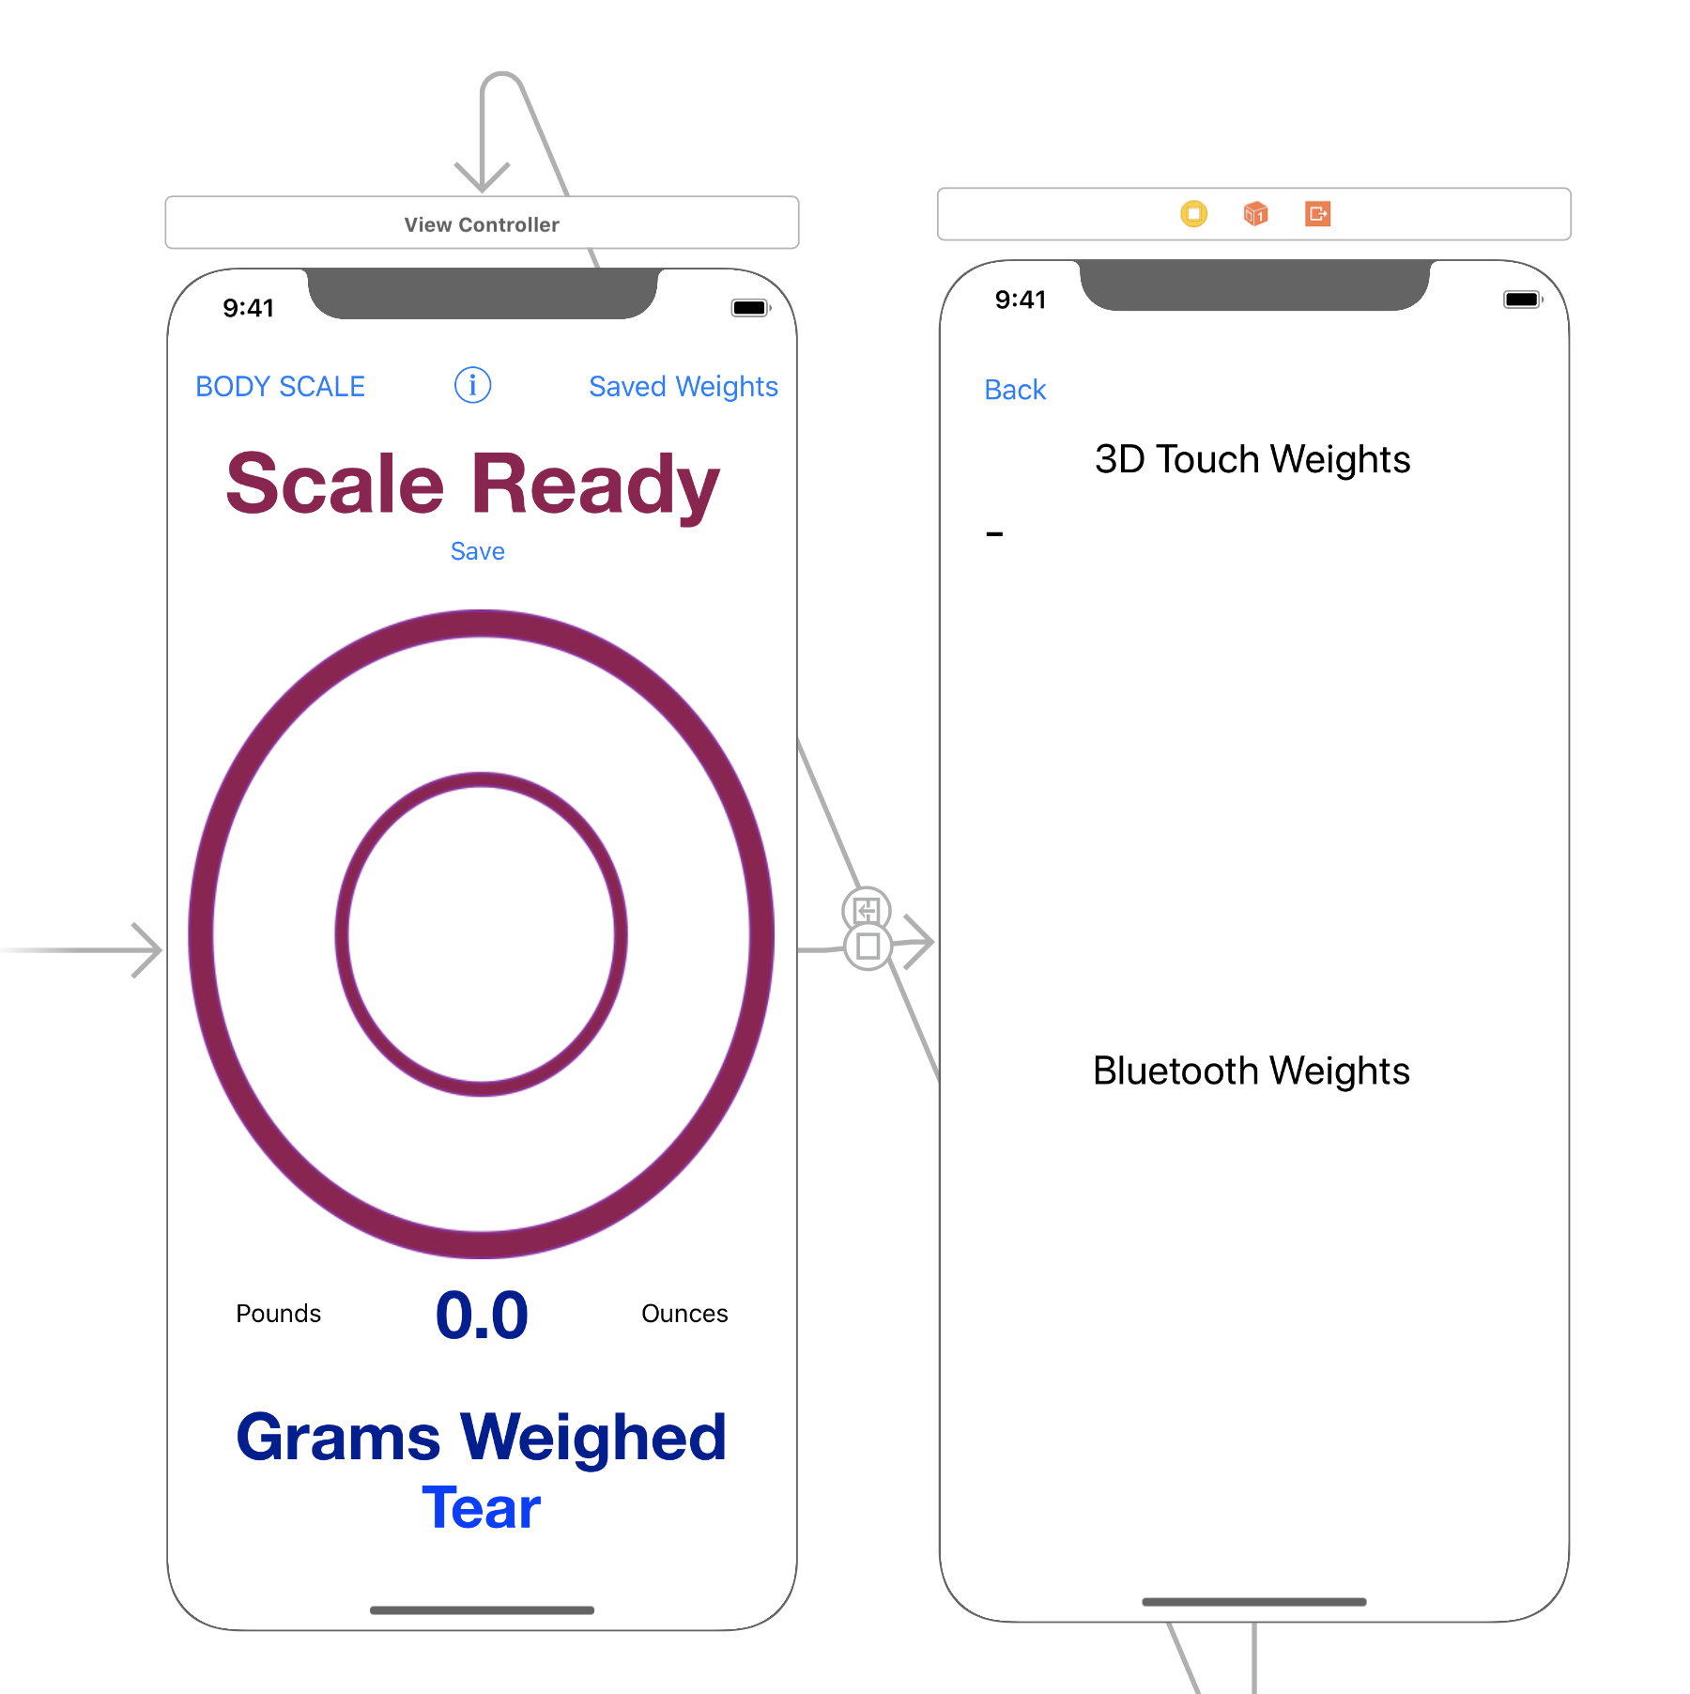
Layout
Connects to the Bluetooth Scale
Segues to the Saved page
Saved Measurements
Weighing area
Measurement
Changes Unit
Tears scale for use with a boat

Slide 5
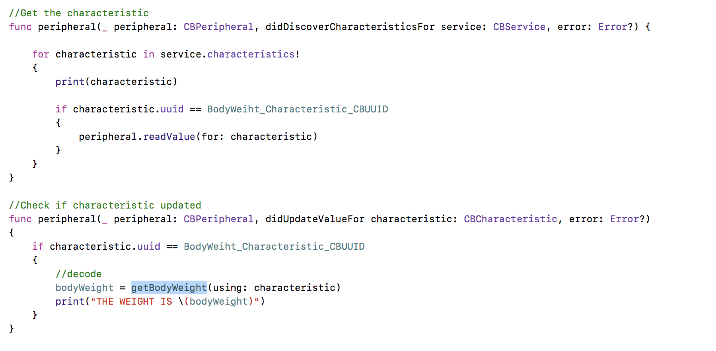
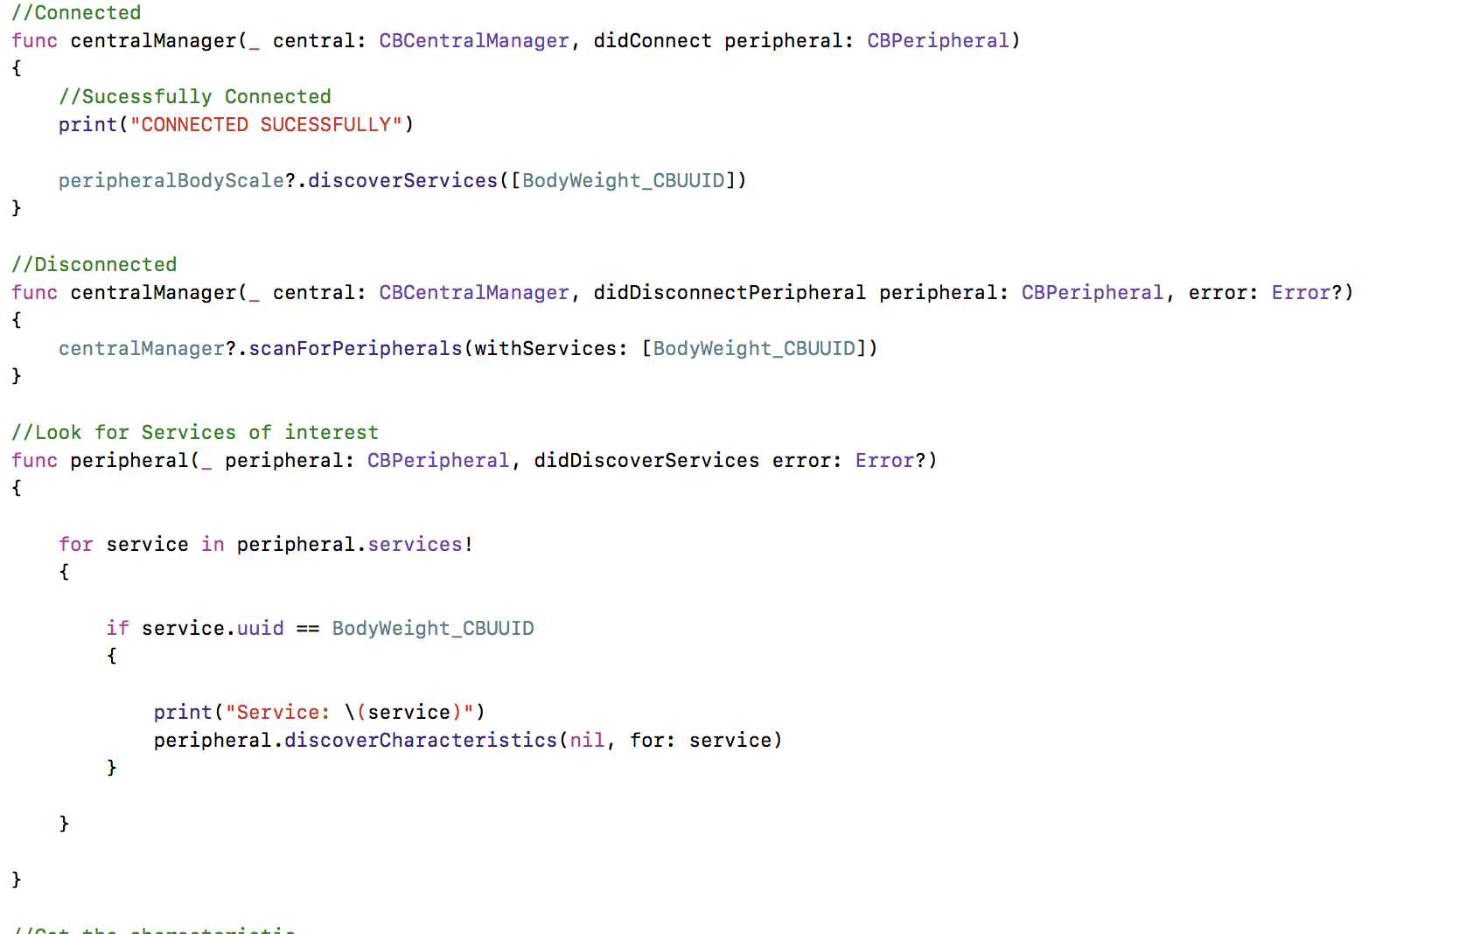
Coding
Use of Apple’s CoreBluetooth framework
Searches for Bluetooth connections broadcasting the desired service UUID
Searches then for the desired Bluetooth characteristic. UUID

Slide 6
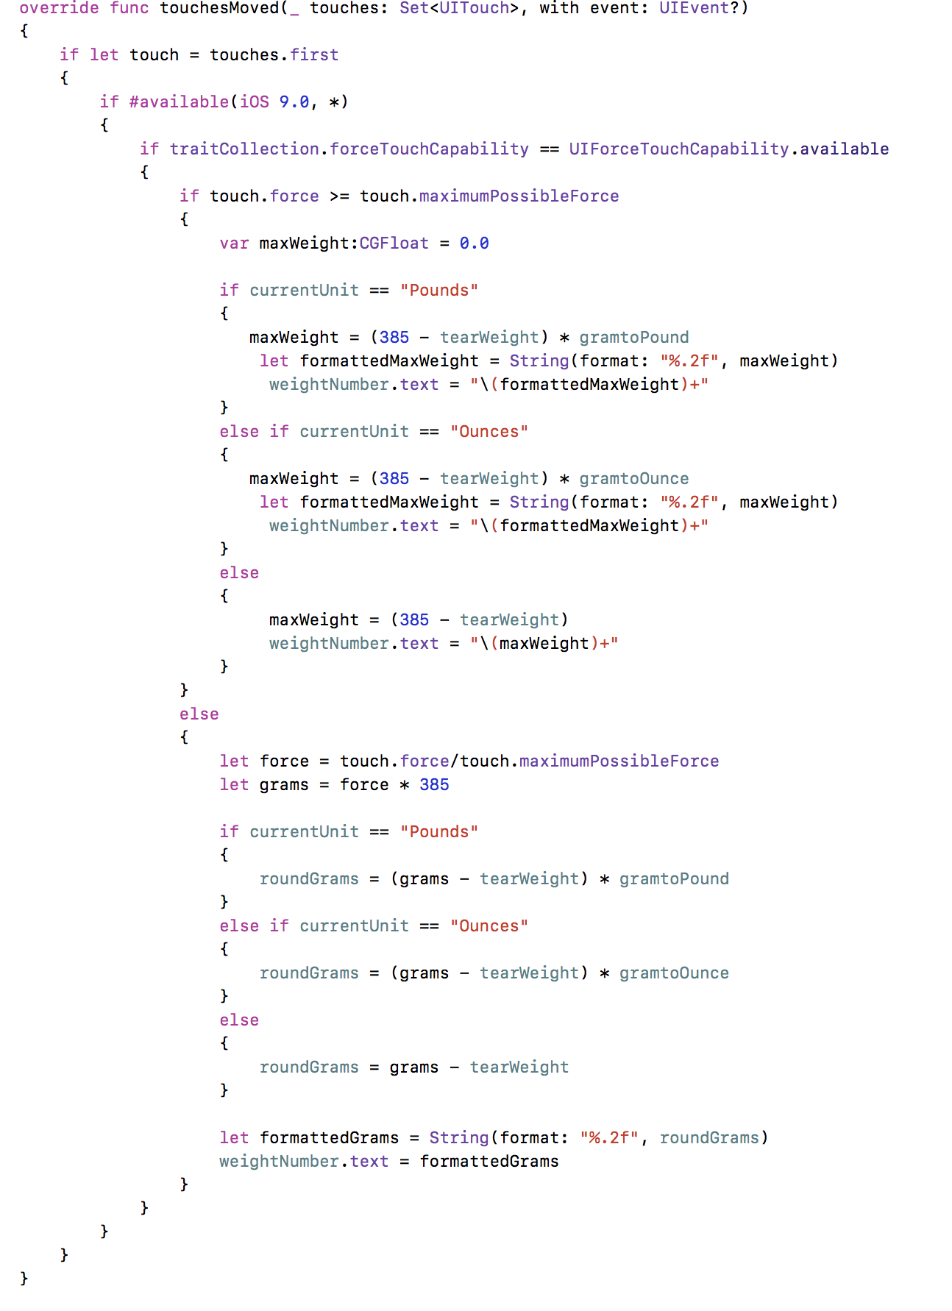
Coding
Use of 3D touch for weighing
Calculates force applied and converts into weight and then into the appropriate unit.
Formatted to 2 significant figures

Slide 7
Future Ideas & Possible Uses
Use for Nutrition
Add in feature to set goals for body weight as well as food weights to build diet plans and help people reach weight goals.
Build own scale to avoid hassle of finding compatible open scale.

