Slide 1
CONGESTION GAMES: DECENTRALIZED VS. CENTRALIZED APPROACHES
Tanner Sundwall

Slide 2
WHAT IS A CONGESTION GAME?
Congestion games, a subclass of game theory first proposed in 1973, study the behaviors of agents faced with a set of potential actions who are trying to maximize (or minimize) their payoff.
Typically, this involves a directed graph, where each agent is trying to go from a fixed source node to a fixed destination node
Edges have an associated loss function (assumed linear); when more agents use this edge, it becomes more costly to use
Generally a minimization problem
A Nash Equilibrium is reached when no agents can improve their outcome, given choices of all other agents
Should exist for any congestion game [2]
Convergence can be reached algorithmically

Slide 3
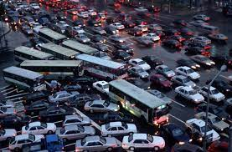

Examples/use cases
Traffic
Network Routing (Centralized?)
Snowboarding/Skiing Powder Day (Maximization)
Simplified Examples
Visiting a party/bar

Slide 4
IMPLICATIONS
Congestion games encourage “selfish routing”
Agents are minimizing their cost of travel, not the overall sum among players
This is our decentralized approach; in practice, how routing actually works
In practice, routing is decentralized, but not as simple
“Rational” motorists use the typical best route, or check Google Maps for the lowest cost route
Utilities differ among agents
i.e.: a given edge has a lesser cost for someone considering a stop for food along that route
A centralized approach finds the socially optimal allocations
Traffic- if someone told everyone where to go
Realistic?

Slide 5

Inefficiency/Price of anarchy
The Price of Anarchy attempts to measure the cost of “selfish routing” [4]
The ratio of the worst possible equilibrium game and the socially optimal game
This value differs depending on domain
For congestion games, “the general cost of a Nash flow is at most 4/3 of the minimum latency flow for graphs with linear latency functions” [1]
Therefore, the cost of an optimal allocation should be no less than 75% of the cost of any congestion game instance
Attempting to find empirical “PoA” across many problem instances

Slide 6
ASSUMPTIONS
All agents are assumed to have the same source and destination nodes
All agents are assumed to have the same weights; that is, each edge is burdened by any given agent equally
Edge load is infinite
Loss functions are assumed linear
Utility functions are assumed discrete

Slide 7



Terminology

Slide 8
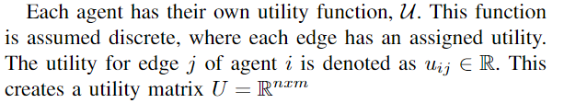
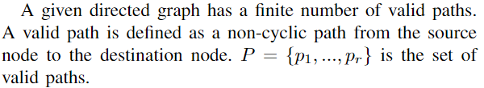
Terminology CONTD.

Slide 9
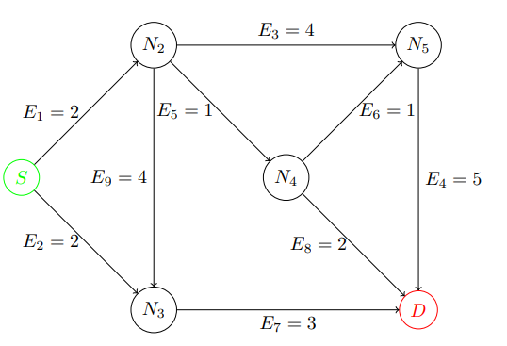

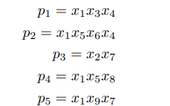
DOMAIN/SCOPE
Analysis focuses on the following directed graph
Values/structure won’t change
Loss scalars:
Potential paths:

Slide 10
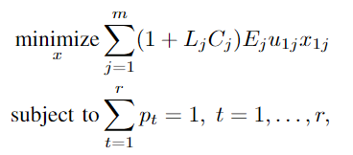

Decentralized OPTIMAL
A congestion game is a decentralized approach
All agents aim to minimize their own objective functions
The process of finding equilibrium does not actually solve the program

Slide 11
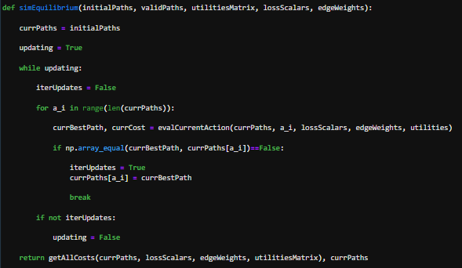
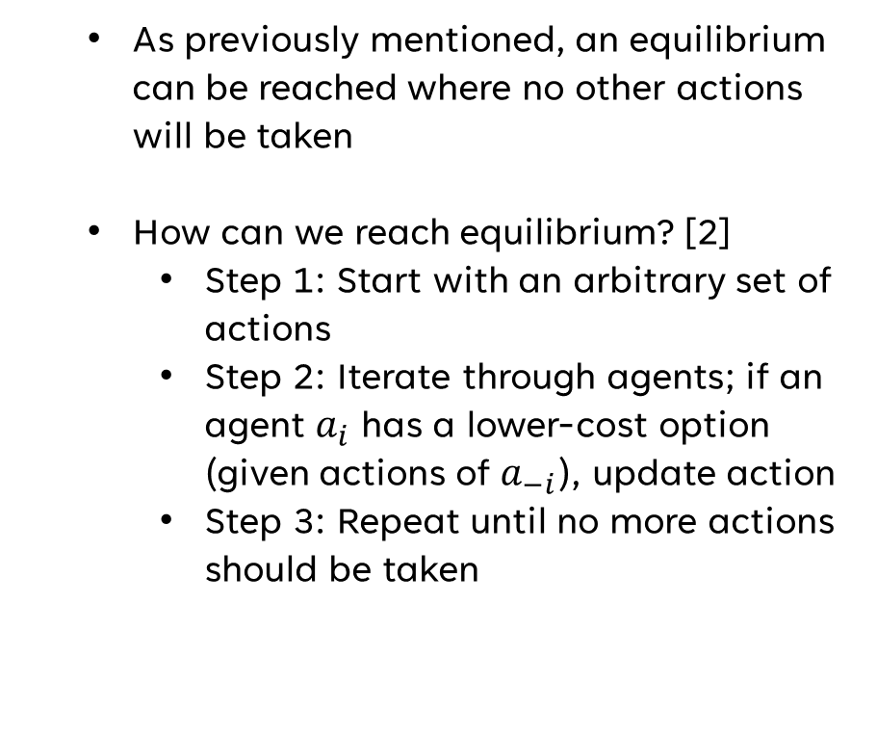
NASH EQUILIBRIUM
As previously mentioned, an equilibrium can be reached where no other actions will be taken
How can we reach equilibrium? [2]
Step 1: Start with an arbitrary set of actions
Step 2: Iterate through agents; if an agent $a_{i}$ has a lower-cost option (given actions of $a_{−i}$), update action
Step 3: Repeat until no more actions should be taken

Slide 12
CENTRALIZED APPROACH
What if some centralized mechanism assigned routes to agents?
Assumed that all agents would be evaluated at the same time, arbitrary (or algorithm-defined) priority
Can this be formulated as a linear program?
While not linear, it still has an objective function/constraints
Technically a zero-one integer program, with non-linearity in both the objective and constraints
Becomes large very quickly; large graph sizes indicate many path permutations, large number of agents indicate large objective function
Computational Limitations
Couldn’t find appropriate methods in ‘cvxpy’ to solve such a program
Because example problem is small, iterated through all permutations of action choices
Is the centralized approach better?

Slide 13
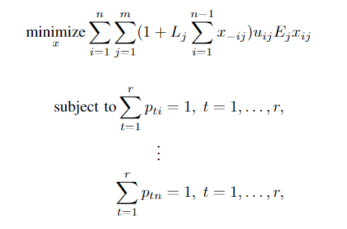

centralized OPTIMAL
If one overarching objective function exists, we can use a centralized approach (L_{eq})
System is now dynamic;
Static C_{j} terms are replaced with sum of objective variables
Constraints are of size n; path constraint for each agent
p_{ti} denotes path t for agent i

Slide 14
EMPIRICAL “PRICE OF ANARCHY”
I simulated eq and opt costs of several problems at 5 different problem sizes (n = 4,5,6,7,8,9,10)
10000+ total problem instances
Edge costs and loss multipliers were static
Stochastic elements: utilities matrix, initial conditions
n=10 was the maximum problem size that could be handled by the brute force centralized approach (almost 10M permutations)
In practice, trying to estimate a practical PoA (although PoA usually assumes only two choices for each agent).
Also included random and naïve strategies
Random: stochastic path assignments
High variance?
Naïve: Agents ignore loss scalars; take the lowest cost paths
Considered Theoretical PoA of 75%

Slide 15
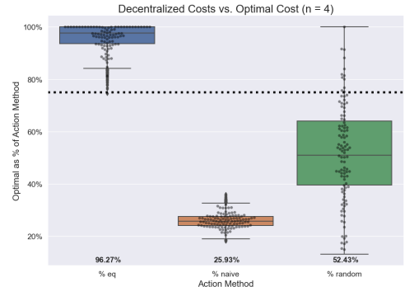
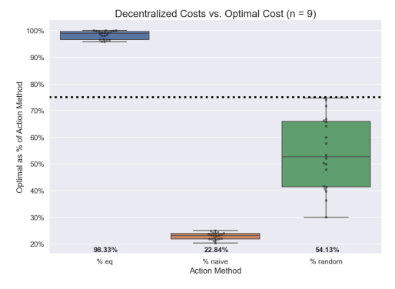
RESULTS

Slide 16
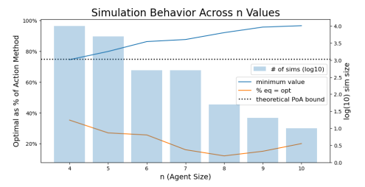
RESULTS (CONTD)
How does performance differ across problem sizes?
Worst-case games seem to get better at higher n values
What about games where opt = eq?
Ambiguous?
What characterizes a worst-case game?
Some interaction in utilities matrix

Slide 17
CONCLUSIONS
Aside from logistical challenges, is centralization worthwhile?
No better than a 4% improvement on average
Inefficiency appears to disappear as n increases
Specific to domain?
What about eq = opt?
Theoretical PoA seems accurate
Random/Naïve strategies are significantly worse

Slide 18
FUTURE WORK
Want to expand upon:
Relationship between worst-case games and problem size
Characteristic of a bad game
Interaction between values in utilities matrix?
Explore:
Non-linear loss functions
More realistic
Effect of variance in loss scalars/edge weights on performance
Scaled systems (agent size and network size)
Need an optimization tool that can handle our centralized objective function

Slide 19
THANK YOU
References:
[1] S. Robinson, “The Price of Anarchy,” SIAM News, Volume 37, Number 5, June 2004 [2] K. Leyton-Brown, “Congestion Games,” University of British Columbia lecture, unpublished [3] Y. Mansour, N. Yosef, A. Koren, “Lecture 6: Congestion and potential games,” Spring Semester, 2003-2004, unpublished [4] D. Grimsman, “Resource Allocation Games,” Brigham Young University, unpublished [5] “SCIP Documentation,” https://www.scipopt.org, unpublished
[6] J. D. Hunter, “Matplotlib: A 2D Graphics Environment,” Computing in Science Engineering, vol. 9, no. 3, pp. 90-95, 2007
[7] “Draw a Graph Using LaTeX,” https://www.baeldung.com, unpublished

