Slide 1
CS 2420: Algorithm Analysis
Dr. Tsung-Wei (TW) Huang
Department of Electrical and Computer Engineering
University of Utah, Salt Lake City, UT
Notes:
Hi everyone, thanks for giving me this opportunity to present Taskflow. This is a project motivated by parallelizing CAD and has gained quite a lot of success. I am going to present Taskflow works and hopefully we can brainstorm some collaboration topics.
Taskflow is a general-purpose parallel and heterogeneous task computing system.

Slide 2
Outline
In this topic, we will examine code to determine the run time of various operations
We will introduce machine instructions
We will calculate the run times of:
Operators +, -, =, +=, ++, etc.
Control statements if, for, while, do-while, switch
Functions
Recursive functions

Slide 3
Motivation
The goal of algorithm analysis is to take a block of code and determine the asymptotic run time or asymptotic memory requirements based on various parameters
Given an array of size n:
Selection sort requires Θ(n²) time
Merge sort, quick sort, and heap sort all require Θ(n ln(n)) time
However:
Merge sort requires Θ(n) additional memory
Quick sort requires Θ(ln(n)) additional memory
Heap sort requires Θ(1) memory

Slide 4
Motivation
The asymptotic complexity of algorithms indicates its ability to scale
Suppose we are sorting an array of size n
Selection sort has a run time of Θ(n²)
2n entries requires (2n)² = 4n²
Four times as long to sort
10n entries requires (10n)² = 100n²
One hundred times as long to sort

Slide 5
Motivation
The other sorting algorithms have Θ(n ln(n)) run times
2n entries require (2n) ln(2n) = (2n) (ln(n) + 1) = 2(n ln(n)) + 2n
10n entries require (10n) ln(10n) = (10n) (ln(n) + 1) = 10(n ln(n)) + 10n
In each case, it requires Θ(n) more time
However:
Merge sort will require twice and 10 times as much memory
Quick sort will require one or four additional memory locations
Heap sort will not require any additional memory

Slide 6
Motivation
We will see algorithms which run in Θ(n^{lg(3)}) time
lg(3) ≈ 1.585
For 2n entries require (2n)^{lg(3)} = 2^{lg(3)} n^{lg(3)} = 3 n^{lg(3)}
Three times as long to sort
10n entries require (10n)^{lg(3)} = 10^{lg(3)} n^{lg(3)} = 38.5 n^{lg(3)}
38 times as long to sort

Slide 7
Motivation
We will see algorithms which run in Θ(n^{lg(3)}) time
lg(3) ≈ 1.585
For 2n entries require (2n)^{lg(3)} = 2^{lg(3)} n^{lg(3)} = 3 n^{lg(3)}
Three times as long to sort
10n entries require (10n)^{lg(3)} = 10^{lg(3)} n^{lg(3)} = 38.5 n^{lg(3)}
38 times as long to sort
Binary search runs in Θ(ln(n)) time:
Doubling the size requires one additional search

Slide 8
Motivation
If we are storing objects which are not related, the hash table has, in many cases, optimal characteristics:
Many operations are Θ(1)
I.e., the run times are independent of the number of objects being stored
If we are required to store both objects and relations, both memory and time will increase
Our goal will be to minimize this increase

Slide 9
Motivation
To properly investigate the determination of run times asymptotically:
We will begin with machine instructions
Discuss operations
Control statements
Conditional statements and loops
Functions
Recursive functions

Slide 10
Machine Instructions
Given any processor, it is capable of performing only a limited number of operations
These operations are called instructions
The collection of instructions is called the instruction set
The exact set of instructions differs between processors
MIPS, ARM, x86, 6800, 68k
You will see another in the ColdFire in ECE 222
Derived from the 68000, derived from the 6800

Slide 11
Machine Instructions
Any instruction runs in a fixed amount of time (an integral number of CPU cycles)
An example on the Coldfire is:
0x06870000000F
which adds 15 to the 7th data register
As humans are not good at hex, this can be programmed in assembly language as
ADDI.L #$F, D7
More in ECE 222

Slide 12
Machine Instructions
Assembly language has an almost one-to-one translation to machine instructions
Assembly language is a low-level programming language
Other programming languages are higher-level:
Fortran, Pascal, Matlab, Java, C++, and C#
The adjective “high” refers to the level of abstraction:
Java, C++, and C# have abstractions such as OO
Matlab and Fortran have operations which do not map to relatively small number of machine instructions:
>> 1.27^2.9 % 1.27**2.9 in Fortran
2.0000036616123606774

Slide 13
Machine Instructions
The C programming language (C++ without objects and other abstractions) can be referred to as a mid-level programming language
There is abstraction, but the language is closely tied to the standard capabilities
There is a closer relationship between operators and machine instructions
Consider the operation a += b;
Assume that the compiler has already has the value of the variable a in register D1 and perhaps b is a variable stored at the location stored in address register A1, this is then converted to the single instruction
ADD (A1), D1

Slide 14
Operators
Because each machine instruction can be executed in a fixed number of cycles, we may assume each operation requires a fixed number of cycles
The time required for any operator is Θ(1) including:
Retrieving/storing variables from memory
Variable assignment =
Integer operations + - * / % ++ --
Logical operations && || !
Bitwise operations & | ^ ~
Relational operations == != < <= => >
Memory allocation and deallocation new delete

Slide 15
Operators
Of these, memory allocation and deallocation are the slowest by a significant factor
A quick test on eceunix shows a factor of over 100
They require communication with the operation system
This does not account for the time required to call the constructor and destructor
Note that after memory is allocated, the constructor is run
The constructor may not run in Θ(1) time

Slide 16
Blocks of Operations
Each operation runs in Θ(1) time and therefore any fixed number of operations also run in Θ(1) time, for example:
// Swap variables a and b
int tmp = a;
a = b;
b = tmp;
// Update a sequence of values
// ece.uwaterloo.ca/~ece250/Algorithms/Skip_lists/src/Skip_list.h
++index;
prev_modulus = modulus;
modulus = next_modulus;
next_modulus = modulus_table[index];

Slide 17
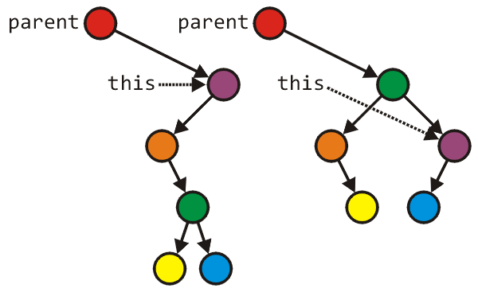
Blocks of Operations
Seldom will you find large blocks of operations without any additional control statements
This example rearranges an AVL tree structure
Tree_node *lrl = left->right->left;
Tree_node *lrr = left->right->right;
parent = left->right;
parent->left = left;
parent->right = this;
left->right = lrl;
left = lrr;
Run time: Θ(1)

Slide 18
Blocks in Sequence
Suppose you have now analyzed a number of blocks of code run in sequence
template <typename T>
void update_capacity( int delta ) {
T *array_old = array;
int capacity_old = array_capacity; array_capacity += delta;
array = new T[array_capacity];
for ( int i = 0; i < capacity_old; ++i ) {
array[i] = array_old[i];
}
delete[] array_old;
}
To calculate the total run time, add the entries: Θ(1 + n + 1) = Θ(n)
Θ(1)
Θ(n)
Θ(1) or Ω(n)

Slide 19
Control Statements
Next we will look at the following control statements
These are statements which potentially alter the execution of instructions
Conditional statements
if, switch
Condition-controlled loops
for, while, do-while
Count-controlled loops
for i from 1 to 10 do ... end do; # Maple
Collection-controlled loops
foreach ( int i in array ) { ... } // C#

Slide 20
Control Statements
Given any collection of nested control statements, it is always necessary to work inside out
Determine the run times of the inner-most statements and work your way out

Slide 21
Control Statements
Given
if ( condition ) {
// true body
} else {
// false body
}
The run time of a conditional statement is:
the run time of the condition (the test), plus
the run time of the body which is run
In most cases, the run time of the condition is Θ(1)

Slide 22
Control Statements
In some cases, it is easy to determine which statement must be run:
int factorial ( int n ) {
if ( n == 0 ) {
return 1;
} else {
return n * factorial ( n – 1 );
}
}

Slide 23
Control Statements
In others, it is less obvious
Find the maximum entry in an array:
int find_max( int *array, int n ) {
max = array[0];
for ( int i = 1; i < n; ++i ) {
if ( array[i] > max ) {
max = array[i];
}
}
return max;
}

Slide 24
Analysis of Statements
In this case, we don’t know
If we had information about the distribution of the entries of the array, we may be able to determine it
if the list is sorted (ascending) it will always be run
if the list is sorted (descending) it will be run once
if the list is uniformly randomly distributed, then???

Slide 25
Condition-controlled Loops
The C++ for loop is a condition controlled statement:
for ( int i = 0; i < N; ++i ) {
// ...
}
is identical to
int i = 0; // initialization
while ( i < N ) { // condition
// ...
++i; // increment
}

Slide 26
Condition-controlled Loops
The initialization, condition, and increment usually are single statements running in Θ(1)
for ( int i = 0; i < N; ++i ) {
// ...
}

Slide 27
Condition-controlled Loops
The initialization, condition, and increment statements are usually Θ(1)
For example,
for ( int i = 0; i < n; ++i ) {
// ...
}
Assuming there are no break or return statements in the loop, the run time is Ω(n)

Slide 28
Condition-controlled Loops
If the body does not depend on the variable (in this example, i), then the run time of
for ( int i = 0; i < n; ++i ) {
// code which is Theta(f(n))
}
is Θ(n f(n))
If the body is O(f(n)), then the run time of the loop is O(n f(n))

Slide 29
Condition-controlled Loops
For example,
int sum = 0;
for ( int i = 0; i < n; ++i ) {
sum += 1; Theta(1)
}
This code has run time
Θ(n·1) = Θ(n)

Slide 30
Condition-controlled Loops
Another example example,
int sum = 0;
for ( int i = 0; i < n; ++i ) {
for ( int j = 0; j < n; ++j ) {
sum += 1; Theta(1)
}
}
The previous example showed that the inner loop is Θ(n), thus the outer loop is
Θ(n·n) = Θ(n²)

Slide 31
Analysis of Repetition Statements
Suppose with each loop, we use a linear search an array of size m:
for ( int i = 0; i < n; ++i ) {
// search through an array of size m
// O( m );
}
The inner loop is O(m) and thus the outer loop is
O(n m)

Slide 32
Conditional Statements
Consider this example
void Disjoint_sets::clear() {
if ( sets == n ) {
return;
}
max_height = 0;
num_disjoint_sets = n;
for ( int i = 0; i < n; ++i ) {
parent[i] = i;
tree_height[i] = 0;
}
}
Θ(1)
Θ(1)
Θ(n)
Θ(1)

Slide 33
Analysis of Repetition Statements
If the body does depends on the variable (in this example, i), then the run time of
for ( int i = 0; i < n; ++i ) {
// code which is Theta(f(i,n))
}
is and if the body is
O(f(i, n)), the result is

Slide 34
Analysis of Repetition Statements
For example,
int sum = 0;
for ( int i = 0; i < n; ++i ) {
for ( int j = 0; j < i; ++j ) {
sum += i + j;
}
}
The inner loop is Θ(1 + i(1 + 1) ) = Θ(i) hence the outer is

Slide 35
Analysis of Repetition Statements
As another example:
int sum = 0;
for ( int i = 0; i < n; ++i ) {
for ( int j = 0; j < i; ++j ) {
for ( int k = 0; k < j; ++k ) {
sum += i + j + k;
}
}
}
From inside to out:
Θ(1)
Θ(j)
Θ(i²)
Θ(n³)

Slide 36
Control Statements
Switch statements appear to be nested if statements:
switch( i ) {
case 1: /* do stuff */ break;
case 2: /* do other stuff */ break;
case 3: /* do even more stuff */ break;
case 4: /* well, do stuff */ break;
case 5: /* tired yet? */ break;
default: /* do default stuff */
}

Slide 37
Control Statements
Thus, a switch statement would appear to run in O(n) time where n is the number of cases, the same as nested if statements
Why then not use:
if ( i == 1 ) { /* do stuff */ }
else if ( i == 2 ) { /* do other stuff */ }
else if ( i == 3 ) { /* do even more stuff */ }
else if ( i == 4 ) { /* well, do stuff */ }
else if ( i == 5 ) { /* tired yet? */ }
else { /* do default stuff */ }

Slide 38
Control Statements
Question:
Why would you introduce something into
programming language which is redundant?
There are reasons for this:
your name is Larry Wall and you are creating the Perl (not PERL) programming language
you are introducing software engineering constructs, for example, classes

Slide 39
Control Statements
However, switch statements were included in the original C language... why?
First, you may recall that the cases must be actual values, either:
integers
characters
For example, you cannot have a case with a variable, e.g.,
case n: /* do something */ break; //bad

Slide 40
Control Statements
The compiler looks at the different cases and calculates an appropriate jump
For example, assume:
the cases are 0, 1, 2, 3, 4, 5, 6, 7, 8, 9, 10
each case requires a maximum of 24 bytes (for example, six instructions)
Then the compiler simply makes a jump size based on the variable, jumping ahead either 0, 24, 48, 72, ..., or 240 instructions

Slide 41
Serial Statements
Suppose we run one block of code followed by another block of code
Such code is said to be run serially
If the first block of code is O(f(n)) and the second is O(g(n)), then the run time of two blocks of code is
O( f(n) + g(n) )
which usually (for algorithms not including function calls) simplifies to one or the other

Slide 42
Serial Statements
Consider the following two problems:
search through a random list of size n to find the maximum entry, and
search through a random list of size n to find if it contains a particular entry
What is the proper means of describing the run time of these two algorithms?

Slide 43
Serial Statements
Searching for the maximum entry requires that each element in the array be examined, thus, it must run in Θ(n) time
Searching for a particular entry may end earlier: for example, the first entry we are searching for may be the one we are looking for, thus, it runs in O(n) time

Slide 44
Serial Statements
Therefore:
if the leading term is big-Θ, then the result must be big-Θ, otherwise
if the leading term is big-O, we can say the result is big-O
For example,
O(n) + O(n²) + O(n⁴) = O(n + n² + n⁴) = O(n⁴)
O(n) + Θ(n²) = Θ(n²)
O(n²) + Θ(n) = O(n²)
O(n²) + Θ(n²) = Θ(n²)

Slide 45
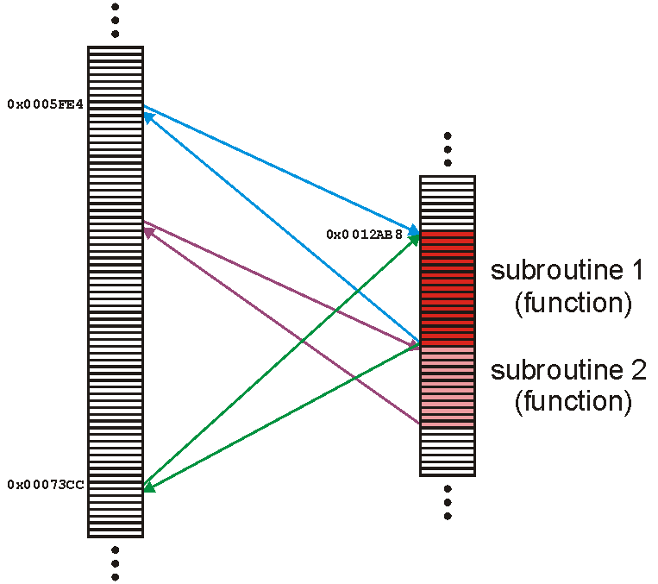
Functions
A function (or subroutine) is code which has been separated out, either to:
and repeated operations
e.g., mathematical functions
group related tasks
e.g., initialization

Slide 46
Functions
Because a subroutine (function) can be called from anywhere, we must:
prepare the appropriate environment
deal with arguments (parameters)
jump to the subroutine
execute the subroutine
deal with the return value
clean up

Slide 47
Functions
Fortunately, this is such a common task that all modern processors have instructions that perform most of these steps in one instruction
Thus, we will assume that the overhead required to make a function call and to return is Θ(1) an
We will discuss this later (stacks/ECE 222)

Slide 48
Functions
Because any function requires the overhead of a function call and return, we will always assume that
T_{f} = Ω(1)
That is, it is impossible for any function call to have a zero run time

Slide 49
Functions
Thus, given a function f(n) (the run time of which depends on n) we will associate the run time of f(n) by some function T_{f}(n)
We may write this to T(n)
Because the run time of any function is at least O(1), we will include the time required to both call and return from the function in the run time

Slide 50
Functions
2T_{find}
T_{set_union}= 2T_{find} + Θ(1)
Θ(1)
void Disjoint_sets::set_union( int m, int n ) {
m = find( m );
n = find( n );
if ( m == n ) {
return;
}
--num_disjoint_sets;
if ( tree_height[m] >= tree_height[n] ) {
parent[n] = m;
if ( tree_height[m] == tree_height[n] ) {
++( tree_height[m] );
max_height = std::max( max_height, tree_height[m] );
}
} else {
parent[m] = n;
}
}

Slide 51
Recursive Functions
A function is relatively simple (and boring) if it simply performs operations and calls other functions
Most interesting functions designed to solve problems usually end up calling themselves
Such a function is said to be recursive

Slide 52
Recursive Functions
As an example, we could implement the factorial function recursively:
int factorial( int n ) {
if ( n <= 1 ) {
return 1;
} else {
return n * factorial( n – 1 );
}
}

Slide 53
Recursive Functions
Thus, we may analyze the run time of this function as follows:
We don’t have to worry about the time of the conditional (Θ(1)) nor is there a probability involved with the conditional statement

Slide 54
Recursive Functions
The analysis of the run time of this function yields a recurrence relation:
T!(n) = T!(n – 1) + Θ(1) T!(1) = Θ(1)

Slide 55
Recursive Functions
If k = n – 1 then
T!(n) = T!(n – (n – 1)) + n – 1
= T!(1) + n – 1
= 1 + n – 1 = n
Thus, T!(n) = Θ(n)

Slide 56
Recursive Functions
Suppose we want to sort a array of n items
We could:
go through the list and find the largest item
swap the last entry in the list with that largest item
then, go on and sort the rest of the array
This is called selection sort

Slide 57
Recursive Functions
void sort( int * array, int n ) {
if ( n <= 1 ) {
return; // special case: 0 or 1 items are always sorted
}
int posn = 0; // assume the first entry is the smallest
int max = array[posn];
for ( int i = 1; i < n; ++i ) { // search through the remaining entries
if ( array[i] > max ) { // if a larger one is found
posn = i; // update both the position and value
max = array[posn];
}
}
int tmp = array[n - 1]; // swap the largest entry with the last
array[n - 1] = array[posn];
array[posn] = tmp;
sort( array, n – 1 ); // sort everything else
}

Slide 58
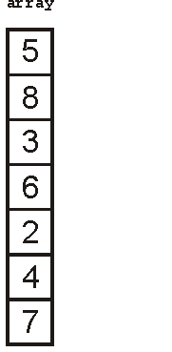
Recursive Functions
We could call this function as follows:
int array[7] = {5, 8, 3, 6, 2, 4, 7};
sort( array, 7 ); // sort an array of seven items

Slide 59
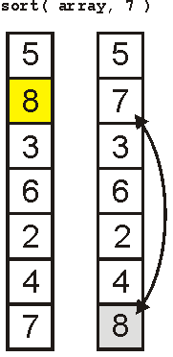
Recursive Functions
The first call finds the largest element

Slide 60
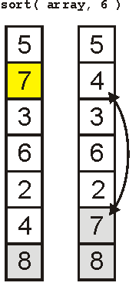
Recursive Functions
The next call finds the 2nd-largest element

Slide 61
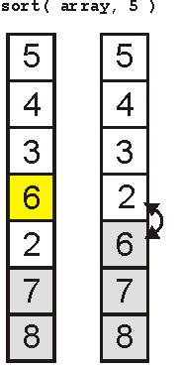
Recursive Functions
The third finds the 3rd-largest

Slide 62
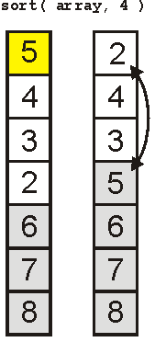
Recursive Functions
And the 4th

Slide 63
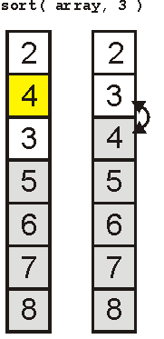
Recursive Functions
And the 5th

Slide 64
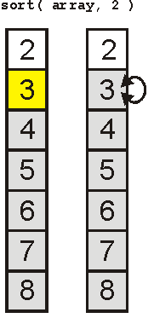
Recursive Functions
Finally the 6th

Slide 65
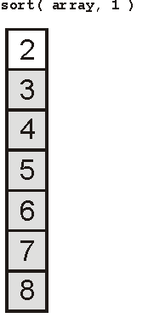
Recursive Functions
And the array is sorted:

Slide 66
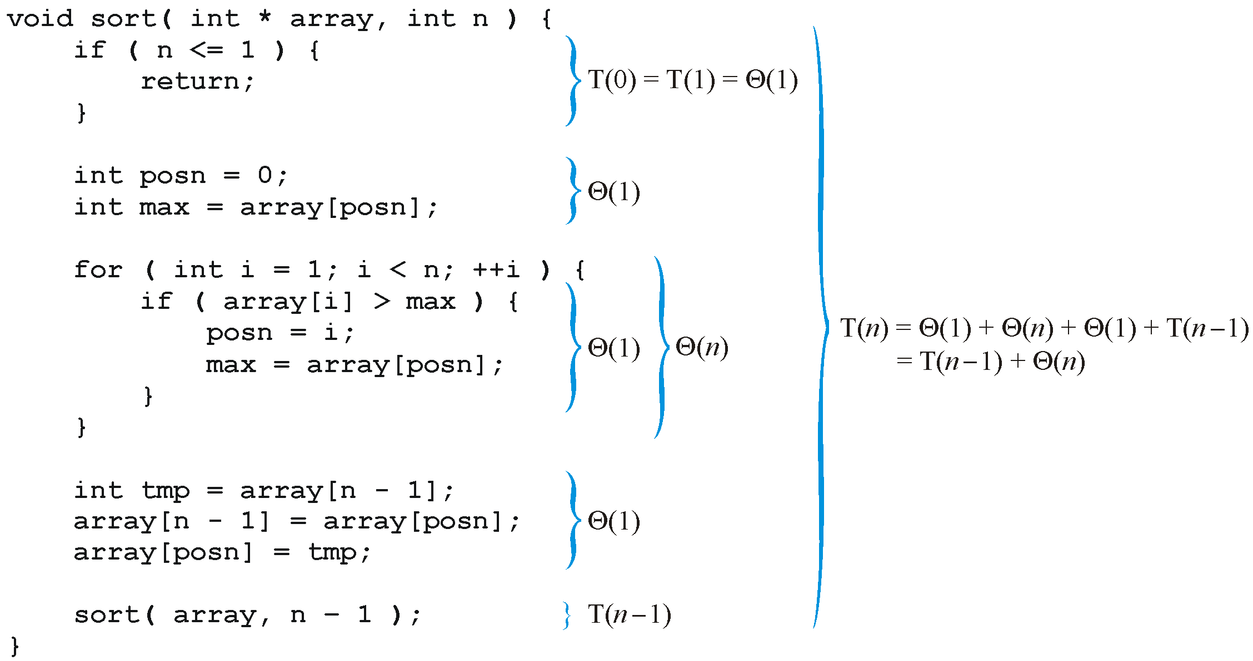
Recursive Functions
Analyzing the function, we get:

Slide 67
Recursive Functions
Thus, replacing each Landau symbol with a representative, we are required to solve the recurrence relation
T(n) = T(n – 1) + n T(1) = 1
The easy way to solve this is with Maple:
> rsolve( {T(n) = T(n – 1) + n, T(1) = 1}, T(n) );
> expand( % );

Slide 68
Recursive Functions
Consequently, the sorting routine has the run time
T(n) = Θ(n²)
To see this by hand, consider the following

Slide 69
Recursive Functions
Consider, instead, a binary search of a sorted list:
Check the middle entry
If we do not find it, check either the left- or right-hand side, as appropriate
Thus, T(n) = T((n – 1)/2) + Θ(1)

Slide 70
Recursive Functions
Also, if n = 1, then T(1) = Θ(1)
Thus we have to solve:
Solving this can be difficult, in general, so we will consider only special values of n
Assume n = 2^{k} – 1 where k is an integer
Then (n – 1)/2 = (2^{k} – 1 – 1)/2 = 2^{k – 1} – 1

Slide 71
Recursive Functions
For example, searching a list of size 31 requires us to check the center
If it is not found, we must check one of the two halves, each of which is size 15
31 = 2⁵ – 1
15 = 2⁴ – 1

Slide 72
Recursive Functions
Thus, we can write

Slide 73
Recursive Functions
Notice the pattern with one more step:

Slide 74
Recursive Functions
Thus, in general, we may deduce that after k – 1 steps:
because T(1) = 1

Slide 75
Recursive Functions
Thus, T(n) = k, but n = 2^{k} – 1
Therefore k = lg(n + 1)
However, recall that f(n) = Θ(g(n)) if for
Thus, T(n) = Θ(lg(n + 1)) = Θ (ln(n))

Slide 76
Summary
In these slides we have looked at:
The run times of
Operators
Control statements
Functions
Recursive functions
We have also defined best-, worst-, and average-case scenarios
We will be considering all of these each time we inspect any algorithm used in this class

