Slide 1
CS 2420: Asymptotic Analysis
Dr. Tsung-Wei (TW) Huang
Department of Electrical and Computer Engineering
University of Utah, Salt Lake City, UT

Slide 2
Outline
In this topic, we will look at:
Justification for analysis
Quadratic and polynomial growth
Counting machine instructions
Big-Θ as the equivalent relation

Slide 3
Motivation
Suppose we have two algorithms, how can we tell which is better?
We could implement both algorithms, run them both
Expensive and error prone
Preferably, we should analyze them mathematically
Asymptotic analysis
Algorithm analysis

Slide 4
Asymptotic Analysis
In general, we will always analyze algorithms with respect to one or more variables
We will begin with one variable:
The number of items n currently stored in an array or other data structure
The number of items expected to be stored in an array or other data structure
The dimensions of an n × n matrix
Examples with multiple variables:
Dealing with n objects stored in m memory locations
Multiplying a k × m and an m × n matrix
Dealing with sparse matrices of size n × n with m non-zero entries

Slide 5
Maximum Value
For example, the time taken to find the largest object in an array of n random integers will take n operations
int find_max( int *array, int n ) {
int max = array[0];
for ( int i = 1; i < n; ++i ) {
if ( array[i] > max ) {
max = array[i];
}
}
return max;
}

Slide 6
Maximum Value
One comment:
In this class, we will look at both simple C++ arrays and the standard template library (STL) structures
Instead of using the built-in array, we could use the STL vector class
The vector class is closer to the C#/Java array

Slide 7
Maximum Value
#include <vector>
int find_max( const std::vector<int>& array ) {
if ( array.size() == 0 ) {
throw underflow();
}
int max = array[0];
for ( int i = 1; i < array.size(); ++i ) {
if ( array[i] > max ) {
max = array[i];
}
}
return max;
}

Slide 8
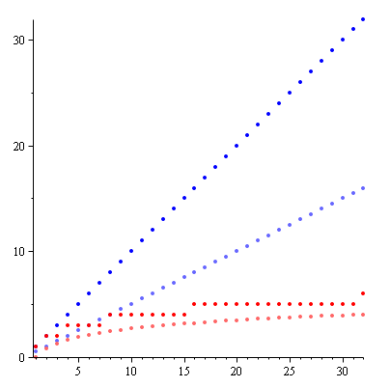
Linear and binary search
n
There are other algorithms which are significantly faster as the problem size increases
This plot shows maximum and average number of comparisons to find an entry in a sorted array of size n
Linear search
Binary search
Notes:
8

Slide 9
Asymptotic Analysis
Given an algorithm:
We need to be able to describe these values mathematically
We need a systematic means of using the description of the algorithm together with the properties of an associated data structure
We need to do this in a machine-independent way
For this, we need asymptotic analysis

Slide 10
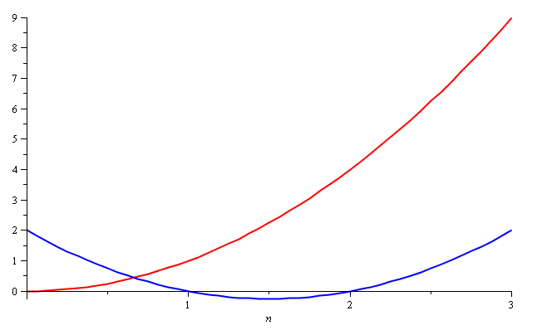
Quadratic Growth
Consider the two functions
f(n) = n² and g(n) = n² – 3n + 2
Around n = 0, they look very different

Slide 11
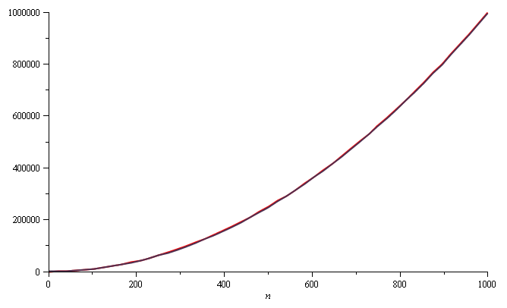
Quadratic Growth
Yet on the range n = [0, 1000], they are (relatively) indistinguishable:

Slide 12
Quadratic Growth
The absolute difference is large, for example,
f(1000) = 1 000 000
g(1000) = 997 002
but the relative difference is very small
and this difference goes to zero as n → ∞

Slide 13
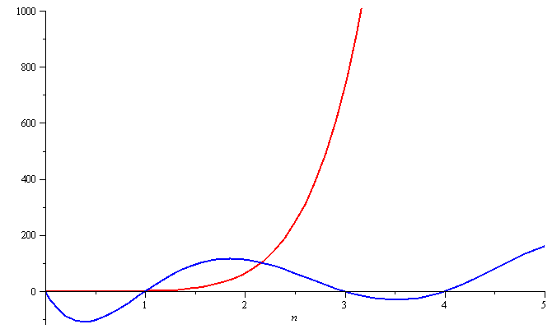
Polynomial Growth
To demonstrate with another example,
f(n) = n⁶ and g(n) = n⁶ – 23n⁵+193n⁴ –729n³+1206n² – 648n
Around n = 0, they are very different

Slide 14
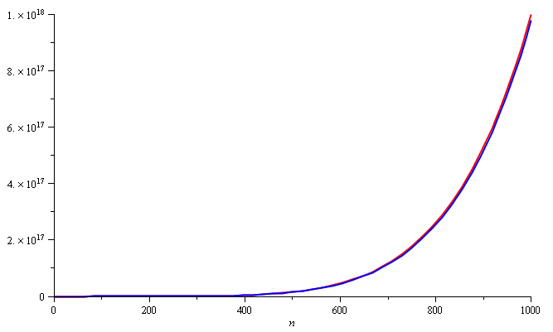
Polynomial Growth
Still, around n = 1000, the relative difference is less than 3%

Slide 15
Polynomial Growth
The justification for both pairs of polynomials being similar is that, in both cases, they each had the same leading term:
n² in the first example, n⁶ in the second example
Suppose however, that the coefficients of the leading terms were different
In this case, both functions would exhibit the same rate of growth, however, one would always be proportionally larger

Slide 16
Examples
Find a power of a number
Input: a, b (1 < a, b < 2147483647)
Output: x = a^{b}
a=3, b=4, x=3⁴=81
a=2, b=5, x=2⁵=32
Assume you can only do multiplication one at a time
Naïve method
2¹⁶ = 2*2*2*2*2*2*…*2 total 15 calculations
Can we do better?

Slide 17
Examples
Naïve method
2¹⁶ = 2*2*2*2*2*2*…*2 total 15 calculations
A better way as follows:
2¹⁶ = 2⁸ * 2⁸
2⁸ = 2⁴ * 2⁴
2⁴ = 2² * 2²
2² = 2 * 2

Slide 18
Examples
Naïve method
# calculations: linear to b
Divide and Conquer
# calculations: log₂(b)
Let’s say n = 2147483648
Naïve method takes 2147483647 calculations (~10-30s)
Divide and Conquer takes only 31 calculations (~1us)
10000000x faster!
Indeed, this is a Goo___ interview question

Slide 19
Sorting Example
Let’s look at two famous sorting algorithms
Bubble sort
Selection sort

Slide 20
Counting Instructions
Suppose we had two algorithms which sorted a list of size n and the run time (in μs) is given by
b_{worst}(n) = 4.7n² – 0.5n + 5 Bubble sort
b_{best}(n) = 3.8n² + 0.5n + 5
s(n) = 4n² + 14n + 12 Selection sort
The smaller the value, the fewer instructions are run
For n ≤ 21, b_{worst}(n) < s(n)
For n ≥ 22, b_{worst}(n) > s(n)

Slide 21
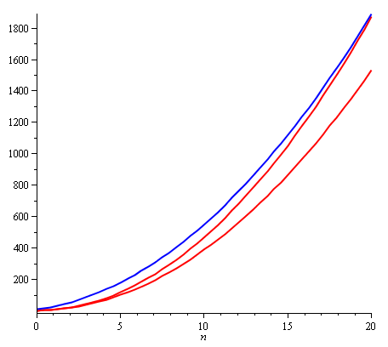
Counting Instructions
With small values of n, the algorithm described by s(n) requires more instructions than even the worst-case for bubble sort

Slide 22
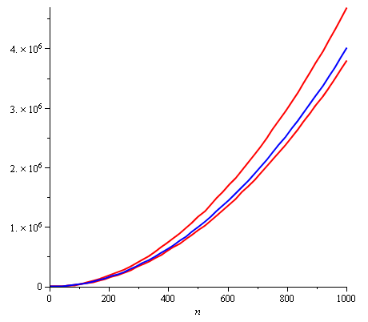
Counting Instructions
Near n = 1000, b_{worst}(n) ≈ 1.175 s(n) and b_{best}(n) ≈ 0.95 s(n)

Slide 23
Counting Instructions
Is this a serious difference between these two algorithms?
Because we can count the number instructions, we can also estimate how much time is required to run one of these algorithms on a computer

Slide 24
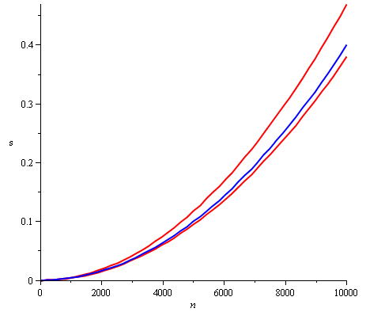
Counting Instructions
Suppose we have a 1 GHz computer
The time (s) required to sort a list of up to n = 10 000 objects is under half a second

Slide 25
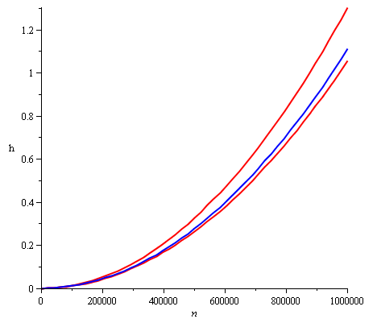
Counting Instructions
To sort a list with one million elements, it will take about 1 h
Bubble sort could, under some conditions, be 200 s faster

Slide 26
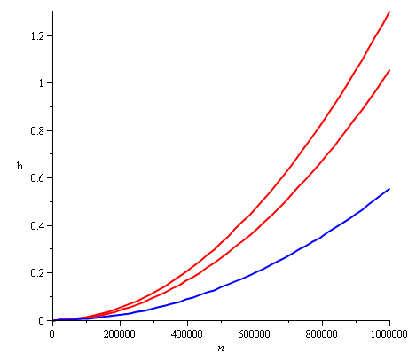
Counting Instructions
How about running selection sort on a faster computer?
For large values of n, selection sort on a faster computer will always be faster than bubble sort

Slide 27
Counting Instructions
Justification?
If f(n) = a_{k}n^{k} + ··· and g(n) = b_{k}n^{k} + ···, for large enough n, it will always be true that
f(n) < Mg(n)
where we choose
M = a_{k}/b_{k} + 1
In this case, we only need a computer which is M times faster (or slower)
Question:
Is a linear search comparable to a binary search?
Can we just run a linear search on a slower computer?

Slide 28
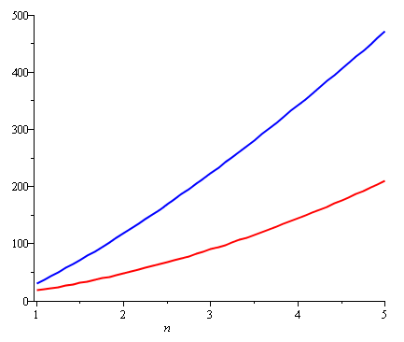
Counting Instructions
As another example:
Compare the number of instructions required for insertion sort and for quicksort
Both functions are concave up, although one more than the other

Slide 29
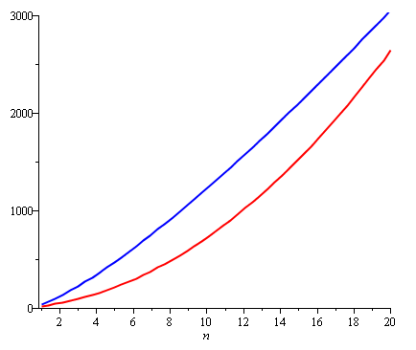
Counting Instructions
Insertion sort, however, is growing at a rate of n² while quicksort grows at a rate of n lg(n)
Never-the-less, the graphic suggests it is more useful to use insertion sort when sorting small lists—quicksort has a large overhead

Slide 30
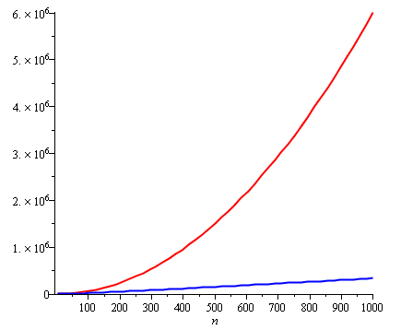
Counting Instructions
If the size of the list is too large (greater than 20), the additional overhead of quicksort quickly becomes insignificant
The quicksort algorithm becomes significantly more efficient
Question: can we just buy a faster computer?

Slide 31
Big-Θ as an Equivalence Relation
For example, all of
n² 100000 n² – 4 n + 19 n² + 1000000
323 n² – 4 n ln(n) + 43 n + 10 42n² + 32
n² + 61 n ln²(n) + 7n + 14 ln³(n) + ln(n)
are big-Θ of each other
E.g., 42n² + 32 = Θ( 323 n² – 4 n ln(n) + 43 n + 10 )

Slide 32
Big-Θ as an Equivalence Relation
Recall that with the equivalence class of all 19-year olds, we only had to pick one such student?
Similarly, we will select just one element to represent the entire class of these functions: n²
We could chose any function, but this is the simplest

Slide 33
Big-Θ as an Equivalence Relation
The most common classes are given names:
Θ(1) constant
Θ(ln(n)) logarithmic
Θ(n) linear
Θ(n ln(n)) “n log n”
Θ(n²) quadratic
Θ(n³) cubic
2^{n}, e^{n}, 4^{n}, ... exponential

Slide 34
Logarithms and Exponentials
Recall that all logarithms are scalar multiples of each other
Therefore log_{b}(n)= Θ(ln(n)) for any base b
Alternatively, there is no single equivalence class for exponential functions:
If 1 < a < b,
Therefore a^{n} = o(b^{n})
However, we will see that it is almost universally undesirable to have an exponentially growing function!

Slide 35
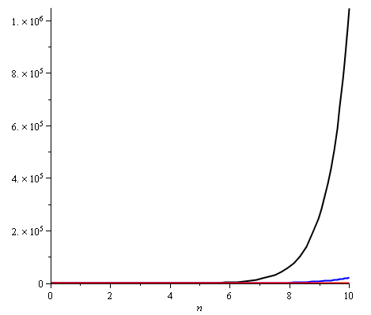
Logarithms and Exponentials
Plotting 2^{n}, e^{n}, and 4^{n} on the range [1, 10] already shows how significantly different the functions grow
Note:
2¹⁰ = 1024
e¹⁰ ≈ 22 026
4¹⁰ = 1 048 576

Slide 36
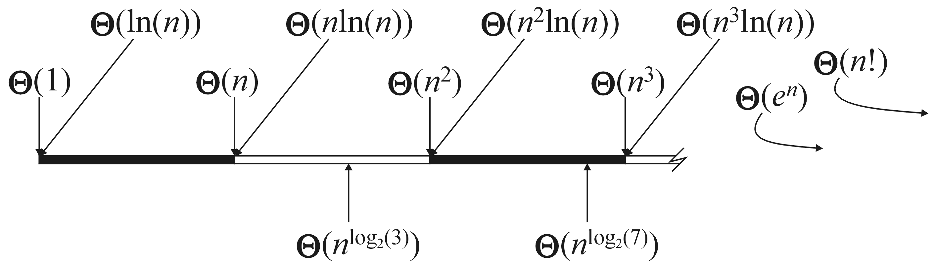
Little-o as a Weak Ordering
Graphically, we can shown this relationship by marking these against the real line

Slide 37
Algorithms Analysis
We will use Landau symbols to describe the complexity of algorithms
E.g., adding a list of n doubles will be said to be a Θ(n) algorithm
An algorithm is said to have polynomial time complexity if its run-time may be described by O(n^{d}) for some fixed d ≥ 0
We will consider such algorithms to be efficient
Problems that have no known polynomial-time algorithms are said to be intractable
Traveling salesman problem: find the shortest path that visits n cities
Best run time: Θ(n² 2^{n})

Slide 38
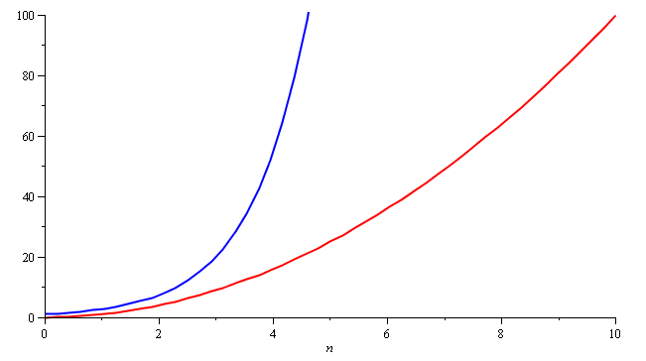
Algorithm Analysis
In general, you don’t want to implement exponential-time or exponential-memory algorithms
Warning: don’t call a quadratic curve “exponential”, either...please

Slide 39
Summary
In this class, we have:
Introducing some new notations: o O Θ Ω ω
Discussed how to use these
Looked at the equivalence relations

Slide 40
LAB 1
Q1: What is the relative error between n² + 2n + 5 and an approximation n² when n = 1000 and when n = 1000000? The relative error is the difference between the actual value and the approximation over the actual value.
Q2: Find the most appropriate representative element that describes each of the following rates of growth. For example, the most appropriate representative of 3n² + 4n ln(n) + 5n + 2 is n²
5n² + 4n + 3n^{lg(6)} + 4 + ln(n)
6n + 7 ln(n) + 8n ln(n) + 9
4n³ + 7n + 514n⁴ + 35n² + 2n⁶ + 5624
10n + 11 ln(n) + 1 + 2n² + 4n²
Email your solution to tsung-wei.huang@utah.edu by 23:59 PM 9/22

