Slide 1
CS 2420: Lists
Dr. Tsung-Wei (TW) Huang
Department of Electrical and Computer Engineering
University of Utah, Salt Lake City, UT

Slide 2
Outline
We will now look at our first abstract data structure
Relation: explicit linear ordering
Operations
Implementations of an abstract list with:
Linked lists
Arrays
Memory requirements
Strings as a special case
The STL vector class

Slide 3
List
An Abstract List (or List ADT) is linearly ordered data where the programmer explicitly defines the ordering
We will look at the most common operations that are usually
The most obvious implementation is to use either an array or linked list
These are, however, not always the most optimal

Slide 4

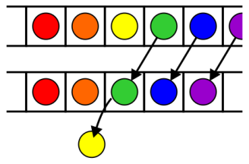
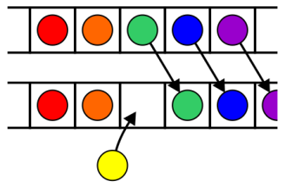
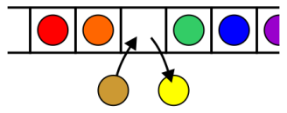
List Operations
Operations at the k^{th} entry of the list include:
Access to the object Erasing an object
Insertion of a new object Replacement of the object

Slide 5
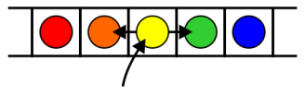
List Operations
Given access to the k^{th} object, gain access to either the previous or next object
Given two abstract lists, we may want to
Concatenate the two lists
Determine if one is a sub-list of the other

Slide 6
Locations and run times
The most obvious data structures for implementing an abstract list are arrays and linked lists
We will review the run time operations on these structures
We will consider the amount of time required to perform actions such as finding, inserting new entries before or after, or erasing entries at
the first location (the front)
an arbitrary (k^{th}) location
the last location (the back or n^{th})
The run times will be Θ(1), O(n) or Θ(n)

Slide 7
Linked lists
We will consider these for
Singly linked lists
Doubly linked lists

Slide 8
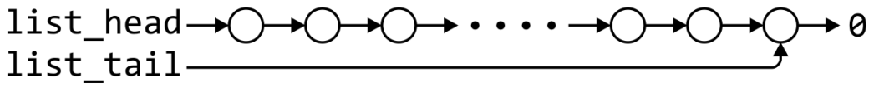
Singly linked list
 | Front/1st node | k^{th} node | Back/n^{th} node
Find | Θ(1) | Ο(n)* | Θ(1)
Insert Before | Θ(1) | Ο(n)* | Θ(n)
Insert After | Θ(1) | Θ(1)* | Θ(1)
Replace | Θ(1) | Θ(1)* | Θ(1)
Erase | Θ(1) | Ο(n)* | Θ(n)
Next | Θ(1) | Θ(1)* | n/a
Previous | n/a | Ο(n)* | Θ(n)
* These assume we have already accessed the k^{th} entry—an O(n) operation

Slide 9
Singly linked list
 | Front/1st node | k^{th} node | Back/n^{th} node
Find | Θ(1) | Ο(n)* | Θ(1)
Insert Before | Θ(1) | Θ(1)* | Θ(1)
Insert After | Θ(1) | Θ(1)* | Θ(1)
Replace | Θ(1) | Θ(1)* | Θ(1)
Erase | Θ(1) | Θ(1)* | Θ(n)
Next | Θ(1) | Θ(1)* | n/a
Previous | n/a | Ο(n)* | Θ(n)
By replacing the value in the node in question, we can speed things up

Slide 10
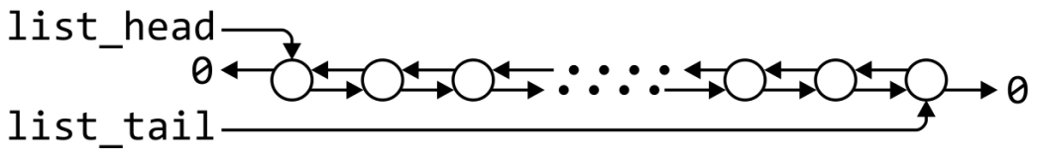
Doubly linked lists
 | Front/1st node | k^{th} node | Back/n^{th} node
Find | Θ(1) | Ο(n)* | Θ(1)
Insert Before | Θ(1) | Θ(1)* | Θ(1)
Insert After | Θ(1) | Θ(1)* | Θ(1)
Replace | Θ(1) | Θ(1)* | Θ(1)
Erase | Θ(1) | Θ(1)* | Θ(1)
Next | Θ(1) | Θ(1)* | n/a
Previous | n/a | Θ(1)* | Θ(1)
* These assume we have already accessed the k^{th} entry—an O(n) operation

Slide 11
Doubly linked lists
 | k^{th} node
Insert Before | Θ(1)
Insert After | Θ(1)
Replace | Θ(1)
Erase | Θ(1)
Next | Θ(1)
Previous | Θ(1)
Accessing the k^{th} entry is O(n)

Slide 12
Other operations on linked lists
Other operations on linked lists include:
Allocation and deallocating the memory requires Θ(n) time
Concatenating two linked lists can be done in Θ(1)
This requires a tail pointer

Slide 13

Standard arrays
We will consider these operations for arrays, including:
Standard or one-ended arrays
Two-ended arrays

Slide 14
Run times
 | Accessing the k^{th} entry | Insert or erase at the
 |  | Front | k^{th} entry | Back
Singly linked lists | O(n) | Θ(1) | Θ(1)* | Θ(1) or Θ(n)
Doubly linked lists |  |  |  | Θ(1)
Arrays | Θ(1) | Θ(n) | O(n) | Θ(1)
Two-ended arrays |  | Θ(1)

Slide 15
Data Structures
In general, we will only use these basic data structures if we can restrict ourselves to operations that execute in Θ(1) time, as the only alternative is O(n) or Θ(n)
Interview question: in a singly linked list, can you speed up the two O(n) operations of
Inserting before an arbitrary node?
Erasing any node that is not the last node?
If you can replace the contents of a node, the answer is “yes”
Replace the contents of the current node with the new entry and insert after the current node
Copy the contents of the next node into the current node and erase the next node

Slide 16
Memory usage versus run times
All of these data structures require Θ(n) memory
Using a two-ended array requires one more member variable, Θ(1), in order to significantly speed up certain operations
Using a doubly linked list, however, required Θ(n) additional memory to speed up other operations

Slide 17
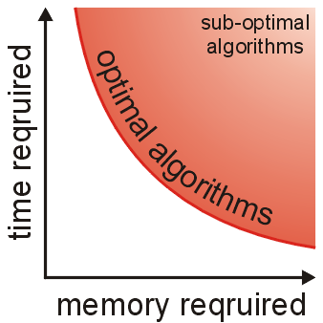
Memory usage versus run times
As well as determining run times, we are also interested in memory usage
In general, there is an interesting relationship between memory and time efficiency
For a data structure/algorithm:
Improving the run time usually requires more memory
Reducing the required memory usually requires more run time

Slide 18
Memory usage versus run times
Warning: programmers often mistake this to suggest that given any solution to a problem, any solution which may be faster must require more memory
This guideline not true in general: there may be different data structures and/or algorithms which are both faster and require less memory
This requires thought and research

Slide 19
The sizeof Operator
In order to determine memory usage, we must know the memory usage of the various built-in data types and classes
The sizeof operator in C++ returns the number of bytes occupied by a data type
This value is determined at compile time
It is not a function

Slide 20
The sizeof Operator
#include <iostream>
using namespace std;
int main() {
cout << "bool " << sizeof( bool ) << endl;
cout << "char " << sizeof( char ) << endl;
cout << "short " << sizeof( short ) << endl;
cout << "int " << sizeof( int ) << endl;
cout << "char * " << sizeof( char * ) << endl; cout << "int * " << sizeof( int * ) << endl;
cout << "double " << sizeof( double ) << endl;
cout << "int[10] " << sizeof( int[10] ) << endl;
return 0;
}
{eceunix:1} ./a.out # output
bool 1
char 1
short 2
int 4
char * 4
int * 4
double 8
int[10] 40
{eceunix:2}

Slide 21
Standard Template Library
In this course, you must understand each data structure and their associated algorithms
In industry, you will use other implementations of these structures
The C++ Standard Template Library (STL) has an implementation of the std::list data structure
Excellent reference: https://en.cppreference.com/w/cpp/container/list

Slide 22
Standard Template Library
#include <iostream>
#include <vector>
using namespace std;
int main() {
list<int> v;
cout << "Is the list empty? " << v.empty() << endl;
cout << "Size of list: " << v.size() << endl;
v.push_back(42);
v.push_back(91);
for ( auto item : v ) {
cout << item << endl;
}
return 0;
}
$ g++ vec.cpp
$ ./a.out
Is the list empty? 1
Size of list: 0
42
91
$

Slide 23
Summary
In this topic, we have introduced Abstract Lists
Explicit linear orderings
Implementable with arrays or linked lists
Each has their limitations
Introduced modifications to reduce run times down to Θ(1)
Discussed memory usage and the sizeof operator
Looked at the String ADT
Looked at the std::list class in the STL

Slide 24
LAB
Write a list using the std::list library to manipulate the following operations
Insert five integers, 2, 5, 9, 10, -3
Print the elements in the list
Erase the element 9
Print the elements in the list
Insert a new integer -100 right after 10
Print the elements in the list
Remove the first element
Remove the last element
Print the elements in the list

