Slide 1
CS 2420: Double-ended Queue (Deque)
Dr. Tsung-Wei (TW) Huang
Department of Electrical and Computer Engineering
University of Utah, Salt Lake City, UT

Slide 2
Outline
This topic discusses the concept of a queue:
Description of an Abstract Deque
Applications
Implementations
The STL and Iterations

Slide 3
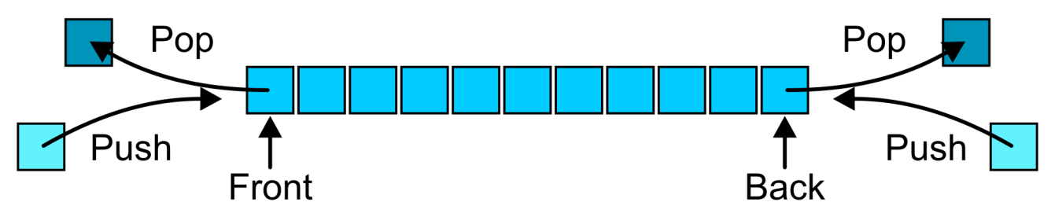
Abstract Deque
An Abstract Deque (Deque ADT) is an abstract data structure which emphasizes specific operations:
Uses a explicit linear ordering
Insertions and removals are performed individually
Allows insertions at both the front and back of the deque

Slide 4
Abstract Deque
The operations will be called
front back
push_front push_back
pop_front pop_back
There are four errors associated with this abstract data type:
It is an undefined operation to access or pop from an empty deque

Slide 5
Applications
Useful as a general-purpose tool:
Can be used as either a queue or a stack
Problem solving:
Consider solving a maze by adding or removing a constructed path at the front
Once the solution is found, iterate from the back for the solution

Slide 6
Deque Implementation
The implementations are clear:
We must use either a doubly linked list or a circular array

Slide 7
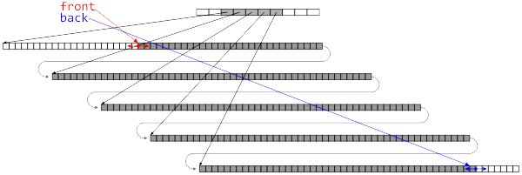
C++ Standard Template Library
The C++ Standard Template Library (STL) has an implementation of the deque data structure
The STL stack and queue are wrappers around this structure
The implementation is not specified, but the constraints are given which must be satisfied by any implementation

Slide 8
Standard Template Library
The STL comes with a deque data structure:
deque<T>
The signatures use stack terminology:
T &front();
void push_front(T const &);
void pop_front();
T &back();
void push_back(T const &);
void pop_back();

Slide 9
Standard Template Library
#include <iostream>
#include <deque>
using namespace std;
int main() {
deque<int> ideque;
ideque.push_front( 5 );
ideque.push_back( 4 );
ideque.push_front( 3 );
ideque.push_back( 6 ); // 3 5 4 6
cout << "Is the deque empty? " << ideque.empty() << endl;
cout << "Size of deque: " << ideque.size() << endl;
for ( int i = 0; i < 4; ++i ) {
cout << "Back of the deque: " << ideque.back() << endl;
ideque.pop_back();
}
cout << "Is the deque empty? " << ideque.empty() << endl;
return 0;
}
{eceunix:1} g++ deque_example.cpp
{eceunix:2} ./a.out
Is the deque empty? 0
Size of deque: 4
Back of the deque: 6
Back of the deque: 4
Back of the deque: 5
Back of the deque: 3
Is the deque empty? 1
{eceunix:3}

Slide 10
Accessing the Entries of a Deque
We will see three mechanisms for accessing entries in the deque:
Two random access member functions
An overloaded indexing operator ideque[10]
The at() member function; and ideque.at( 10 );
The iterator design pattern
The difference between indexing and using the function at( int ) is that the second will throw an out_of_range exception if it accesses an entry outside the range of the deque

Slide 11
T &deque::operator[]( int ) T &deque::at( int )
#include <iostream>
#include <deque>
using namespace std;
int main() {
deque<int> ideque;
ideque.push_front( 5 ); ideque.push_back( 4 );
ideque.push_front( 3 ); ideque.push_back( 6 ); // 5 3 4 6
for ( int i = 0; i <= ideque.size(); ++i ) {
cout << ideque[i] << " " << ideque.at( i ) << " ";
}
cout << endl;
return 0;
}
{eceunix:1} ./a.out # output
5 5 3 3 4 4 6 6 0
terminate called after throwing an instance of 'std::out_of_range’ what(): deque::_M_range_check
Abort

Slide 12
Iterators
Project 1 exposes the underlying data structure for evaluation purposes
This is, however, not good programming practice
The C++ STL uses the concept of an iterator to solve this problem
The iterator is not unique to C++
It is an industry recognized approach to solving a particular problem
Such a solution is called a design pattern
Formalized in Gamma et al. work Design Patterns
Notes:
12

Slide 13
Standard Template Library
Associated with each STL container class is an nested class termed an iterator:
deque<int> ideque;
deque<int>::iterator itr;
The iterator “refers” to one position within the deque
It is similar a pointer but is independent of implementation

Slide 14
Analogy
Consider a filing system with an administrative assistant
Your concern is not how reports are filed (so long as it’s efficient), it is only necessary that you can give directions to the assistant
Of course, God help you if your assistant is sick...

Slide 15
Analogy
You can request that your assistant:
Starts with either the first or last file
You can request to see the file the assistant is currently holding
You can modify the file the assistant is currently holding
You can request that the assistant either:
Go to the next file, or
Go to the previous file

Slide 16
Iterators
In C++, iterators overloads a number of operators:
The unary * operator returns a reference to the value stored at the location pointed to by the iterator
The operator ++ updates the iterator to point to the next position
The operator -- updates the iterator to point to the previous location
Note: these look like, but are not, pointers...

Slide 17
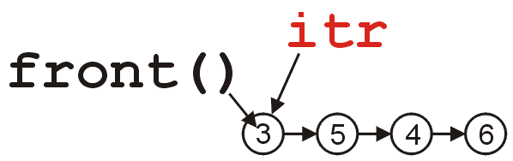
Iterators
We request an iterator on a specific instance of a deque by calling the member function begin():
deque<int> ideque;
ideque.push_front( 5 ); ideque.push_back( 4 );
ideque.push_front( 3 ); ideque.push_back( 6 );
// the deque is now 3 5 4 6
deque<int>::iterator itr = ideque.begin();

Slide 18
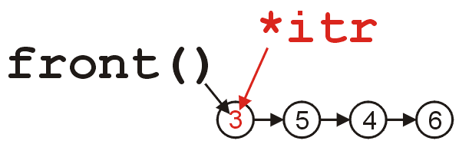

Iterators
We access the value by calling *itr:
cout << *itr << endl; // prints 3
Similarly, we can modify the value by assigning to *itr:
*itr = 11;
cout << *itr << " == " << ideque.front() << endl;
// prints 11 == 11

Slide 19
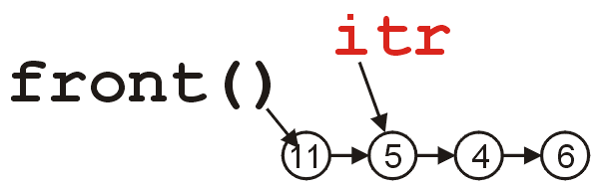
Iterators
We update the iterator to refer to the next value by calling ++itr:
++itr;
cout << *itr << endl; // prints 5

Slide 20
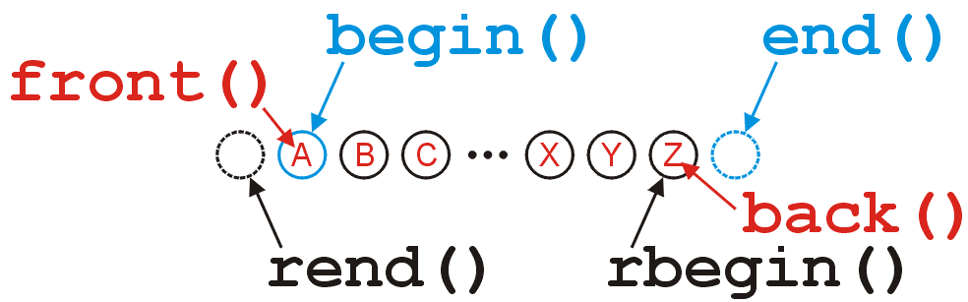
Iterators
The iterators returned by begin() and end() refer to:
The first position (head) in the deque, and
The position after the last value in the deque,
respectively:

Slide 21
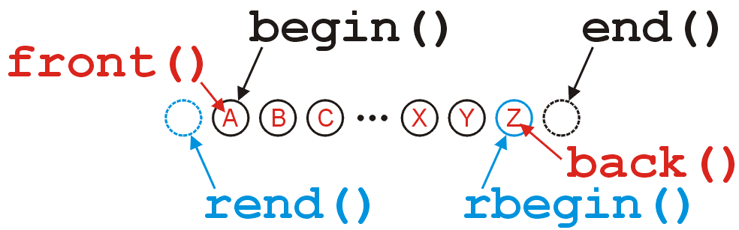
Iterators
The reverse iterators returned by rbegin() and rend() refer to:
the last position (tail) in the deque, and
the position before the first location in the deque,
respectively:

Slide 22
Iterators
If a deque is empty then the beginning and ending iterators are equal:
#include <iostream>
#include <deque>
using namespace std;
int main() {
deque<int> ideque;
cout << ( ideque.begin() == ideque.end() ) << " "
<< ( ideque.rbegin() == ideque.rend() ) << endl;
return 0;
}
{eceunix:1} ./a.out # output
1 1
{eceunix:2}

Slide 23
Iterators
Because we can have multiple iterators referring to values within the same deque, it makes sense that we can use the comparison operator == and !=

Slide 24
Iterators
This code gives some suggestion as to why end() refers to the position after the last location in the deque:
for ( int i = 0; i != ideque.size(); ++i ) {
cout << ideque[i] << end;
}
for ( deque<int>::iterator itr = ideque.begin(); itr != ideque.end(); ++itr ) {
cout << *itr << end;
}

Slide 25
Iterators
Note: modifying something beyond the last location of the deque results in undefined behaviour
Do not use
deque<int>::iterator itr = ideque.end();
*itr = 3; // wrong
You should use the correct member functions:
ideque.push_back( 3 ); // right

Slide 26
Iterators
#include <iostream>
#include <deque>
using namespace std;
int main() {
deque<int> ideque;
ideque.push_front( 5 ); ideque.push_back( 4 );
ideque.push_front( 3 ); ideque.push_back( 6 ); // 3 5 4 6
deque<int>::iterator itr = ideque.begin();
cout << *itr << endl;
++itr;
cout << *itr << endl;
while ( itr != ideque.end() ) {
cout << *itr << " ";
++itr;
}
cout << endl;
}
{eceunix:1} ./a.out # output
3
5
5 4 6
{eceunix:2}

Slide 27
Why Iterators?
Now that you understand what an iterator does, lets examine why this is standard software-engineering solution; they
Do not expose the underlying structure,
Require Θ(1) additional memory,
Provide a common interface which can be used regardless of whether or not it’s a vector, a deque, or any other data structure
Do not change, even if the underlying implementation does

Slide 28
Summary
In this topic, we have introduced the more general deque abstract data structure
Allows insertions and deletions from both ends of the deque
Internally may be represented by either a doubly-linked list or a two-ended array
More important, we looked at the STL and the design pattern of an iterator

