Slide 1
CS 2420: Insertion Sort
Dr. Tsung-Wei (TW) Huang
Department of Electrical and Computer Engineering
University of Utah, Salt Lake City, UT

Slide 2
Outline
This topic discusses the insertion sort
We will discuss:
the algorithm
an example
run-time analysis
worst case
average case
best case

Slide 3
Background
Consider the following observations:
A list with one element is sorted
In general, if we have a sorted list of k items, we can insert a new item to create a sorted list of size k + 1

Slide 4
Background
For example, consider this sorted array containing of eight sorted entries
Suppose we want to insert 14 into this array leaving the resulting array sorted
5 | 7 | 12 | 19 | 21 | 26 | 33 | 40 | 14 | 9 | 18 | 21 | 2

Slide 5
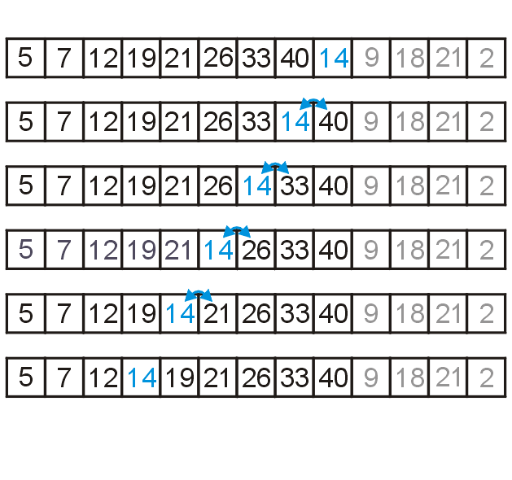
Background
Starting at the back, if the number is greater than 14, copy it to the right
Once an entry less than 14 is found, insert 14 into the resulting vacancy

Slide 6
The Algorithm
For any unsorted list:
Treat the first element as a sorted list of size 1
Then, given a sorted list of size k – 1
Insert the k^{th} item in the unsorted list into it into the sorted list
The sorted list is now of size k + 1

Slide 7
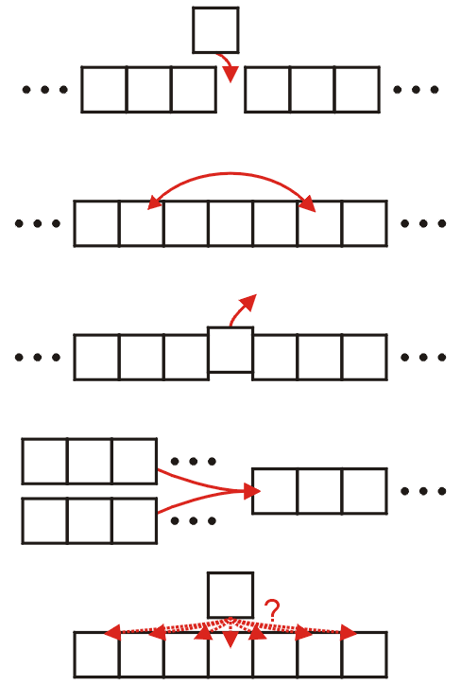
The Algorithm
Recall the five sorting techniques:
Insertion
Exchange
Selection
Merging
Distribution
Clearly insertion falls into the first category

Slide 8
The Algorithm
Code for this would be:
for ( int j = k; j > 0; --j ) {
if ( array[j - 1] > array[j] ) {
std::swap( array[j - 1], array[j] );
} else {
// As soon as we don't need to swap, the (k + 1)st
// is in the correct location
break;
}
}

Slide 9
Implementation and Analysis
This would be embedded in a function call such as
template <typename Type>
void insertion_sort( Type *const array, int const n ) {
for ( int k = 1; k < n; ++k ) {
for ( int j = k; j > 0; --j ) {
if ( array[j - 1] > array[j] ) {
std::swap( array[j - 1], array[j] );
} else {
// As soon as we don't need to swap, the (k + 1)st
// is in the correct location
break;
}
}
}
}

Slide 10
Implementation and Analysis
Let’s do a run-time analysis of this code
template <typename Type>
void insertion_sort( Type *const array, int const n ) {
for ( int k = 1; k < n; ++k ) {
for ( int j = k; j > 0; --j ) {
if ( array[j - 1] > array[j] ) {
std::swap( array[j - 1], array[j] );
} else {
// As soon as we don't need to swap, the (k + 1)st
// is in the correct location
break;
}
}
}
}

Slide 11
Implementation and Analysis
The Θ(1)-initialization of the outer for-loop is executed once
template <typename Type>
void insertion_sort( Type *const array, int const n ) {
for ( int k = 1; k < n; ++k ) {
for ( int j = k; j > 0; --j ) {
if ( array[j - 1] > array[j] ) {
std::swap( array[j - 1], array[j] );
} else {
// As soon as we don't need to swap, the (k + 1)st
// is in the correct location
break;
}
}
}
}

Slide 12
Implementation and Analysis
This Θ(1)- condition will be tested n times at which point it fails
template <typename Type>
void insertion_sort( Type *const array, int const n ) {
for ( int k = 1; k < n; ++k ) {
for ( int j = k; j > 0; --j ) {
if ( array[j - 1] > array[j] ) {
std::swap( array[j - 1], array[j] );
} else {
// As soon as we don't need to swap, the (k + 1)st
// is in the correct location
break;
}
}
}
}

Slide 13
Implementation and Analysis
Thus, the inner for-loop will be executed a total of n – 1 times
template <typename Type>
void insertion_sort( Type *const array, int const n ) {
for ( int k = 1; k < n; ++k ) {
for ( int j = k; j > 0; --j ) {
if ( array[j - 1] > array[j] ) {
std::swap( array[j - 1], array[j] );
} else {
// As soon as we don't need to swap, the (k + 1)st
// is in the correct location
break;
}
}
}
}

Slide 14
Implementation and Analysis
In the worst case, the inner for-loop is executed a total of k times
template <typename Type>
void insertion_sort( Type *const array, int const n ) {
for ( int k = 1; k < n; ++k ) {
for ( int j = k; j > 0; --j ) {
if ( array[j - 1] > array[j] ) {
std::swap( array[j - 1], array[j] );
} else {
// As soon as we don't need to swap, the (k + 1)st
// is in the correct location
break;
}
}
}
}

Slide 15
Implementation and Analysis
The body of the inner for-loop runs in Θ(1) in either case
template <typename Type>
void insertion_sort( Type *const array, int const n ) {
for ( int k = 1; k < n; ++k ) {
for ( int j = k; j > 0; --j ) {
if ( array[j - 1] > array[j] ) {
std::swap( array[j - 1], array[j] );
} else {
// As soon as we don't need to swap, the (k + 1)st
// is in the correct location
break;
}
}
}
}
Thus, the worst-case run time is

Slide 16
Implementation and Analysis
Problem: we may break out of the inner loop…
template <typename Type>
void insertion_sort( Type *const array, int const n ) {
for ( int k = 1; k < n; ++k ) {
for ( int j = k; j > 0; --j ) {
if ( array[j - 1] > array[j] ) {
std::swap( array[j - 1], array[j] );
} else {
// As soon as we don't need to swap, the (k + 1)st
// is in the correct location
break;
}
}
}
}

Slide 17
Implementation and Analysis
Recall: each time we perform a swap, we remove an inversion
template <typename Type>
void insertion_sort( Type *const array, int const n ) {
for ( int k = 1; k < n; ++k ) {
for ( int j = k; j > 0; --j ) {
if ( array[j - 1] > array[j] ) {
std::swap( array[j - 1], array[j] );
} else {
// As soon as we don't need to swap, the (k + 1)st
// is in the correct location
break;
}
}
}
}

Slide 18
Implementation and Analysis
As soon as a pair array[j - 1] <= array[j], we are finished
template <typename Type>
void insertion_sort( Type *const array, int const n ) {
for ( int k = 1; k < n; ++k ) {
for ( int j = k; j > 0; --j ) {
if ( array[j - 1] > array[j] ) {
std::swap( array[j - 1], array[j] );
} else {
// As soon as we don't need to swap, the (k + 1)st
// is in the correct location
break;
}
}
}
}

Slide 19
Implementation and Analysis
Thus, the body is run only as often as there are inversions
template <typename Type>
void insertion_sort( Type *const array, int const n ) {
for ( int k = 1; k < n; ++k ) {
for ( int j = k; j > 0; --j ) {
if ( array[j - 1] > array[j] ) {
std::swap( array[j - 1], array[j] );
} else {
// As soon as we don't need to swap, the (k + 1)st
// is in the correct location
break;
}
}
}
}
If the number of inversions is d, the run time is Θ(n + d)

Slide 20
Consequences of Our Analysis
A random list will have d = O(n²) inversions
The average random list has d = Θ(n²) inversions
Insertion sort, however, will run in Θ(n) time whenever d = O(n)
Other benefits:
The algorithm is easy to implement
Even in the worst case, the algorithm is fast for small problems
Considering these run times, it appears to be approximately 10 instructions per inversion
Size | Approximate Time (ns)
8 | 175
16 | 750
32 | 2700
64 | 8000

Slide 21
Consequences of Our Analysis
Unfortunately, it is not very useful in general:
Sorting a random list of size 2²³ ≈ 8 000 000 would require approximately one day
Doubling the size of the list quadruples the required run time
An optimized quick sort requires less than 4 s on a list of the above size

Slide 22
Consequences of Our Analysis
The following table summarizes the run-times of insertion sort
Case | Run Time | Comments
Worst | Θ(n²) | Reverse sorted
Average | O(d + n) | Slow if d = ω(n)
Best | Θ(n) | Very few inversions: d = O(n)

Slide 23
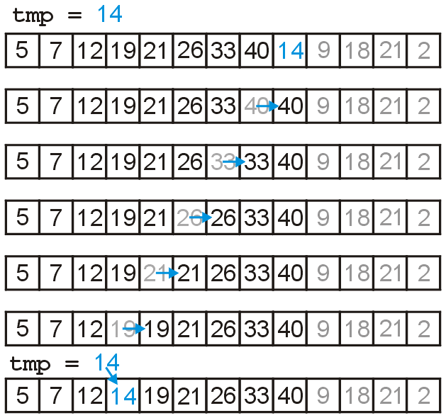
The Algorithm
Now, swapping is expensive, so we could just temporarily assign the new entry
this reduces assignments by a factor of 3
speeds up the algorithm by a factor of two

Slide 24
Implementation and Analysis
A reasonably good* implementation
template <typename Type>
void insertion( Type *const array, int const n ) {
for ( int k = 1; k < n; ++k ) {
Type tmp = array[k];
for ( int j = k; k > 0; --j ) {
if ( array[j - 1] > tmp ) {
array[j] = array[j - 1];
} else {
array[j] = tmp;
goto finished;
}
}
array[0] = tmp; // only executed if tmp < array[0]
finished: ; // empty statement
}
}
* we could do better with pointers

Slide 25
A Comment about Using goto
Why use goto? Isn’t goto “evil”?!
template <typename Type>
void insertion( Type *const array, int const n ) {
for ( int k = 1; k < n; ++k ) {
Type tmp = array[k];
for ( int j = k; k > 0; --j ) {
if ( array[j - 1] > tmp ) {
array[j] = array[j - 1];
} else {
array[j] = tmp;
goto finished;
}
}
array[0] = tmp; // only executed if tmp < array[0]
finished: ; // empty statement
}
}

Slide 26
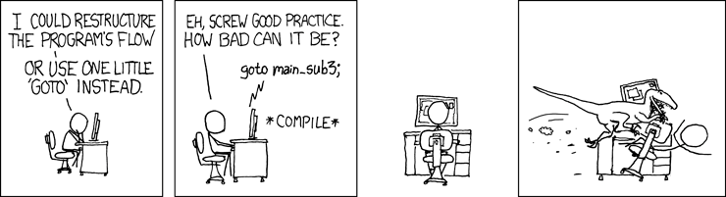
A Comment about Using goto
Even xkcd knows it is evil!
http://xkcd.com/292/

Slide 27
A Comment about Using goto
Unfortunately, any other fix appears to be less than elegant…
template <typename Type>
void insertion( Type *const array, int const n ) {
for ( int k = 1; k < n; ++k ) {
Type tmp = array[k];
for ( int j = k; k > 0; --j ) {
if ( array[j - 1] > tmp ) {
array[j] = array[j - 1];
} else {
array[j] = tmp;
break;
}
}
if ( array[0] > tmp ) {
array[0] = tmp; // only executed if tmp < array[0]
}
}
}

Slide 28
A Comment about Using goto
The excessive use of the goto statement resulted in spaghetti code
Edsger Dijkstra’s 1968 commentary
“Go To Statement Considered Harmful”
started what (against Dijkstra’s better judgment) took on the form of a religious crusade against using goto
Donald Knuth gives a more reasoned approach in his 1972 paper “Structured Programming with go to Statements”
Unfortunately, in 2011, one student saw this and immediately used a goto that resulted in spaghetti code and claimed it was “reasonable”
In general, use a goto if and only if it is going forward to an obvious point in the routine

Slide 29
Summary
Insertion Sort:
Insert new entries into growing sorted lists
Run-time analysis
Actual and average case run time: O(n²)
Detailed analysis: Θ(n + d)
Best case (O(n) inversions): Θ(n)
Memory requirements: Θ(1)

