Slide 1

Lecture 14: Start Drafting Your Final Report
Dr. Tsung-Wei Huang
Department of Electrical and Computer Engineering
University of Utah, Salt Lake City, UT
Notes:
Hello everyone, today we are going to help you go through the team forming process.

Slide 2
Final Report
Due today (4/23) 11:59 PM
Each group is required to turn in a report
It is a proposal for what you plan to finish next semester
It is a contract between you and me
It is a document to tell people why they will care
This is a big report that has many items
Introduction, challenges, timelines, etc…
Finish the report along the way
Don’t push it to the LAST minute!
A good proposal takes time, effort, and people to compile which doesn’t happen just overnight

Slide 3
We will use Latex
LaTeX is pronounced “lay-tech” or “lah-tech,” not “la-teks.”
LaTeX is a document preparation system for high-quality typesetting.
LaTeX is most often used to produce technical or scientific documents, but it can be used for almost any form of publishing.

Slide 4
Why use Latex Not Micro… Off…
Designed by academics and easily accommodates academic use.
Professionally crafted predefined layouts make a document really look as if “printed.”
Mathematical symbols and equations are easily integrated.
Even complex structures such as footnotes, references, table of contents, and bibliographies can be generated easily.
Forces author to focus on logical instead of aesthetic structure of a document.
Creates more beautiful documents.
Portable, compatible, flexible, versatile, and cheap (or free)!

Slide 5
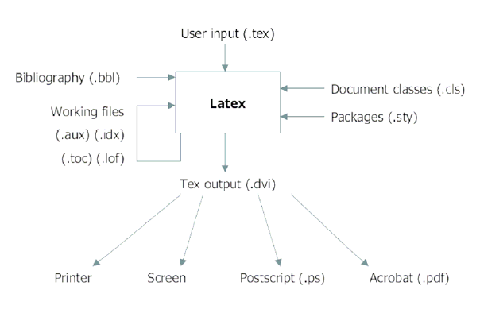
Latex Workflow

Slide 6
Installing Latex
https://www.latex-project.org/get/

Slide 7
Live Demo
We have created a final report template for you
https://github.com/tsung-wei-huang/cs3992/tree/main/final_report/template
You can use collaborative editors
Overleaf: https://www.overleaf.com/

