Slide 1
PA1: Debrief
Tsung-Wei (TW) Huang
Department of Electrical and Computer Engineering
University of Utah, Salt Lake City, UT

Slide 2
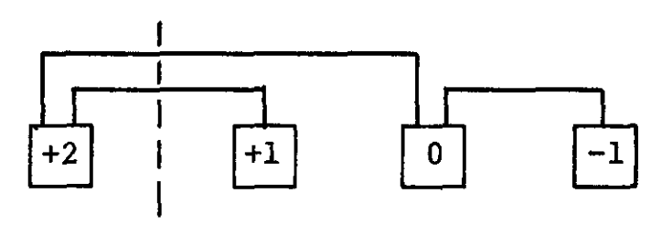
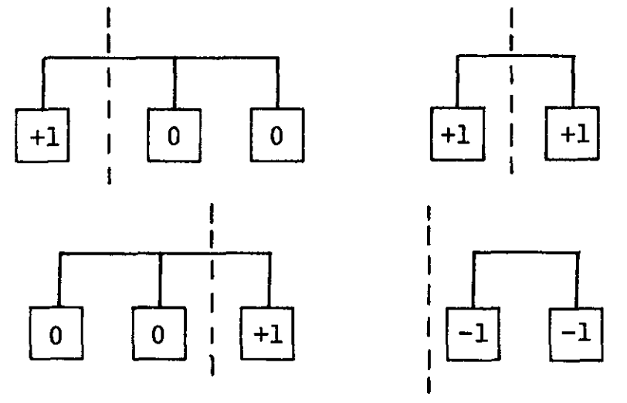
Recap: Programming Assignment (PA) #1
Implement a FM partitioning algorithm
Fiduccia and Mattheyses, “A linear time heuristic for improving network partitions,” ACM DAC, 1982
Cell gains based on “net”

Slide 3
Evaluation
Evaluated on a Linux Ubuntu Server
Intel 6138 CPU @ 2GHz
256 GB RAM
A total of six real circuits
Input0, input1, input2, input3, input4, input5
Command (each program is given 300 seconds only)
timeout 300 time ./a.out input output

Slide 4
Cut Size
 | 7218 | 0934 | 2423 | 2280 | 4130 | 5418 | 6858 | 6826 | 5427 | 2289 | 8044
input0 | 10085 | - | - | 72536 | 16669 | 43115 | 31966 | - | 30928 | 3285 | 5050
input1 | 1257 | 2761 | 1518 | 2729 | 1513 | 1646 | 1464 | 1489 | 1459 | 1232 | 1253
input2 | 2202 | 4648 | 2992 | 5291 | 2741 | 2942 | 2749 | 2637 | 2570 | 2209 | 2210
input3 | 27819 | - | - | 56837 | 29536 | 35169 | 32057 | 31792 | 33197 | 27733 | 27684
input4 | 44931 | - | - | 104460 | 58835 | 61932 | 55453 | 54586 | 52522 | 44967 | 44875
input5 | 143505 | - | - | - | 175365 | 188036 | 171483 | 169179 | 165373 | 143285 | 143606

Slide 5
Runtime (Seconds)
 | 7218 | 0934 | 2423 | 2280 | 4130 | 5418 | 6858 | 6826 | 5427 | 2289 | 8044
input0 | 45.73 | - | - | 18.11 | 49.07 | 2.97 | 41.5 | - | 2.93 | 2.3 | 13.7
input1 | 0.23 | 0.12 | 1.82 | 0.03 | 0.02 | 0.02 | 0.08 | 0.12 | 0.02 | 0.03 | 0.05
input2 | 0.35 | 2.56 | 3.98 | 0.12 | 0.04 | 0.06 | 0.15 | 0.18 | 0.07 | 0.06 | 0.11
input3 | 19.31 | - | - | 11.05 | 0.6 | 1.13 | 1.27 | 3.14 | 1.18 | 3.63 | 2.21
input4 | 22.02 | - | - | 65.19 | 1.67 | 2.11 | 2.9 | 10.16 | 2.71 | 7.04 | 8.03
input5 | 97.8 | - | - | - | 5.74 | 6.09 | 8.4 | 65.0 | 8.53 | 35.4 | 59.4

Slide 6
Memory (MB)
 | 7218 | 0934 | 2423 | 2280 | 4130 | 5418 | 6858 | 6826 | 5427 | 2289 | 8044
input0 | 364 | - | - | 46.7 | 88.4 | 176 | 82.7 | - | 113 | 55.8 | 82.4
input1 | 11 | 7.5 | 8 | 4.8 | 5.6 | 6.6 | 5.7 | 6.9 | 6.9 | 4.4 | 5.54
input2 | 18 | 11.5 | 12.2 | 5.7 | 7.5 | 9.3 | 7.9 | 9.7 | 8.5 | 5.7 | 7.6
input3 | 155 | - | - | 22.4 | 39.2 | 65.8 | 40 | 74.3 | 51.0 | 25.6 | 40.2
input4 | 300 | - | - | 43.5 | 75.4 | 128.1 | 79 | 177.6 | 98.9 | 50.6 | 79.3
input5 | 500.1 | - | - | - | 195.6 | 345.6 | 206 | 747.2 | 262.7 | 127.4 | 206.7

Slide 7
Final Results
Normalized all scores to [0, 1] wrt column of “2289”
Final score = 0.5 * cutsize + 0.3 * runtime + 0.2 * mem
 | 7218 | 0934 | 2423 | 2280 | 4130 | 5418 | 6858 | 6826 | 5427 | 2289 | 8044
cut | 1.031825999 |  |  |  | 1.2781542 | 1.494492863 | 1.325358873 | 1.166008864 | 1.284395472 | 1 | 1.008832074
runtime | 3.826661164 |  |  |  | 1.179116797 | 0.2554684276 | 1.120511762 | 1.621956253 | 0.3140734626 | 1 | 1.723070574
mem | 6.21187384 |  |  |  | 1.527643785 | 2.713914657 | 1.563265306 | 3.768831169 | 2.00742115 | 1 | 1.564897959
Score | 2.906286117 |  |  |  | 1.298340896 | 1.366669891 | 1.311486026 | 1.823357541 | 1.139265953 | 1 | 1.334316801

Slide 8
Final Results – Ranking
Normalized all scores to [0, 1] wrt column of “2289”
Final score = 0.5 * cutsize + 0.3 * runtime + 0.2 * mem
 | 7218 | 0934 | 2423 | 2280 | 4130 | 5418 | 6858 | 6826 | 5427 | 2289 | 8044
cut | 1.031825999 |  |  |  | 1.2781542 | 1.494492863 | 1.325358873 | 1.166008864 | 1.284395472 | 1 | 1.008832074
runtime | 3.826661164 |  |  |  | 1.179116797 | 0.2554684276 | 1.120511762 | 1.621956253 | 0.3140734626 | 1 | 1.723070574
mem | 6.21187384 |  |  |  | 1.527643785 | 2.713914657 | 1.563265306 | 3.768831169 | 2.00742115 | 1 | 1.564897959
Score | 2.906286117 |  |  |  | 1.298340896 | 1.366669891 | 1.311486026 | 1.823357541 | 1.139265953 | 1 | 1.334316801
Place | 8 |  |  |  | 3 | 6 | 4 | 7 | 2 | 1 | 5

