Slide 1
Lecture 5: Circuit Partitioning – III
Tsung-Wei (TW) Huang
Department of Electrical and Computer Engineering
University of Utah, Salt Lake City, UT

Slide 2
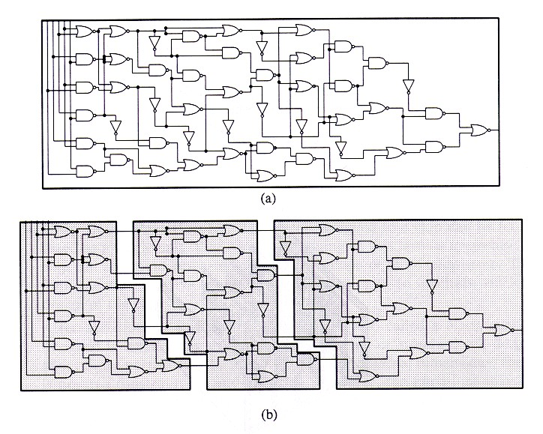
Circuit Partition
An essential step for reducing algorithm design complexity
Divide and conquer (D&C)
Input
A circuit graph
Output
A set of partitioned subgraphs
Objective
Minimize cross-connection

Slide 3
KL Algorithm: Recap
1. Pair-wise exchange of nodes to reduce cut size
2. Allow cut size to increase temporarily within a pass
3. Compute the gain of a swap
Repeat
Perform a feasible swap of max gain
Mark swapped nodes “locked”
Update swap gains
Until no feasible swap
4. Find max prefix partial sum in gain sequence g₁, g₂, …, g_{m}
5. Make corresponding swaps permanent
6. Start another pass if current pass reduces the cut size
u •
v •
v •
u •
locked

Slide 4
FM Algorithm: Recap
Moves are made based on object gain – extended from KL algorithms
Object Gain: The amount of change in cut crossings that will occur if an object is moved from its current partition into the other partition
A pass description
While there is unlocked object
1. Each object is assigned a gain
2. Objects are put into a sorted gain list
3. The object with the highest gain from the larger of the two sides is selected and moved
4. The moved object is "locked"
5. Gains of "touched" objects are recomputed
6. Gain lists are resorted
Repeat the pass until there is no improvement

Slide 5
State Space Search Problem
Combinatorial optimization problems (like partitioning) can be thought as a State Space Search Problem
A State is just a configuration of the combinatorial objects involved
The State Space is the set of all possible states (configurations)
A Neighborhood Structure is also defined (which states can one go in one step)
There is a cost corresponding to each state
Search for the min (or max) cost state

Slide 6
Greedy Algorithm
A very simple technique for State Space Search Problem
Start from any state
Always move to a neighbor with the min cost (assume minimization problem)
Stop when all neighbors have a higher cost than the current state

Slide 7
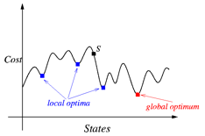
Problem with Greedy Algorithm
Easily get stuck at local minimum
Will obtain non-optimal solutions
Optimal only for convex (or concave for maximization) functions

Slide 8
Greedy Nature of KL and FM
KL and FM are almost greedy algorithms
Purely greedy if we consider a pass as a “move”
A
B
Pass 1
Pass 2
Cut Value
Move
B
A
Partitions

Slide 9
Simulated Annealing (SA) Algorithm
Very general search technique
Try to avoid being trapped in local minimum by making probabilistic moves
Popularize as a heuristic for optimization by:
Kirkpatrick, Gelatt and Vecchi, “Optimization by Simulated Annealing”, Science, 220(4598):498-516, May 1983

Slide 10
Basic Ideas of SA
Inspired by the Annealing Process:
The process of carefully cooling molten metals in order to obtain a good crystal structure
First, metal is heated to a very high temperature
Then slowly cooled
By cooling at a proper rate, atoms will have an increased chance to regain proper crystal structure
Attaining a min cost state in simulated annealing is analogous to attaining a good crystal structure in annealing

Slide 11
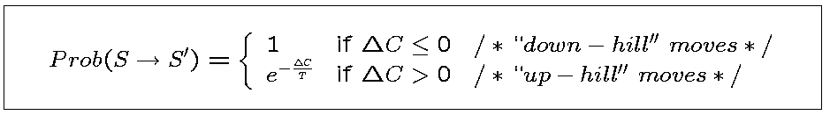
Basic Ideas of SA (cont’d)
Non-zero probability for “up-hill” moves.
Probability depends on
magnitude of the “up-hill” movement
total search time
△C = cost(S’) – cost(S)
T: Control parameter (temperature)
Annealing schedule: T = T₀, T₁, T₂,…, where T_{i} = r^{i}T₀, r <1.

Slide 12
Things to Consider in SA
When solving a combinatorial problem, we have to decide:
The state space
The neighborhood structure
The cost function
The initial state
The initial temperature
The cooling schedule (how to change t)
The freezing point

Slide 13
SA Algorithm Pseudocode
1 begin
2 Get an initial solution S;
3 Get an initial temperature T > 0;
4 while not yet “frozen” do
5 for 1 i P do
6 Pick a random neighbor S’ of S;
7 △← cost(S’) – cost(S); /* down hill move */
8 if △ 0 then S←S’ /* uphill move */
9 if △ > 0 then S←S’ with probability;
10 T←rT ; /* reduce temperature */
11 return S
12 end

Slide 14
Common Cooling Schedules
Initial temperature, cooling schedule, and freezing point are usually experimentally determined
Parameter tuning is very critical in getting a good SA result
Some common cooling schedules
t = αt, where α is typically around 0.95
t = e^{-βt} t, where β is typically around 0.7
…

Slide 15
Basic SA Algorithm Structure
Solution space
Neighborhood structure
Cost function
Annealing schedule

Slide 16
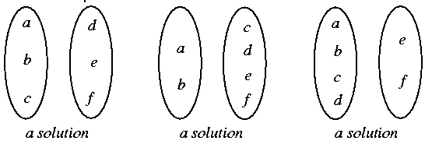
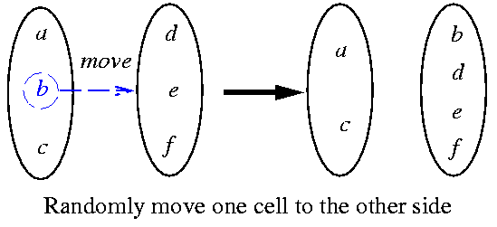
SA-based Partitioning Algorithm
Kirkpatrick, Gelatt, and Vecchi, “Optimization by simulated annealing,” Science, May 1983.
Solution space: set of all partitioning solutions
Neighborhood structure: move one cell to another partition

Slide 17
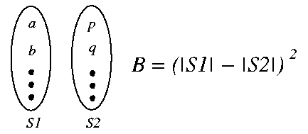
SA-based Partitioning Algorithm (cont’d)
Cost function: f = C + λB
C: the solution cost as used before
B: a measure of balance
λ: a constant
Annealing schedule
T_{n} = r^{n}T₀, r = 0.9
At each temperature, either 1. There are 10 accepted moves/cell on the average, or 2. # of attempts = 100 * total # of cells.
The system is “frozen” if very low acceptances at 3 consecutive temperatures

Slide 18
Evaluation of SA-based Partitioning
An extensive empirical study of Simulated Annealing versus Iterative Improvement Approaches have been studied over the past decades
Conclusion: SA is a competitive approach, getting better solutions than KL for random graphs
Remarks:
Netlists are not random graphs, but sparse graphs with local structure
SA is too slow. So KL/FM variants are still most popular
Multiple runs of KL/FM variants with random initial solutions may be preferable to SA

Slide 19
The Use of Randomness
For any partitioning problem:
Suppose solutions are picked randomly
If |G|/|A| = r, Pr(at least 1 good in 5/r trials) = 1-(1-r)^{5/r}
If |G|/|A| = 0.001, Pr(at least 1 good in 5000 trials) = 1-(1-0.001)⁵⁰⁰⁰ = 0.9933
All solutions (state space)
G
A
Good solutions

Slide 20
Adding Randomness to KL/FM
In fact, # of good states are extremely few
Therefore, r is extremely small
Need extremely long time if just picking states randomly
Therefore, we can running KL/FM variants several times with random initial solutions
Good Initial States
Cut Value
Good States

Slide 21
Tie-breaking Strategy
For each vertex, instead of having a gain bucket, a gain vector is used
Gain vector is a sequence of potential gain values corresponding to numbers of possible moves into the future
Therefore, r^{th} entry looks r moves ahead
Time complexity is O(pr), where r is max # of look-ahead moves stored in gain vector
If ties still occur, some researchers observe that LIFO order improves solution quality

Slide 22
Other Partitioning Approaches
KL/FM-SA Hybrid: Use KL/FM variant to find a good initial solution for SA, then improve that solution by SA at low temperature
Tabu Search
Genetic Algorithm
Spectral Methods (finding Eigenvectors)
Network Flows
Quadratic Programming
…

Slide 23
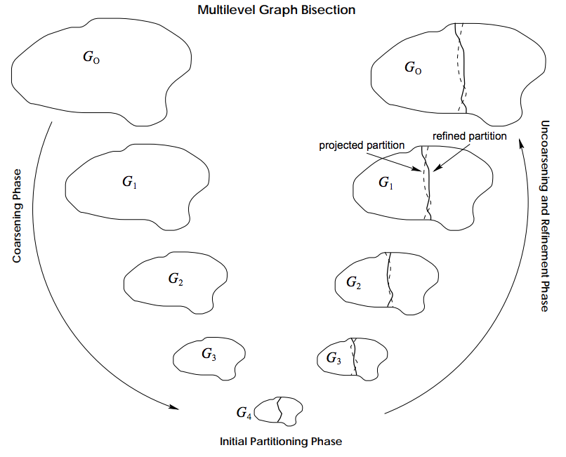
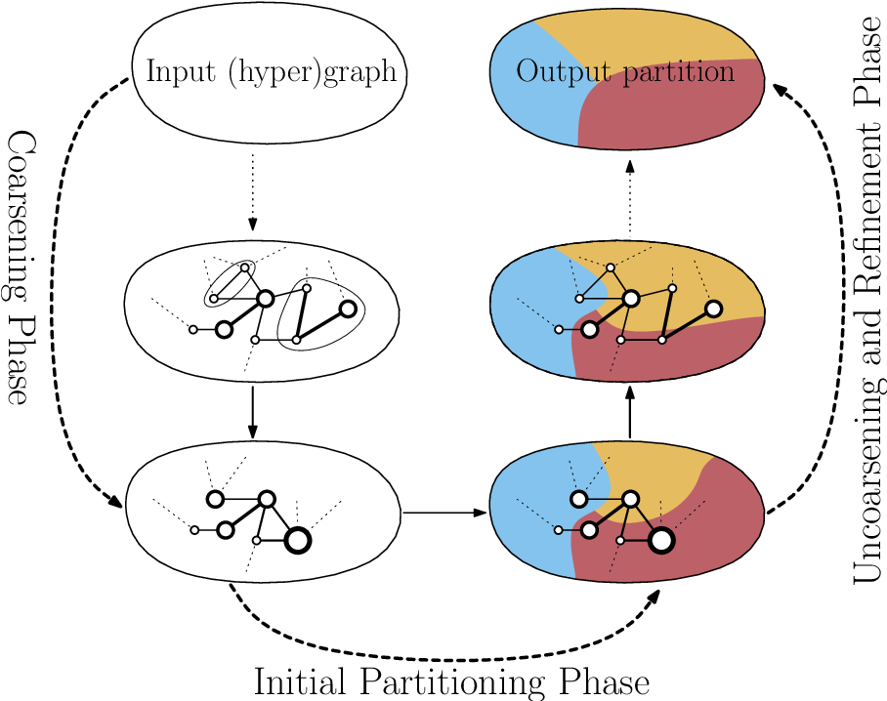
Multilevel Partitioning Techniques

Slide 24

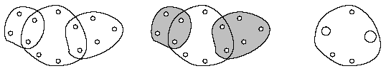

Coarsening Phase
Edge coarsening
Hyperedge coarsening (HEC)
Modified hyperedge coarsening (MHEC)

Slide 25
Uncoarsening Phase
Based on FM with two simplifications
Limit number of passes to 2
Early-Exit FM (FM-EE), stop each pass if k vertex moves do not improve the cut
HER (Hyperedge Refinement)
Move a group of vertices between partitions so that an entire hyperedge is removed from the cut

Slide 26
hMETIS Algorithm: A Mixed Strategy
https://course.ece.cmu.edu/~ee760/760docs/hMetisManual.pdf
hMETIS-EE₂₀
20 random initial partitions
with 10 runs using HEC for coarsening
with 10 runs using MHEC for coarsening
FM-EE for refinement
hMETIS-FM₂₀
20 random initial partitions
with 10 runs using HEC for coarsening
with 10 runs using MHEC for coarsening
FM for refinement

Slide 27
Summary
We have discussed problems of greedy partitioning algorithms
We have discussed simulated annealing (SA) algorithm
We have discussed SA-based partitioning algorithm
We have discussed multi-level partitioning algorithms

