Slide 1
Lecture 12: Placement – II
Tsung-Wei (TW) Huang
Department of Electrical and Computer Engineering
University of Utah, Salt Lake City, UT

Slide 2
Recap: Placement Problem
What does a placer do?
Input: Netlist of gates & nets
Output: Exact location of each gate
Goal: Able to route (connect) all wires
Placement is VERY HARD!
Bad placement → Much more wire
More wire: bigger, slower chip
If placement is very bad, next tool in the flow—the router—unable to connect all wires, or meet timing

Slide 3
Recap: Placement Problem (cont’d)
Grid-based model of the chip
A simple grid – like a chess board
Cells (gates) go in grid slots
Pins (connect off-chip, fixed at edges)
Grid-based model of gates
All gates are exactly the same size.
(Unrealistic, but simplifies things)
Each grid slot can hold 1 gate
Any gate can go in any slot

Slide 4
Recap: Placement Problem (cont’d)
Placer optimizes the ability of router to connect all the nets
But routers are computationally expensive tools. We can’t run one “inside” placer
We need a simplified approximation at this stage
Every real placer minimizes expected wirelength
For each wire in the design, estimate the expected length of the routed wire
Minimize this objective: ∑_{wires Wi} EstimatedLength(Wi)
Placer finds gate locations to minimize this objective

Slide 5
Recap: Wirelength Estimation
Most placers adopt Half-Perimeter Wirelength (HPWL)
Also know as Bounding Box (BBOX) wirelength
Put smallest “bounding” box around all gates
Assume gate lives in “center” of the grid slot
Add width (∆X) and height (∆Y) of the BBOX for the wirelength estimate
A “2-point net”
A “4-point net”
y=5
4
3
2
1
0
y=5
4
3
2
1
0
∆X=3-1=2; ∆Y=4-1=3. HPWL=5
∆X=4-1=3; ∆Y=5-1=4. HPWL=7
x=0 1 2 3 4
x=0 1 2 3 4

Slide 6
Recap: Wirelength Estimation (cont’d)
Easy to calculate, even for a multi-point net:
[max{X coordinates of all gates) – min{X coordinates of all gates}] + [max{Y coordinates of all gates) – min{Y coordinates of all gates}]
Always a lower bound on the real wire length
No matter how complex the final routed wire path is…
…you need at least this much wire to connect everything
Aside: all wiring on big chips (and most boards) is strictly horizontal & vertical – no “arbitrary angles” for manufacturing reasons which is another reason HPWL is good

Slide 7
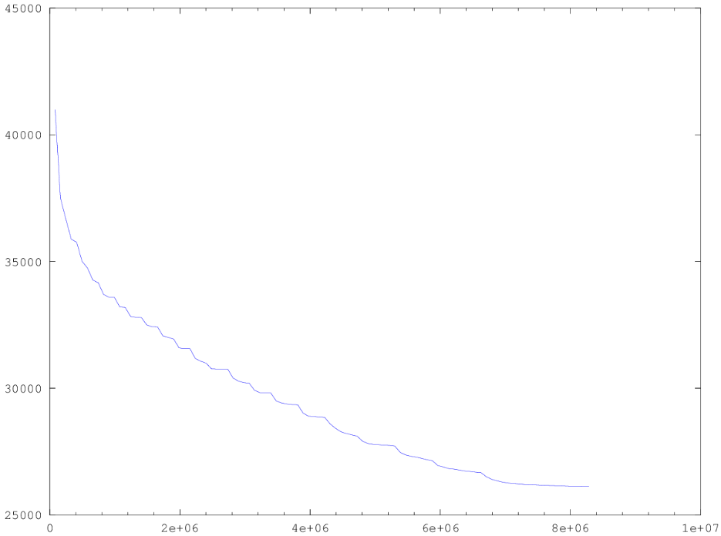
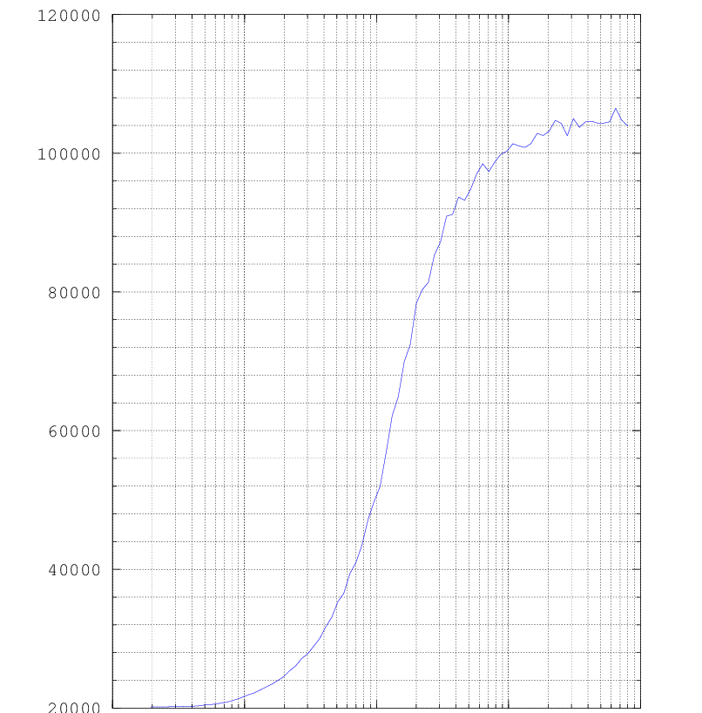
Recap: Placement Algorithm
Iterative Placer
(fast but bad quality)
∑HPWL
SA-based placer
(good quality but slow)
100K
80K
L = ∑_{nets Ni} HPWL(Ni)
60K
← Placer progress
40K
T→
20K
# random gate swaps→
0.1
1
10
100
1000

Slide 8
Analytical Placer
Write an equation whose minimum is the placement
If you have a million gates, need a million (xi, yi) values as result
Formulate an appropriate cost function for all the gate-level (xi, yi): F( x₁, x₂, … x_{1M}, y₁, y₂, … y_{1M})
Solve analytically for X*=(x₁, x₂, … x_{1M}), Y*=(y₁, y₂, … y_{1M}) to minimize F( )
The resulting values of X*, Y* give you the placement of all 1M gates
This sounds sort of crazy… but it works great
All modern placers for big ASICs and SOCs are “analytical”
Big trick is write the wirelength in mathematically “friendly” form we can optimize

Slide 9
Key: Optimize Quadratic Wirelength Model
For 2-point net, we optimize squared length of “distance” line between points: (x1-x2)² + (y1-y2)²
A “2-point net”
Quadratic wirelength
=(3-1)² + (4-1)²
=13
y=5
4
3
2
1
0
BUT… what happens if your net has more than 2 points in it?
x= 0 1 2 3 4

Slide 10
What About k-point Net, k>2?
Replace one “real” net with k(k-1)/2 2-point nets and add a new net between every pair of points–called a fully-connected clique model
A “k=4-point net”
Clique model
y=5
4
3
2
1
0
y=5
4
3
2
1
0
4
k(k-1)/2
=4(4-1)/2
=6 2-point nets
1
3
2
x= 0 1 2 3 4
x= 0 1 2 3 4

Slide 11
What About k-point Net, k>2? (cont’d)
Each new 2-point net is weighted by 1/(k-1)
Why? 1 net became k(k-1)/2 nets. Need to compensate so we don’t “overestimate”
Note also: when k=2, this weight is just (2-1)=1, so no special treatment for common 2-point nets
Clique model
Quadratic estimate:
(1/3)[(4-1)² + (5-4)²]
+(1/3)[(4-3)² + (5-1)²]
+(1/3)[(3-1)² + (4-1)²]
+(1/3)[(3-1)² + (4-3)²]
+(1/3)[(4-3)² + (5-3)²]
+(1/3)[(3-3)² + (3-1)²]
=sum of 6 weighted 2-point lengths
y=5
4
3
2
1
0
x= 0 1 2 3 4

Slide 12
Gates as Points
To make the math work out easily, one more simplification:
Ignore the physical size of all the gate – pretend gates are dimensionless points
And, we will ignore (for now…) constraint that gates can’t go on top of each other
Sounds strange… Why?
Allow us to write a very simple, very elegant “equation” for the placement
Allow us to solve the problem very quickly and effectively

Slide 13
Easiest to See with Small Example
Chip surface is a rectangle
X from 0 to 1; Y from 0 to 1
This it totally arbitrary, btw
2 gate “points”, index 1 and 2
3 nets, each with a weight
Each net is 2 points to keep manual example small and easy
Weights are 1, 2, 4 in diagram
2 pads
Pad = fixed pin (red square) on the edge of the chip. These do not move.
(1,1)
Gate 2
4
(1,0.5)
Gate 1
2
1
(0,0)

Slide 14
Easy to Write the Quadratic Wirelength
(1,1)
4(x2-1)² + 4(y2-0.5)²
Gate 2
4
Gate 1
(1,0.5)
2
2(x2-x1)² + 2(y2-y1)²
1
(0,0)
1(x1-0)² + 1(y1-0)²
Next step: How do we optimize this equation?

Slide 15
How Do We Minimize This?
Basic calculus! Differentiate, set derivative to 0, then solve!
But this is multiple variables? So, we do partial derivatives, set each to 0, solve x and y independently!
Q(X): 4(x2-1)² + 2(x2-x1)² + 1(x1-0)²
Q(Y): 4(y2-0.5)² + 2(y2-y1)² + 1(y1-0)²
∂Q/∂x1 = 0 + 4(x2-x1)(-1) + 2(x1)
= 6 x1 – 4 x2 = 0
∂Q/∂y1 = 0 + 4(y2-y1)(-1) + 2(y1)
= 4 y1 – 4 y2 - 8 = 0
∂Q/∂x2 = 8(x2-1) + 4(x2-x1) + 0
= -4 x1 + 12 x2 - 8 = 0
∂Q/∂y2 = 8(y2-0.5) + 4(y2-y1) + 0
= -4 y1 + 12 y2 - 4 = 0

Slide 16
How Do We Minimize This? (cont’d)
These are linear equations! We know how to solve these!
Two matrix equations: Ax=b_{x} and Ay=b_{y} → N gates gives NxN matrix
Same matrix for X,Y, different b vectors → X, Y, b are Nx1 vectors
Q(X): 4(x2-1)² + 2(x2-x1)² + 1(x1-0)²
Q(Y): 4(y2-0.5)² + 2(y2-y1)² + 1(y1-0)²
Minimize
Minimize
6 -4
-4 12
x1
x2
0
8
6 -4
-4 12
y1
y2
0
4
=
=
x1 = 0.571 x2 =0.857
y1 = 0.286 y2 =0.429

Slide 17
Placement Result
Observation: placement result makes visual sense!
All points on a straight line between the pads
Each 2-point wire is like a spring–placement minimizes all spring lengths
Bigger weight on the wire → shorter wire. Gives us lots of control over placement
Same matrix, different right-hand-side b vectors. Why? Different x, y pad coordinates
(1,1)
(1,1)
x1 = 0.571 x2 =0.857
2
4
y1 = 0.286 y2 =0.429
(1,0.5)
2
(1,0.5)
1
2
1
4
2
1
1
(0,0)
(0,0)

Slide 18
What is Matrix A? (cont’d)
Surprisingly simple recipe to build the required A matrix
First, build the NxN connectivity matrix, called C
If gate i has a 2-point wire to gate j with weight w, c[i,j] = w, else = 0
Another example of 3 gates, 3 wires, and 1 I/O pad (P)
5
P
1
1
2
C =
0 1 0
1 0 4
0 4 0
4
Note: C matrix ignores the pads
3

Slide 19
What is Matrix A?
Use the connectivity C matrix to build A matrix
Elements a[i,j] not on the matrix diagonal are just a[i,j] = -c[i,j]
Elements on the diagonal are a[i,j]= ∑_{j=1,n} c[i,j] + (weight of any pad wire)
…ie, add up the i^{th} row of C and then add in weight on a (possible) wire to pad
Note: A matrix accounts for pads
5
P
1
1
2
C =
0 1 0
1 0 4
0 4 0
A =
6 -1 0
-1 5 -4
0 -4 4
4
3
diagonal

Slide 20
What is Vector b?
i
wi
(xi,yi)
For Ax = b_{x} vector:
If gate i connects to a pad at (xi, yi) with a wire with weight wi
Then set b_{x}[i] = wi • xi
For Ay = b_{y} vector:
If gate i connects to a pad at (xi, yi) with a wire with weight wi
Then set b_{y}[i] = wi • yi
A
x
=
b_{x}
A
y
=
b_{y}
i^{th} element of b_{x} vector
i^{th} element of b_{y} vector

Slide 21
How to Solve Ax=b?
Are these difficult to do, in practice?
If we have 1M gates, this is a 1M x 1M A matrix, with 1M element x and b vectors!
No – these are VERY EASY to solve, even when very large
The A matrix has a special form—it is sparse, symmetric, diagonally dominant
Mathematically: A is positive semi-definite—very simple to solve!
We use iterative, approximate solvers, in practice (i.e., not Gaussian elimination but techniques like conjugate gradient)
This means the solver converges gradually to the right answer
But, also means that the answers can be a little bit “off”, not quite perfect

Slide 22
Another Example
(0, 1)
(1,1)
1
0 1 10 0 0
1 0 1 1 1
10 1 0 1 0
0 1 1 0 1
0 1 0 1 0
21 -1 -10 0 0
-1 4 -1 -1 -1
-10 -1 13 -1 0
0 -1 -1 4 -1
0 -1 0 -1 3
3
C =
A =
4
Weight=10
5
2
Weight=10
b_{x} = 0
0
1
1
0.5
b_{y} = 10
0
0
1
0
(1,0)
(0.5,0)
All wire weights = 1 except two highlighted:
gate1 to pad and gate1 to gate2

Slide 23
Another Example: Result

Slide 24
Summary
We have discussed a new analytical placement algorithm
We have discussed the quadratic wirelength model
Construct the matrix A (NxN) for a placement problem of N gates
Construct the vector b_{x} and the vector b_{y}
Formulate the placement problem into a linear system
Solve the linear system and get the gate locations
We will dive into the quadratic placement problem next

