Slide 1
Lecture 8: Graph Algorithms – II
Tsung-Wei (TW) Huang
Department of Electrical and Computer Engineering
University of Utah, Salt Lake City, UT

Slide 2
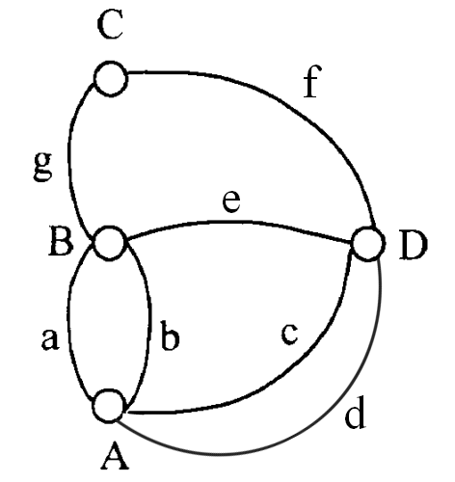
Graph Definition
Vertex (V)
A, D, B, D
Edge (E)
BC, CD,…
Degree (deg)
The branch of a vertex
Path (P)
A sequence of connected vertices, e.g. ADCB
Cycle (C)
A sequence of connected vertices with same end points

Slide 3
Graph Definition (cont’d)
Undirected Graph – G1, G2
Directed Graph – G3
Indegree and outdegree
1
1
1
1 is adjacent to 3
2
3
2
3
2
edge is incident to2
4
4
5
6
7
3
G1
G2
G3

Slide 4
Subgraph
1
1
1
2
3
1
2
3
2
3
2
3
G1
4
4
4
1
1
1
1
2
1
2
2
G3
2
3
3
3
Notes:
A subgraph is a graph whose vertex set is a subset of the vertex set …

Slide 5
Graph Data Structure
Adjacent list
Each node keeps a list of adjacent nodes
Commonly, we use std::vector<std::vector<Vertex>>
1
v1
2
3
4
2
3
v2
1
3
4
v3
1
2
4
4
v4
1
2
3
G1

Slide 6
Graph Data Structure (cont’d)
Adjacency Matrix
A complete matrix denotes all-pair connections
1 2 3 4
1 0 1 1 1
2 1 0 1 1
3 1 1 0 1
4 1 1 1 0
1
2
3
4
G1

Slide 7
Graph Traversal Algorithms
Depth First Search (DFS)
The algorithm starts at the root node (selecting some arbitrary node as the root node in the case of a graph) and explores as far as possible along each branch before backtracking
Traversal order is last-in-first-out (stack)
Breadth First Search (BFS)
The algorithm starts at the root node, and explores all of the neighbor nodes at the present depth prior to moving on to the nodes at the next depth level
Traversal order is first-in-first-out (queue)

Slide 8
DFS Walkthrough – 1
V₁
1
2
3
V₁
V₂
2
1
4
5
V₃
3
1
6
7
V₂
V₃
V₄
4
2
8
0
V₅
5
2
8
0
V₄
V₅
V₆
V₇
V₆
6
3
9
0
V₈
V₉
V₇
7
3
9
0
V₈
8
4
5
10
V₁₀
V₉
9
6
7
10
V₁₀
10
8
9

Slide 9
DFS Walkthrough – 2
Start from v1 and insert v2 and v3
V₁
V₂
V₃
V₄
V₅
V₆
V₇
V₂
V₈
V₉
V₁
V₃
V₁₀
output：V₁

Slide 10
DFS Walkthrough – 3
Pop v2 and inserts its v4 and v5
V₁
V₂
V₃
V₄
V₄
V₅
V₆
V₇
V₂
V₅
V₈
V₉
V₃
V₃
V₁₀
output：V₁ V₂

Slide 11
DFS Walkthrough – 4
Pop v4 from the stack and insert v8
V₁
V₂
V₃
V₄
V₈
V₄
V₅
V₆
V₇
V₅
V₅
V₈
V₉
V₃
V₃
V₁₀
output：V₁ V₂ V₄

Slide 12
DFS Walkthrough – 5
Pop v8 from the stack and insert v10
V₁
V₂
V₃
V₈
V₁₀
V₄
V₅
V₆
V₇
V₅
V₅
V₈
V₉
V₃
V₃
V₁₀
output：V₁ V₂ V₄ V₈

Slide 13
DFS Walkthrough – 6
Pop v8 from the stack and insert v10
V₁
V₂
V₃
V₁₀
V₉
V₄
V₅
V₆
V₇
V₅
V₅
V₈
V₉
V₃
V₃
V₁₀
output：V₁ V₂ V₄ V₈ V₁₀

Slide 14
DFS Walkthrough – 7
Pop v9 and insert v6 and v7
V₁
V₂
V₃
V₇
V₉
V₆
V₄
V₅
V₆
V₇
V₅
V₅
V₈
V₉
V₃
V₃
V₁₀
output：V₁ V₂ V₄ V₈ V₁₀ V₉

Slide 15
DFS Walkthrough – 8
Pop v7 from the stack and insert v3
V₁
V₂
V₃
V₇
V₃
V₆
V₆
V₄
V₅
V₆
V₇
V₅
V₅
V₈
V₉
V₃
V₃
V₁₀
output：V₁ V₂ V₄ V₈ V₁₀ V₉ V₇

Slide 16
DFS Walkthrough – 9
Pop v3 from the stack
V₁
V₂
V₃
V₃
V₆
V₆
V₄
V₅
V₆
V₇
V₅
V₅
V₈
V₉
V₃
V₃
V₁₀
output：V₁ V₂ V₄ V₈ V₁₀ V₉ V₇ V₃

Slide 17
DFS Walkthrough – 10
Pop v6 from the stack
V₁
V₂
V₃
V₆
V₄
V₅
V₆
V₇
V₅
V₅
V₈
V₉
V₃
V₃
V₁₀
output：V₁ V₂ V₄ V₈ V₁₀ V₉ V₇ V₃ V₆

Slide 18
DFS Walkthrough – 11
Pop v5 from the stack
V₁
V₂
V₃
V₄
V₅
V₆
V₇
V₅
V₈
V₉
V₃
V₃
V₁₀
output：V₁ V₂ V₄ V₈ V₁₀ V₉ V₇ V₃ V₆ V₅

Slide 19
DFS Walkthrough – 12
Pop v3 from the stack
No output for v3 as we visited it before!
V₁
V₂
V₃
V₄
V₅
V₆
V₇
V₈
V₉
V₃
V₁₀
output：V₁ V₂ V₄ V₈ V₁₀ V₉ V₇ V₃ V₆ V₅

Slide 20
Stack-based Implementation of DFS
vector<bool> visited(V, false);
stack<int> stack;
stack.push(s);
while (!stack.empty()) {
s = stack.top();
stack.pop();
// Stack may contain same vertex twice – only print unvisited ones
if (!visited[s]) {
cout << s << " ";
visited[s] = true;
}
// Get all nonvisited adjacent vertices of the popped vertex s
for (auto i = adj[s].begin(); i != adj[s].end(); ++i)
if (!visited[*i]) stack.push(*i);
}

Slide 21
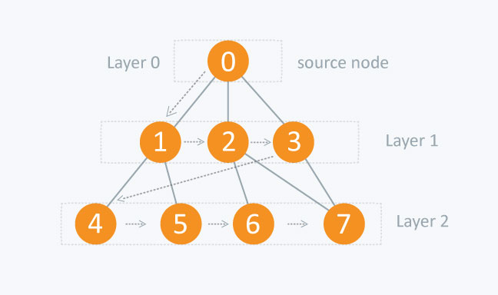
BFS Algorithm
Breadth First Search (BFS)
The algorithm starts at the root node, and explores all of the neighbor nodes at the present depth prior to moving on to the nodes at the next depth level
Traversal order is first-in-first-out (queue)
Start
Insert the starting node(s) to the queue
yes
empty？
no
Pop a node u from the queue
BFS is also known as “level-by-level” traversal (e.g., finding shortest paths in an undirected graph)
Insert all neighboring nodes of u to the queue
stop

Slide 22
BFS Walkthrough – 1
V₁
1
2
3
V₁
V₂
2
1
4
5
V₃
3
1
6
7
V₂
V₃
V₄
4
2
8
0
V₅
5
2
8
0
V₄
V₅
V₆
V₇
V₆
6
3
9
0
V₈
V₉
V₇
7
3
9
0
V₈
8
4
5
10
V₁₀
V₉
9
6
7
10
V₁₀
10
8
9

Slide 23
DFS Walkthrough – 2
Pop v1 and insert v2 and v3
V₁
V₂
V₃
V₄
V₅
V₆
V₇
V₂
V₈
V₉
V₁
V₃
V₁₀
output：V₁

Slide 24
DFS Walkthrough – 3
Pop v3 and insert v6 and v7
V₁
V₂
V₃
V₇
V₄
V₅
V₆
V₇
V₂
V₆
V₈
V₉
V₃
V₂
V₁₀
output：V₁ V₃

Slide 25
DFS Walkthrough – 4
Pop v2 and insert v4 and v5
V₁
V₂
V₃
V₅
V₇
V₄
V₄
V₅
V₆
V₇
V₆
V₇
V₈
V₉
V₂
V₆
V₁₀
output：V₁ V₃ V₂

Slide 26
DFS Walkthrough – 5
Pop v6 and insert v9
V₁
V₂
V₃
V₅
V₉
V₄
V₅
V₄
V₅
V₆
V₇
V₇
V₄
V₈
V₉
V₆
V₇
V₁₀
output：V₁ V₃ V₂ V₆

Slide 27
DFS Walkthrough – 6
Pop v7 and insert nothing
v9 has been inserted by v6 before!
V₁
V₂
V₃
V₉
V₅
V₉
V₄
V₅
V₆
V₇
V₄
V₅
V₈
V₉
V₇
V₄
V₁₀
output：V₁ V₃ V₂ V₆ V₇

Slide 28
DFS Walkthrough – 7
Pop v4 and insert v8
V₁
V₂
V₃
V₉
V₈
V₄
V₅
V₆
V₇
V₅
V₉
V₈
V₉
V₄
V₅
V₁₀
output：V₁ V₃ V₂ V₆ V₇ V₄

Slide 29
DFS Walkthrough – 8
Pop v5
V₁
V₂
V₃
V₈
V₄
V₅
V₆
V₇
V₉
V₈
V₈
V₉
V₅
V₉
V₁₀
output：V₁ V₃ V₂ V₆ V₇ V₄ V₅

Slide 30
DFS Walkthrough – 9
Pop v9 and insert v10
V₁
V₂
V₃
V₄
V₅
V₆
V₇
V₈
V₁₀
V₈
V₉
V₉
V₈
V₁₀
output：V₁ V₃ V₂ V₆ V₇ V₄ V₅ V₉

Slide 31
DFS Walkthrough – 10
Pop v8 and insert nothing
v10 has been inserted by v9 before!
V₁
V₂
V₃
V₄
V₅
V₆
V₇
V₁₀
V₈
V₉
V₈
V₁₀
V₁₀
output：V₁ V₃ V₂ V₆ V₇ V₄ V₅ V₉ V₈

Slide 32
DFS Walkthrough – 11
Pop v10
V₁
V₂
V₃
V₄
V₅
V₆
V₇
V₈
V₉
V₁₀
V₁₀
output：V₁ V₃ V₂ V₆ V₇ V₄ V₅ V₉ V₈ V₁₀

Slide 33
Queue-based Implementation of BFS
vector<bool> visited(V, false);
queue<int> queue;
queue.push(s);
while (!queue.empty()) {
s = queue.top();
queue.pop();
// Stack may contain same vertex twice – only print un-visited ones
if (!visited[s]) {
cout << s << " ";
visited[s] = true;
}
// Get all un-visited adjacent vertices of the popped vertex s
for (auto i = adj[s].begin(); i != adj[s].end(); ++i)
if (!visited[*i]) queue.push(*i);
}

Slide 34
Summary
We have discussed two fundamental data structures
Stack organizes data in last-in-first-out order
Queue organizes data in first-in-first-out order
We have discussed application of stack
Recursive program implementation
Parenthesis checking
Both data structures are widely used in physical design
Slicing-tree Floorplan will leverage stack to recover the chip area from a linear representation string
Routing will leverage queue to establish shortest routes among gates

