Slide 1
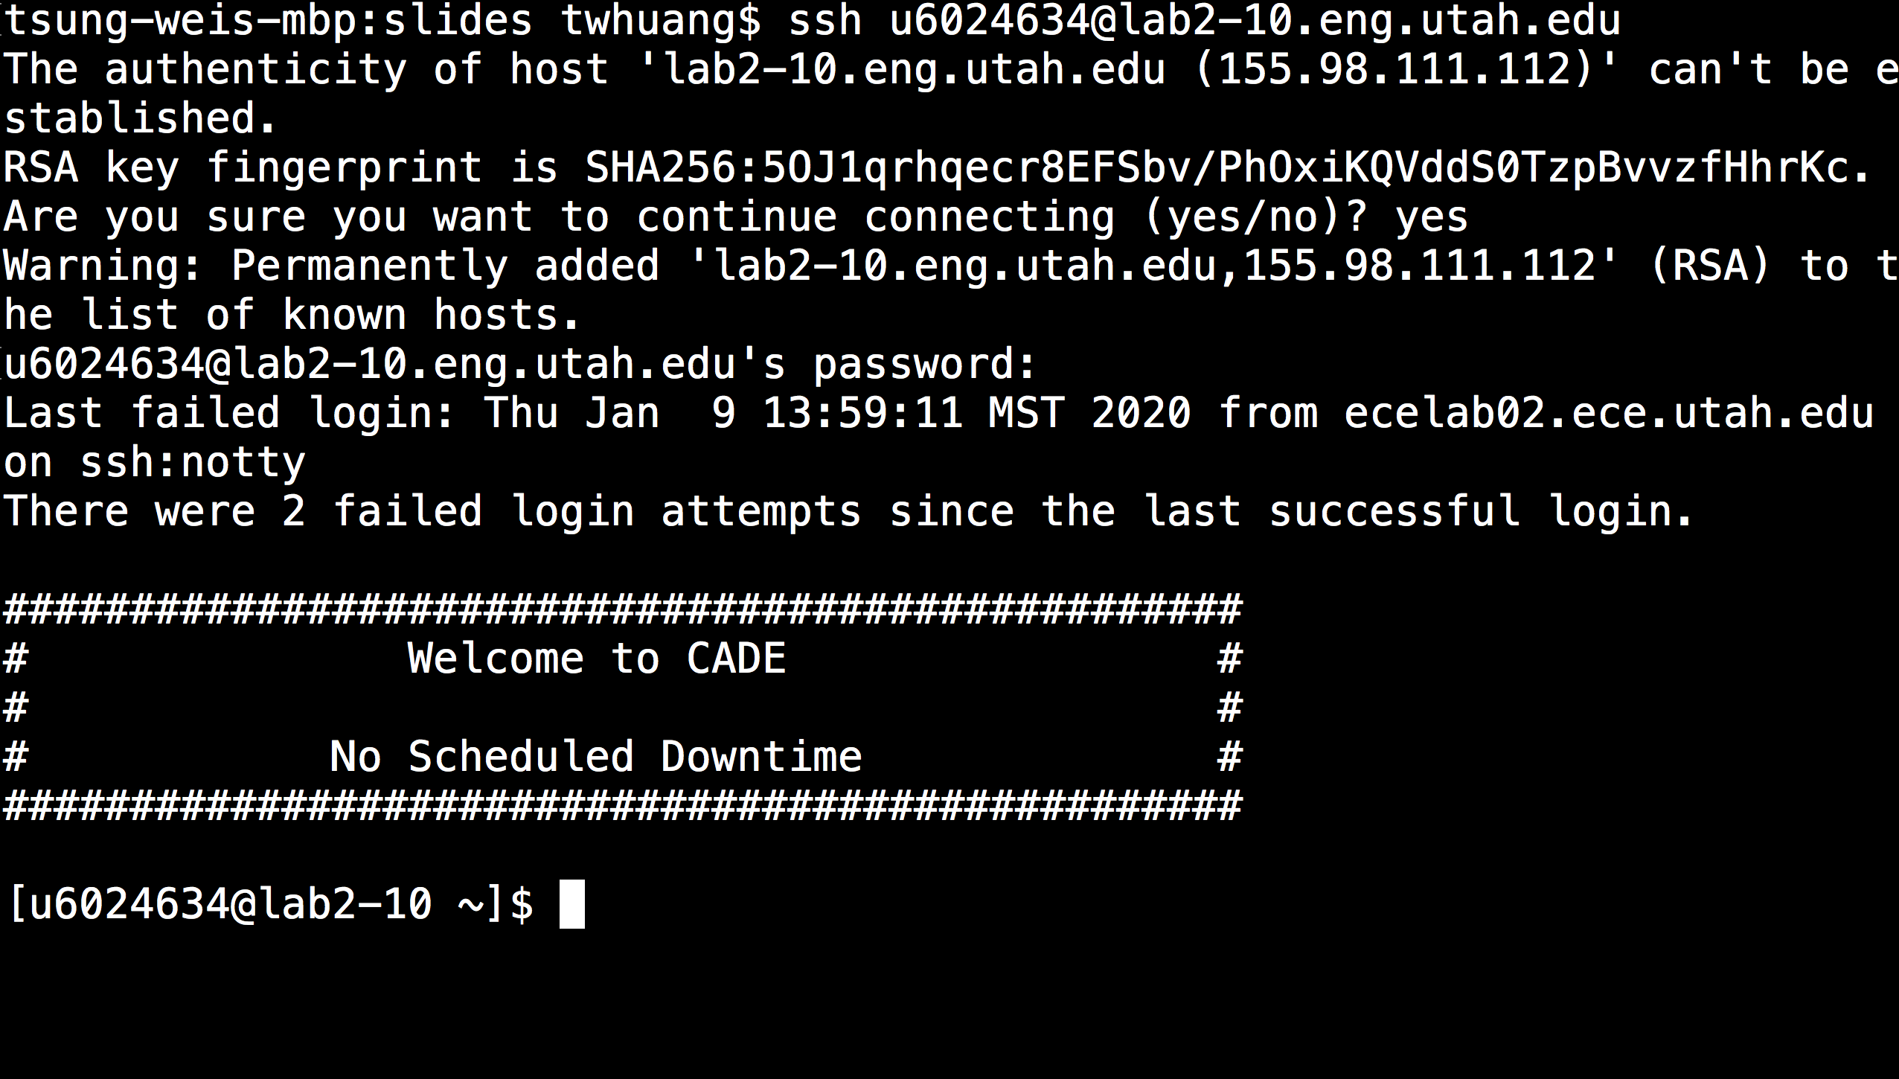
The easiest way to connect to CADE: ssh
Your password
Host-format: labx-y.eng.utah.edu
Replace x with 1-4 and y with 1-20 to avoid traffic

Slide 2
The second way from Windows: NoMachine

Slide 3
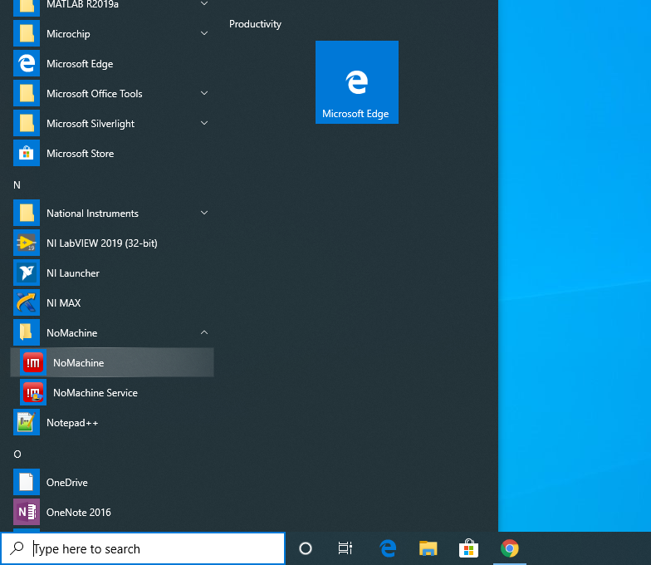

Slide 4
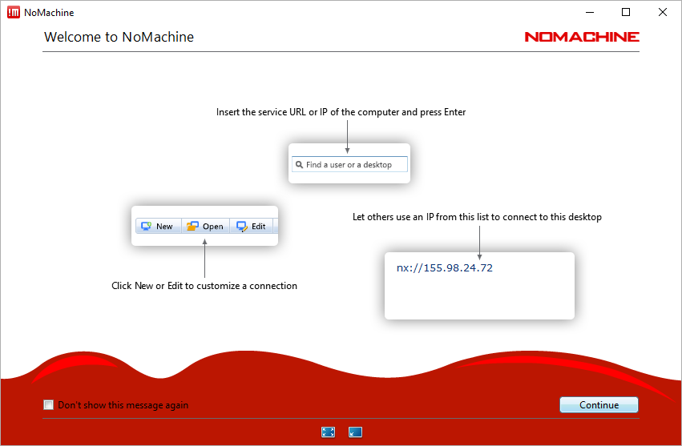

Slide 5
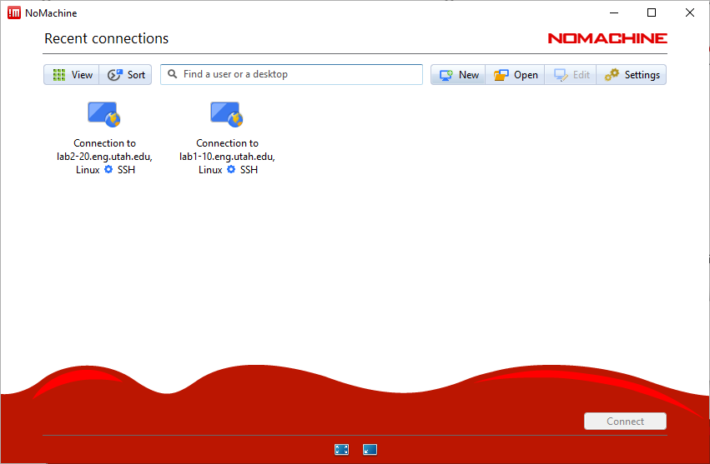

Slide 6
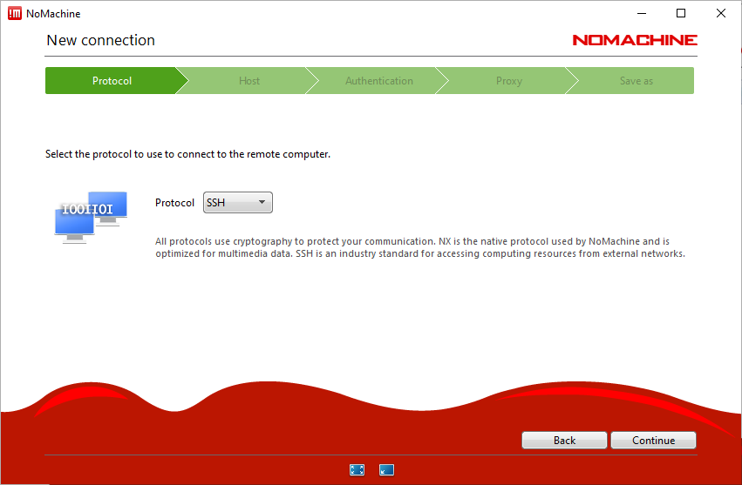

Slide 7
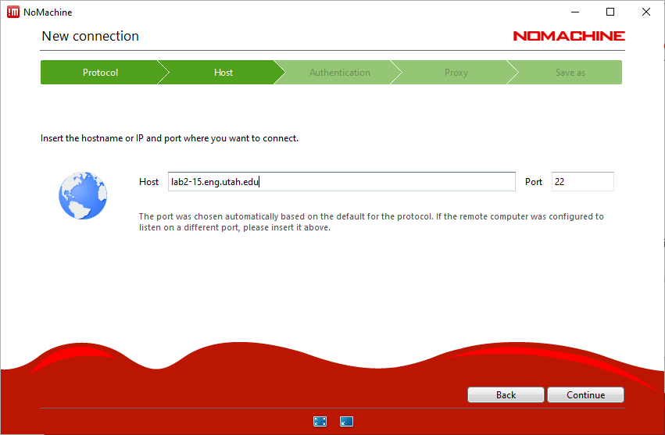
Host-format: labx-y.eng.utah.edu
Replace x with 1-4 and y with 1-20 to avoid traffic

Slide 8
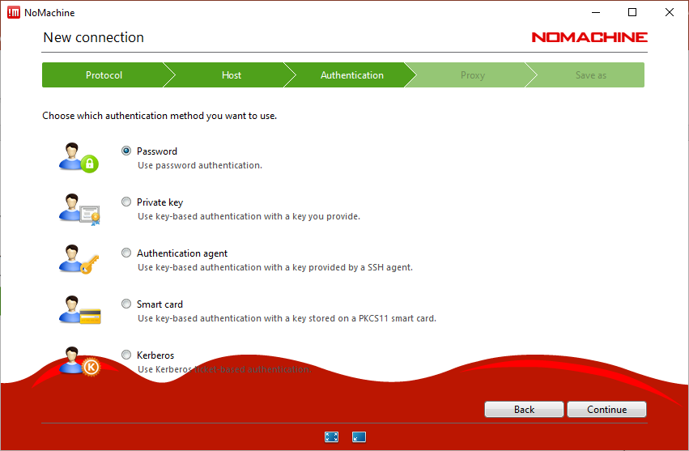

Slide 9
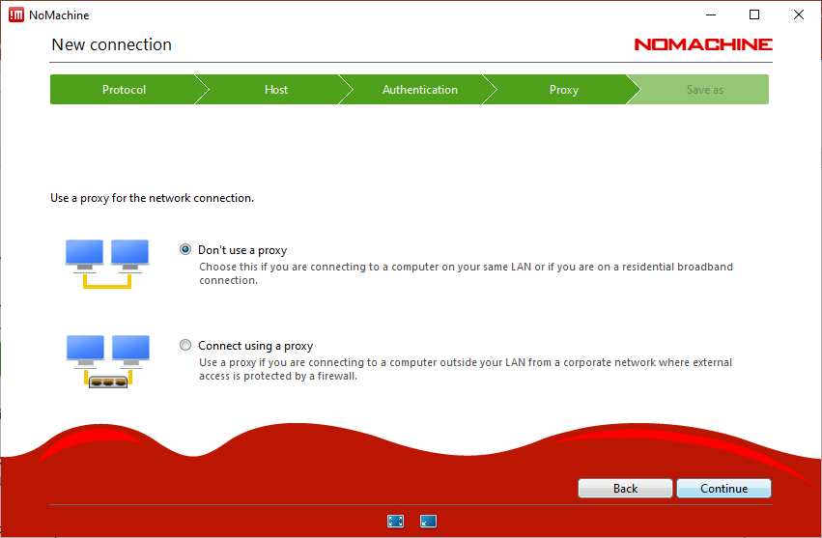

Slide 10
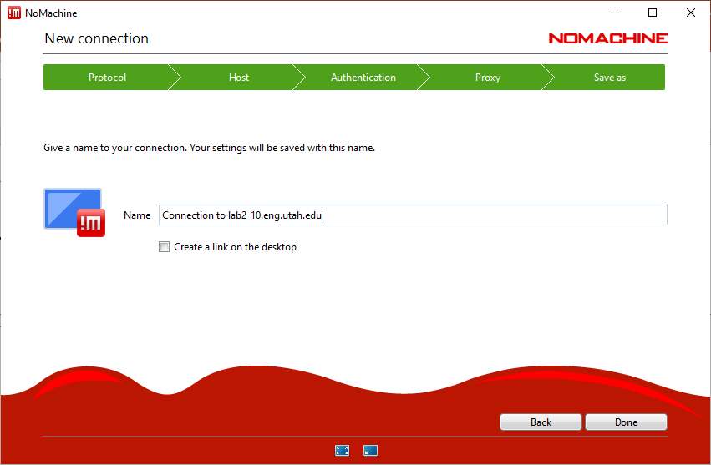
You can give a name to this connection and save it for later use.

Slide 11
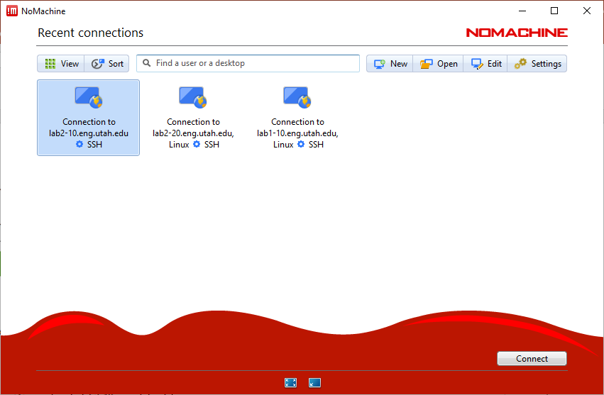
Connect to CADE

Slide 12
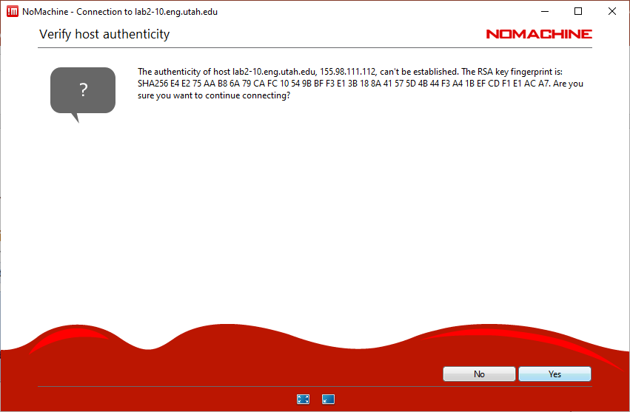
Select yes

Slide 13
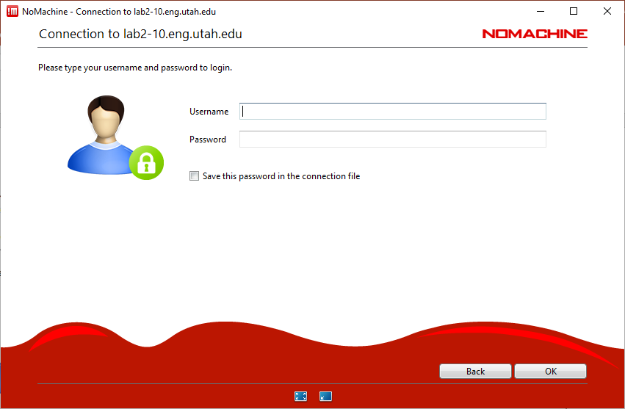
Type in your uid and password

Slide 14
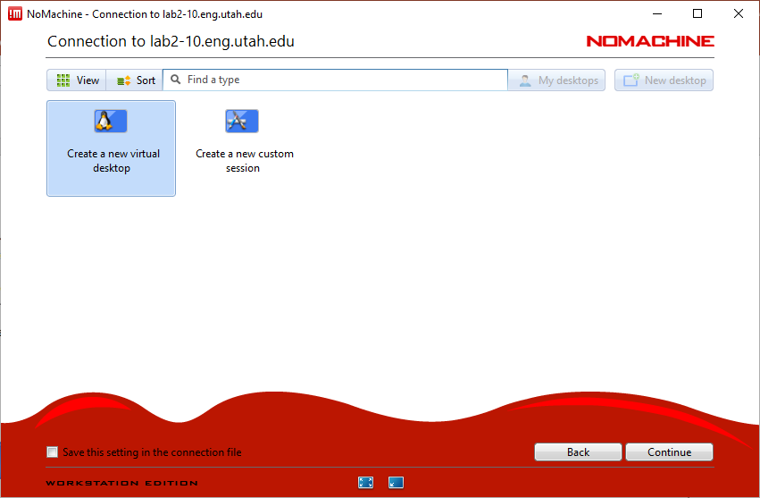
Create a virtual desktop

Slide 15
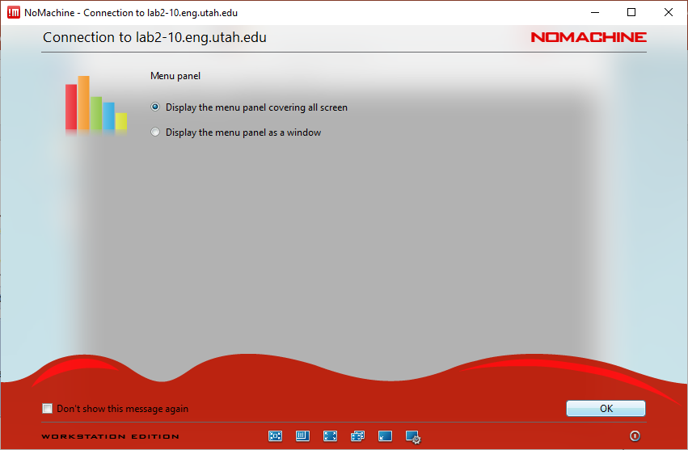

Slide 16
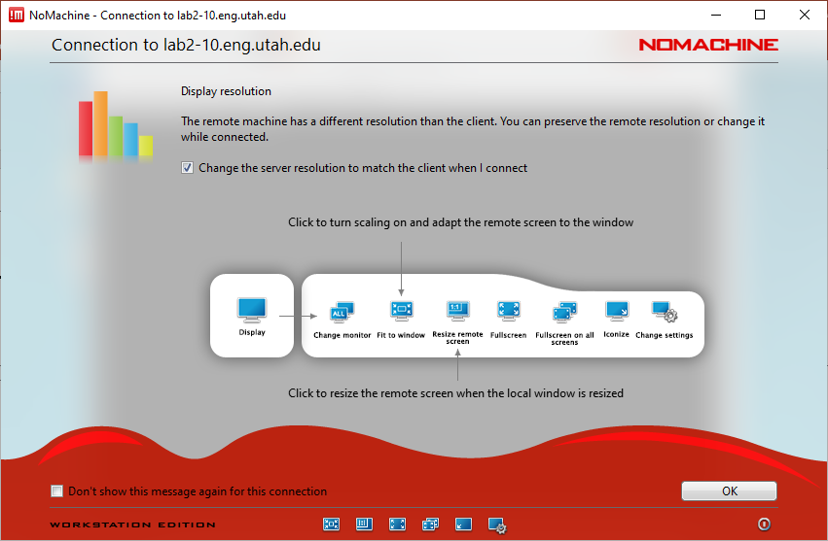

Slide 17
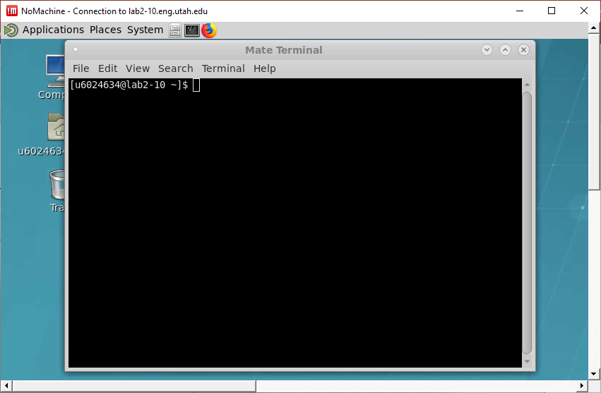
Open a terminal for coding

